Slide 1

Reducing the occupancies in the calorimeter endcaps of the CLIC detector
Suzanne van Dam
Supervisor: André Sailer
CERN, 2 April 2014

Slide 2
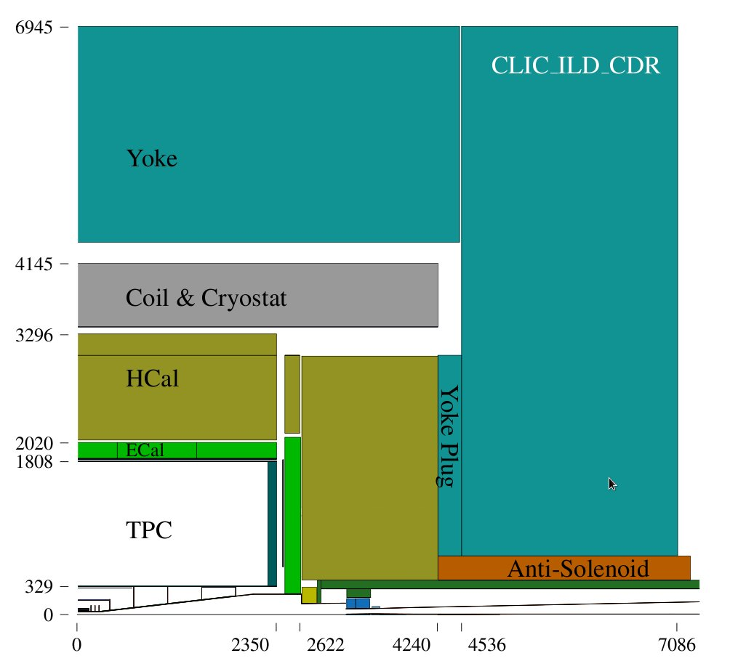
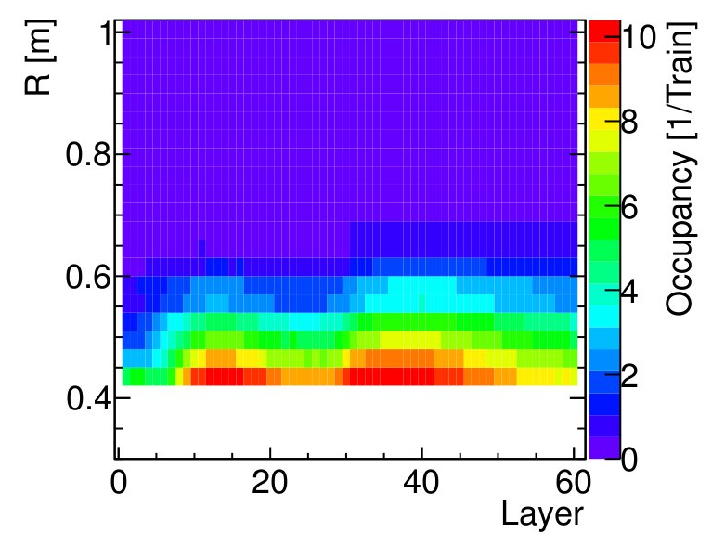
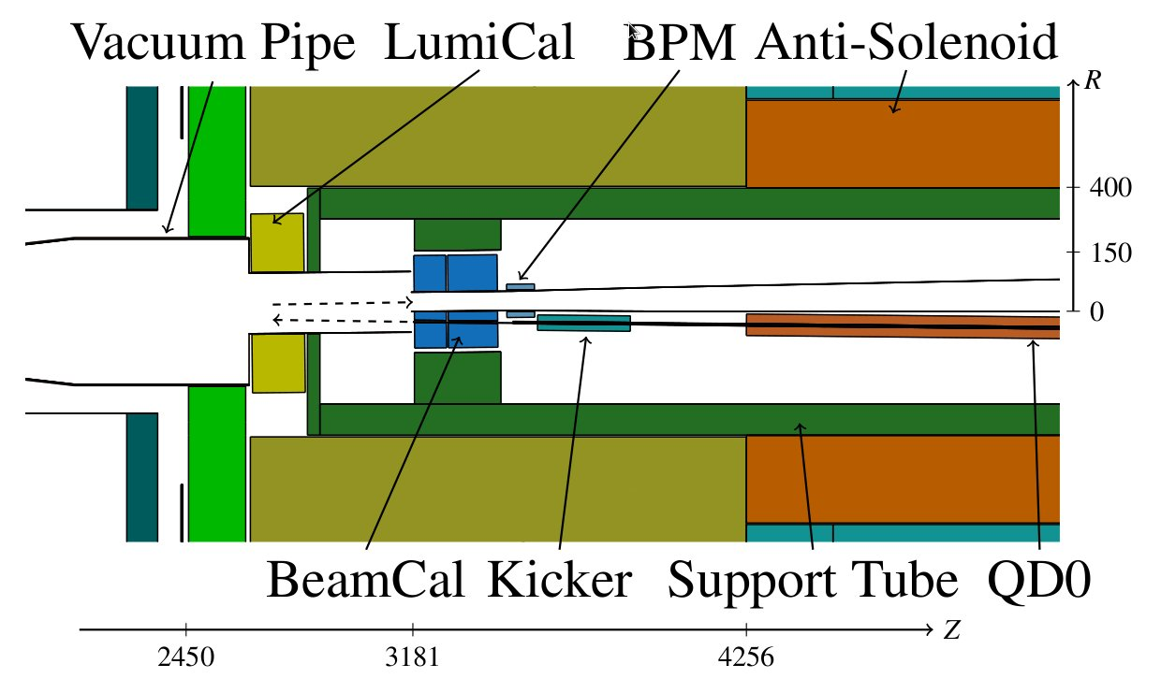
Introduction
Incoherent background pairs induce showers in the forward region of the CLIC detector
→ High Occupancy in HCal endcap
To reduce the occupancy, optimize material and thickness of support tube
CERN-THESIS-2012-223

Slide 3
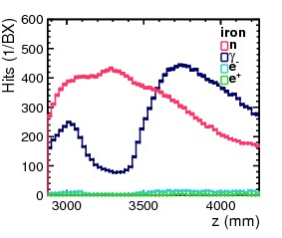
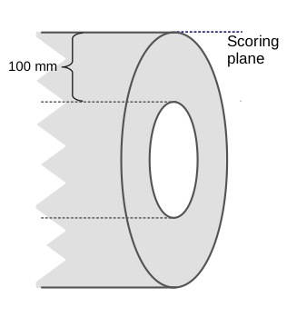
Contributions to occupancy
The high occupancy in the HCal Endcap due to incoherent pairs is caused by neutrons and photons
Photons have relatively more impact on the occupancy
Energy deposits
in HCal endcap
Hits in scoring plane
around support tube

Slide 4
Figure of merit
Minimization of the occupancy is based on minimizing the neutron (n) and photon (γ) hits (H) in a scoring plane around the support tube
Therefore a figure of merit (FOM) is defined that reflects the higher impact of photons:

Slide 5
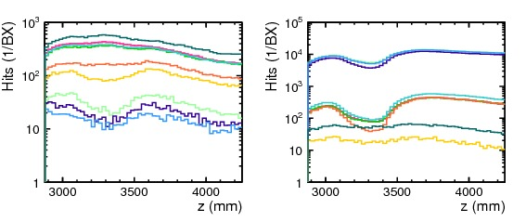
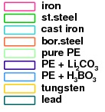
Support tube material
Simulations indicate that
  Tungsten → photon shielding
  Polyethylene (PE) → neutron shielding
  Combine materials to shield both neutrons and photons
photons
neutrons

Slide 6
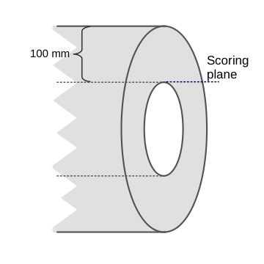
Particles inside the support tube
Photon hits on a scoring plane inside the support tube show a dip at the location of the BeamCal
Neutron hits peak at the location of the BeamCal
→ Photons from showers in the BeamCal are shielded by the tungsten absorber

Slide 7
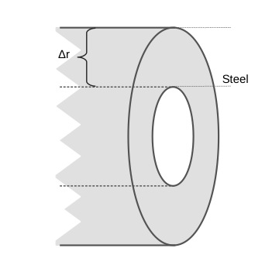
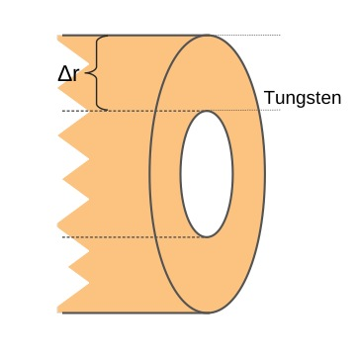
Support tube thickness
Stainless steel
A thicker tube results in a decrease in the number of hits
A tungsten support tube with maximal thickness minimizes the figure of merit
Tungsten

Slide 8
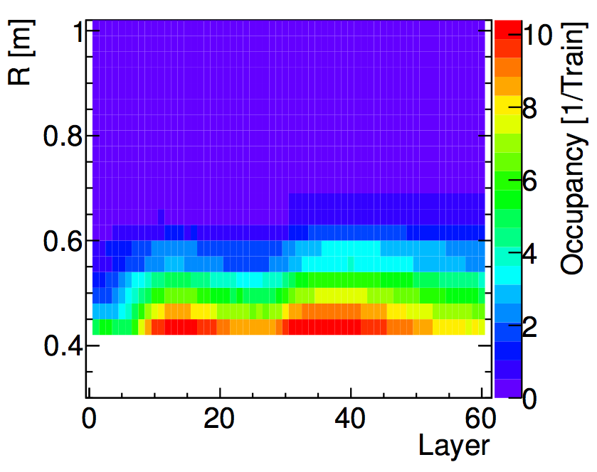
Occupancy for tungsten tube
Iron (initial)
Simulation of the occupancy in the HCal endcap with a maximally thick tungsten support tube
Energy threshold: 300 keV
12 time windows of 25 ns
Occupancy is reduced ~20 times compared to the initial situation
Tungsten
CERN-THESIS-2012-223

Slide 9
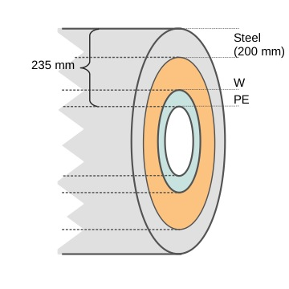
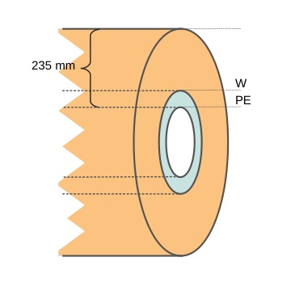
Combinations of materials
PE + W + Steel
Unexpected:
less photon hits when replacing W with PE
The figure of merit is minimized for 110 mm PE + 125 mm W
PE + W

Slide 10
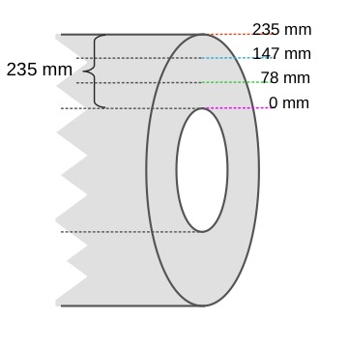
Energy spectra
Why are there less photon hits when we replace W with PE?
Look at the energy spectra of neutrons and photons inside, within and outside the support tube
Stainless steel
NIST Photon Cross Section Database

Slide 11
Energy spectra
Tungsten
Polyethylene
Replacing W by PE can decrease photon hits due to lower photon energy after the PE layer
NIST Photon Cross Section Database

Slide 12
Hits inside the support tube
The number of hits in the
scoring plane before the
support tube depends on
the material choice.
This is possibly due to reflections in the tube.
Looking at only outgoing particles shows the dependency not for photons, but still for neutrons.
A description of the occupancy in terms of hits in the scoring plane becomes increasingly complex

Slide 13
Summary and conclusions
The high occupancy in the Hcal Endcap is mainly due to photons and neutrons; the photons have a relatively higher impact.
The occupancy is related to the number of particles passing the support tube, with a figure of merit (FOM):
A maximal support tube thickness maximally decreases the figure of merit and therefore the occupancy.
The occupancy of a tungsten support tube of maximal thickness is ~ 20 times lower than for the initial iron tube.
Combinations of materials can shield both photons and neutrons. A tube of 110 mm polyethylene and 125 mm tungsten minimizes the figure of merit.

Slide 14
Outlook
A detailed description in terms of hits in a scoring plane demands an increased complexity, that goes beyond the initial purpose of simplicity.
Continue with simulating full occupancies for relevant geometries
110 mm PE + 125 mm W, preliminary
Tungsten

