Slide 1
HEB@LHC layout changes
1/4/2014
B.Goddard, W.Herr

Slide 2
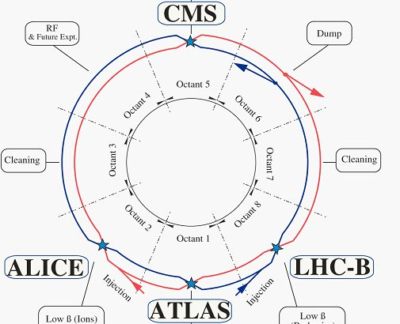
From this…

Slide 3
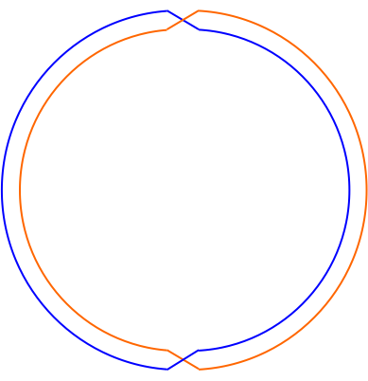
To this…?
Empty?
RF/Xing
Dump
P5
P4
P6
Cleaning
P3
P7
Cleaning
P2
P8
P1
Injection
B1
Injection
B2
Extraction

Slide 4
Changes per IR (1-4)
P1: extraction to collider:
  removal of low-beta insertion, ATLAS, construction of floor through ATLAS cavern, civil engineering for junctions to new TLs to collider, installation of extraction system
P2: injection of B1 (no crossing)
  removal of low-beta and ALICE, modification of injection system to inject into INNER ring (presently outer!)
P3: collimation – unchanged
P4: RF and new crossing
  Rearrangement of RF to accommodate D1-D2, plus required low-beta for crossing only

Slide 5
Changes per IR (5-8)
P5: FODO transport, no crossing
  removal of low-beta and CMS, construction of floor through CMS cavern, installation of FODO quads
P6: beam dump – unchanged
P7: collimation – unchanged
P8: Injection beam 2 (crossing)
  removal of low-beta and LHCb, modification of low-beta

Slide 6
Potential difficulties
Decomissioning of experimental and highly activated machine areas in P1 and P5 (?)
Injection into inner ring in P2 (Wolfgang?)
Rearrangement of RF in P4 with crossing elements (Werner?)

