Slide 1
Beam instrumentation for machine protection
Evian workshop
2-4 June 2014
E. Bravin – CERN
For the BE-BI group

Slide 2
Outline
Interlocked BPMs
  Changes
  Status at startup
  Scrubbing with doublets
FBCCM (dI/dt)
  Changes
  Status at startup
Abort gap monitor
  Changes
  Status at startup

Slide 3
Interlocked BPMs
Strip line pick-ups installed in IR6 just after Q4 (BPMSX was BPMSA) and just before the TCDQ (BPMSI was BPMSB)
Prevent beam on TCDS
Acquisition is based on the LHC BPM design with dedicated firmware
Two operational ranges used (high and low sensitivity modes)

Slide 4
Issues in run 1
Interlock fires for bunches near the detection threshold
Reflections from intense bunches cause false triggers (seen as weak bunches)
Detection threshold adjusted (by changing attenuators) between signal and reflections
Insufficient diagnostics for the PM analysis

Slide 5
Actions during LS1
Replaced shorted strip-lines with 50 Ω terminated s.l.
Added absorptive filter at strip-line output (100 MHz)
Separated orbit and interlock functions (2 DABs)
Improved HW & firmware: bunch-by-bunch interlock post-mortem data (3564 slots x 294 turns)
Installed thermal controlled racks (stability)
FESA adapted to new firmware (and new CPUs)
New GUI for the interlock post-mortem t.b.d. (BI/OP)

Slide 6
Old BPM setup

Slide 7
New BPM setup
The BPMs have been renamed
(LHC-BP-EC-0002)
The Interlock and orbit systems have been separated

Slide 8
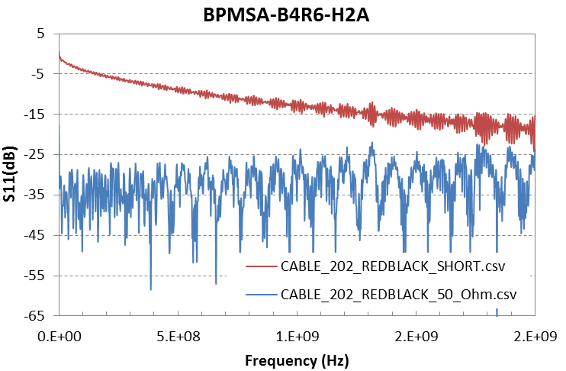
BPMs Reflections
LPF BW
> 20dB

Slide 9
Reflections in time domain
Shorted strip-lines reflections
Measurement: -27 dB
Simulation: -34 dB
Terminated strip-lines with LPF:
Simulations: <-46 dB

Slide 10
Interlock thresholds
Noise floor
Nominal
Ultimate
Thresholds to be defined
Verifications with beam required

Slide 11
Scrubbing doublets
Beam “simulator” tests (beam signal replaced by pulse generator)
May be possible to test on SPS with beam

Slide 12
FBCCM (dI/dt)
Interlock system based on the reading of the fast beam current transformers
Detects rapid changes of beam currents i.e. losses or debunching (of one or more bunches)
Six different time integration windows
  1, 4, 16, 64, 256 and 1024 turns
32 energy thresholds
Prototypes tested in 2012

Slide 13
FBCCM Signal Processing
From FBCT
LP Filter
ADC
Band Pass Filter
40 MHz (FIR)
IQ demodulation
Moving average
1
Loss Calculation
Threshold
Comparator
To CIBU
Moving average
4
Loss Calculation
Threshold
Comparator
(16, 64, 256)
.
.
.
.
.
.
.
.
.
Moving average
1024
Loss Calculation
Threshold
Comparator
Energy from telegram

Slide 14
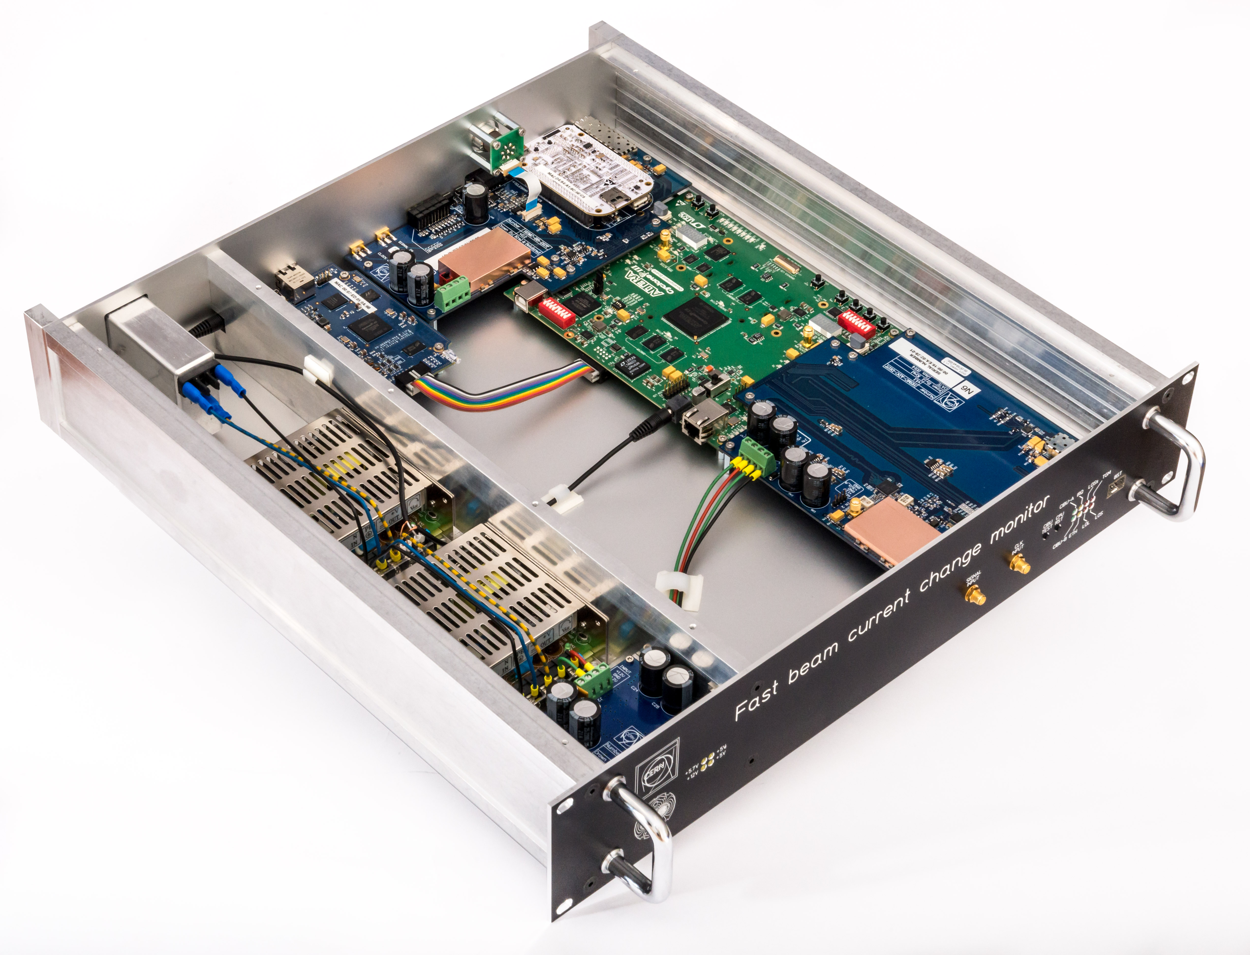
FBCCM units
6 Units produced based on prototype
  Reduced noise
  One beam per box
4 Will be installed in July (2 oper. B1/B2 + 2 dev. B1/B2)

Slide 15
FBCCM for 2015
Two systems per beam running in parallel
  One will be operational (System A) (stable HW and FW)
  One will be used for debugging/development (system B)
New fast current transformers (to address position sensitivity)
  System A remains old FBCT (position and σ_{z} sensitivity)
  System B will be CERN/BERGOZ BCTI on Beam 1 and CERN BCTW on Beam 2
  Switch to BCTIs or BCTWs on both beams (without breaking vacuum) later on depending on results with beam
FESA class 90% ready, expert GUI almost ready, Post mortem analysis tool to be defined (BI/OP)
Connected to the BIS but initially masked (allowing to collect statistics)

Slide 16
FBCCM commissioning
Need dedicated beam time for repeating the lab measurement (controlled losses, scraping)
Lot of learning, debugging and setting-up can be done in parallel with the normal operation of the machine
Possibility to carry out realistic beam simulations in the lab?

Slide 17
Abort Gap Monitor
Monitors the particles population inside the 3μs abort gap (needed by the dump kickers)
It is based on the detection of synchrotron light by a gated photomultiplier and is integrated in the BSRT telescope

Slide 18
Issues during run 1
Interference between BSRT and AGM
Extraction mirror heating
Software issue affecting reliability
Lots of manual actions for calibration and verification (expert only)

Slide 19
Changes during LS1
New extraction mirror [LHC-BSRTM-EC-0002]
  No more heating problem (TBC with beam)
New layout of optical table (optimized)
New readout electronic (not deployed at start up)
New automated software procedures for calibration and diagnostics [EDMS 1337184]
  Actions to be included in the sequencer

Slide 20
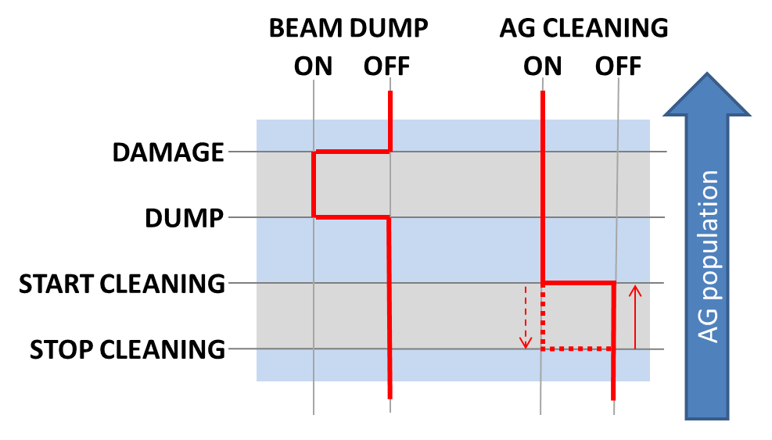
AGM and SIS
AGM will eventually be connected to SIS
SIS also used for triggering AG cleaning
AGM-FESA to handle cleaning and dump logic
Thresholds need to be finalized (based on new quench limits)

Slide 21
Conclusions
The impact of the interlocked BPMs on the length of fills should be minimized (surely for ions)
  Thresholds levels to be defined
4 FBCCM will be available at startup
  Prototype and lab test give encouraging results, some debugging and fine tuning required when beam comes back
Reliability of AGM improved
  No significant changes in performances (better if any)
  System should become much more reliable and self-diagnosing

Slide 22
Thanks!
The End

Slide 23
Support slides

Slide 24
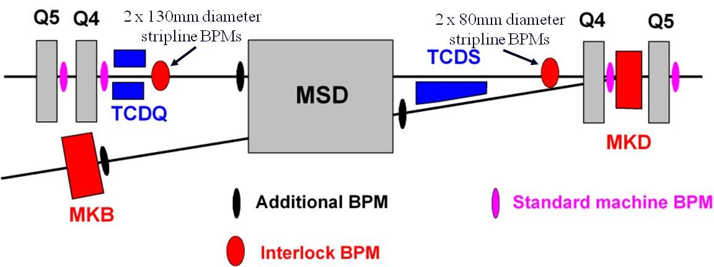
Dump Channel
BPMSI (.A/.B)
BPMSX (.A/.B)
The main aim of these BPMs is to avoid large orbit offsets leading to high losses on the septum protection during a dump

Slide 25
Interlock Mechanism
Two separate trigger logics
  70 reading in the last 100 turns out of limits (a single bunch can trigger the dump)
  250 reading in the last 10 turns out of limits (response to fast orbit changes)
Limits set to ~±3mm
The whole chain from readout to beam dump trigger is in hardware (and firmware)
Interlock signal connected to a maskable channel of the BIS

Slide 26
BPMs Signals (Protons)
Useful range
New useful range
Reflections
-27 dB
Moved limits beginning of 2012 to allow longer physics fills
(reduced attenuators)
Hi sensitivity
Low sensitivity
Pilot
Sensitivity
switch
Nominal
Ultimate
Note: 1% ~220um for BPMSA and ~330um for BPMSB

Slide 27
BPMs Signals (Ions)
With p-Pb only use Hi Sensitivity mode (only 1.5 10¹⁰ charges / bunch)
P-Pb MD showed that the satellites of the nominal beam triggered the interlock
Reflections
-27 dB
New end of fill
Hi sensitivity
Low sensitivity
Moved limits beginning of 2013 to cover ~1.5E10 bunches
Pilot
Nominal

Slide 28
Doublets simulations 1
Bunch 1 and bunch 2 with same position
Y scale for arc BPM
Multiply time 2.5 for BPMS

Slide 29
Doublets simulations 2
Bunch 2 always centred

Slide 30
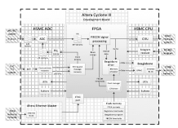
Detail of Implementation

Slide 31
AGM Performance
A-gap population published and logged at 1Hz
Sensitivity and accuracy depends on the energy and the particle type
  The higher the emission the more precise the measurement
For protons the sensitivity is better than 10% of quench level (fulfilling the specs) for all Energies
For Pb ions the AGM only fulfills the specs above 1.5 TeV
  Would need a new undulator to solve this
The error on the measurement is of the order of 50%

Slide 32
AGM Error Sources
Alignment and steering
  Light collection efficiency very sensitive to these
Attenuation of light in optical components
  Can change due to dust, radiation etc.
PMT gain vs. voltage stability and HV control
Photocathode ageing
Electromagnetic noise in the signal

Slide 33
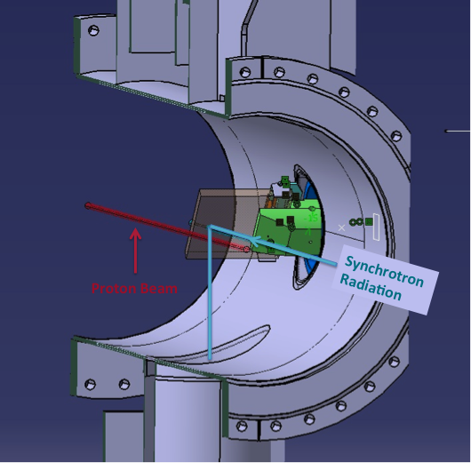
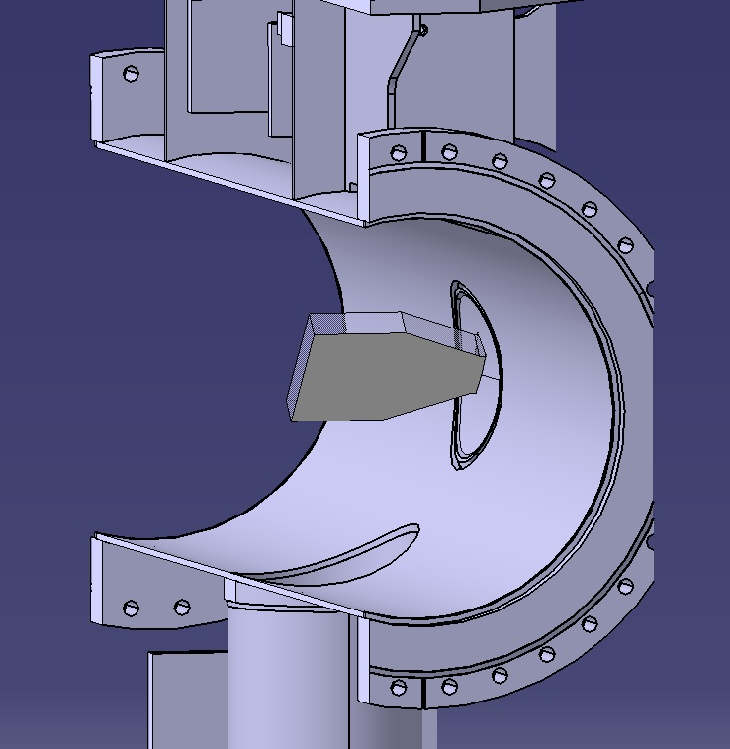
BSR extraction mirror
Old
New

Slide 34
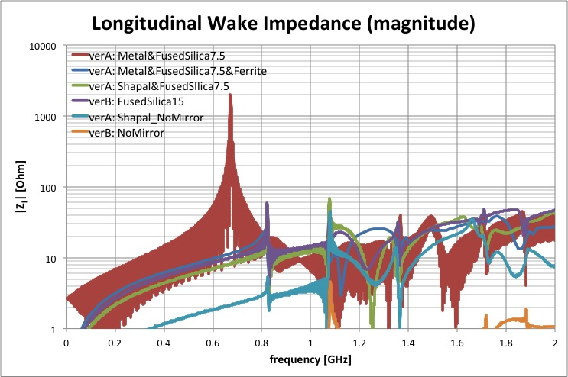
Frequency domain simulations
2012 Design
In reality the peak is much higher
New Design
Power dissipated reduced ~100 times (~1w now)

Slide 35
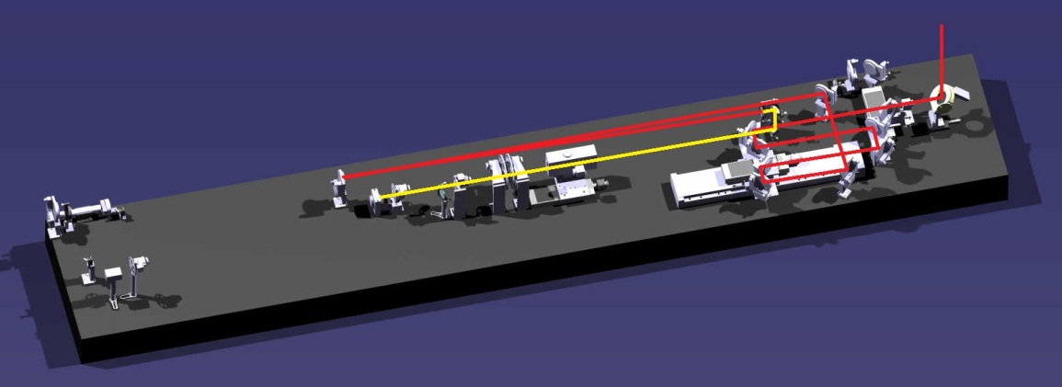
Original BSRT Telescope Layout
Light path shared between BSRT and AGM
Light path only used by AGM
From extraction mirror
Splitting mirror
Steering mirror
AGM
Telescope was based on spherical mirrors (hoping to use IR for ions at inj.)
In order to cope with the different synchrotron light sources an optical delay line (“trombone”) was used. This meant that the light had to go through many mirrors making alignment difficult
Errors in the alignment resulted in large variation of light collection efficiency

Slide 36
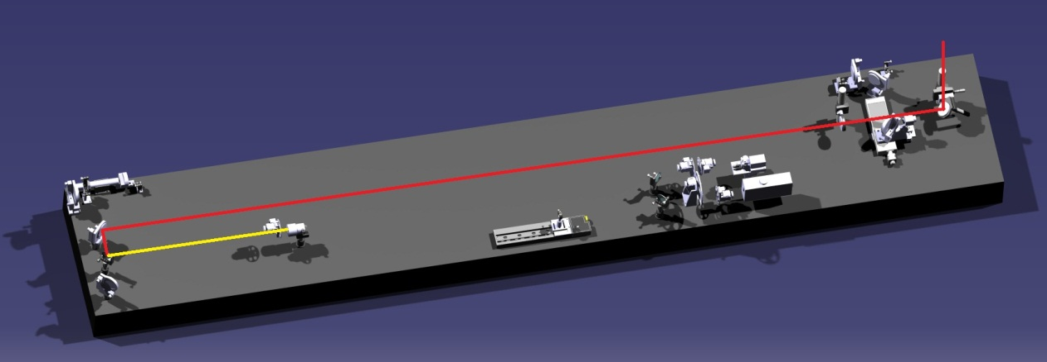
New BSRT Layout
Light path shared between BSRT and AGM
Light path only used by AGM
From extraction mirror
Fixed lens
Splitting mirror
Steering mirror
AGM
Moving lens
Spherical mirrors replaced by lenses
Since we can move the lenses, there is no need for the optical delay line anymore (“trombone”)
No moving parts before the AGM
Alignment much simpler and light collection less influenced

