Slide 1
Site operations
Costin.Grigoras@cern.ch

Slide 2
Outline
Central services
VoBox services
Monitoring
Storage and networking

Slide 3
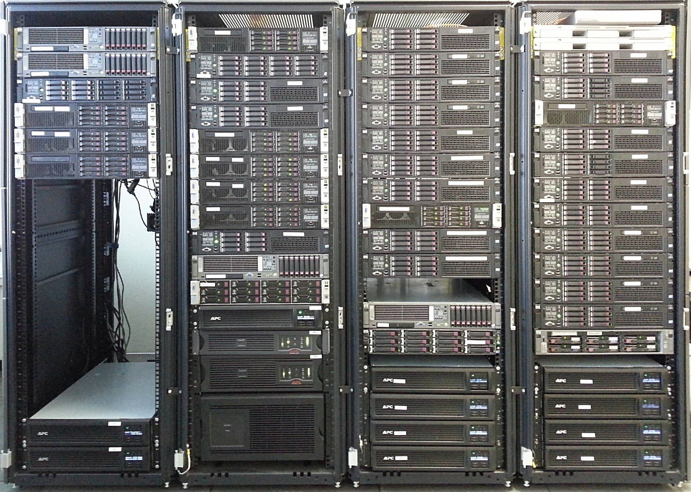
Central Services

Slide 4
Core central services
Central MySQL databases + hot backups
  Catalogue: 1B files
  Task Queue: 250K jobs/day (avg) (up to 2x in analysis periods)
  Scheduled transfers
AliEn services
  Authen: alice-authen.cern.ch:8080
  PackMan: alice-packman.cern.ch:9991
  Job Broker: alice-jobbroker.cern.ch:8050
  Job Manager: aliendb8.cern.ch:8083
  Job Info Manager: alice-jobinfomanager.cern.ch:8081
  Information Service: alice-is.cern.ch:8099
  API: alice-apiserv1.cern.ch:10000, alice-apiserv2.cern.ch:10000
  LDAP: alice-ldap.cern.ch:8389
  Various optimizers and internal services
Transfer agents
  Third party copying or store and forward of the data

Slide 5
Monitoring services
MonALISA central repository: alimonitor.cern.ch:80,443
  2 independent PostgreSQL backends
MonALISA proxy service: alimlproxy.cern.ch:6001

Slide 6
Build servers
AliEn and AliROOT build systems for
  SLC5, 32b and 64b
  SLC6, 32b and 64b
  Ubuntu, 64b
  Mac OSx
Daily analysis tags + 2 revisions weekly
  Automatically deployed on CVMFS
  Also available for users to install
    wget directly from build servers via alienbuild.cern.ch:80,8880,8888,8889
    alitorrent.cern.ch:80,8088,8092

Slide 7
Various other services
Automatic revision testing of QA and refiltering code
LEGO train wagon testing machinery
AliRoot code checkers
Shifter and detector construction databases
ALICE public web site
Backup service and software repository

Slide 8
VoBox services
CE
  Submitting generic Job Agents to the local BQ when something in the central task queue matches the site resources
Cluster Monitor: TCP/8084
  Message proxy between job agents and the central services
CMReport
  Periodic message buffer flushes to the central services
MonALISA:
  Collects and aggregates all site-produced monitoring data
  Periodic tests of VoBox services health
  ApMon listener: UDP/8884
  Xrootd monitoring: UDP/9930
  Bandwidth tests: TCP/1093, ICMP, UDP/33434

Slide 9
Job Agent monitoring
Instrumented with ApMon
Full host monitoring parameters
  CPU, load, network traffic, number of processes and sockets in each state, disk and swap IO, CPU type and spec power, OS
Self monitoring
  Proxy time left, CPU and memory utilization, status, current job ID, number of jobs picked up so far
Current job monitoring
  CPU, memory and disk utilization, number of open files, job meta information (queue ID, master job ID, owner name)

Slide 10
Job monitoring
Root is compiled with ApMon support as well, so jobs can use TMonaLisaWriter
  Used eg. for grid-wide CPU benchmarking using Root stress benchmark
xrdcp command reports transfer details to the VoBox
  Source and destination, amount of data, time it took etc

Slide 11
Storage monitoring
Xrootd and EOS data servers publish two monitoring streams
  ApMon daemon reporting the data server host monitoring and external Xrootd params
    Node total traffic, load, IO
    Version, total and used space
  Xrootd internal reporting on file close
    xrootd.monitor all flush 60s window 30s dest files info user MONALISA_HOST:9930
    Client IP, read and written bytes, speed

Slide 12
Site monitoring data aggregation
Monitoring data is aggregated in real time by the VoBox ML service
Summaries are publishes along side the individual values
  Total traffic on the Xrootd servers
    And split by remote site, LAN/WAN
  Aggregated resource consumption by jobs
    By queue, by user name
  Count jobs in each state
  Various aggregation functions available
    min/max/avg/sum
    Top jobs in terms of allocated memory

Slide 13

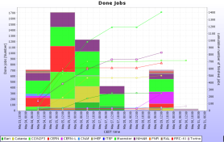
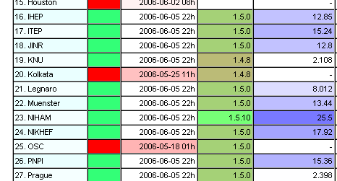
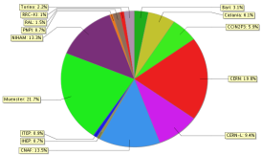
Central monitoring repository
AliEn
CE
Cluster
Monitor
AliEn
IS
AliEn
Optimizers
AliEn
Job Agent
ApMon
AliEn
TQ
ApMon
ApMon
AliEn
Brokers
ApMon
ApMon
AliEn
SE
job
slots
ApMon
net
In/out
ApMon
AliEn
Job Agent
cpu
time
run
time
ApMon
processes
free
space
jobs
status
load
MySQL
Servers
ApMon
vsz
MonALISA
AliEn Site
MonALISA
@CERN
sockets
rss
ApMon
AliEn
Job Agent
migrated
mbytes
ApMon
active
sessions
CastorGrid
Scripts
Aggregated Data
ApMon
API
Services
AliEn
CE
Cluster
Monitor
AliEn
SE
ApMon
ApMon
ApMon
ApMon
AliEn
Job Agent
Queued
JobAgents
open
files
nr. of
files
ApMon
MonALISA
Repository
job
status
Alerts
MonALISA
LCG Site
AliEn
Job Agent
cpu
ksi2k
Actions
ApMon
disk
used
Long History
DB
AliEn
Job Agent
MyProxy
status
http://alimonitor.cern.ch/
ApMon
LCG Tools

Slide 14
What you can see centrally
Current status
  Of all services, central and site local
  Of all jobs and ongoing productions, analysis or user activity
  Catalogue browser
  Various test results: storage, network
Aggregated history data
  Job accounting: running time, efficiency, consumed spec power
    Per site and per user
  Storage status
  Network utilization
Overview of current issues

Slide 15
Network monitoring
Periodic one TCP stream throughput test between all VoBoxes in ALICE
  Similar to what the jobs would experience
Pairs of VoBox machines selected by the repository
Very important for debugging network connectivity for new sites or after major changes
Also records traceroute/tracepath result along with the test for later comparison
And VoBox kernel network parameters
See the earlier firewall requirements

Slide 16
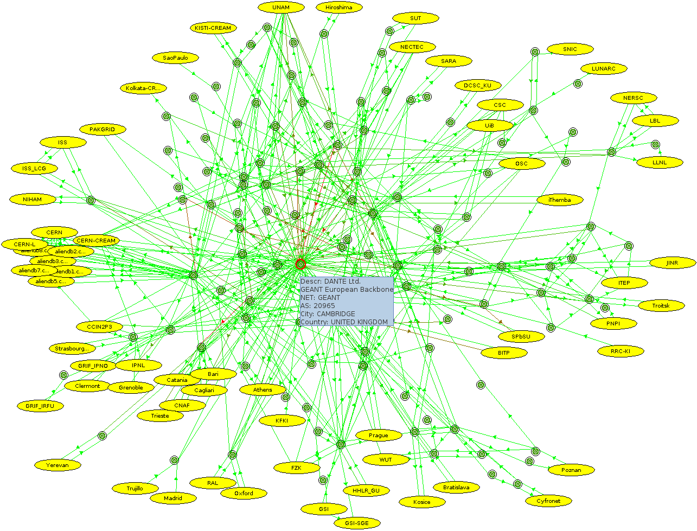
Topology map (AS level)

Slide 17
Storage monitoring
Every 2h a full add/get/rm test suite from the repository machine
  Storage functional status
  Remote access to it
If the storage is full only a get operation is performed, but it is still marked as bad for writing
For xrootd: individual server testing with a similar test suite
Alarms raised on reported size different from LDAP declared size
  Sometimes data servers are not seen by the redirector any more – restart usually cures it

Slide 18
Storage discovery
Closest working replicas are used for both reading and writing
  Sorting the SEs by the network distance to the client making the request
    Combining network topology data with the geographical location
  Leaving as last resort only the SEs that fail the respective functional test
  Weighted with their recent reliability and remaining free space
Writing is finally slightly randomized for more ‘democratic’ data distribution

Slide 19
Distance metric function
distance(IP, IP)
  Same C-class network
  Common domain name
  Same AS
  Same country (+ function of RTT between the respective AS-es if known)
  If distance between the AS-es is known, use it
  Same continent
  Far, far away
distance(IP, Set<IP>): Client's public IP to all known IPs for the storage
0
1

Slide 20
Weight factors
Free space contributes with
  f (ln(free space / 5TB))
Recent history contributes with
  75% * last day success ratio +
  25% * last week success ratio
add test result used for write discovery, get test result used for reading
Resulting value added to the distance

Slide 21
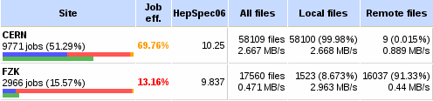
Impact on analysis jobs
Local SE problems makes the jobs read remotely
In this particular case the SE tests are all fine
  Under investigation why the jobs cannot access local data
Remote access can severely impact the jobs efficiency

Slide 22
Remote access efficiency
Storage WNs | CERN | LEGNARO | TORINO | CNAF | FZK
CERN | 2.668 MB/s |  | 0.27 MB/s
FZK | 0.486 MB/s | 0.161 MB/s | 0.213 MB/s |  | 2.963 MB/s
LEGNARO | 1.611 MB/s | 2.628 MB/s | 0.673 MB/s |  | 0.749 MB/s
TORINO | 1.848 MB/s | 1.609 MB/s | 0.684 MB/s |  | 0.891 MB/s
CNAF | 2.193 MB/s |  | 0.623 MB/s | 2.126 MB/s
Problems can come from both network and the storage
IO performance seen by jobs doesn’t always match the VoBox-to-VoBox throughput measurements
  Congested firewall / network segment, different OS settings, saturated storage IO
Reflected in the overall efficiency

Slide 23
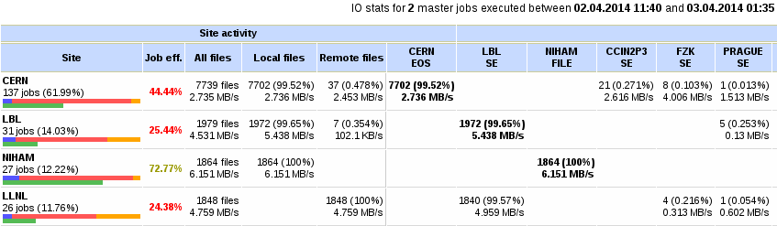
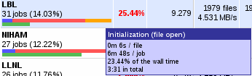
Focus on US
http://alimonitor.cern.ch?1163

Slide 24
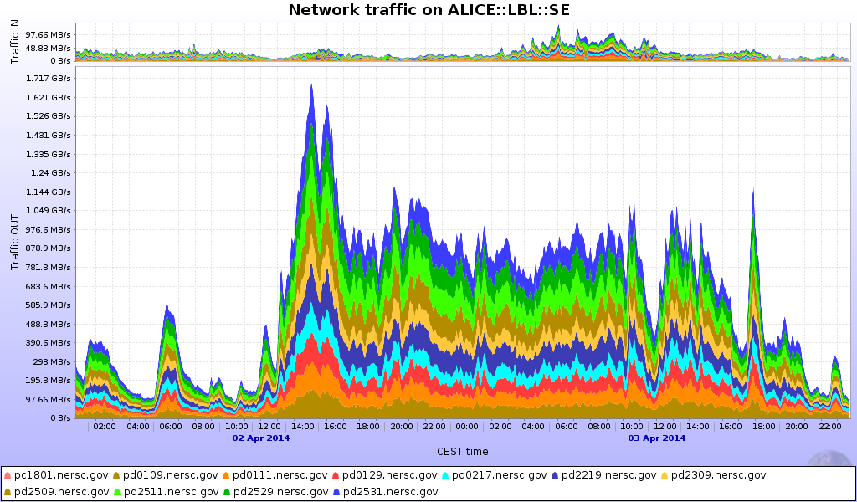
LBL::SE traffic during that time

Slide 25
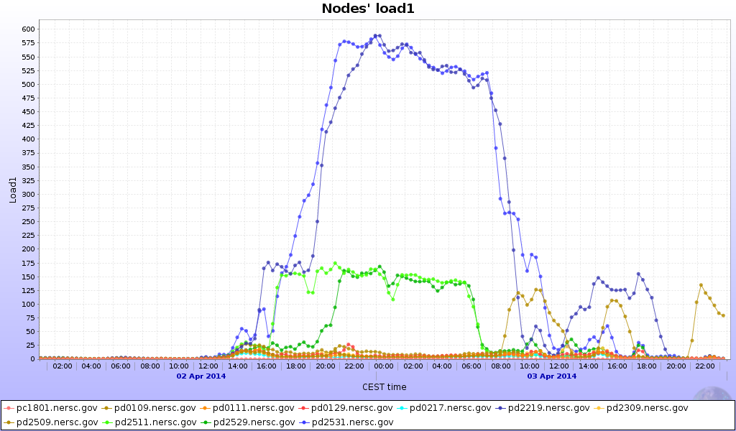
LBL::SE server load

Slide 26
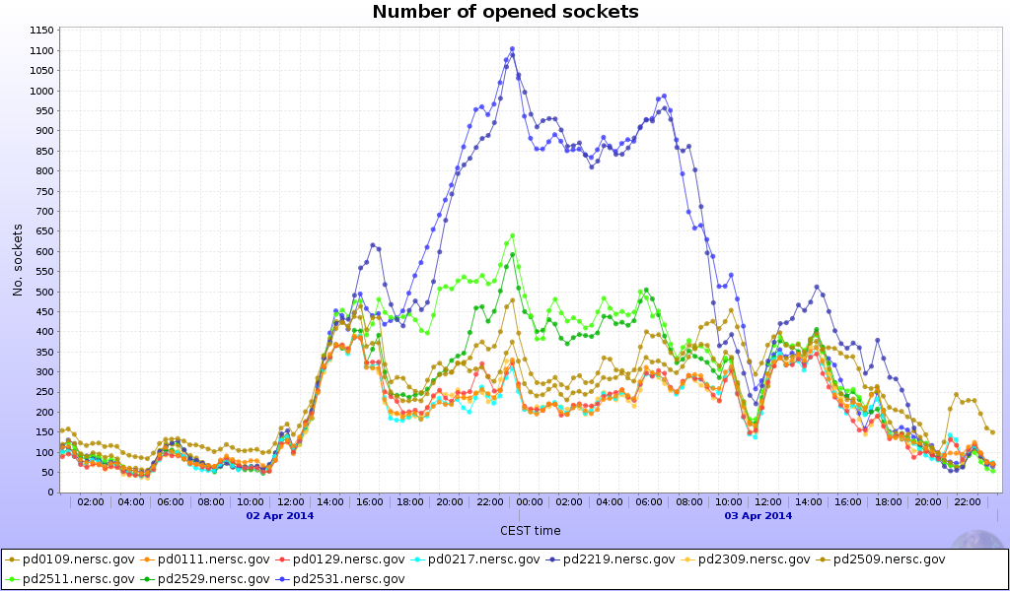
LBL::SE socket count

Slide 27
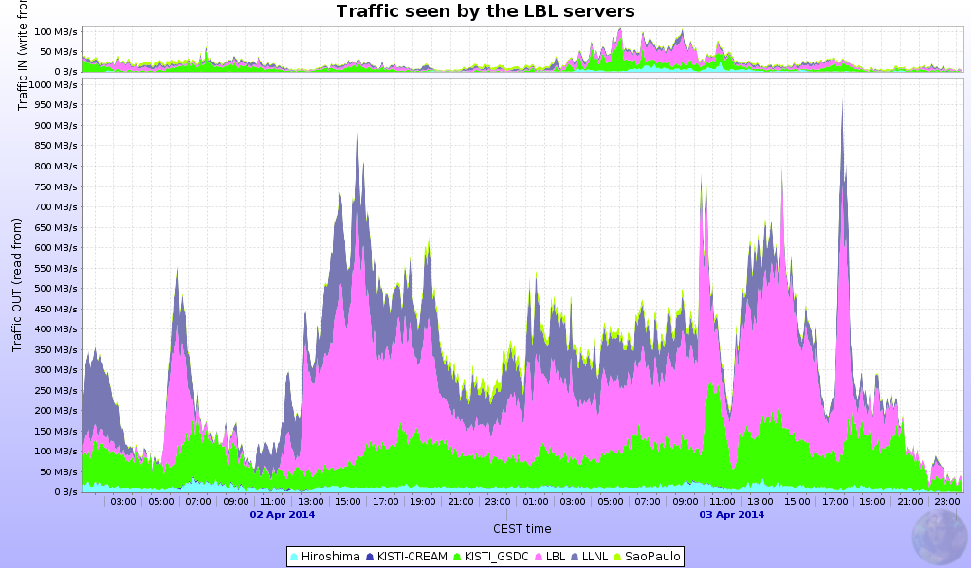
LBL::SE top client sites

Slide 28
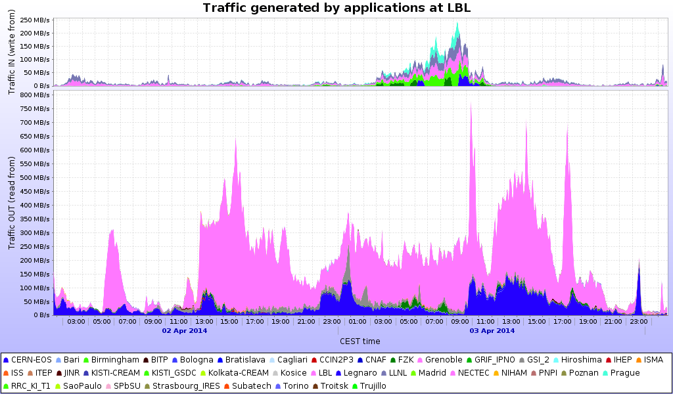
LBL WNs data access

Slide 29
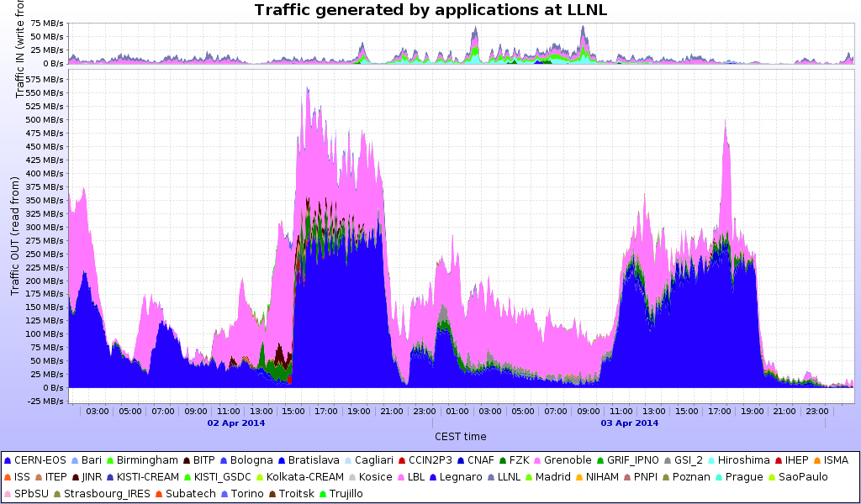
LLNL WNs data access

Slide 30
Remote data access is significant
Remember to tune all machines in your clusters for large average RTT (WNs, data servers, and use same values on the VoBox for reference)
Kernel parameters as seen here:
http://monalisa.cern.ch/FDT/documentation_syssettings.html
Or even better the ESNet recommended values:
http://fasterdata.es.net/host-tuning/linux/

Slide 31
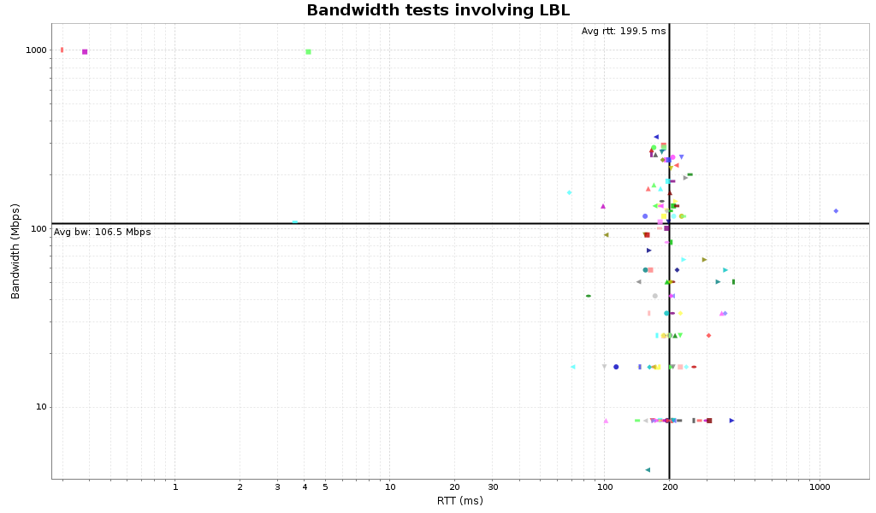
Network 1 TCP stream throughput

