Slide 1
ALICE-USA Computing Project Meeting

Slide 2
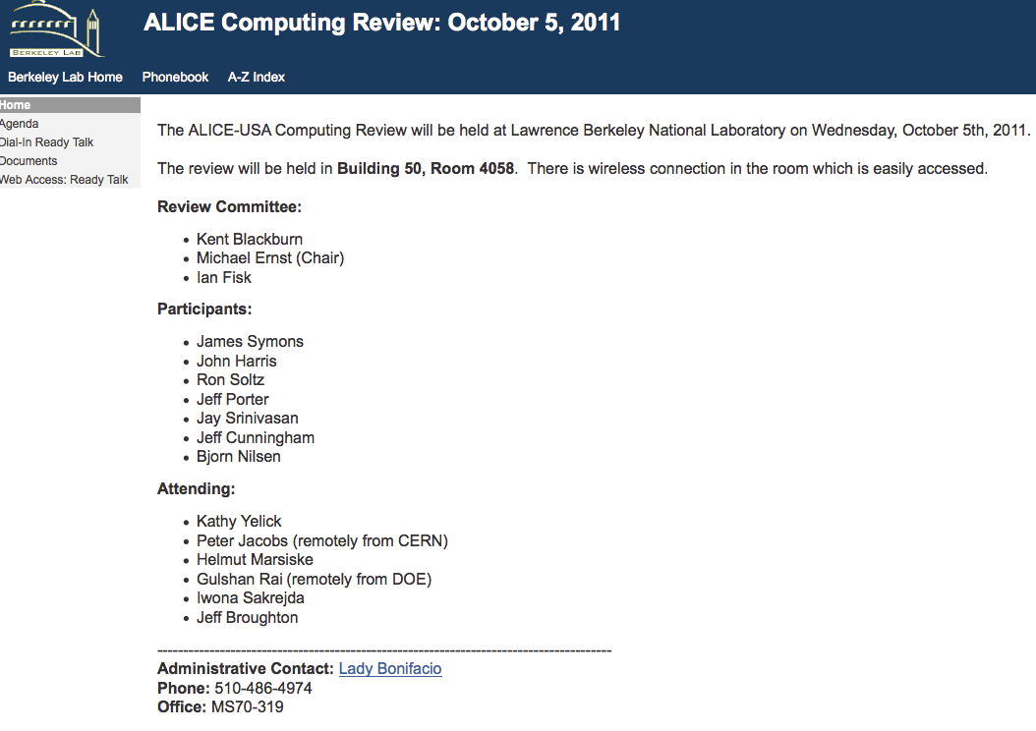
Goals
Review facility performance
  Assess grid operations
  US relative to ALICE-wide
Plan near term tasks
  HW deployment & maintenance
  Operations maintenance
  Service upgrades
Review proposal for new facility
  LLNL/LC → ORNL/CADES
Review Recommendation:
Project should invite ALICE Computing team to US for annual assessment

Slide 3
Logistics Overview
Expected Attendees:
LBNL: Jeff Porter, Jay Srinivasan (Monday morning), Iwona Sakrejda (Tuesday), Lisa Gerhardt (Tuesday)
CERN: Latchezar Betev, Costin Grigoras
LLNL: Ron Soltz & Jeff Cunningham (Monday)
ORNL: Ken Read, Galen Shipman & Pete Eby (both remote and only Monday morning)
Monday Morning (50-5014)
  Review US project & operations
  CADES Introduction
Monday Afternoon (50B-4205)
  Run 2 requirements
  Review new project plan
Tuesday Morning (Cafeteria + 50-5014)
  10AM start in Cafeteria
  NERSC operations & building move
  Site services discussion
Tuesday Afternoon (50-5014)
  EOS review
  Overflow discussion
Cafeteria
  Lunch 11:30 – 14:00
  Espresso closes at 15:00

Slide 4
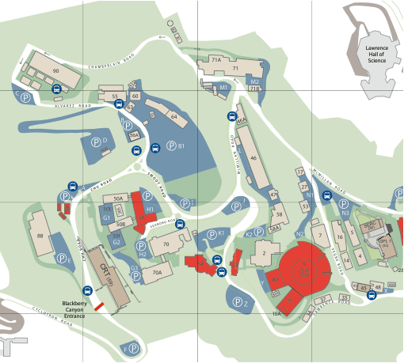
Monday morning
& Tuesday
Bldg 50-5014
Jeff & Lady offices:
70 310 & 319A
Guest House
Monday afternoon
Bldg 50B-4205
Cafeteria
Bldg 54

