Slide 1
Interaction with OSG & WLCG
ALICE-USA Resource Review
Apr 7-8 2014

Slide 2
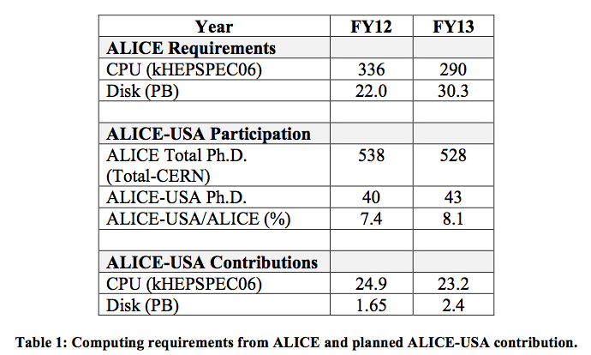
Recap: Evaluating ALICE-USA Obligations
ALICE annual computing requirements
  from ALICE Offline group
  # events, event size, real/MC processing times & samples, data duplication …
Requirements vetted by WLCG
  Final requirements in WLCG DB
    6 months before they take effect
ALICE-USA Obligations:
  Fraction of total requirements defined by proportion of ALICE-USA/ALICE

Slide 3
WLCG
Computing Resource Review Board (CRRB)
RRB Year April – March
Bi-annual meetings of RRB:
  April:
    Review of RRB year just concluded
    Present vetted experiment requirements for next RRB year
  October
    Adjust and finalize experiment requirements for next RRB year
    Review pledges relative to requirements
Site pledges
  Due October for resources to be deployed by upcoming April
  Placed into RRB database by site representative
  After deadline, database becomes read only

Slide 4
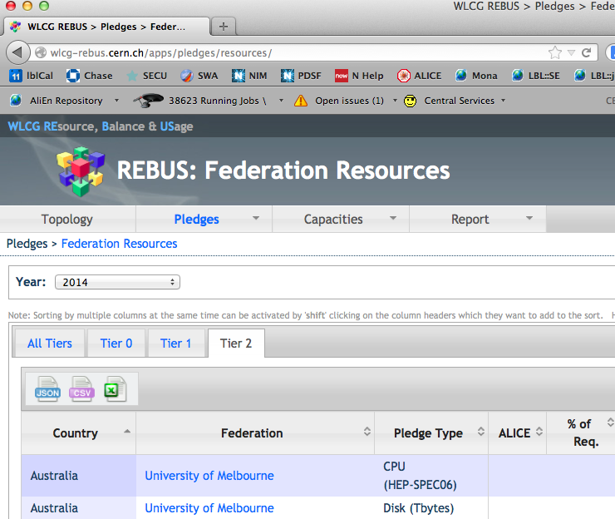
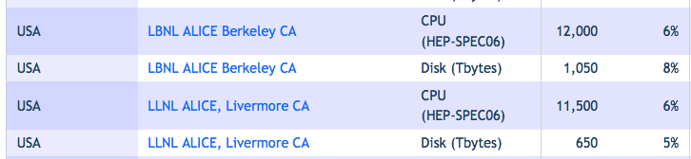
WLCG Computing Resource Review Board (CRRB) http://wlcg-rebus.cern.ch/apps/pledges/resources/
Web Interface
  Record of all pledges
  Can edit during pledge period
Signed MoU prerequisite
CPU Pledges
  Target for monthly reports

Slide 5
Site Configurations
  LLNL/LC
    Vobox Submits to PBS
    OSG-CE: independent external interface
    OSG Accounting
  LBNL/NERSC/PDSF
    Submits to CondorG service on VO box
    CondorG submits to OSG-CE at PDSF
    OSG Accounting
VO box
PBS Cluster
WN ‘SL’6.4
OSG CE
Accounting/
Monitoring
External
non-ALICE jobs
Report all grid jobs
to OSG → WLCG
VO box
CondorG
OSG CE
Accounting/
Monitoring
Univa GE
Cluster:
WN SL6.2
External
non-ALICE jobs
Report OSG Jobs
to OSG → WLCG

Slide 6
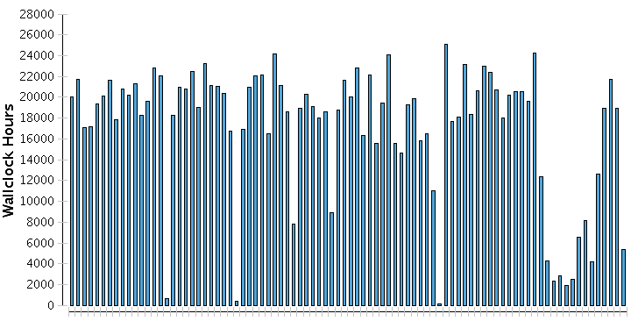
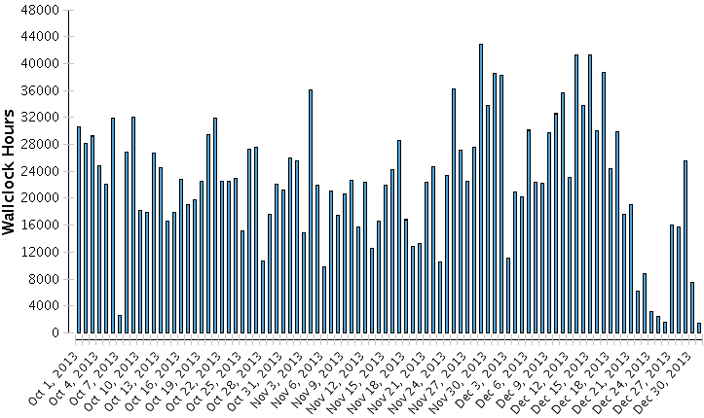
ALICE-USA & Open Science Grid
ALICE-USA project leverages OSG capabilities
  OSG Registration Authority
    ALICE-USA user certificates
    PDSF & LLNL machine certificates
  Resource reports sent to WLCG
    Availability and Reliability
      Critical services scans
    Accounting Reports
      Gratia site service
      OSG central repository → WLCG
  Funding agency monitors that we are not oversized for our mission
OSG Reports
NFS hangs
VOBox
Power
Outage
CVMFS hangs
VOBox
Pledged
LLNL/LC
Scheduled Maintenance
ALICE Grid-wide
job lull
Pledged
NERSC/PDSF
Q1FY14 Report to DOE Oct 1 – Dec 31, 2013

Slide 7
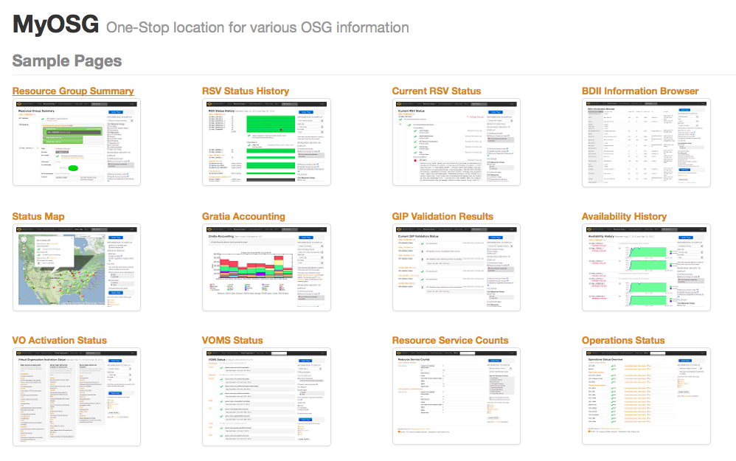
OSG Monitoring Services http://myosg.grid.iu.edu/

Slide 8
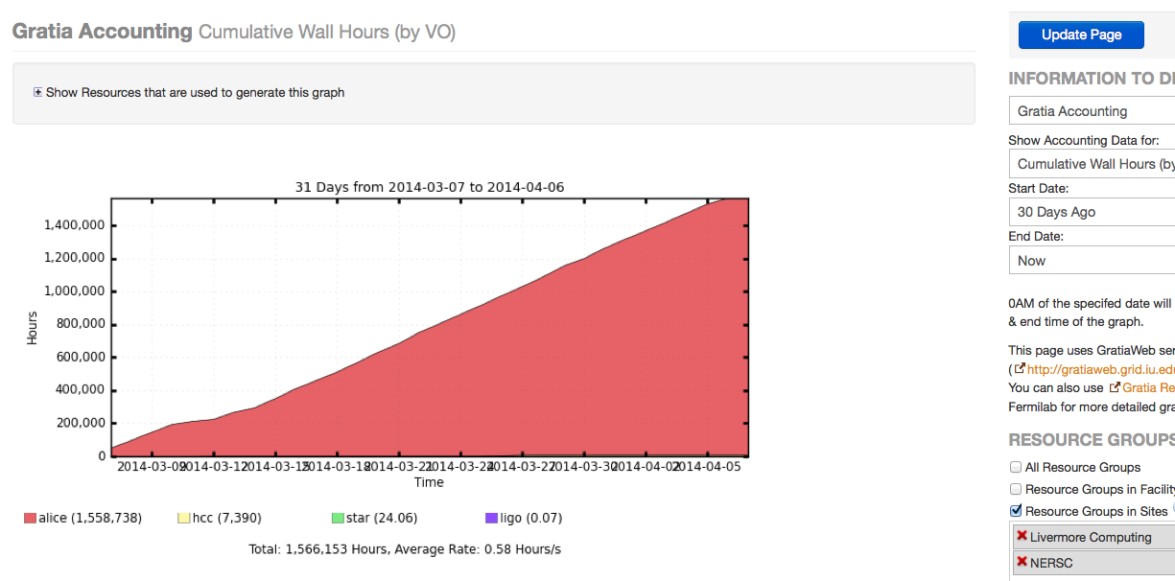
Gratia Accounting Portal
http://gr13x6.fnal.gov:8319/gratia-apel/

Slide 9
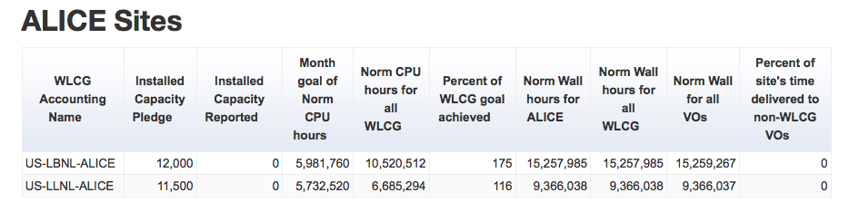
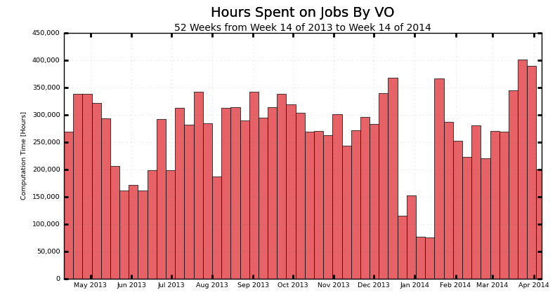
http://gratiaweb.grid.iu.edu/gratia/wlcg_reporting#gip
1 month
http://gratiaweb.grid.iu.edu/gratia/byvo
1 year
33k wall/day
18k jobs/day
PDSF + LLNL/LC

Slide 10
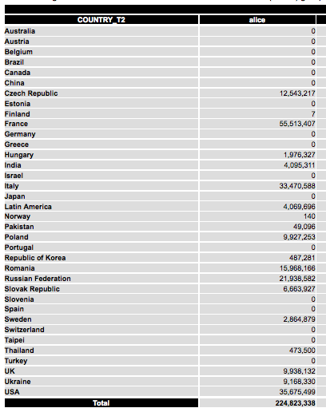
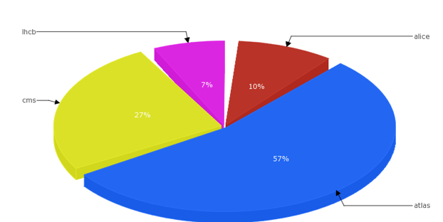
EGI Tier 2 Accounting Portal http://accounting.egi.eu/tier2.php
T2 Reports by country
  Shown: normalized CPU in kSi2k
VO Report
  ALICE @ 10% of WLCG

Slide 11
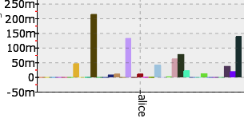

CPU Utilization 2013 RRB Year
10 Months: 3/13 – 01/14
CPU Utilization eff: CPU/wall
  LLNL/LC & NERSC/PDSF ~ 65-70% efficiency
    70% Allowed by WLCG Accounting for T2
Utilization relative to pledges
  LLNL/LC
    Pledge : 11,500 HS x 24 x 300 x 0.7 (allowed eff.) = 58.0 MHS-hrs
    Delivered: 51.6 MHS-hrs → 89%
  NERSC/PDSF
    Pledge: 12,900 HS x 24 x 300 x 0.7 = 65.0 MHS-hrs
    Delivered: = 79.9 MHS-hrs →123%
  Combined
    Pledge = 123.0 MHS-hrs , Delivered = 131.5 MHS-hrs →107%
EGI Portal Country T2
USA

Slide 12
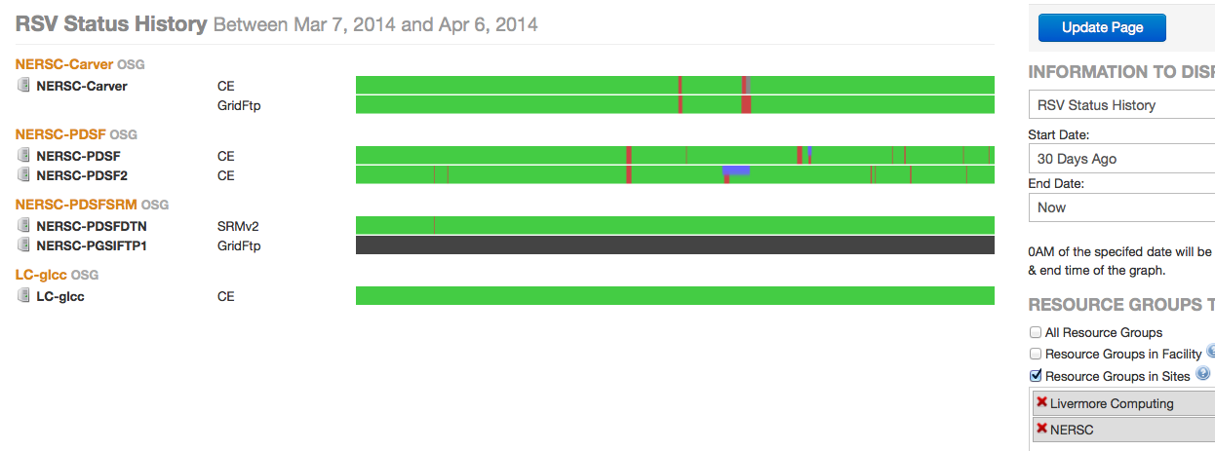
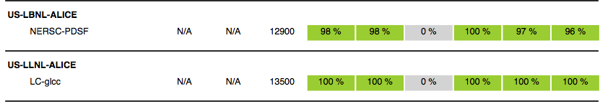
Availability & Reliability
OSG-RSV → deprecated (see below)
RSV Monitors OSG CE for a handful of critical metrics
WLCG Monthly Report on Availability & Reliability
Future in 2 Steps (ORNL likely only 2nd step):
Direct tests from CERN “SAM”
Data taken from ALICE Monitoring - MonaLisa

Slide 13
Site Configurations
  LLNL/LC
    Vobox Submits to PBS
    OSG-CE: independent external interface
    OSG Accounting
  LBNL/NERSC/PDSF
    Submits to CondorG service on VO box
    CondorG submits to OSG-CE at PDSF
    OSG Accounting
VO box
PBS Cluster
WN ‘SL’6.4
OSG CE
Accounting/
Monitoring
External
non-ALICE jobs
Report all grid jobs
to OSG → WLCG
VO box
CondorG
OSG CE
Accounting/
Monitoring
Univa GE
Cluster:
WN SL6.2
External
non-ALICE jobs
Report OSG Jobs
to OSG → WLCG

