Slide 1

ALICE Grid operations
+some specific for T2s
US-ALICE Grid operations review
7 March 2014
Latchezar Betev

Slide 2
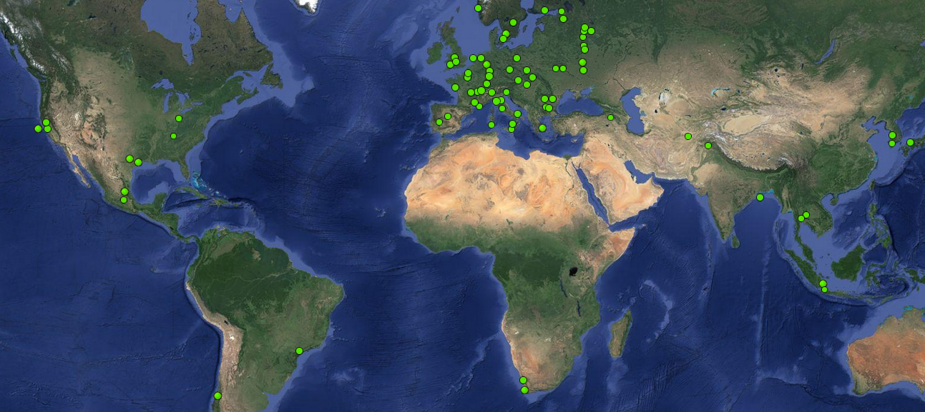
The ALICE Grid
8 in North America
4 operational
4 future + 1 past
53 in Europe
10 in Aisa
8 operational
2 future
2 in Africa
1 operational
1 future
2 in South America
1 operational
1 future

Slide 3
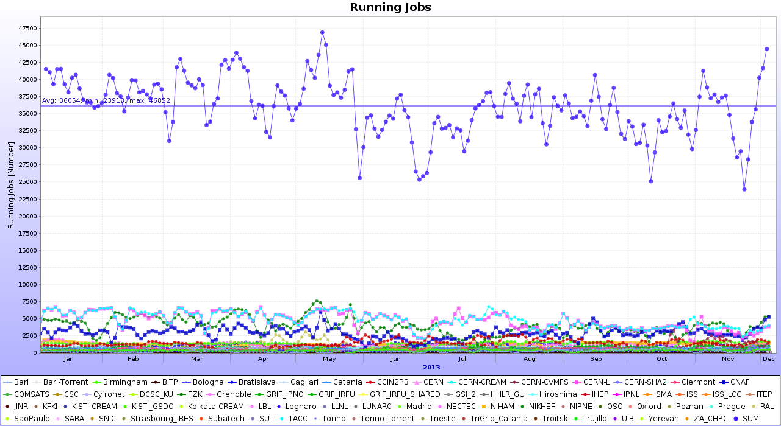
Grid job profile in 2013
Average 36K jobs

Slide 4
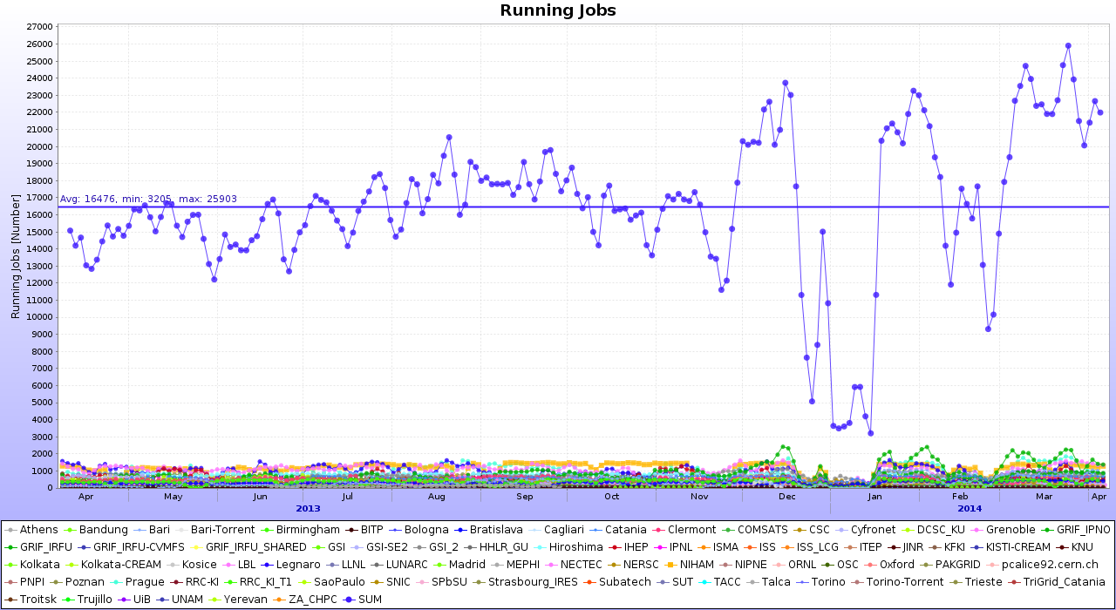
Grid job profile in 2013 – T2s
Average 17K jobs

Slide 5
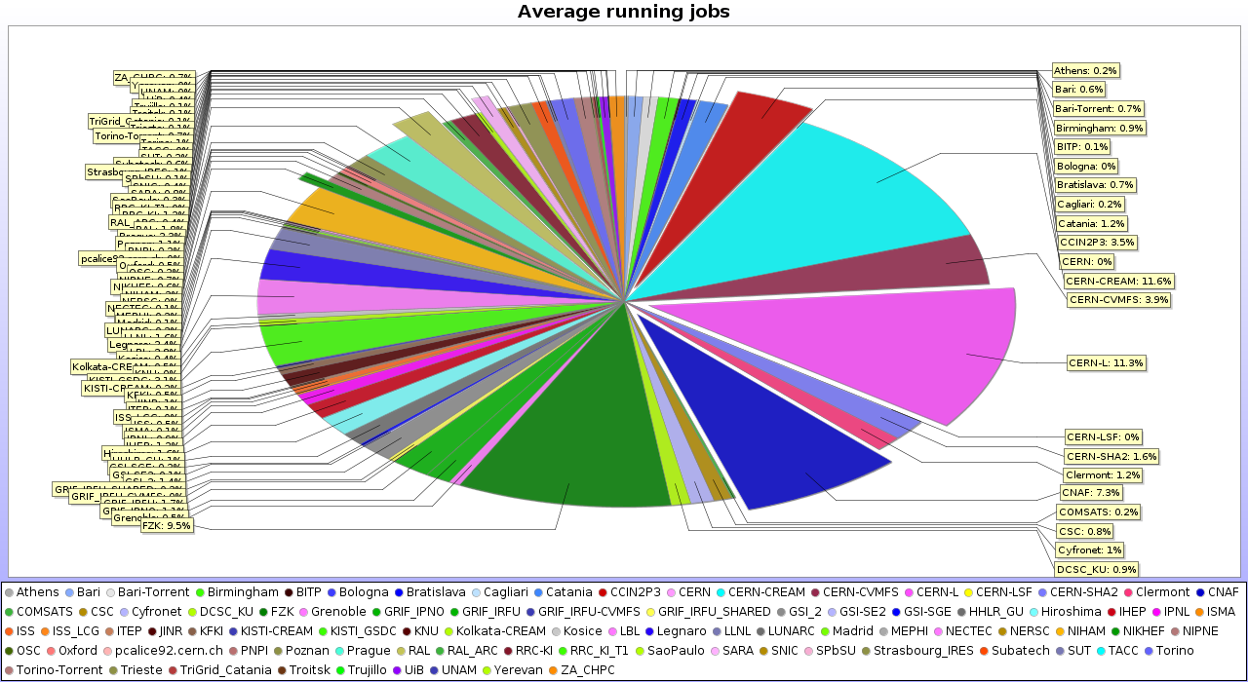
Resources delivery distribution
The remarkable 50/50 share T1/T2 is still alive
and well

Slide 6
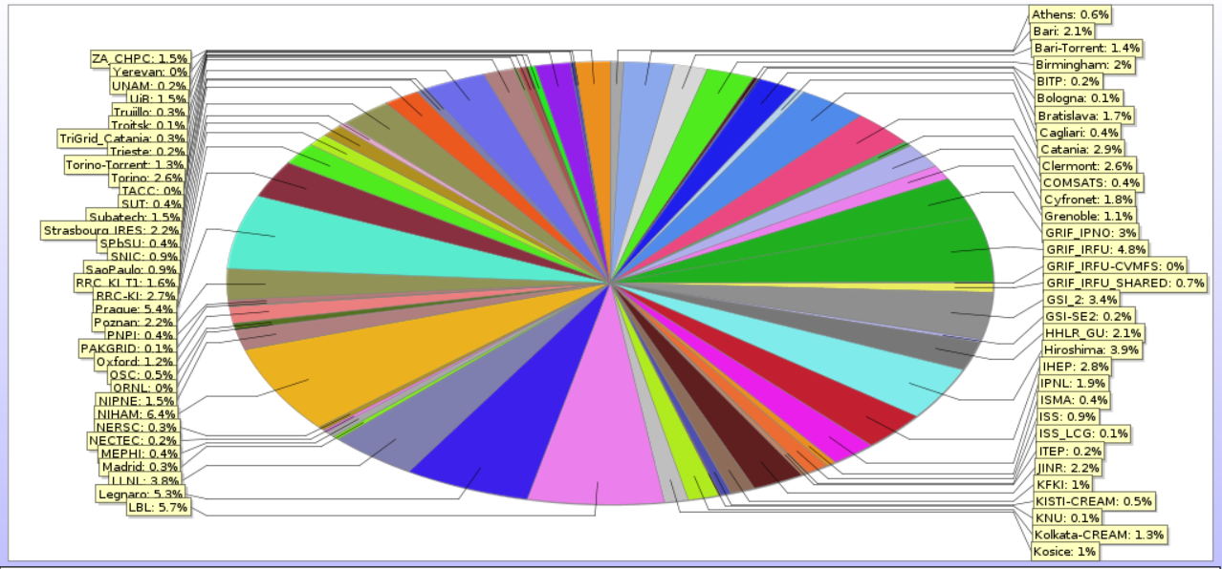
Resources delivery T2s
LBL (6%) + LLNL (4%) + OSC (0.5%) = 10.5% of total T2

Slide 7
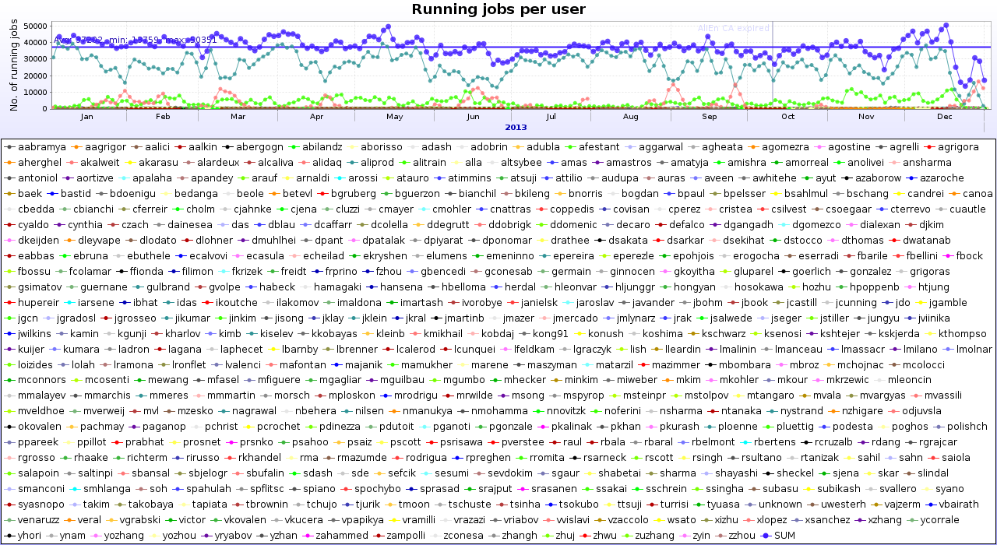
Job mixture
69% MC, 8% RAW, 11% LEGO, 12% individual, 447 individual users

Slide 8
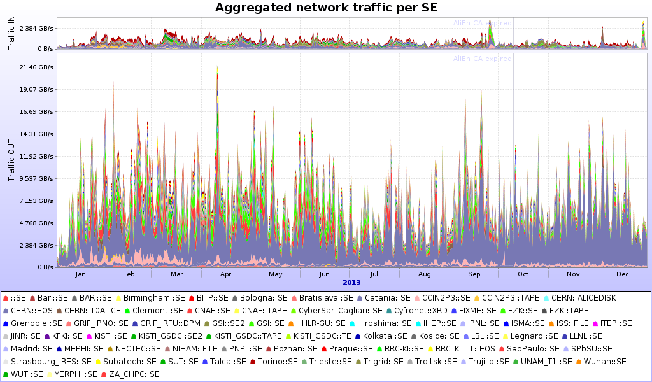
Access to data (disk SEs)
69 SEs, 29PB in, 240PB out, ~10/1 read/write

Slide 9
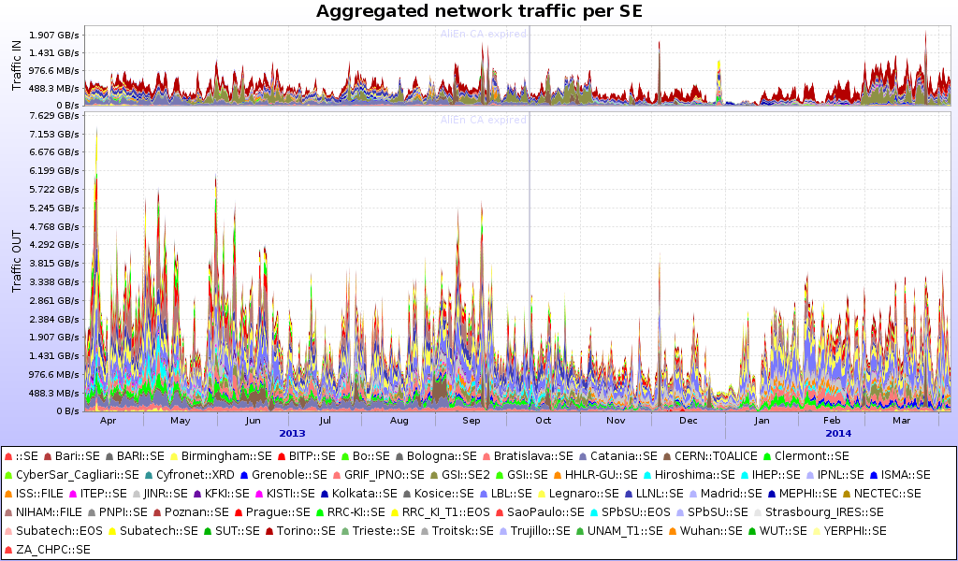
Access to data (disk SEs, T2s)
62 SEs, 17PB in, 83PB out, ~5/1 read/write

Slide 10
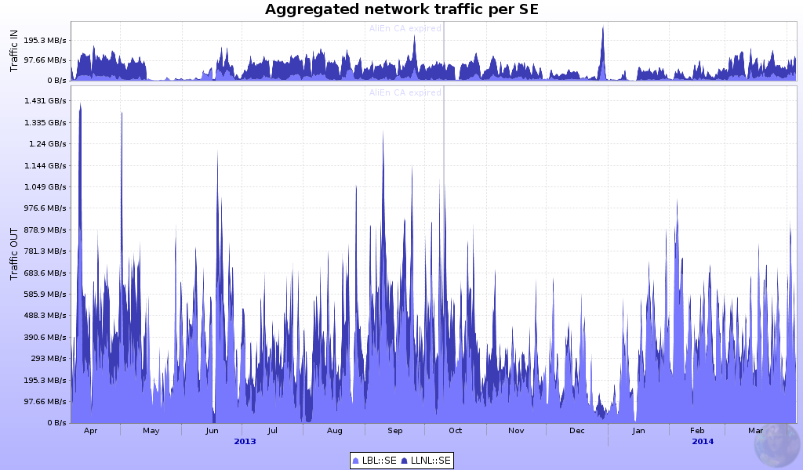
Access to data (disk SEs, US)
2 SEs, 2PB in (12% of T2s)
13PB out (16% ot T2s), ~7/1 read/write

Slide 11
Data access 2
99% of the data read are input (ESDs/AODs) to analysis jobs, the remaining 1% are configurations and macros
From LEGO train statistics, ~93% of the data is read locally
  The job is sent to the data
The 7% is file cannot be accessed locally (either server not returning it or file missing)
  In all such cases, the file is read remotely
  Or the job has waited for too long and is allowed to run anywhere to complete the train (last train jobs)
Eliminating some of the remote access (not all possible) will increase the global efficiency by few percent
  This is not a showstopper at all, especially with better network

Slide 12
Storage availability
More important question – availability of storage
ALICE computing model – 2 replicas => if SE is down, we lose efficiency and may overload the remaining SE
  The CPU resources must access data remotely, otherwise there will be not enough to satisfy the demand
In the future, we may be forced to go to one replica
  Cannot be done for popular data

Slide 13
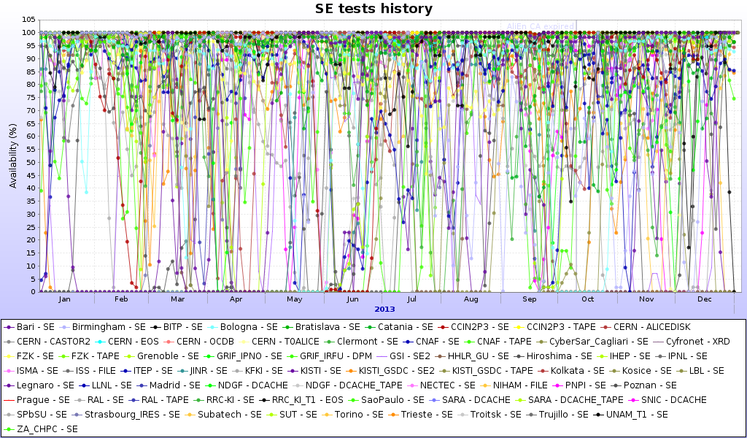
Storage availability (2)
Average SE availability in the last year: 86%

Slide 14
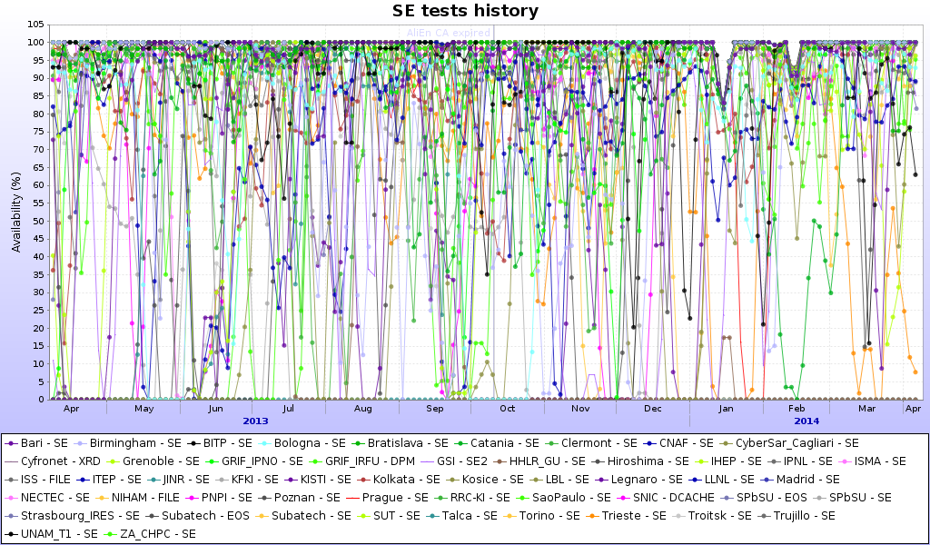
Storage availability – T2s
Average SE availability in the last year: 80%

Slide 15
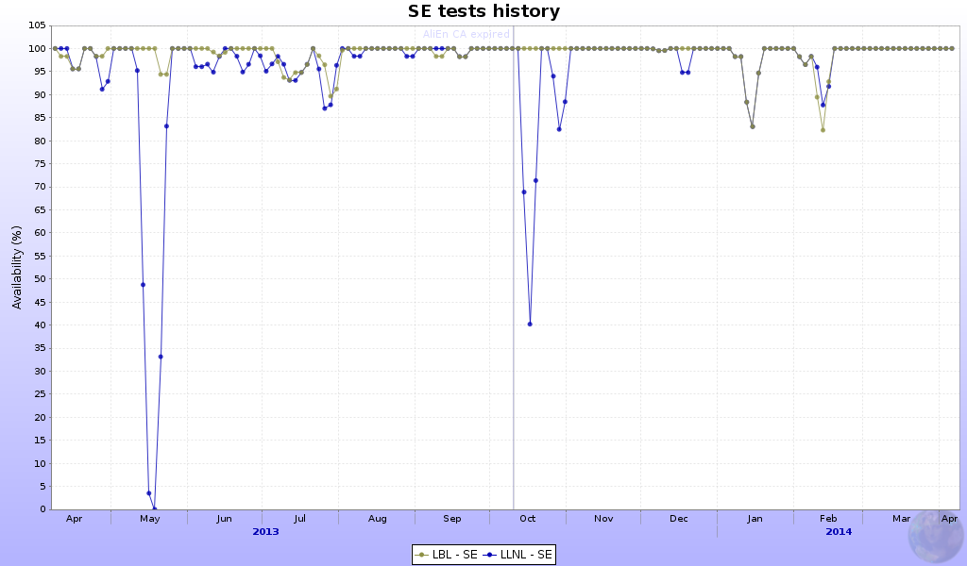
Storage availability – US
Average SE availability in the last year: 97% (!)

Slide 16
Other services
Nothing special to report
  Services are mature and stable
  Operators are well aware of what is to be done and where
  Ample monitoring is available for every service (more on this will be reported throughout the workshop)
  Personal reminders needed from time to time
  Several services updates were done in 2013…

Slide 17
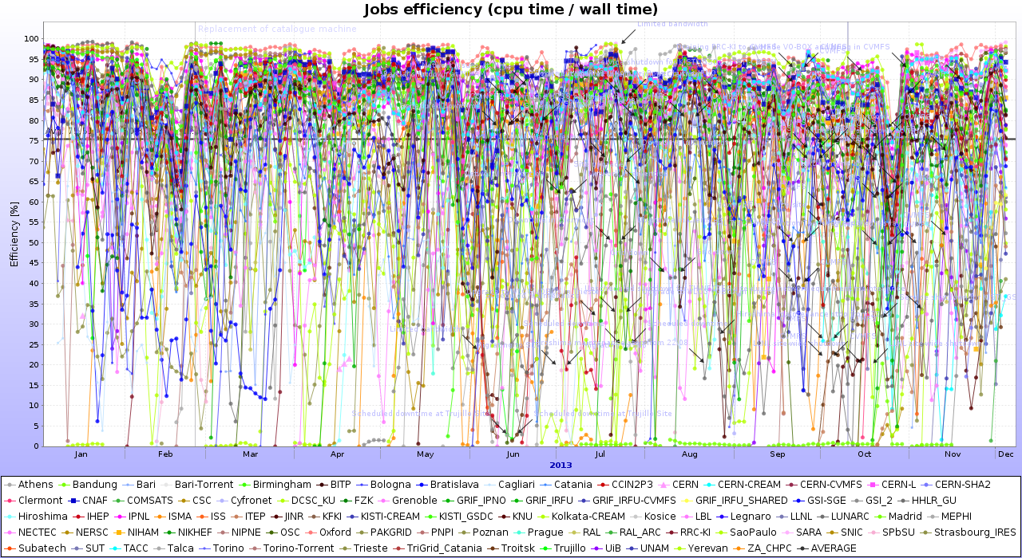
The Efficiency
Average of all sites: 75% (unweighted)

Slide 18
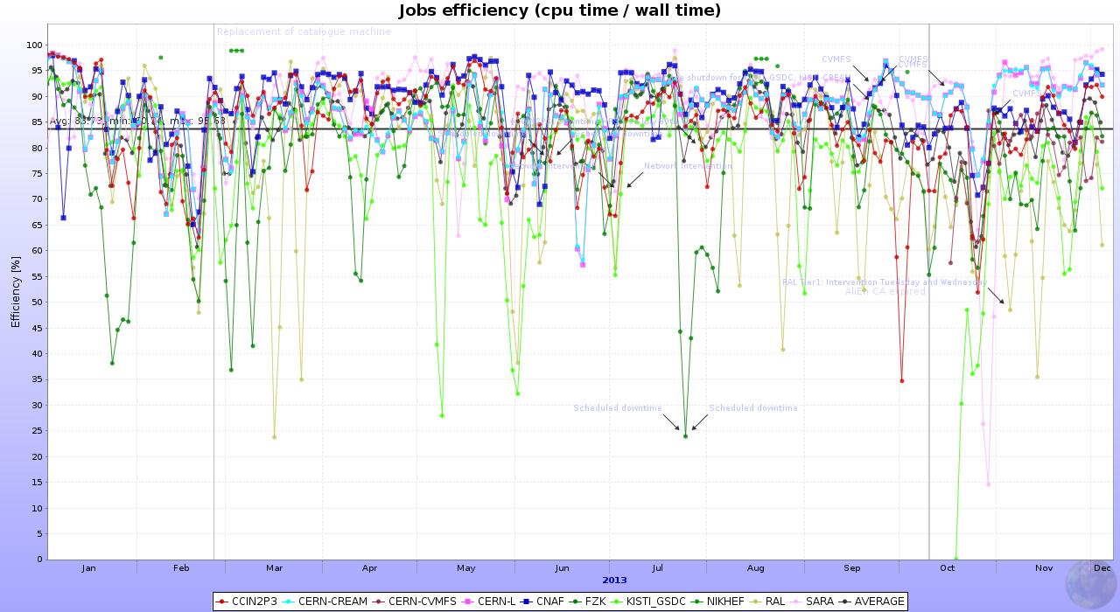
Closer look – T0/T1s
Average – 85% (unweighted)

Slide 19
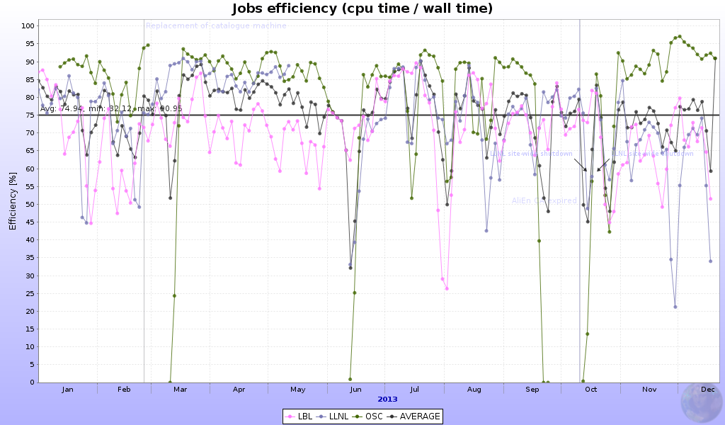
Closer look – US
Average –75% (unweighted)

Slide 20
Summary on efficiency
Stable throughout the year
T2s efficiencies are not much below T0/T1s
  It is possible to equalize all, it is in the storage and networking
Biggest gains through
  Inter-sites network improvement (LHCONE);
  Storage – keep it simple – xrootd works best directly on a Linux FS and on generic storage boxes

Slide 21
What’s in store for 2014
Production and analysis will not stop – know how to handle these, nothing to worry about
  Some of the RAW data production is left over from 2013
Another ‘flat’ resources year – no increase in requirements
Year 2015
  Start of LHC RUN2 - higher luminosity, higher energy
  Upgraded ALICE detector/DAQ – higher data taking rate; basically 2x the RUN1 rate

Slide 22
What’s in store for 2014 - sites
We should finish with the largest upgrades before March 2015
  Storage – new xrootd/EOS
  Services updates
  Network – IPv6, LHCONE
  New sites installation – Indonesia, US, Mexico, South Africa
  Build and validate new T1s – UNAM, RRC-KI (already on the way)

Slide 23
Summary
Stable and productive Grid operations in 2013
Resources fully used
Software updates successfully completed
MC productions completed according to requests and planning
  Next year – continue with RAW data reprocessing and associated MC
Analysis – OK
2014 - focus on SE consolidation, resources ramp-up for 2015 (where applicable), networking, new sites installation and validation

