Slide 1
ALICE USA Computing Project Proposal
ALICE-USA Resource Review
Apr 7-8, 2014

Slide 2
Outline
Run 2 Project Proposal Context
Complications
  NERSC Move
  LLNL/LC → ORNL/CADES
Requirements & Deployment plans
  CPU
  Disk Storage
Summary

Slide 3
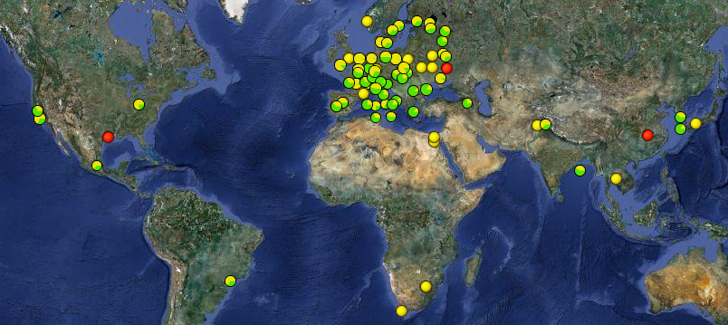
ALICE-USA Computing Project
Goal: supply cost-effective Grid-enabled computing resources to ALICE
  Fulfill MoU-based ALICE USA obligations for computing & storage resources to ALICE
  Based on ALICE USA participation at about 7-8% of ALICE
2009 Project Proposal
  Operate facilities at two DOE labs
    NERSC/PDSF at LBNL
    Livermore Computing (LC) at LLNL
    3-year procurement plan
  LBNL as the host lab
  Fully operational since Summer 2010
Operations defined in “Project Execution & Acquisition Plan”: PEAP
  Organization structure
  Procurement strategy
  Deliverables & Milestones
Project due for a 3 year DOE Review
& originally planned for 2/2014

Slide 4
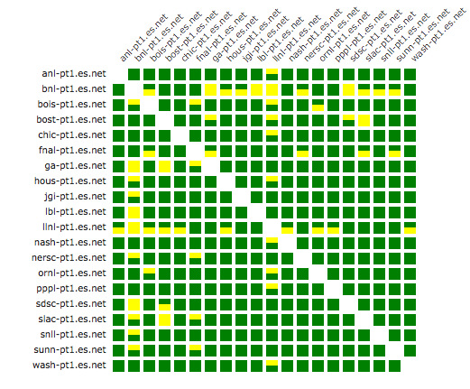
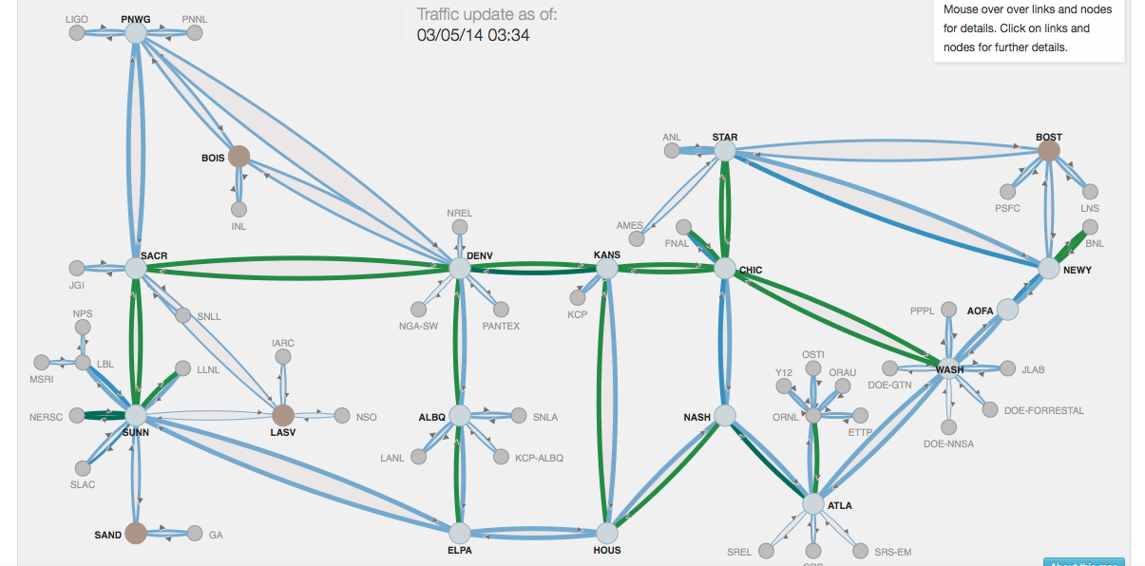

Recommendation for Two Facilities
NERSC/PDSF and ORNL/CADES
NERSC/PDSF + ORNL/CADES
  Scientific Computing strength
  High-bandwidth connection: ESNet
  Favorable cost structure
  Proximity to HPC Resources
    Oak Ridge Leadership Class Facility
    NERSC Flagship facility
    Strategic alignment with O² project
ESnet
ESnet Monitoring
LLNL
ORNL
LLNL/LC → ORNL/CADES
demands a new proposal
NERSC

Slide 5
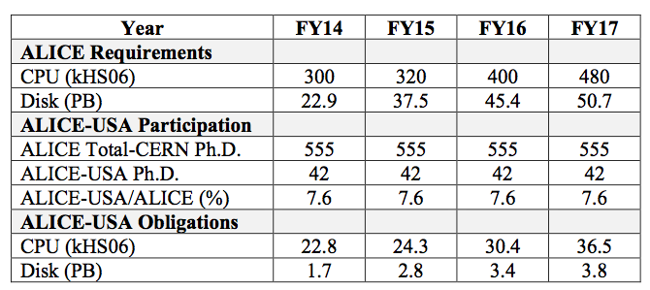
Proposal Timeline
Develop a new Project Execution and Acquisition Plan (PEAP)
  Schedule new resources for NERSC/PDSF and ORNL CADES to:
    Adequately meet new ALICE requirements in FY15
    Fill all ALICE-USA obligations estimated through Run 2
  Establishes operational milestones
    Stable grid operations @ORNL CADES
      AliEn VO box & SE
      OSG Services (TBD)
    WLCG MoU with ORNL CADES
Aggressive timeline:
  Draft in progress - working document by end of April
  April 7th-8th: host ALICE Offline at LBNL to review proposal and plan
  DOE Chaired External Review of project proposal is being scheduled ~ June 2014
ALICE Run-2 Requirement Estimates

Slide 6
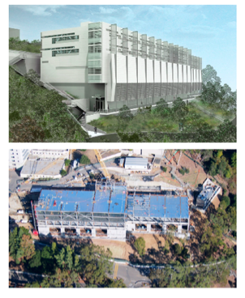
Additional Complication
NERSC new building in early 2015
  More details Tuesday, in NERSC Report
  No new hardware will be installed in the current building
  Operate in both buildings for ~1 year
    Most of PDSF CPU nodes will move
      Duration of move/downtime is unclear
      Will attempt to mitigate with other cpu
    Storage will remain in old building
    New storage →new building
LLNL/LC will continue into 2015
  Allows us flexibility to meet obligations

Slide 7
Timing Constraints
Target next heavy ion run → Fall 2015
  Both NERSC and CADES meeting all ALICE-USA obligations
LLNL/LC should assumed to be decommissioned → Oct 2015
  Regardless of flexibility
NERSC CRT building ready for new HW → Spring 2015
  NERSC Oakland Facility assumed to be decommissioned → Fall 2015
ORNL/CADES ready for deployment as needed
  Current target for new hardware is by April 2015

Slide 8
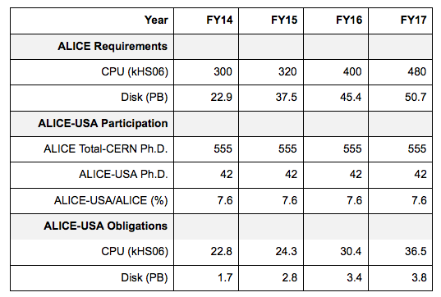
ALICE-USA Obligations
(preliminary)
ALICE PhD & ALICE-USA PhD Counts are estimates
Columns are US FY:
  By DOE request
ALICE Disk puzzle:
  63% jump in 2015
  21% increase in 2016
  10% increase in 2017
  Data rate 2015 = 2016 ?

Slide 9
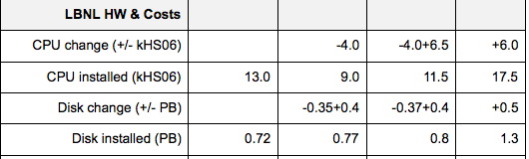
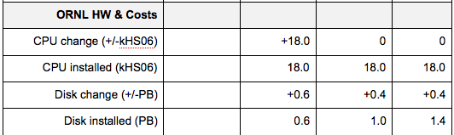

Deployment plan by site

Slide 10
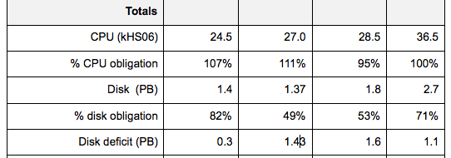
Preliminary summary plan
Meets CPU targets at ~100%
Falls well short of disk obligation
  Need to better understand year-to-year requirements
  Expect that we will catch up ~FY17 or if need arises from ALICE
Does not
include LLNL/LC

Slide 11
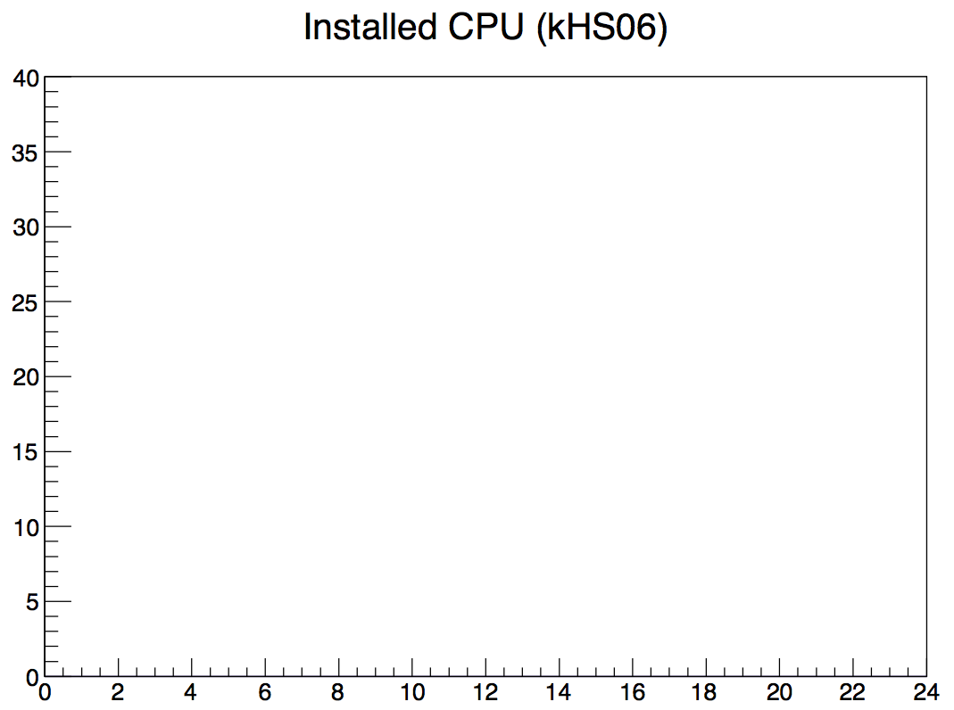
CPU Deployment Profile
ALICE-USA
ALICE Req
ORNL
LBNL
LLNL
Apr ‘14
Apr ‘15
Apr ‘16

Slide 12
WLCG Resource Pledge Guidance
LLNL/LC will operate for ½ of RRB 2015
  Assume to continue with current pledge & then remove pledge mid-year
    should verify with WLCG
ORNL/CADES available to make pledges after MoU
  Targets MoU signed by Oct 2015
LBNL/PDSF will lose resources mid-2015 RRB year
  Will pledge to the lower value

Slide 13
Storage replacement
Storage is or will be out of warranty:
  LLNL/LC
    680TB ended ~Aug 2013
  NERSC/PDSF:
    144TB ended June 2013
    288TB ends Apr 2014
    288TB ends Oct 2014
  Project plans to operate ~1.4PB storage at LLNL & LBNL into 2015
Replacement storage will be new SE at both LBNL and ORNL
  Requires migrating >700TB data between new and old SEs
    LLNL::SE → ORNL::SE --- WAN transfer
    LBL::SE → LBLEOS::SE --- local high bandwidth transfer
  Migration will take time
    How to operate during migration?
      Do we make source SE readonly?
    Does ALICE know how to do this?

Slide 14
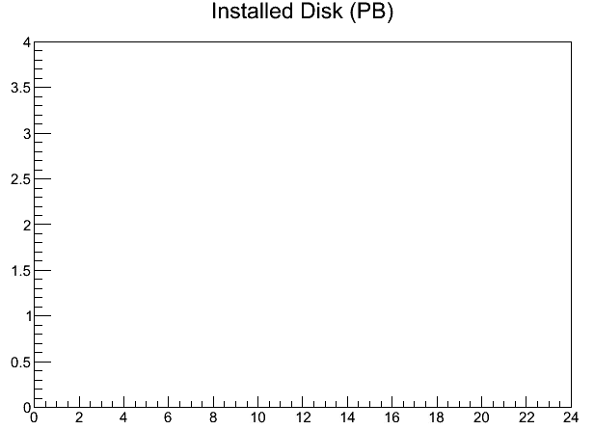
Disk Deployment Plan
ALICE Req
ALICE-USA
LBNL
LLNL
ORNL
Apr ‘14
Apr ‘15
Apr ‘16

Slide 15
Summary
New ALICE-USA Computing project proposal required for Run 2
  Two US based ALICE Tier-2 facilities, ORNL/CADES & LBNL/NERSC
  Subject to DOE review in early June
Hardware deployment plan is preliminary
  Will satisfy CPU requirements
  Needs to understand disk requirements, year-to-year changes
The project plan is made complicated
  Movement of NERSC to new building in 2015
  Replacement LLNL/LC resources with new resources at ORNL/CADES
    Particularly transfer of ~400TB of data over WAN

