Slide 1

T1 at LBL/NERSC/OAK RIDGE
General principles

Slide 2
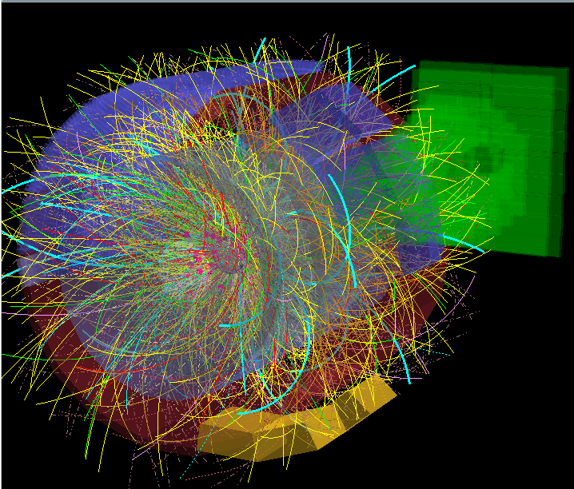
RAW data flow
Copy 1 (full)
CERN Tape
disk
buffer
Raw data
T0 disk buffer
DAQ & HLT
AliEn FC
out Tape
disk
buffer
Condition & Calibration & data DB
Copy 2 (partial)

Slide 3
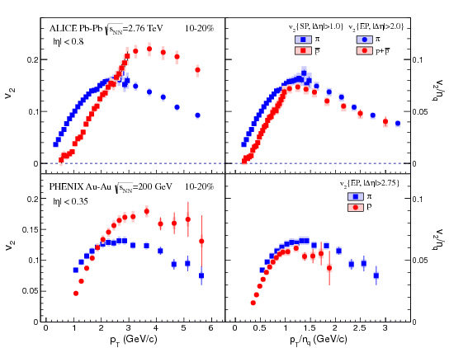
Data processing
Reconstruction
Filtering
Raw data
ESD × 2
AOD × 3
MC data
800 users

Slide 4
Hirearchy
Tier 0 (CERN & Budapest)
10 Gb/s
Tier 1
…
Tier 2
…
Connectivity – anyone to anyone, T0<->T1 is 10GB/sec (LHCOPN)

Slide 5
Grid node
CPU
3GB/core RAM
10GB/core HDD
MC & analysis
OUT – data
to other centres
Local traffic – one copy of all locally processed data + all analysis jobs I/O
IN – data replicas
from other centres
Disk storage
xrootd management
1TB/3cores
OUT – remote WNs data requests (small volumes)
AliEn + grid services
Batch services

Slide 6
Processing principles
  All resources are pooled together
Any site performs any kind of tasks (except RAW data access limited to T0 & T1s)
    Even this is not ‘a rule’
Data placement guided by topological location of sites
    Storage auto discovery
Job goes to the data
Network scales with #users and amount of data

Slide 7
Some numbers
ALICE has been collecting data since 2010
2010: pp @ 0.9 – 7 TeV
Pb-Pb @ 2. 76 TeV (MB); L_{int} = 3 μb⁻¹
2011: pp @ 2.76 – 7 TeV (MB & rare)
PbPb @ 2.76 TeV (MB & rare); L_{int} = 80 μb⁻¹
2012: pp @ 8 TeV (rare)
p-Pb @ 5.02 TeV (MB & rare); L_{int} = 30 nb⁻¹

Slide 8
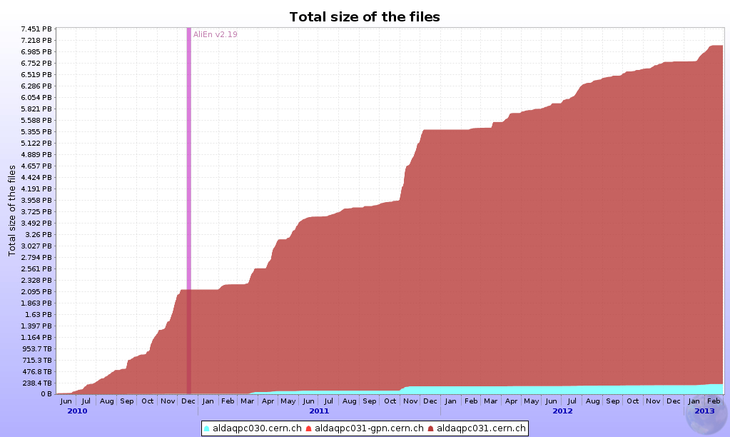
RAW Data collection
pPb@5.02 TeV
pp@8 TeV
PbPb@2.76 TeV
pp@2.76-7 TeV
PbPb@2.76 TeV
pp@0.9-7 TeV

Slide 9
Processing needs
~ 10 HEP-Spec06 / core
~ 50 HEP-Spec06 × s / PbPb event
~ 1 TB / 50,000 PbPb events

Slide 10
Processing capacities
CPU
Disk
Tape
8-core
PB
PB
Tier 0
1,300
8.1
22.8
24%
28%
Tier 1
1,500
7.8
13.1
…
27%
29%
Tier 2
2,700
12.8
…
49%
45%

Slide 11
Capacity evolution

Slide 12
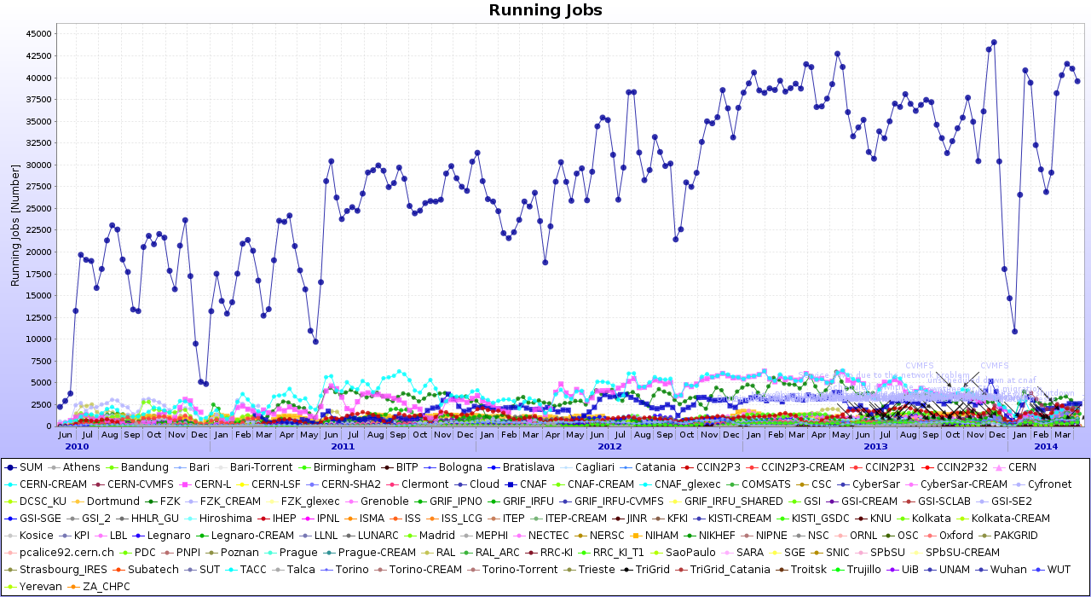
Capacity evolution (2)

Slide 13
T1 definition
From WLCG MoU
acceptance of an agreed share of raw data from the Tier0 Centre, keeping up with data acquisition;
acceptance of an agreed share of first-pass reconstructed data from the Tier0 Centre;
acceptance of processed and simulated data from other centres of the WLCG;
recording and archival storage of the accepted share of raw data (distributed back-up);
    provision of managed disk storage providing permanent and temporary data storage for files and databases;
    provision of access to the stored data by other centres of the WLCG and by named AF’s;
    operation of a data-intensive analysis facility;
    provision of other services according to agreed Experiment requirements;

Slide 14
T1 services
Ensure high-capacity network bandwidth and services for data exchange with the Tier0 Centre, as part of an overall plan agreed amongst the Experiments, Tier1 and Tier0 Centres;
Ensure network bandwidth and services for data exchange with Tier1 and Tier2 Centres, as part of an overall plan agreed amongst the Experiments, Tier1 and Tier2 Centres;
Administration of databases required by Experiments at Tier1 Centres.
All storage and computational services shall be “grid enabled” according to standards agreed between the LHC Experiments and the regional centres.
    Services must be provided on a long-term basis, with excellent reliability, a high level of availability and rapid responsiveness to problems.

Slide 15
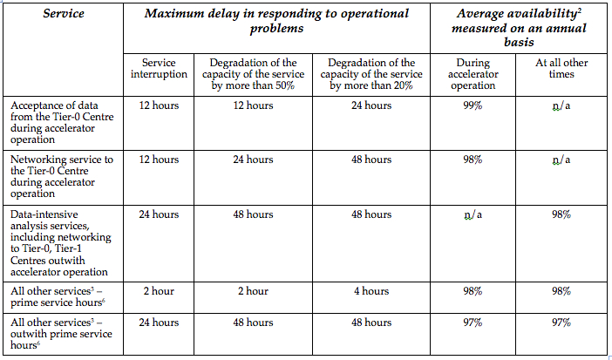
QoS

Slide 16
Approval process (KISTI T1)
Preparation/running of CPU, disk storage, local networking – existing
Setting up tape copy through xrootd – 3 months
RAW data replication/reconstruction tests – 2 months

Slide 17
Summary
Being T1 is the only reasonable choice for a large computing centre
Most of the components are already in place, additional elements add expertise
    Important for the progress of the centre itself
    Can be a source of substantial R&D programme
The ‘prestige’ factor should not be ignored – there are 150+ T2 and only 8 T1s

