Slide 1

ODU Crab Cavity Stress Analysis
March 9th 2014
Norbert Kuder
Notes:
Method:
individual interviews with group leaders based on the April schedule -> to gather bottom-up data,
EN retreat on 1st July -> the aim was to bring the MTP in line with the last schedule & saving requests from the Council in June
ENMB on 26th July -> validate with group leaders the top-down arbitration

Slide 2
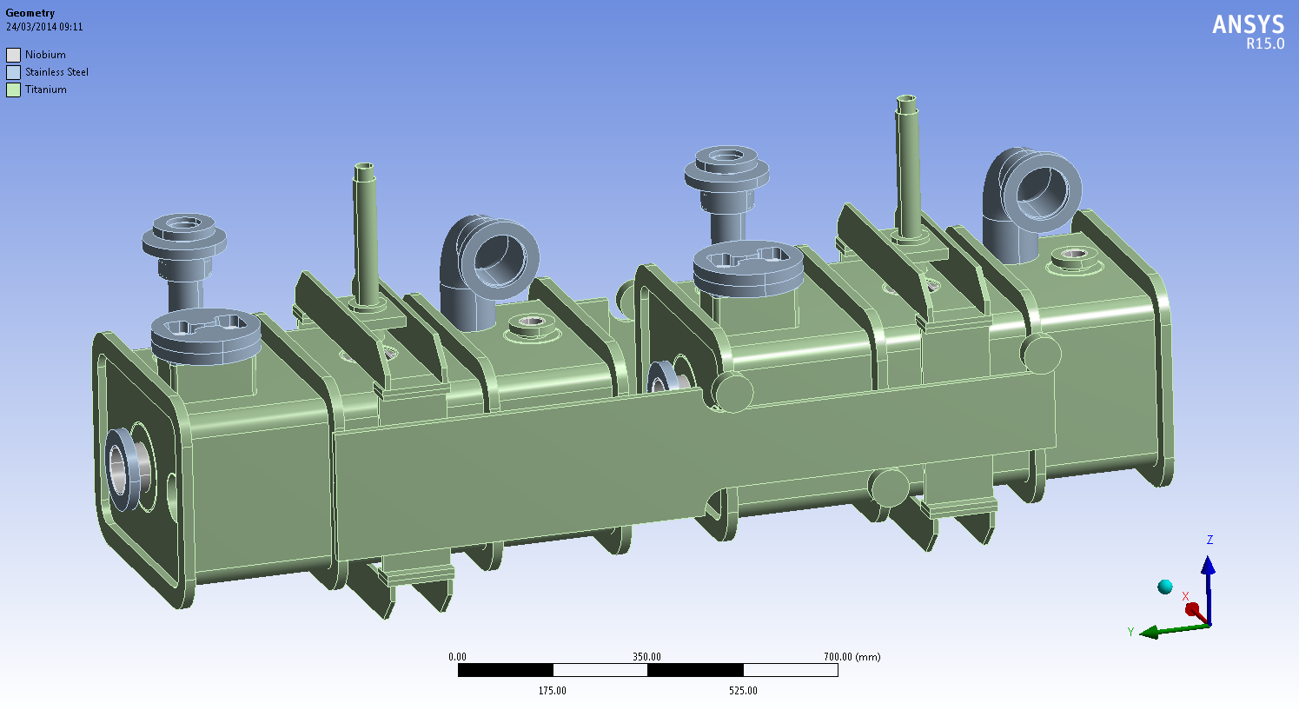
Simplified geometry of the ODU crab cavity
The UK 4-Rod Cavity: 1st model
±1.3mm

Slide 3
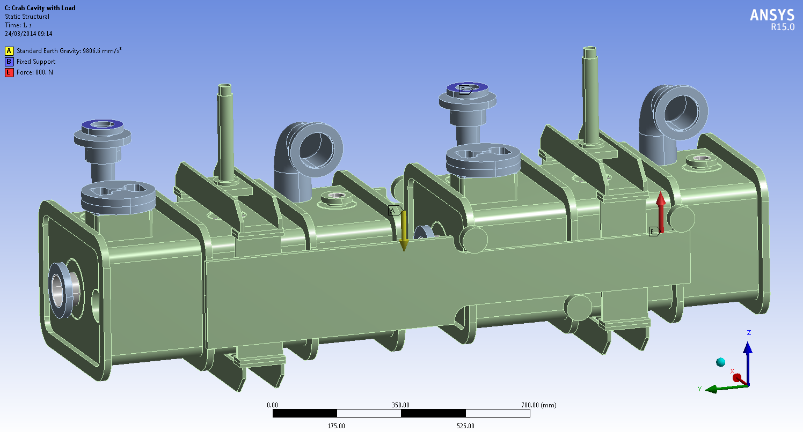
Boundary conditions

Slide 4
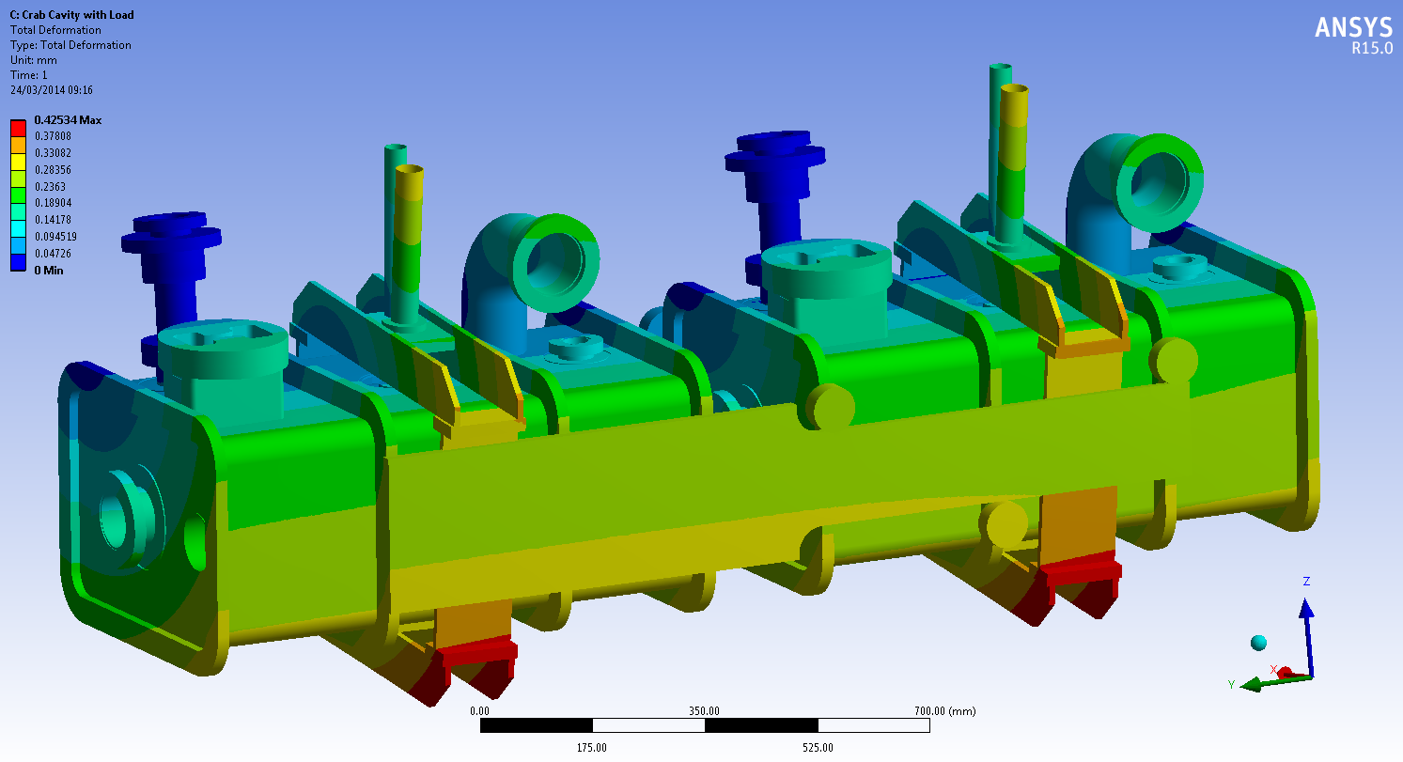
Total deformation

Slide 5
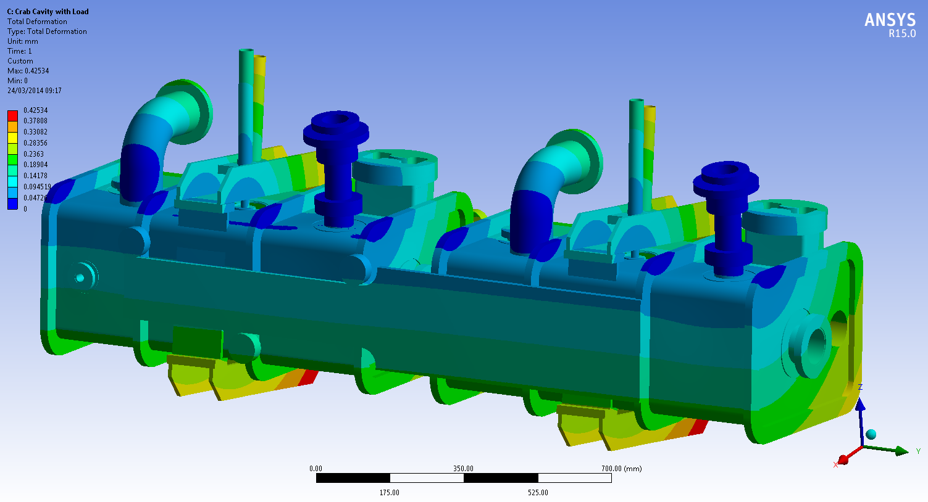
Total deformation

Slide 6
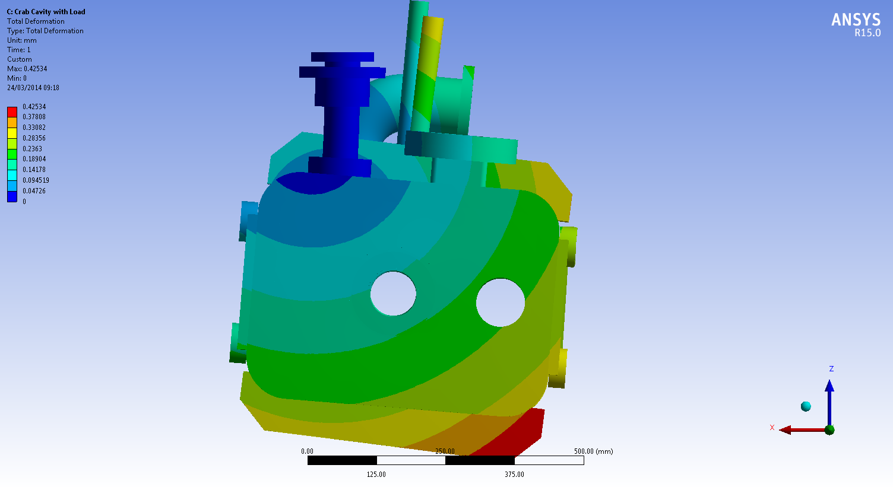
Total deformation
Stress Intensity

Slide 7
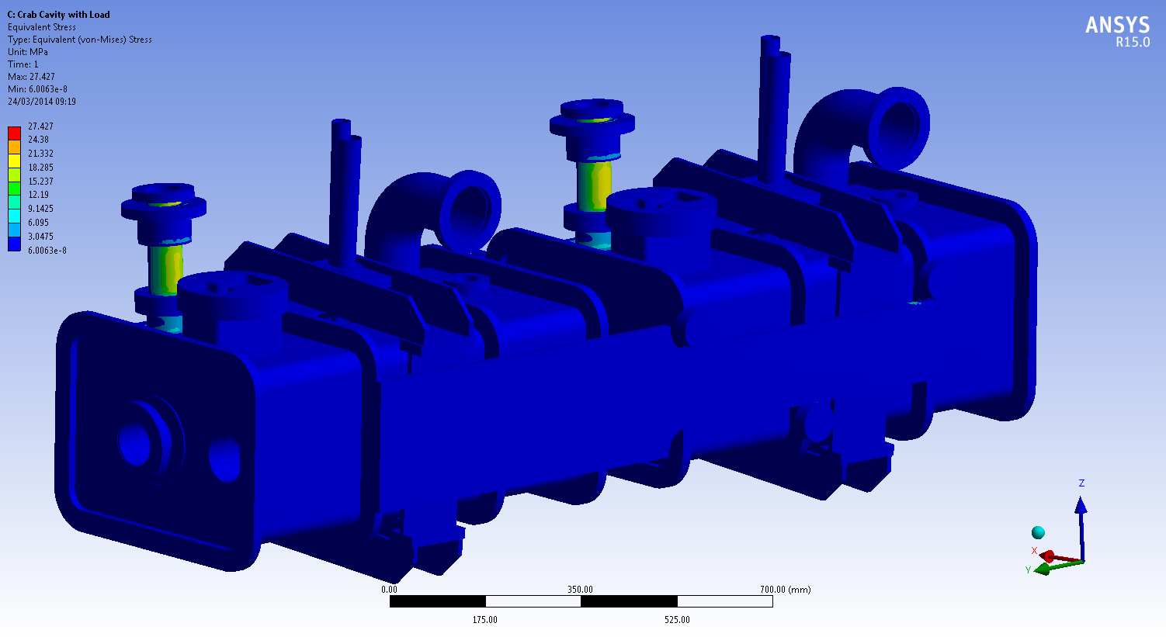
Equivalent stress

