Slide 1
LHC longitudinal collective effects
J. F. Esteban Müller
T. Argyropoulos, E. Shaposhnikova
9th HiLumi WP2 Task 2.4 meeting – 9 April 2014

Slide 2
Outline
Introduction
Review of measurements
Analytical estimation
Simulations
Next steps
Conclusions

Slide 3
Introduction (1)
LHC impedance is very small: according to DR Im Z/n ≈ 0.1 Ω, compared to 4 Ω in the SPS or 20 Ω in the PS
  Difficult to measure with beam using existing methods
No longitudinal instability in the LHC for operational beam parameters (so far)

Slide 4
Introduction (2)
Our plans:
Check LHC impedance model with:
  measurements
  analytical calculations
  simulations
Study the case of HL-LHC parameters
  Single RF system
  Double harmonic RF systems
Currently working on this

Slide 5
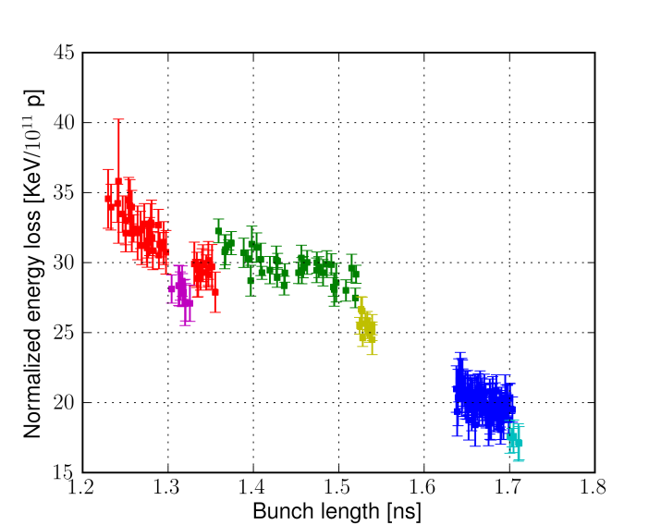

Review of measurements (1)
Resistive impedance
From synchronous phase shift (MD 2012)
Good relative measurements for the TDI
$\sin{∆φ_{s}}= \frac{W}{e V N}$
TDI in
W:= bunch energy loss per turn
V := RF voltage
N := bunch intensity
TDI out

Slide 6
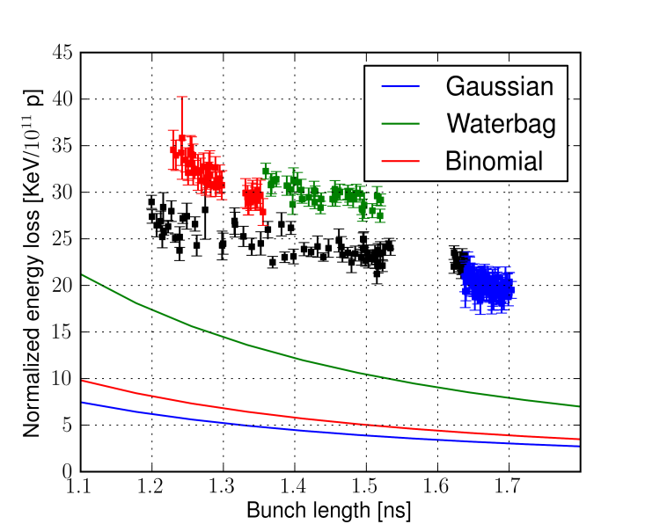
Review of measurements (2)
Resistive impedance
From synchronous phase shift (MD 2012)
Factor 4-5 with respect to estimation using the impedance model
  Possibly due to errors in the phase module (very high accuracy needed, ̴0.01 deg at 400 MHz)

Slide 7
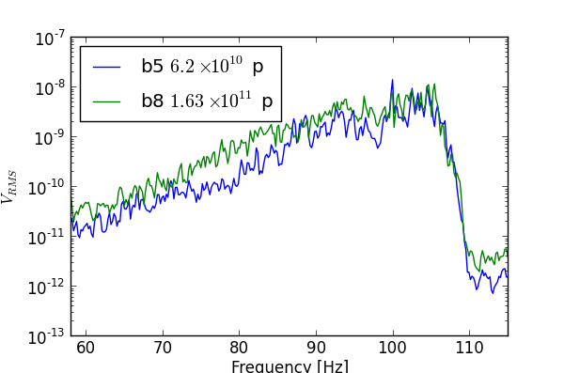
Review of measurements (3)
Peak detected Schottky spectrum at 2 f_{s}
Synchrotron frequency shift smaller than 1 Hz/10¹¹ at 2 f_{s} → Im Z/n < 0.1 Ω
Similar results for frequency shift from excitation by RF phase modulation
Frequency [Hz]

Slide 8
Review of measurements (4)
Loss of Landau damping
Observations during the ramp:
  2010:
    acceleration with Phase Loop (PL) on
    bunch with 1x10¹¹ and 0.38 eVs unstable at 1.5 TeV
    → F Im Z/n ≈ 0.06 Ω
  Two MDs in 2011:
    acceleration with PL on for one bunch only
    acceleration with PL on for all bunches
Difficult to compare with simulations (PL)
MD in 2012 w/o PL

Slide 9
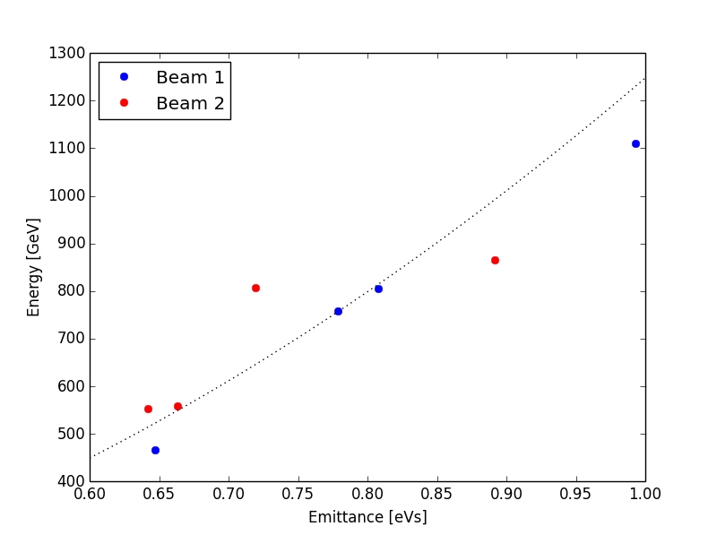
Review of measurements (5)
Loss of Landau damping
MD #2 2012:
  Acceleration without Phase Loop
  Similar intensities and
  different emittances
  Qualitative agreement
  with the expected
  dependence on energy
  (E_{th} ~ ε²)
  Need to simulate the
  acceleration ramp

Slide 10
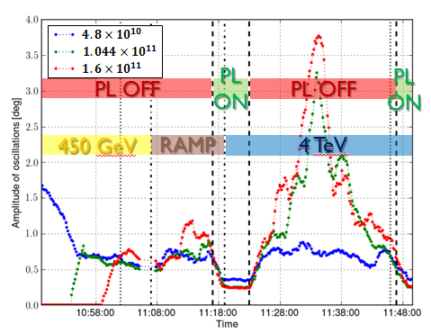
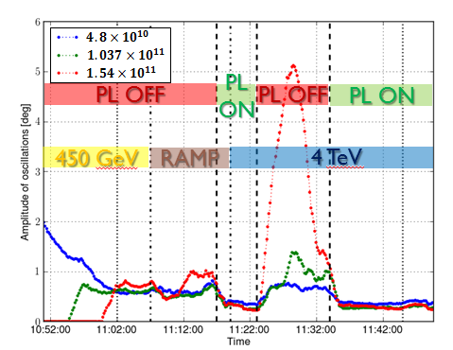
Review of measurements (6)
Loss of Landau damping
MD #3 2012:
  Acceleration with Phase Loop on
  Controlled emittance blow-up during ramp
  → Similar emittances (1 eVs) and different intensities
  4 TeV without PL
  Can be used for comparison with theory and simulations!
Beam 1
Beam 2

Slide 11
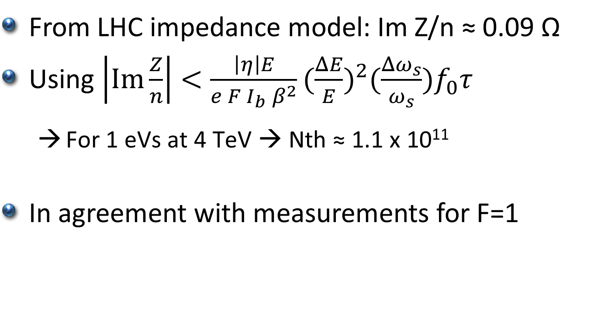
Analytical estimation
Loss of Landau damping
From LHC impedance model: Im Z/n ≈ 0.09 Ω
Using $\left|\text{Im}\frac{Z}{n}\right|<\frac{\left|η\right|E}{e F I_{b} β^{2}}{(\frac{ΔE}{E})}^{2}(\frac{Δω_{s}}{ω_{s}})f_{0}τ$
  $\text{For} \text{1 }\text{eVs} \text{at} \text{4 }\text{TeV} \text{→ }\text{Nth}\text{ ≈ }\text{1.1 }\text{x} \text{1011}$
In agreement with measurements for F=1
F depends on distribution!

Slide 12
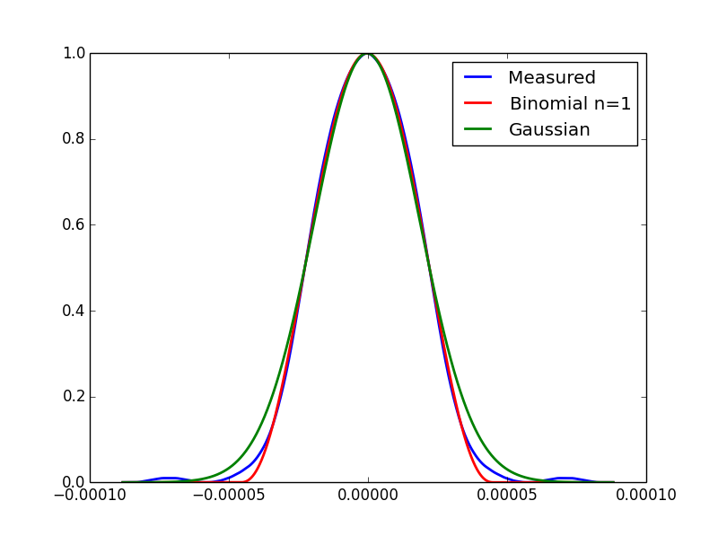
Simulations (1)
Loss of Landau damping
Aim: to reproduce measurements
Distribution similar to measurements
Emittance 1 eVs
Different intensities
LHC impedance model
+ RF cavities + HOM
4 different codes used

Slide 13
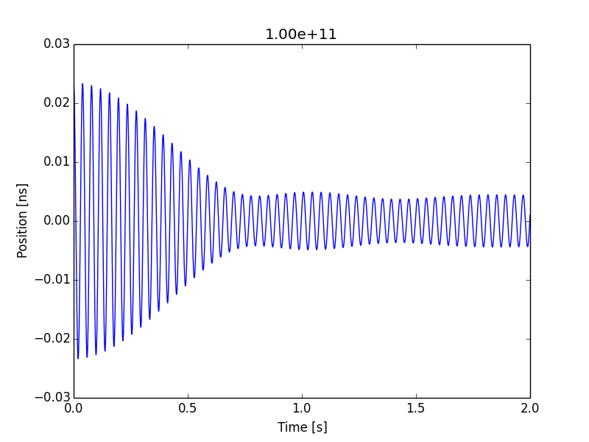
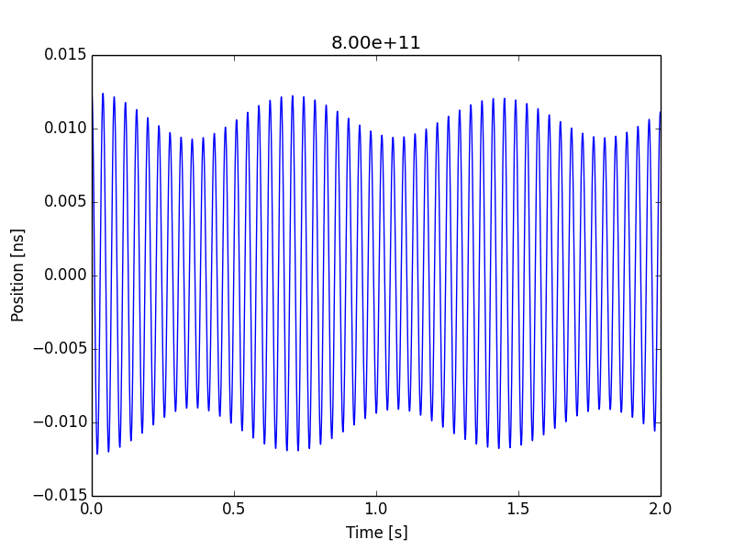
Simulations (2)
Loss of Landau damping
Measured instability growth rate is slow (>10 min)
→ Phase kick in simulations to excite oscillations
Considered as damped (?)
Considered as undamped

Slide 14
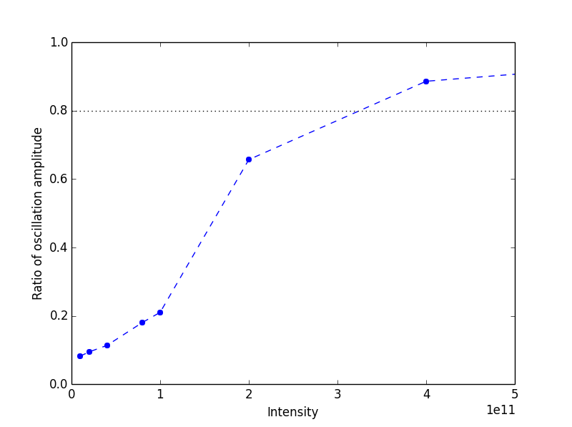
Simulations (3)
Loss of Landau damping
Criteria: 0.8 in ratio of initial to residual oscillation is based on previous work (comparison of simulations with analytical threshold from Van Kampen modes by T. Argyropoulos and A. Burov)
With criteria chosen: N_{th} ≈ 3 x 10¹¹ → About factor 3 difference with measured threshold for similar bunch shape:
  Different bunch lengths and distributions
  Factor 3 in impedance (?)
  Damped / Undamped criteria

Slide 15
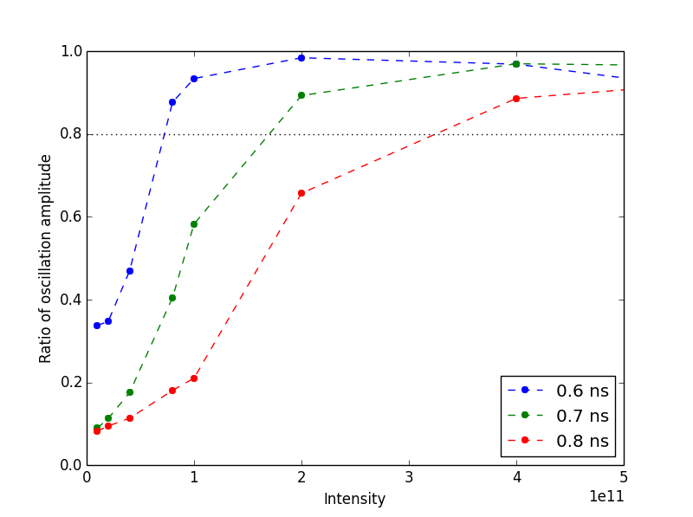
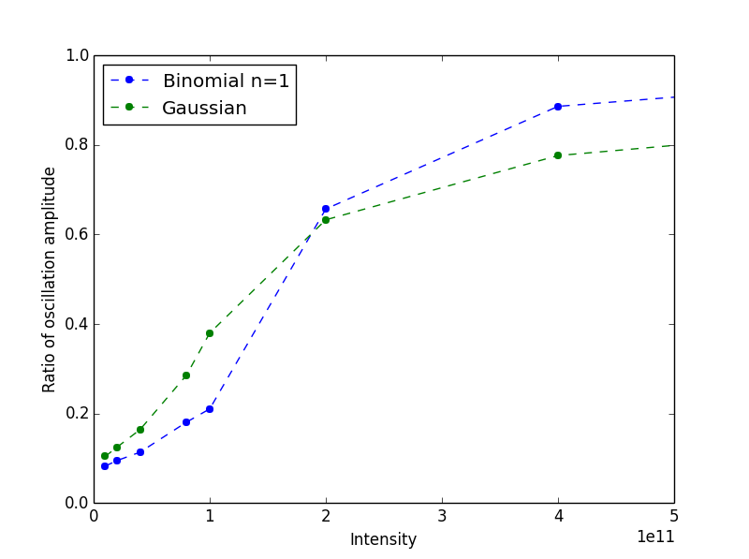

Different bunch lengths and distributions
  Very strong dependence on bunch length (τ⁵) and distribution
Effect of bunch length
Distribution

Slide 16
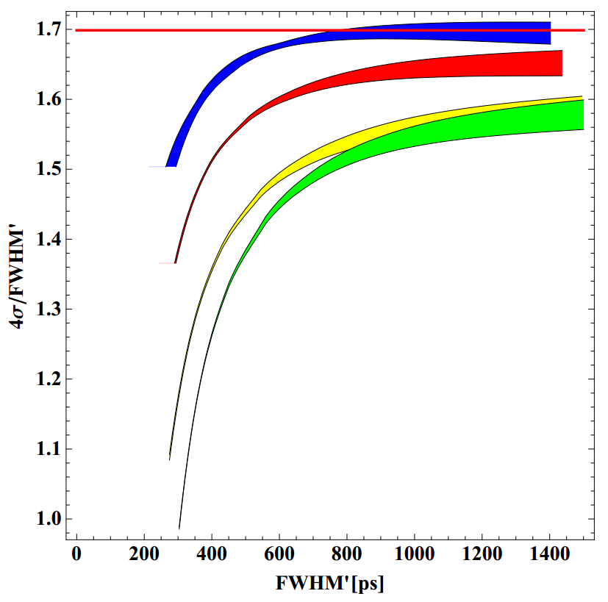
Different bunch lengths and distributions
Bunch length is measured by BQM from FWHM
A correction for the system transfer function is made assuming Gaussian bunches
Different distributions might
need a different correction
Correction of the FWHM measurement
T. Bohl

Slide 17
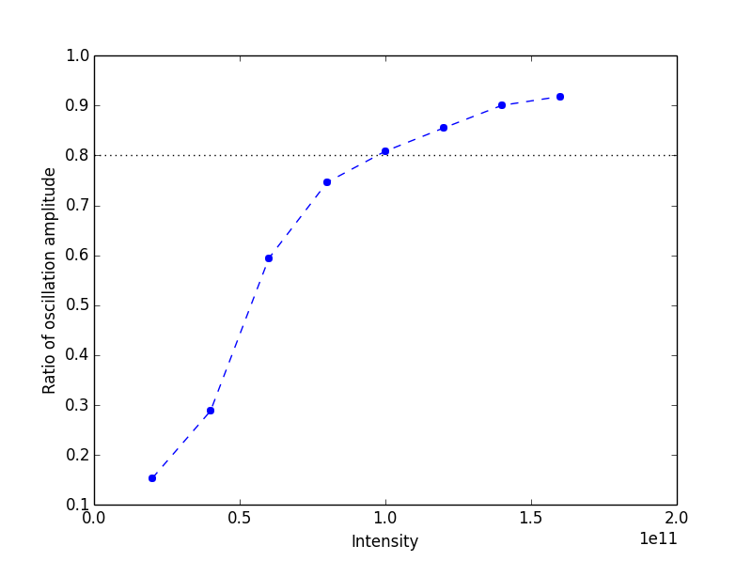
Factor 3 in impedance (?)
Total Z/n ≈ 0.27 Ω is needed to reproduce measurements:
  BB resonator: f_{r} = 5 GHz, R_{sh} = 80 kΩ, Q = 1 (0.18 Ω)

Slide 18
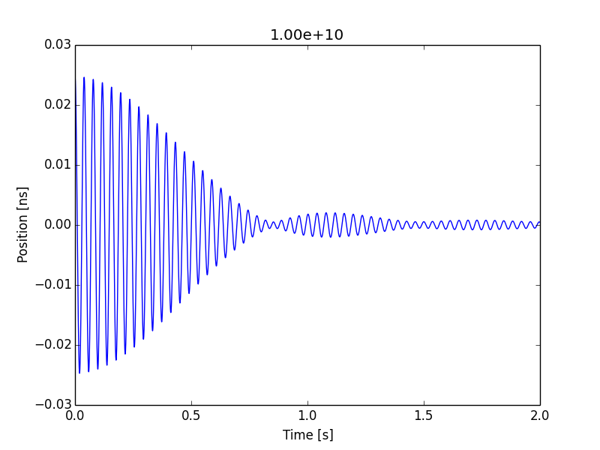
Damped / Undamped criteria
Criteria for damped oscillations should be reconsidered
Both are considered as damped with the current criteria

Slide 19
Next steps
To be verified:
  Effect of distribution on bunch length measurements
  LHC longitudinal impedance model
  Criteria to distinguish between damped and undamped oscillations

Slide 20
Conclusions
Agreement between measurements and simple theory
Simulations suggest:
  Bunches are shorter than measured
  Higher impedance (factor 3)
  Different criteria needed
More data to simulate:
  Flat top
  Ramp
HL-LHC can be studied after impedance model is consolidated
Simulations with high harmonic RF system will require to study the effect of beam loading (relative phase shift)

