Slide 1
LBNE Status and Issues
LBNE-doc-8762
Jim Strait
LBNE Project Director
US-EU Meeting on SBN Program
4 April 2014

Slide 2
Outline
LBNE overview
  Science Goals
  Collaboration
  LBNE Project scope and design status
Summary of main development issues
  Beam
  Detectors
  Physics
Potential benefits to LBNE of SBN program
  LAr1-ND
  MicroBooNE
  ICARUS
Comments on LBNE near detector
  Fine-grained tracker
  LAr TPC

Slide 3
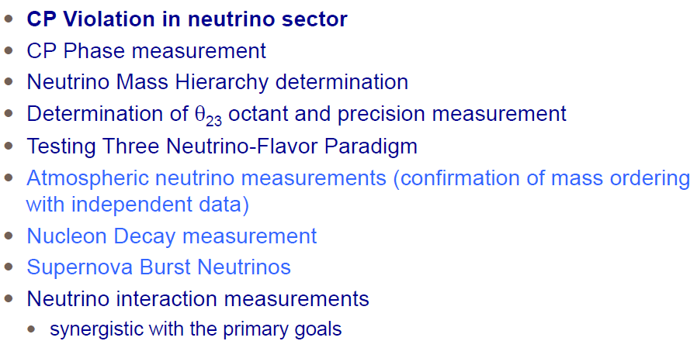
LBNE Science Goals

Slide 4
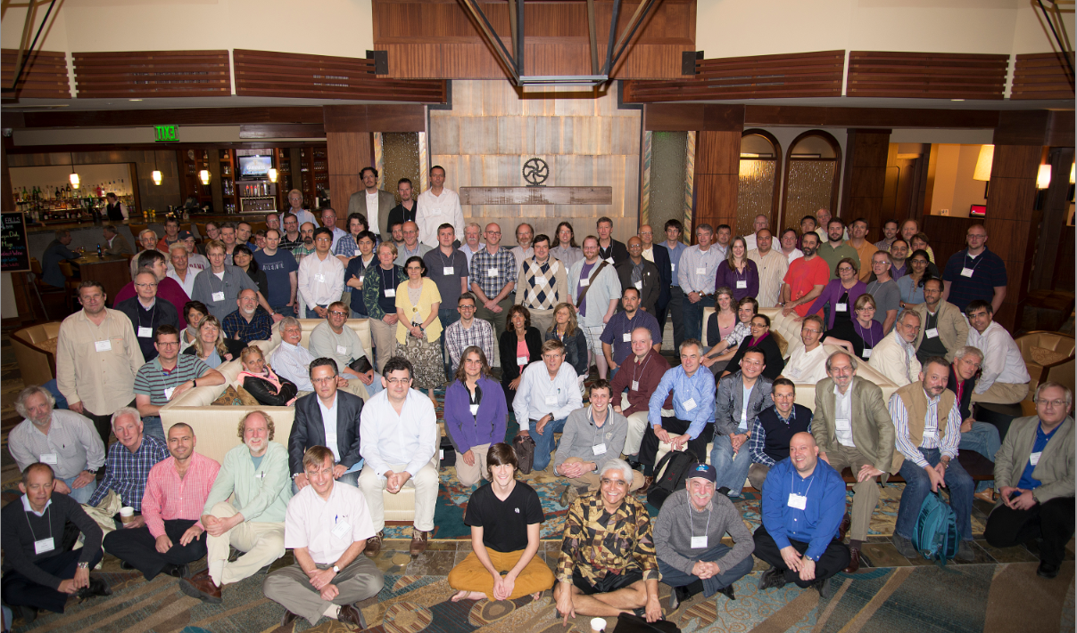
LBNE Collaboration
UFABC
Alabama
Argonne
Banaras
Boston
Brookhaven
Cambridge
Catania/INFN
CBPF
Chicago
Cincinatti
Colorado
Colorado State
Columbia
Dakota State
Delhi
Davis
Drexel
Duke
Duluth
Fermilab
Goias
Gran Sasso
GSSI
HRI
Hawaii
Houston
IIT Guwati
Indiana
Iowa State
Irvine
Kansas State
Kavli/IPMU-Tokyo
Lancaster
Lawrence Berkeley NL
Livermore NL
Liverpool
London UCL
Los Alamos NL
Louisiana State
Manchester
Maryland
Michigan State
Milano
Milano/Bicocca
Minnesota
MIT
Napoli
NGA
New Mexico
Northwestern
Notre Dame
Oxford
Padova
Panjab
Pavia
Pennsylvania
Pittsburgh
Princeton
Rensselaer
Rochester
Rutherfod Lab
Sanford Lab
Sheffield
SLAC
South Carolina
South Dakota
South Dakota State
SDSMT
Southern Methodist
Sussex
Syracuse
Tennessee
Texas, Arllington
Texas, Austin
Tufts
UCLA
UEFS
UNICAMP
UNIFAL
Virginia Tech
Warwick
Washington
William and Mary
Wisconsin
Yale
484 (379 US + 105 non-US) members,
85 institutions, 6 countries
22% non-US; approx. 26% of faculty/scientists
Since CD1:
  Collaboration has increase in size by more 30%
  Non-US fraction more than doubled
Non-US member (UK) elected to Exec. Comm.
New applications received from 13 new institutions (45 individuals) representing four new countries.

Slide 5
LBNE Design
LBNE has a well-developed conceptual design for the full-project
Neutrino beam at Fermilab for 1.2 MW initial operation, upgradeable to ≥ 2.3 MW.
Highly-capable near detector on the Fermilab site
34 kt fiducial mass (50 kt total mass) LAr TPC far detector at
  A baseline of 1300 km
  A depth of 4300 m.w.e. at the Sanford Underground Research Facility (SURF) in Lead, South Dakota
This conceptual design was developed assuming this was a purely U.S. DOE-funded project. It has been independently reviewed and found to be sound.

Slide 6
Evolving Scope of the LBNE Project
We are developing international partnerships, with the goal of delivering an initial project consisting of:
- A neutrino beamline, operating initially at 1.2 MW,
- A highly-capable near detector system,
- A ≥10 kt fiducial mass far detector underground at SURF
- CF including a cavern for a full 34 kt fiducial mass detector
system.
- The designs of the near and far detectors (and perhaps
the beam) will incorporate concepts from new partners.
DOE/HEP supports this approach.
The planned project allows for future upgrades:
- The beamline is designed to upgradeable to ≥2.3 MW
proton beam power
- Future detector module(s) can be installed in the
underground cavern.

Slide 7
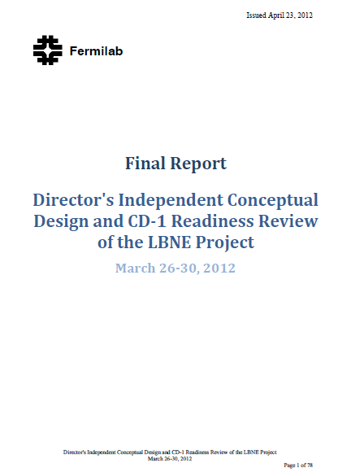
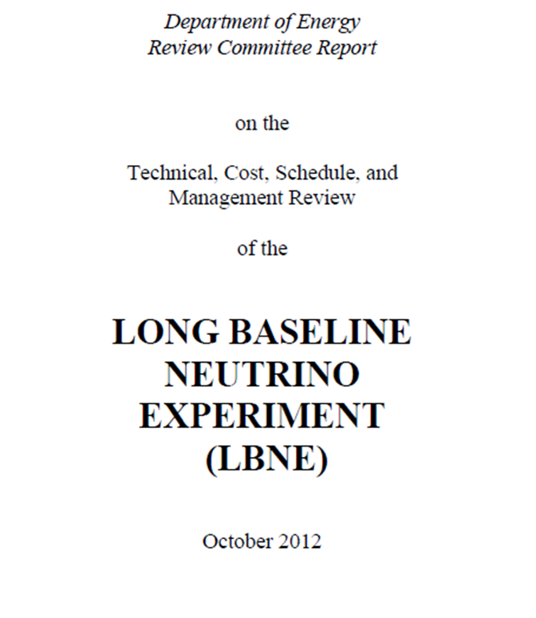
Director’s Review of the full-scope LBNE
DOE Review of the reduced-scope CD-1 LBNE
“The committee finds that the Conceptual Design for the LBNE project is sound…. The committee is confident that the LBNE project can be ready for a CD-1 review …[by] summer of 2012…”
“The LBNE project developed a credible conceptual design and associated cost and schedule.”

Slide 8
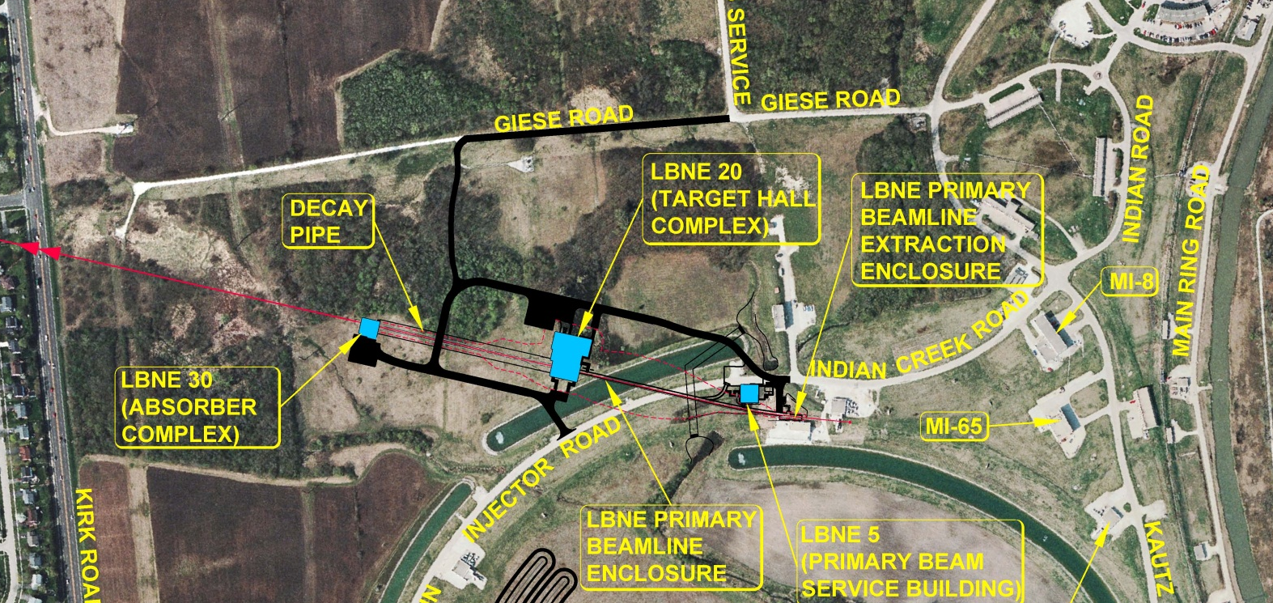
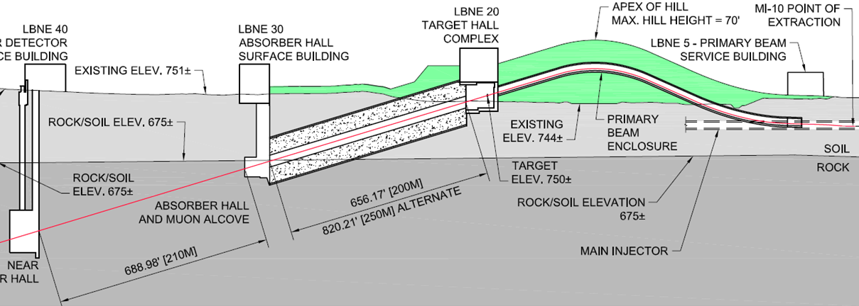
LBNE Beamline Design
Antiproton Source
NEAR DETECTOR
Tevatron
Kirk Rd
Main Injector
Designed for 1.2 MW initial beam power;
upgradeable to at least 2.3 MW.

Slide 9
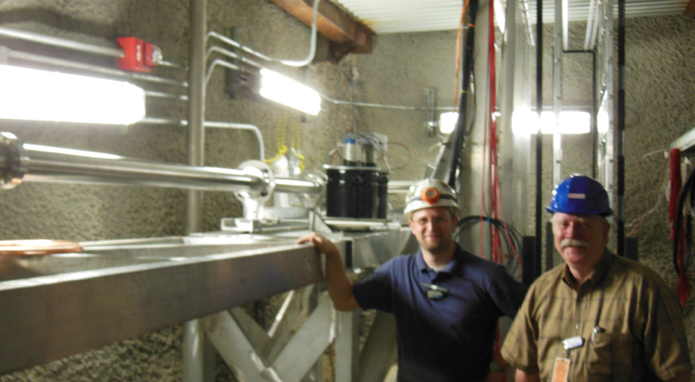
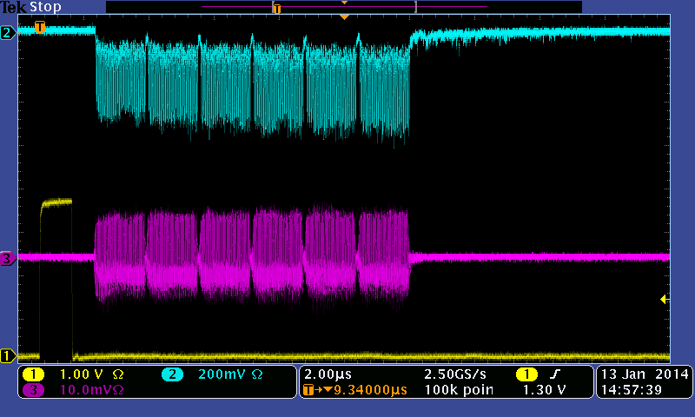
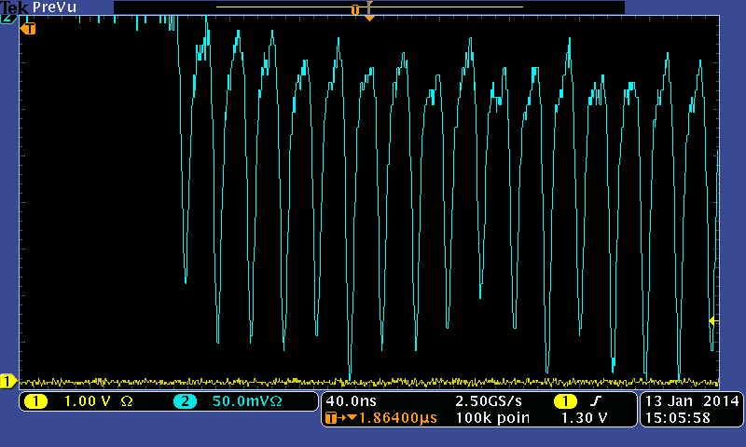
Prototype Muon Detectors in NuMI Beamline
Cherenkov Detector
Stopped Muon Detector

Slide 10
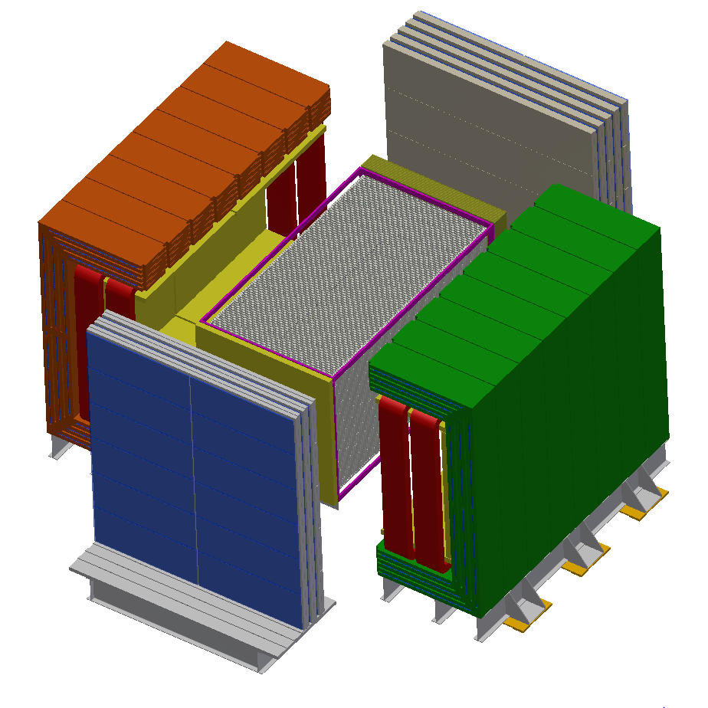
Near Neutrino Detector
Proposed by collaborators from the Indian institutions
High precision straw-tube tracker with embedded high-pressure argon gas targets
4π electromagnetic calorimeter and muon identification systems
Large-aperture dipole magnet

Slide 11
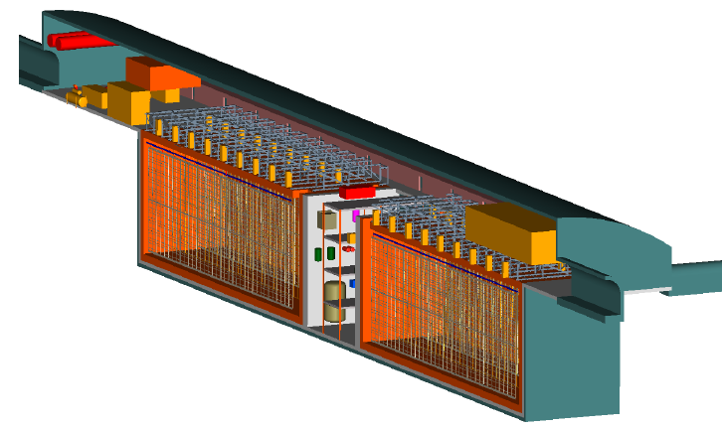
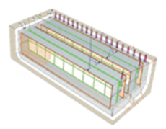
Far Detector – US Design
LBNE Liquid Argon TPC
GOAL: 34 kt fiducial mass
Volume: 18m x 23m x 51m x 2
Total Liquid Argon Mass:
~50,000 tonnes
Based on the ICARUS design
Actual detector design will evolve
with input from new partners, and may
involve multiple modules of different designs.

Slide 12
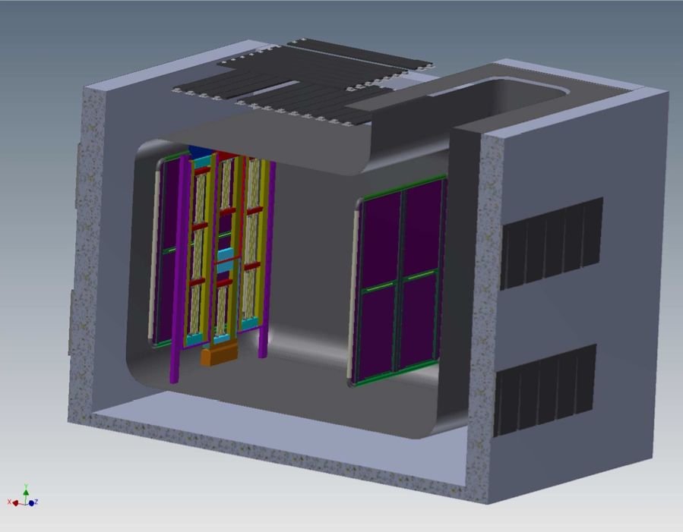
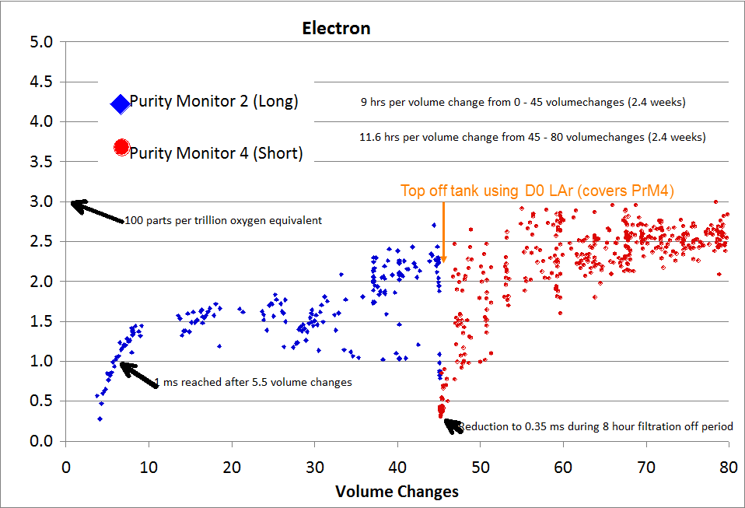
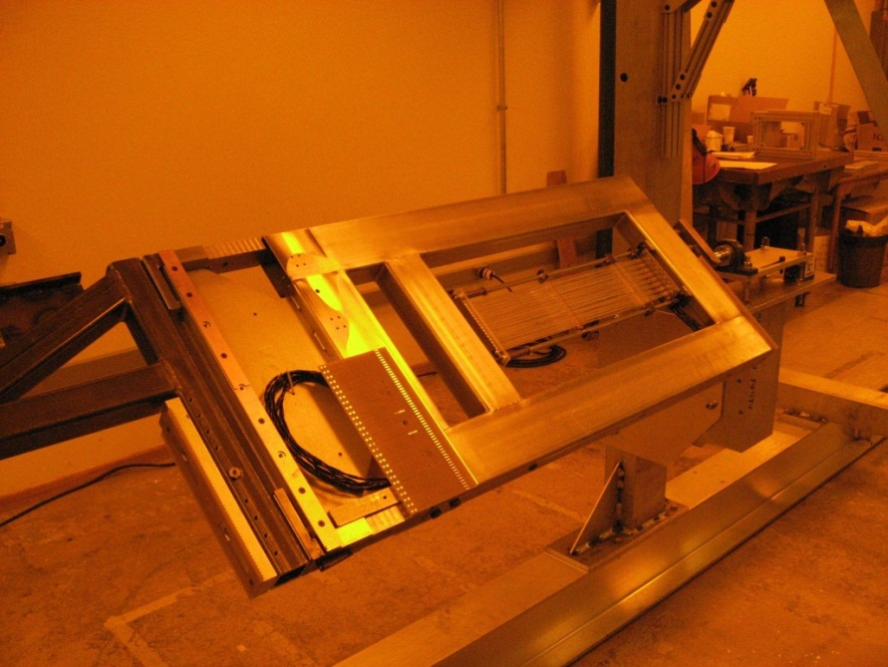
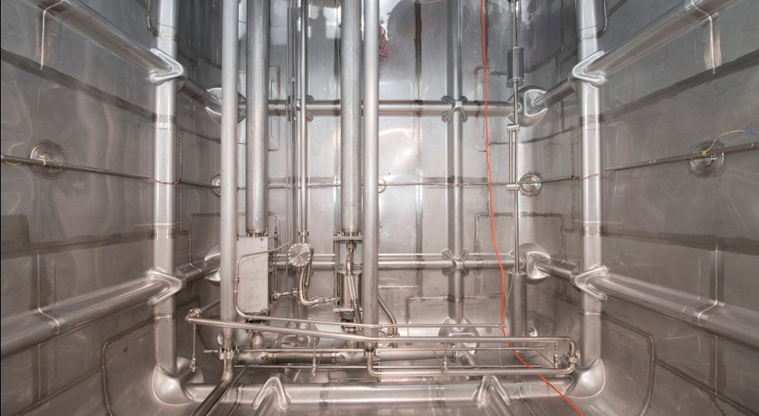
35 t Prototype Cryostat and Prototype TPC Detector
Foam insulation
20 cm short drift region
~2m drift region
Concrete
Photon Detectors (8 total)
In 4 APAs

Slide 13
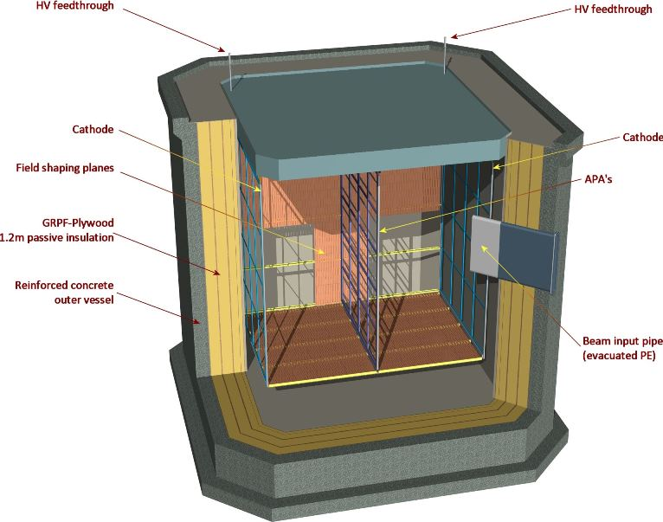
Full-Scale Prototype in LAGUNA-LBNO Cryostat
We are developing a plan to test full-scale LBNE drift cell(s) in the 8x8x8 m³ cryostat to be built at CERN as part of WA105.

Slide 14
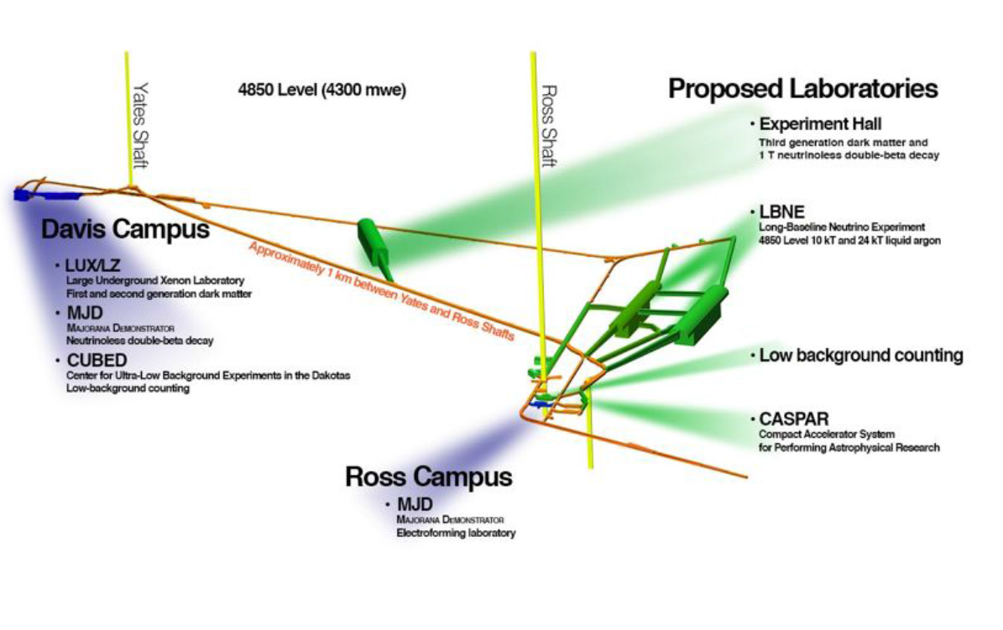
Planned Location of LBNE Cavern(s) at SURF
Actual layout will follow from detector design(s) agreed upon with international partners.

Slide 15
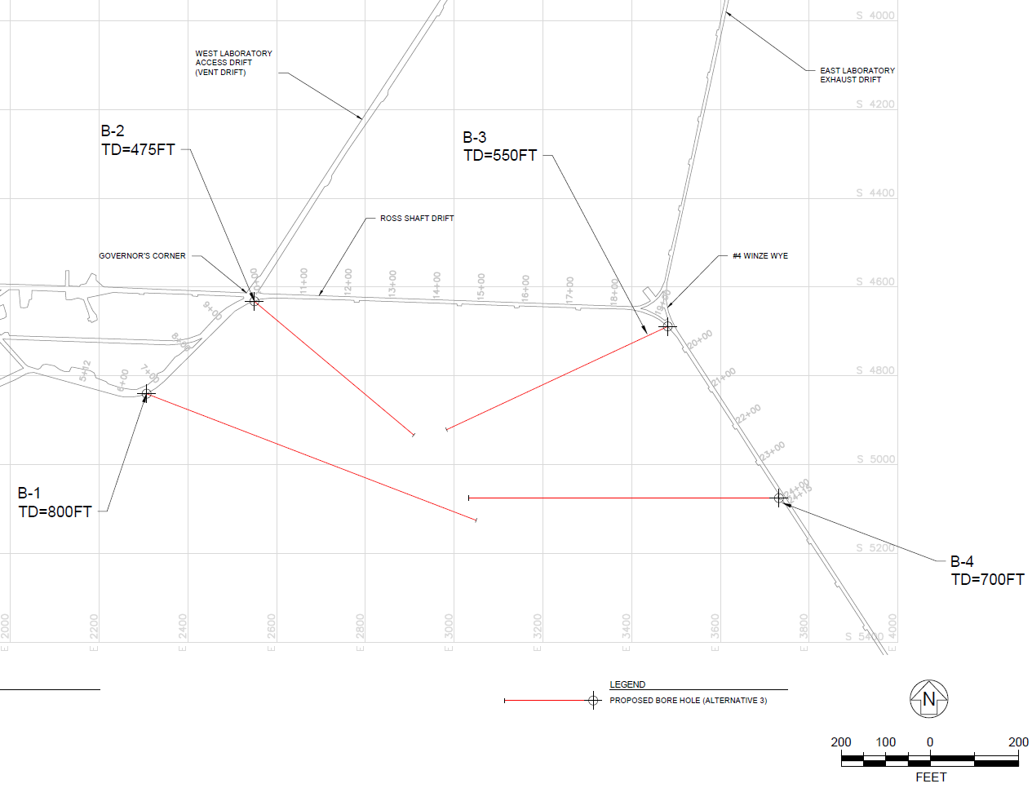
Geotechnical Site Investigation at SURF
  A “generic” geotechnical site investigation program is under way to explore the rock mass south of the south access drift without regard to detector size or configuration.
  Three of four bore holes finished. Rock quality appears excellent.

Slide 16
Main Development Issues
The conceptual design of LBNE and the engineering basis for it are well established in most areas.
Only a modest amount of “true” R&D is needed to establish feasibility or determine the basic concepts or principles on which a design will be based.
There is a significant amount of engineering development and prototyping to be done to demonstrate the chosen engineering designs are sound.
There is research and development that is not required to complete the construction of LBNE, but can aid in the analysis of the data, e.g. test beam runs, or can lead to future upgrades.

Slide 17
Main Development Issues: Beam
Target/horn system for 1.2 MW
Improved target and horn design for increased neutrino flux, especially at low energy.
Hadron monitor for 1.2 MW
Decay pipe air-to-helium window for 1.2 MW
Absorber design for 2.3 MW
Primary beam window for 2.3 MW

Slide 18
Main Development Issues: Near Detector System
Prototype tests (then production) of beamline muon detectors
Clarification of requirements clarification for Near Neutrino Detector
Evaluation of the reference design relative to requirements
Engineering design and prototyping for Near Neutrino Detector systems in India

Slide 19
Main Development Issues: Far Detector
R&D/development of improved designs for photon detector => lower threshold
Prototyping TPC cells: scale models in 35 t; full-scale in WA105 cryostat at CERN
Develop calibration system
Continuing study of limits on LAr purity
Cryogenic system scale-up
Development of simulations and reconstruction software; charged particle and neutrino test beam data to benchmark simulations and test reconstruction

Slide 20
Main Development Issues: Physics
Cross-section measurements, particularly from argon
Development of long-baseline oscillation analysis
Normalization of beam flux
trigger signatures and backgrounds for non-beam physics:
  atmospheric neutrinos
  nucleon non-conservation searches
  supernova neutrinos
  other low-energy physics

Slide 21
Potential benefits to LBNE of SBN program
LAr1-ND
Loosely modeled on LBNE FD design, but with important differences
Provides modest size cryostat that could be used for “quick” turnaround tests to address specific questions for LBNE, if it is not being used for a physics experiment
Provides significant neutrino event dataset in a LBNE-like detector (but only LBNE-like and at lower beam energy than LBNE)
Provides hands-on experience building and operating a LBNE-like detector
=> train the workforce that will build LBNE

Slide 22
Potential benefits to LBNE of SBN program
MicroBooNE
Has already and will continue to provide valuable technological experience … adding to the database of engineering “lore”
Provides significant neutrino dataset earlier than
LAr1-ND => drive development of reconstruction code

Slide 23
Potential benefits to LBNE of SBN program
ICARUS T600 FD
Bring experience of the group that originated the LAr TPC technology to Fermilab
Provide large dataset from the far off-axis NuMI beam in an energy range similar to the LBNE beam, enhances in electron neutrinos => develop detailed understanding of event topologies, cross-sections, etc. relevant for understanding LBNE signal and background
Opportunity for US people to work with ICARUS and CERN on its refurbishment.
ICARUS T150
Opportunity for US people to work with ICARUS and CERN on its construction

Slide 24
Comments on LBNE near detector(s)
We already have a design for a high-resolution ND
  Pending proposal by Indian colleagues to their funding agency to build it.
  Its low-density is a virtue: e⁺/e‒ separation over a wide energy range; minimal pileup, further reduced by event timing (inherently fast detector).
LAr TPC large enough to contain events in the 1-10 GeV range will be subject to pileup:
  All events within 10 μs beam spill are simultaneous within the 1 ms drift time.
  Within the ~120 t active volume of T150 and with 1.2 MW LBNE beam, there will be ~30 events per spill.
  This will make precision physics very difficult.
  At 2.3 MW there will be ~ 55 events per spill.

Slide 25
Comments on LBNE near detector(s)
The ability to understand and reconstruct events in a LAr TPC “just like” the LBNE far detector and in the same beam could be important for achieving the ultimate systematic errors in LBNE, e.g. cancellation of “confusion” from nuclear effects, which will be reconstructed different in the low-density reference ND.
Can this be adequately addressed using “neutrino test beam” data, e.g. T600 at Fermilab?
Would a hybrid design, using a small (few ton) LAr TPC together with the fine-grain tracker reference design, adequately address this?
Summer LBNE workshops on the near detector and on systematic errors are designed to address these and related questions.

Slide 26
Summary
LBNE is developing an international partnership to deliver:
  A high-power neutrino beam
  A high-resolution near detector system
  A far detector of ≥10 kt fiducial mass in a cavern that can accommodate a full-size 35 kt detector.
LBNE designs incorporate ideas of new partners and we are open to new designs from additional partners.
This approach has strong support from the US and international HEP community.
A well-constructed LAr-based short-baseline program at Fermilab can help LBNE by:
  Developing LAr TPC technology -- hardware and software
  Providing large datasets of neutrino events in LAr
  Enhancing world-wide collaboration on LAr-based neutrino physics.

