Slide 1
CERN Neutrino Platform
4th April, 2014
FNAL
M.Nessi

Slide 2
2013: a intense discussion year
<2013 : Several proposals or letter of interest submitted to CERN program committees : ICARUS-NESSiE (SPSC-P-347) for the search of sterile neutrinos, LAGUNA-LBNO consortium (SPSC-E-007) to demonstrate a new generation of neutrino detectors of double-phase LAr TPC with prototypes
CERN management (end 2012) asked for a feasibility study to provide a neutrino beam (short baseline + charged beam test facility) at CERN in the medium term (~4 years) with 2 experimental facilities ( near and far ). Main goal : satisfy the existing requests and allow new detectors/ideas to come forward
In March 2013 we submitted to the CERN management a LOI for a Short Baseline Facility at CERN (CENF) : first beam in late 2017, far and near detector facility, SPS 100 GeV proton beams, investment ~80-100 MCHF → this generated an avalanche of discussions and opinions in the CERN and in the neutrino community …. and a lot of passion !!!
Then the agreed European Strategy : “Rapid progress in neutrino oscillation physics, with significant European involvement, has established a strong scientific case for a long-baseline neutrino programme exploring CP violation and the mass hierarchy in the neutrino sector. CERN should develop a neutrino program to pave the way for a substantial European role in future long-baseline experiments. Europe should explore the possibility of major participation in leading long-baseline neutrino projects in the US and Japan.”

Slide 3
2013: a intense discussion year
CERN Management decided not to bring to the council a discussion for a CERN neutrino beam in the first half of 2013, but introduced in the new CERN Medium Temp Plan (MTP) a budget line for neutrino studies and created a CERN neutrino project
In August 2013 the CERN Research Board, approved SPSC-P-347 as WA104 and SPSC-E-007 as WA105. Both experiments are finalizing their MOU with CERN … and are preparing detail plans. Approval is for R&D, but no neutrino beam at CERN.
  CERN introduced the concept of a Neutrino R&D platform and is making financial plans for it
  In the mean time we are keeping an open discussion with communities outside Europe (US in particular) to explore possible future synergies
  But now we have to start doing something for real!

Slide 4
CERN Neutrino Project
CERN Neutrino Platform
Investigate new programs (mu storage ring, betabeams ?, …)
Logistics +
Test Beams (charged) Infrastructure (EHN1 ext)
Neutrino detectors R&D
It will happen
Design and eventually implement a Neutrino Beam at CERN
EU participation in neutrino expt.
(detectors, beam, infrastr.)
PHYSICS

Slide 5
CERN Neutrino Platform
2014 -2018
Neutrino detectors R&D
WA104: rebuild ICARUS T600 in bldg 185 and make it ready for a FNAL beam
WA104: R&D on an AIR core muon detector (NESSiE) or eventually integrate a solenoid in the main TPC
WA105: R&D on 2 phases LAr TPC prototypes
MIND : R&D on muon tracking detectors
MOUs preparation in progress

Slide 6
How to get a new project in ?
Get in contact with us (Sergio and myself) to prepare the ground for a possible R&D activity
Submit a LOI to the CERN SPCS committee for approval
If YES : receive approval from CERN research board and become a real experiment/collaboration
Finalize with us a MOU addendum (to the main MOU Frame) defining the project in term of WPs and resources. Define the support needed from CERN
Get FAs and CERN management signature (MOU)
    -> operation model inspired to the one of the LHC experiments (monitoring : LHCC->SPSC, RRB -> FRC)

Slide 7
CERN Neutrino Platform
2014 -2018
Neutrino detectors R&D
WA104: rebuild ICARUS T600 in bldg 185 and make it ready for a FNAL beam
WA104: R&D on an AIR core muon detector (NESSiE) or eventually integrate a solenoid in the main TPC
WA105: R&D on 2 phases large LAr TPC prototypes (first small 1x1x3, then large 6x6x6)
MIND : R&D on muon tracking detectors
All these activities have/are presented/ing now a detailed technical report to the SPSC (Tuesday 8 April)

Slide 8
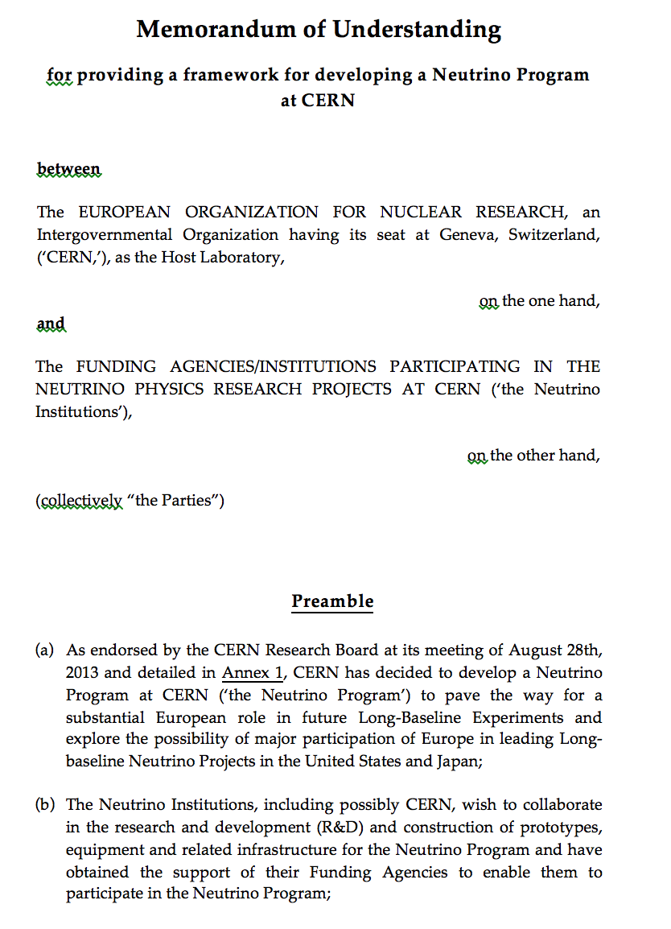
MOU frame
https://edms.cern.ch/document/1353815

Slide 9
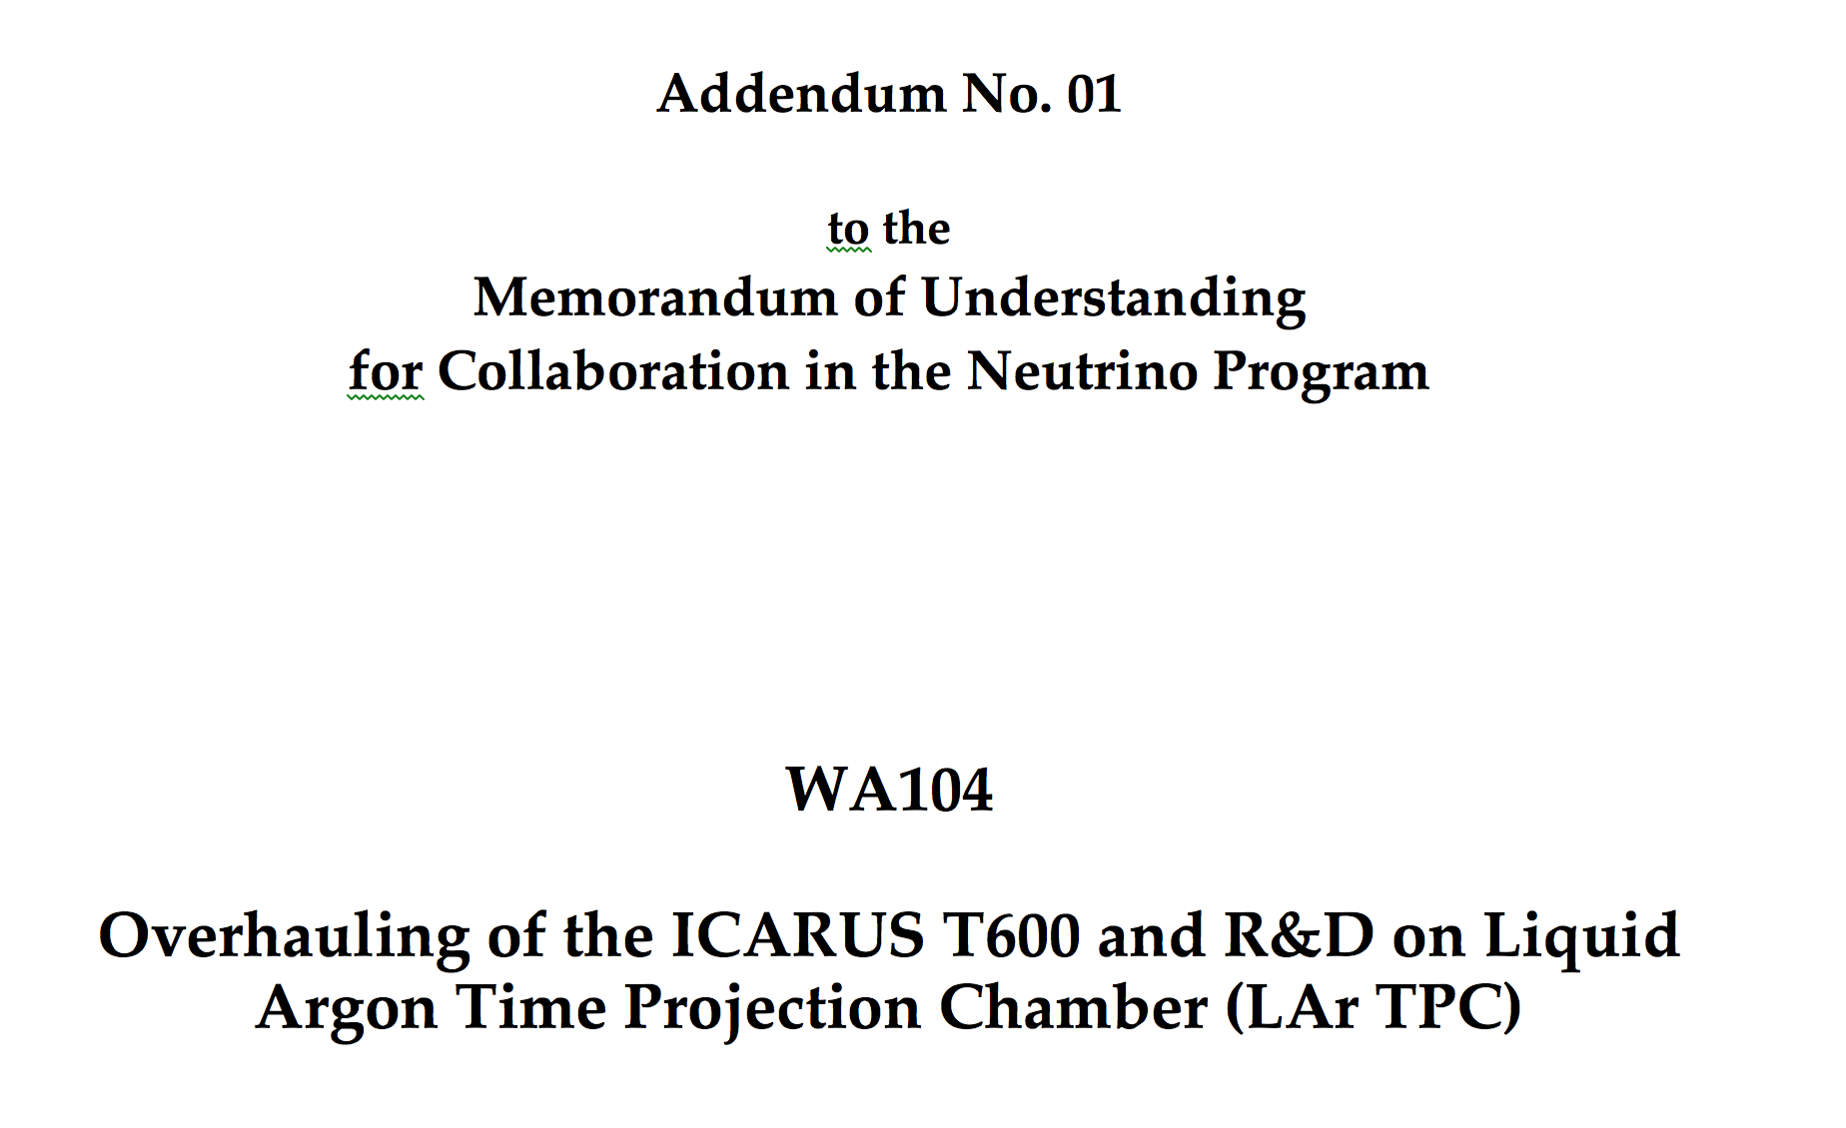
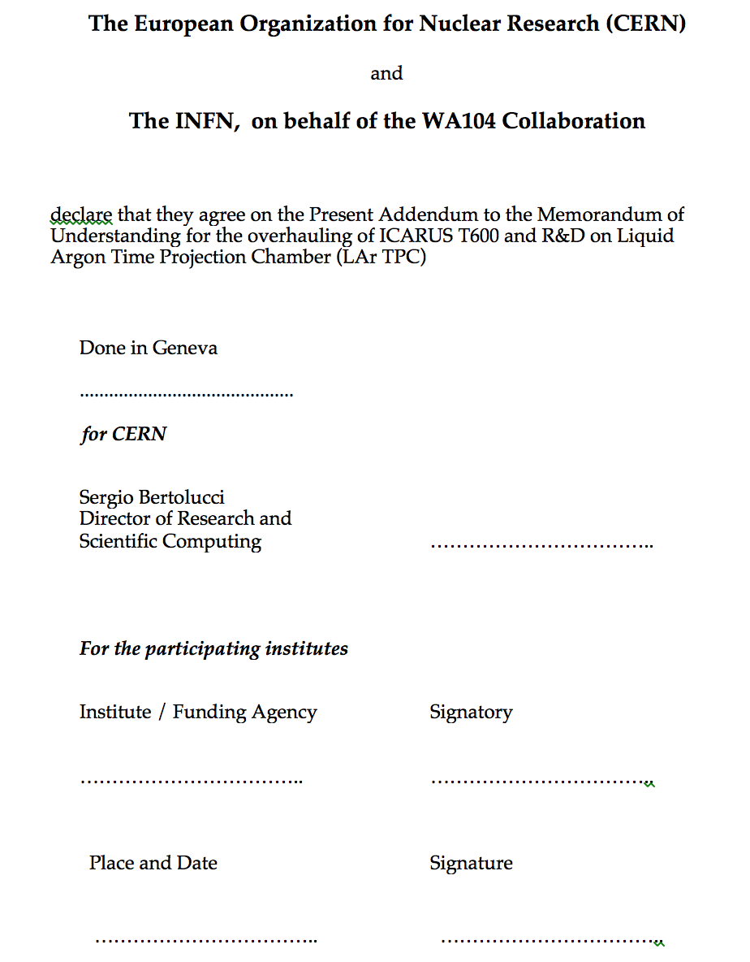
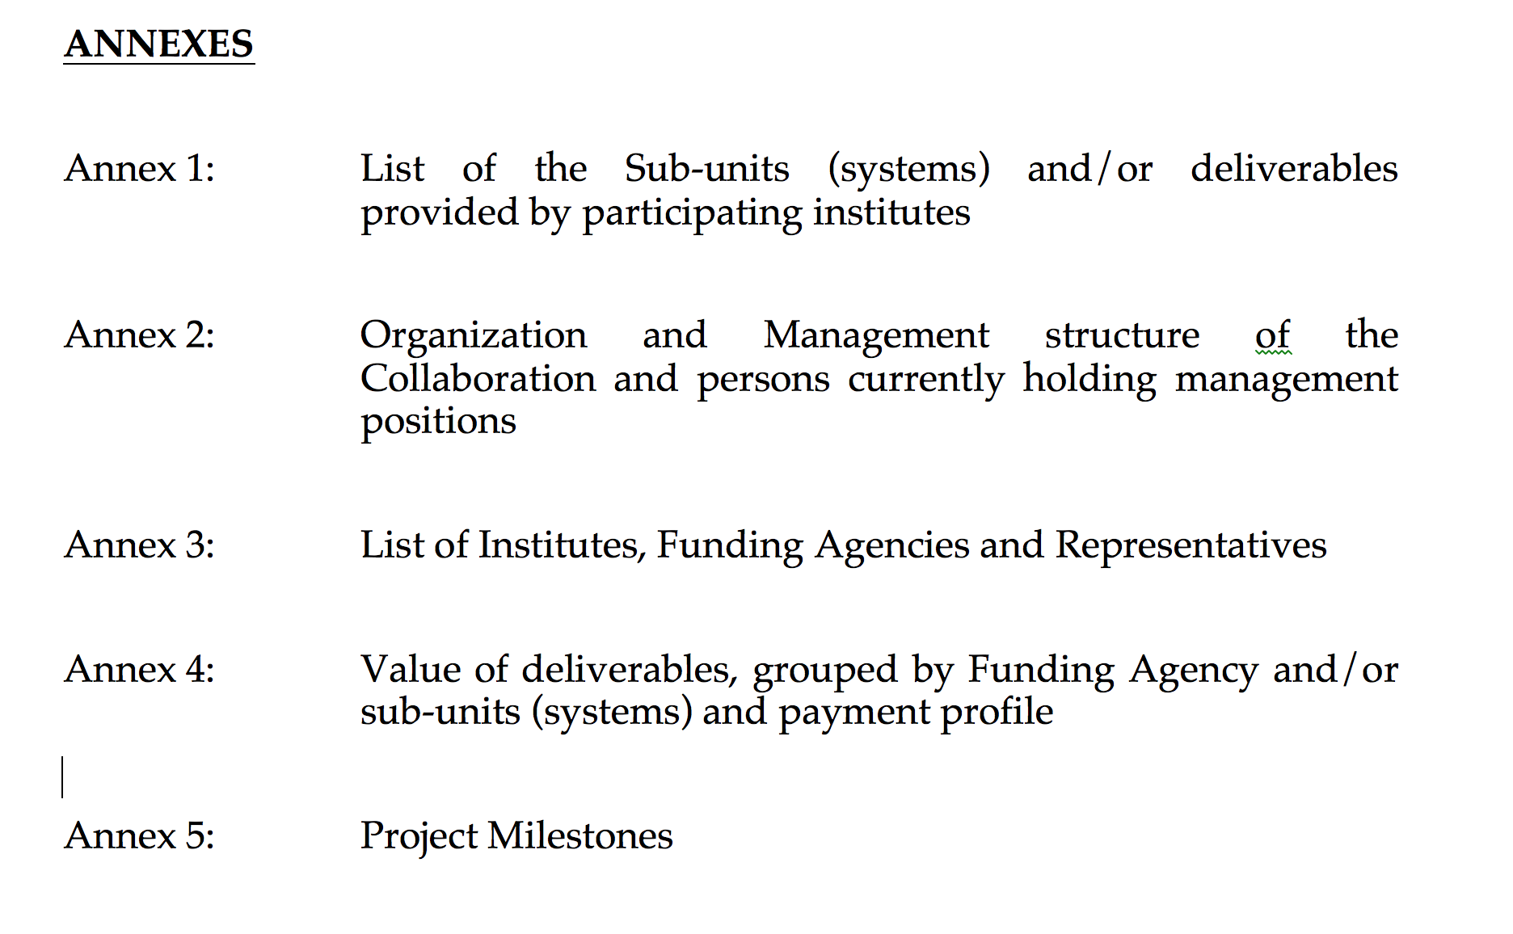
4 MOUs being prepared for signature

Slide 10
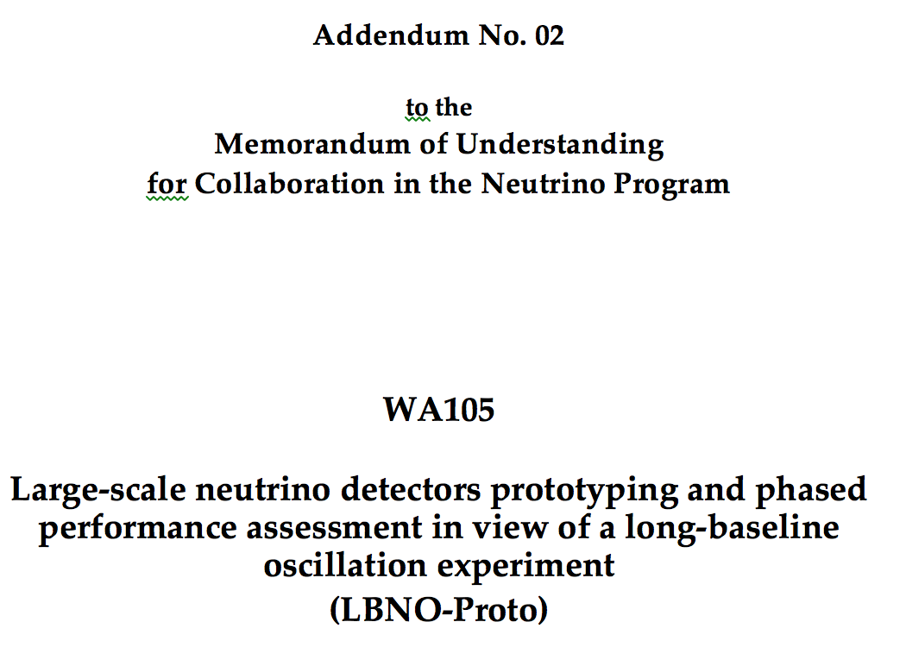
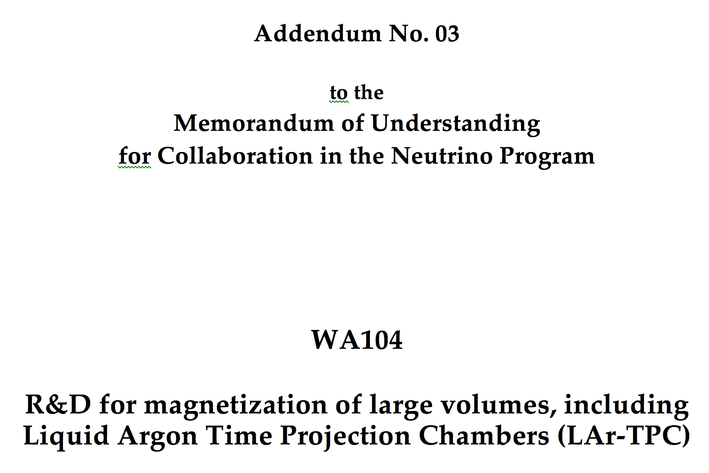
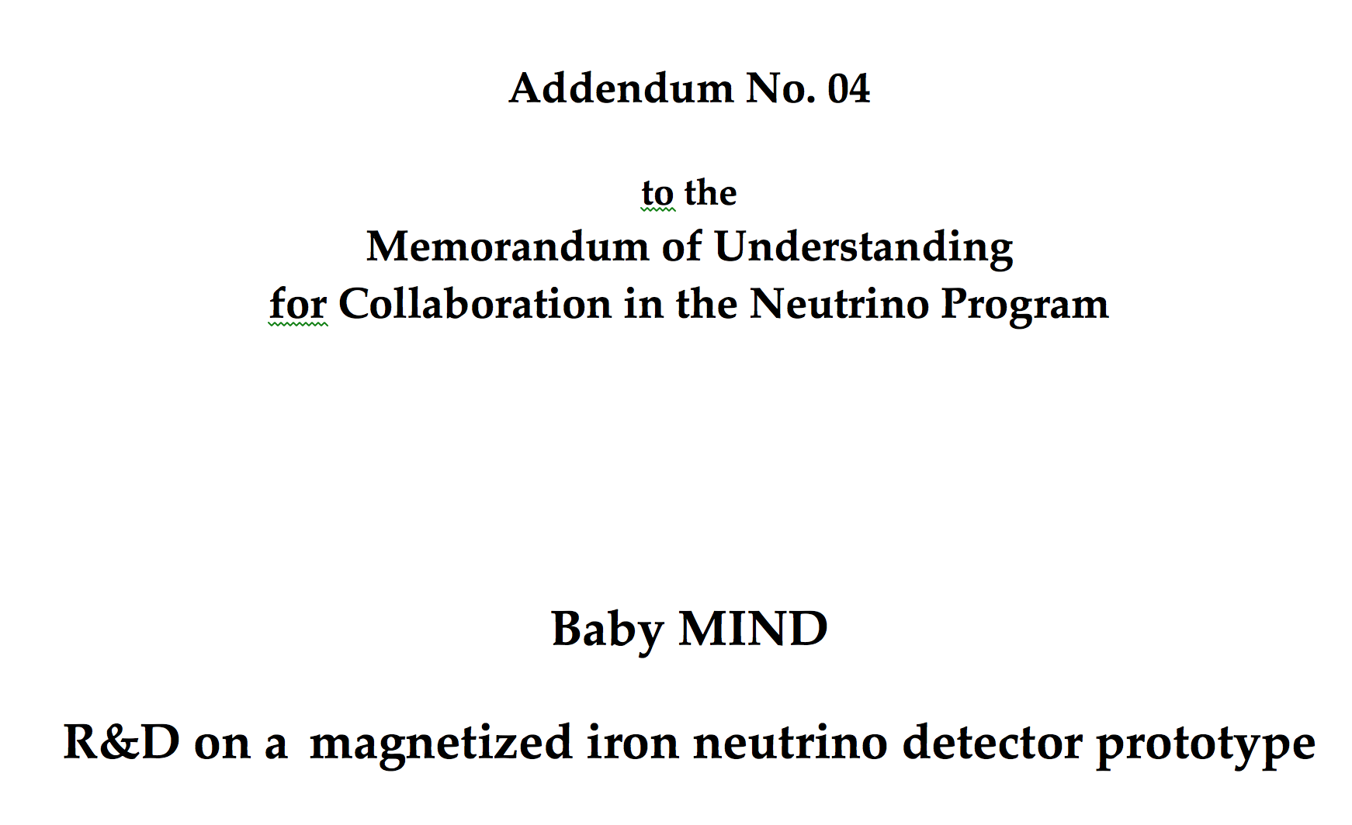
4 MOUs being prepared for signature
In different stages of preparation, approval once CERN budget (medium term plan) released

Slide 11
More projects are surfacing or are under preparation
Development of a new generation of TPCs, ~200 tons ( see ICARUS 150T ++, a new concept best suited for LBNE rescaling, might be fully magnetized, ….) … a candidate for a LBNE near detector on the long future?
EU/CERN participation in the SBL near detector at FNAL (LAr-ND, ICARUST-T150, new?)
Test of LBNE modules inside the large cryostat in preparation for LAGUNA prototype
New R&D for water detectors for ESS, Japan, … (again possible near detectors)
ArgonCube: a novel, fully-modular approach for the realisation of large-mass liquid argon TPC neutrino detectors
A feasibility study for a nu-storm at CERN
…..

Slide 12
In practice what are we doing at CERN right now?

Slide 13
Logistics +
Test Beams Infrastructure (EHN1 ext)
We are preparing the infrastructure for T600 and LAGUNA small prototype (1x1x3)
Logistics :
- prepare hall 182 for WA105
- prepare hall 185 for T600 (old GARGAMELLE)
- organize the transport of T600 to CERN (tools, frames, transport)

Slide 14
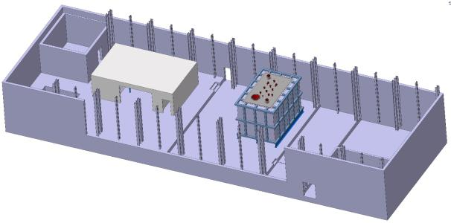
Logistics +
Test Beams Infrastructure (EHN1 ext)
b182 : for LAGUNA small prototype
Cryostat
Clean Room
For both items we are in the procurement phase

Slide 15
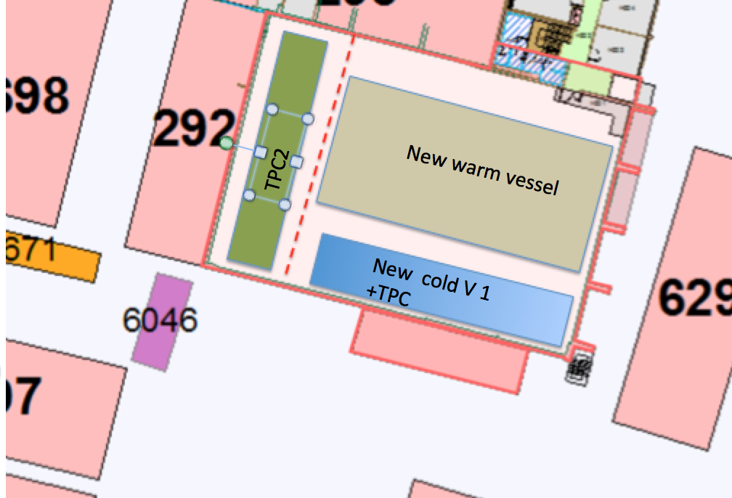
Logistics +
Test Beams Infrastructure (EHN1 ext)
ICARUS 600 will be moved here and will be reconstructed and made operational
Transport # 1 : existing cryogenics, now to b292
Transport # 2 : first TPC (Sept 2014)
Transport # 3 : second TPC (Oct 2014)
New clean room to receive the TPCs and rework it
B185 : for ICARUS

Slide 16
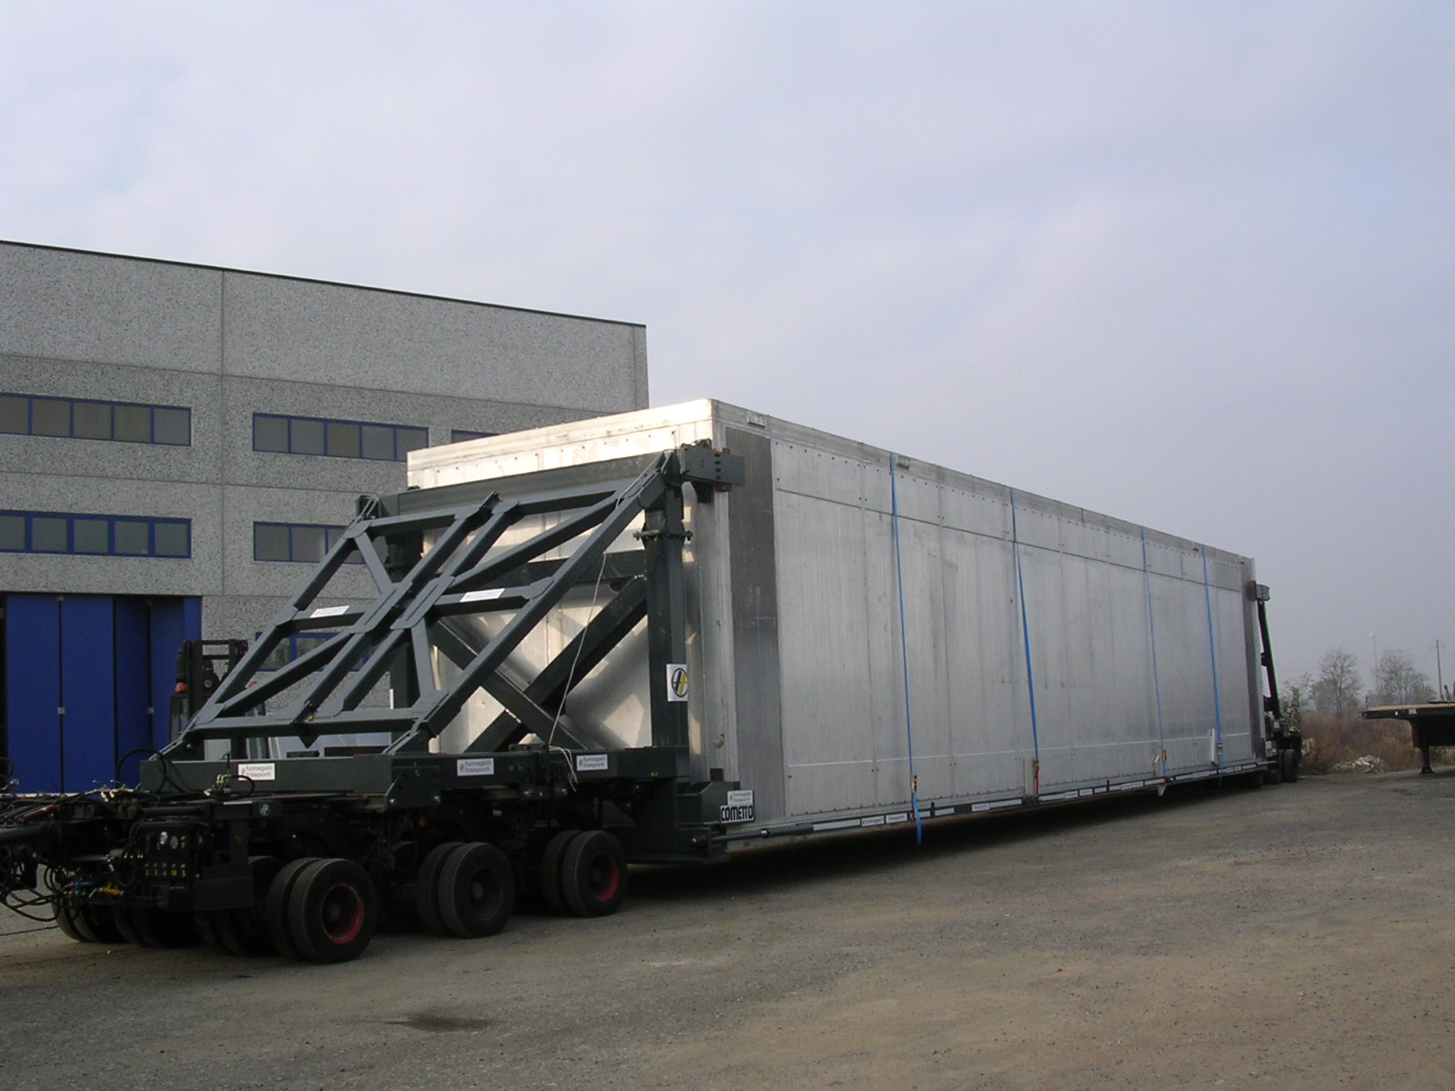
Logistics +
Test Beams Infrastructure (EHN1 ext)

Slide 17
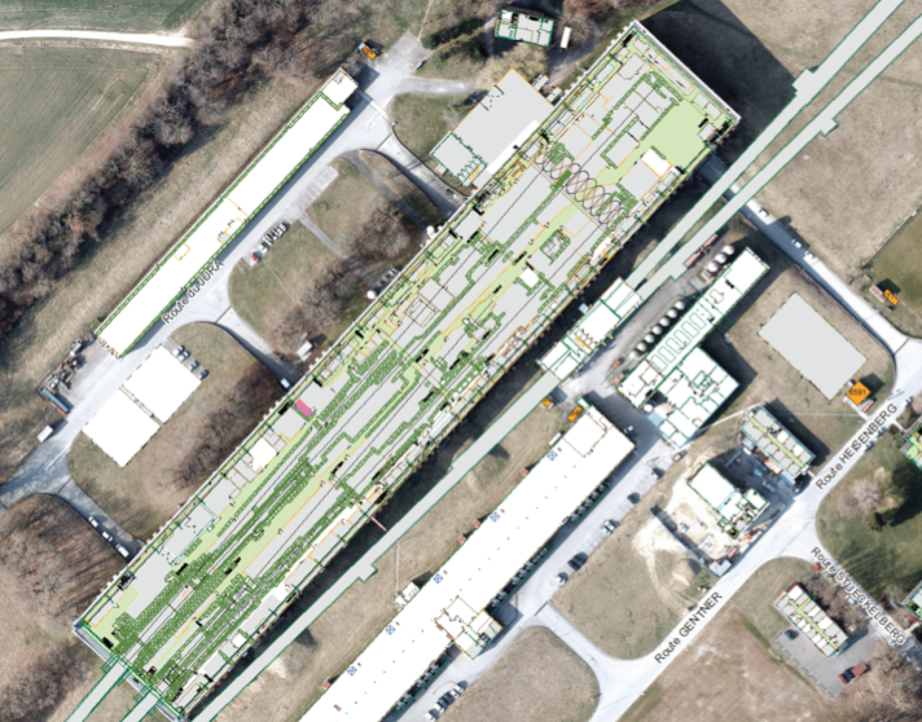
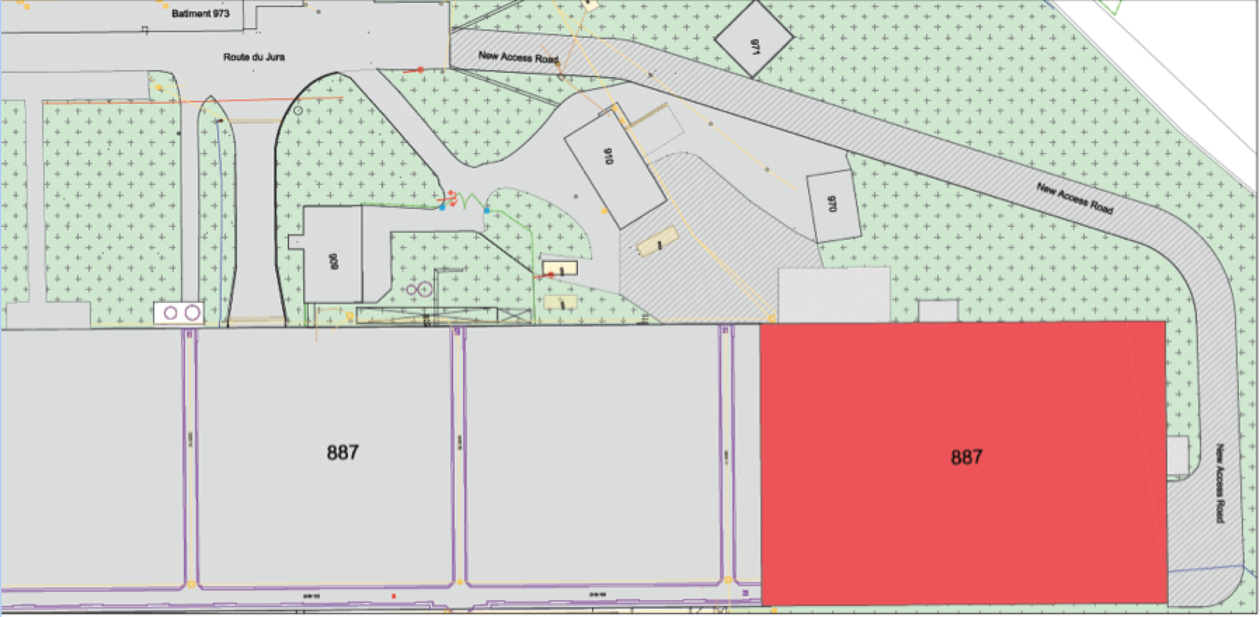
Logistics +
Test Beams Infrastructure (EHN1 ext)

Slide 18
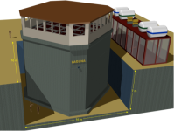
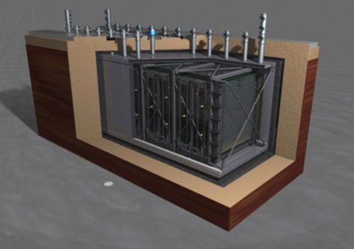
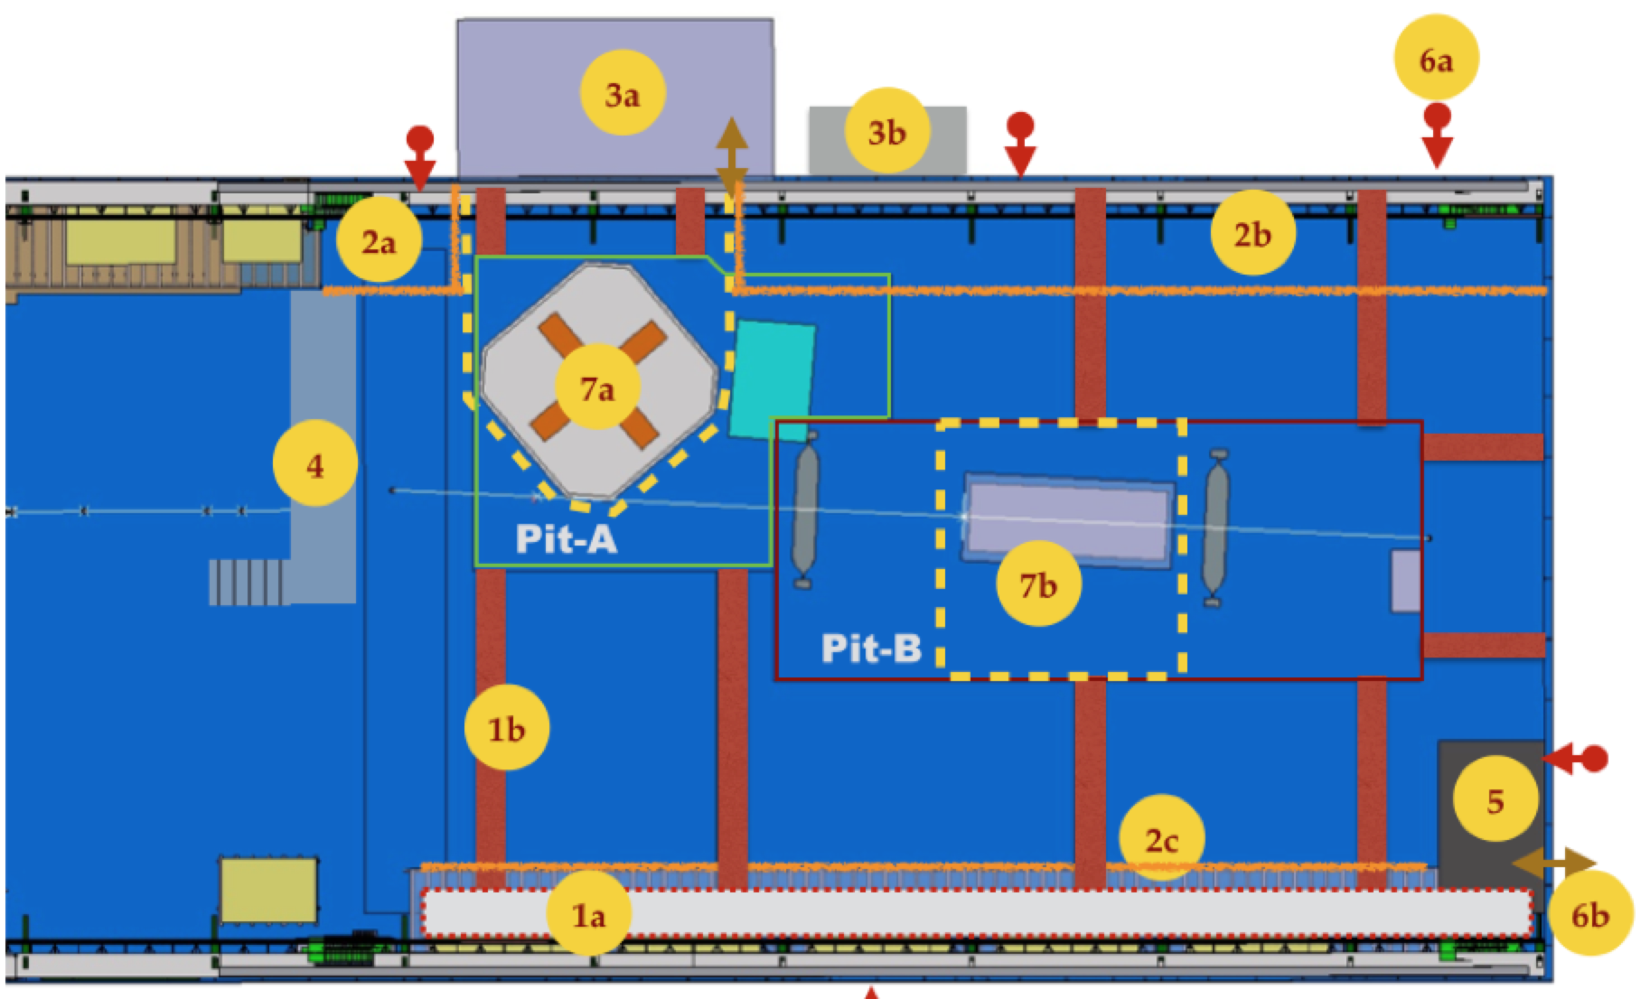
Logistics +
Test Beams Infrastructure (EHN1 ext)
Integration with all CERN services done
CE detail design given to a new CE CERN contract
Ready for tendering construction in Summer 2014
If approved and CERN resources released, CE ready for end 2015
Operational mid/fall 2016
Beams design ongoing
Safety and Radio Protection issues taken care
Designed to host various projects, large space available ….. Compatible with a near detector position of a future CERN short baseline neutrino beam (detectors below ground) !

Slide 19
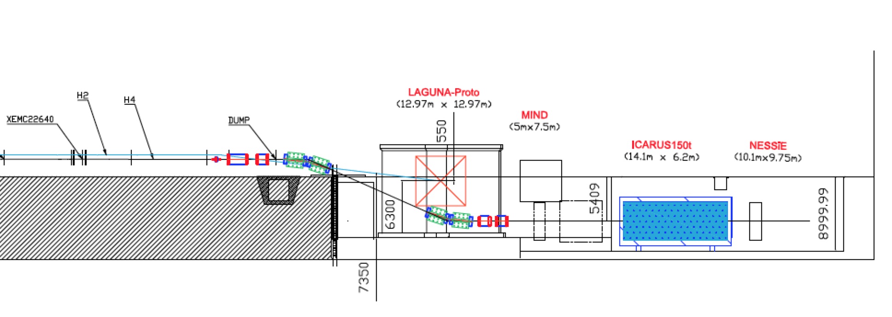
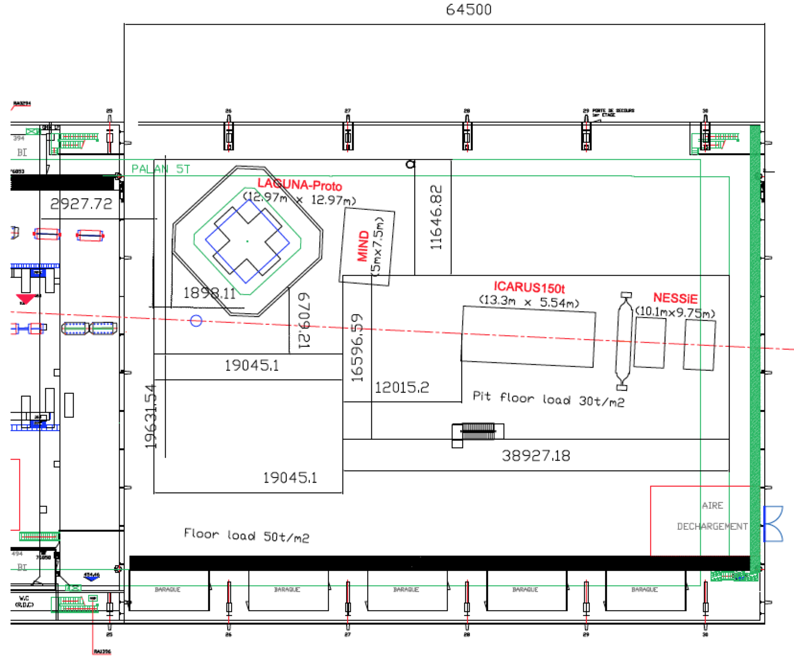
Logistics +
Test Beams Infrastructure (EHN1 ext)
charged beams layout
(~0.5-20 GeV/c)

Slide 20
Neutrino detectors R&D
CRYOGENICS
Rebuild/consolidate the existing detector cryogenics group in the CERN cryolab (with years of experience on LAr, Xe large detectors)
CORE exist (eng. + cryolab technical support), to be added 1 new dedicated engineer + 1-2 visiting positions for existing LAr cryo experts in the neutrino community
Positive discussions with CERN technical management, waiting for next steps on the CERN budget
Short term tasks:
- reconfigure and do maintenance on the T600 cryogenics
- cryo support to the small LAGUNA prototype in b182
- support to a near detector cryo project for the FNAL-SBL (LAr-ND/T150/new)
- support in the definition/procurement of various cryostats at CERN
Examples of ongoing discussions:
- LAr-ND cryogenics first design discussions (already 2 video conf. with FNAL)
- participation in LBNE reviews, next week meeting with LBNE experts at CERN

Slide 21
Neutrino detectors R&D
CRYOSTATS
Short term: participation in the design and procurement of the cryostats for T600 and LAGUNA small proto:
  Design phase with GTT in Paris done for both
  Design of the Warm and Cold cryo for T600 done with ICARUS and an engineering firm (aluminum extruded cold vessels)
  GTT thermal insulation for T600
  GTT full membrane system for LAGUNA
  Now entering the procurement phase
  Sharing experience with FNAL-35t, very important
Longer term : Large cryostat for LAGUNA demonstrator
  Which could be used also for LBNE tests

Slide 22
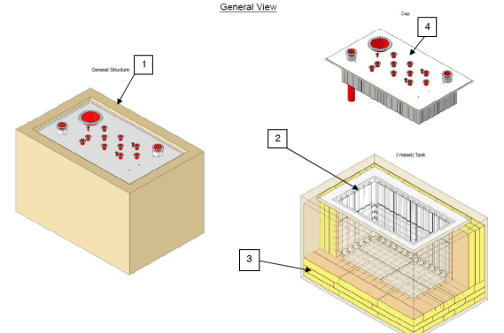
Neutrino detectors R&D
CRYOSTAT (LAGUNA proto)
3.0 * 4.8 * 2.4 m³:
Inner dimensions: height*length*width
In the tendering phase!

Slide 23
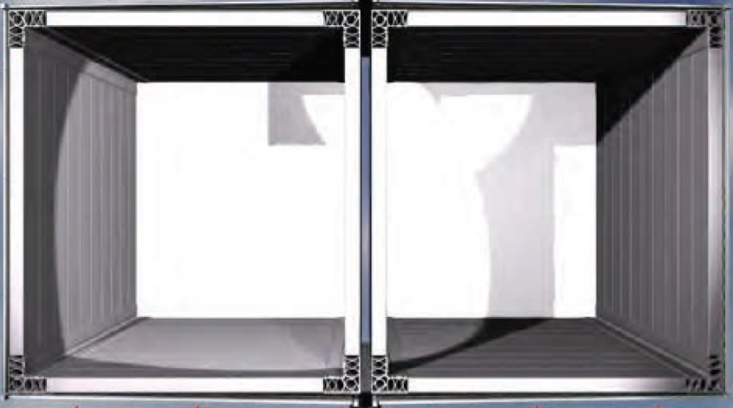
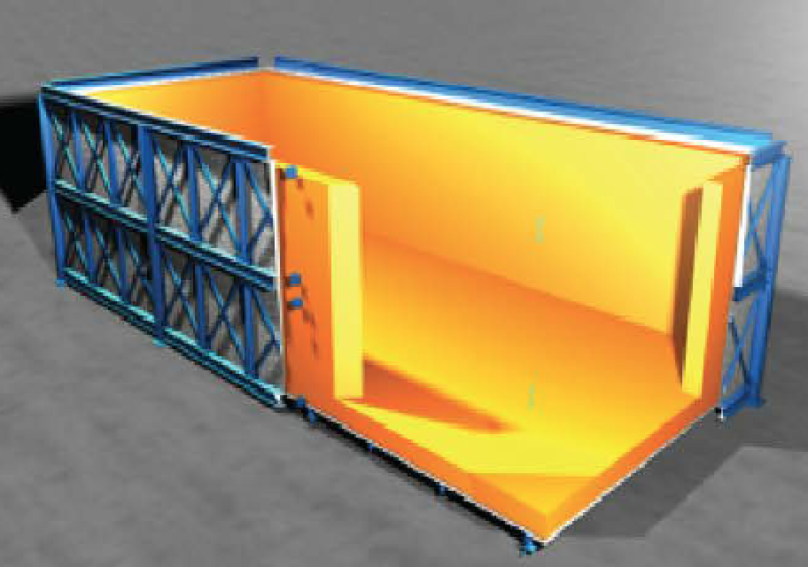
Neutrino detectors R&D
CRYOSTATS (T600)
Warm vessel
GTT INSULATION
4.24 * 20.12 * 3.94 m³:
Each cold vessel dimensions: height*length*width

Slide 24
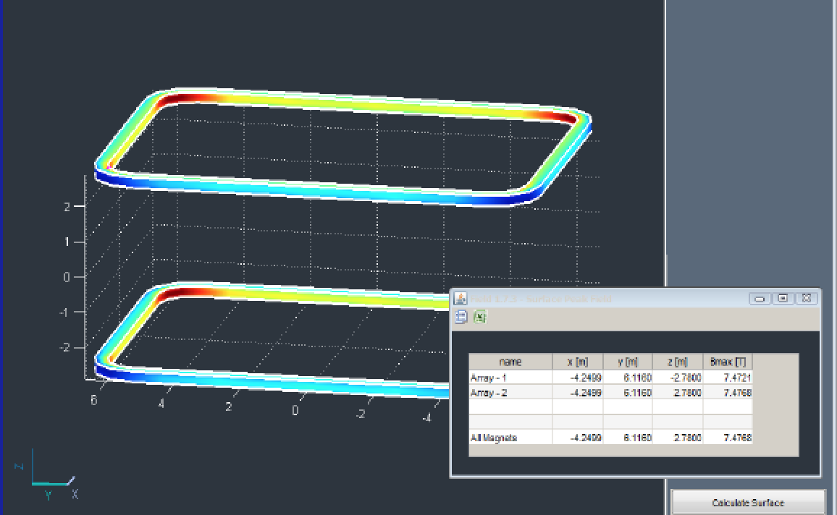
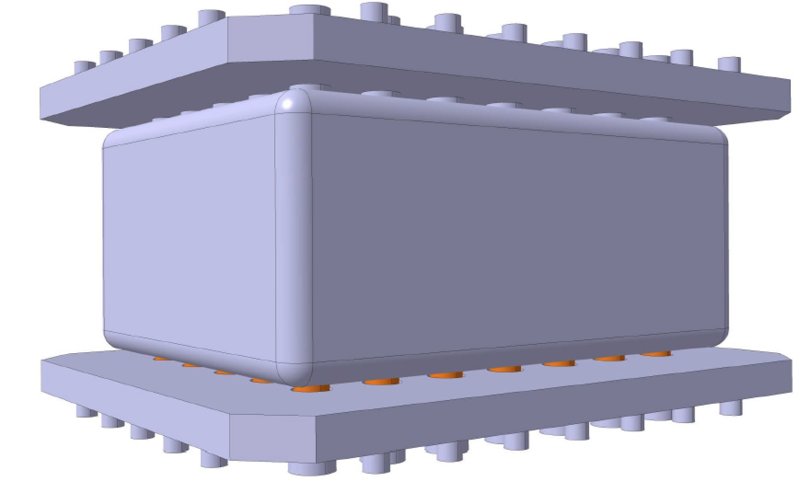
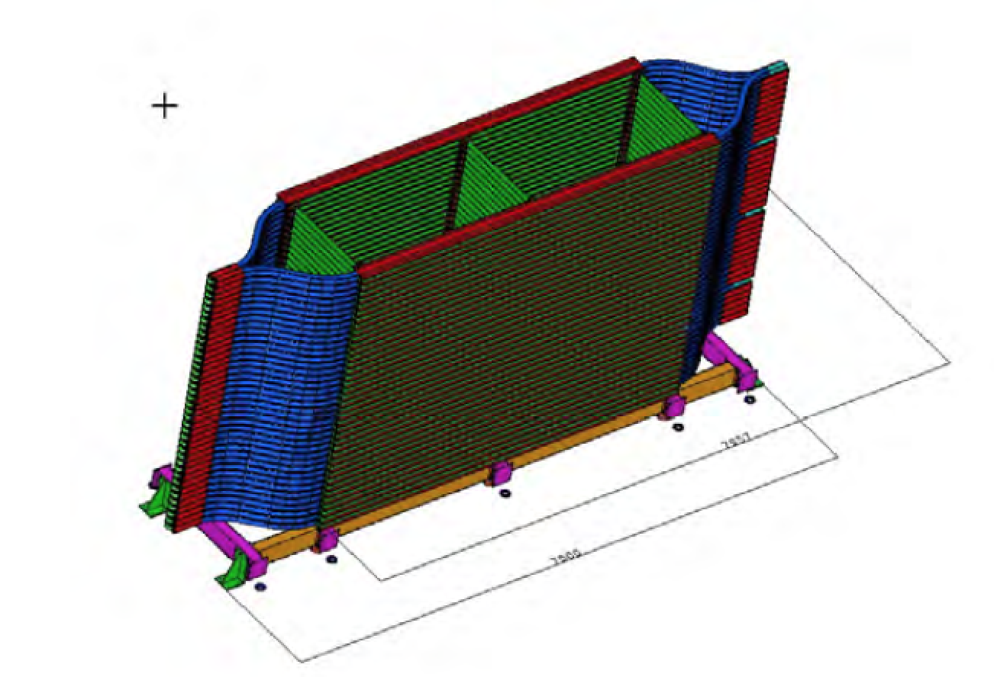
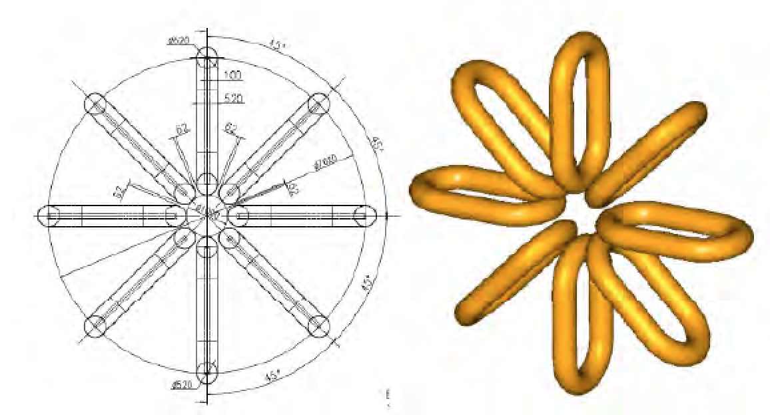
Neutrino detectors R&D
Magnets
Feasibility study for 2 superconducting coils a la ATLAS (Double Racetrack Magnet ): first idea collected, next step a real engineering feasibility study to define the project and the needed resources for the construction and operation (CERN + NESSiE groups ?)
- NESSiE WA104 proposal, now in the reshaping phase both at CERN (R&D) and at FNAL (SBL). Role of CERN under discussion!
Double Racetrack Magnet
Possible Forward air-core magnets

Slide 25
Neutrino detectors R&D
More general
We are starting discussing a possible role of CERN in the Slow control system, as it was done for LHC
Same for TDAQ where we could imagine a common architecture/software for TDAQ upstream of a agreed common interface (as it was done in the LHC experiments)
Preparing technical support manpower (in-outsourced) for the proper installation work (riggers, mechanical assembly, transports, …. )
CERN PHYSICS team: (also as host and support for visitors)
Under preparation
  Already 3 physicists with neutrino experience (Chorus, Opera,CNGS)
  Requesting CERN fellows, Scientific Associates, Project Associates, Doctoral and technical students, as part of the CERN internal programs
  Already 1 associate + 1 staff for FLUKA calculations
  Already 1 fellow for radio protection calculations
  Already 2 mech engineers (1 fellow + 1 associate) for calculations and design work
- NESSiE WA104 proposal, now in the reshaping phase both at CERN (R&D) and at FNAL (SBL). ole of CERN under discussion!

Slide 26
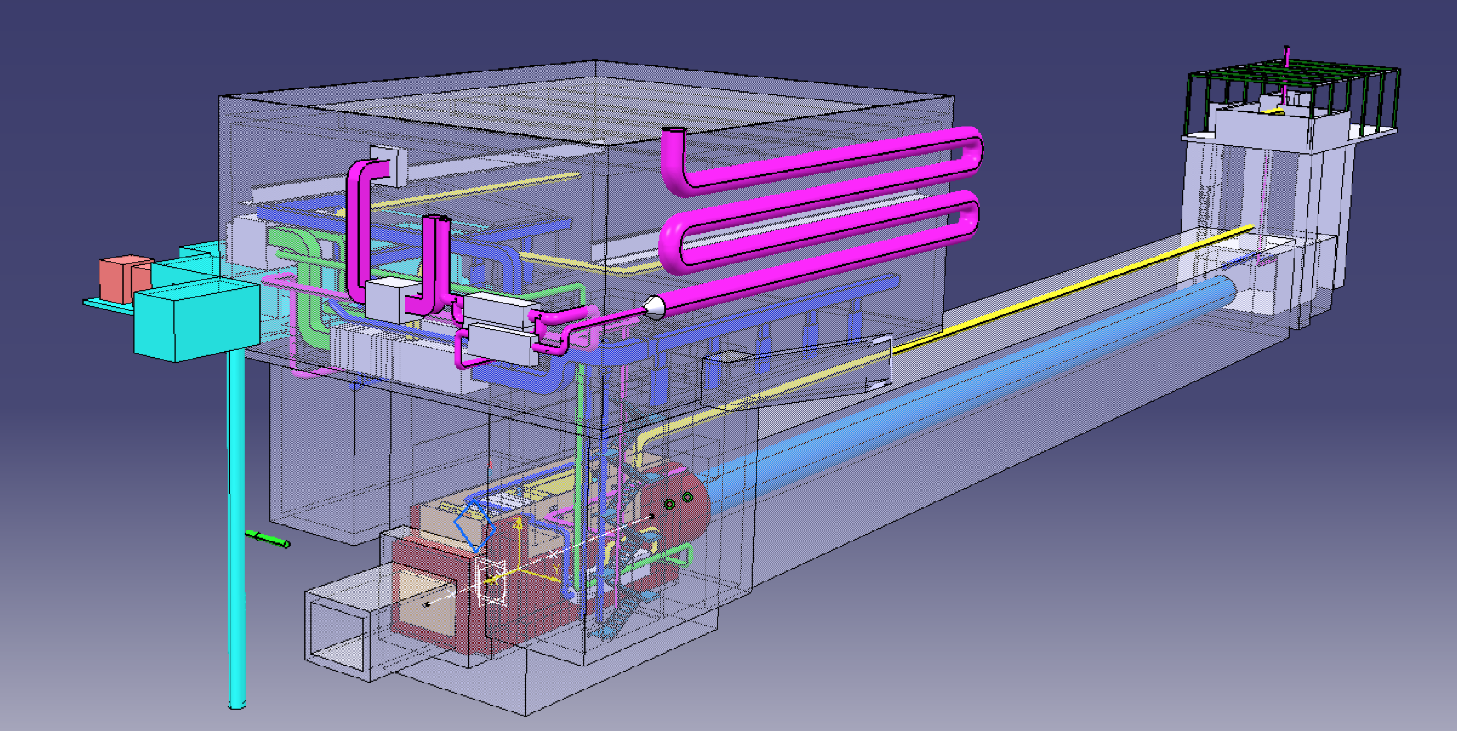
Design of a Neutrino Beam SBL at CERN (CENF)
Target area, decay pipe and hadron absorber/dump

Slide 27
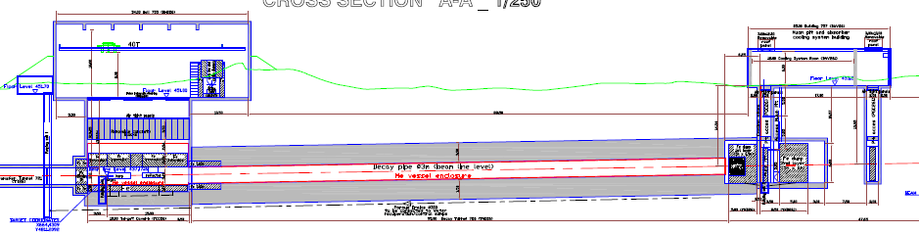
Target cavern and hall
Hadron absorber and μ pits
Decay pipe
Beam line under He, to avoid NO_{x} formation and to reduce air activation
Angle, distance and depth optimised to keep dose rate in EHN1 <1 mSv/h
Target shielding such that dose rate in target building area < 15 mSv/h
Air treatment and water recuperation
Civil engineering (CE) drillings already performed
CE design contract running

Slide 28
Design of a Neutrino Beam SBL at CERN (CENF)
Very active group of physicists and engineers from several technology groups at CERN (~15 persons part time):
Overall functional concept
Detailed target design and cooling
He tank first concept and design
He purification methodology (with industry)
Fluka calculations
Radiation calculations
Environmental studies
Muon counters using LHC technologies
Ready for detailed CE design (within the existing CE contract) by May
Summary report by October-November 2014
Ongoing:
- first discussions (video) with the LBNE-FNAL design team
- ready for a further cooperation in various aspects (design, calculations, specific prototyping, …) → possibility to draft a first FNAL-CERN R&D cooperation proposal

Slide 29
Investigate new programs (mu storage ring, betabeams ?, …)
Nu-storm
Strong request in the recent Paris ICFA EU meeting by the community to consider the possibility to do a feasibility study for a nu-storm program at CERN
One has to start based on what already was done in the US
Define a reasonable plan and layout proper to CERN
Define all necessary R&D activities necessary prior to open a real construction project
Define the resources which will be needed and a realistic construction schedule
This is a large enterprise which will need the support of various technical group at CERN and the effective support of the nu-storm collaboration in many aspects
We will need just for the feasibility study important resources in and outside CERN
A first plan has been presented to the SPSC committee and more discussions will follow

Slide 30
CERN Neutrino Platform
Summary - CERN:
offers a platform for Neutrino detectors R&D open to EU, J and US colleagues
will support this platform in an active way and will help the community to establish a coherent R&D program
will construct a large neutrino test area (EHN1 extension) with charged beams capabilities, available in 2016 (and compatible with a future neutrino beam)
will continue the detailed studies towards a neutrino short baseline at CERN in particular for the secondary beam facility
will assist the EU neutrino community in their long term common plans
will help the community in their SBL experiments at FNAL (ICARUS, LAr-ND, NESSiE)

