Slide 1
The Proposal P-1052
Claudio Montanari
INFN-Pavia, Italy
For the ICARUS Collaboration

Slide 2
The ICARUS Collaboration
M. Antonello¹, B. Baibussinov², V. Bellini^{4,5}, H. Bilokon⁶, F. Boffelli⁷, M. Bonesini⁹, E. Calligarich⁸, S. Centro^{2,3}, K. Cieslik¹⁰, D. B. Cline¹¹, A. G. Cocco¹², A. Curioni⁹, A. Dermenev¹³, R. Dolfini^{7,8}, A. Falcone^{7,8}, C. Farnese², A. Fava³, A. Ferrari¹⁴, D. Gibin^{2,3}, S. Gninenko¹³, F. Guber¹³, A. Guglielmi², M. Haranczyk¹⁰, J. Holeczek¹⁵, A. Ivashkin¹³, M. Kirsanov¹³, J. Kisiel¹⁵, I. Kochanek¹⁵, A. Kurepin¹³, J. Łagoda¹⁶, F. Mammoliti⁴, S. Mania¹⁵, G. Mannocchi⁶, V. Matveev¹³, A. Menegolli^{7,8}, G. Meng², G. B. Mills¹⁷, C. Montanari⁸, F. Noto⁴, S. Otwinowski¹¹, T. J. Palczewski¹⁶, P. Picchi⁶, F. Pietropaolo², P. Płoński¹⁸, R. Potenza^{4,5}, A. Rappoldi⁸, G. L. Raselli⁸, M. Rossella⁸, C. Rubbia^{19,14,a}, P. Sala²⁰, A. Scaramelli²⁰, E. Segreto¹, D. Stefan¹, J. Stepaniak¹⁶, R. Sulej¹⁶, C. M. Sutera⁴, D. Tlisov¹³, M. Torti^{7,8}, R. G. Van de Water¹⁷, F. Varanini³, S. Ventura², C. Vignoli¹, H. G. Wang¹¹, X. Yang¹¹, A. Zani^{7,8}, K. Zaremba¹⁸
INFN, LNGS, Assergi (AQ), Italy ¹⁾, INFN, Sezione di Padova, Padova, Italy ²⁾, Dipartimento di Fisica, Università di Padova, Padova, Italy ³⁾, Dipartimento di Fisica, Università di Catania, Catania, Italy ⁴⁾ INFN, Sezione di Catania, Catania, Italy ⁵⁾, INFN, Laboratori Nazionali di Frascati (LNF), Frascati (Roma), Italy ⁶⁾, Dipartimento di Fisica, Università di Pavia, Pavia, Italy ⁷⁾, INFN, Sezione di Pavia, Pavia, Italy ⁸⁾, INFN, Sezione di Milano Bicocca, Dipartimento di Fisica G. Occhialini, Milano, Italy ⁹⁾, The H. Niewodniczanski Institute of Nuclear Physics, Polish Academy of Science, Kraków, Poland ¹⁰⁾, Department of Physics and Astronomy, University of California, Los Angeles, USA ¹¹⁾, INFN, Sezione di Napoli, Dipartimento di Scienze Fisiche, Università Federico II, Napoli, Italy ¹²⁾, INR-RAS, Moscow, Russia ¹³⁾, CERN, Geneva , Switzerland ¹⁴⁾, Institute of Physics, University of Silesia, Katowice, Poland ¹⁵⁾, National Center for Nuclear Research, Warszawa, Poland ¹⁶⁾, Los Alamos National Laboratory, New Mexico, USA ¹⁷⁾, Institute for Radioelectronics, Warsaw University of Technology, Warsaw, Poland ¹⁸⁾, GSSI, L’Aquila (AQ), Italy ¹⁹⁾ , INFN, Sezione di Milano, Milano, Italy ²⁰⁾
IF in RED, ALSO at LBNE

Slide 3
The P-1052 proposal
Our proposal for a definitive search for sterile neutrinos had been submitted to CERN on Oct. 14, 2011 based on the (simultaneous) ν observation at different distances. It is only in this way that the values of Δm² and of sin²(2θ) can be separately identified. The experiment, although approved by the SPS-C, has not been granted because of the absence of a neutrino beam in the EU.
Therefore the proposal for the FermiLab accelerator has been presented on December 2013 under the heading P-1052, closely following the proposal P-347 originally presented at CERN.
FNAL-PAC response is still pending from last January. Our experiment will extend the information coming from MicroBooNE, foreseen to start operation in 2014 at ~470 m distance from target.
The ICARUS T600 detector would be located along the Booster Neutrino Beam line (BNB) at 600±100 m from target. The new T150 with sensitive mass ~1/4 of the T600 (~200 tons of LAr) could be located at 150±50 m from the target.
In order to contribute also to the LBNE experiment, the T600 will also receive neutrinos from the off-axis kaon-neutrino NUMI beam peaked at ~2 GeV with an enriched flux of νe events as large as ~5%.

Slide 4
CERN-16 March 2013
Deliberation Document on the update of the European Strategy for Particle Physics
The European Strategy Group ESG (Prepared by the Scientific Secretariat for the European Strategy Session of the Council)
at point f)
Rapid progress in neutrino oscillation physics, with significant European involvement, has established a strong scientific case for a long-baseline neutrino programme exploring CP violation and the mass hierarchy in the neutrino sector.
CERN should develop a neutrino programme to pave the way for a substantial European role in future long — baseline experiments.
Europe should explore the possibility of major participation in leading long — baseline neutrino projects in the US and Japan.

Slide 5
A new approach to sterile oscillations
The experiment introduces important new features, which should allow a definitive clarification of all the above described “anomalies”:
  L/E oscillation paths lengths to ensure appropriate matching to the Δm² window for the expected anomalies.
  “Imaging” detector capable to identify unambiguously all reaction channels with a “Gargamelle class” LAr-TPC
  Liquid Argon magnetization to determine accurately the signs and the momenta of all charged particles, including muons.
  Interchangeable ν and anti-ν focussed beams
  Very high rates due to large masses, in order to record relevant effects at the % level (>10⁶ νμ,≈10⁴ νe)
  Both initial νe and νμ components cleanly identified.

Slide 6
Basic features
Our proposed experiment, may be able to give a likely definitive answer to the 4 following queries:
  the LSND/+MiniBooNe both antineutrino and neutrino νμ → νe oscillation anomalies;
  The Gallex + Reactor oscillatory disappearance of the initial ν−e signal, both for neutrino and antineutrinos
  an oscillatory disappearance maybe present in the ν−μ signal, so far unknown.
  Accurate comparison between neutrino and antineutrino related oscillatory anomalies, maybe due to CPT violation.
  The near position at ≈150 m is justified by the closer identity with the far location.
In absence of these “anomalies”, the signals of the detectors should be as much as possible a copy of each other for all experimental signatures, minimizing the effects in the comparisons.

Slide 7
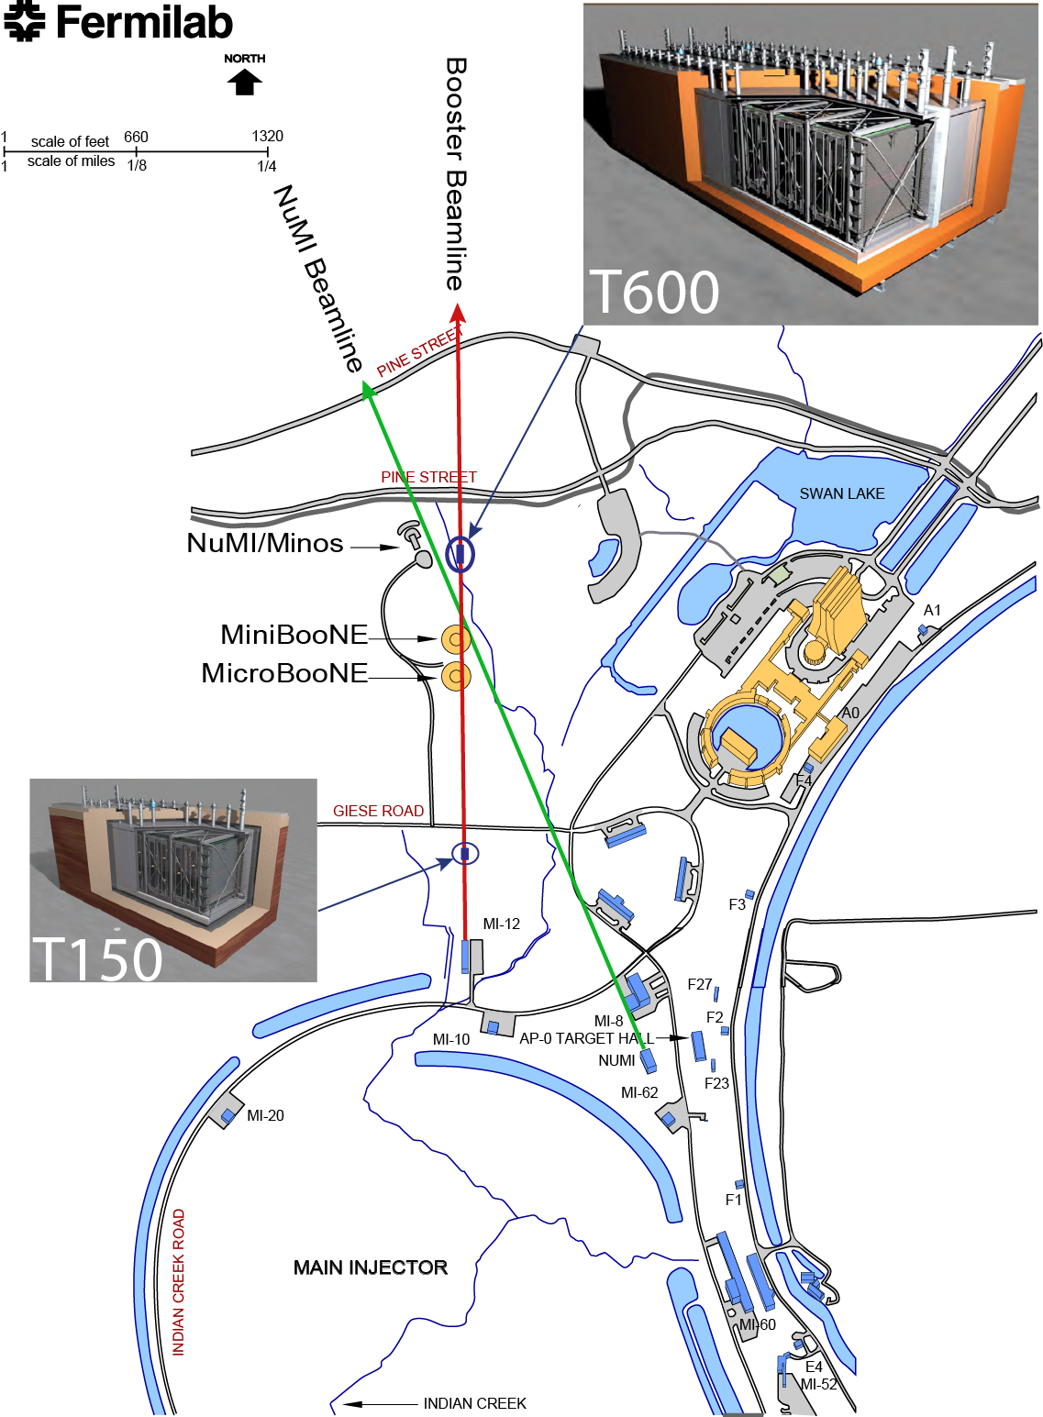
Our proposed layout at the FNAL neutrino beam lines
ICARUS T600 detector should be located along the Booster Neutrino Beam line (BNB) at ~600±100 m distance from the target.
The new T150 will be located at about 150±50 m from the target.
The dual presence of T600 and of the new T150 will extend the information already coming from MicroBooNE, foreseen to start operation in 2014 at ~470 m distance from target.
T600 will also receive ν’s from the off-axis kaon-neutrino NUMI beam peaked at ~2 GeV with an enriched flux of ν_{e} events as large as ~ 5%.

Slide 8
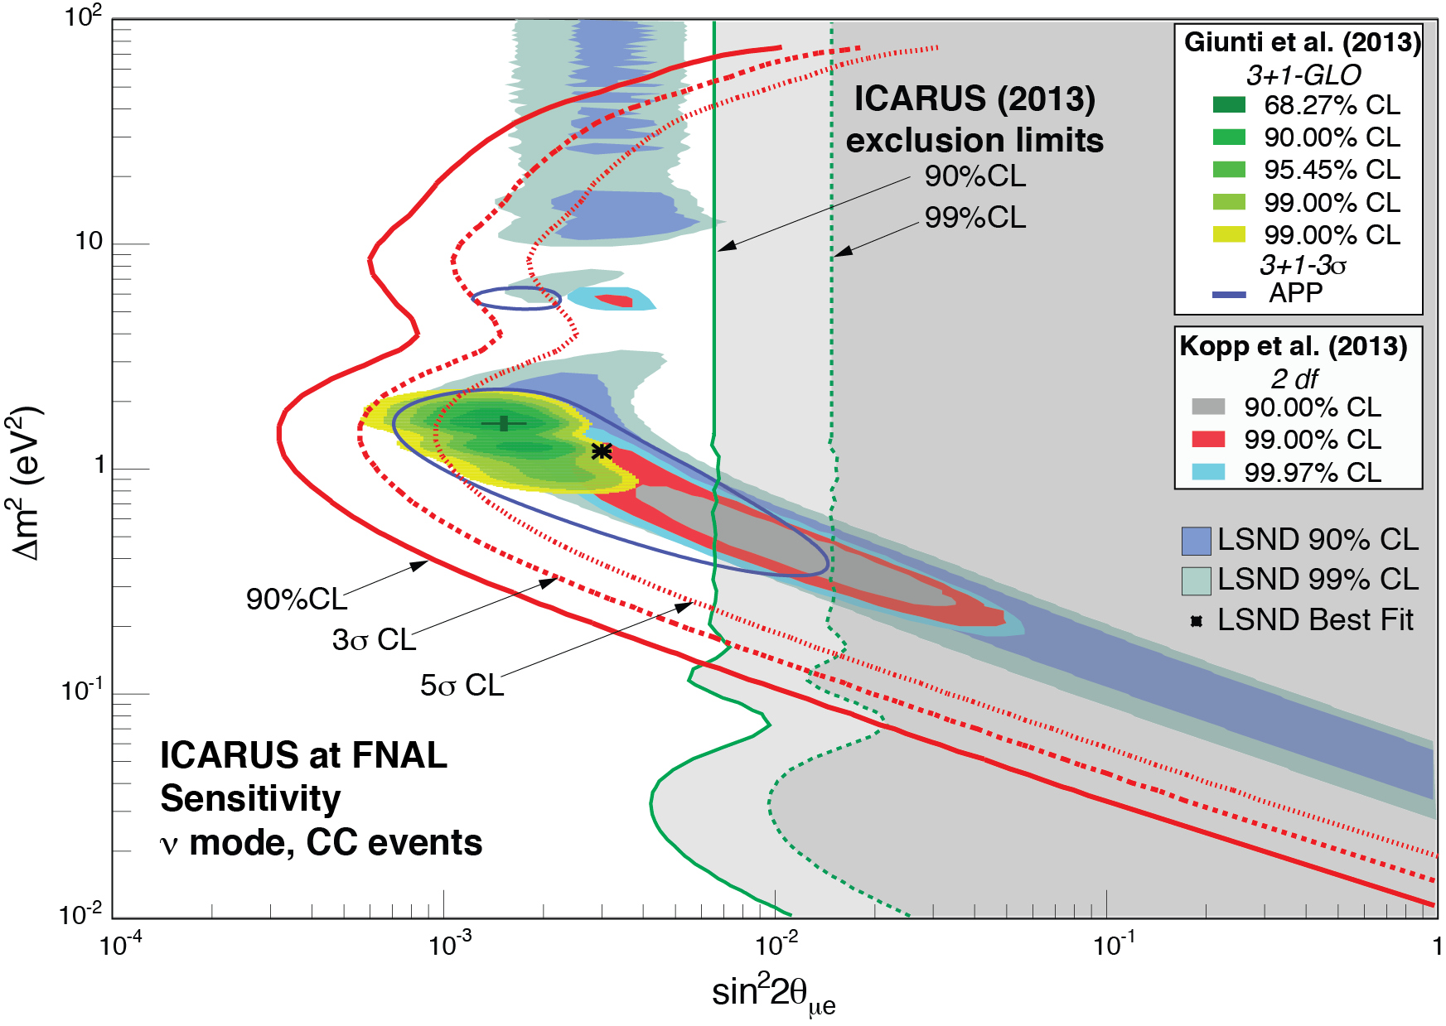
A definitive assessment of the LSND anomaly:
Expected LSND like sensitivity with 5σ CL of T150 and T600 to νμ -> νe oscillations after 3 years - 6.6 10²⁰ pot BNB positive focusing at the present FNAL beam rates
Signal is computed as difference between Far and Near detectors with a small correction for the expected Near to Far beam shape differences
The predicted signal regions are well covered within 5σ.
The possibility exists to double the neutrino intensity at FNAL with a second horn

Slide 9
The P-1052 is based on the exploitation of the dual detector.
The ICARUS team, already participating in LBNE, is willing to extend participation to other short baseline neutrino activities collaborating with the FNAL groups. The details of the collaboration are presently under active discussion.
CERN will be an asset for the future developments of neutrino physics, providing support with expertise and infrastructures.
The ICARUS T600 and new components of the experiment will be provisionally located at CERN in the “Gargamelle Hall”.
The addition of a pair of Helmholtz coils, necessary for the anti-neutrino program at FNAL will be also investigated, in view of the subsequent magnetization of the LAr-TPC’s .
Magnetization is of considerable interest also for the future LBNE extrapolation to larger masses.

Slide 10
Other neutrino activities
In view of the relative novelty of the LAr-TPC technology, a vast “LAr programme” must be continued, in which real neutrino and antineutrino events are studied at lower Eν ’s.
In addition to a definitive clarification of sterile neutrino, the LAr programme at FNAL may pave the way to the ultimate realization of the LNBE detector for instance with
  An accurate determination of cross sections in Argon
  The experimental study of all individual CC and NC channels
  The realization of sophisticated algorithms capable of the most effective identification of the events.

Slide 11
The closing down phase of T600 at LNGS
July-August 2013: T600 emptying + warming‐up
From Sept. 2013, still ongoing: Disassembling
  Third floor: detector materials (HV, trigger racks, PMT racks, rack power distributors, ...), LN₂ tanks, GN₂ / LN₂ pipes and valves, pneumatic panels, electrical components
  Second floor: Electronics racks, electrical and safety plant, T600 PLC and other instruments
  Ground floor: Water, compressed air, electrical plant, Stirling cryocooler system, safety plant
  Counting room: in progress
LNGS Hall B

Slide 12
Hall-B is an extremely crowded area
You must pass through
this leftover space !

Slide 13
Stirling skid system (before)
Stirling skid dismantling (now)
LN2 tanks area (before)
LN2 tanks area (now)

Slide 14
South part (before)
South part (now)
Electronics area (before)
Electronics area (now)

Slide 15
Expected completion schedule
Some delays have been introduced by administrative procedures, interferences and logistic problems.
We have been ready since February to transport: the 12 Stirling units (to be kept in a closed place), the rest of the Stirling skids (can be stored into containers or outside), cryogenic transfer lines and the 2 LN2 tanks (exceptional transports).
Depending on logistics and transports we will go on dismantling within ~2 months the 3rd floor, the stairs, the wall; removing LN2, LAr, GAr pipes on the 2nd floor, electronics racks, feed-throughs and chimneys.
The vertical insulation and cooling screen will then be removed (≈1.5 month) and the two cold vessels will be opened to access internal detectors.
The transport boxes for the internal detectors have been designed, and they will be ordered by CERN.
Summer months may forbid the exceptional transport on the highway, now planned for beginning of September. This would represent a ~3 months delay with respect to the previous schedule.

Slide 16
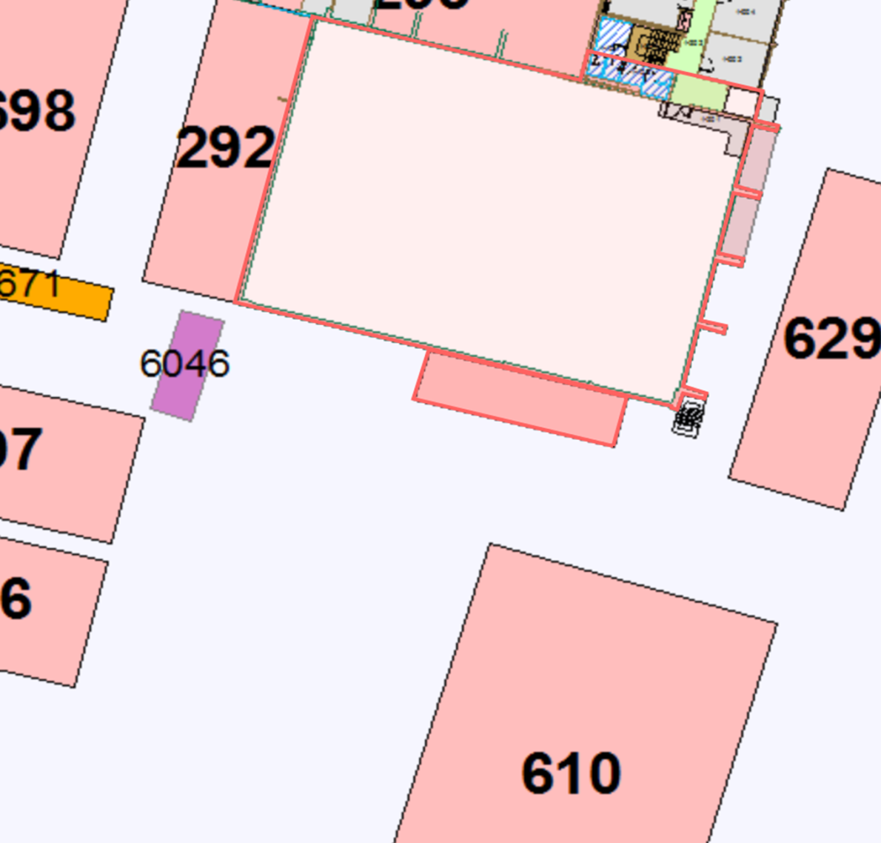
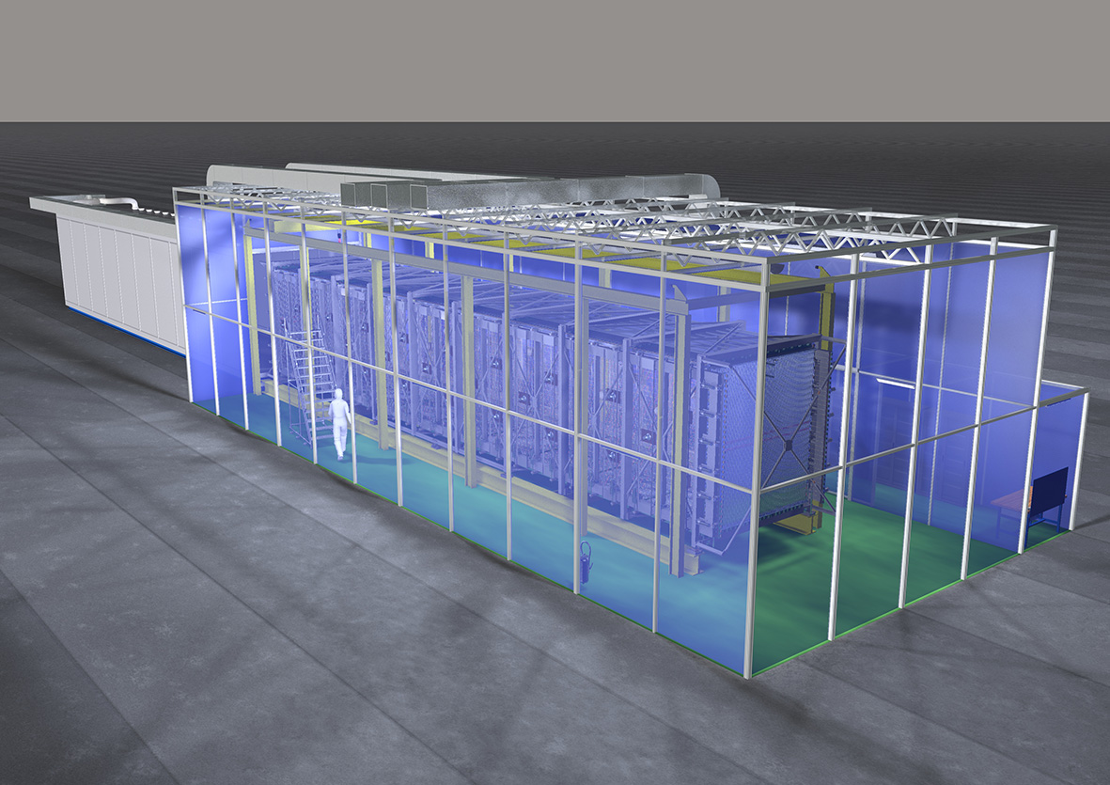
Location of T600 at CERN
A bldg. (185) is being adapted and dedicated to assemble the TPCs in the cold vessels (T600 and T150).
Clean room for TPC assembly
185
7m
22m
10m

Slide 17
WA104: improvement and developments on LAr
New thermal insulations
New cold bodies
Improved LAr purification system
New light collection system
New T150 LAr-TPC
Overhauling of T600 electronics and new electronics for T150
Electron-ion recombination effects and improving detector performance
Magnetizing LAr
The contribution at CERN of the US teams is being investigated since it may represent an important step within the WA104 program.

Slide 18
Work Schedule and Project Milestones
First T600 TPC transport to CERN: Sept 2014
Second T600 TPC transport to CERN: +1 month
First T600 aluminum vessel transport to CERN: April 2015
Second T600 vessel transport to CERN: November 2015
First T600 TPC ready for insertion in the new vessel: April 2015
Second T600 TPC ready for insertion in vessel: November 2015
T150 vessel transport to TPC assembly site: January 2015
T150 TPC assembly complete: December 2015
Equipment ready for transportation to FNAL starting from end 2015
This schedule is indicative but realistic, since it is based on the previous experience in constructing the T600 at Pavia.

Slide 19
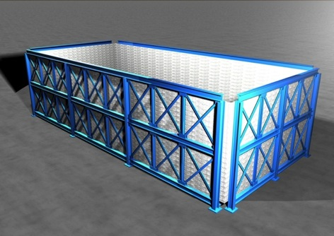
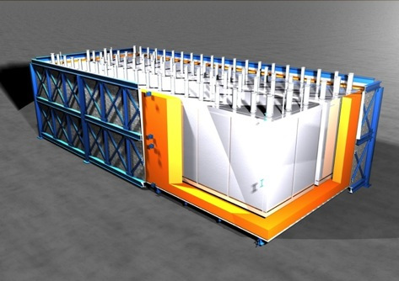
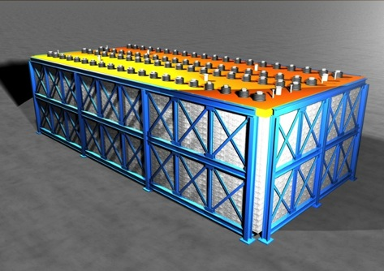
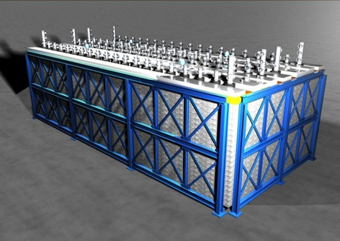
T600/T150 new Thermal insulation
Purely passive insulation chosen for T600/T150 installation, coupled to ICARUS standard cooling shield with boiling N₂
GTT technique developed for 50 years and widely used for large industrial storage vessels and ships for liquefied natural gas.
Expected heat loss through the insulation:
T600 ≈ 6.6 kW ; T150 ≈ 3.5 kW
Warm cage + ext. skin
Insulation +T600 modules
Insulation top
Top flanges (final layout)

Slide 20
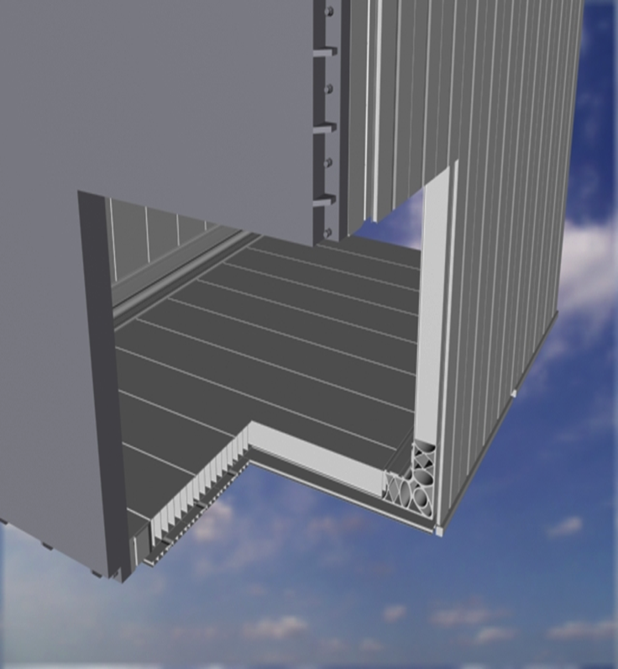
The new Cold Vessels
Aluminum vessels of welded extruded profiles, designed in collaboration with Industries and Milano Politecnico to be super clean, vacuum-tight and to stand 1.5 bar max operating internal overpressure.
Work has addressed:
Detailed modelling of the aluminium profiles.
Computation of behaviour under the several loading conditions.
Optimization of the aluminium profiles.
Assembly and welding procedures.
Time scale and construction cost.
This solution could represent a valid alternative to membrane (as originally foreseen for MODULAr) for LAr containment.

Slide 21
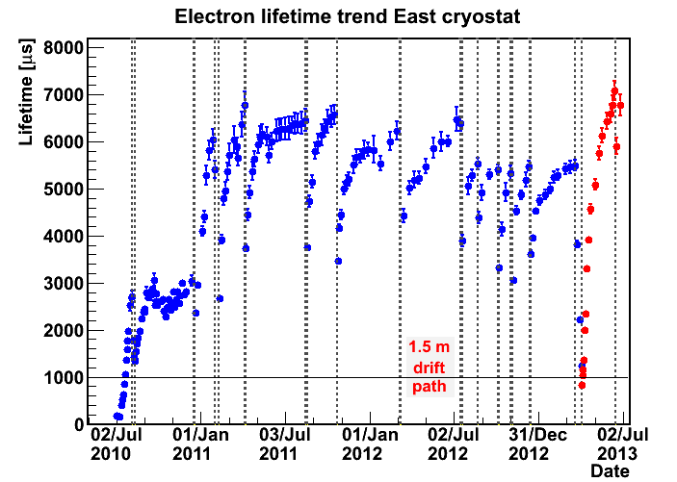
Cryogenics and LAr purification
The cryogenic system of T600 required > 10 liquefiers with a total electric consumption of ~400 kW and a “brute force” approach.
The system has been therefore very demanding :
The new passive insulation, reducing losses, addresses this issue
Purification (100 Nm³/h) of gas phase (~40 Nm³) to block impurity diffusion from warm parts and micro-leaks
Purification (4 m³/h) of the bulk liquid volume (~550 m³) to efficiently reduce the initial impurities concentration
As soon as the purification stops purity decreases within days: improvements concern pump reliability and recirculation speed.
New pumps
Both gas and liquid purifications are mandatory

Slide 22
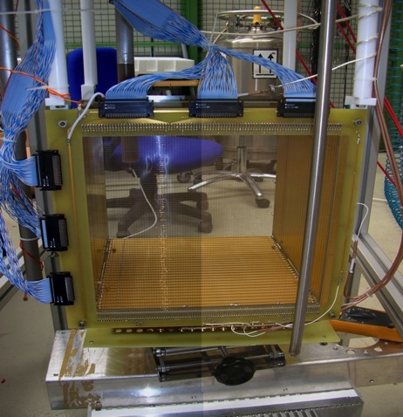
Recent achievements of the LAr purity
Extremely high τ_{ele} have been already obtained at lab scale in the ICARINO R&D program where the short path length used (30 cm) is compensated by the accuracy in the observation of the specific ionization of cosmic muons.
The result repeatedly reached is τ_{ele} > 20 ms corresponding to ≈15 ppt, namely a ≈10⁻¹¹ molecular Oxygen eq. impurities.
These activities have been initiated in view of the already published “Modular” Project.

Slide 23
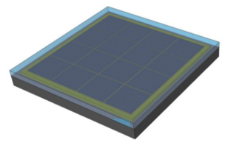
Scintillation light detection system
Alternative solution to PMTs:
  Silicon Photomultipliers (SiPM)
  coupled to wave shifting light guides.
SiPMs have been proven to work under very high magnetic fields, but they have to be better characterized at cryogenic temperature.
The SiPM device is able to detect VUV LAr scintillation light when coupled to a standard wavelength shifter (TPB) with high quantum efficiency (~ 40% - higher than that of the best PMTs ), without requiring high voltage and any amplification
The read-out electronic configuration has to be set-up with SiPM arrays and high sensitive surface.
Investigations on materials and doping are necessary.

Slide 24
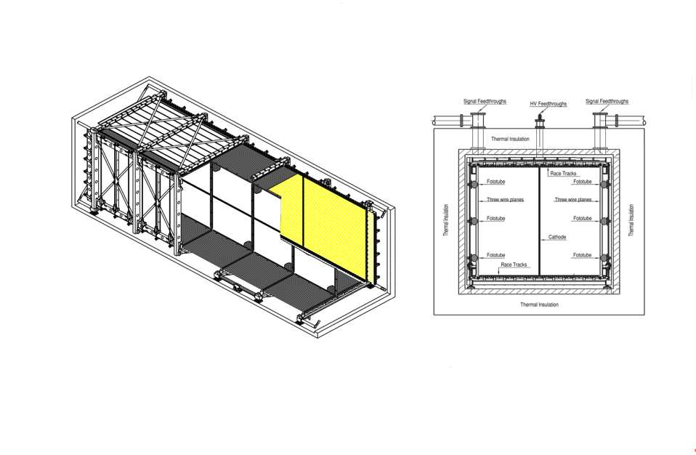
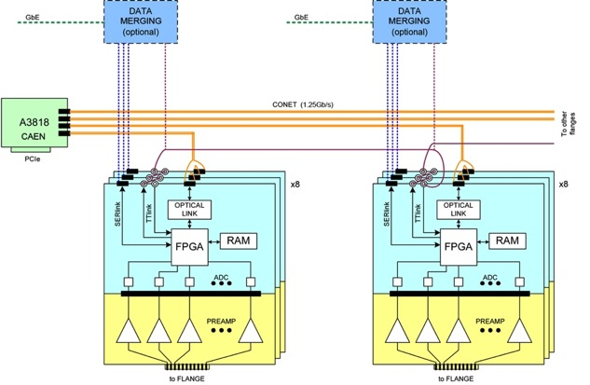
The additional “clone” of a T150 LAr-TPC
Present T600 is complemented by an additional T150 module (1/4 T600).
This is a “clone” entirely based on the already demonstrated LNGS program.
Thought intended as the near detector for the sterile neutrino search, the T150 is the ideal tool to implement initially also improved solutions, especially for introducing the magnetic field, purification schemes and cryogenics and a more modern electronics, by now over 10 years old.

Slide 25
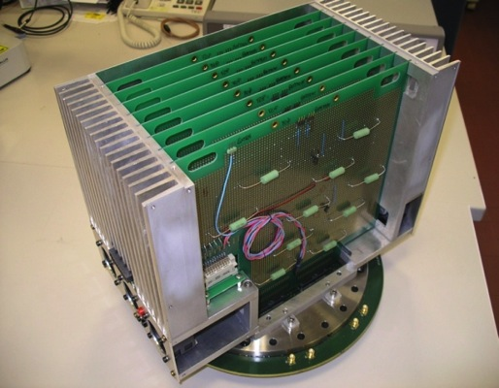
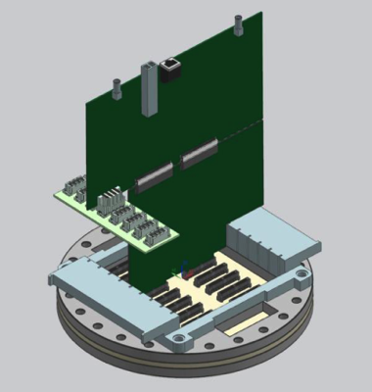
Modifications on the ICARUS Electronics
The T600 system is being re-designed adopting a modern switched I/O and parallelization of data flow, with an upgrading program concerning:
  A more compact electronics both for analogue and digital;
  Improvements of the signal to noise ratio shortening cables;
  Integrating electronics onto the flanges with lower power;
  Adopting serial switched I/O for data flow + optical link (for Gb/s transmission rate).
I/O connectors
(Optical, Lemo, Ethernet)
Power distribution on auxiliary connectors on side bus
Backplane integrated on flange
This layout is also suitable for front-end amplifiers in LAr in order to improve S/N: tests are in preparation with cold front-end and warm digital processing

Slide 26
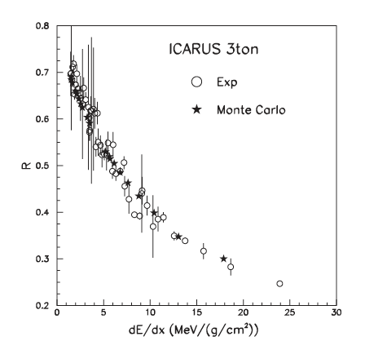
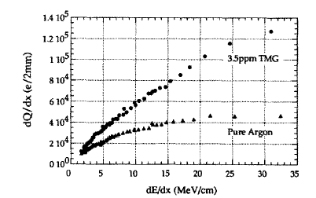
Recombination effects
Charge recombination, increasing with ionization density, induces non-linear detector response:
No full theoretical description
Phenomenological approaches allow to reproduce the data
Substantial software corrections needed
Signal
Dep. Energy
Vs
dE/dx
Signal vs
Dep. Energy
Add dopants to convert part of the scintillation light into electron-ion pairs
Few PPM tetra-methyl-germanium
Observed signal increase : +25% to +220%
Purity and resolution not affected

Slide 27
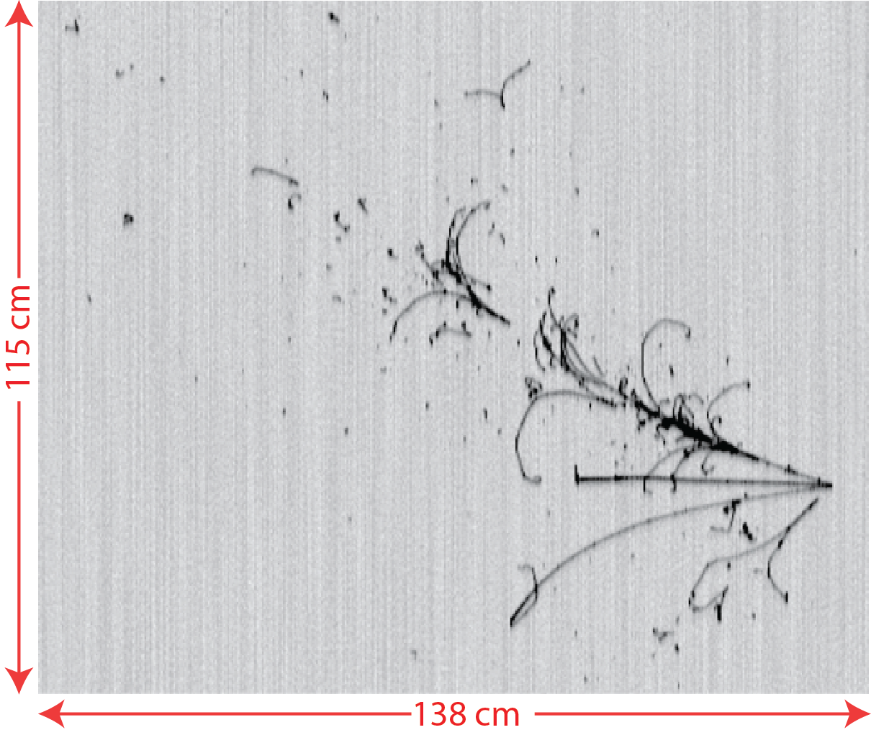
Magnetizing LAr
The addition of magnetic field to the LAr-TPC detector has been already described in the first ICARUS proposals (1985).
An appropriate magnetic field to the LAr-TPC permits to further contribute to the progress of LAr technology, allowing the unambiguous determination of the sign and momentum of the secondary charged particles and a greatly improved visibility of the e.m. showers.
Example of a 4 GeV e-neutrino event in LAr-TPC with 1 Tesla magnetic field.
A negative electron, π⁰, π⁺ and proton are recognized in the final state

Slide 28
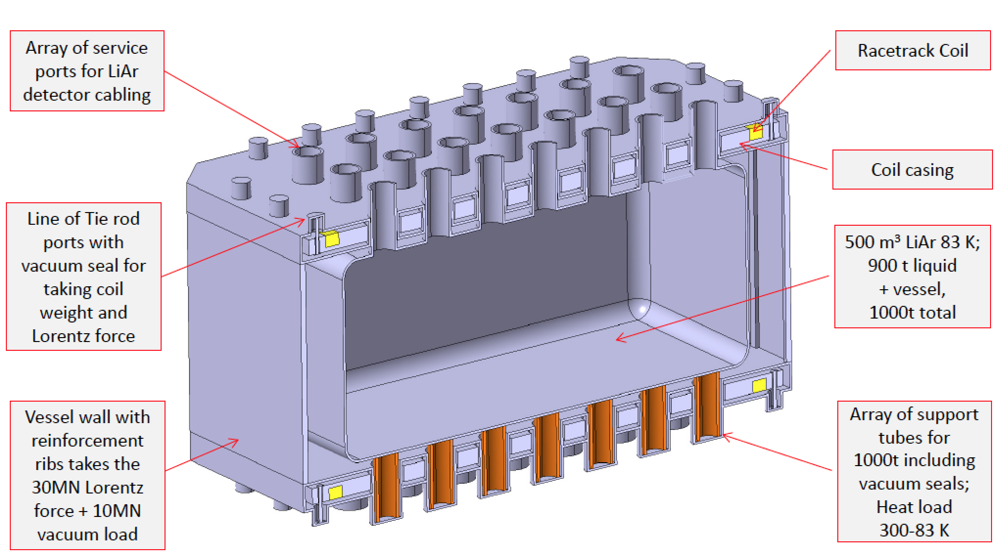
Implementation with available location for magnetic coils
A concept design has been elaborated both for the T600 and the T150 at CERN (exploiting also the experience on the similar ATLAS toroidal magnet coils arrangement).

Slide 29
Arrival at FNAL
Transport of the T600 to FNAL can occur between end 2015 and beginning 2016.
The time needed to re-install the T600 and to be ready for the commissioning will be about 6 months.
  Most of the components will arrive at FNAL largely pre-assembled and tested. The onsite assembly operations, and the related manpower, will be limited and dominated by external cabling and electronics installation.
Commissioning can take place during the second half of 2016. It will require from 3 to 5 months (it was 5 months in LNGS including about 3 months of vacuum pumping).
Readiness for data taking can be at the end of 2016.

Slide 30
FAR Detector Space Requirements
TOP VIEW
FRONT VIEW

Slide 31
Technical Infrastructure at FNAL
Civil engineering:
  1 crane 5/10 t capacity
  External roof hosting the LN2 and LAr discharge ramp
Mains:
  400 kW: Stirling re-liquefaction system;
  100 kW: R/O electronics;
  150 kW: Cryogenics & others.
  Total: 700 kW – Trafos: 2x1 MVA
  General services (light, heating, cooling, ventilation, etc.) not included.
  UPS for the control and monitoring system.
Cooling:
  Closed circuit cooling water:
    flow rate =30m³/h;
    pressure drop=1.5bar;
    temperature drop=10ºC

Slide 32
Technical Infrastructure at FNAL (cont.)
Safety (specific requirements):
  Separation wall around ICARUS and cryogenics areas: 3-4 m high
  Ventilation: following FNAL instructions with 2 flow rates systems, the minor always running, the other to intervene in case of alarm (low Oxygen). Aspiration at ground level outlet outside the hall.
  Safety sensors: oxygen, smoke, temperature.
  Emergency lights.
  Cameras.
  Audio alarms.
Control room:
  Computer environment (DAQ, slow control system, etc.) 4x6 m², the the FAR Detector building.
For other standard services (Conditioning, heating, etc.) we have no specific requests and therefore FNAL Standards and Rules apply.

Slide 33
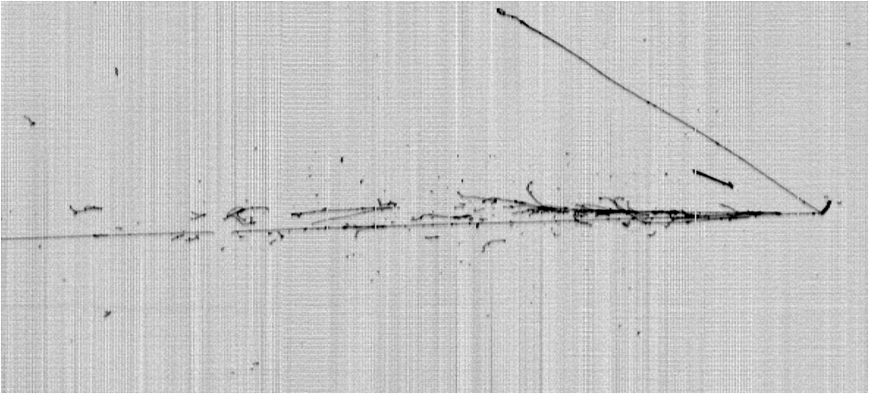
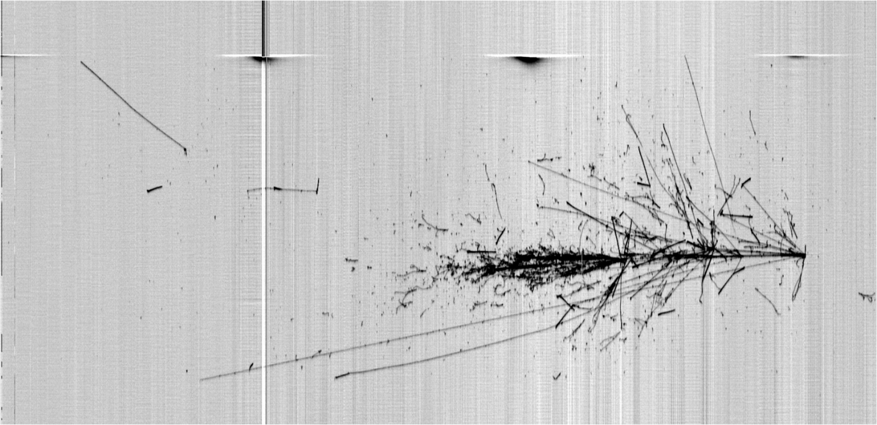
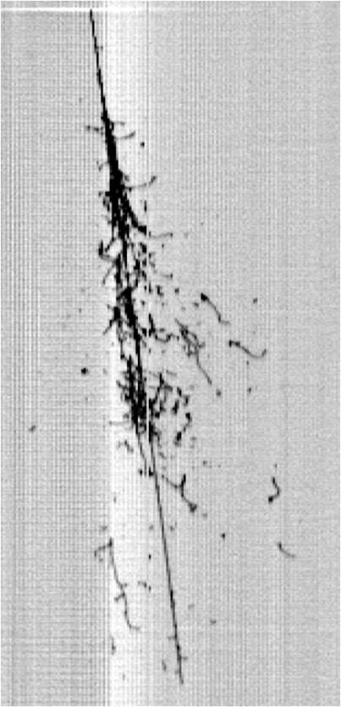
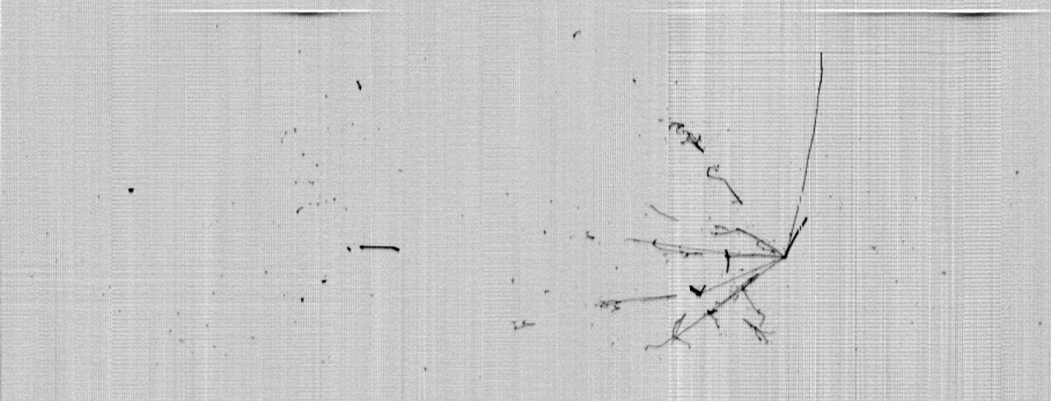
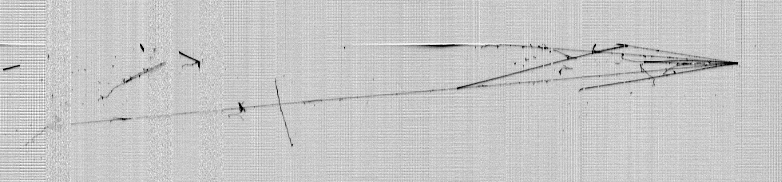
Thank you !
LNGS_May2011
Slide 33

