Slide 1




Efficient Live Checkpointing Mechanisms for computation and memory-intensive VMs in a data center
ALICE O2 Presentation
Kasidit Chanchio
Vasabilab
Dept of Computer Science,
Faculty of Science and Technology,
Thammasat University
http://vasabilab.cs.tu.ac.th
Notes:
Good afternoon, my name is kasidit chanchio. Today, I am going to talk about TLC

Slide 2
Outline
Introduction and problems
Checkpointing mechanisms
Our Proposal
  Time-bound Live Checkpointing (TLC)
  A Scalable Checkpointing Technique
Conclusion and Future Works
Notes:
First I will give an introduction. Then, tell you about exiting VM live checkpointing mechanism. And, I will present our proposal and conclude the presenattion.

Slide 3
Introduction
Today, applications require more CPUs and RAM
  Big Data Analysis
  Large Scale simulation
  Scientific Computation
  Legacy Applications, etc.
Cloud computing has become a common platform for large-scale computations
  Amazon offers VM with 8 vcpus and 68.4GiB Ram
  Google offers VM with 8 vcpus and 52GB Ram
Large-scale applications can have long exe time
  In case of failures, users must restart apps from beginning

Slide 4
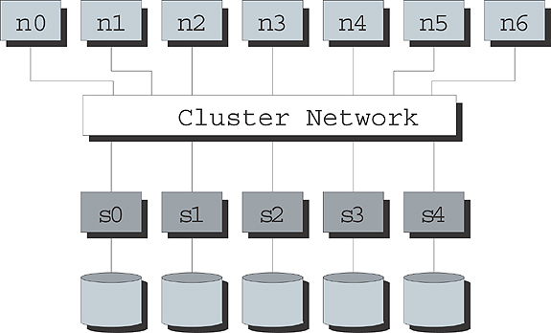
How do we handle server crashes?
Checkpointing: The state of long running apps should be saved regularly so that the computation can be recovered from the last saved state if failures occur
It usually take a long time to save state of CPU and memory-intensive apps
  Downtime could also be high
Parallel File System (PFS) can be a bottleneck and slowdown the entire system when saving state of multiple nodes simultaneously
From
Notes:
So, how do we handle server crashs? One of the most common techniques to provide fault tolerance is checkpointing. Checkpointing is a mechanism that save state of a running process regularly. If the server crashes, we can restart the process from the last checkpoint instead of from the beginning.
For a large application, the checkpoint and downtime time can be long due to large state info. Moreover, in a cluster, it is hard to checkpoint every node at the same time because the PFS can become a bottleneck.

Slide 5
What is Checkpointing?
Periodically Save Computation State to Persistent Storage for recovery if failures occur
Application-Level
Modify App
More works on development
Know exactly what to save
User Level
Link with Chkpt library
Depend on exe environments
Don’t have to recompile app
OS-Level
Modify Kernel
Depend on Kernel version
Can reuse executable
VM-Level
Modify Hypervisor
Must handle all VM state
Transparent to Guest OS/App
Linux/Hardware
Notes:
Checkpointing can be implemented in many levels. At the application-level, the programers have to incorporate the checkpointing mechanism into their codes. At user-level, app must be linked with a chekpointng library. This approach depend on a particular programming environment. The checkpointing mechanism can also be implentd in the OS kernel. However, the apps must rely on a particular kernel version to run. Finally, checkpointing mechanism can be implemented at the hypervisor level or vm-level. This level of implementation is highly transparent; however, it must deal with large amount of state information of the VM.

Slide 6
VM Checkpointing
Highly Transparent to Guest OS & Applications
Save all apps and execution environments
Techniques:
  Stop & Save [kvm]
  Copy on Write & Chkpt Thread [vmware ESXi]
  Copy to Memory Buffer [TLC 2009]
  Live replication to a backup host [Remus]
  Time-bound Live Checkpointing [TLC]
Notes:
VM checkpointing has two major advantages. First, it is highly transparent. You can checkpoint app running on MS windows or on Linux platforms. Second, when you check point a vm, you checkpoint every app that run on that machine at the same time. There are several technieqs for VM checkpoinitng.

Slide 7
1. Stop and Save
Stop the VM to save state to disk
Long Downtime and Checkpoint time
Saving to shared storage is necessary if want to restore on a new host
Saving to shared storage cause higher checkpoint time
VM
Hypervisor
Local or
Shared
Storage

Slide 8
2. Copy on Write
Hypervisor create a thread to scan memory and save unmodified pages
If VM modifies a page, hypervisor copy the original contents of that page to directly to disk
Can cause high downtime if large number of pages are modified in a short period of time
VM
Hypervisor
Local or
Shared
Storage
One memory
scan

Slide 9
3. Memory Buffer
Hypervisor create a thread to scan memory and save unmodified pages
Hypervisor stop VM to copy dirty pages to a memory buffer and write the buffer to disk later when checkpointing done
Need large amount of memory
VM
Hypervisor
Memory
One memory
scan
Local/
Shared
Storage

Slide 10
4. Replication
Hypervisor stop VM periodically to copy and sync state information with a backup host
Great for High Availability
Need to reserve resource on a backup host for the VM throughout its lifetime
VM
Source
Host
Backup
Host
Hypervisor
Memory
Local/
Shared
Storage

Slide 11
Time-bound Live Migration
TLC is based on the Time-bound, Thread-based Live Migration (TLM) [CCgrid 2014]
Basic Principles of TLM:
  TLM finishes within a bounded period of time,i.e., one round of memory scan
  Performs with best efforts to minimize downtime
  Dynamically adjust VM computation speed to reduce downtime by balancing dirty page generation rate and available data transfer bandwidth
Notes:
Our approach is based on the live migration mechanism that we have recently proposed at the Ccgrid 2014 conference, namely the TLM mechanism.
Live migration mechanism is the ability to capture a snapshot of VM state while the VM is running. TLM is based on 3 basic principles. First, the migration must be completed in a bounded period of time. This time is proportional to the size of VM memory. Second, it perform with best effort to minimize downtime. Finally, the TLM will adjust the computation speed of the VM to facilitate migration activities.

Slide 12
TLM Design
VM State Transfer
Add two threads to source hypervisor
  Mtx: scan entire ram
  Dtx: new dirty pages
Use two receiver threads to dest
Optimization
Manage Resource Allocation and handle downtime minimization
VM State Transfer
Downtime reduction
Notes:
In this picture there are two hypervisor running at the source nd destination of migration. The hypervisir on the source originally consist of an io-thread and a number of vcpu threads.
The TLM design consists of two part. The first part is the vm state transfer mechanism that add two new threads, the mtx and dtx threads in the picture, to the hypervisor architecture to handle data transfer between the source and destination of migration.
The first thread scan the VM memory and send the unmodified memory pages to the destination.
The second thread sends dirty pages or memory pages that have been modified to the destination.
After the the first thread finish sacnning the VM memory, the hypervisor will stop the VM and transfer the ret of dirty pages at once.
The second part is the resource management component that manage resource allocation and handle downtime minimization.

Slide 13
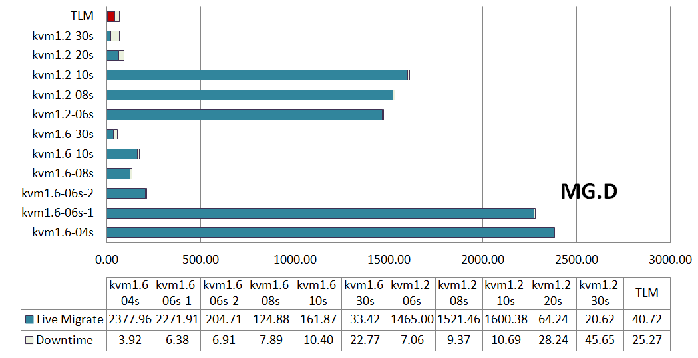
Kvm Migration and Downtime
(over a 10 Gbps network)
TLM
kvm-1.x-<tolerable downtime>
1. Hard to find right
tolerable downtime
2. Same param may cause very different migration behaviors
Notes:
In the experiment, we migrate a VM running MG class D using different tolerable downtime parameter. So, we found that if the tolerable downtime is too high, the migration will finish quiickly and have high downtime. But if we set it too low, the migration can take a long time. So, it is hard to find the right tolerable downtime value.

Slide 14
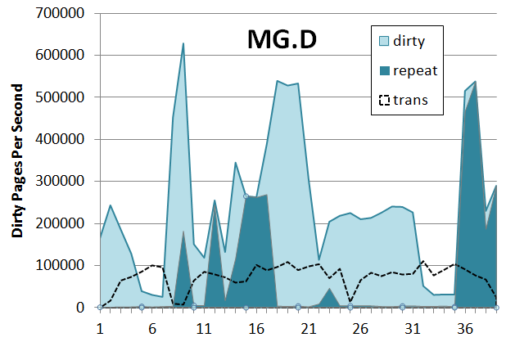
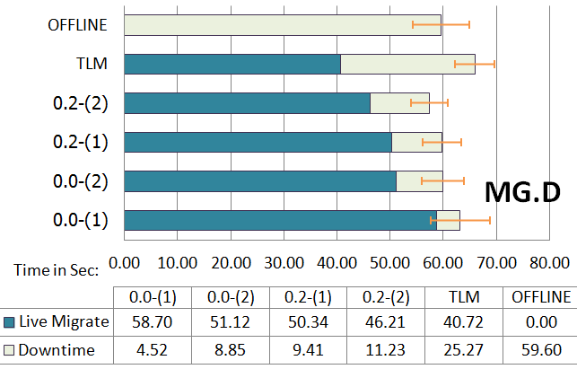
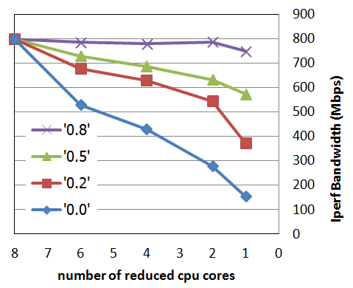
TLM:Kernel MG Class D
(1)
(2)
1 Gbps
network
  36GB VM Ram, 27.3GB WSS
  Low locality, 600,000 pages can be updated in one second but pages are transfer no more than 100,000 page/sec
  Reasonable Bandwidth
(3)
Notes:
In this slide, the right graph show dirty page genaration and transfer activities of the kernel MG benchamrk. Basically, the dirty page generation rate is much higher than the data transfer rate. You can see more detail in the paper. And, therefore, the downtime is high. But when we perform downtime minimization the downtime reduce significantly.

Slide 15
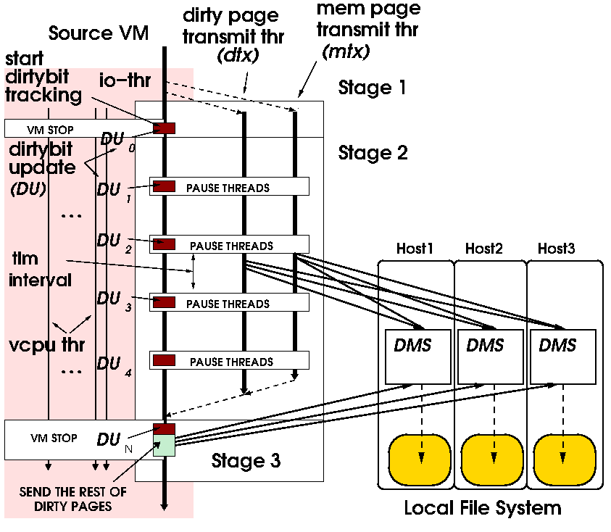
Time-bound Live
Checkpointing (TLC)
Based on TLM
Send state evenly to set of Distributed Memory Servers
Let each DMS saves the state to local disk when finish Stage 3
Each DMS can write state to PFS later
Perf: migtime + 1/3 of saving the entire VM state to local disk

Slide 16
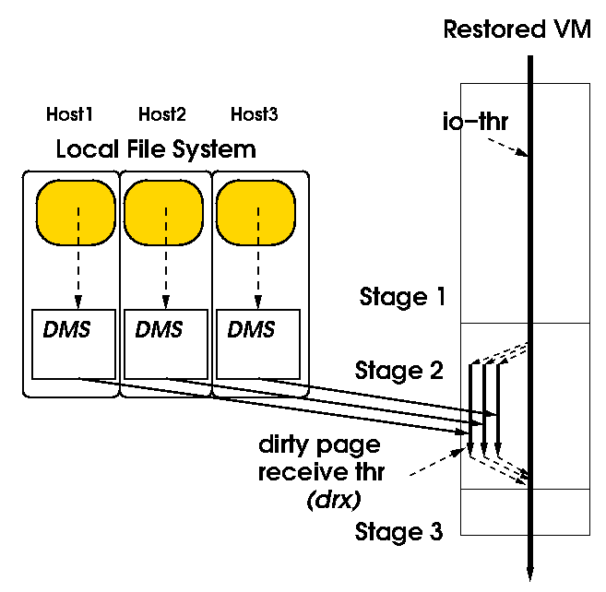
Time-bound Live
Checkpointing (TLC)
Based on TLM
Each DMS load state info from local disk
When the loading is done, send data simultaneously to the restored VM
The restored VM put the transmitted state info at the right place and resume computation
Perf: 1/3 of traditional VM restoration time

Slide 17
How do we make
TLC checkpointing scale?
Define a set of host, namely a circle
Let each host in the same circle takes turn to checkpoint while the rests help saving its state

Slide 18
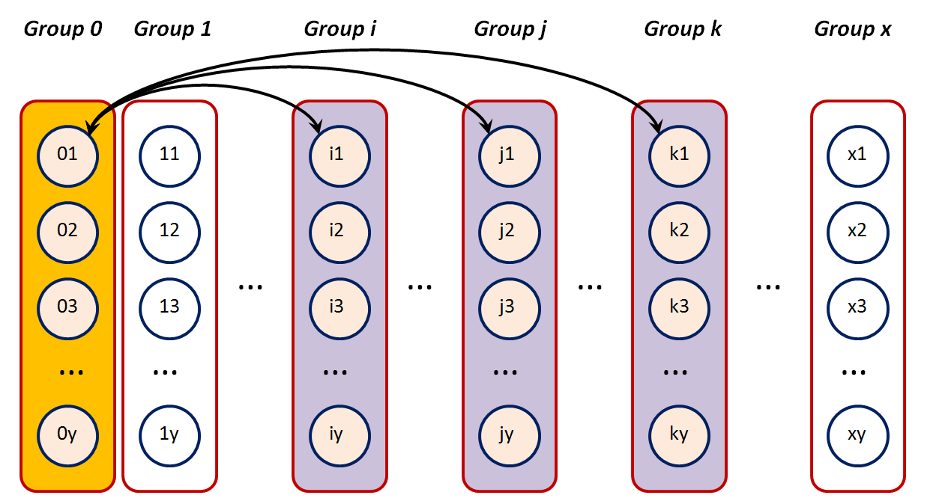
Scalable Checkpointing
Put each host in a circle into a separate group

Slide 19
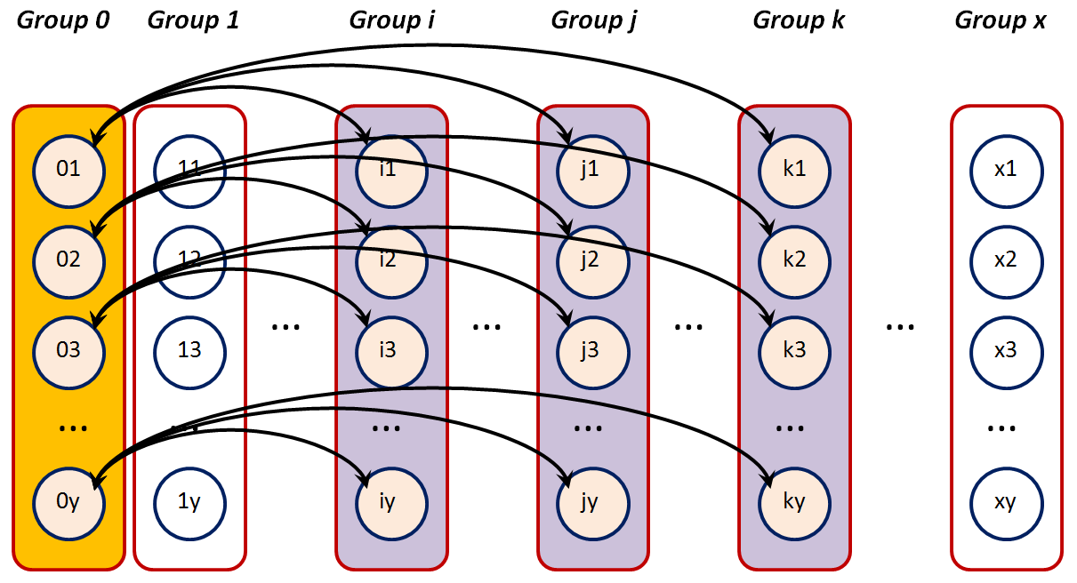
Scalable Checkpointing
VM on host in the same group chkpt at the same time
VMs in the same group could be communicating with one another

Slide 20
Scalable Checkpointing
VM on host in the same group chkpt at the same time

Slide 21
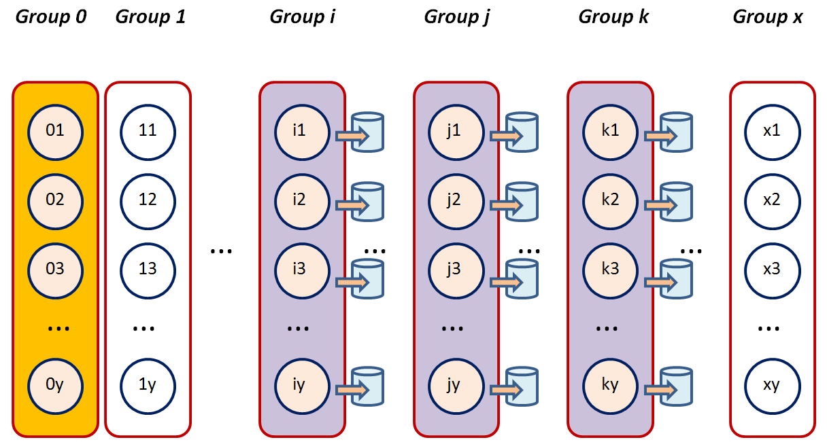
Scalable Checkpointing
Every DMS on a helping host save state to local disk

Slide 22
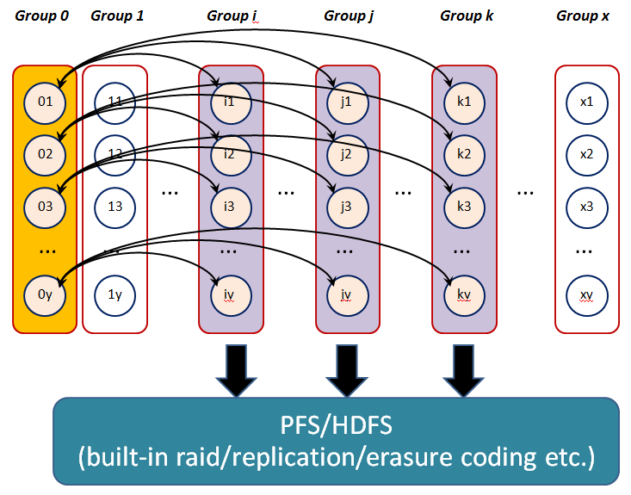
Scalable Checkpointing
DMS can later saves state to PFS

Slide 23
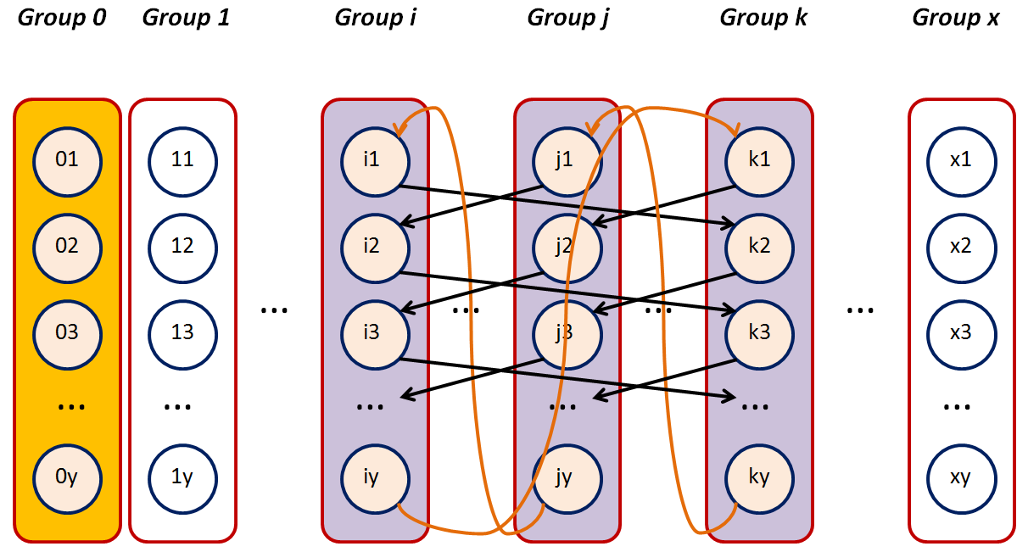
Scalable Checkpointing
Or, DMS can collaborate to replicate state information

Slide 24
Conclusion and Future Works
We propose a Time-bound Live Checkpointing (TLC) mechanism
  Finish in a bound time period (proportional to Ram size)
  Provide best effort downtime minimization
  Reduce dirty page generation rate to minimize downtime
We propose using a set of the Distributed Memory Server to speed up checkpointing time
We propose a method to perform checkpointing at a large scale
We have implemented TLC and DMS and conducted preliminary experiments
Next, we will evaluate the scalable checkpointing ideas
Thank you. Questions?

Slide 25
BACKUP

Slide 26
Experimental Setup
Each VM uses 8 vcpu
NAS Parallel Benchmark v3.3
  OpenMP Class D (and MPI Class D in paper)
VM migrate from source to dest computer
Two separate networks:
  10 Gbps for migration
  1 Gbps for iperf
Iperf fires from supporting computer
VM disk image of migrating VM is on NFS
Notes:
In our experimental setup, we use 3 opteron servers. They are the source computer, the destination computer, and the supporting computer in the picture. Then , we create a VM with 8 vcpus core. It runs a workload taken from the NAS Parallel benchmark on it. We tested both OpenMp and MPI versions but we wil present only the OPenMP version here. The VM migrate from the source computre in the picture to the destination computer. There are two separate netpwrk in our test bed. The migration is perform over a 10 gbps netwprk. And, the vm communcation use the 1 gps network. We assume that source and destination vm share the same VM imge over NFS.

Slide 27
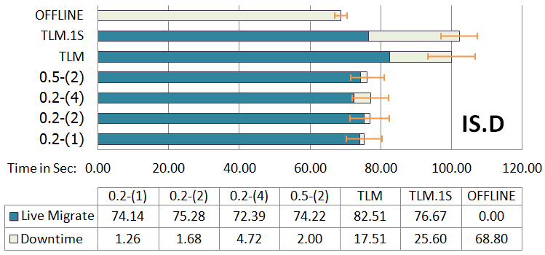
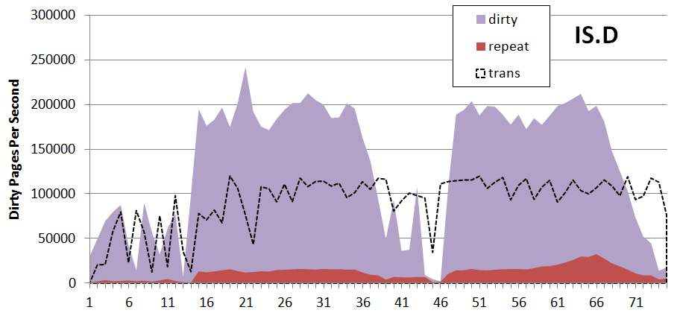
TLM Performance:
Kernel IS Class D
36GB VM Ram, 34.1GB WSS
Update large amount of pages continuously
VM page transfer rate is about half of dirty page generation
The migration tome of TLM and TLM.1S are close
TLM downtime is about 0.68 of that of TLM.1S
Notes:
Dtx can help reduce downtime around 32%.

