Slide 1

ITS - activities @ COMSATS Institute of Information Technology
Arshad Saleem Bhatti
Department of Physics
COMSATS Institute of Information Technology, Islamabad. PKISTAN
asbhatti@comsats.edu.pk

Slide 2
History
2010: Associate member of ALICE
2012: Collaboration board approved member status

Slide 3
Activities
Established a grid node for ALICE computing resources
Physics analysis group
Participation in the ITS – upgrade activities

Slide 4
Facilities
Device design (TCAD) and testing (electrical)
Device fabrication facilities for 4” wafer (mask aligner, RIE, Sputtering, E-beam evaporation, PECVD)
Characterization facilities: structural, electrical and optical
Radiation physics laboratory: HPGe detector, Autoscanner
RF laboratory for communication
PCB design and access to PCB fabrication (outside)

Slide 5
Activities for ITS
TCAD simulation studies of diodes used in MAPS (one such result shown by Magnus yesterday)
  Muhammad Fahad Bhopal Magnus Megar (CERN)
  Hira Khan Luciano Musa (CERN)
  Sujjiya Shaukat
  Arshad Bhatti
Test setup of serial Link Characterization using Virtex-6 (presently simulations)
  Jibran Ahmed Abbasi Antoine Junique (CERN)
  Hira Ilyas Luciano Musa (CERN)
  Madeeha Tajwar
  Attiq ur Rehman (left but still in touch)
Evaluation board for characterizing communication links using Virtex 6
  Raise Akram Antoine Junique (CERN)
  Fasih Butt

Slide 6
Activity I
TCAD simulation studies of diodes used in MAPS:

Slide 7
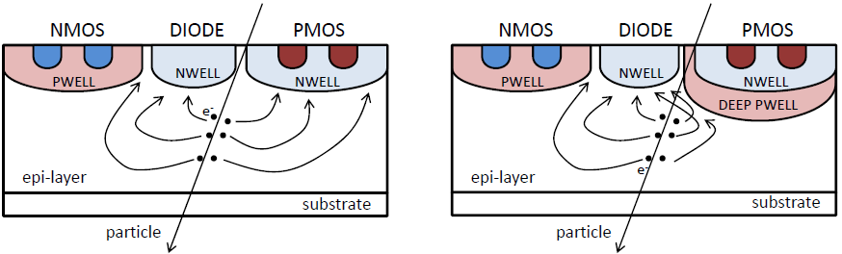
Explorer chips
To optimize the sensors
Monolithic Active Pixel Sensors using TowerJazz 0.18 μm CMOS Imaging Process
  High-resistivity epitaxial layer on p-type substrate
  Special deep p-well prevents the n-well containing PMOS transistors from collecting signal charge from the epitaxial layer and therefore allows full CMOS within the pixel.
MAPS standard CMOS (left) and MAPS with deep p-well(right).

Slide 8
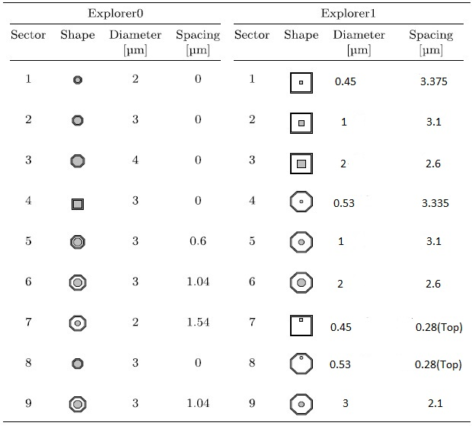
Diode geometries for Explorer chips

Slide 9
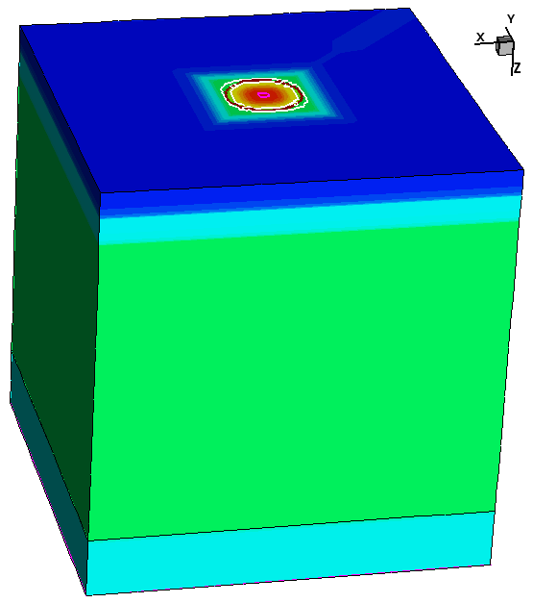
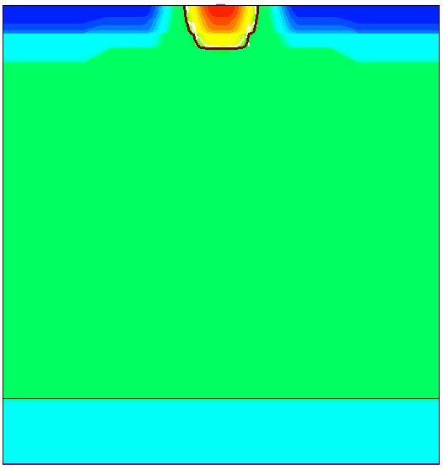
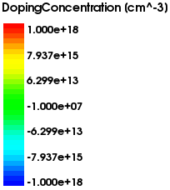
Explorer 1(Sector 1) and its parameters
P type doping, 1e18cm⁻³
Space, 3.375μm
2μm
N type doping, 1e18cm⁻³,
N doped width: 0.45μm,
N contact: 0.45 μm
18μm
21μm
P-type Epitaxial layer, 1e13cm⁻³
21μm
20μm
3μm
P-type Substrate, 1e15cm⁻³
20μm
20μm

Slide 10
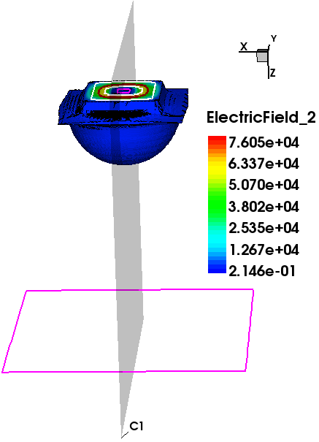
Electric field region
In diodes, the electric field resides only in the depleted region.

Slide 11
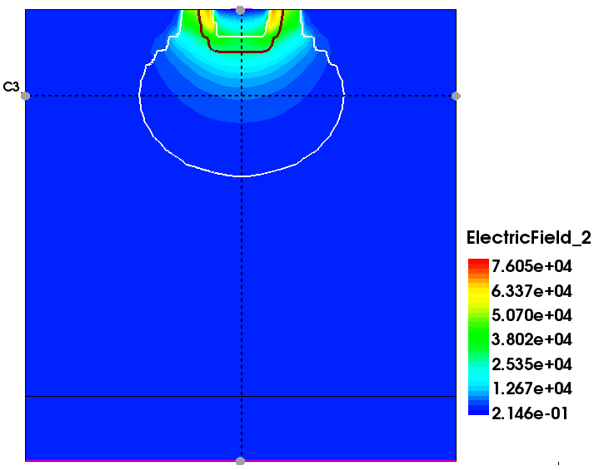
Process used to Calculate Depletion Region
The structure is symmetric, so the Electric field will be maximum at its center.
A 2D plane from the center of the 3D structure was extracted.

Slide 12
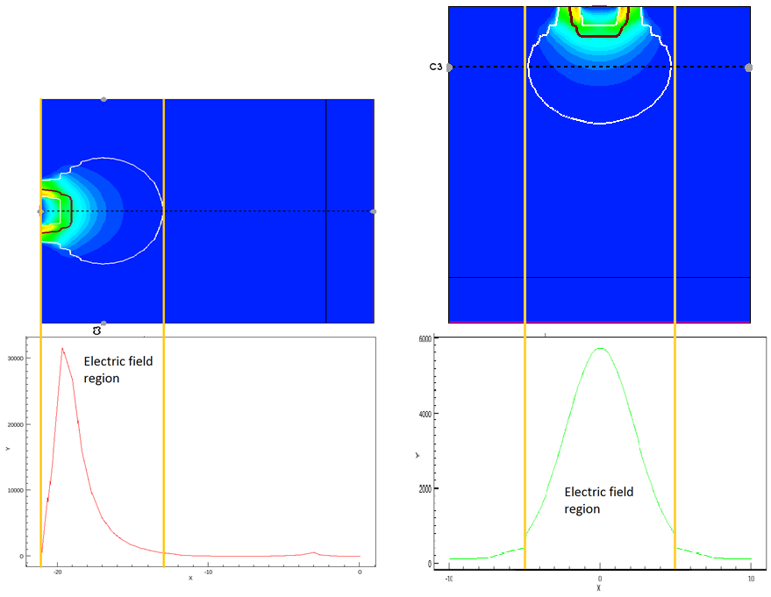




Data Extraction
$$r_{x}$$
$$=$$
$$r_{y }$$
$$r_{z}$$

Slide 13

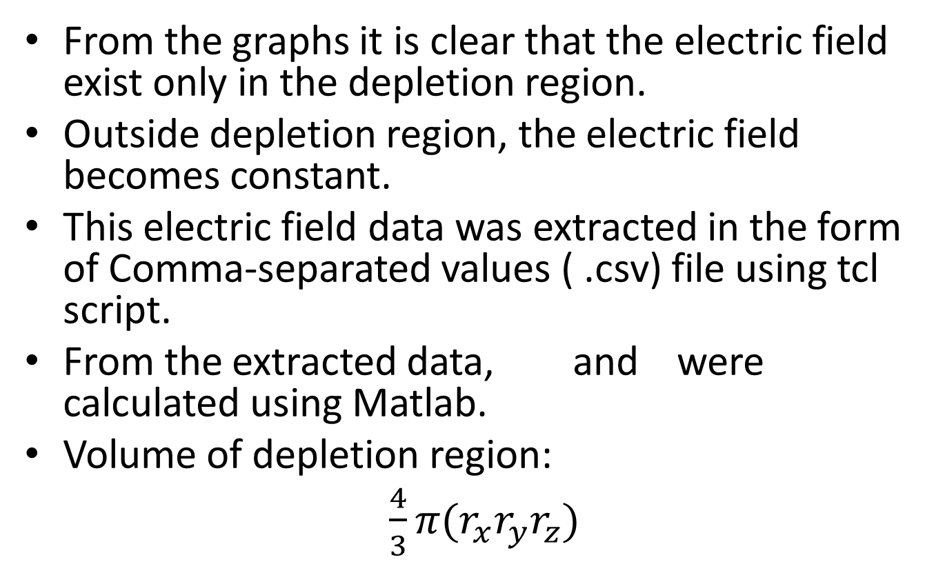


Data Extraction
From the graphs it is clear that the electric field exist only in the depletion region.
Outside depletion region, the electric field becomes constant.
This electric field data wasextracted in the form of Comma-separated values ( .csv) file using tcl script.
From the extracted data, and were calculated using Matlab.
Volume of depletion region:
$\frac{4}{3}π{(r}_{x}r_{y}r_{z})$
$$r_{x}$$
$$r_{y }$$
$r_{z}$

Slide 14
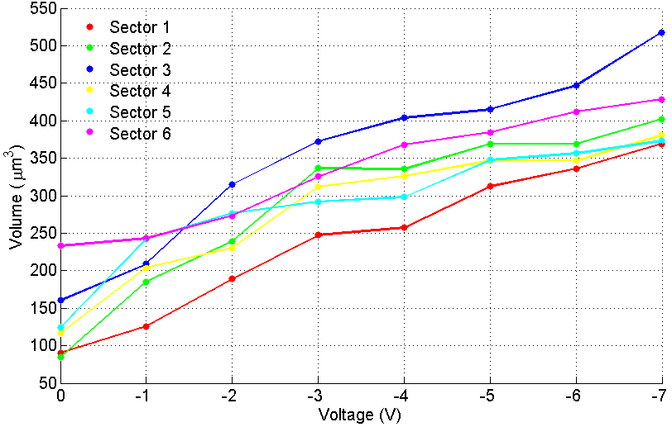
Volume comparison of different sectors of Explorer-1 chip using Electric field data

Slide 15
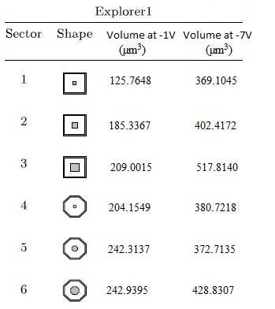
Summary

Slide 16
Activity II
Test setup of serial Link Characterization using Virtex-6

Slide 17
Nature of Work
Multiple clocks and phase shifts generation.
BER, jitter analysis and crosstalk characterization based on multiple clocks and variable phase shift.
GUI based computer interface and integration of the whole system.
Serial link characterization with different standards (LVDS, MVDS, CMOS, etc.)

Slide 18
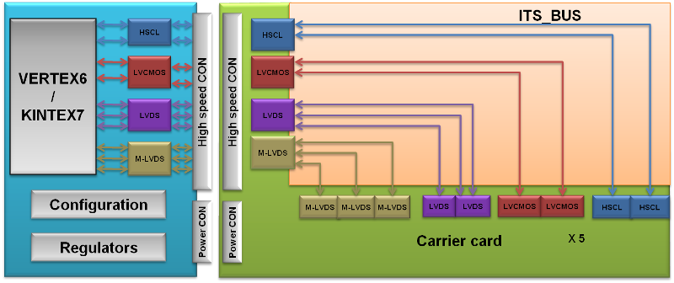
Univgersal picture

Slide 19
Characterization of high speed serial data links at Gbps
Understanding the different High speed data transmission standards
  Study of Xilinx VERTEX 6 & KINTEX 7 working.
  Study of Giga bit transceivers of VERTEX 6 & KINTEX 7.
  Study of LVDS and MLVDS standards and their configuration.
  Study of LVCMOS and HSCL standards and their configuration.
Implementation status
  Design for the Development board using VERTEX 6 & KINTEX 7.
  Schematic capturing for the development board.
  Component creation for the development board.
  Interfacing LVDS and MLVDS data buses with development board.
  Interfacing LVCMOS and HSCL data buses with development board.
Performance analysis and comparison
Each high speed standard and it configuration.
Implement the best and desired high speed standard for ALICE ITS bus serial link (hopefully in time).

Slide 20
IBERT
The ChipScope™ Pro Integrated Bit Error Ratio Tester (IBERT) core for Virtex-6 GTX transceivers is a customizable core that can be used to evaluate and monitor the health of Virtex-6 GTX Transceivers. The design includes pattern generators and checkers implemented in FPGA logic, as well as access to the ports and dynamic reconfiguration port (DRP) attributes of the GTX transceivers. Communication logic is also included, to allow the design to be runtime accessible through JTAG. The IBERT core is a self-contained design, and when it is generated, will run through the entire implementation flow, including bit-stream generation.
Software Requirements
Core Generator
Chip-scope Pro Analyzer
Hardware Requirements
Virtex-6, ML605
SMA Cables

Slide 21
Madiha’s tasks
Characterization of bit error rate (BER)
Generate clocks with different phase shifts, and
Different frequencies using clocking wizard to characterize BER.

Slide 22
DATA FLOW DIAGRAM
Clocking Wizard
(Phase shifted clocks, and reference clock)
rst
Ref_clk
clk
Clocking Wizard
(Phase shifted clocks
Counter Generator
(Every time Push Button is pressed,
phase is shifted,
phase resolution is variant)
PB_x2
PB_x4
IBERT Core
PB_shift
Clocking Wizard
(Phase shifted clocks
Clocking Wizard
( x2 , x4… frequency generator)

Slide 23
Current Status
Shifted clocks generated dynamically with resolution upto 50 degree for 50MHz clock, frequency multiplied with 2 and 4 (achieved)
Generating shifted clocks dynamically with enhanced resolution to 15 degree (accomplished).
Work in progress
To increase resolution as much as possible and generate maximum shifted clocks to characterize BER.
To increase clock frequency upto 1 GH.

Slide 24
Hira Ilyas’s tasks
Logical characterization using detection of bit error rate through IBERT

Slide 25
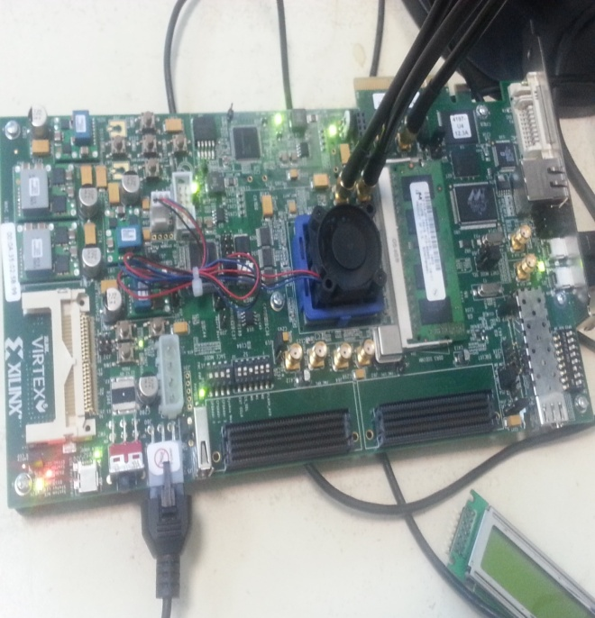
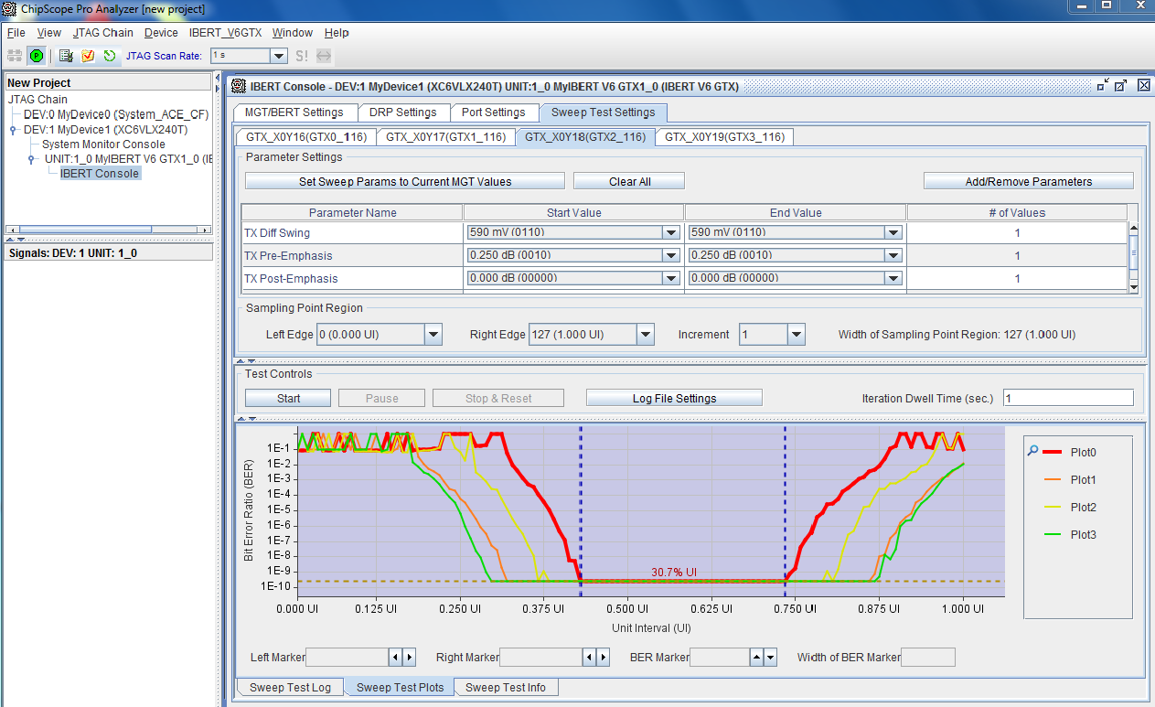
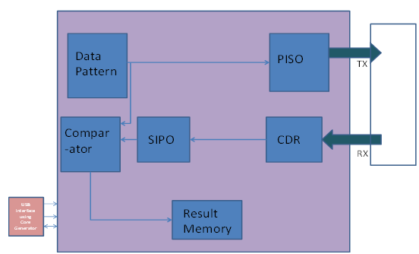
Accomplished tasks
Implementation of bit error rate tester on Xilinx – ISE version 14.2.
Bit Error Rate testing with IBERT.
BERT
Hardware Setting For
IBERT
BER Through IBERT
NEST STEP (in progress):
Detection of BER using clock of different frequencies and phase shifts.

Slide 26

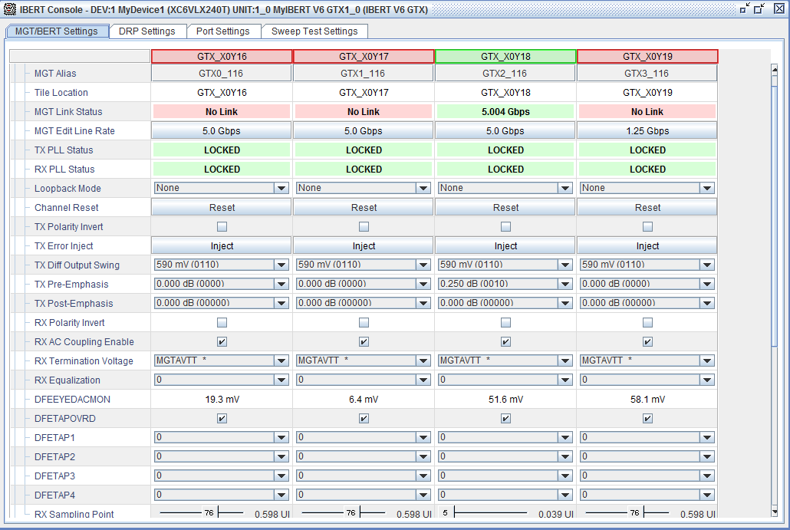
Hardware Setup and Initial Settings
Hardware setup
IBERT Initial Settings

Slide 27
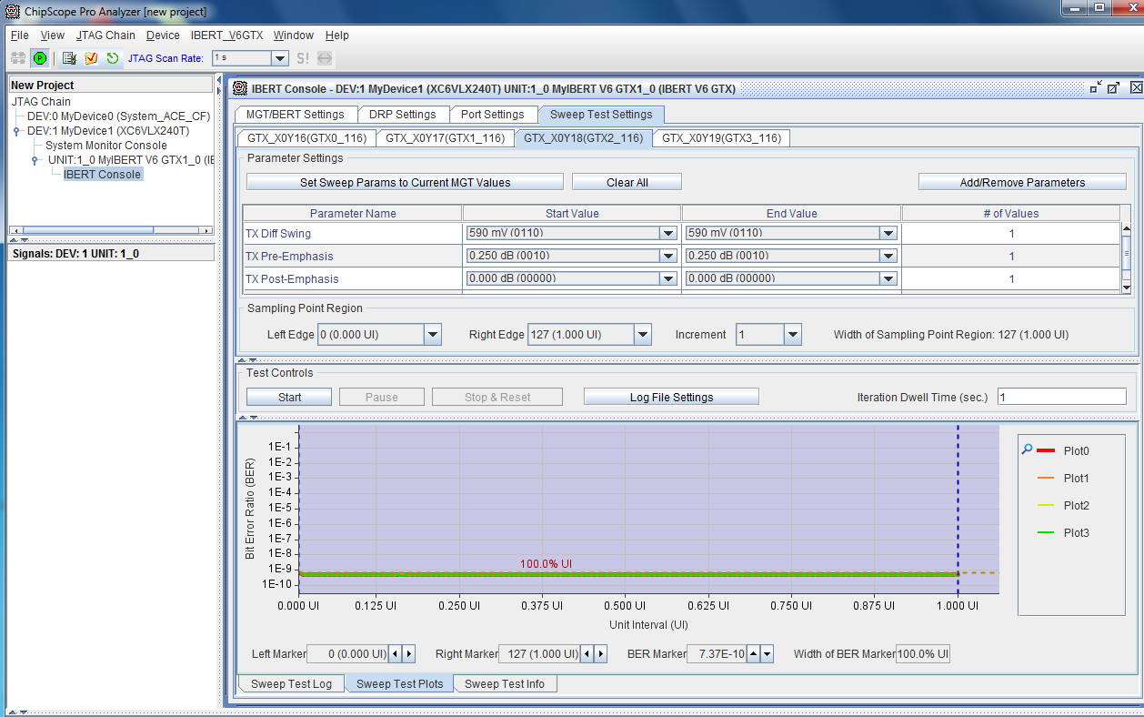
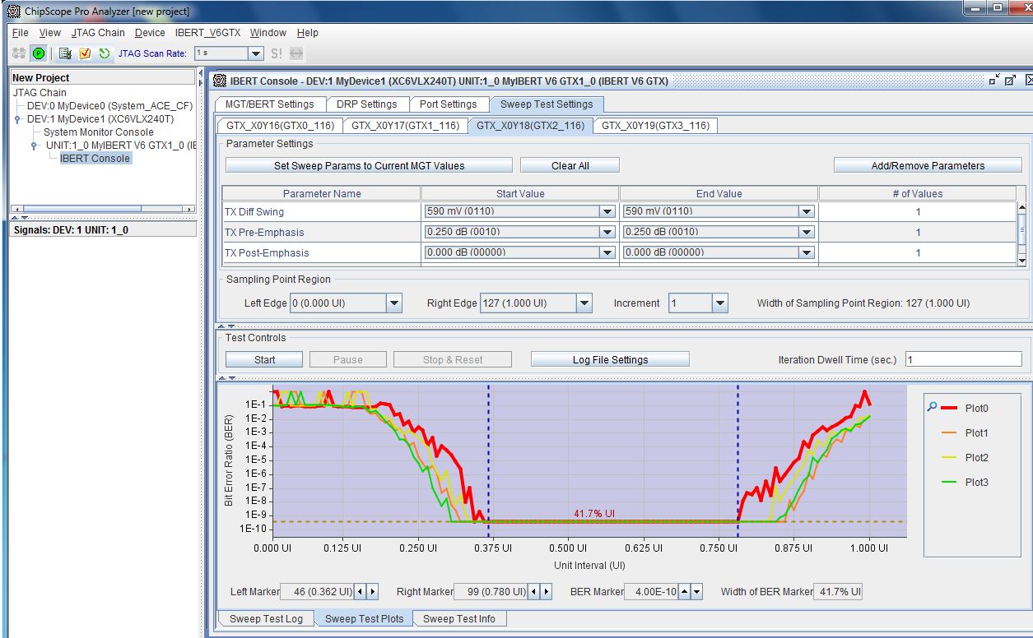
Bathtub curves to calculate bit error rate
Line rate: 2.5 Gbps
Line rate: 3.125 Gbps
Line rate: 5Gbps
It can be observed from the above figures that if the line rate is increased from 2.5 gbps to 5 gbps the bit error rate also increasesd.

Slide 28
Future Work
Next Step is to calculate Bit Error rate by giving different phase shifts to clock

Slide 29
Jibran’s tasks
Integration of the system,
Development of GUI and FPGA bpard – PC communication using USB, and
The serial link characterization

Slide 30
Integration of the system
FPGA-Computer interface using USB
Clock speed and phase shift selection
BER and Jitter Testing for every clock
Store and compare results in computer
Bath tub curve and Eye diagram analysis for every clock frequency .
Future work:
→Bitrate up to multi Gbps

Slide 31

Test setup Overview
RESULT UNIT
Error/status register/
memory
LINK
Configuration
Carrier card
Clock
Manager
Logical and physical characterization block
High speed CON
High speed CON
Address/
Command decoder
USB interface using
Core
Generator
Configuration test block register
USB INTERFACE
FPGA

Slide 32







Complete System overlook (GUI)
BER
BER
BER
JITTER
Phase
JITTER
10⁰
20⁰
30⁰
45⁰
Channel Select
1 2 3 4 5 6 7 8 9
Periodic
Frequency
Pattern
Duty Cycle
100 MHZ
200 MHz
300 MHz
400MHz
Fixed Random
CHIP
SELECT
2 3
4 5 6
5
Cross Talk on channel
1 2 3 4 5 6 7 8 9
7 8 9
Cross talk Pattern
Random Worst case

Slide 33
Work in progress and future Work
To give shifted clock as input to the IBERT core for fatigue test.
Check BER through Chip scope Pro Analyzer.
To determine the upper frequency limit using clocking wizard.

Slide 34
Activity III
Evaluation Board For ALICE ITS SYSTEM USING VERTEX 6
Syed Raise Akram
COMSATS ISLAMABAD

Slide 35
Design Details of Evaluation Board
  Virtex-6 XC6VLX240T-1FFG1156 FPGA
  128 Mb Platform Flash XL
  32 MB Linear BPI Flash
  USB JTAG
  Clock Generation
  Multi-Gigabit Transceivers (GTX MGTs)

Slide 36
Design Details of Evaluation Board
  10/100/1000 Tri-Speed Ethernet PHY
  USB-to-UART Bridge
  USB Controller
  Status LEDs
  Switches
  Power Management
  Configuration Options

Slide 37
  Clock Generation
    Oscillator (Differential).
    Oscillator Socket (Single-Ended, 2.5V).
  Multi-Gigabit Transceivers (GTX MGTs)
    The Evaluation board provides access to 20 MGTs.
    All of MGTs are wired to high speed connectors.
  10/100/1000 Tri-Speed Ethernet PHY
    The Evaluation board utilizes the onboard PHY device for Ethernet communications at 10, 100, or 1000 Mb/s.
    The board supports MII, GMII, RGMII, and SGMII interfaces from the FPGA to the PHY.

Slide 38
  USB-to-UART Bridge
    The Evaluation board contains a Silicon Labs CP2103GM USB-to-UART bridge device.
    Allows connection to a host computer with a USB cable.
  USB Controller
    The Evaluation Board provides USB support via a Cypress CY7C67300 Programmable Embedded USB Host and Peripheral Controller.
  Status LEDs
    Ethernet PHY Status LEDs
    FPGA INIT and DONE LEDs

Slide 39
  Switches
    Power On/Off Slide Switch
    PROG Switch
    RESET Switch
  Power Management
    AC Adapter and Input Power Jack/Switch.
    Onboard Power Regulation.
  Configuration Options
    128 Mb Platform Flash XL
    32 MB Linear BPI Flash
    USB JTAG

Slide 40
Design Work
Symbol Creation
  Examples

Slide 41
Design Work
Foot Print Creation
  Examples

Slide 42
Design Work
Schematic Design
  Example

Slide 43
Future task commitments
TCAD simulations:
  Charge collection efficiency
  Capacitance measurements
  Radiation damage by introducing static charges in the oxide layers
Read out electronics:
  Serial link characterization: simulation and testing
  Board characterization
    (waiting for the ordered equipment to arrive to set up testing platform)
Would like to develop collaborative links with Asian colleagues for sensor chip characterization

Slide 44
THANKS

