Slide 1
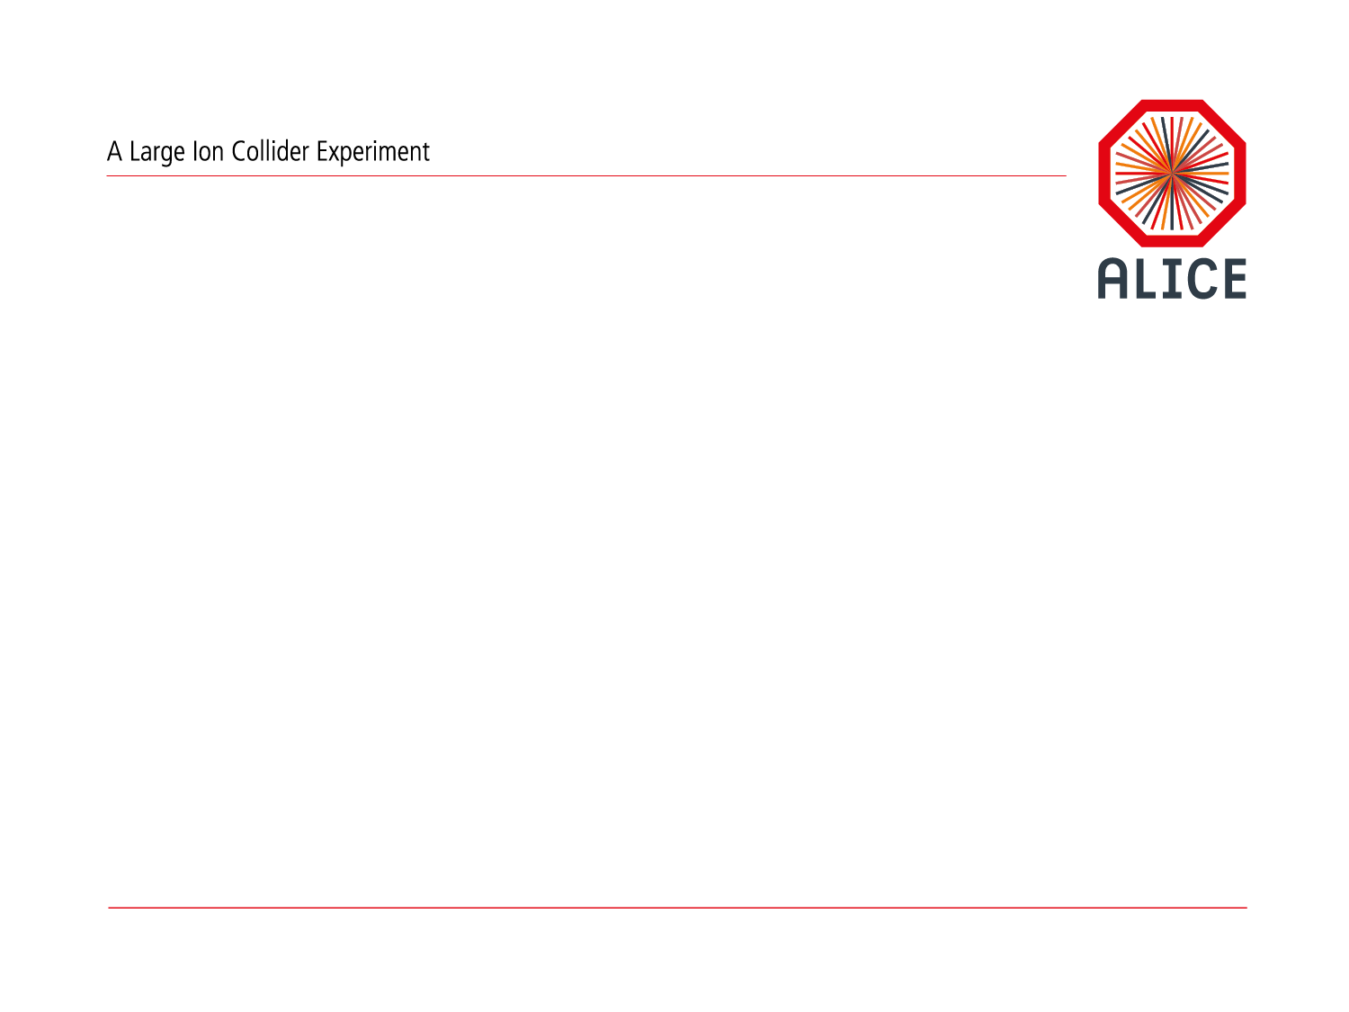
Software Framework Development
P. Hristov for CWG13

Slide 2

CWG13 Objectives (P. Vande Vyvre, 24/03/2014)
Design and development of a new modern framework targeting Run3 (CWG1-CWG12)
Should work in Offline and Online environment
  Has to comply with O² requirements and architecture
Based on new technologies
  Root 6.x, C++11
Optimized for I/O
  New data model
Capable of utilizing hardware accelerators
  FPGA, GPU, MIC…
Support for concurrency in an heterogeneous
and distributed environment
Based on ALFA - common software foundation jointly developed between ALICE & GSI/FAIR
Strong collaboration with the other CWGs
ALFA
Common Software Foundations
O²
Software
Framework
FairRoot
PandaRoot
CbmRoot

Slide 3
Running an online system for physics data processing
Some technical challenges
Data transport Cluster infrastructure File systems and package distribution Access of large data sets Process orchestration
Some algorithmic challenges
Fast algorithms Scalable processing instances Data model
Some collaborative challenges
Combination of computer scientists (online) and physicists (offine)
M.Richter

Slide 4
Design considerations
Some questions to be answered at the beginning => prototype
  Target data rate: Pb-Pb recorded luminosity ≥ 10 nb⁻¹ => 8 x 10¹⁰ ev., pp (@5.5 Tev) recorded luminosity ≥ 6 pb⁻¹ => 4.2 x 10¹¹ ev. 50kHz Pb-Pb interaction rate, x100 increase
  Data/event dropping policy
Physics objectives (ALICE advantages: PID, detection @ low PT)
  Measurement of heavy-flavor transport parameters
  Measurement of low-mass and low-P_{T} di-leptons
  J/ψ , ψ’, and χ_{c} states down to zero transverse momentum
  Jet quenching and fragmentation
  Heavy-nuclear states
Developer community: try to extend it!
Hardware platforms: where is the project running in development, test, and production mode?
Use cases: collect all! use cases together with the detector groups
Functionality: What is the system supposed to do? Everything? NO! Focus on concrete use cases within an open architecture
Trigger system: does it support online data filtering at all?
M.Richter

Slide 5
ALFA & O²: Design constrains
Highly flexible:
  different data paths should be modeled.
Adaptive:
  Sub-systems are continuously under development and improvement
Should work for simulated and real data:
  developing and debugging the algorithms
It should support all possible hardware where the algorithms could run (CPU, GPU, FPGA)
It has to scale to any size! With minimum or ideally no effort.
No separation between Online and Offline
=> A message queue based system would:
  Decouple producers from consumers.
  Spread the work to be done over several processes and machines.
  We can manage/upgrade/move around programs (processes) independently of each other.
  Use multi-processing and multi-threading
M.Al-Turany

Slide 6


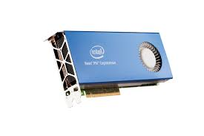

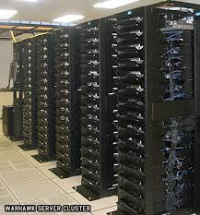
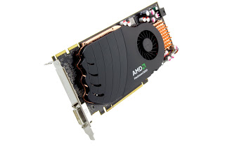
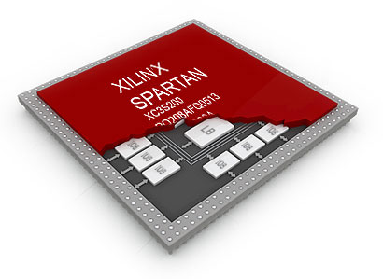
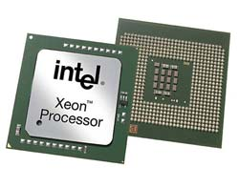
ALFA will use ZeroMQ to connect different pieces together
A very lightweight messaging system specially designed for high throughput/low latency scenarios
Zmq supports many advanced messaging scenarios
BSD sockets API
Bindings for 30+ languages
Lockless and Fast
Automatic re-connection
Multiplexed I/O
M.Al-Turany

Slide 7
ALFA & FairRoot
AliRoot6 (O²)
CbmRoot
R3BRoot
SofiaRoot
MPDRoot
PandaRoot
AsyEosRoot
FopiRoot
EICRoot
ALFA
FairRoot
????
DDS
Building configuraion
Testing
Fair MQ
Fair DB
MC Application
Module
Detector
Magnetic Field
Event
Generator
Runtime DB
Libraries and Tools
Protocol Buffers
BOOST
ROOT
ZeroMQ
CMake
Geant4
Genat4_VMC
Geant3
VGM
…
M.Al-Turany

Slide 8
The Dynamic Deployment System
(DDS) Should:
Deploy task or set of tasks
Use (utilize) any RMS (Slurm, Grid Engine, … ),
Secure execution of nodes (watchdog),
Support different topologies and task dependencies
Support a central log engine
….
First test release is expected this month
More discussions during the Alice Offline Week in June 2014
See also the talk by Anar Manafov @ Alice Offline week (March 2014)
https://indico.cern.ch/event/305441/
M.Al-Turany

Slide 9
Serialization
Support for Protocol buffers is implemented
  Example in Tutorial 3 in FairRoot
Boost
  Code portability - depend only on ANSI C++ facilities.
  Code economy - exploit features of C++ such as RTTI, templates, and multiple inheritance, etc. where appropriate to make code shorter and simpler to use.
  Independent versioning for each class definition. That is, when a class definition changed, older files can still be imported to the new version of the class.
  Deep pointer save and restore. That is, save and restore of pointers saves and restores the data pointed to.
http://www.boost.org/doc/libs/1_55_0/libs/serialization/doc/index.html

Slide 10
/local/home/cwg13/new_test_21.05.2014/single/startAll.sh
aidrefma04
EPN
EPN
EPN
EPN
EPN
FLP
EPN
EPN
EPN
EPN
EPN
EPN
EPN
aidrefma06
aidrefma08
aidrefma02
EPN
FLP
EPN
EPN
EPN
EPN
EPN
EPN
EPN
aidrefma01
EPN
EPN
aidrefma03
EPN
EPN
aidrefma05
aidrefma07
M.Al-Turany

Slide 11
Simplified Online Processing Scheme
First Level
Processor
Event Processing
Node

Slide 12
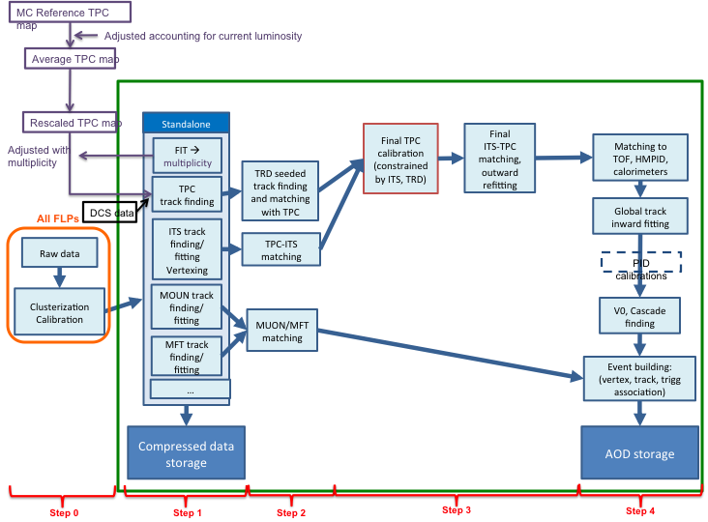
Processing Scenarios
Calibration/reconstruction

Slide 13
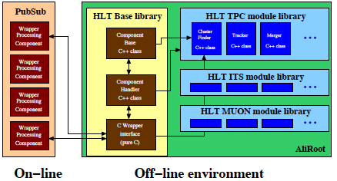
Reusing existing code
Wrapper for the HLT algorithms
HLT component implemented in shared libraries, identified by library name, component id, and component parameters
  SystemInterface Interface to libHLTbase and the external ALICE HLT interface all ALICE libraries loaded at runtime
  WrapperDevice inherits from FairMQDevice and implements the data block handling for ALICE HLT components, uses SystemInterface
M.Richter

Slide 14
Wrapper for the HLT algorithms
Current status
First version of the Wrapper device released
Successful small-scale test on a single 8-core machine
Ready for extensive testing and usage in the data transport prototype
Ready for profiling and further optimization of both framework and reconstruction code
Possibility to use the Run1 raw data with the current prototype
M.Richter

Slide 15
The CDB for Run 3
O² CDB
"First pass" (a)synchronous reconstruction will be done at the O² farm
  => moving from offline to online most accesses to CDB objects
Online timeframe-based calibration
  => x10³ rate of read/write accesses?
Access frequencies and characteristics will strongly differ between online parallel processes and offline distributed processes
 | online | offline
f_{write} | high ~(10⁻¹)s | low
f_{read} | high ~(10⁻¹)s | low
max latency | short ~(10⁻¹)ms | long
replication | no | yes
predictable access | yes | no
R.Grosso

Slide 16
Short & Mid term tasks
O² Prototype
Refine the data transport model
Test existing HLT algorithms with Run1 raw data
  Include the existing demonstrators (CWG5) in the chain
Implement the first version of Run3 raw data format (continuous readout for TPC & ITS, together with CWG4)
  Convert Run1 raw data to Run3 format
  Run3 format from MC
Adapt the existing algorithms and develop new ones for the Run3 raw data format (together with CWG5, CWG6, CWG7)

Slide 17
Short & Mid term tasks
O² Prototype
Simulation (together with CWG8)
  Geant4 validation
  VMC support for multithreaded Geant4 simulation
  Detector description
  Fast simulation
Calibration (together with CWG6)
  Design of the new calibration DB
  Calibration algorithms
Performance studies and optimization
  Provide input for the TDR

