Slide 1
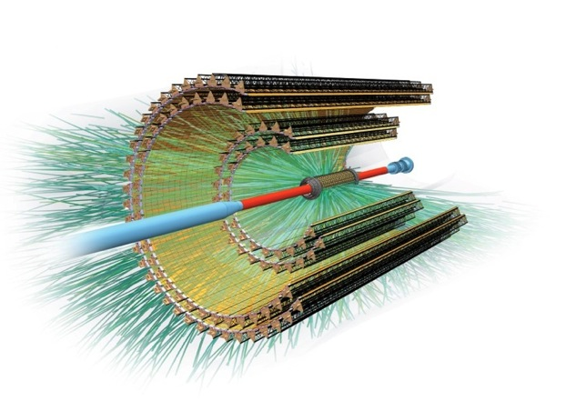
Module and Stave Assembly
Krabi, 16 June 2014
V. Manzari – INFN/Bari & CERN
ALICE ITS upgrade and O2 Asian Workshop 2014 @ Thailand

Slide 2

Outline
Detector layout overview
Module assembly procedure
Stave assembly procedure
Automatic Module Assembly System

Slide 3
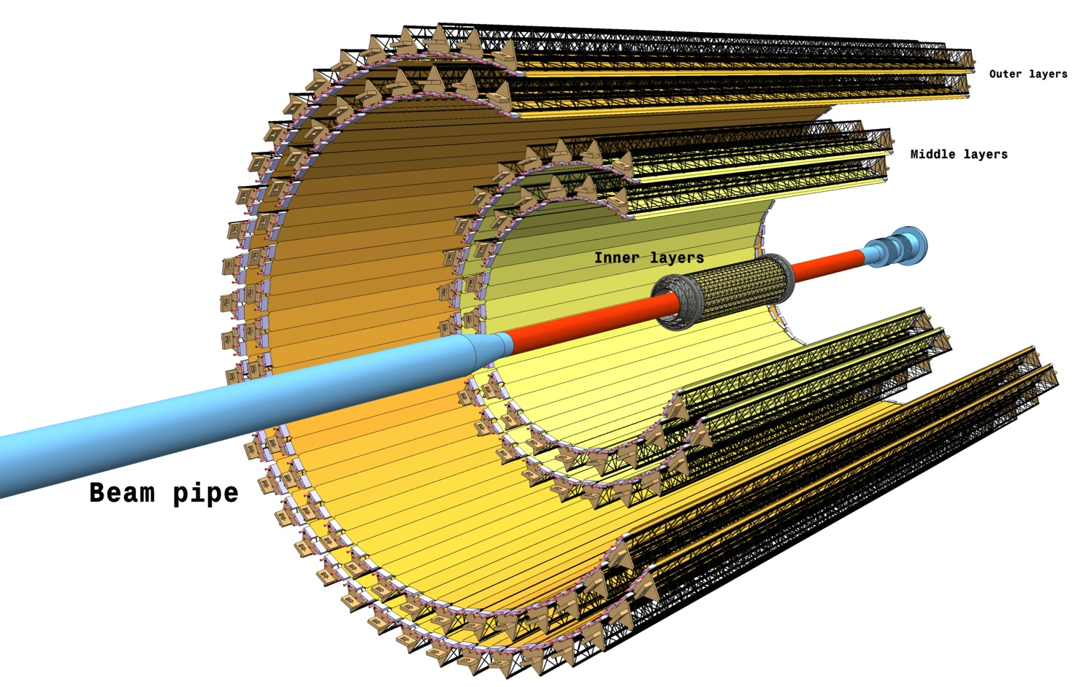
The New Inner Tracking System
7 layers of Monolithic Active Pixel Sensors
12.5 G-pixel (~10 m²)
r coverage:
22 – 400 mm
η coverage: |η| ≤ 1.22
for tracks from 90% most luminous region
700 krad/ 1x10¹³ 1 MeV n_{eq}
includes safety factor 10

Slide 4
Detector Layout Overview
Stave: The ITS layers are azimuthally segmented in Staves, which are mechanically independent. Staves are fixed to a support structure, half-wheel shaped, to form the Half-Layers.
Space Frame: truss-like lightweight mechanical support structure for the single stave based on composite material (carbon fiber).
Cold Plate: carbon ply that embeds the cooling pipes.
Module or Hybrid Integrated Circuit (HIC): assembly consisting of the polyimide Flexible Printed Circuit (FPC) on which the Pixel Chips (1 x 9 for IB and 2 x 7 for OB) and some passive components are bonded.
Half-Stave: the Stave of the Outer Barrel is segmented in azimuth in two halves, named Half-Stave. Each Half-Stave is further segmented longitudinally in a number of modules (4 for ML and 7 for OL) glued on a common cooling unit.

Slide 5
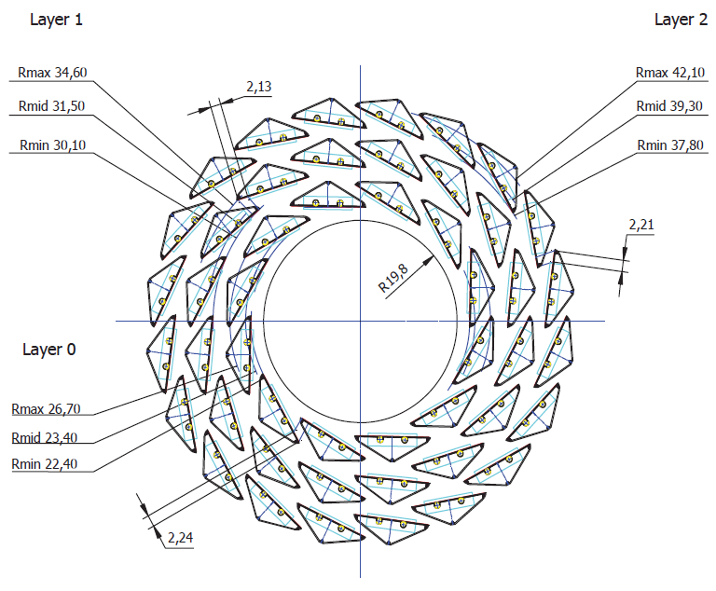
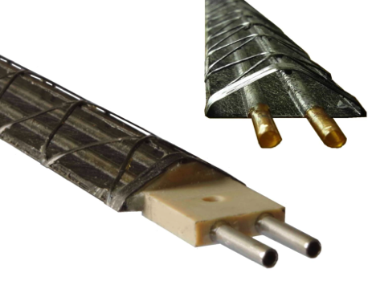
Inner Barrel
Inner Barrel Stave
Inner Barrel (IB): 3 Inner Layers
Radial position (mm): 23, 31, 39
Length in z (mm): 271
Nr. of staves: 12, 16, 20
Nr. of modules/stave: 1
Nr. of chips/module: 9
Nr. of chips/layer: 108, 144, 180
Material thickness: ≤ 0.3% X₀ per layer
Stave weight
~ 1.4 grams

Slide 6
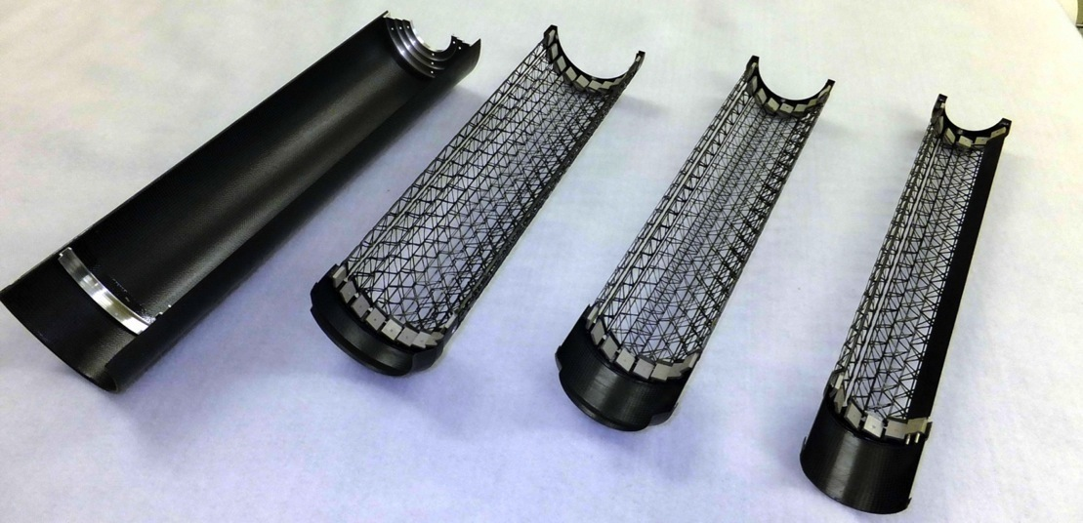
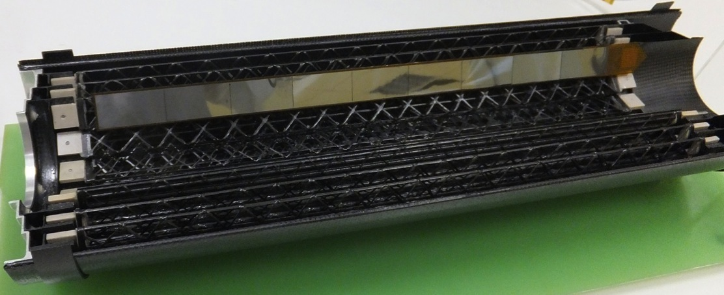
Inner Barrel: full-scale prototypes of the mechanical structures
Layer 0
Layer 1
Structural Sandwich
Layer 2

Slide 7
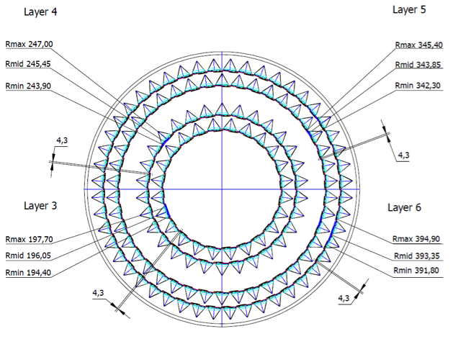
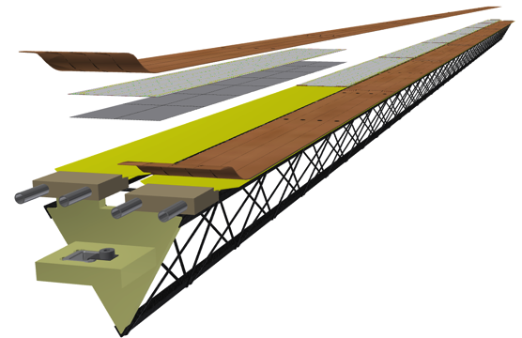
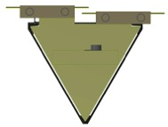
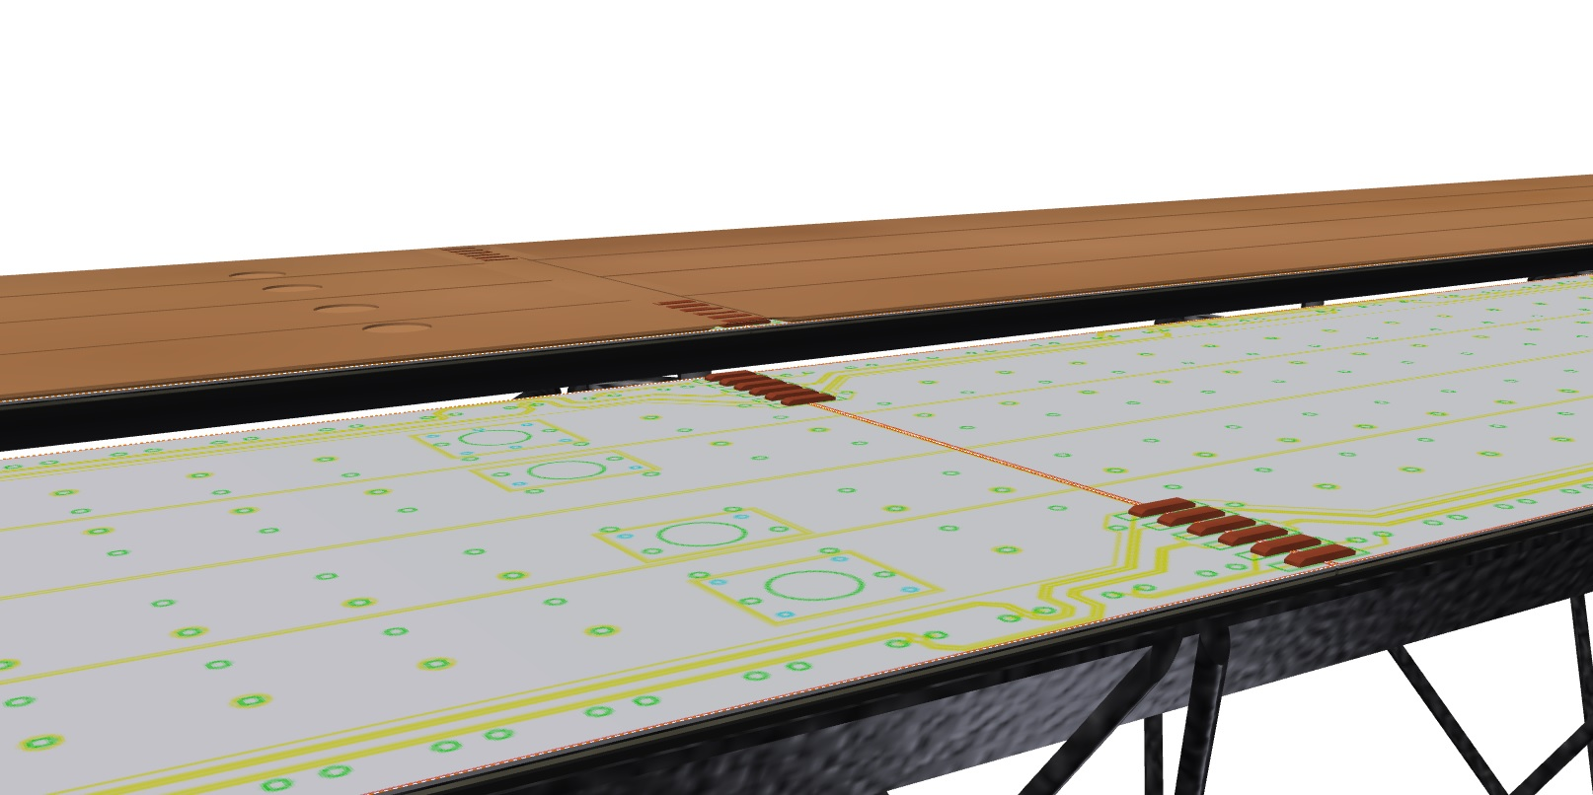
Outer Barrel
Outer Barrel Stave
Power Bus
Module:
Half-Stave
Flexible Printed Circuit
Half-Stave
2x7 Pixel Chips
Cold Plate
Space Frame
Half-Stave Left
Half-Stave Right
Outer Barrel (OB): 2 ML + 2 OL
Radial position (mm): 196, 245, 344, 393
Length in z (mm): 843, 1475
Nr. of staves: 24, 30, 42, 48
Nr. of half-staves/stave: 2
Nr. of modules/half-stave: 4 (ML), 7 (OL)
Nr. of chips/module: 14
Nr. of chips/layer: 2688, 3360, 8232, 9408
Material thickness: ~ 0.9% X₀ per layer
Module to Module and Power Bus connections

Slide 8
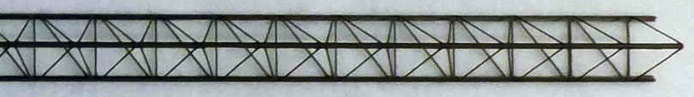
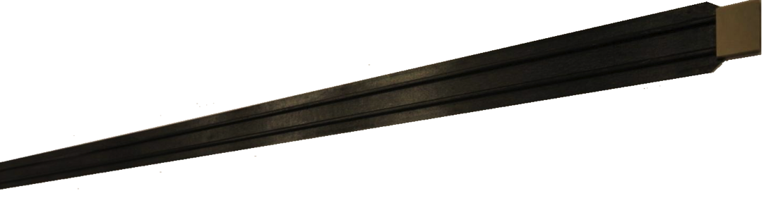
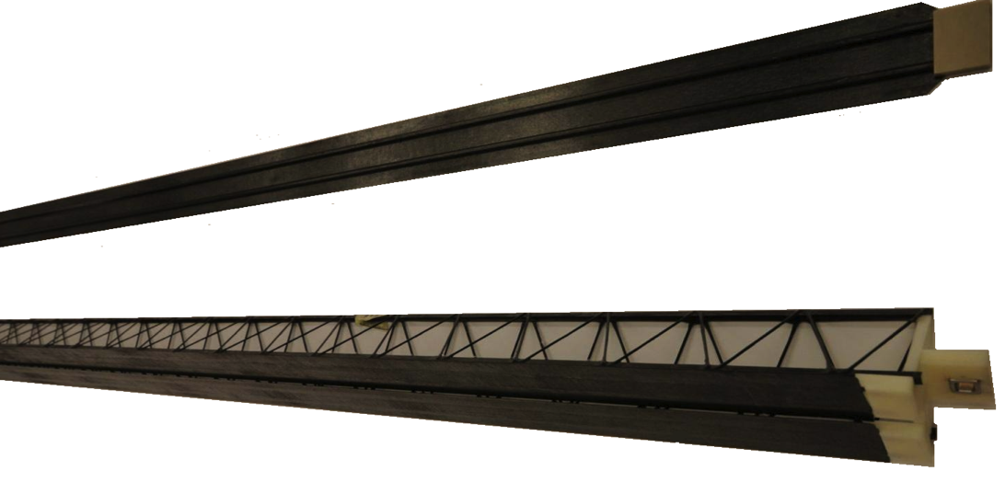
Outer Barrel: full-scale prototypes of the mechanical structures
Space Frame
Cold Plates
Space Frame + Cold Plates

Slide 9

Construction of Outer Barrel Staves
Staves for the Outer Barrel
  Middle Layers: 24 (L3) +30 (L4), length 843 mm
  Outer Layers: 42 (L5) + 48 (L6), length 1475 mm
Stave main components
  Space Frame & Cold Plate → different length for Middle and Outer Layers
  Module → identical for Middle and Outer Layers
    Flexible Printed Circuit (FPC)
    2 x 7 Pixel Chips
  Power Bus (different Length for Middle and Outer Layers)
Work organization
  Module construction and test (up to 7 centers):
    CCNU (China), INFN (Bari), IPHC (Strasbourg),
    LBNL, Liverpool, NIKHEF, Pusan
  Stave assembly and test (up to 4 centers):
    INFN (Turin or LNF), Daresbury, NIKHEF for Outer Layers
    Berkeley (+ CERN backup) for Middle Layers
Power Bus
Module:
Half-Stave
Flexible Printed Circuit
Half-Stave
2x7 Pixel Chips
Cold Plate
Space Frame
Half-Stave Left
Half-Stave Right

Slide 10
Summary Table of OB Modules and Staves
Layer | Stave | Half-stave | Module | Chip
L3 | 24 | 48 | 192 | 2688
L4 | 30 | 60 | 240 | 3360
L5 | 42 | 84 | 588 | 8232
L6 | 48 | 96 | 672 | 9408
Spares (20%) | 11 (ML) 18 (OL) | 22 (ML) 36 (OL) | 340 | 4760
Total | 65 (ML) 108 (OL) | 130 (ML) 216 (OL) | 2032 | 28448
Power Bus
Module:
Half-Stave
Flexible Printed Circuit
Half-Stave
2x7 Pixel Chips
Cold Plate
Space Frame
Half-Stave Left
Half-Stave Right

Slide 11
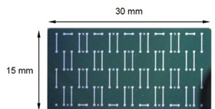
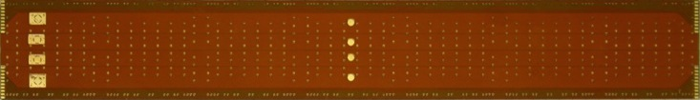
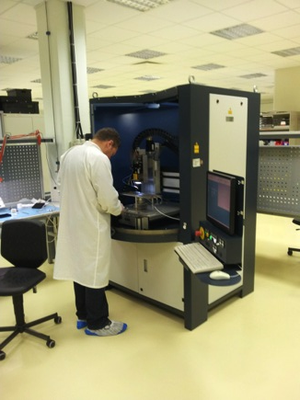
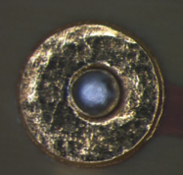
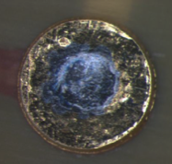
OB Module Components
The components of the Module or HIC (Hybrid Integrated Circuit) are:
Laser soldering
Pixel chip
with pads over logic
Flexible Printed Circuit (FPC)
(Cu/Polyimide double layer)
+
+
x 14
x 1
X 1400 (~100/chip)
Interconnection of Pixel chip on FPC by selective laser soldering
Before
After
10 µm
200 µm
25 µm
50 µm
25 µm
10 µm
Laser soldering machine operational at the CERN ITS Lab (Sep 2013)
50 µm

Slide 12
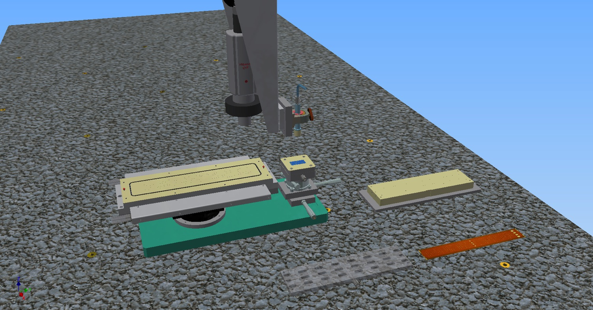
OB Module Construction
Handling of components performed by vacuum based jigs

Slide 13
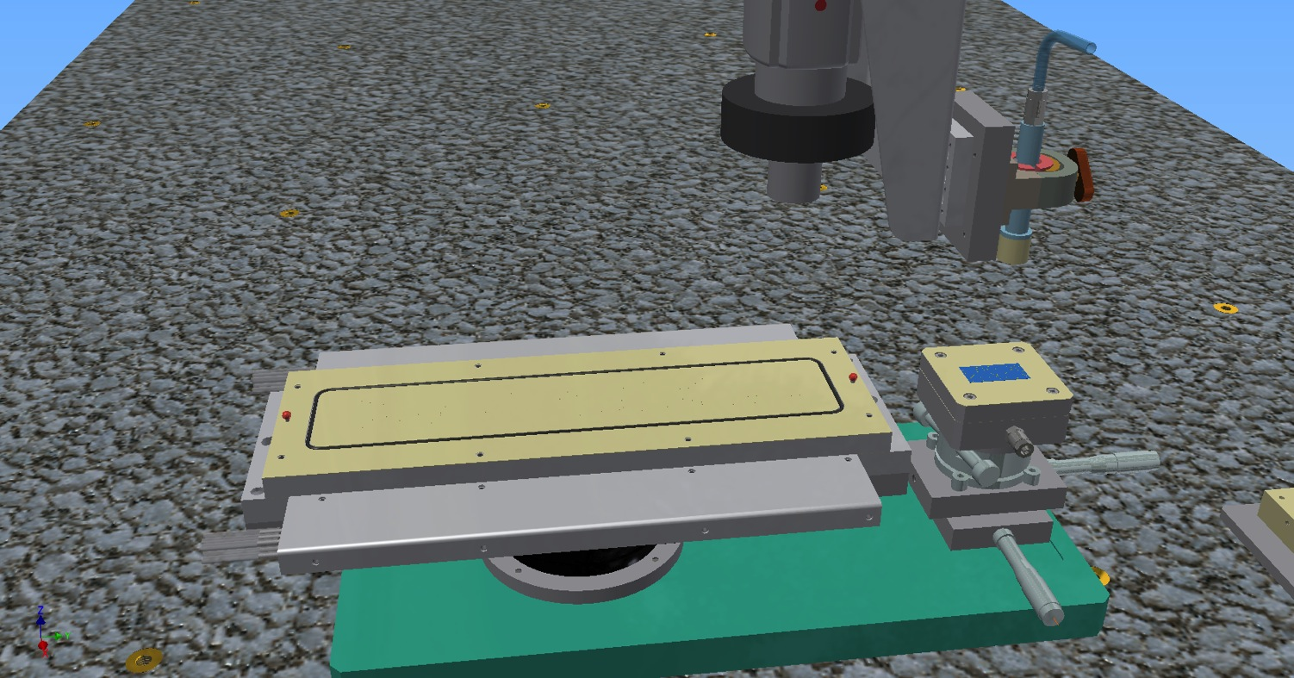
OB Module Construction

Slide 14
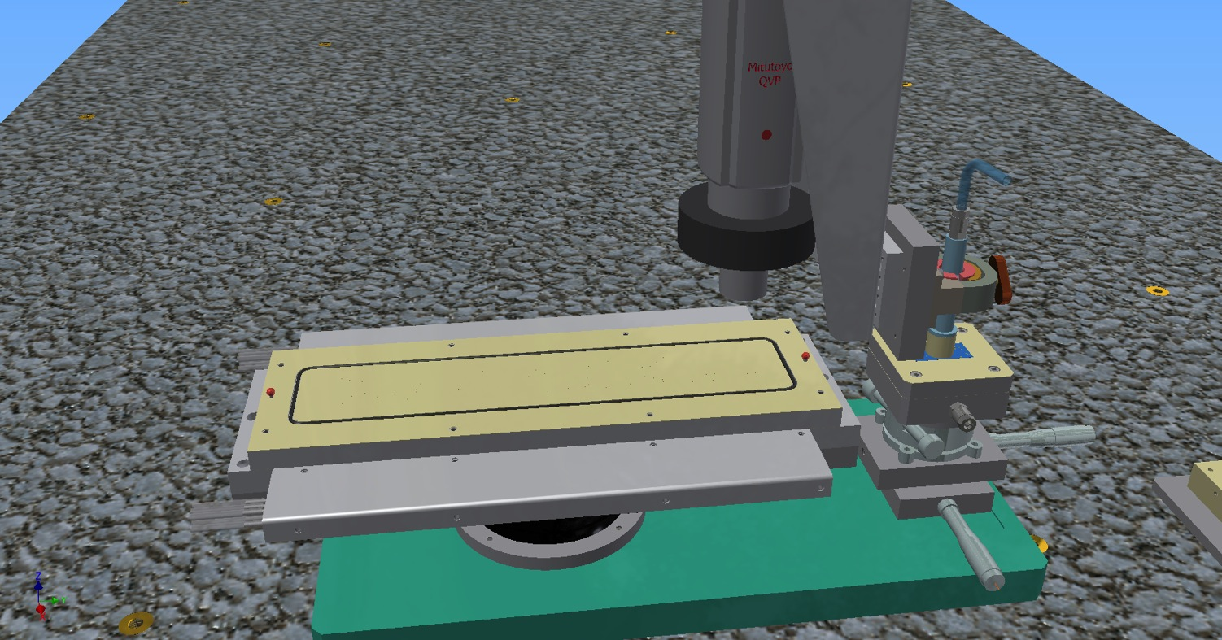
OB Module Construction

Slide 15

OB Module Construction

Slide 16
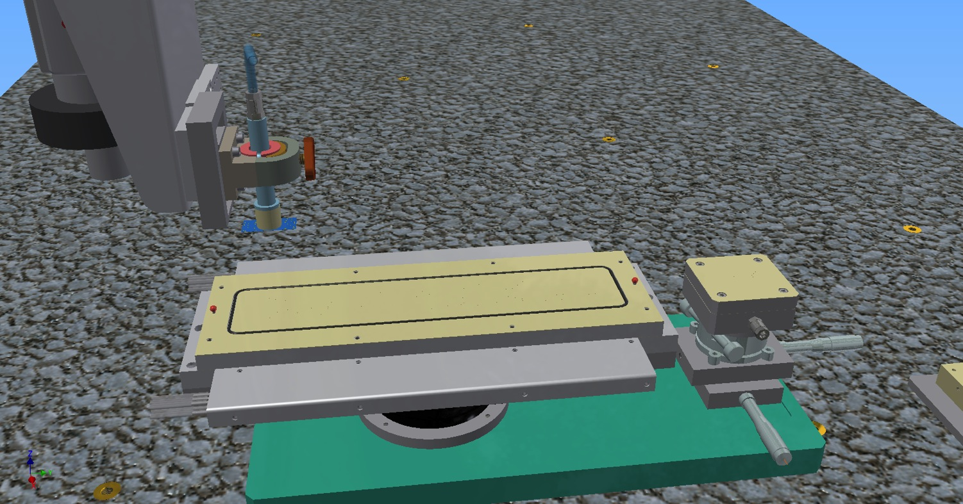
OB Module Construction

Slide 17
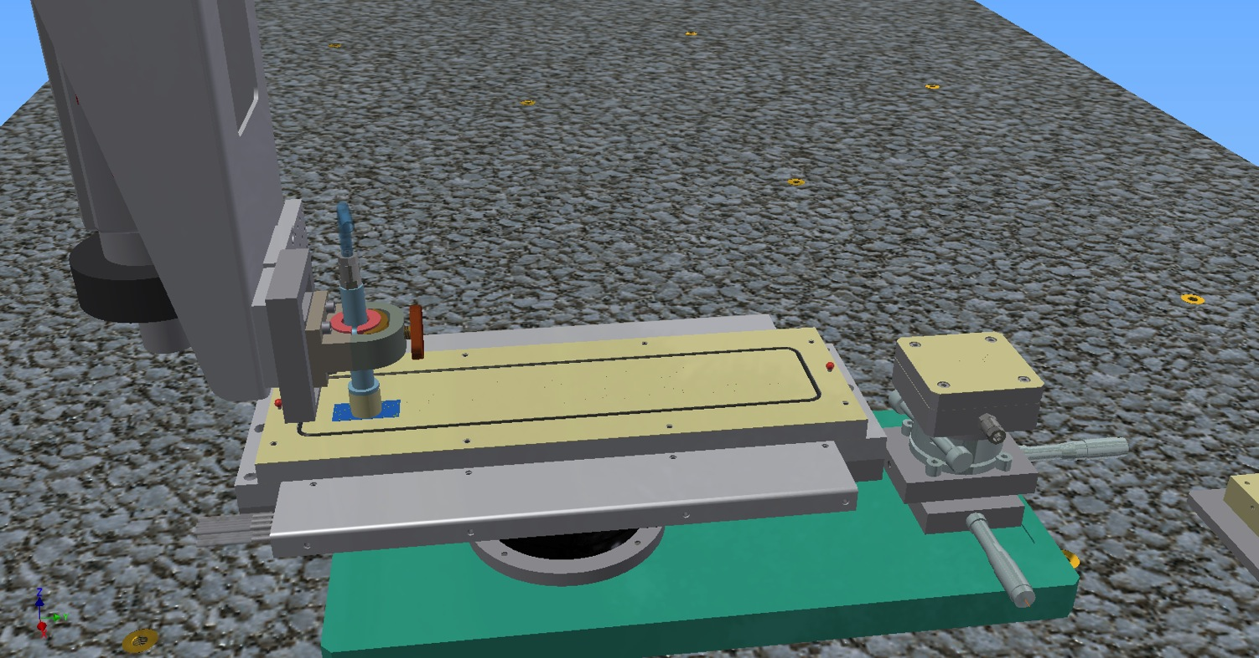
OB Module Construction

Slide 18
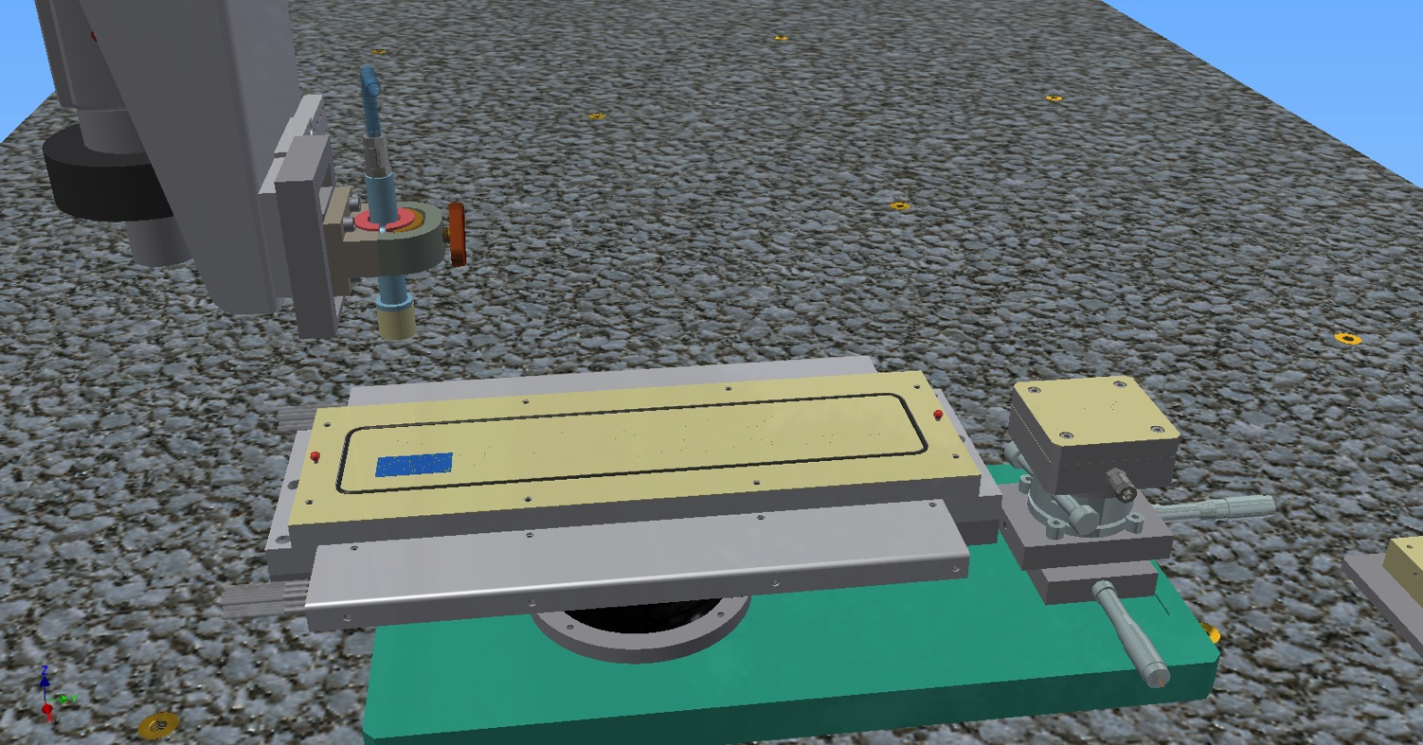
OB Module Construction

Slide 19
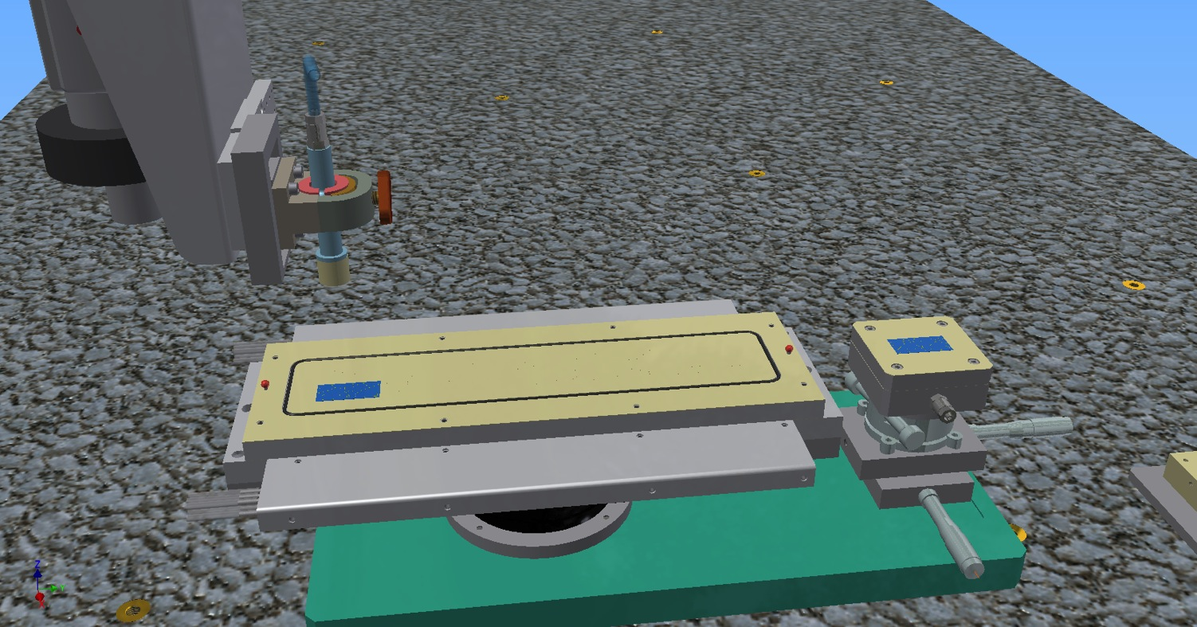
OB Module Construction

Slide 20
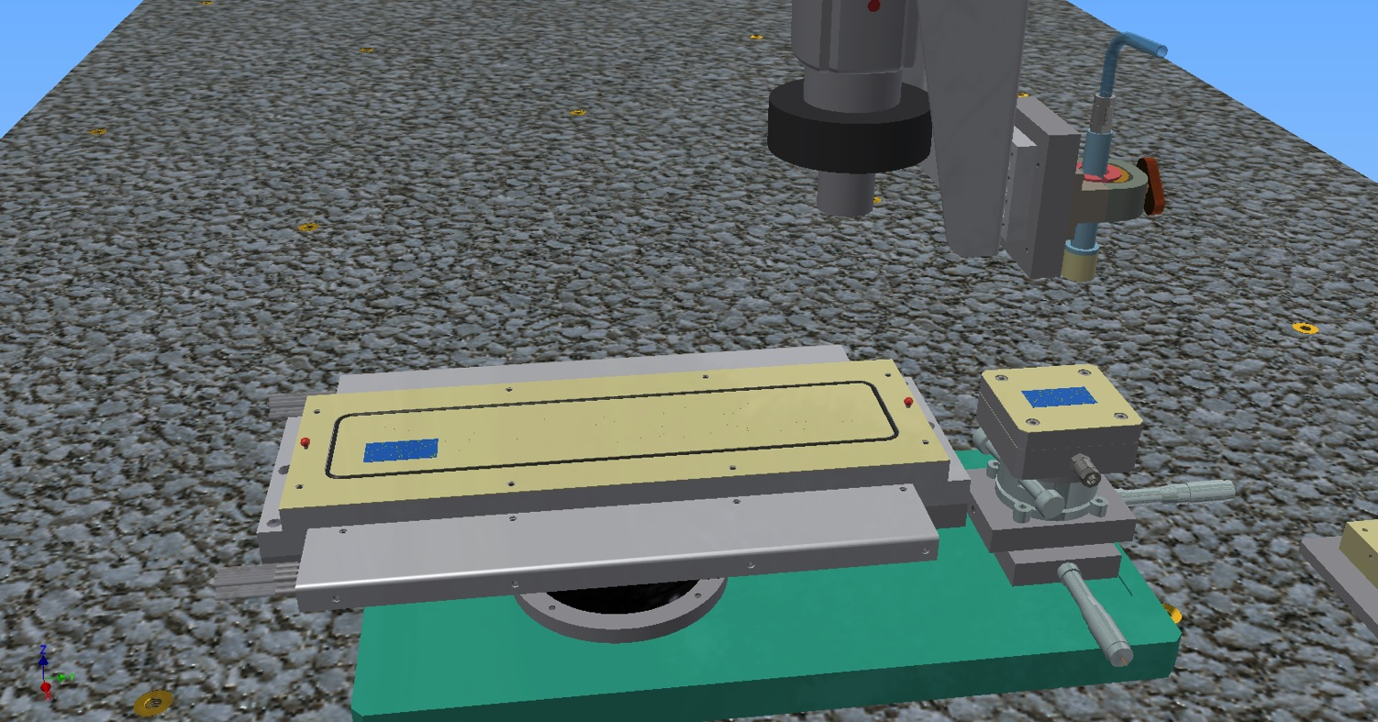
OB Module Construction

Slide 21

OB Module Construction

Slide 22
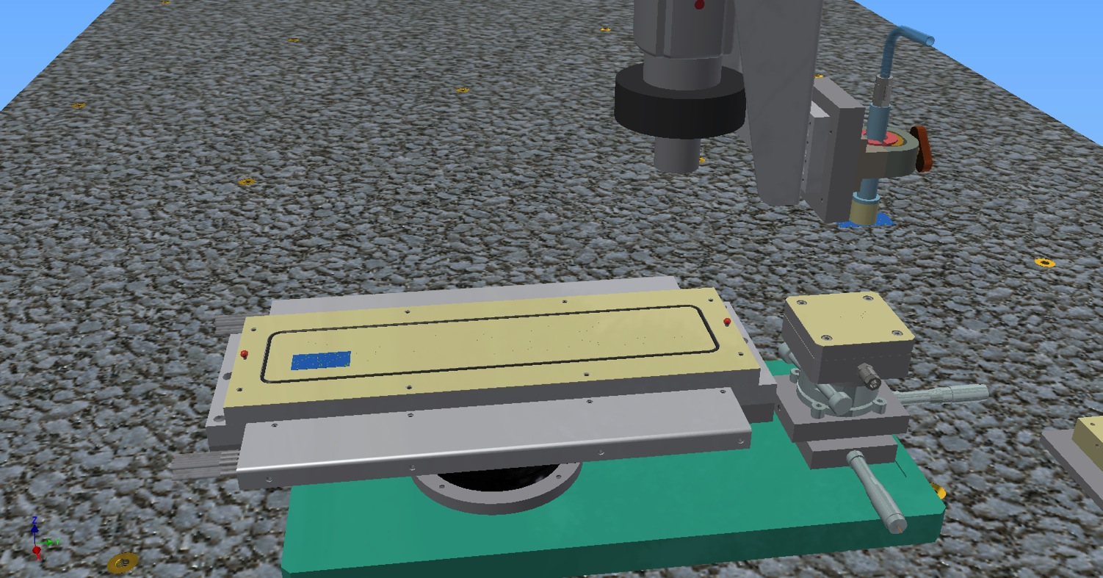
OB Module Construction

Slide 23
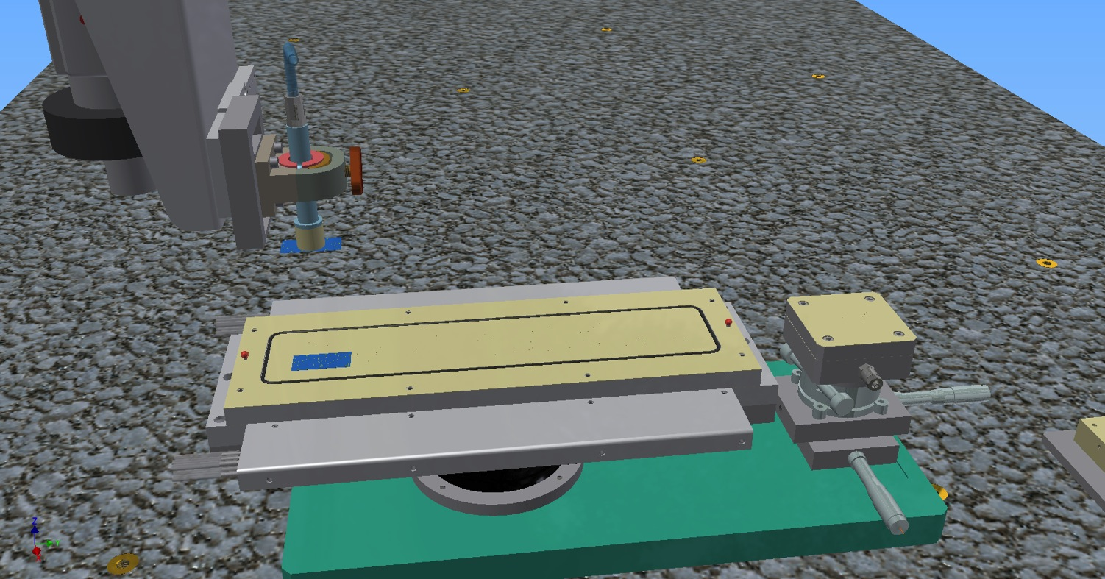
OB Module Construction

Slide 24
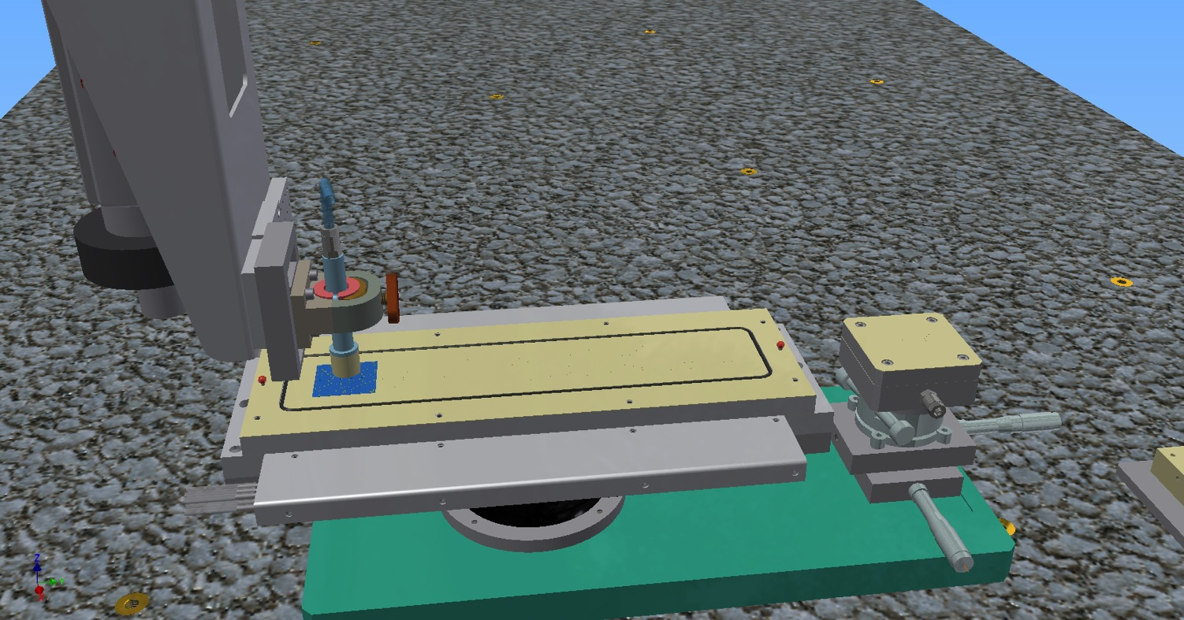
OB Module Construction

Slide 25
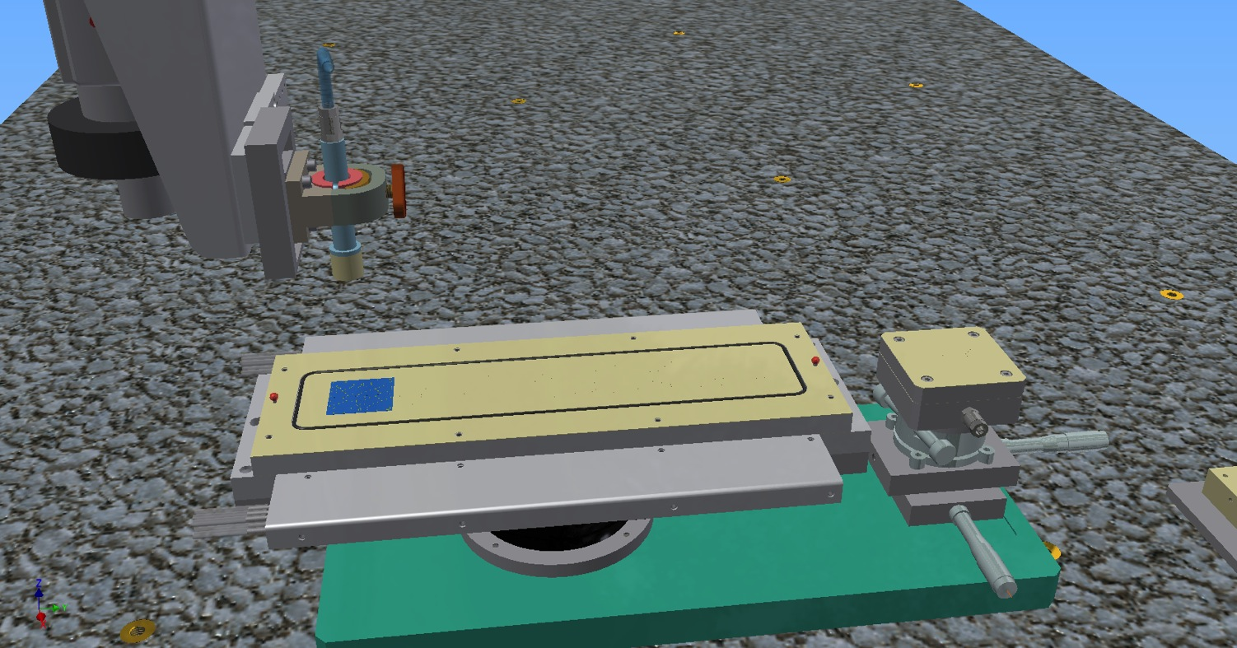
OB Module Construction

Slide 26

OB Module Construction

Slide 27

OB Module Construction

Slide 28
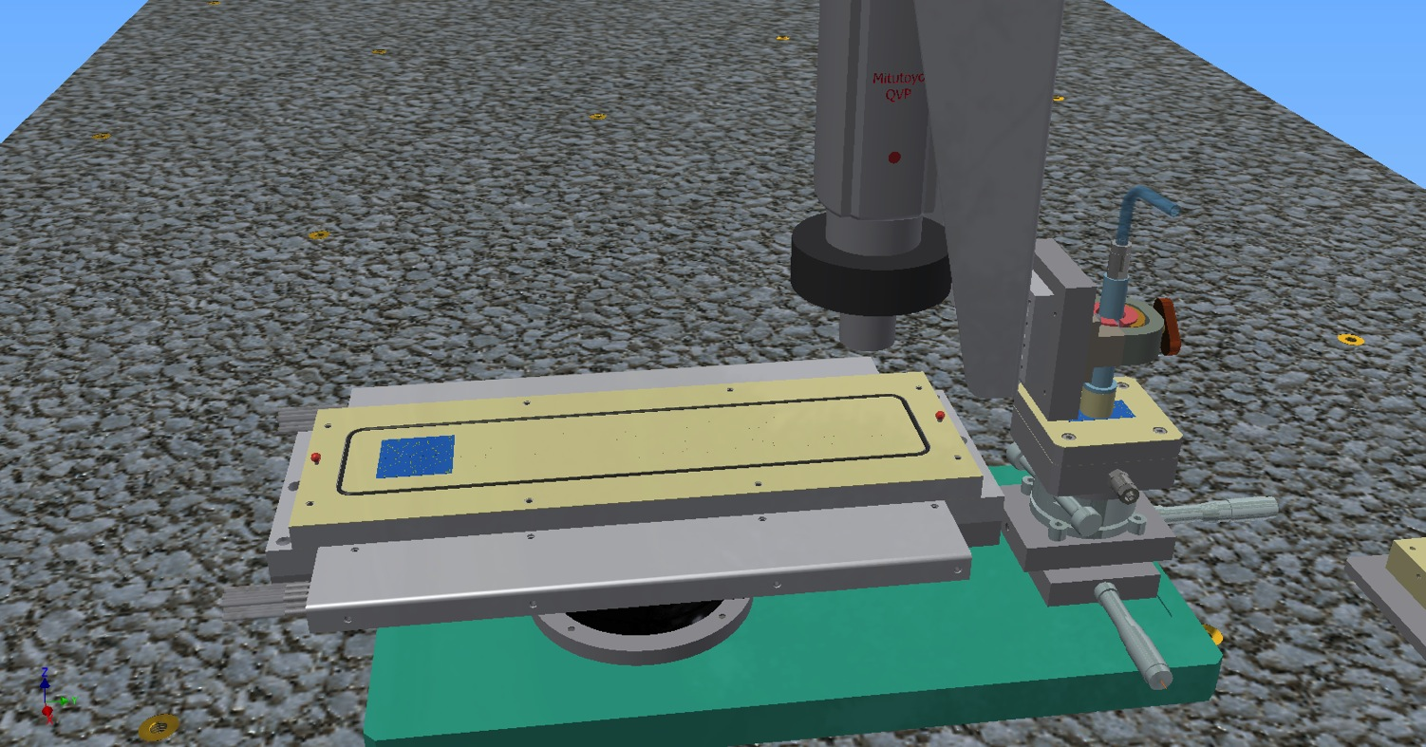
OB Module Construction

Slide 29

OB Module Construction

Slide 30
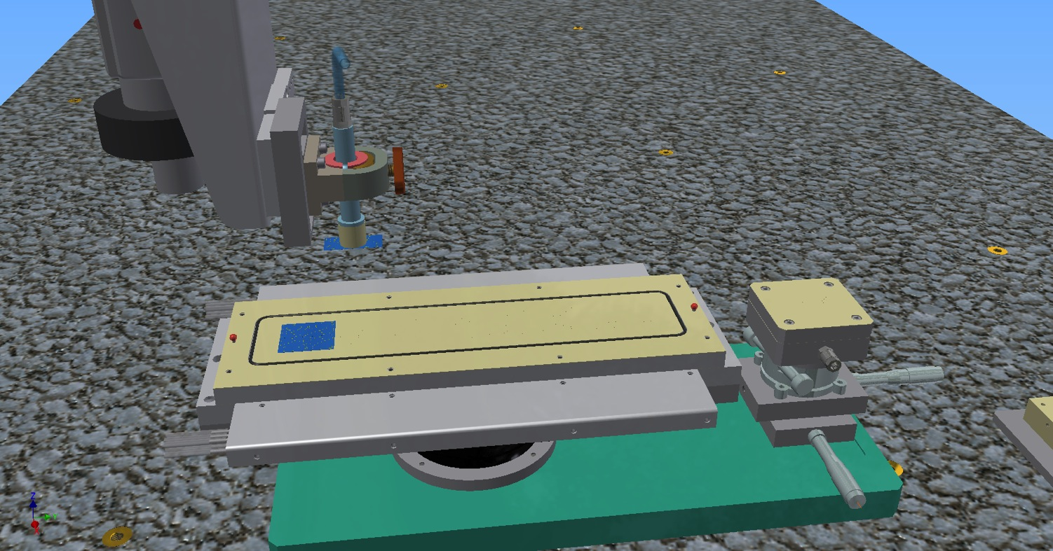
OB Module Construction

Slide 31
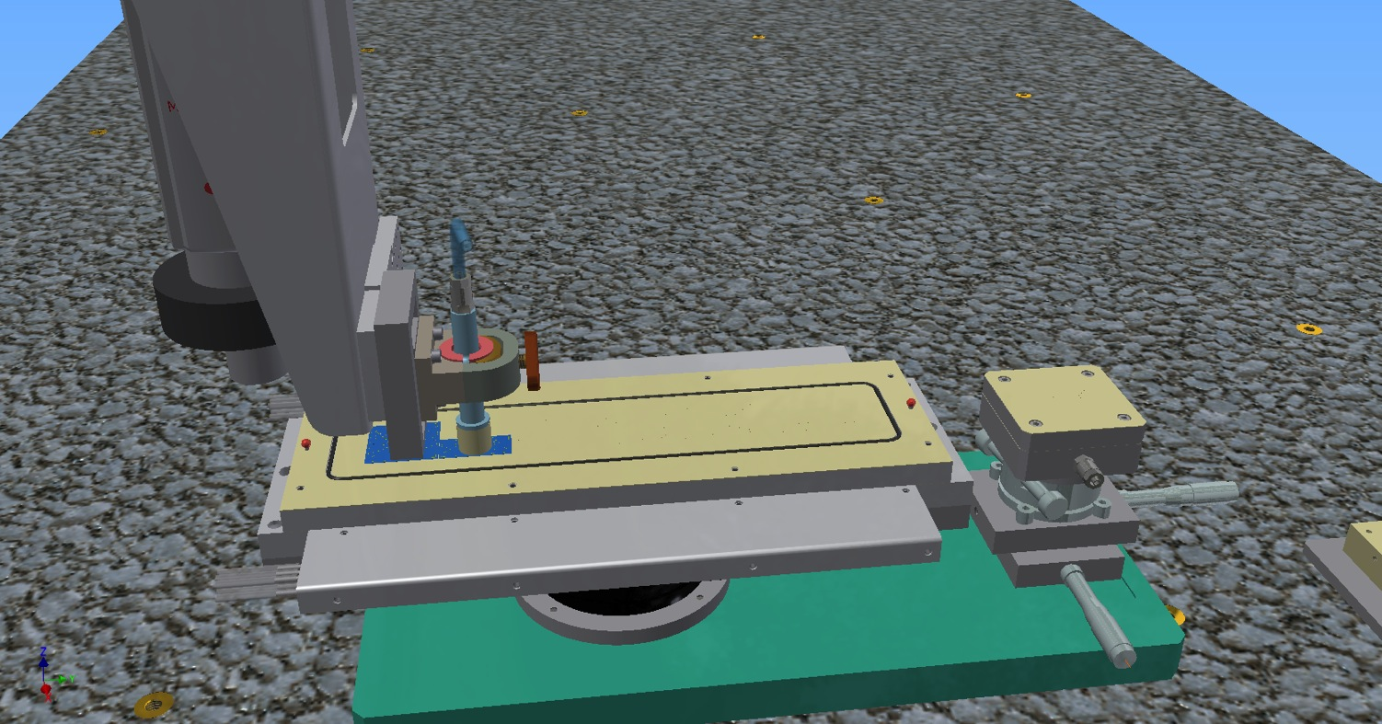
OB Module Construction

Slide 32
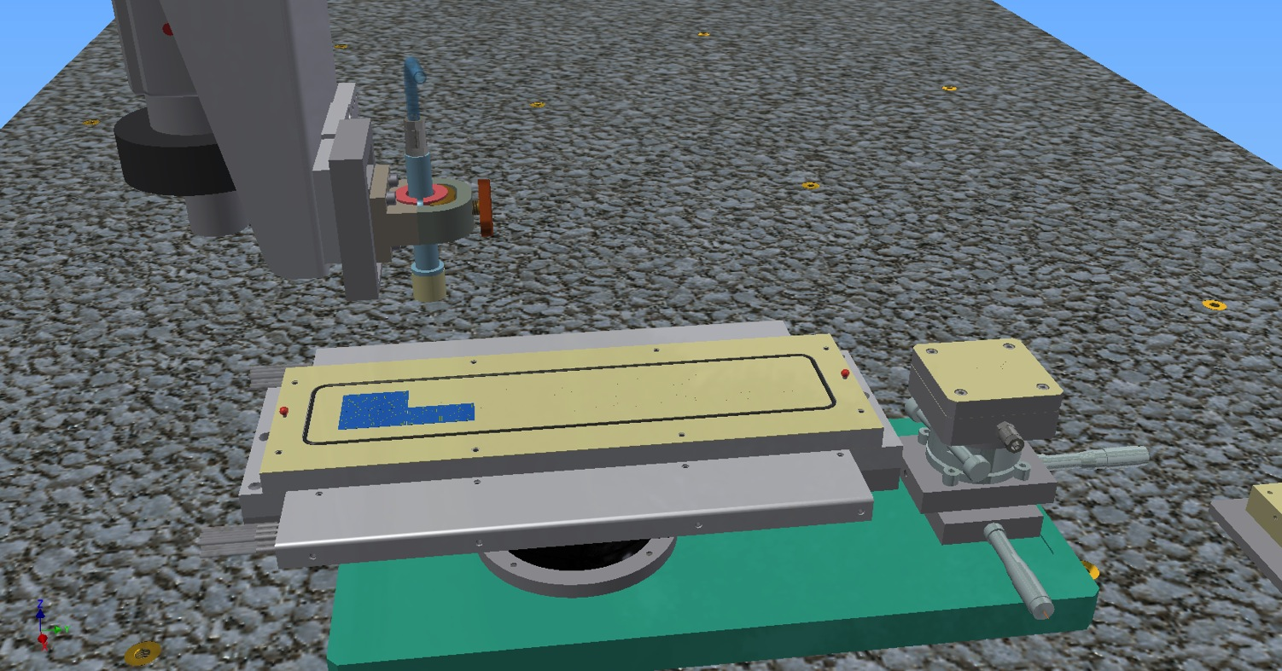
OB Module Construction

Slide 33

OB Module Construction

Slide 34
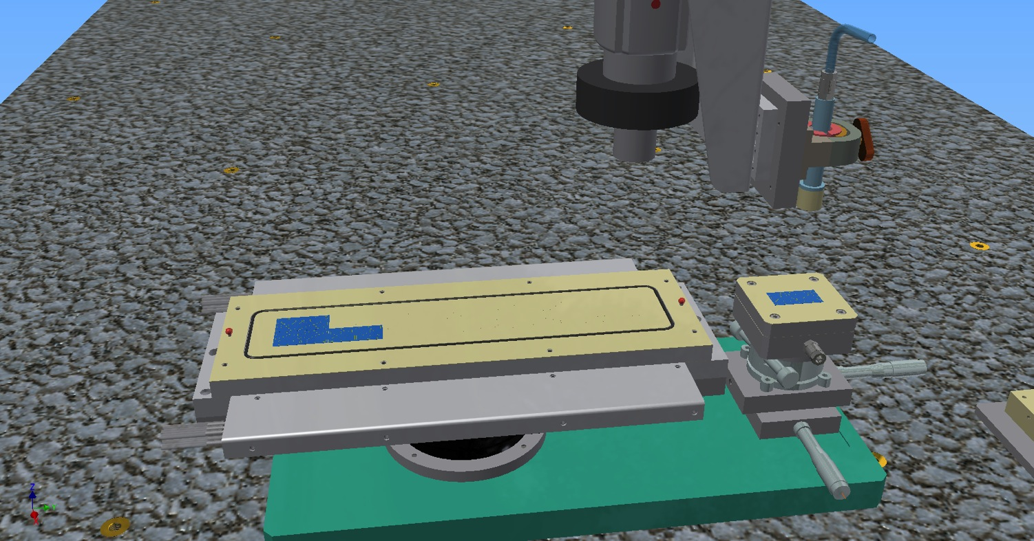
OB Module Construction

Slide 35
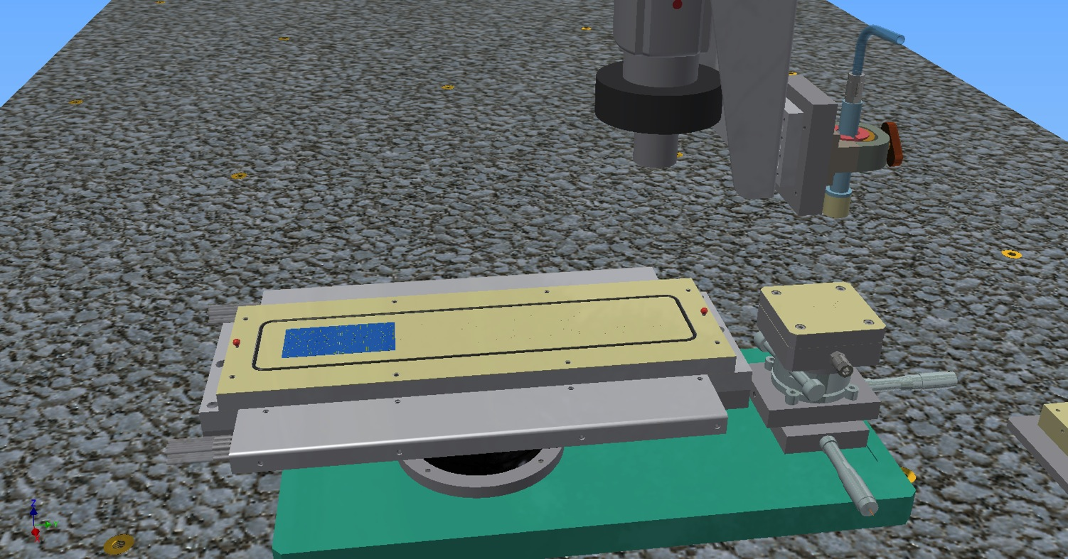
OB Module Construction

Slide 36
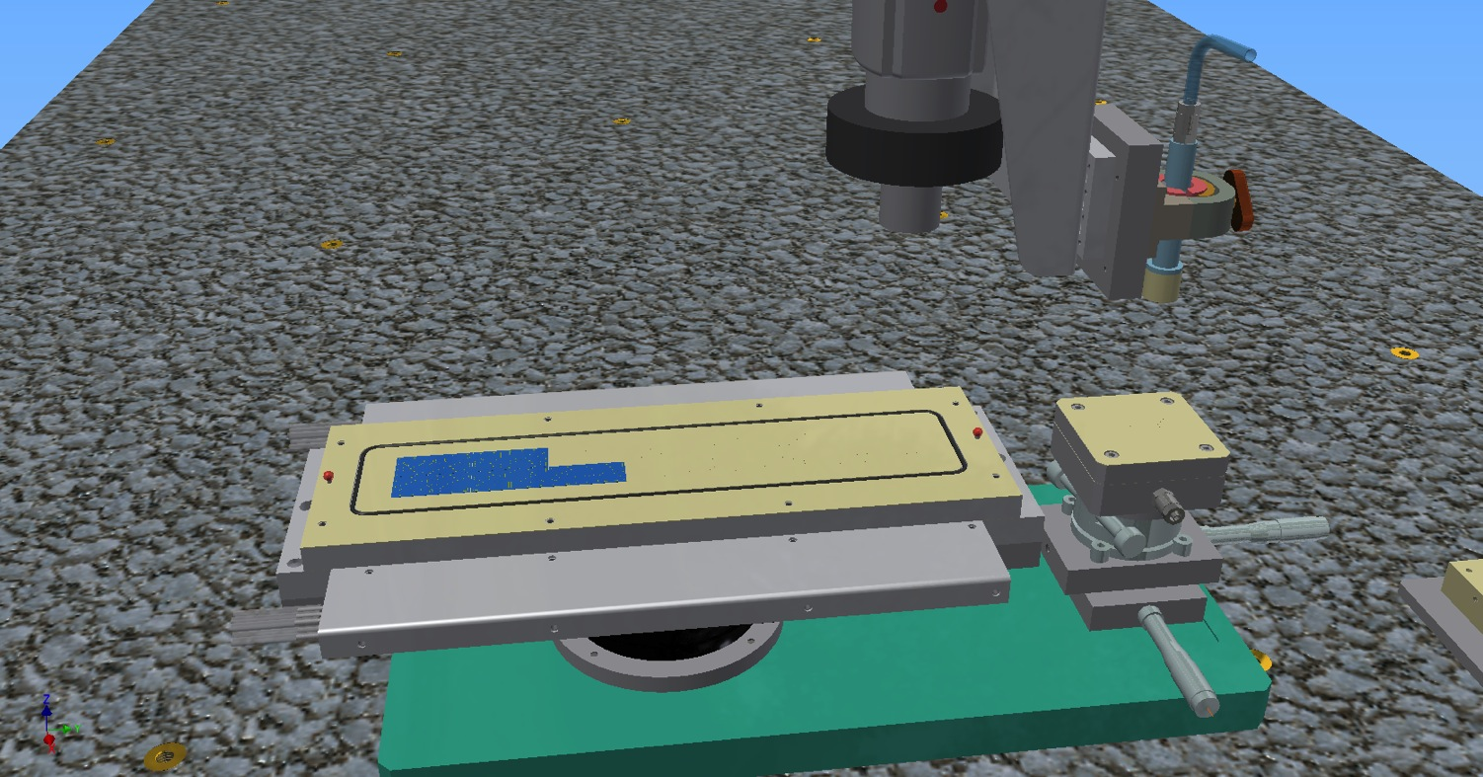
OB Module Construction

Slide 37
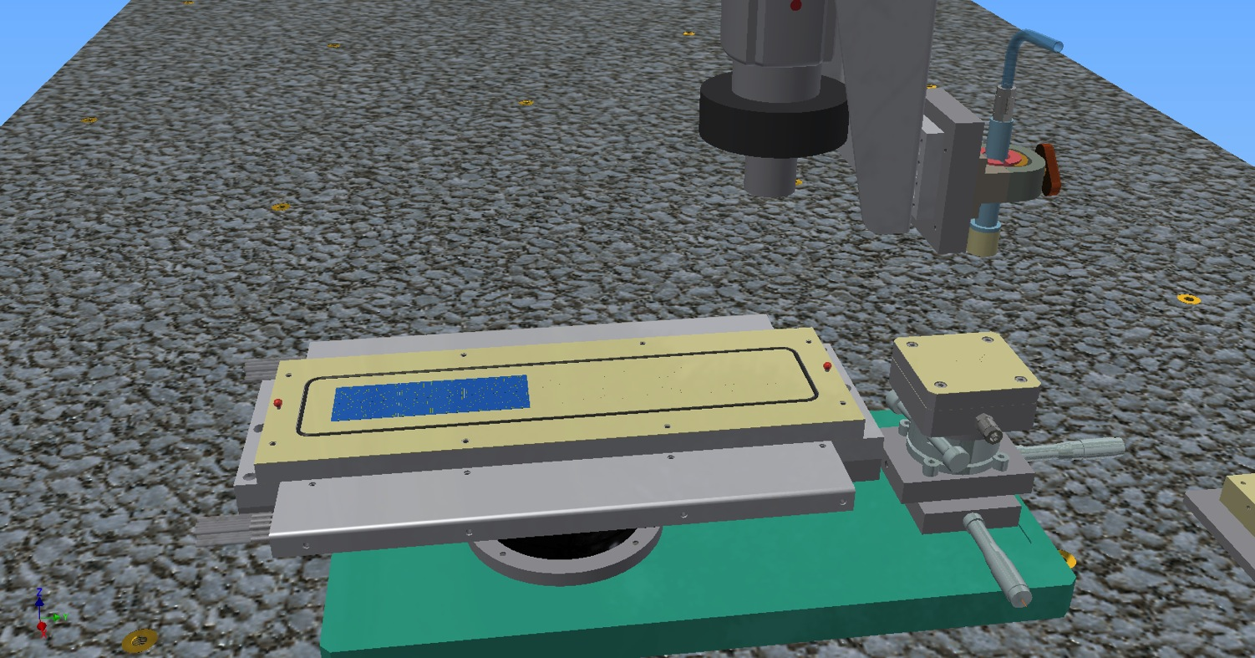
OB Module Construction

Slide 38

OB Module Construction

Slide 39
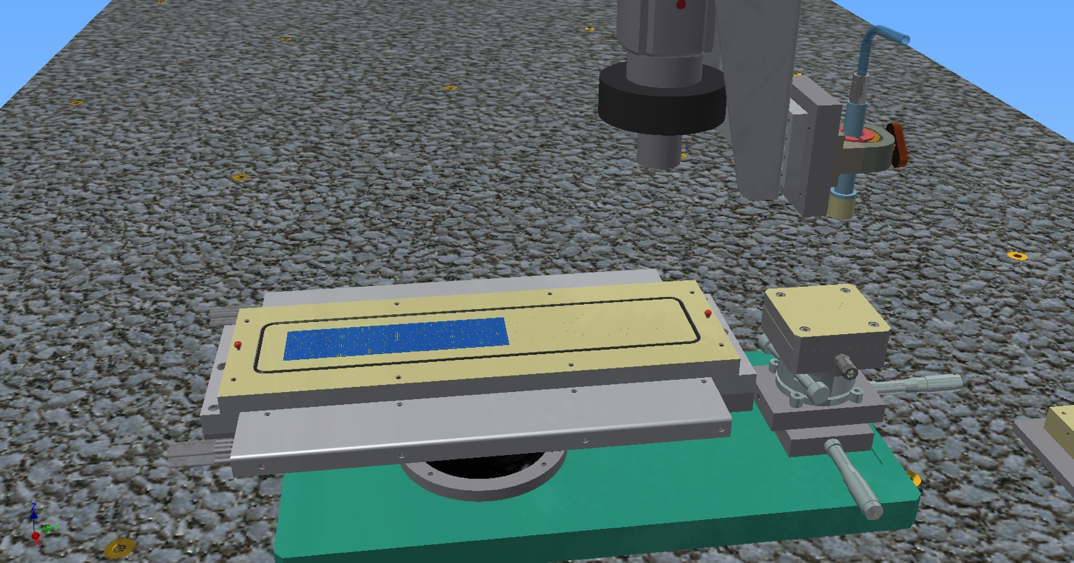
OB Module Construction

Slide 40
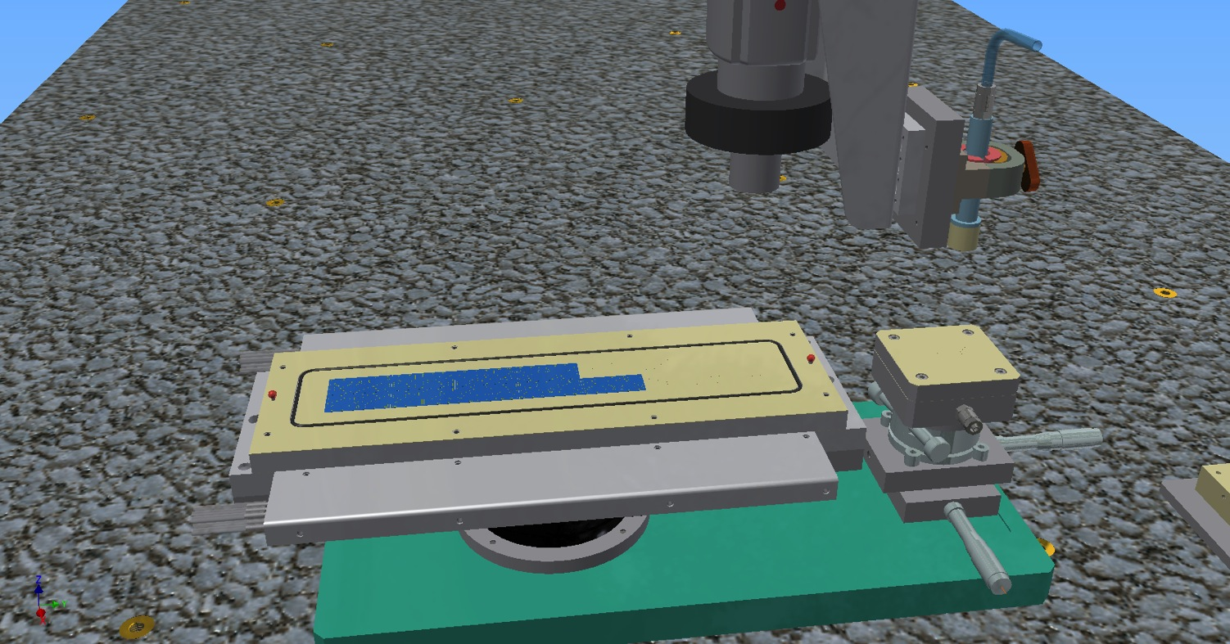
OB Module Construction

Slide 41
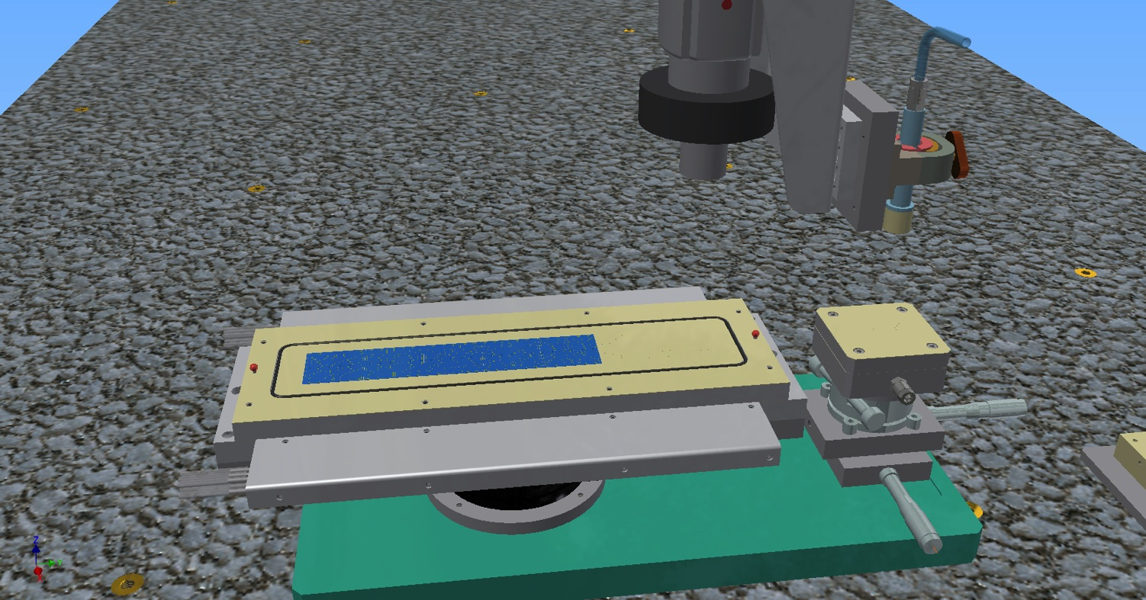
OB Module Construction

Slide 42

OB Module Construction

Slide 43
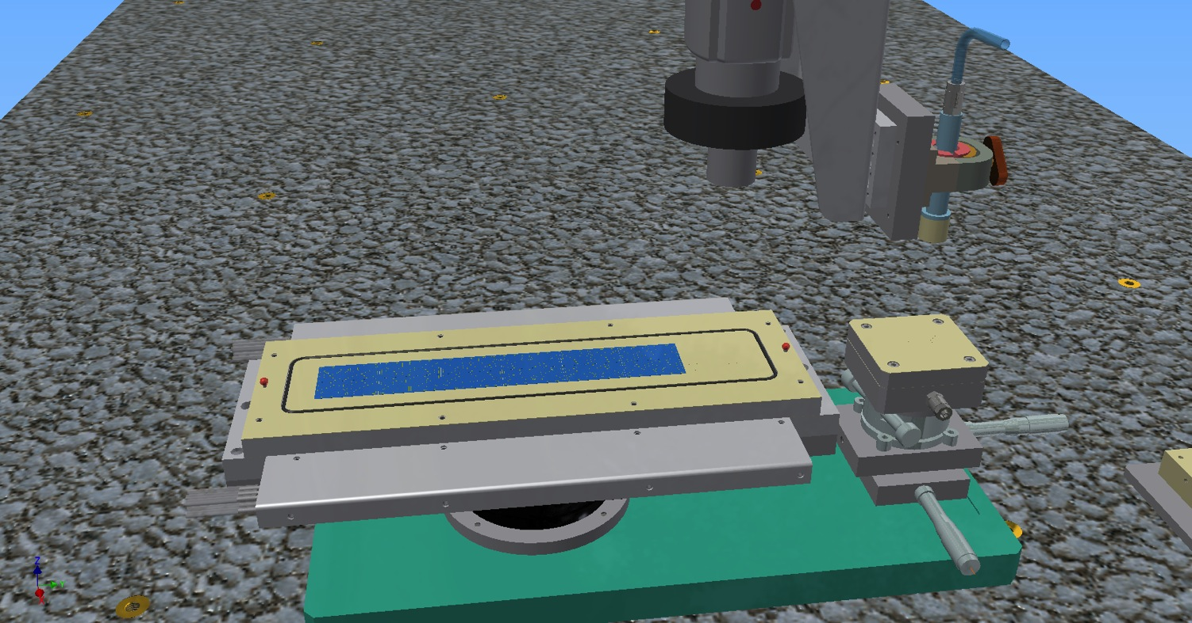
OB Module Construction

Slide 44
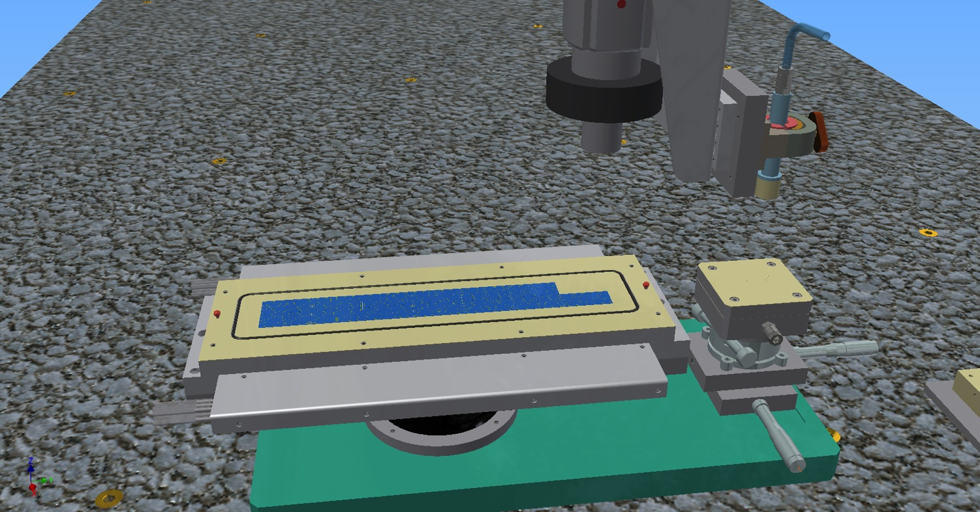
OB Module Construction

Slide 45
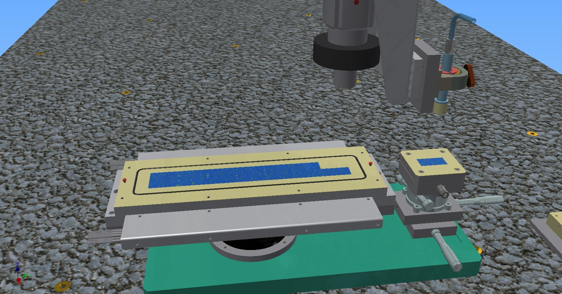
OB Module Construction

Slide 46
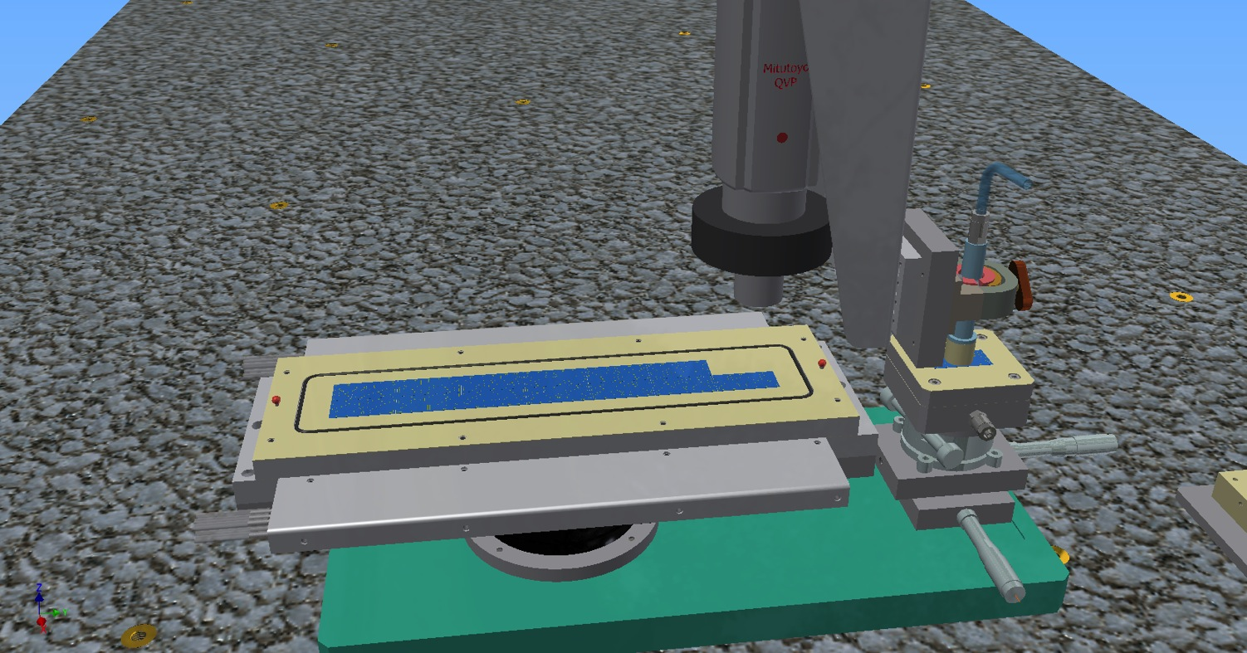
OB Module Construction

Slide 47

OB Module Construction

Slide 48
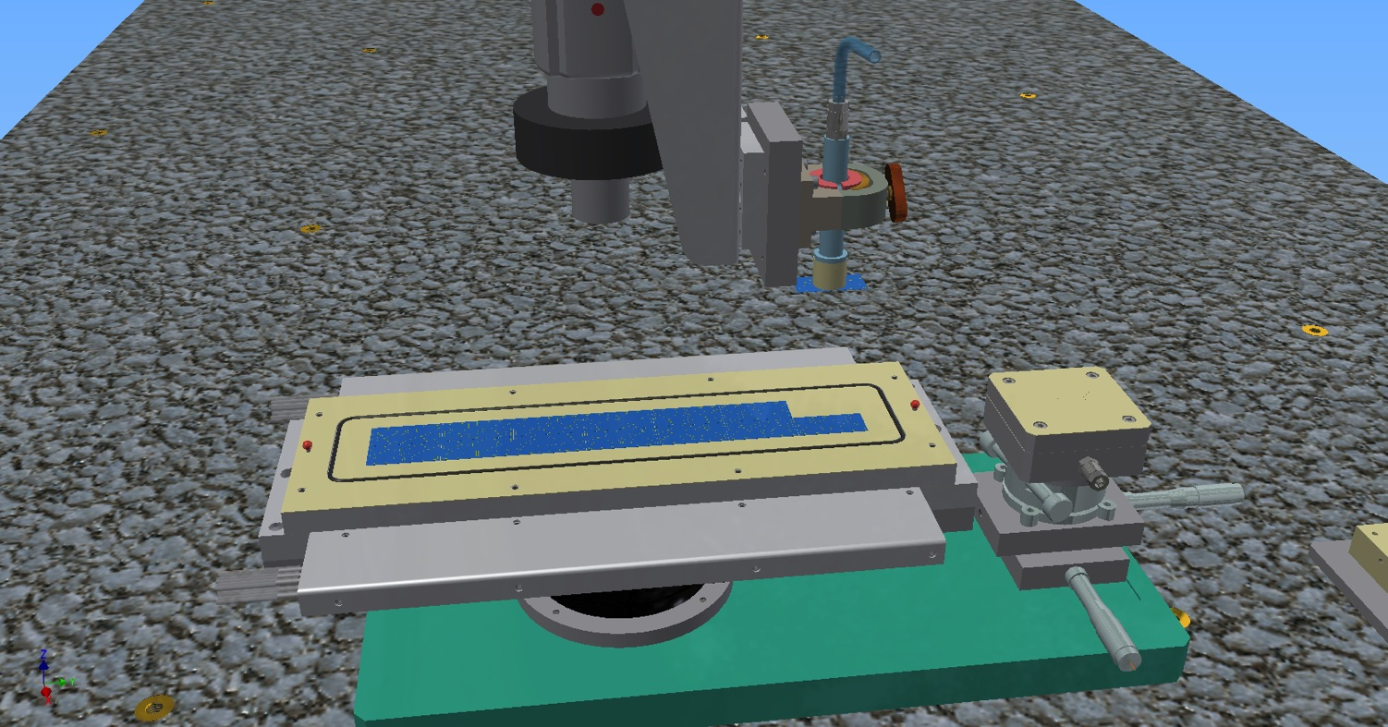
OB Module Construction

Slide 49
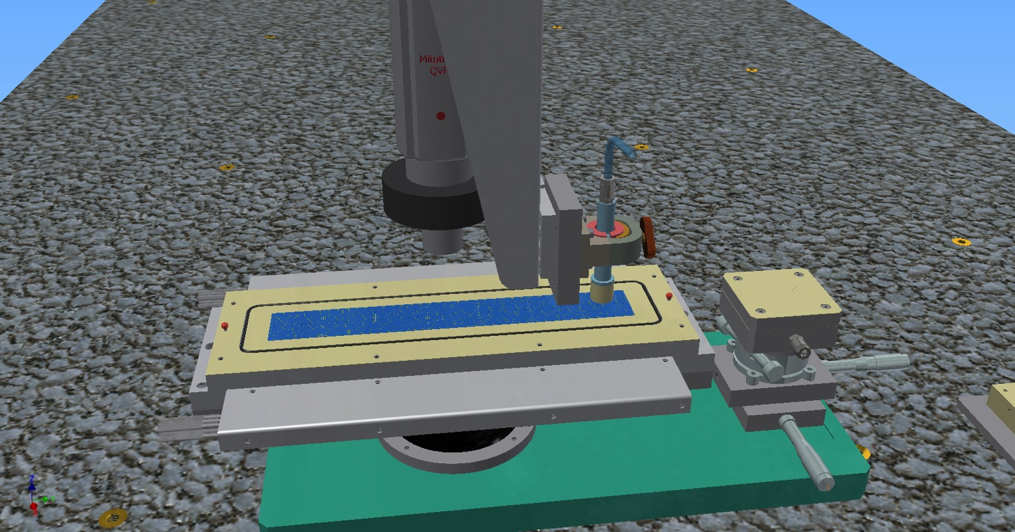
OB Module Construction

Slide 50

OB Module Construction

Slide 51
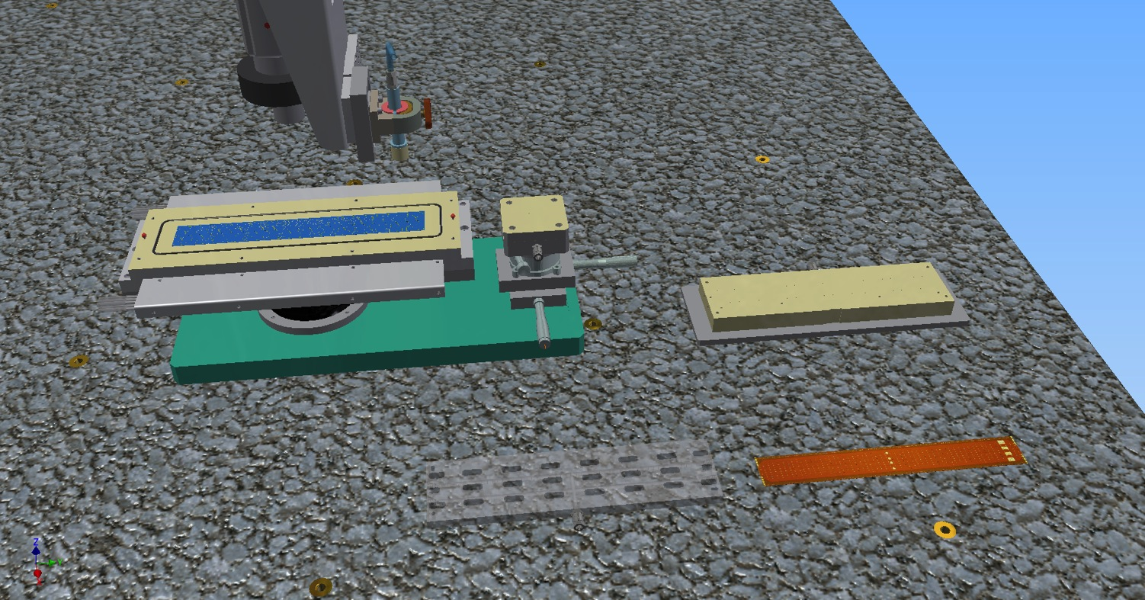
OB Module Construction

Slide 52
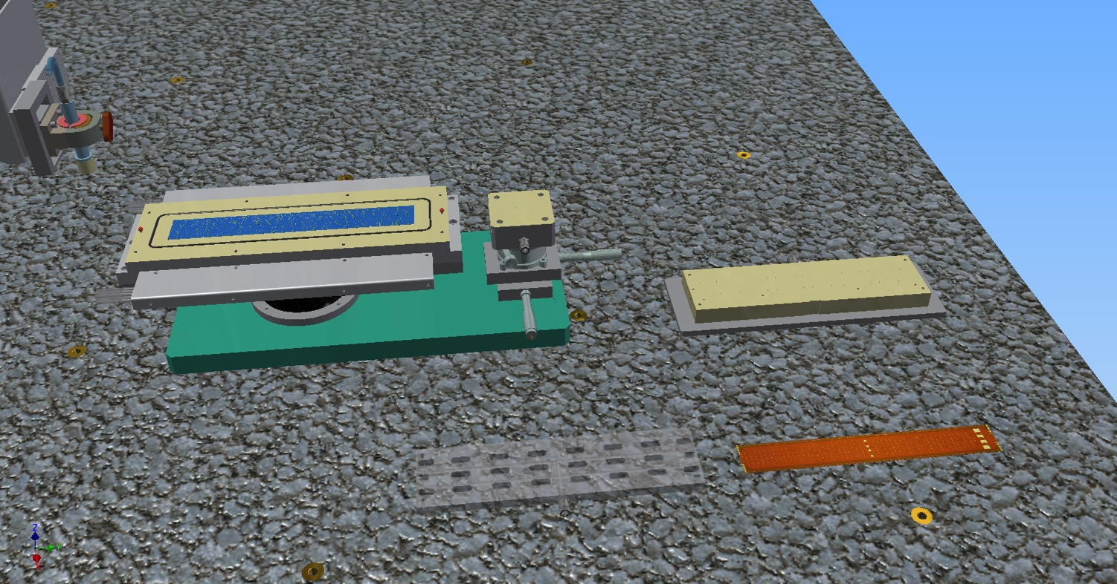
OB Module Construction

Slide 53
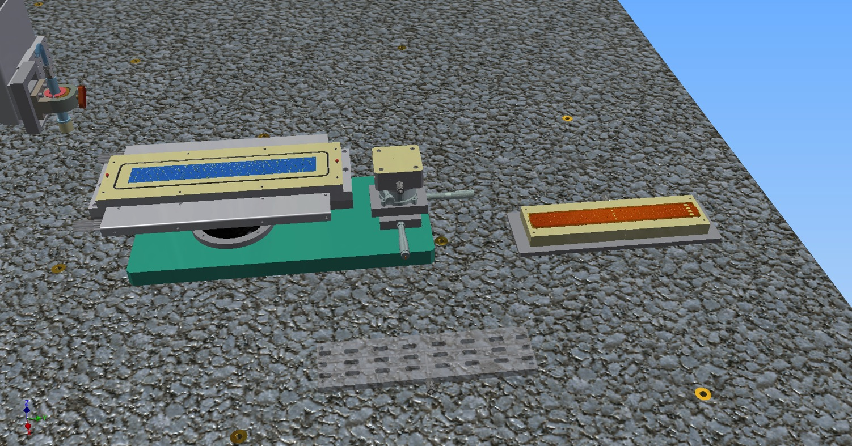
OB Module Construction

Slide 54

OB Module Construction

Slide 55

OB Module Construction

Slide 56

OB Module Construction

Slide 57

OB Module Construction

Slide 58

OB Module Construction

Slide 59

OB Module Construction

Slide 60

OB Module Construction

Slide 61

OB Module Construction

Slide 62
OB Module Construction

Slide 63
OB Module Construction

Slide 64
OB Module Construction

Slide 65
OB Module Construction

Slide 66
OB Module Construction

Slide 67
OB Module Construction

Slide 68
OB Module Construction

Slide 69
OB Module Construction

Slide 70



OB Module Assembly

Slide 71

OB Module Assembly
Pixel chips are aligned with ±5 μm space accuracy and 100 μm gap between adjacent chips

Slide 72




OB Module Assembly

Slide 73



Module Production, Testing and Shipping
Each Module Construction Center will be in charge for
  construction and test of a fraction
  of modules
  shipping them to one of the Stave
  Construction Center
Construction
Dummy module prototypes: chips glued to the FPC instead of soldered
Test
Transport

Slide 74

Automatic Assembly System for the Module Production
Module Production for ML and OL will take place in several production sites.
Homogeneous quality over the whole production
requires an automatic system to be deployed in each site.
Main automatic features of the system
  Quality assurance by optical inspections of components (pixel chip, FPC) and metrology of the final assembly
  Alignment and Positioning of pixel chips
  Distribution of the soldering spheres inside the FPC holes
  Laser soldering
  Moreover:
  it should be able to perform electrical test of chips by a needle probe card.
Timeline for the Supply Contract
  Market Survey → 6 Jul ‘14
  Firms selection and technical committee → 27 Jul ‘14
  Call for tender → 21 Sep ‘14
  (including 4 weeks of holidays)
  Analysis of offers and contract adjudication → 5 Oct ‘14
  Delivery of the first prototype system → March ‘15

Slide 75



Half-Stave assembly

Slide 76


Half-Stave assembly

Slide 77



OB Stave assembly
Two Half-Staves are attached to one Space Frame to form the Stave
  Each Half-Stave
    picked up by a vacuum based jig (in yellow)
    rotated
    placed underneath the Space Frame
    aligned and fixed to some reference pins
    glued to the Space Frame
  The stave is rotated for survey and testing
Each Stave Construction Center will be in charge for
  construction and test of a fraction of staves
  shipping them to CERN for the integration in Half-Layers

Slide 78

Detector Integration
Main structural components
End-wheels: provide precise positioning of staves in a layer
Detector Barrel and Service Barrel
end-wheels

Slide 79


Insertion (and Removal)
Detector Cage : stiff shell (light composite material)
fixed inside the TPC bore
Provides common support for the barrels
and the beampipe
Outer
Barrel
Cage contains precise guiding rails
for the insertion of the
detector-service barrels
Inner
Barrel

Slide 80

Integration in ALICE

Slide 81
Conclusions
The Module assembly procedure fully assisted by the operator has been studied in detail and the validation is well advanced
The Module production will be distributed among up to 7 construction center each equipped with an Automatic Module Assembly System to ensure standardized features and Quality Assurance
  Market survey ongoing, followed by a call for tender
  Delivery of the first Automatic Module Assembly System prototype expected by March 2015
The definition of the Stave assembly procedure is in progress and will be completed in the next months
The full-scale prototypes of the IB and OB Stave mechanics, and of the IB end-wheels have been produced.
The study of the detector integration is ongoing

