Slide 1

Wafer Procurement, Sensor Post-processing and Interconnect R&D

Slide 2
Wafer procurement and QA
Choice of starting wafer material
Used different high-res epi wafers in ER2013
Final choice will depend on test results of prototype chips:
  Select epi thickness
  Select resistivity
Procurement of the wafers for the production should start end of 2014/beginning of 2015
Goals for 2014:
Finalize choice of high-res wafers by end 2014
Finalize QA by end of 2014

Slide 3
Wafer procurement and QA
Ordered new set of wafers to be available for the next engineering runs.
Partially delivered (will be completed July 31, 2014)
Epi thickness | Resistivity | # wafers | Status
20 µm | >1kΩcm | 12 | Delivered 9/6
25 µm | >1kΩcm | 6 | Delivery ~ 25/6
30 µm | >1kΩcm | 12 | Delivered 9/6
30 µm | >2kΩcm | 25 | Delivery ~ 31/6

Slide 4
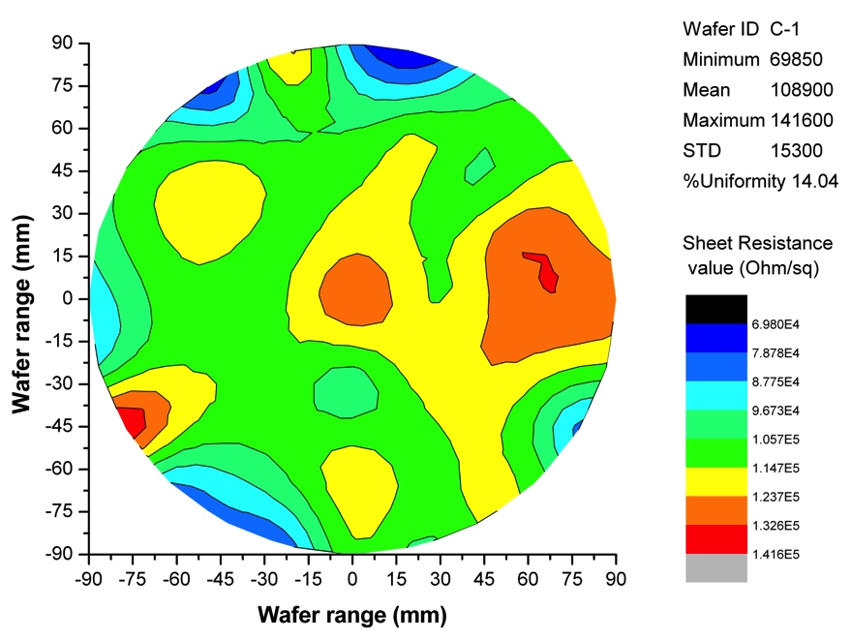
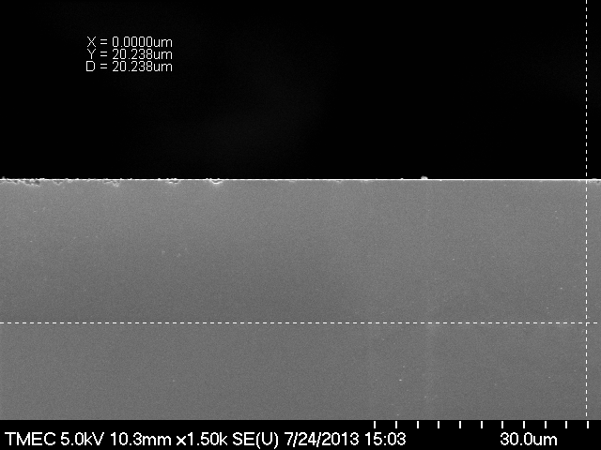
Wafer QA before processing
Data supplied by vendor for custom wafers: epi thickness, resistivity
QA activities with TMEC on sample basis:
SEM cross-section inspection
Surface resistivity measurement
SRP measurement of resistivity profile in the epi layer
  Ordering reference samples
TMEC
TMEC

Slide 5
Wafer Post-Processing List
Processing after delivery of CMOS wafers from the foundry:
Plating (Ni/Au)
Thinning&Dicing
Several wafers presently in the pipeline for post-processing:
 | # wafers | Ni/Au plating | DBG | Status
ITS2 - I | 2 (high res) | PacTech | tbd | At PacTech
ITS2 - II | 5 (high res) | PacTech | tbd | At PacTech
ITS_pad (50c) | 7+1 (setup) | PacTech | tbd | At PacTech
ITS_pad (50c) | 16 | PacTech | tbd | At PacTech
Total | 31

Slide 6
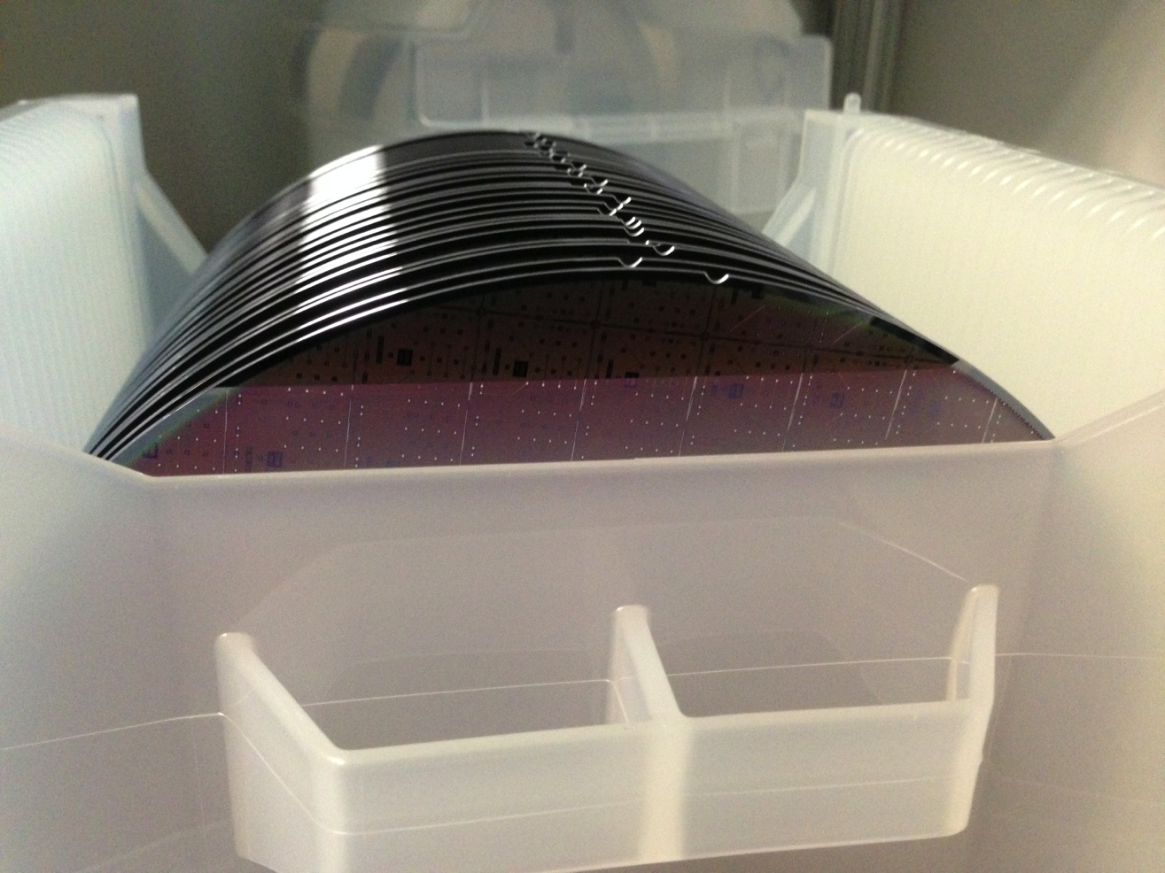
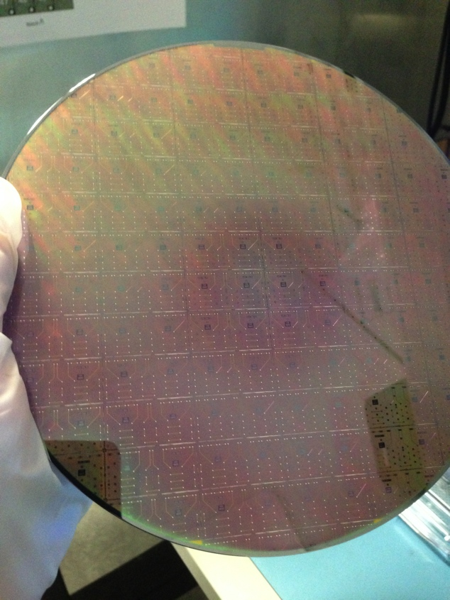
Pad wafers with 50 contacts
To be used for assembly tests

Slide 7
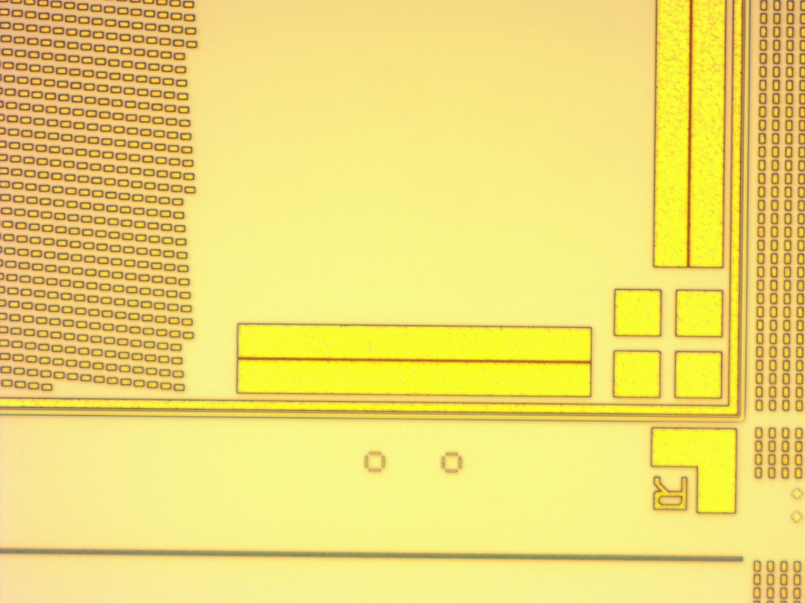
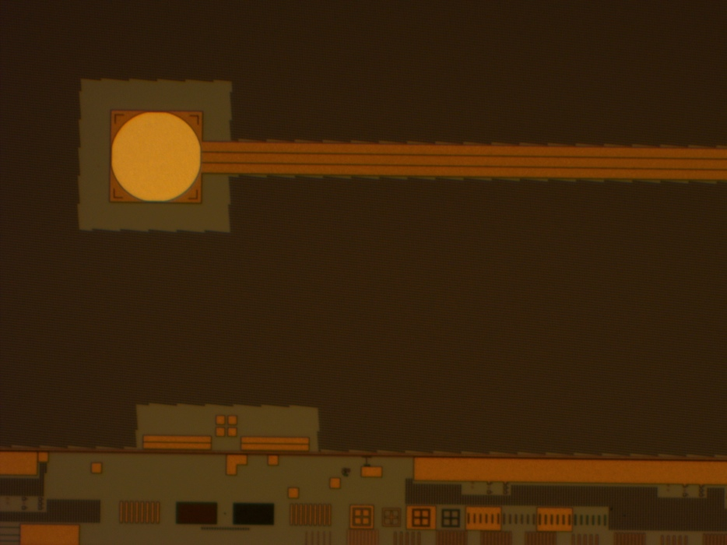
Pad wafers with 50 contacts
M6+Passivation
Produced by TowerJazz
Scribeline (and test structures) as on full CMOS wafers → can be used for thinning and dicing tests

Slide 8
Post-Processing Schedules
Turn-around time is not negligible for complex DBG and Ni/Au plating → requires careful planning not to delay subsequent activities.
Ni/Au plating
(mask generation, processing ~ 4 weeks)
Transport time
3-4 days
Dicing and grinding
~ 1 week (if slot is available)
Transport time
3-4 days

Slide 9
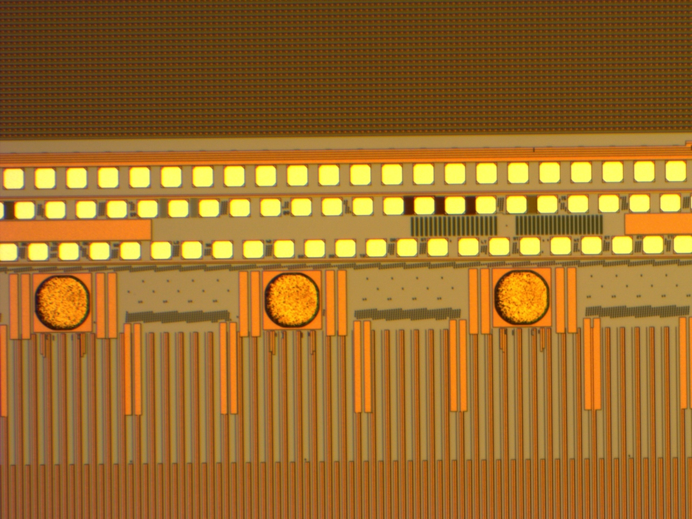
Ni/Au plating
1 ITS2 pad wafer (8”) returned from plating at PacTech
Mask was applied to cover all areas except pALPIDEfs contacts, visual inspection before DBG:

Slide 10
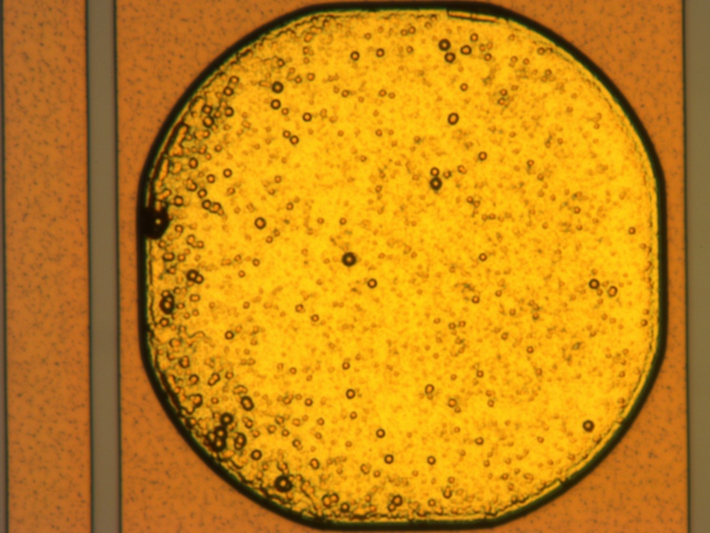
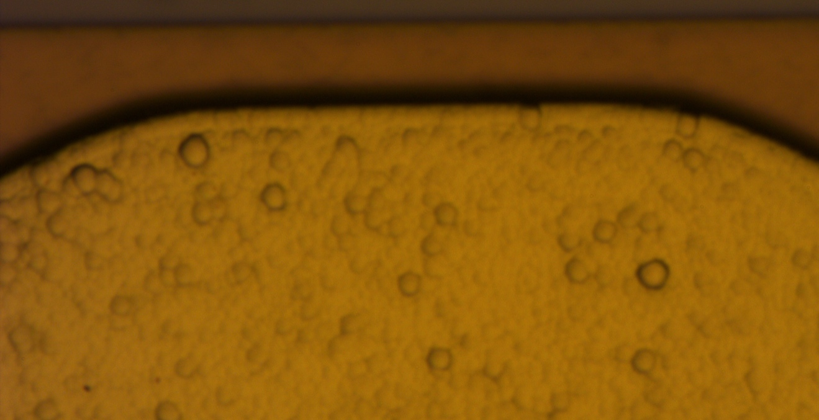
Ni/Au plated ITS2 padwafer
Wafer sent for DBG – partially lost due to mishandling at the grinder.
Remaining dies will be delivered beginning of the week.
QA of this processing step needs to be defined, e.g:
Visual inspection
Solder test
Height control (5 um Ni, 50 nm Au)

Slide 11
Ni/Au Plating – Next Steps
1. Solder test of chips from first wafer plated by PacTech
2. Next 2 wafers (ITS2 CMOS) expected to be delivered back from PacTech end of June → visual inspection, DBG, solder tests
3. Preparing market survey for Ni/Au plating:
Pre-meeting with purchasing officer (June)
Aiming to complete market survey by the end of summer
Should be completed before receiving new wafers later this year

Slide 12
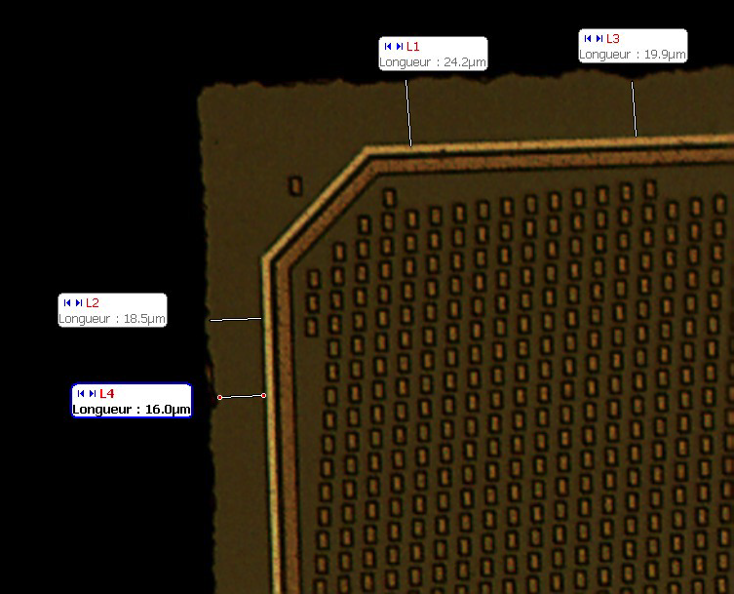
Thinning & Dicing
Definition of the criteria for thinning and dicing:
Thickness: 50 um +/- 5 um
Max. extent from seal-ring: +/- 30 um (20 um?)

Slide 13
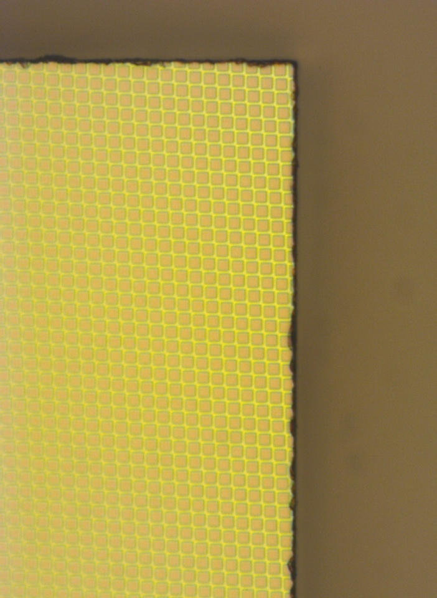
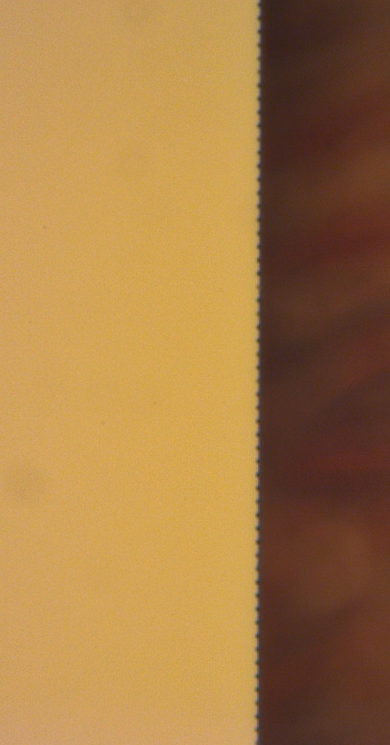
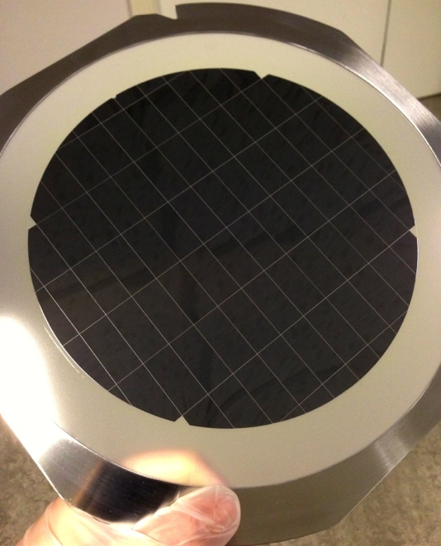
CMOS wafer
Blank wafer
Blank wafer
Laser diced by STARS
ER2013 wafer
Diamond wheel dicing
(2000 mesh wheel)
Blank wafer
Laser diced by STARS
(front view)

Slide 17
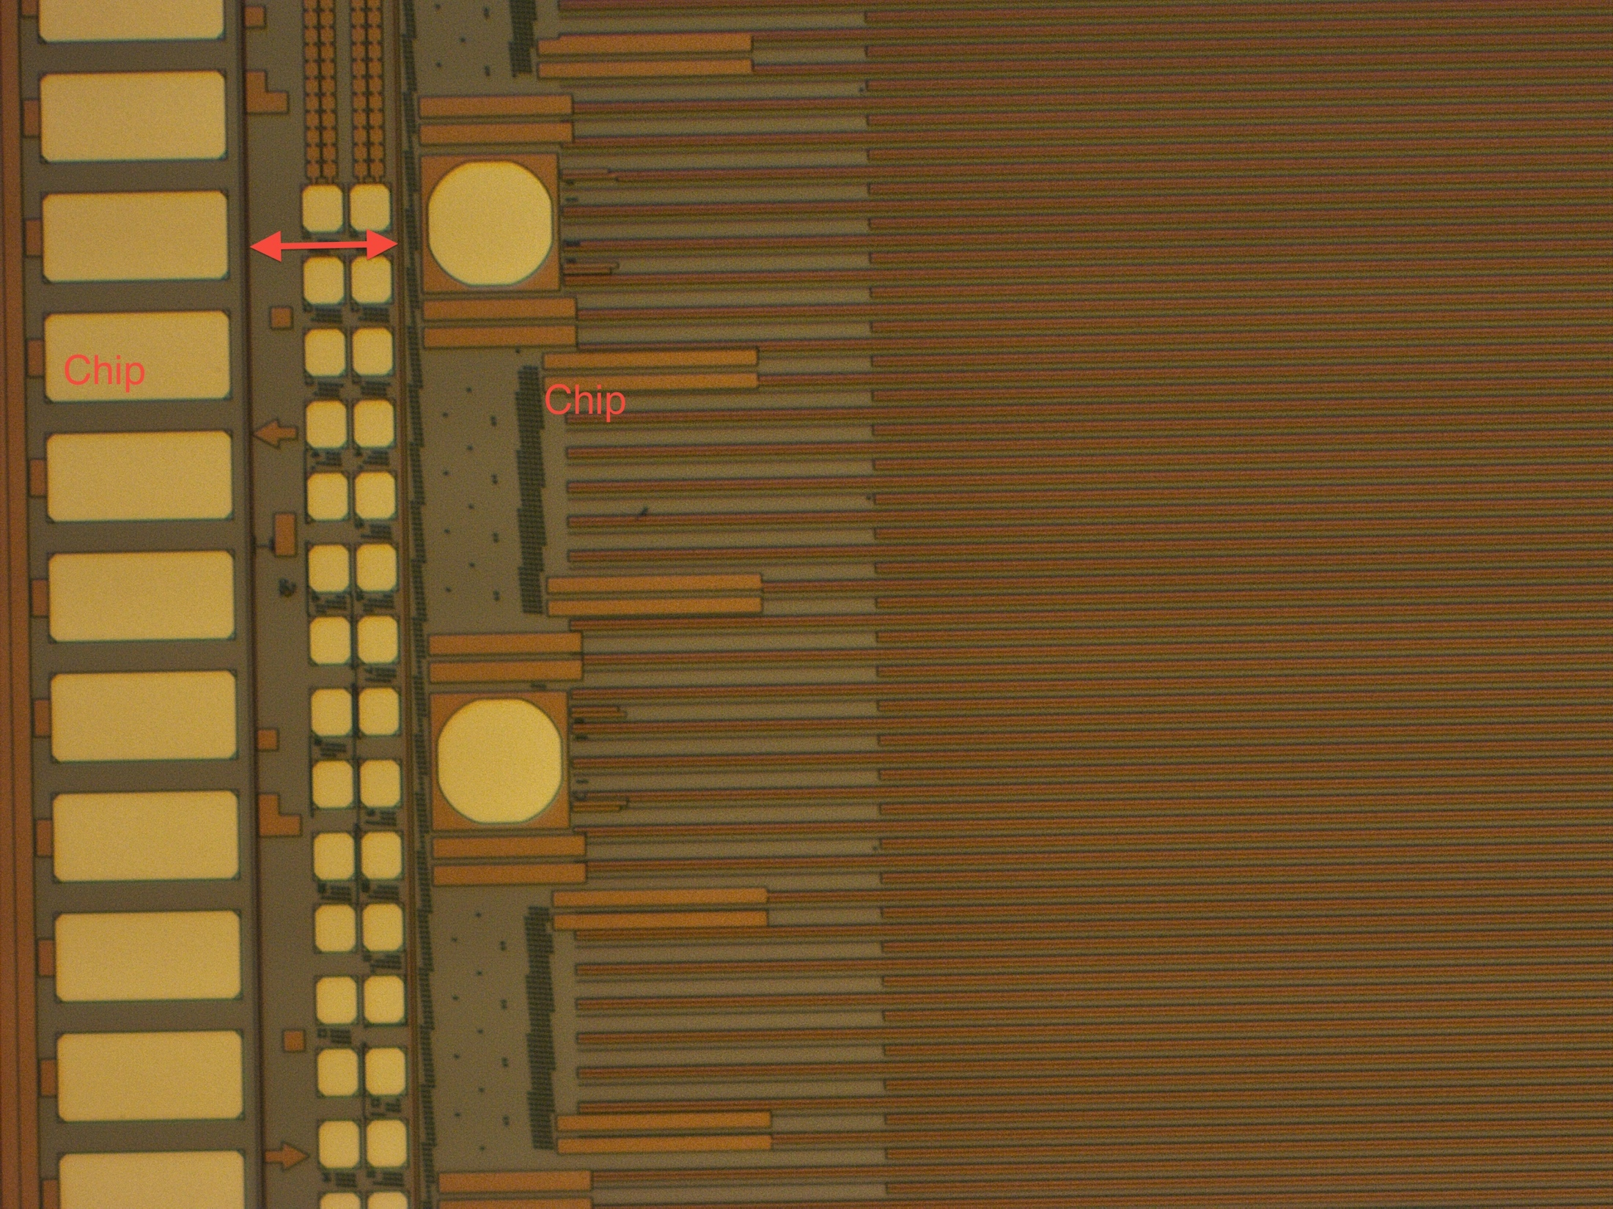
Laser dicing from the front will require free dicing lanes
Laser dicing from the back will require grinding to 50 um first → handling of thin wafer

Slide 18
Thinning & Dicing Status and Next Steps
STARS is preparing a pick-up tool: news beginning of July → test dicing of real CMOS processed pad wafer?
Asked offers from DISCO for blade and laser dicing: die picking not provided – evaluating
Rockwood investigated grinding accident with ITS2 pad wafer: origin found
Need to prepare market survey as for the plating: meeting with purchasing office in the next weeks.

Slide 19
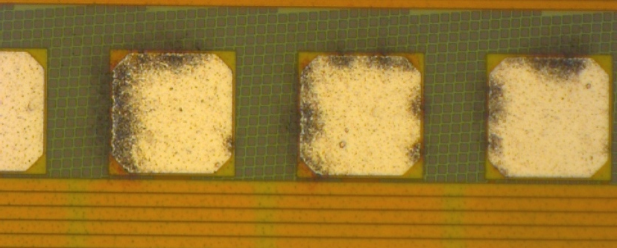
Wafer QA after processing
Main task: Basic visual inspection on the wafers, i.e. the connection pads, prior to
Post-processing and/or
Thinning and dicing
Rockwood carried out visual inspection on recent wafers following SEMI standard: provide pictures and summary report for each wafer.
Need to define procedure for production
(cost, time, etc. ).

Slide 20
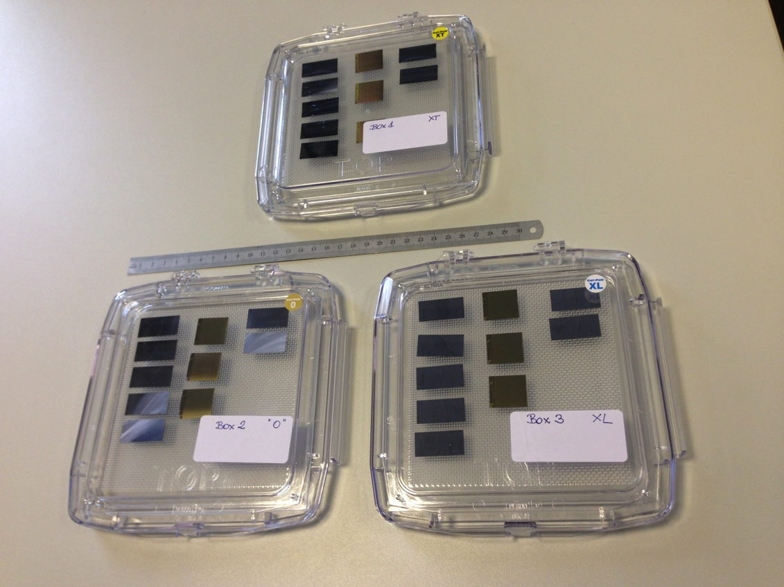
Transport and Storage
Planned transport test involving a number of institutes: i.e. IPHC, Pusan, Liverpool, …
Prepared gel-pak boxes with 50 um dummy chips and 50 um thick STAR HFT pixel chips

Slide 21
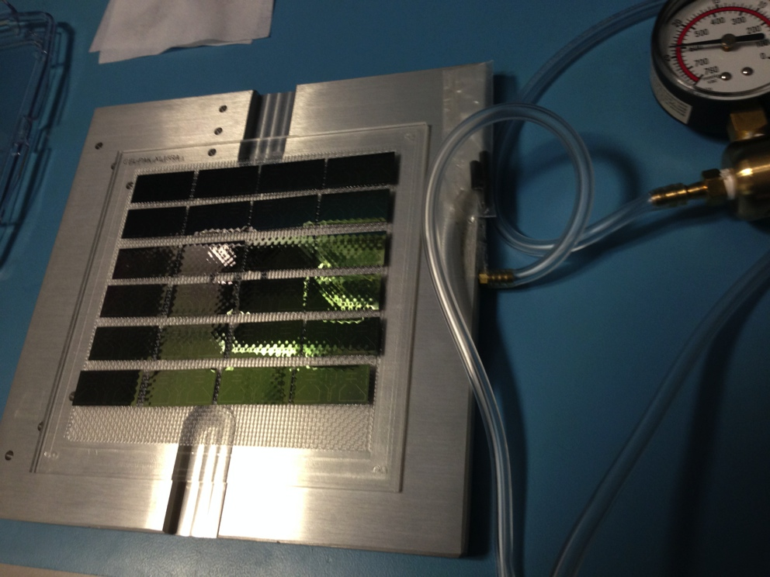
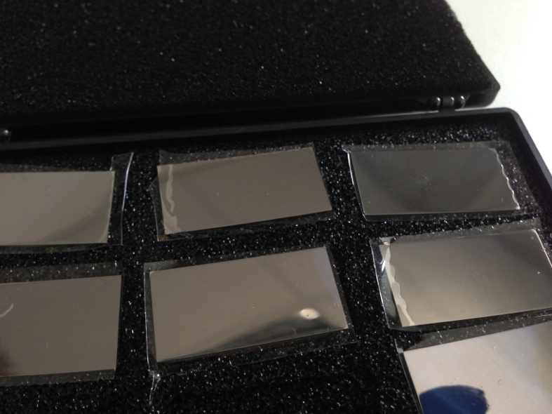
Chip Transport
Used identical large gel-paks to return pad chips (TMEC) from Rockwood (2 x 24 chips)
Chips cannot be removed applying vacuum
Cut out chips freed from gel by using HF-acid – limited use due to oxidation on the pads

Slide 22
Chip Transport
Discussion with Rockwood ongoing to identify whether the problem is due to one of the processing steps.
Short term solution: ordered and received foam boxes
Alternative solutions:
Foam box: needs improvement (flakes, dust, counter-pieces)
Waffle packs: requesting offer, investigating how to fix chip in the compartment

Slide 23
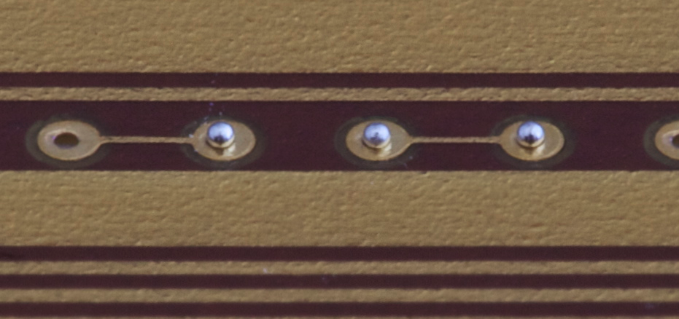
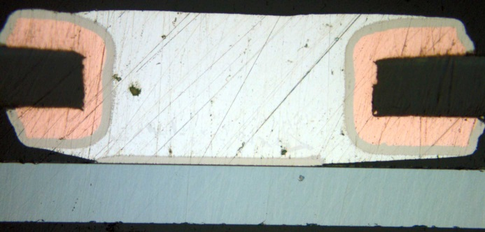
Interconnect R&D
Direct flux-free laser soldering on silicon chip
Solder balls (diameter 200 um)
50 um thick silicon chip

Slide 24
Interconnection R&D
Number of single chip assemblies soldered with very good yield:
 | Sample | Flex | Poly thickness | chip | contact | gas | daisy-chain resistance
1 | 04022014-SA1 | Test 15, new Ni/Au | 75 µm | TMEC new Ni/Au | 50/50 | N/H | 125 Ω
2 | 04022014-SA2 | Test 15, new Ni/Au | 75 µm | TMEC new Ni/Au | 50/50 | N/H | 115 Ω
3 | 07022014-SA1 | Test 15, new Ni/Au | 75 µm | TMEC new Ni/Au | 50/50 | Vacuum | 160 Ω
4 | 10022014-SA1 | Test 15 | 75 µm | TMEC new Ni/Au | 50/50 | Vacuum | 84 Ω
5 | 10022014-SA2 | Test 15 | 75 µm | TMEC new Ni/Au | 50/50 | Vacuum | 80 Ω
6 | 12022014-SA1 | Test 11 new production | 50 µm | TMEC new Ni/Au | 50/50 | Vacuum | 94 Ω
7 | 12022014-SA2 | Test 11 new production | 50 µm | TMEC new Ni/Au | 50/50 | Vacuum | 74 Ω
8 | 13022014-SA1 | Test 11 new production | 50 µm | TMEC new Ni/Au | 50/50 | Vacuum | 60 Ω
9 | 13022014-SA2 | Test 11 new production | 50 µm | TMEC new Ni/Au | 50/50 | Vacuum | 46 Ω
10 | 13022014-SA3 | Test 11 new production | 50 µm | TMEC new Ni/Au | 50/50 | Vacuum | 59 Ω
11 | 19022014-SA1 | Test 11 new production | 50 µm | TMEC new Ni/Au | 48/50 | Vacuum
12 | 24022014-SA1 | Test 11 new production | 50 µm | TMEC 3 produc | 50/50 | Vacuum | 39 Ω
13 | 26022014-SA1 | Test 11 new production | 50 µm | TMEC new Ni/Au | 49/50 | Vacuum
650 solder contacts
3 failures (understood)
Can correlate good soldering quality with integrated laser power value → no need to cut the sample → first step in defining quality procedure

Slide 25
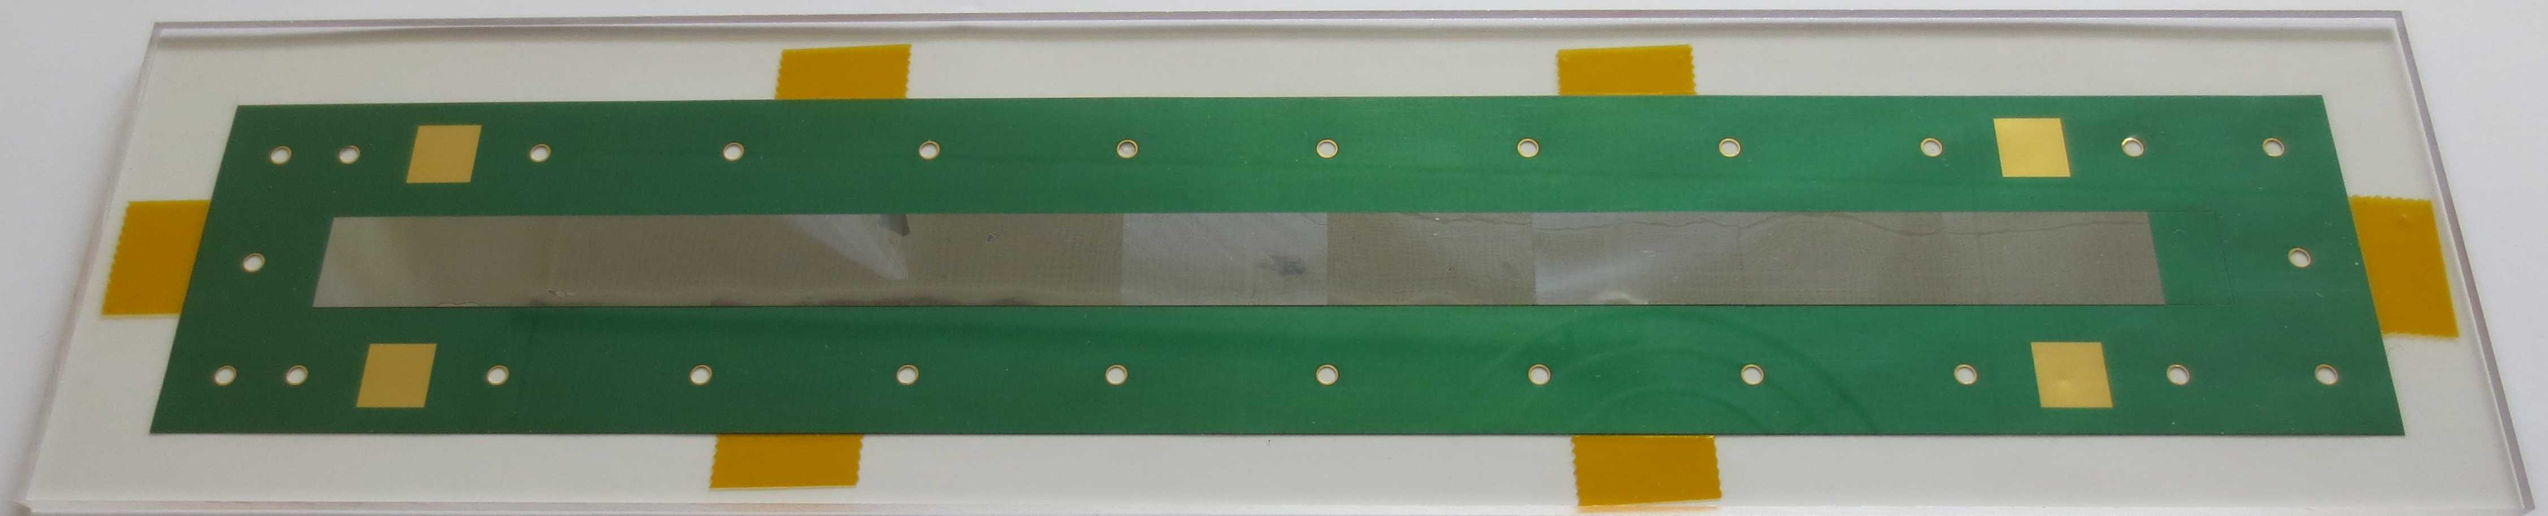
Interconnection R&D
2 IB modules built with 50 contact pad chips (TMEC)
Alignment done fully manually
Vacuum box leaking (missed 7 contacts out of 450 due to oxidation)
Daisy chain resistance value ok
Next: waiting for plated chips to assemble pALPIDEfs and pad chip modules

Slide 26
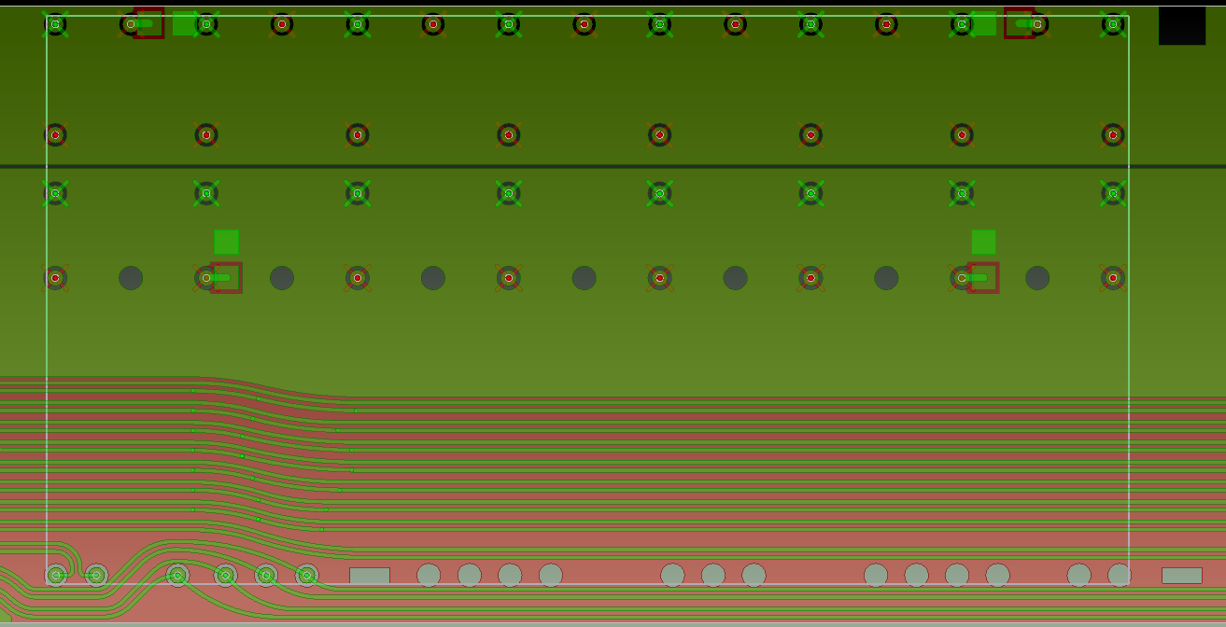
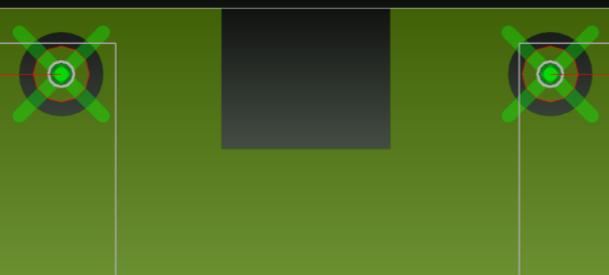
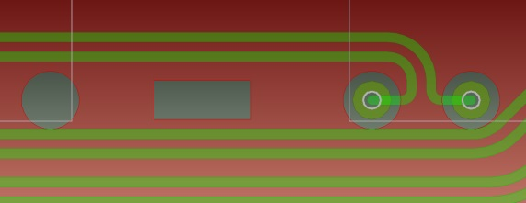
Al-FPC design
Di Mauro
A. Junique
Openings for chip position measurement
1 mm
1 mm
1 mm
1 mm
0.4 mm
0.4 mm

Slide 27
Al-FPC manufacturing
Al coating | Etching | Status
LERMPS (F) | Chemical etching (CERN - R. De Oliveira) | Al quality OK: roughness 0.39 μm, surf. index 1.06, resistivity ~ 0.22 Ω/cm Machine capability (guaranteed Al layer homogeneity): 0.1x1 m² Delivered 2 samples (9-chip): 1 daisy chain + 1 with signal tracks
DEPHIS (F) |  | Al quality not OK: too porous (roughness 0.62 μm, surf. index 1.2) and too high resistivity ~ 0.7 Ω/cm Investigation is ongoing, setting up of machine to reproduce LERMPS parameters (machine capability: 0.5x1.5 m²)
FHR (DE) |  | Best Al quality: roughness 0.14 μm, surf. index 1.007, resistivity ~ 0.16 Ω/cm Issue with presence of fibres and particles embedded in Al layer under investigation Machine capability: 0.5x1.6 m² Delivered 2 samples (9-chip): 1 daisy chain + 1 with signal tracks
IREIS/HEF (F) |  | Leader “surface engineering” French company Machine capability 4 x 1x0.30 m² Al coating tests this week
LERMPS baseline solution, mass production affordable ( ~ 18 batches of 6 FPC)
Tests with other companies driven by R. De Oliveira to find alternative supplier, very often LERMPS delivery time quite long

Slide 28
Laser etching (Swiss Micro Laser)
Optimized laser parameters
Delivered 9-chip FPC prototype (on old DEPHIS foil)

Slide 29
Mass Test – Probecard Preparation
Probecard for the pALPIDEfs prepared by Youngil Kwon (Yonsei):
Double needles for the contacts to check contact quality automatically
Complex probecard needle matrix with double needles reaching into the contact window from 4 sides.
Card was delivered at CERN early May:
Mechanical test on prober
Contact test on ITS2 CMOS wafer (pad wafer and real CMOS wafer)
Now: connecting to pALPIDEfs test system – work ongoing

Slide 30
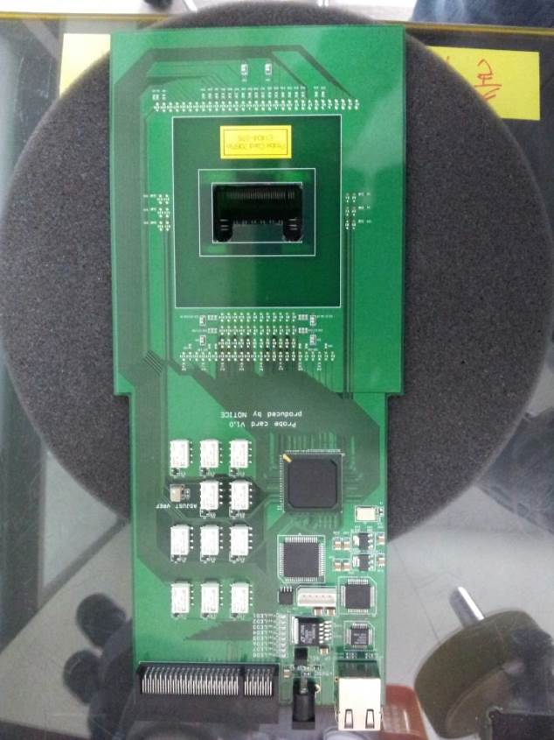
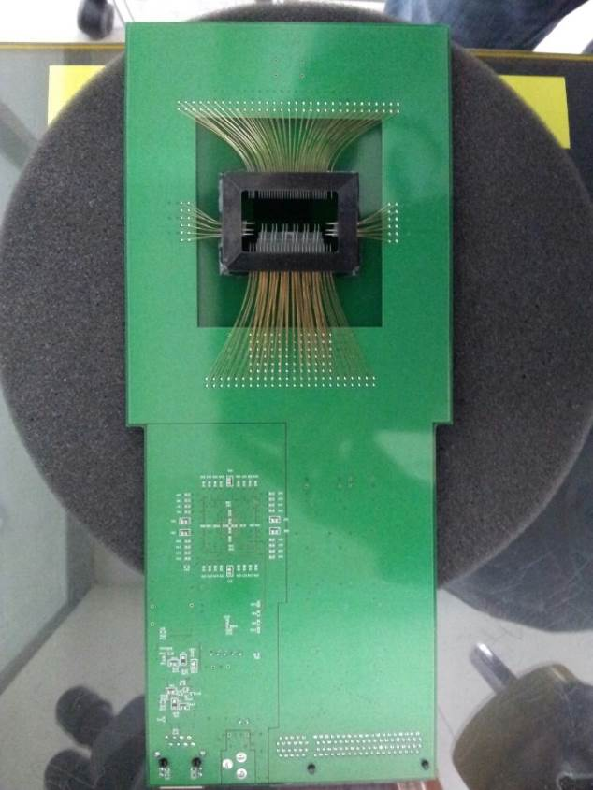
2. Probe Card Pin Contact Analysis
2.1 Probe card Contact
206pin Top/Bottom
Youngil Kwon
EQ Eng

Slide 31
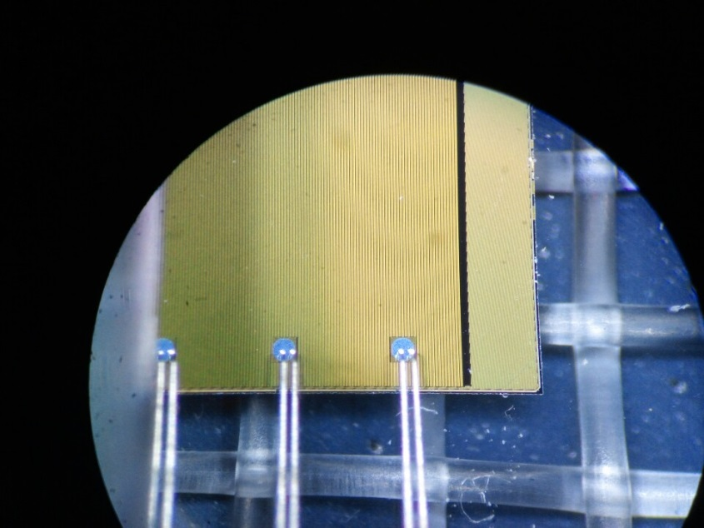
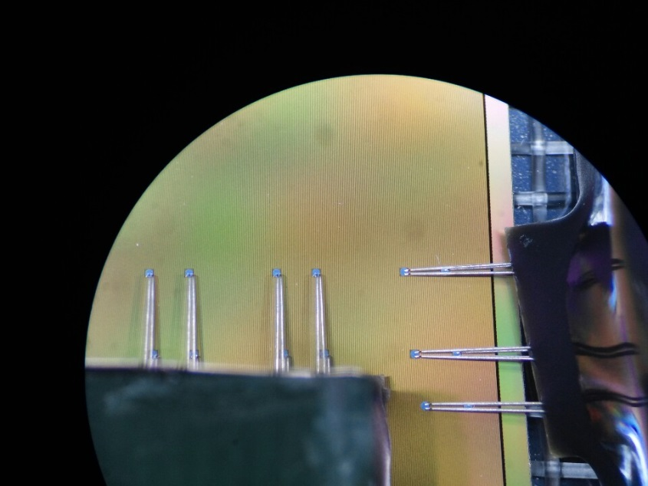
2. Probe Card Pin Contact Analysis
2.2 Probe card Contact
Youngil Kwon
Wafer 우측 하단向 Position
Wafer Center 우측向 Position
Pin 數 | 206pin(1Pad 2Pin)
Pad Size | 224*224um | Pad Pitch 874um
Needle thickness | 80um
Band Length | 290~310um
EQ Eng

Slide 32
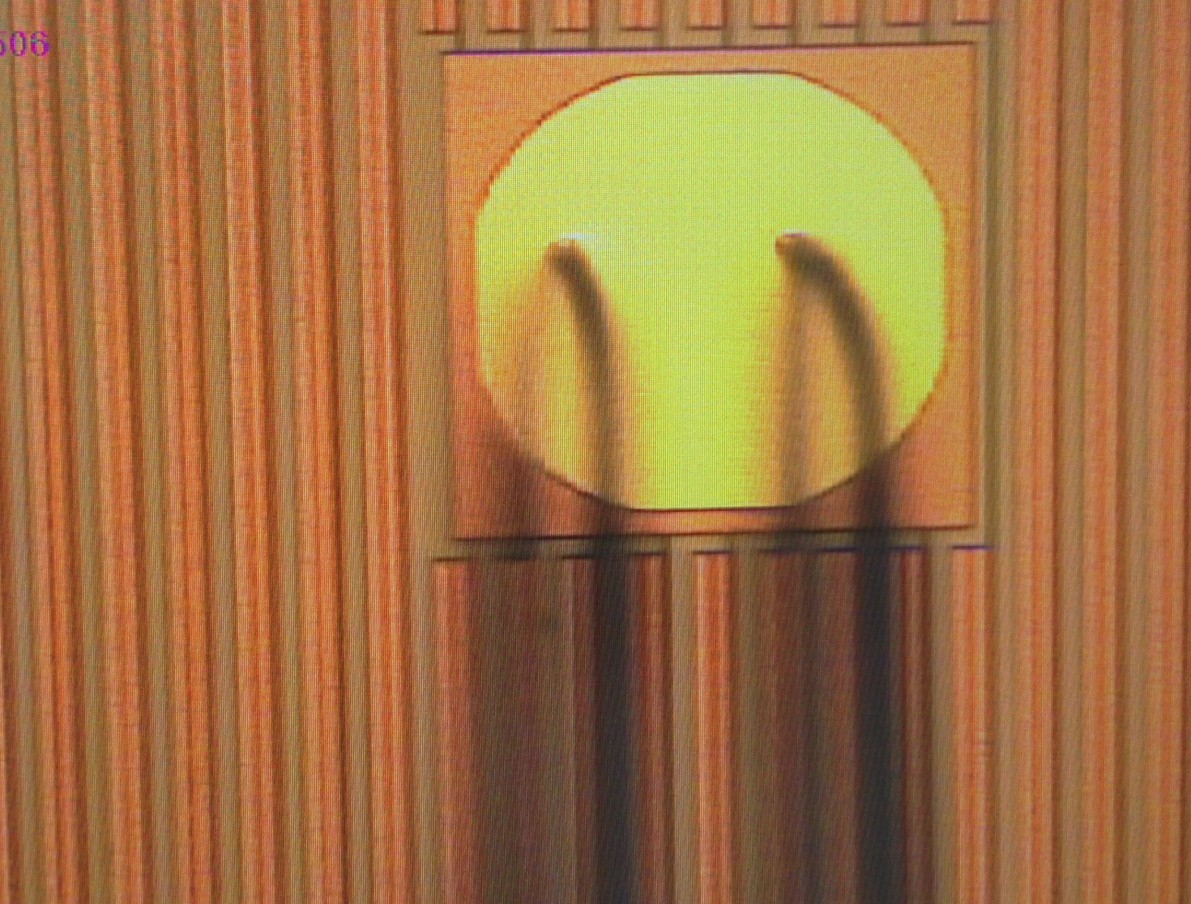
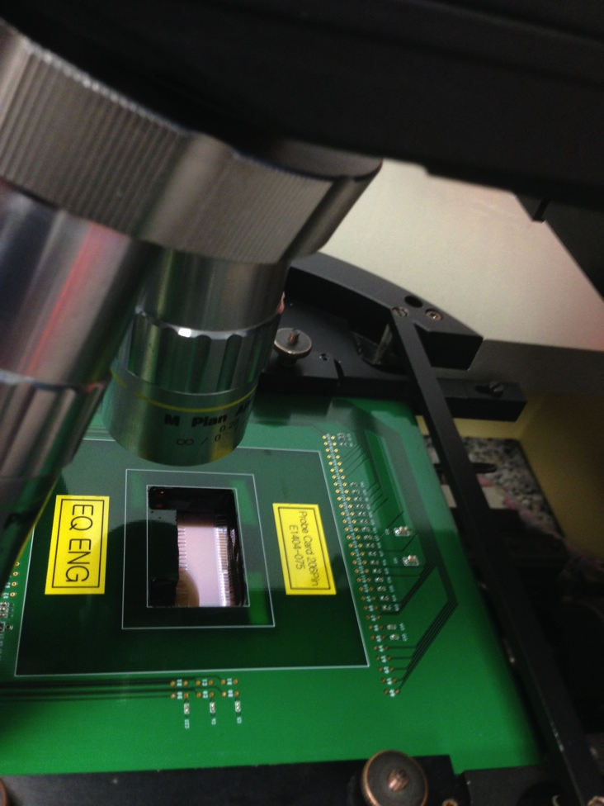
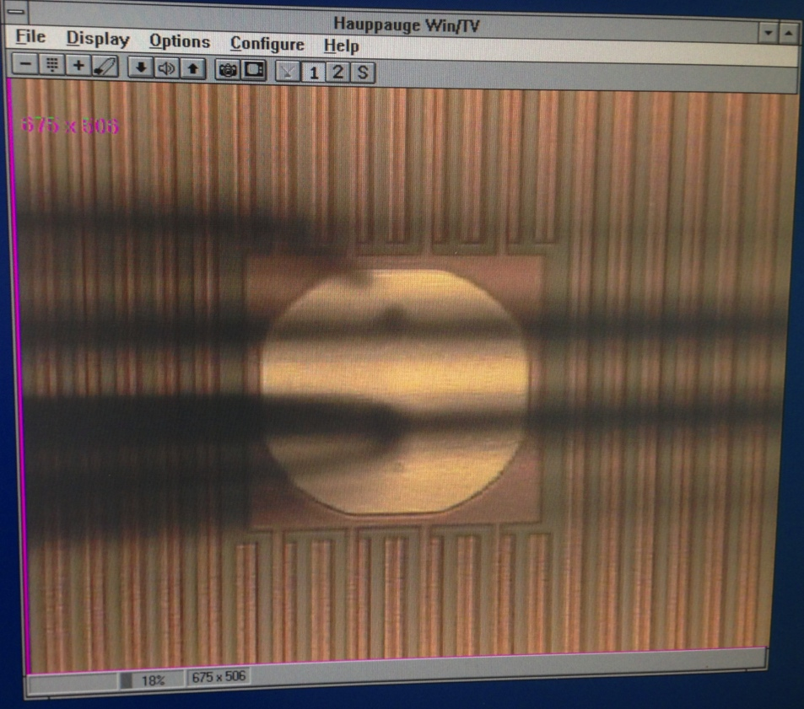
Pictures from mounting test at CERN

Slide 33
Summary
Blank wafer status: wafers for next runs procured, work on QA ongoing
Interconnect R&D: spTAB bonded pALPIDEfs assembly in preparation, waiting for plated chips for laser soldering of modules
Ni/Au plating of present wafers ongoing
Dicing and thinning of plated wafers in the next weeks
Probe-card installed at CERN prober; connection tests with pALPIDEfs test system ongoing
Investigations and alternatives for chip transport boxes ongoing

Slide 35
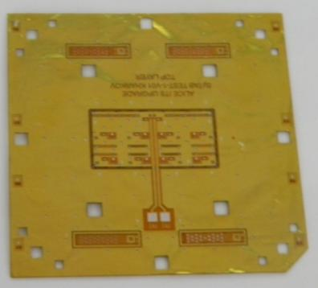
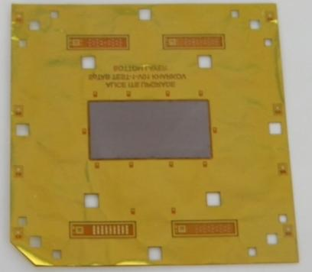
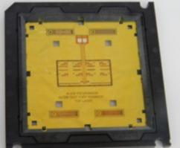
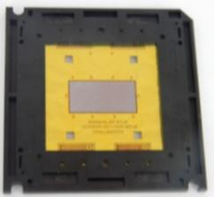
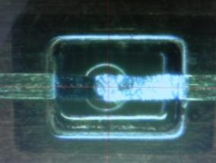
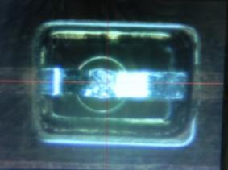
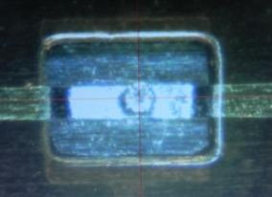




Assembled prototype of the FPC
View from FPC side
View from chip side
FPC prototype with mounted chip in
TAB-70 technological frame
Different types of bond joints
Assembled FPC prototype was electrically and visually tested -results are OK!
(all 60/60 TAB joints are OK, chip is OK).
Top layer-to -chip
Bottom layer-to-chip
Interlayer connection
viatcheslav.borshchov@cern.ch

