Slide 1
LFD / Tuning Summary
Geometry | LF Detuning (Hz) † | Tuning (Hz) ‡ | Max Deformation (mm) | Peak Stress Intensity (MPa) | Sensitivity (Hz/mm)
LFD-0 | -6500.0
LFD-1 | -8131.5
LFD-2 | -7163.5
LFD-3 | -7013.9
LFD-4 | -6701.3
LFD-5 | -7341.7
LFD-6 | -7338.0
LFD-7 | -6665.2
LFD-8 | -6403.1 | 608055.6 | 0.479 | 157 | 1269427
LFD-9 | -6688.8
LFD-10 | -6539.3
LFD-11 | -7709.9 | 755826.5 | 0.480 | 178 | 1574639
LFD-12 | -5008.4 | 668048.8 | 0.399 | 159 | 1674308
LFD-13 | -7937.2 | 787447.4 | 0.567 | 222 | 1388796
LFD-14 | -7767.6
LFD-15 * | -4264.3 | 726247.2 | 1.059 | 368 | 685656
LFD-15-a * | -4182.8 | 660286.6 | 0.939 | 347 | 703173
LFD-16 * | -4951.7 | 839077.4 | 1.087 | 369 | 771849
* Tuner tab fixed.
† LFD simulation at 3.4 MV.
‡ Tuning is separate simulation with the simplified helium tank. Applied force on top and bottom is 4448N. Max deformation is measured from one side. Sensitivity is the tuning frequency shift divided by the max deformation at one side.

Slide 2
LFD / Tuning Summary
Geometry | LF Detuning (Hz) † | Tuning (Hz) ‡ | Max Deformation (mm) | Peak Stress Intensity (MPa) | Sensitivity (Hz/mm)
LFD-15 * | -4264.3 | 726247.2 | 1.059 | 368 | 685656
The geometry LFD-15 is showing the best optimization for LFD and Tuning sensitivity.
Geometry | Tuning force (N) | Tuning range (Hz) | Max Deformation (mm) | Peak Stress Intensity (MPa) | Sensitivity (Hz/mm)
LFD-15 | 4448 | 726247 | 1.059 | 368 | 685656
LFD-15 | 1500 | 244666 | 0.357 | 124 | 684936
If the both direction (push or pull) is used the tuning range is twice of the range shown above. For example, tuning range is +/- 245 kHz for +/-1500 N.

Slide 3
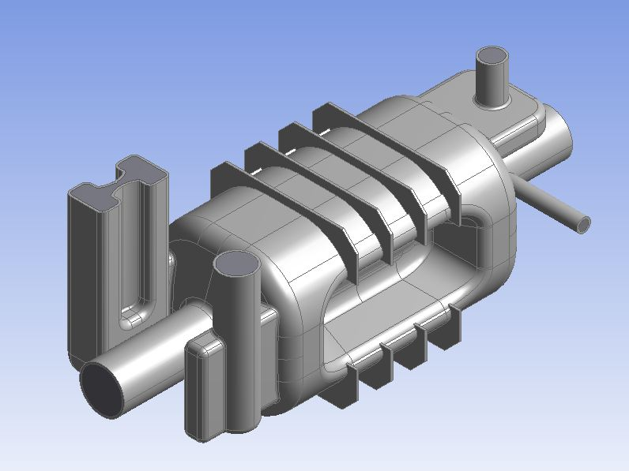
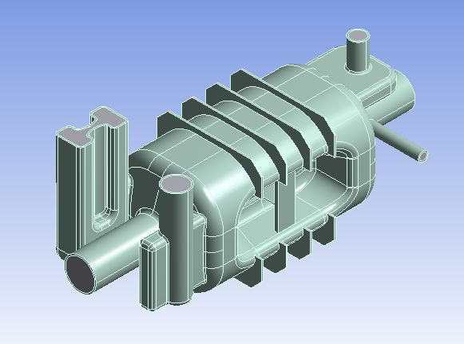
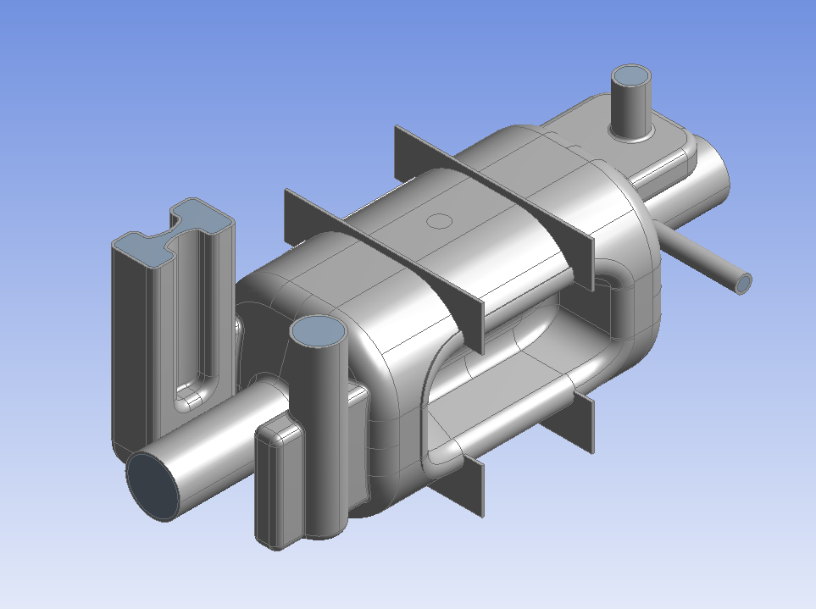
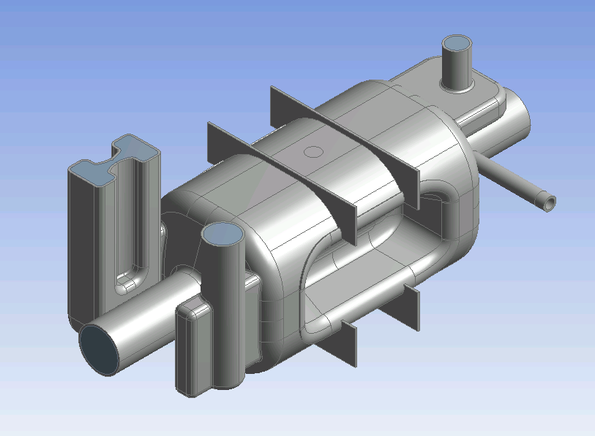
Study Geometries
LFD-8
LFD-12
LFD-15
LFD-15-a

Slide 4
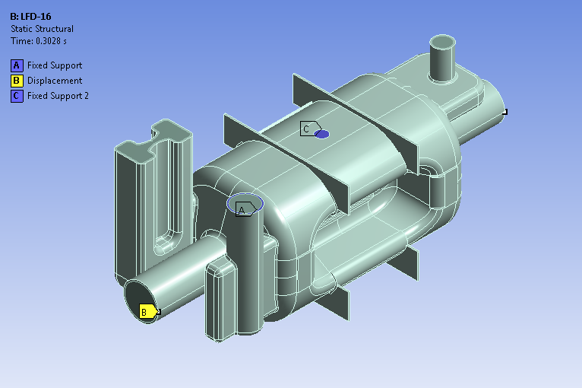
Lorentz Force Detuning
Boundary Conditions

Slide 5
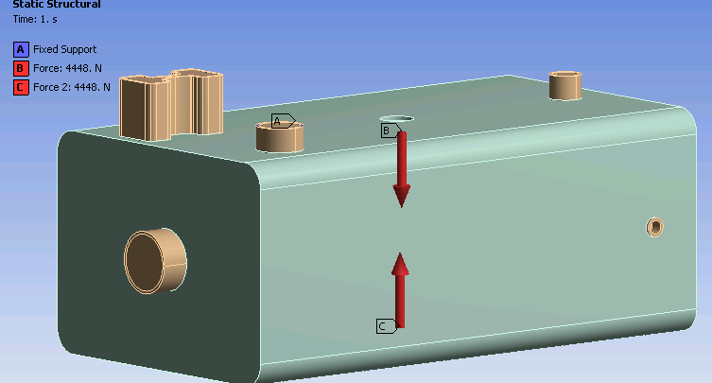
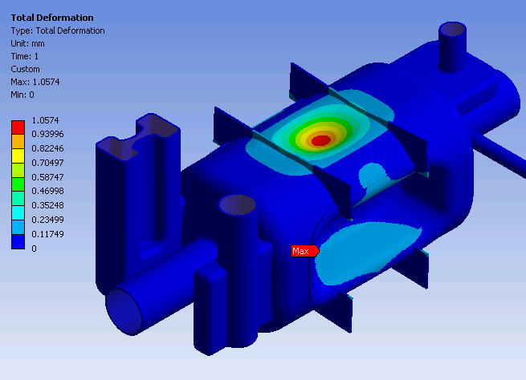
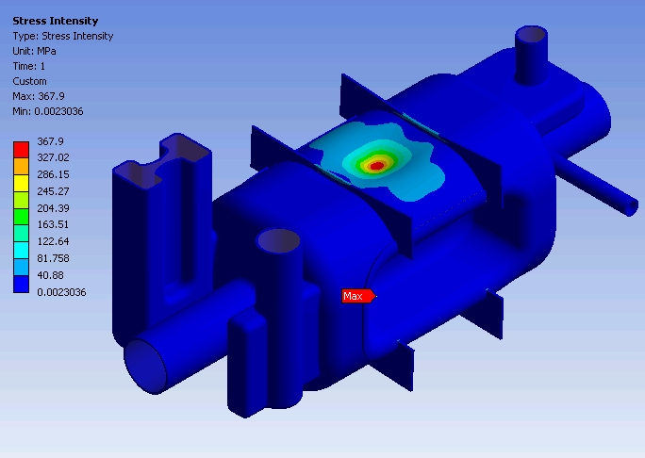
Tuning LFD-15
Bonded connections

Slide 6
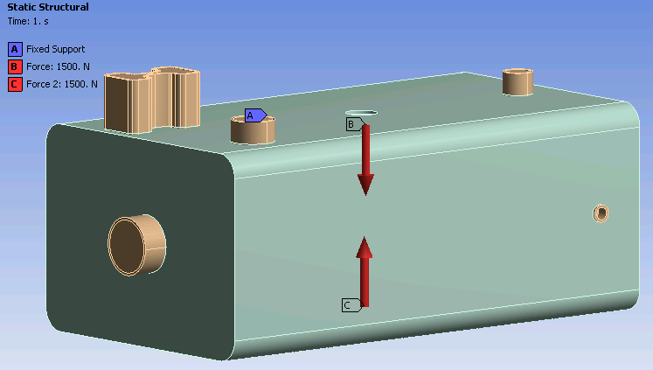
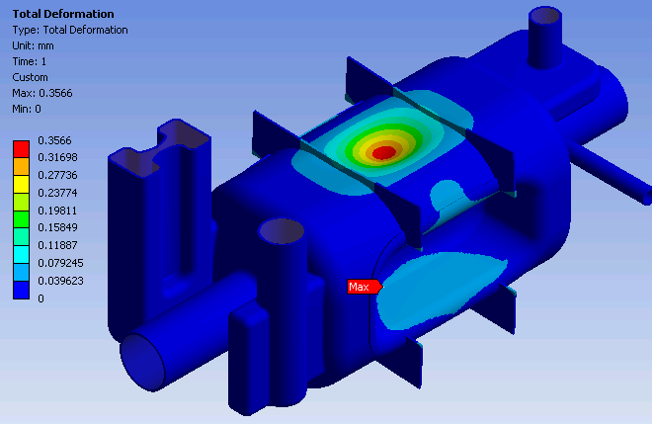
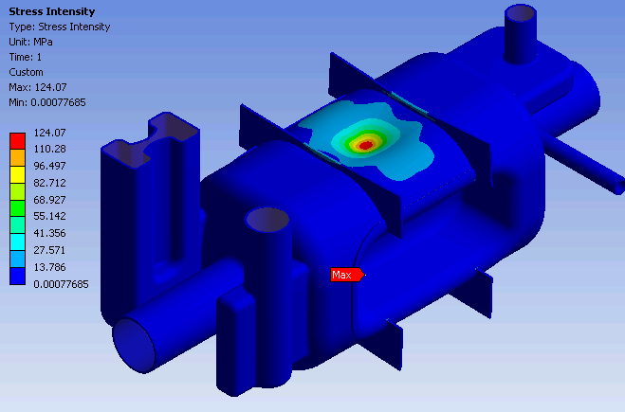
Tuning LFD-15
Same boundary conditions

