Slide 1

TRIUMF Data Analysis

Slide 2
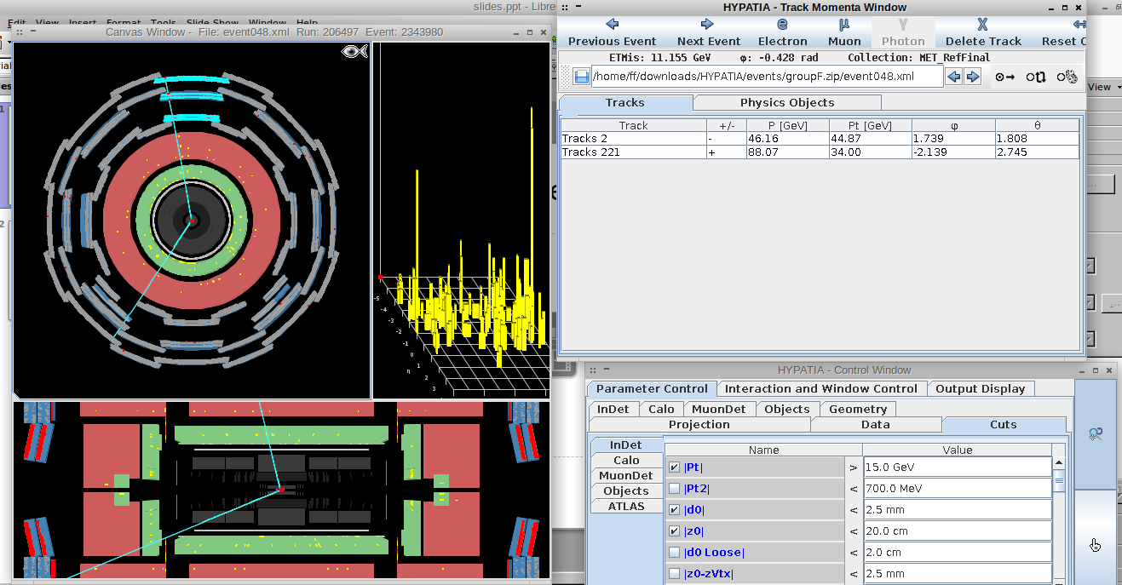
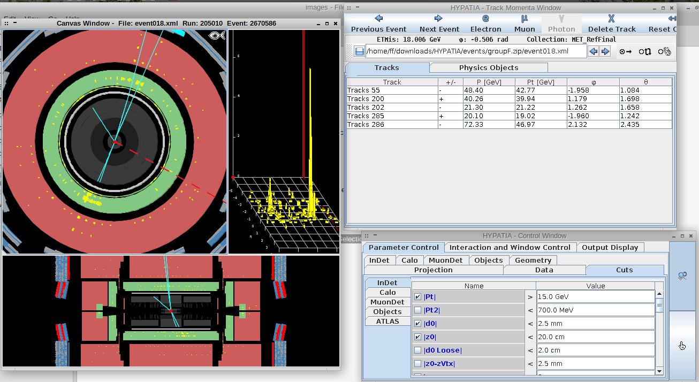
Event Selection
Electron events involve two tracks that each create a cluster in the green
EM calorimeter section. In the event that two electrons
choose the one with the opposite charge
Muon events involve two tracks going through the detector
4-lepton events may involve two muons
going through the whole detector and
two tracks with clusters

Slide 3
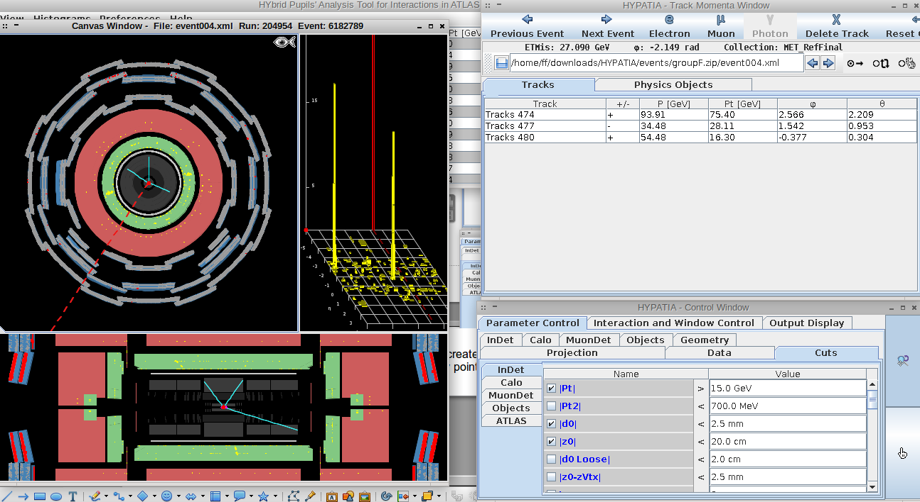
Event Selection
Photon events involve two clusters that were not generated by anything that
generates tracks.

Slide 4
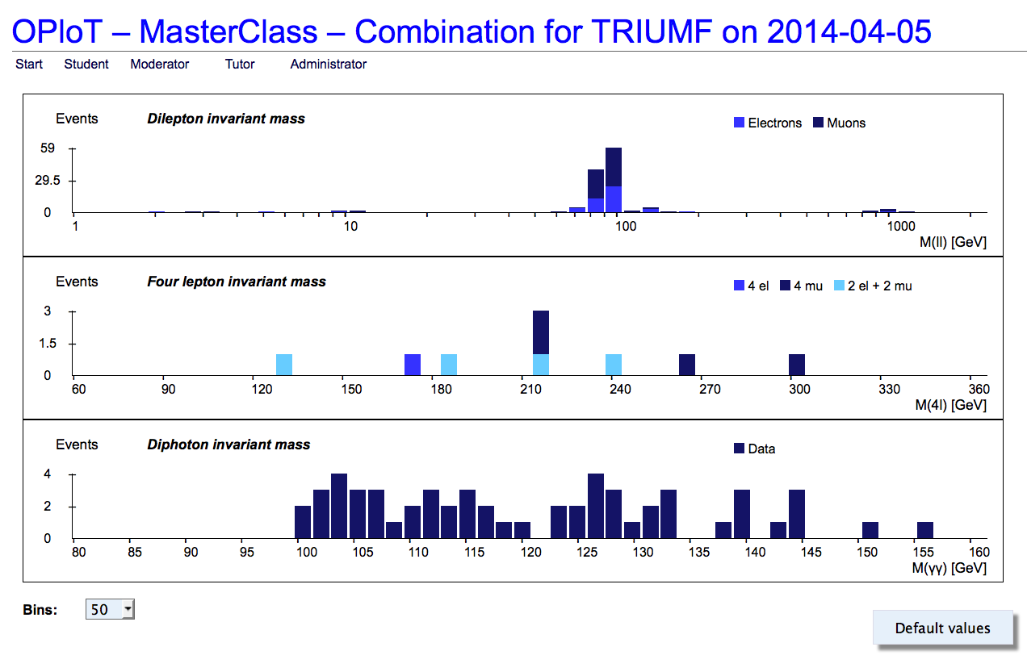
Final Data from All Groups

Slide 5
See Z boson
Why is there a 1000 GeV and 10 GeV dilepton event?
  Error?
  Z-boson: Z’ postulated in theories
  Upsilon meson: b quark-antiquark meson

