Slide 1
Beam Measurements After the Sources
at the Ion Source Test Stand
Including H₂, N₂ and Kr Gas Injection
Lots of input from Cristhian, Jan, Chiara, Nicolas, Roberto, Albin, Federico, Francesca, Jean-Baptiste, Jacques, Oystein …
R Scrivens, Linac 4 10/04/2014

Slide 2
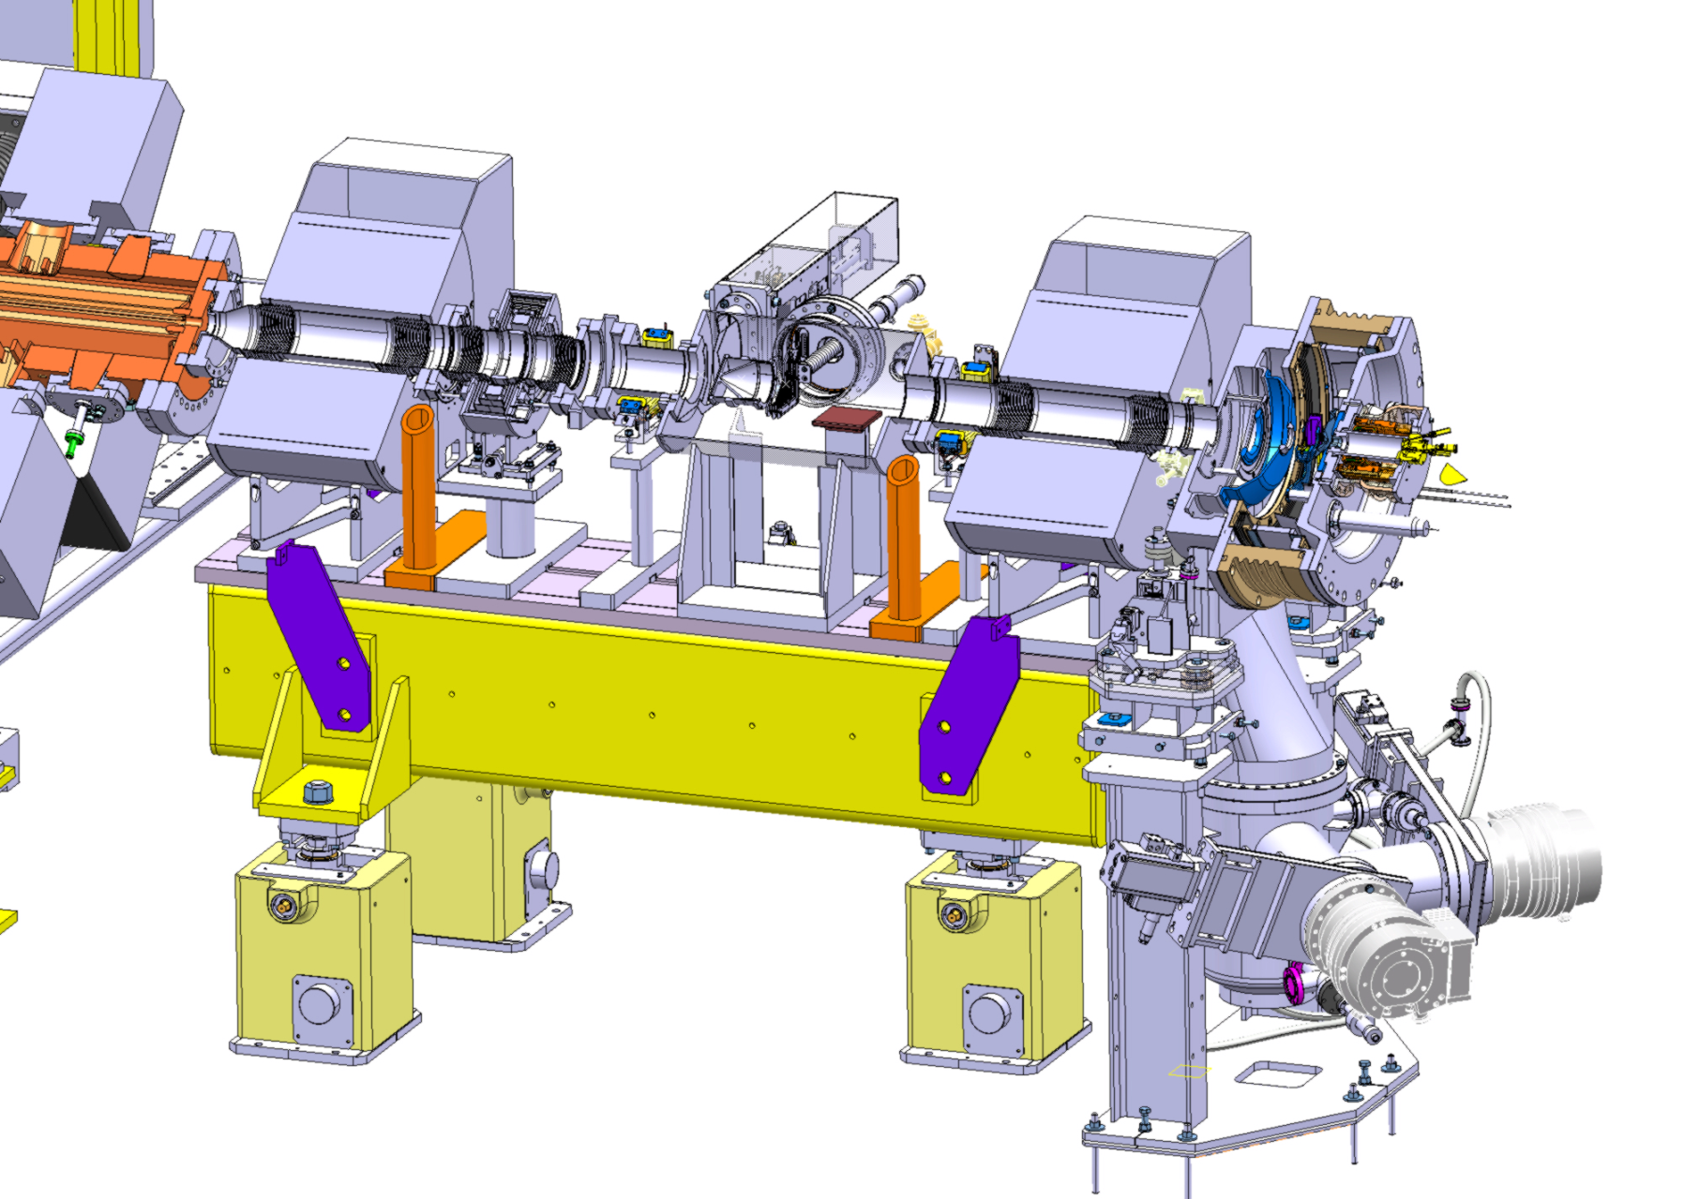
LEBT
Source
Plasma G
Extraction

Slide 3
Plasma Generators
 | DESY | IS02-25kW | IS02-40kW | IS02-Cs | IS-01
 | DESY design No Cesium RF: 20 kW | IS02 No Cesium RF: 25 kW | IS02 No Cesium RF: 40 kW | IS02 With Cesium RF: 90 kW | IS01 – latest version No Cesium RF : ?
 | Using the multi-electrode extraction and magnetised dump. The source used at the 3MeV TS. Used at the Linac4 tunnel up to now. | Installed at the test stand in December 2013. Ran for ~ 1 week without Cs. |  | The exact same source after cesiation (and has been running at test stand up to now, with additional cesiation) | Installed and about to be tested.

Slide 4
What have we measured?

Slide 5
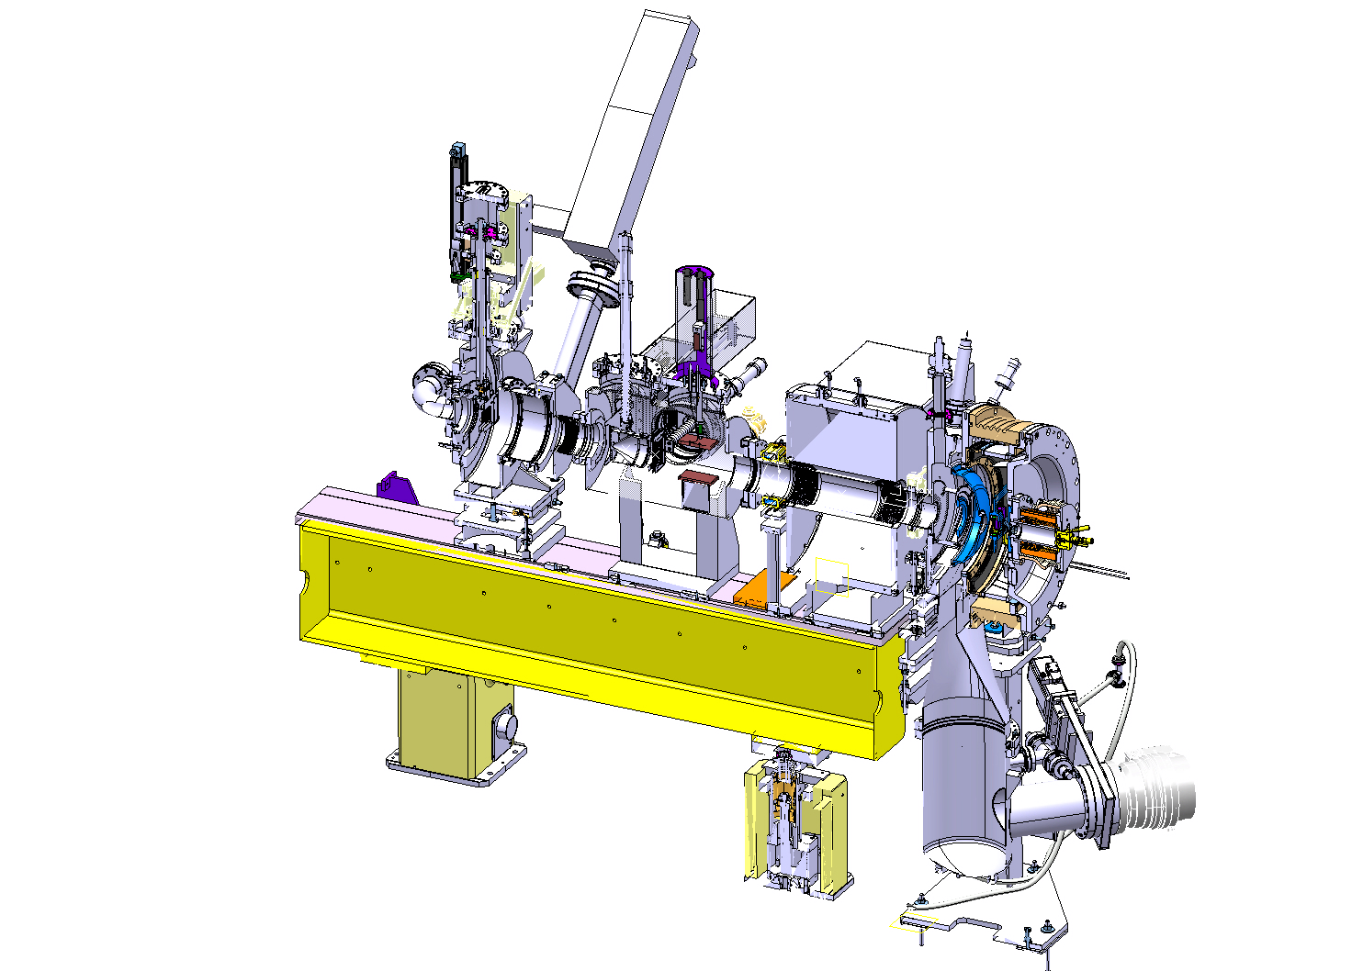
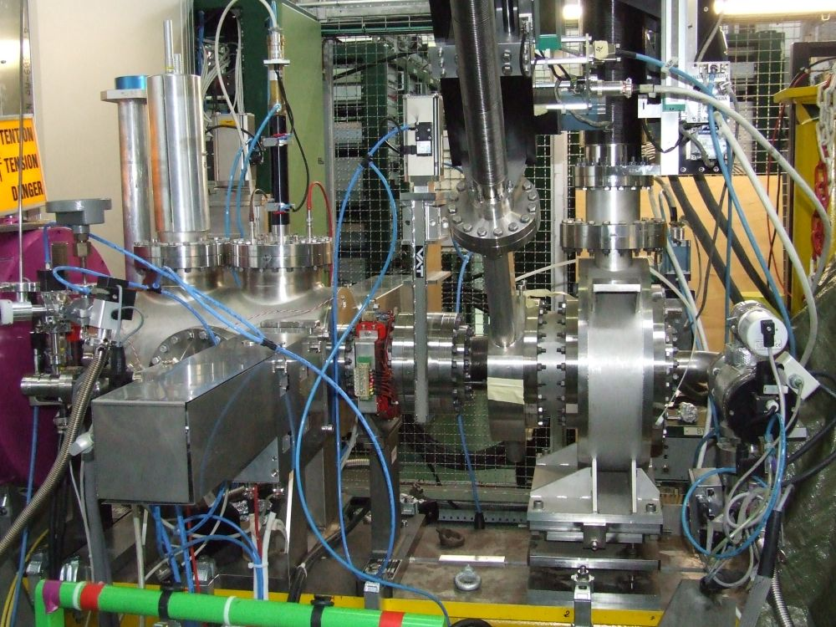
Set up
At the Ion source Test Stand (drawing is not fully accurate)
  Solenoid, 1 Steerer
  Prechopper – grounded
  Gas Injection (not on for all measurements)
  Faraday cup
  SEMGrid
  Emittance meter

Slide 6
4 Plasma Generators Compared
Intensity
 | DESY | IS02-25kW | IS02-40kW | IS02-Cs
 | DESY design Multi electrode extraction | IS02 No Cesium RF: 25 kW | IS02 No Cesium RF: 40 kW | IS02 With Cesium RF: 90 kW
Current | 17mA | 16mA | 29mA | 50mA
Date EM | 05/03/2013 | 02/12/2013 | 10/12/2013 | 16/12/2013
Date FCup | 22/11/2013 | 22/11/2013 | 09/12/2013 | 16/12/2013

Slide 7
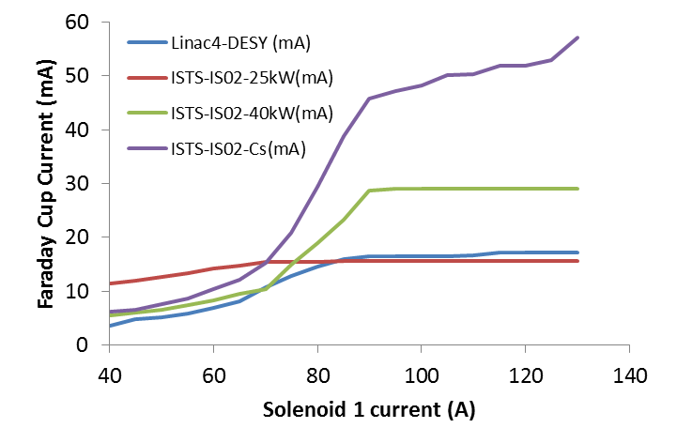
Faraday Cup – Intensity Measurement

Slide 8
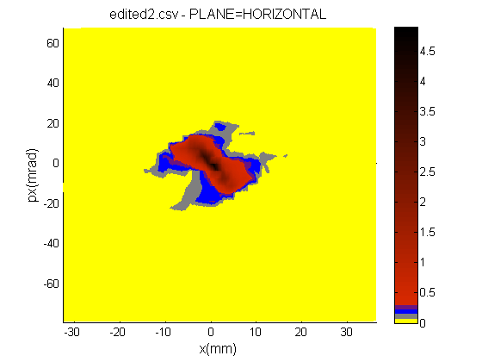
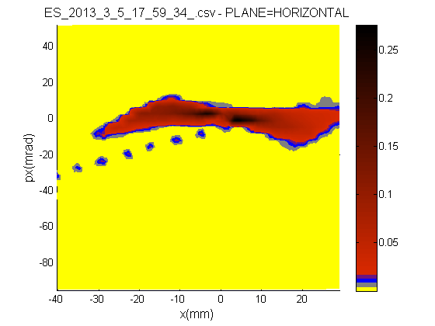
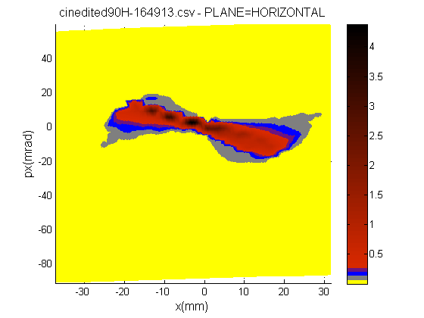
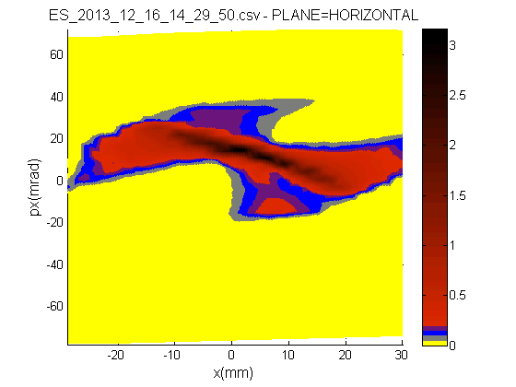
Emittance H – sol=90A
IS02-25kW
DESY-20kW
IS02-40kW
IS02-Cs-90kW

Slide 9
Data Summary – For Measurements on Prev Slide
 | DESY | IS02-25 | IS02-40 | IS02-Cs
Current | 17mA | 16mA | 29mA | 50mA
RF power | 20 | 25 | 40 | 90
Time slice | SEJ+480us | SEJ+480us | SEJ+480us | SEJ+380us
εn 0.4% | 0.69 | 0.44 | 0.655 | 1.04
εn 10% | 0.40 | 0.09 | 0.16 | 0.37
Vsource | 45 | 44.8 | 44.4 | 45
Vpuller | 30 | 34.5 | 28.8 | 20.8
Vdump | 36 | 37.1 | 37.2 | 36.4
LEBT P (mbar) N2 equiv | 5e-7 | 1e-6 | 1e-6 | 1e-6
Sol Current (A) | 90 | 90 | 90 | 90
Today | DESY
Vsource | 45
Vpuller | 24
Vdump | 38
Currents are from the Faraday Cup scan. Not the max achieved.

Slide 10
If we switch to an IS01 in the tunnel
What would be the conditions with an IS01 in the tunnel?
This is the proposal being put forward by us for 12MeV commissioning.
Today’s closest measurement to this source configuration is the
“IS02-40kW uncesiated” from 10/12/2013.
Jean-Baptiste has transported this beam through the RFQ and sees a similar 68% transmission (to DESY).
But the intensity from the source is >50% greater than DESY.
IS02-40kW

Slide 11
Do the Simulations Match?

Slide 12
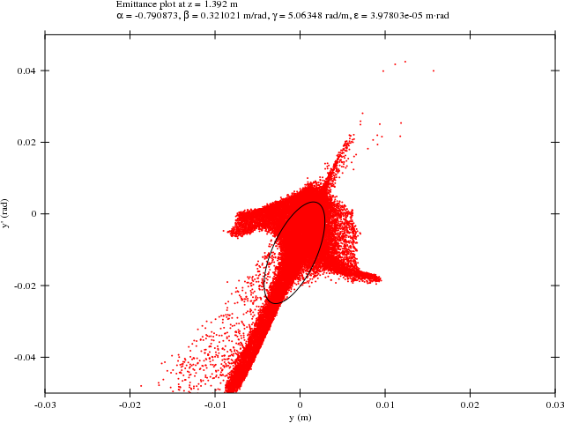
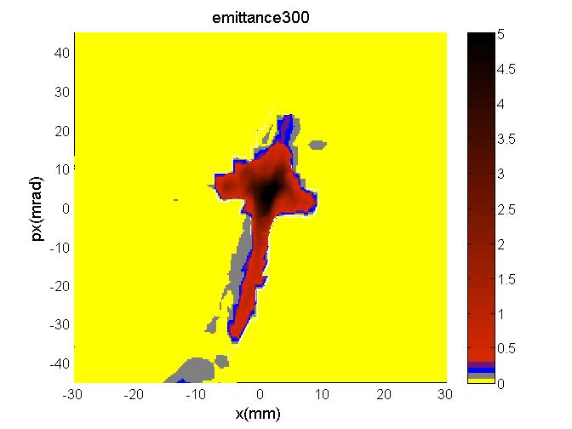
Do the Simulations Match?
Simulations can be made from Source Plasma to Emittance Meter.
Uses IBSIMU (a C++ library for plasma->beam extraction)
Oystein Midttun has extensively studied the currents in the extraction region to refine the simulations.
Transfer this beam to the LEBT and emittance meter (using space-charge compensation of trapped ions) – Cristhian Valerio.
Simulation real data
Solenoid 100 amps Horizontal
Outliers are coming from the “edge” of the beam.
In turn they came from the edge of the source aperture.

Slide 13
Space-charge Compensation – gas change?

Slide 14
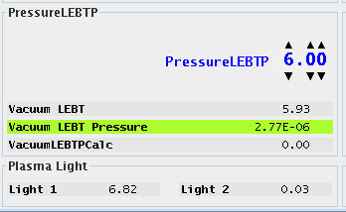
High current, unbunched beams are compensated by ions created by the beam striking the residual gas.
Electric field from the beam can be reduced by 80%. This make a large difference to the beam transport at low energy.
At Linac4 we have foreseen to be able to adjust the pressure in the LEBT to allow control over the generation rate of these secondary ions.
Its been operational at Linac4 since the beginning.
A rather complicated control loop (PH-DH -> BE-ABP -> TE-VAC) stabilises the pressure in the LEBT.
Dynamic H₂ pressure

Slide 15
Cristhian Valerio made tests in the Source Test Stand with 3 different gases:
  H₂ : Present anyway, sure will not affect the source.
  N₂ : Safe, easy to pump.
  Kr : High cross section for ionization, heavy, hard to pump with getter based pumping.
For each gas we measured the beam emittance for a range of injection pressures.
The source was maintained at 30mA with daily correction of the RF power (it was in cesiated mode).
The full series of measurements took about 2 weeks.
At the test stand we do not have a pre-chopper, so the rise of the source pulse is also visible.

Slide 16
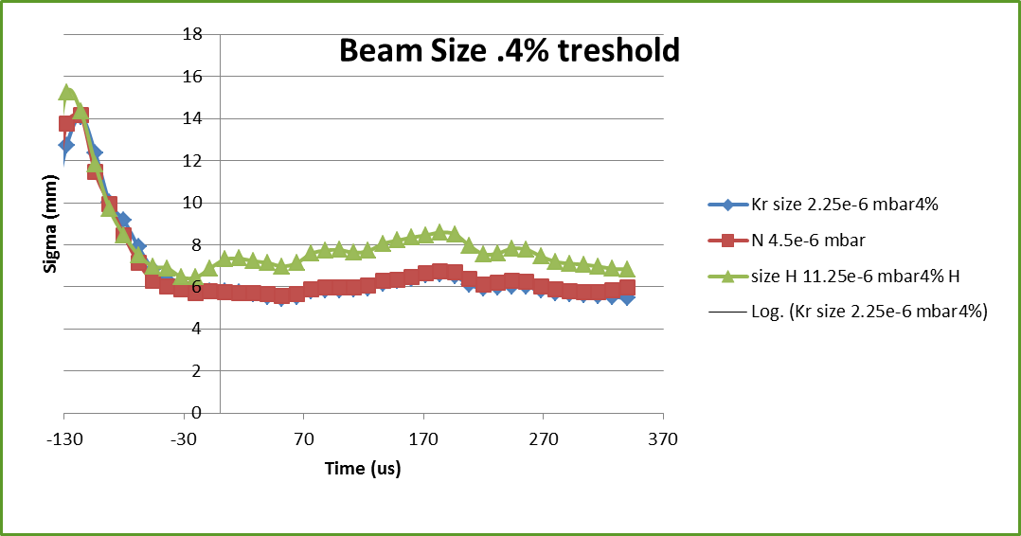
From the emittance meter data, we reconstruct the beam SIZE as a function of time in the pulse.
From this we derive a stabilisation for that measurement.
Higher pressure -> shorter stabilisation time.
We need to run Linac4 with a stabilisation time of approx 25us.

Slide 17
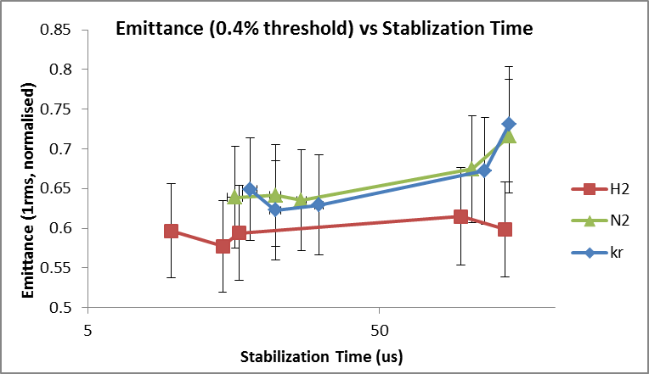
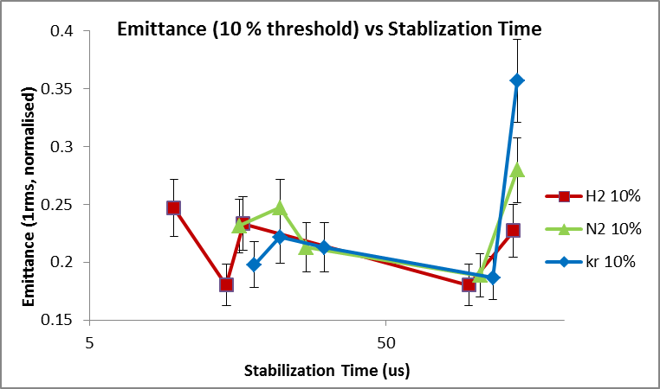
The Final Results…. ε is the statistical phase space emittance for all data “SEJ -> SEJ+350us”

Slide 18
Within the error bars, there is nothing to strongly conclude one gas is better than another for beam transport reasons.
However the cross sections for ion production of the gases is different, such that for the same stabilisation time requirement, we could operate at
H2 1x10⁻⁵ mbar == N2 5x10⁻⁶mbar == Kr 2.5x10⁻⁶mbar (examples)
Heavier N2 and Kr would reduce flow into the RFQ.
But for Kr NEG pumps and ion pumps are inefficient.
Propose to test N2 at Linac4, to see effect on RFQ.
  Carlo agrees for RFQ for a test.
  Vacuum agree pressure in RFQ should be lower, and pump lifetime higher.
Could we do a test within DTL commissioning period.
  Start up with H2
  1 day to switch gas, restart source / LEBT and recover beam through RFQ.
  1 day to switch back to H2 if bad results.
H2 will still be present from the source. RFQ vacuum gauges would reduce by a factor 2 only (whereas the gas density will be a factor 4 lower).
For the long term effects on a Cs source, we would switch to N2 at the source test stand in the future.

Slide 19
Summary and Conclusions
Multiple plasma generators measured.
An IS01 could be ready soon, and should lead to more beam through the RFQ.
N2 could be a better alternative as a LEBT gas for the RFQ.

