Slide 1
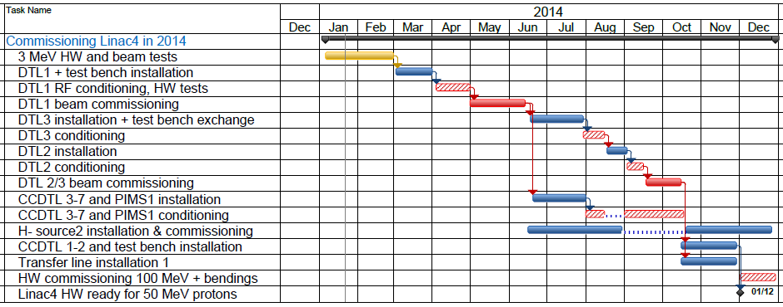
News:
Transfer line elements delayed (~2 m, cryostats HIE ISOLDE)
DTL2 plating and cleaning accumulates delay (overload end LS1)
Idea: profit to install the new ion source and test at 12 MeV
LINAC4 TENTATIVE SCHEDULE FOR 2ND HALF OF 2014
New (probable) date for DTL beam tests: 15.5.14
August/September:
Beam tests 12 MeV
Conditioning DTL3, CCDTL 3-7
Nov./December:
Conditioning DTL3
Beam tests 50 MeV
End of tests not changed (15.6)
October:
Install. meas. line
Installation DTL2
MV 08.04.14

Slide 2
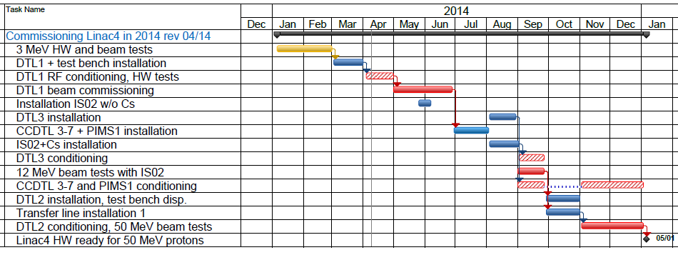
Tentative new schedule
(integrating all these inputs)
Considering another stop in January/February 2015 for installation of CCDTL1/2 measurement bench and transfer line elements, we would have only 2 months delay with respect to the Masterplan! (100 MeV in March instead of January)

