Slide 1
Linac4 H⁻ source: Status & objectives
April 2014
Nov. 2013 ISWP-Review:
Report available Apr. 2014:
ISWP met essential deadlines.
Probability of H-beam within nom. emitance.
Recommend to set equal effort on Cesiated surface and magnetron H⁻ sources
H⁻ beam | IS02 | Magnetron
40 mA | 90 % | 95 %
60 mA | 40 % | 80 %
80 mA | 5-10 % | 65 %
Tilted Magnetron WP:
Budget request launched

Slide 2
Tests prior installation of Cesiated IS02 in L4

Slide 3
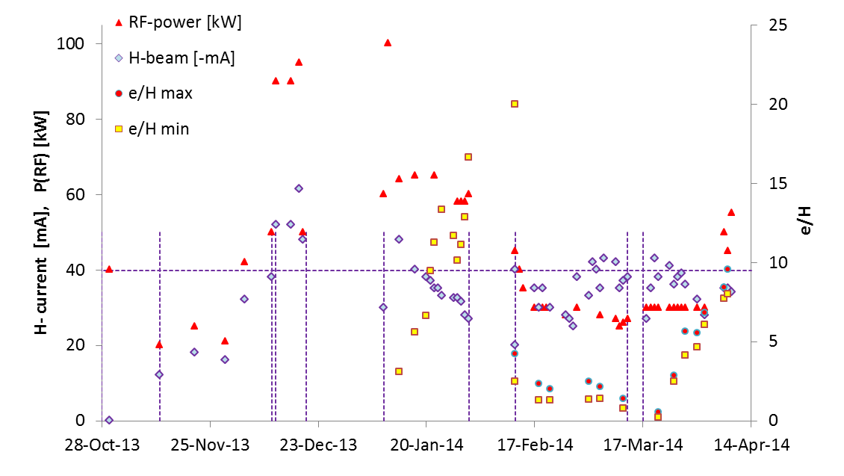
First cesiated source (IS02) operation Nov. 2013 - Apr. 2014
RF Conditioning
Xmas stop
HV-modif.
Volume prod.
Cesiation 1&2
0.2 & 1 mg Cs
Cesiation 3
5 mg Cs
Logbook data

Slide 4
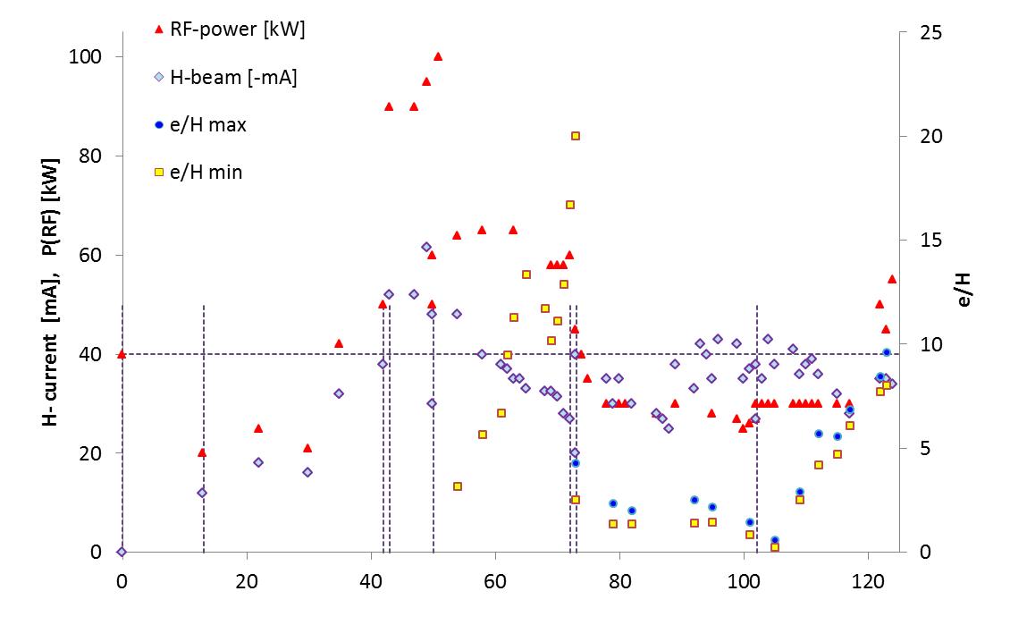
IS02 Accumulated experience in conditioning
& H⁻ Production:
Notes on IS02:
Volume production 30 mA
Cesiated 60 mA
Cs-shortage: Strong anti-correlation between H⁻ current and e-current
Improvement of e/H few hours after cesiation
Holds 100 kW RF
Plasma Generator cond.: 10 days
Volume production: 30 days
Cesiated surface: 80 days
D-base operational

Slide 5
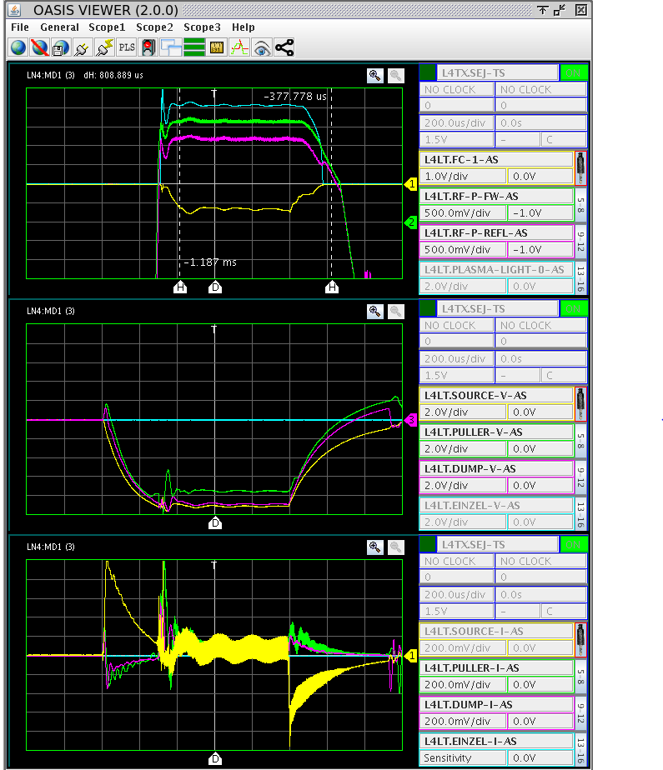
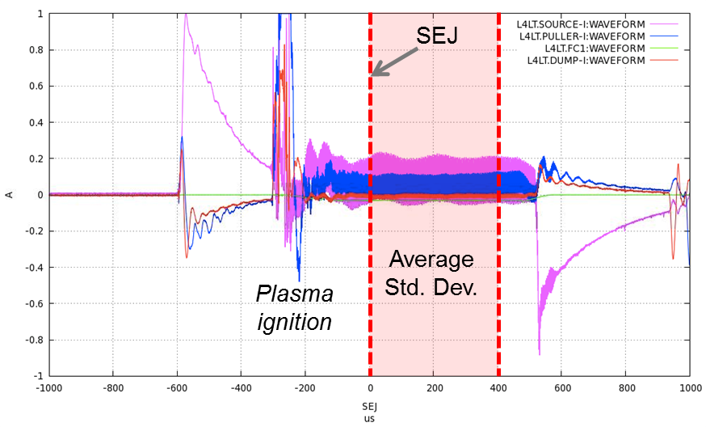
Database input via OASIS
A standardized OASIS menu fixed scaling
and insertion of units and physical scaling factors leads to the observable (voltage current, pressure temp. power).

Slide 6
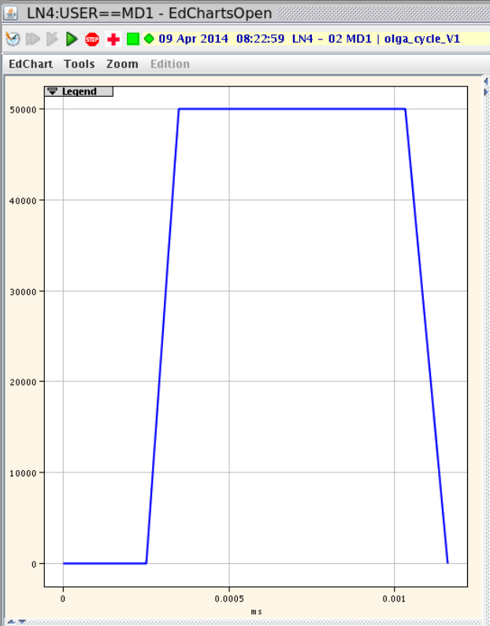
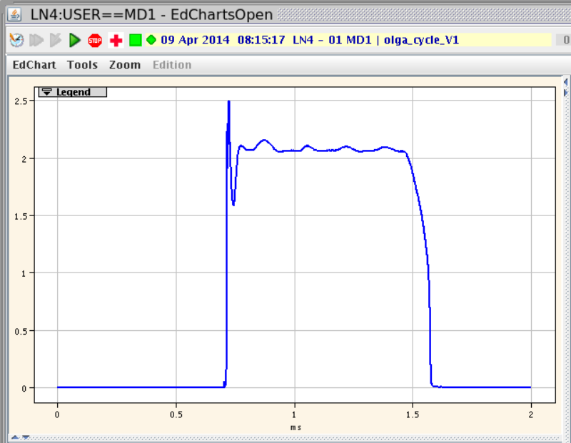
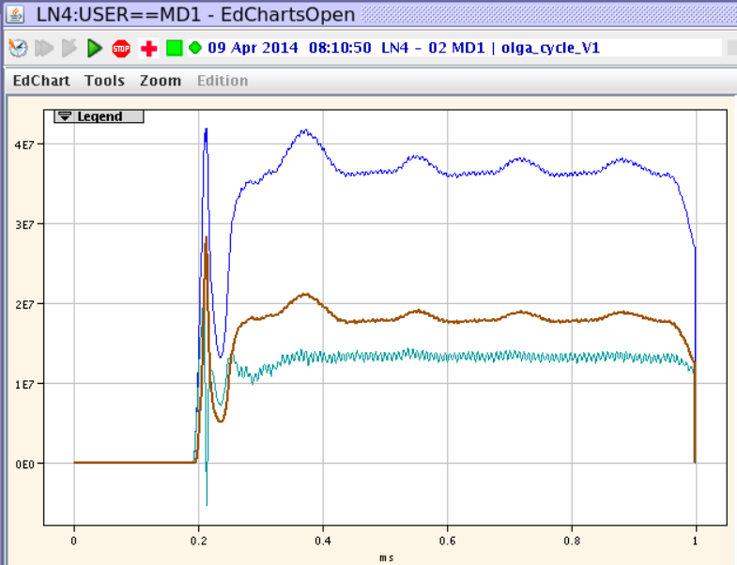
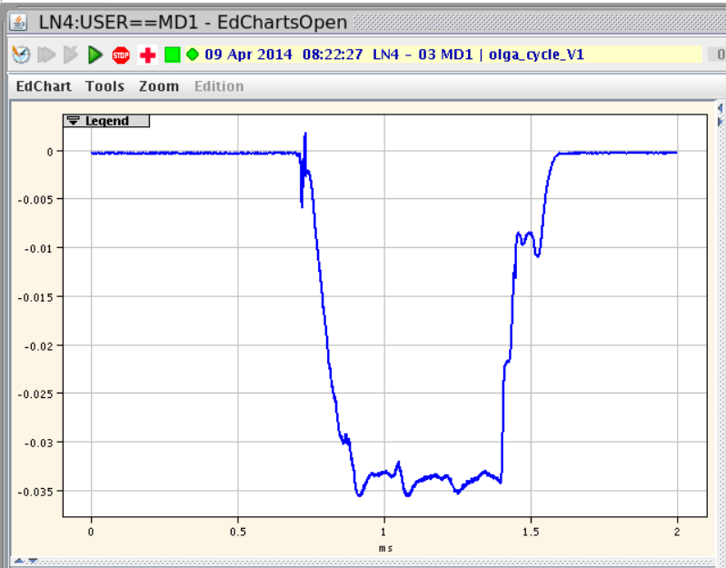
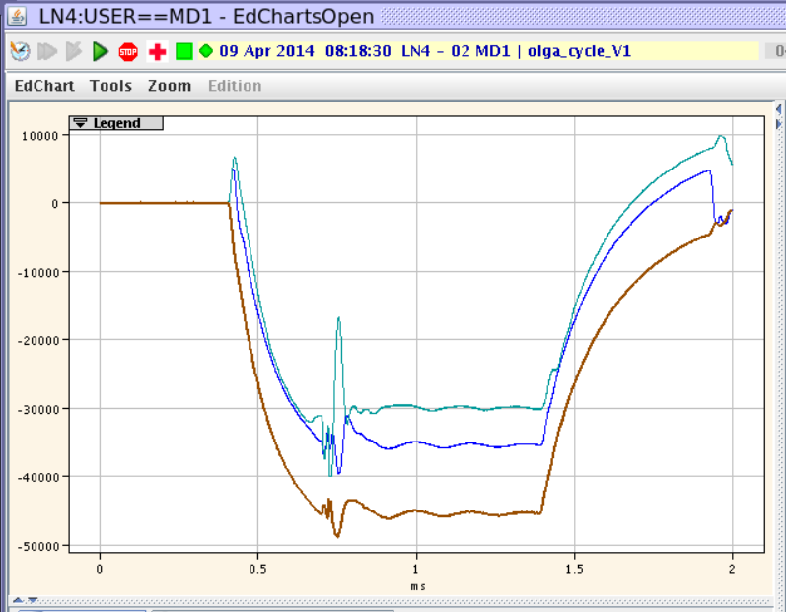
Monitoring & tuning tool:
50 kW RF
Plasma
light
LLRF-power
Pulsed HV
-35 mA H⁻
Improvement of the RF
Feed back loop
Is our next challenge

Slide 7
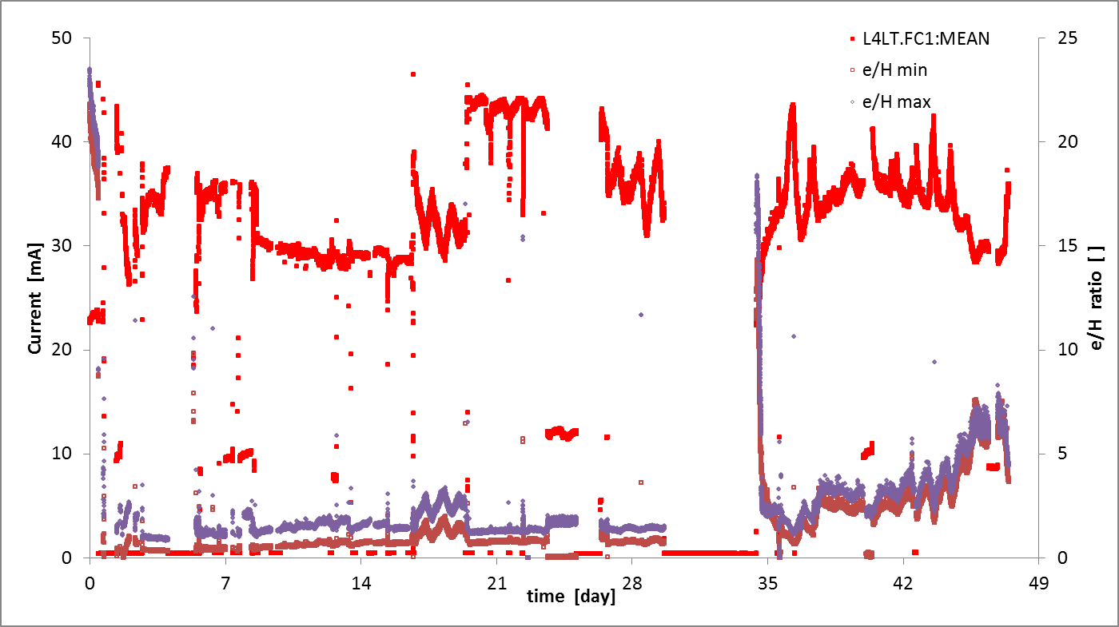
6 weeks int. operation after the 3rd cesiation
H⁻ beam between 27 and 45 mA.
Overall beam availability 61% (47 days period), Average 33.2 mA H⁻
ε measurements
Exchange HV-transfo
Puller HV trip: H⁻ beam drops to 5-10 mA.
Regulation tests

Slide 8
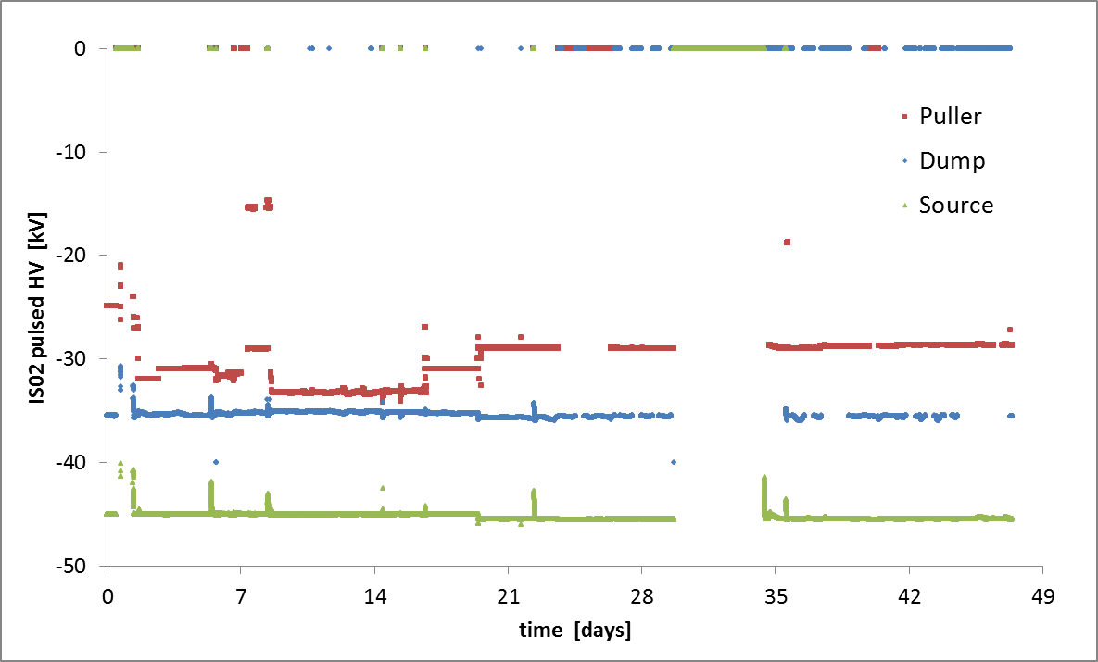
High voltage
Overall availability: source & dump HVs: 87% (47 days period),
Availability Puller HV: 78% mandatory reset after over current.

Slide 9
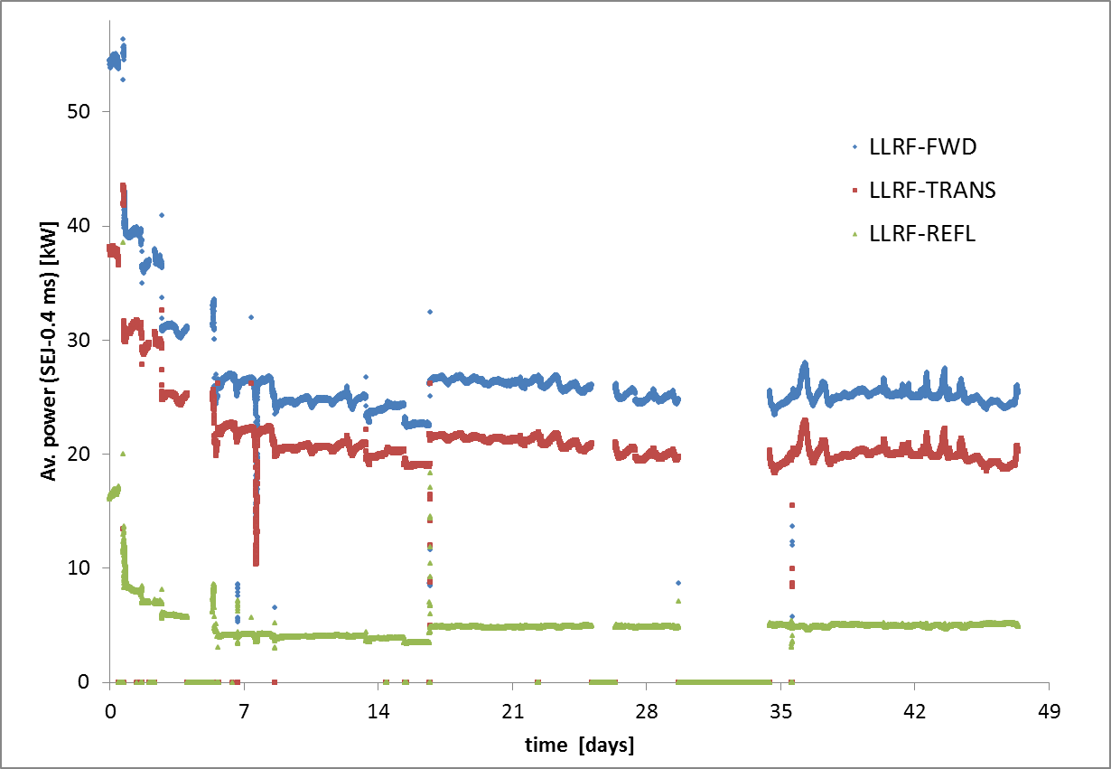
RF
Overall availability: RF: 83% (47 days period),

Slide 10
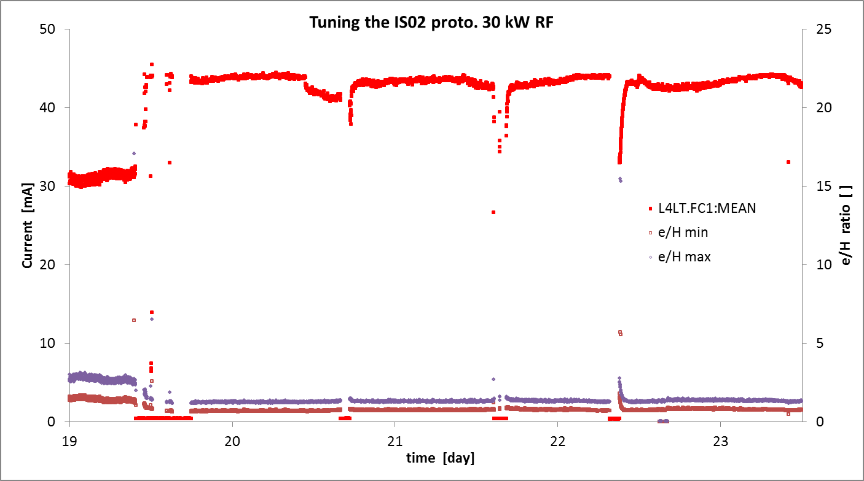
Daily tuning of the cesiated source
Few days of optimum operation,
Daily source-HV trips: An auto restart is needed.

Slide 11
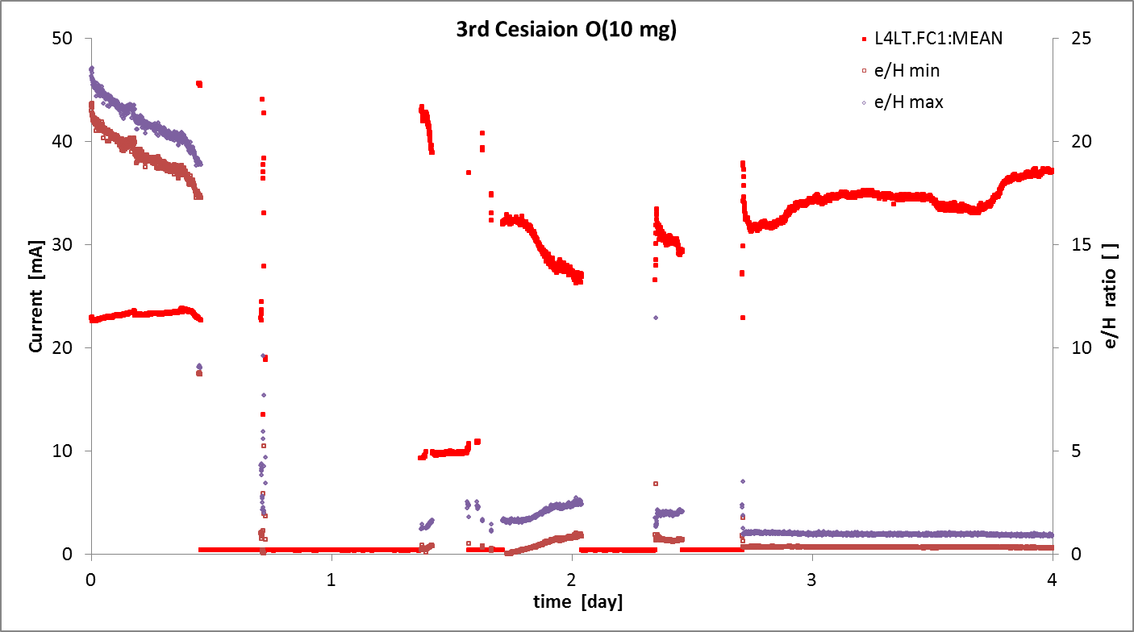
O(10 mg) cesiation
Plasma conditionning
cesiation

Slide 12
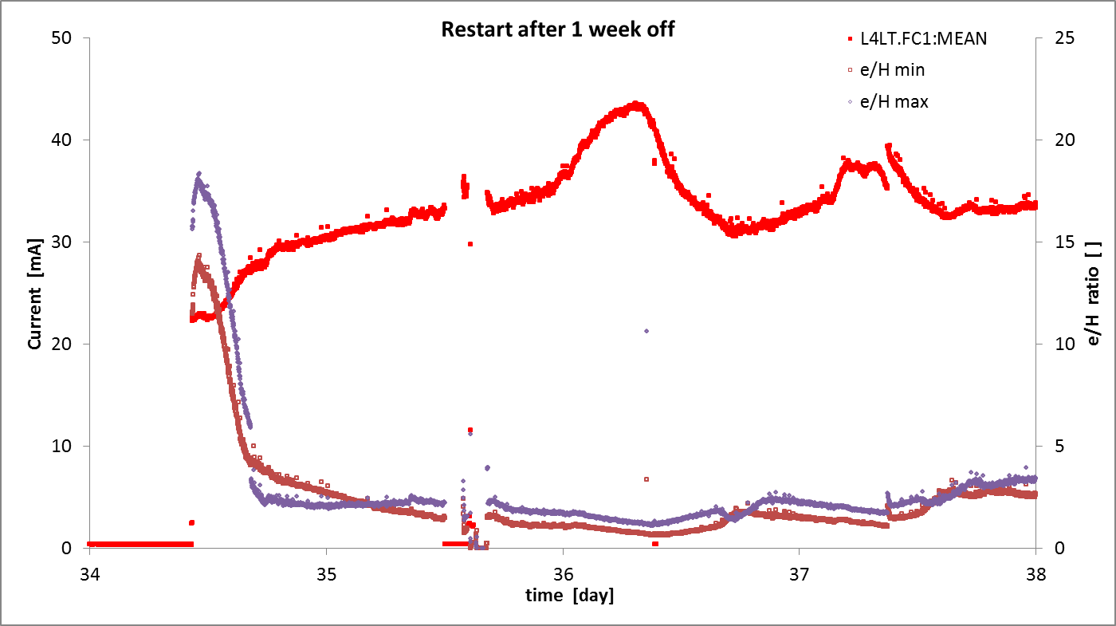
Recuperation of the Cs-surface production
After 1 week interruption under high vacuum IS-02 restarts in volume mode, half a day of continuous operation is needed to switch back to Cs-surface production
monitored via the e/H ratio.
Exchange HV-transfo
The I-source signal is proportional to the scale of the OASIS viewer !
We have to freeze the scales to secure the Dbase.

Slide 13
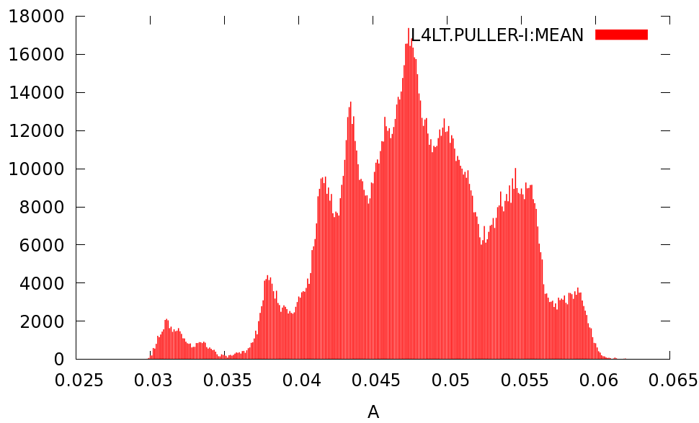
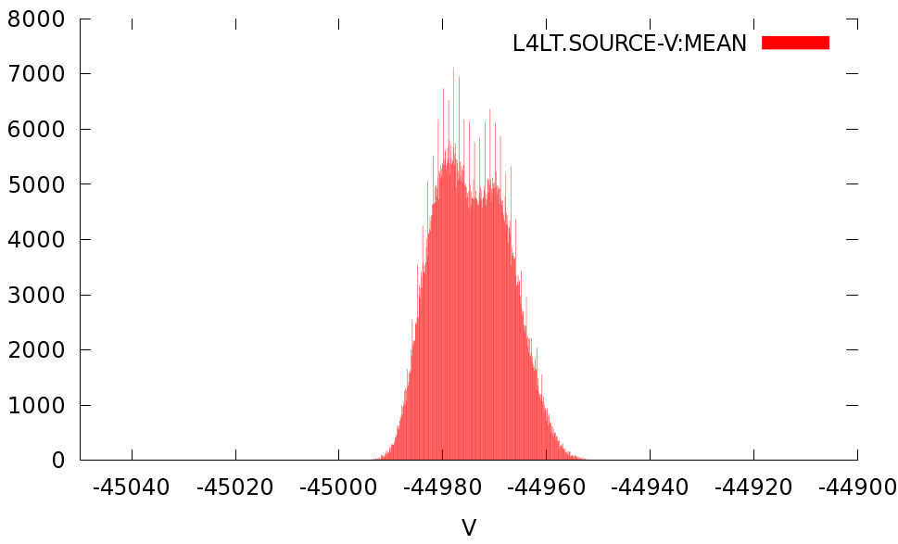
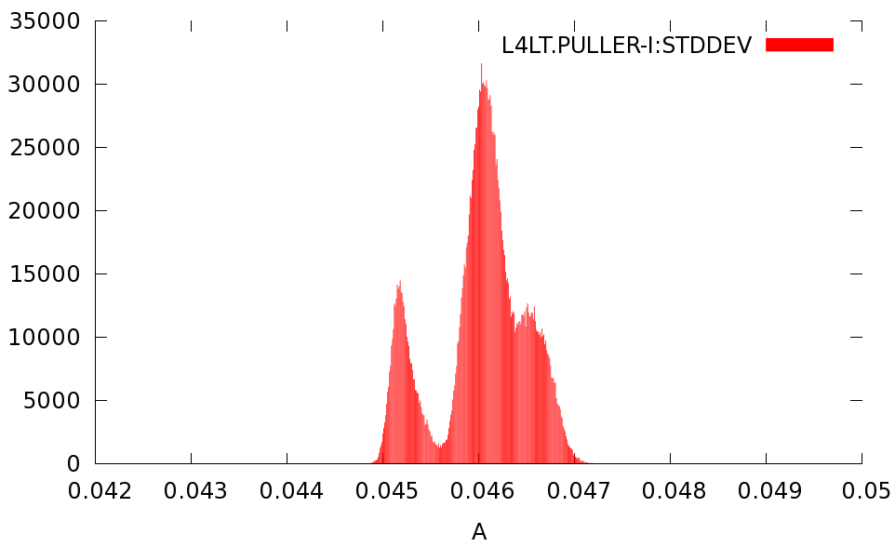
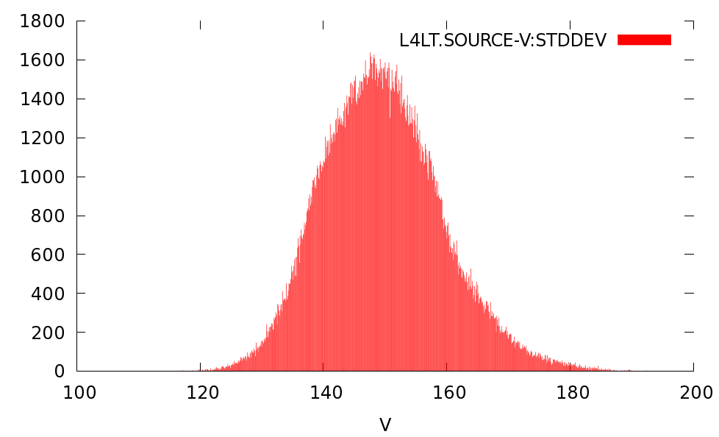
Histograms of observables i.e I-Puller and Beam energy
45.5±15mA
-44970±20V
Std. Dev:
150±25V
46±1.5 mA

Slide 14
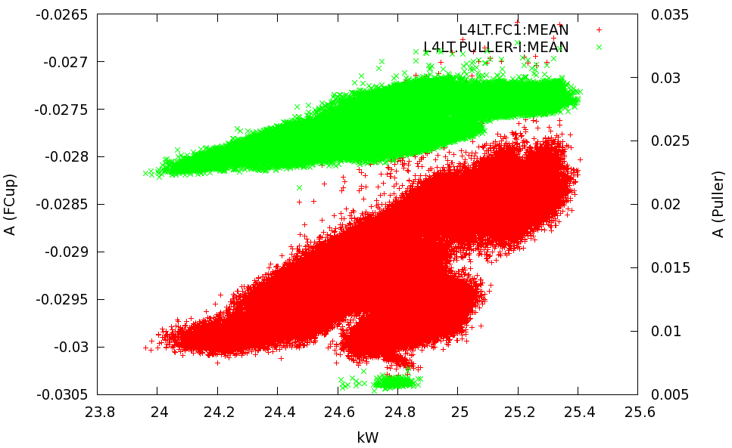
DB-correlations
Puller: 4.6 mA/kW
F. cup: -1.4 mA/kW

Slide 15
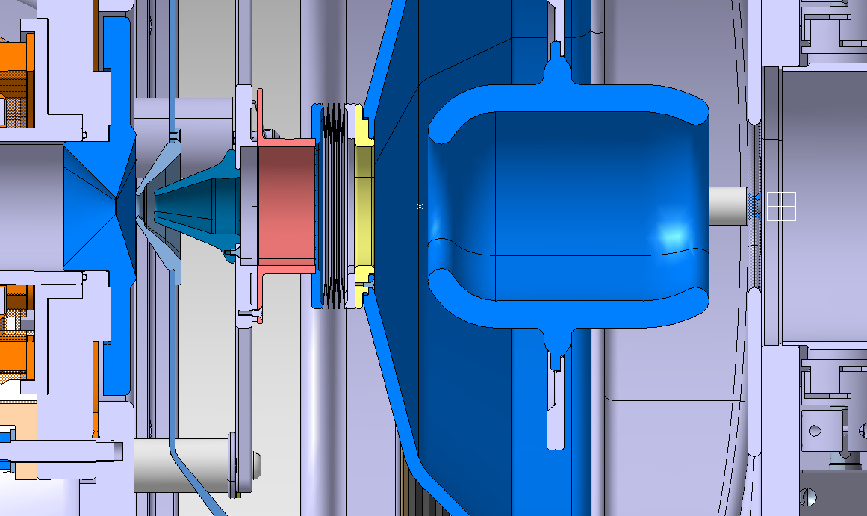
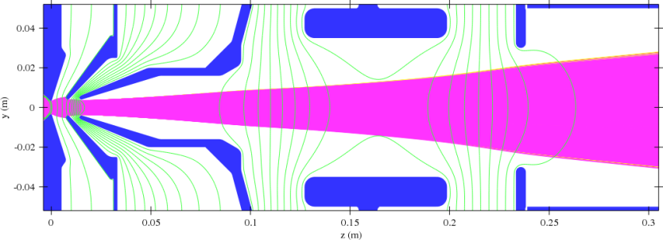
Proton, H₂⁺, H₃⁺ source
IS01 PG
+45 kV
Boundary: compatible with existing front end.
Iteration between design and beam simulation on-going
Puller 35 kV
Einzel lens -35 kV

Slide 16
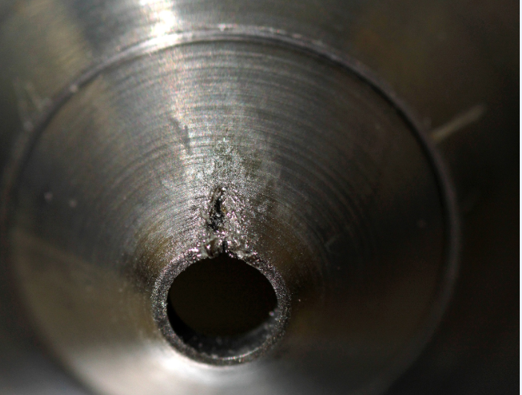
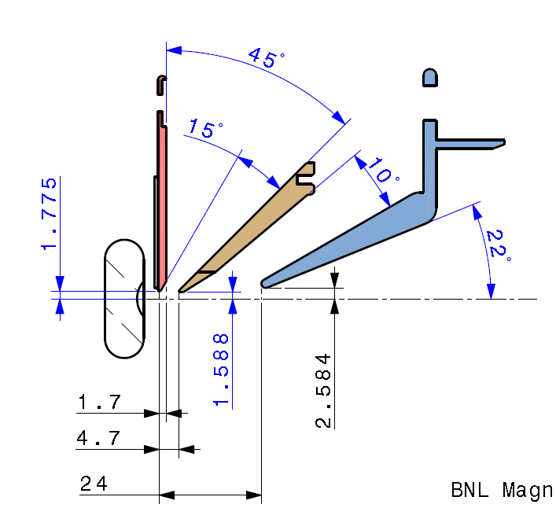
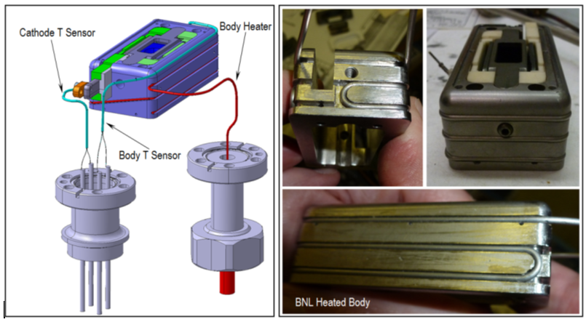
Magnetron: BNL-test Post mortem, Status and outlook
2 stage extraction: Puller at 30 kV
Molten W-tip
https://edms.cern.ch/document/1352150/1
Heated Anode body mandatory for 0.8Hz operation designed and ready for production
W-tip and broken isulator ceramics will be replaced.

Slide 17
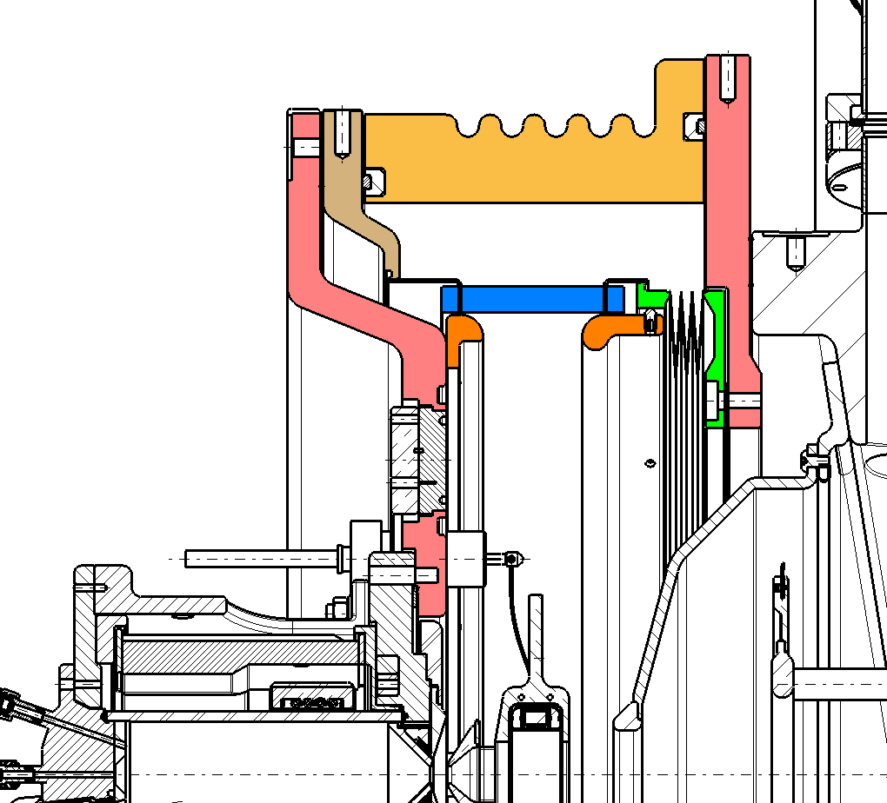
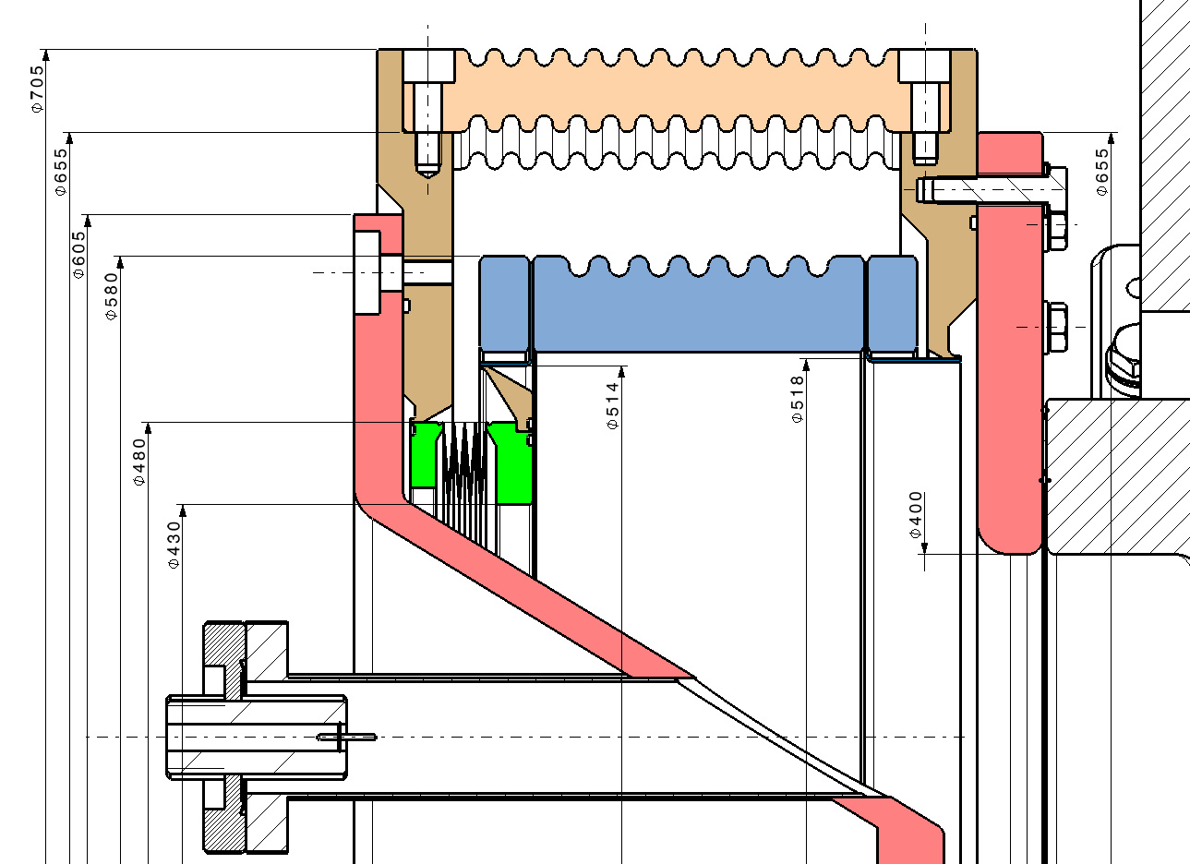
Modification of the Is-Front end: Large ceramic insulator
Delivery:
Ceramic insulator: March-April 2015
Deep flange
Mtl. End Nov,
Machining end January 2015
Today’s Front end

Slide 18
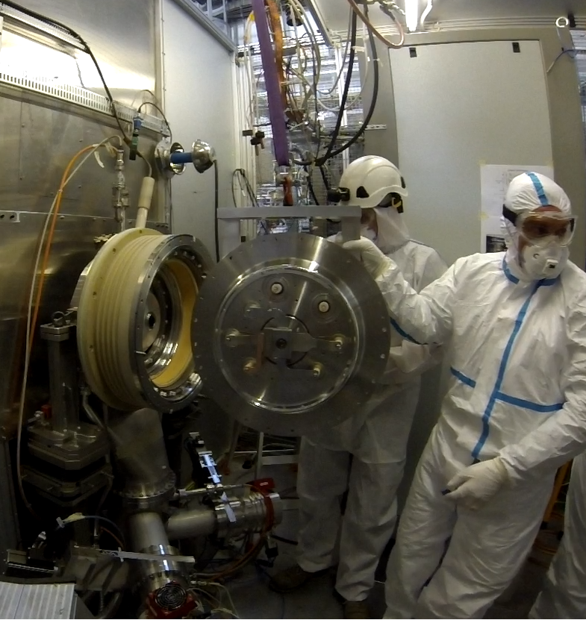
Procedures: i.e. Exchange of a cesiated source
IS-test stand: preparation 3h, operation 2h, Restart 5h + 1 night
 | Date: …………………………….
Op1: | Leads mechanical tasks, handling
Op2: | Vacuum operation, Handling
Op3: | Prepares specific tools,
Op4: | Organization ad safety: Ensures follows up of the procedure, written proceedings, and safety.

Slide 19
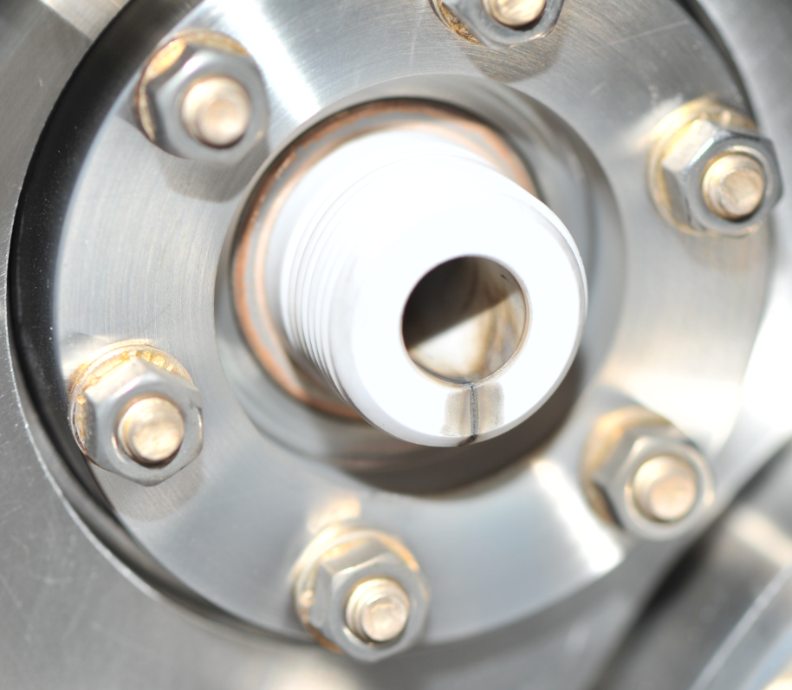
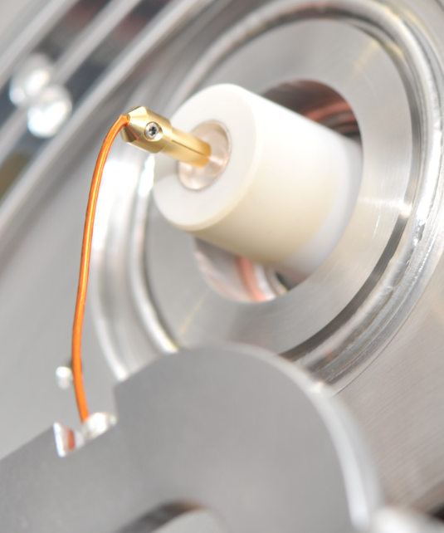
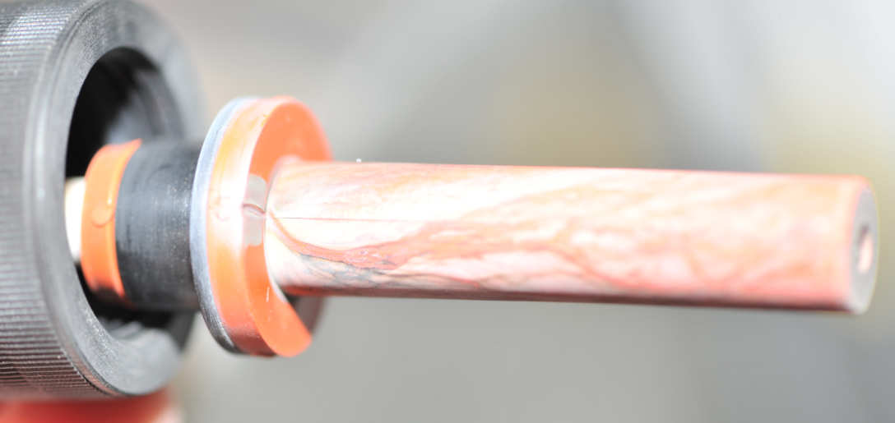
Post mortem of IS02
Findings:
Damaged HV-feedthrough
Coloration of the HV ceramic insulators

Slide 20
Conclusion summary
  First 2 month operation of a cesiated source at CERN is a very positive sign. However;
    IS02 PG+IS01 optics dumps the beam on the wrong electrode. Good enough to measure e/H, less for operation.
    On-going design of an optics for e/H of 2 to 8.
    Installing Cs-heating in L4: July 2014
  After 2 month and ~12 mg Cs a yellowish layer is seen on all insulators.
  New ceramics insulator should provide additional space for Cs-condenser, only available by 2015.
  Next: calibrated IS-DB in Linac4
  Installing IS02 with IS01 optics in L4 requires later modification of the optics; Preferably
    Minimize number of installations: install IS02 only in august.
    Consider discussing the installation of IS01 instead of Desy if satisfactory results are available by beginning of May 2014
Invaluable inputs from the IS-team is thankfully acknowledged

Slide 21
Nov. 2013 ISWP-Review mandate
The second review of the Linac4 ion source work package took place at CERN on November 14, 15 2013. The review committee was asked to assess the following three items:
Review of the Linac4 ion source Work Package; Compare what has been achieved with respect to what was planned and review what is foreseen.
Estimate the probability of having a sufficient beam current (40, 60, 80 mA) within the design emittance of 0.25 π·mm·mrad in time for the final commissioning before the connection (February 2016).
Is it still necessary to pursue an alternative solution, and is the magnetron source still considered as the most appropriate option? When a decision has to be made and what has to be prepared to make such a source available on-time for the final commissioning of Linac4?

Slide 22
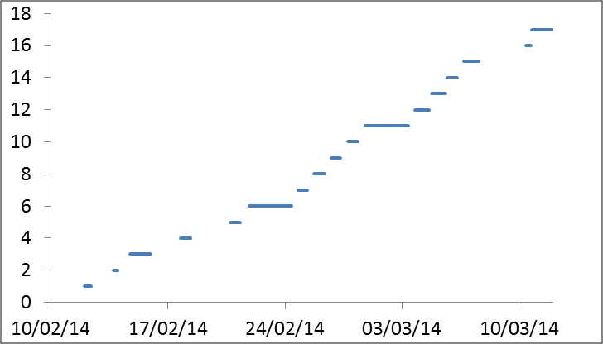
3rd Cesiation: Stable datasets: 54%
Space charge compensations studies
Hydrogen regulations studies
Next:
IS02 Stability above 40 mA
Complete DAQ
Handling/Storage of a cesiated source
Operation of IS01 in volume mode
Restart of a cesiated source after storage

Slide 23
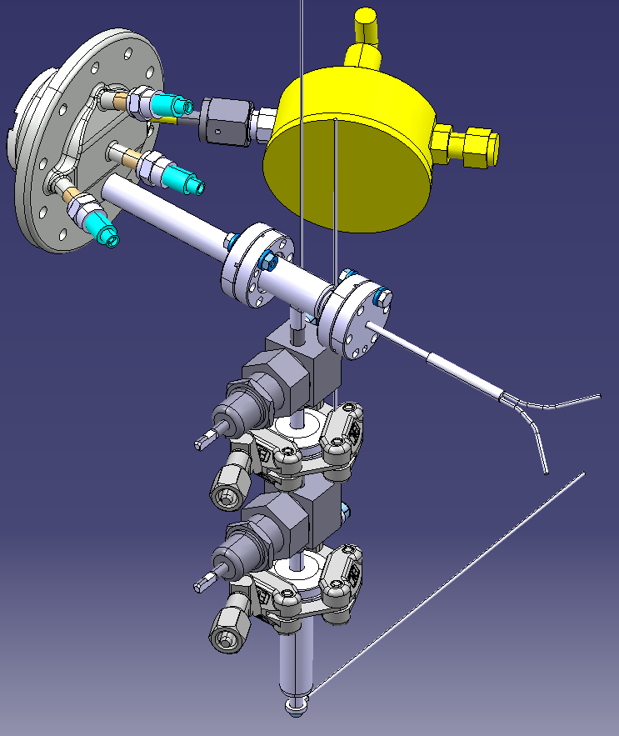
Cs-Oven

