Slide 1


Modeling of QXF protection
Vittorio Marinozzi
04/29/2014

Slide 2
Summary:
MQXF state of protection presented at MT-23
Dynamic effects on the inductance
Magnet coupling with external circuits
MQXF inner layer quench heaters
MQXF protection at 90 % of SSL
MQXF protection redundancy
CLIQ and MQXF

Slide 3
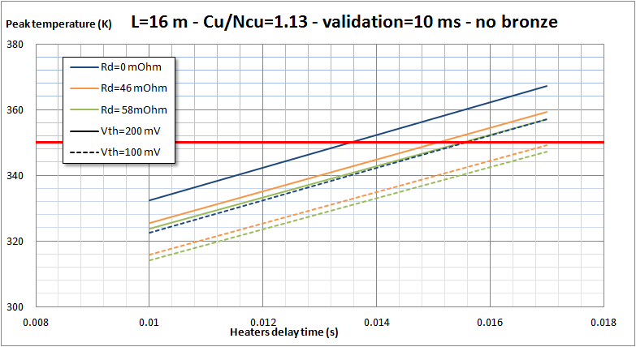
0.1 MQXF protection state at MT-23
MT-23: MQXF hot spot temperature is very close to the conventional maximum of 350 K
Simulations have been performed making conservative assumptions on quench heaters and magnet inductance
How much conservative are the simulations?

Slide 4
1.1 Dynamic effects
MIITS comparison between experimental data-simulations on HQ02a tests
Current/SSL | 0.8 | 0.7 | 0.6 | 0.5
MIITs difference % | 16.5 | 13.3 | 4.8 | 2.4
Dumping resistance 5 mΩ
dI/dt similar to MQXF
Most significant case for MQXF
HQ02a tests: considering the assumptions made for MQXF, there is a MIITs overestimations between experimental data and simulations of 16 %, which is 80 K less in hot spot temperature.
This is due to dynamic effects on the inductance (plus other conservative assumptions)

Slide 5
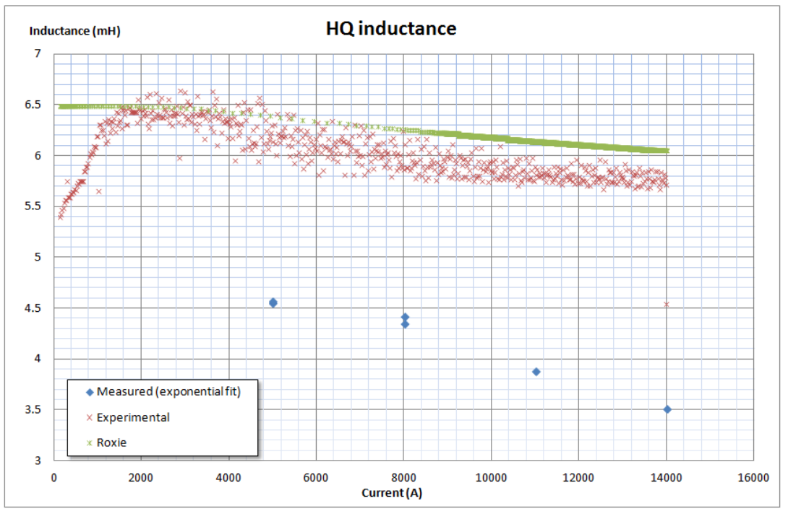
1.2 Dynamic effects
After a quench, during a discharge, magnets inductance appears lower than expected
Probably due to additional energy extraction (besides dumping resistance)
Possible explanations:
Coupling with shell, yoke, or any metallic part surrounding the magnet
Inter-filament eddy currents

Slide 6

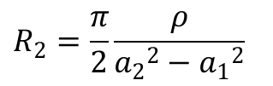
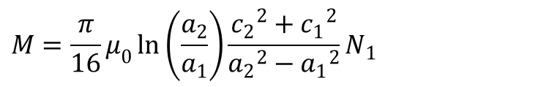
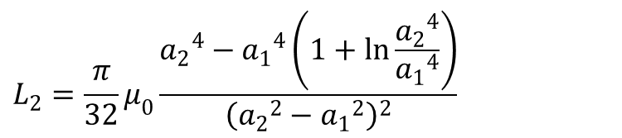

2.1 Coupling – external ring
It can be proved that a cylinder external to the coils is interested by cos(2θ) currents
The collar can be described as a coupled, filamentary circuit
Collar
$$a_{2}$$
$$a_{1}$$
$$R_{2}=\frac{π}{2}\frac{ρ}{{a_{2}}^{2}−{a_{1}}^{2}}$$
You can solve the equation of two coupled circuits
$$L_{2}=\frac{π}{32}μ_{0}\frac{{a_{2}}^{4}−{a_{1}}^{4}\left(1+\ln{\frac{{a_{2}}^{4}}{{a_{1}}^{4}}}\right)}{{\left({a_{2}}^{2}−{a_{1}}^{2}\right)}^{2}}$$
$$M=\frac{π}{16}μ_{0}\ln\left(\frac{a_{2}}{a_{1}}\right)\frac{{c_{2}}^{2}+{c_{1}}^{2}}{{a_{2}}^{2}−{a_{1}}^{2}}N_{1}$$

Slide 7
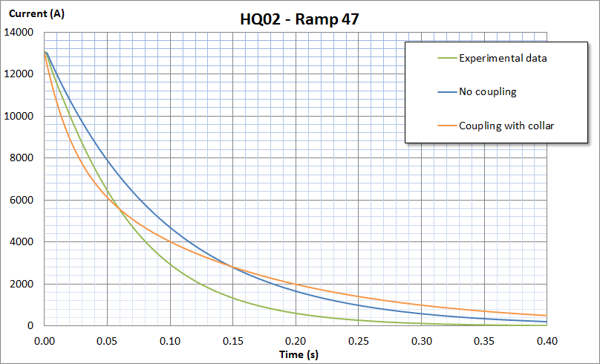
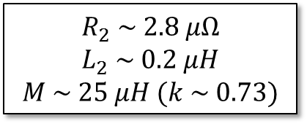
2.2 Coupling – external ring
$$R_{2} \sim 2.8 μΩ$$
$$L_{2} \sim 0.2 μH$$
$$M \sim 25 μH (k \sim 0.73)$$
The coupling strongly affects the current decay
The mutual inductance is too much high

Slide 8
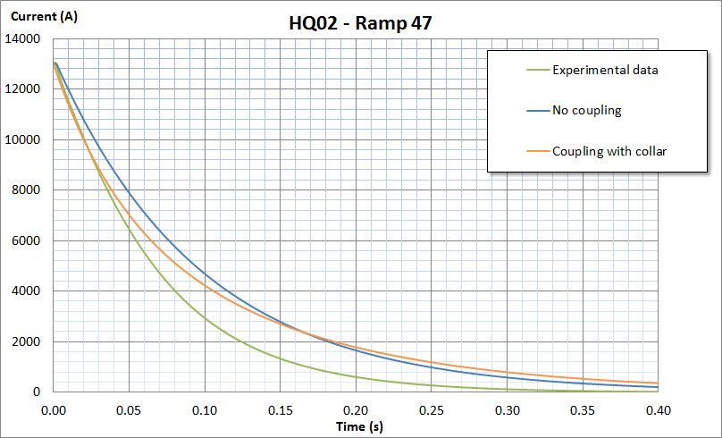
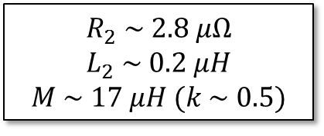
2.3 Coupling – external ring
$$R_{2} \sim 2.8 μΩ$$
$$L_{2} \sim 0.2 μH$$
$$M \sim 17 μH (k \sim 0.5)$$
The fitting at the start of the decay is good
At the end of the decay, the inductance comes back to the nominal value

Slide 9
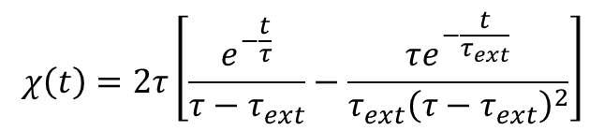
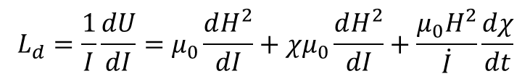
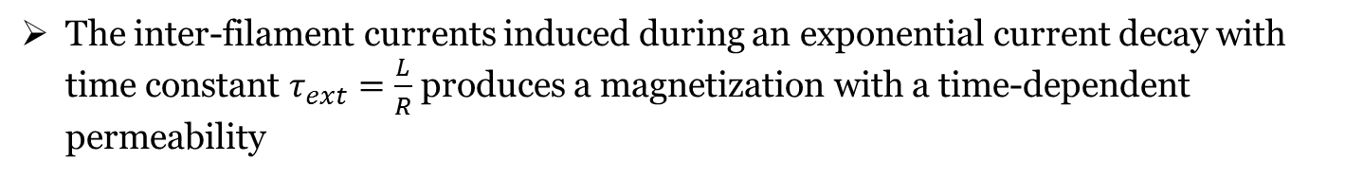
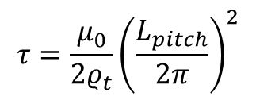
2.4 Coupling – inter-filament eddy currents
Calculation based on “Superconducting magnets”, M.N. Wilson - 1983
The inter-filament currents induced during an exponential current decay with time constant $τ_{ext}=\frac{L}{R}$ produces a magnetization with a time-dependent permeability
$$χ\left(t\right)=2τ\left[\frac{e^{−\frac{t}{τ}}}{τ−τ_{ext}}−\frac{τe^{−\frac{t}{τ_{ext}}}}{τ_{ext}{\left(τ−τ_{ext}\right)}^{2}}\right]$$
$$τ=\frac{μ_{0}}{2ρ_{t}}{\left(\frac{L_{pitch}}{2π}\right)}^{2}$$
The inter-filament currents constant time is
The consequential dynamic inductance can be obtained as
$$L_{d}=\frac{1}{I}\frac{dU}{dI}=μ_{0}\frac{dH^{2}}{dI}+χμ_{0}\frac{dH^{2}}{dI}+\frac{μ_{0}H^{2}}{\dot{I}}\frac{dχ}{dt}$$

Slide 10
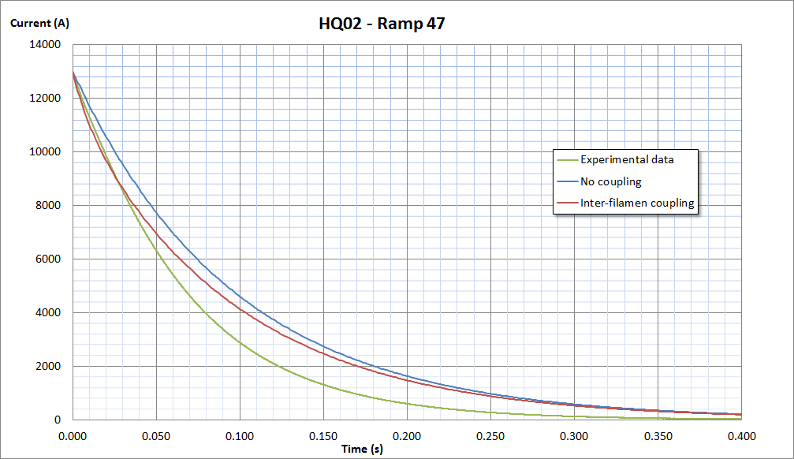
2.5 Coupling – inter-filament eddy currents
Again, a better according can be seen at the start of the decay
Then, the inductance gets back to the nominal value

Slide 11
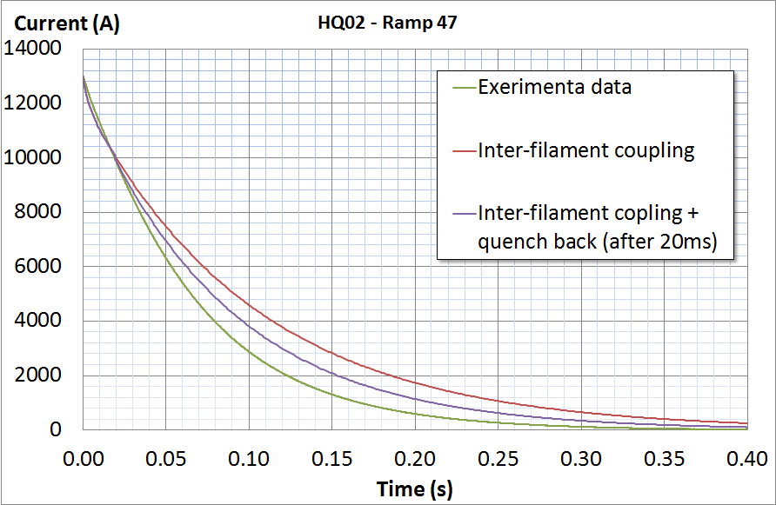
2.6 Coupling – conclusions
Both the coupling with an external ring and the inter-filament eddy currents could explain the magnet reduced inductance at the start of the discharge
In both the models, after few tens of ms, the inductance gets back to the nominal value.
  Possible explanation: quench back?
Next step: FE simulation for a better description of the magnet geometry

Slide 12
3.1 MQXF IL protection heaters
MQXF protection with only outer-layer heaters is not sufficient
Inner-layer protection heaters were not considered because of the bubbling issue; anyway, they are needed for reaching a margin of safety
Two possible designs of inner-layer protection heaters have been proposed

Slide 13
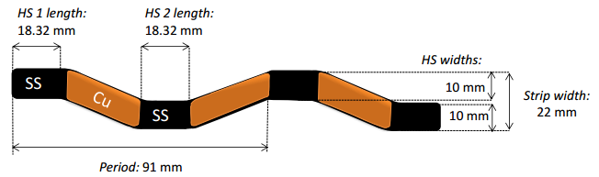
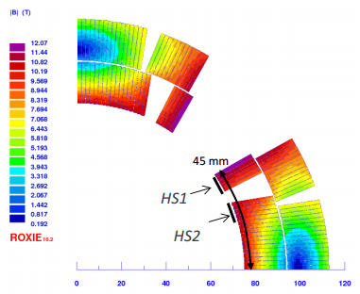
3.2 MQXF IL protection heaters – proposal 1
Proposal 1 (Tiina Salmi)
S-type
It covers only HF zone
13 ms average heaters delay time (from CoHDA - Tiina Salmi)

Slide 14
3.3 MQXF IL protection heaters – proposal 1
Assumptions made in QLASA simulations:
46 mΩ dumping resistance – 800 V maximum voltage (nominal value)
10 ms validation time (nominal value)
100 mV voltage threshold (nominal value)
16 ms outer layer PH delay time (from CoHDA – Tiina Salmi) -> old design!
13 ms inner layer PH delay time (from CoHDA – Tiina Salmi)
No quench in the LF zone (transversal propagation neglected)
Quench length 17 mm under each HS -> longitudinal propagation
Material properties from MATPRO
Nominal cable dimensions after reaction
Dynamic effects neglected (nominal inductance)

Slide 15
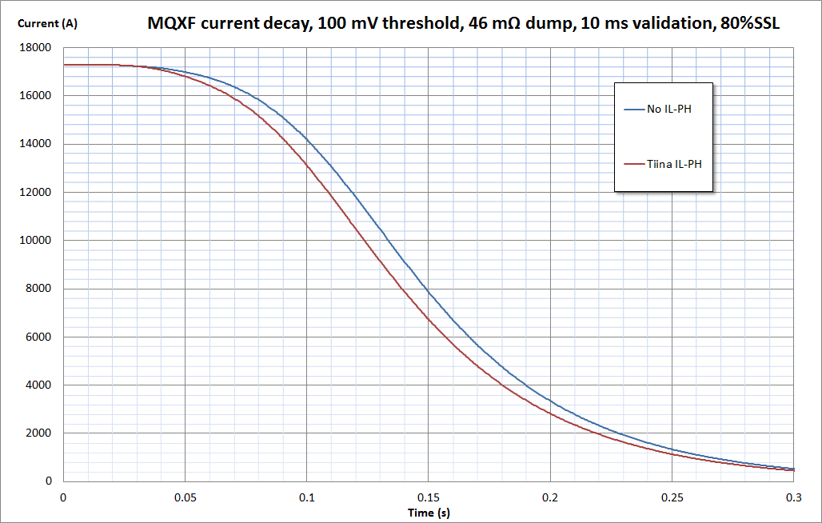
3.4 MQXF IL protection heaters – proposal 1
 | No IL-PH | Tiina IL-PH
MIITs (MA²s) | 35.5 | 32.8
Hot spot temperature (K) | 330 | 290

Slide 16
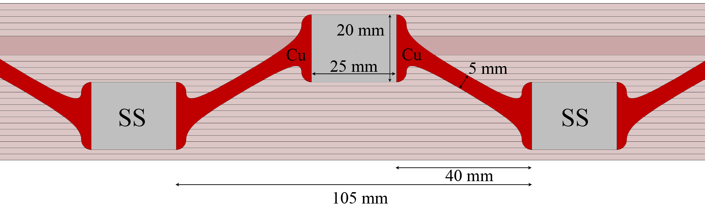
3.5 MQXF IL protection heaters – proposal 2
Proposal 2 (Ezio Todesco)
S-type
It covers both HF and LF zone
Heaters delay time not available for this computation

Slide 17
3.6 MQXF IL protection heaters – proposal 2
Assumptions made in QLASA simulations:
46 mΩ dumping resistance – 800 V maximum voltage (nominal value)
10 ms validation time (nominal value)
100 mV voltage threshold (nominal value)
16 ms outer layer delay time (from CoHDA – Tiina Salmi) -> old design!
13 ms HF PH inner layer delay time (assumed equal to proposal 1, to be improved)
17 ms LF PH inner layer delay time (my assumption, to be improved)
Quench length 23 mm under each HS -> longitudinal propagation
Material properties from MATPRO
Nominal cable dimensions after reaction
Dynamic effects neglected (nominal inductance)

Slide 18
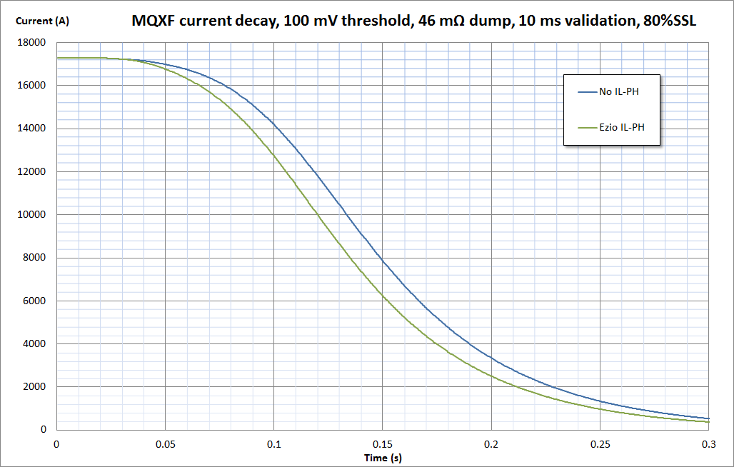
3.7 MQXF IL protection heaters – proposal 2
 | No IL-PH | Tiina IL-PH | Ezio IL-PH
MIITs (MA²s) | 35.5 | 32.8 | 31.7
Hot spot temperature (K) | 330 | 290 | 275

Slide 19
3.8 MQXF IL protection heaters – conclusions
Inner layer protection heaters significantly affect the quench protection:
  Tiina Salmi design -> 40 K less
  Ezio Todesco design -> 55 K less
Next steps:
  Improve heaters delay time using CoHDA in Ezio’s design
  Consider the transversal propagation in the LF zone in Tiina’s design
  Use unreacted cable dimensions (void in cables issue)
  Consider dynamic effects?

Slide 20
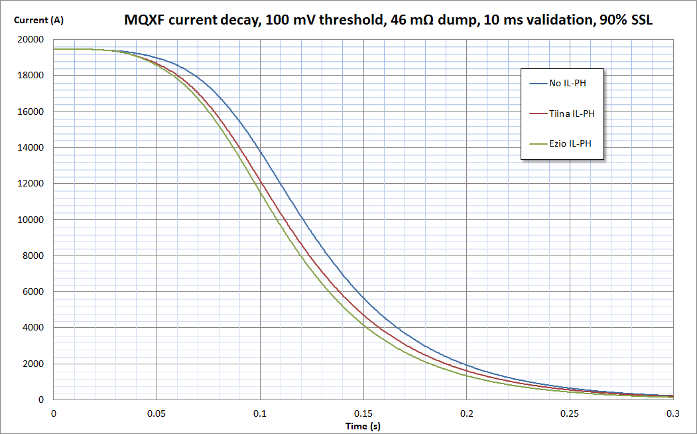
4.1 Protection at 90% of SSL
MQXF will be tested at current higher than the nominal one (80 % of SSL)
It could be needed to reach current higher than the nominal one in the machine, too
Protection study at 90% of SSL is needed

Slide 21
4.2 Protection at 90% of SSL
 | No IL-PH | Tiina IL-PH | Ezio IL-PH
MIITs (MA²s) | 38.6 | 35.3 | 34.1
Hot spot temperature (K) | 388 | 339 | 320
No safety without inner layer heaters
Marginal protection with both the IL-PH designs
Dynamic effects neglected

Slide 22
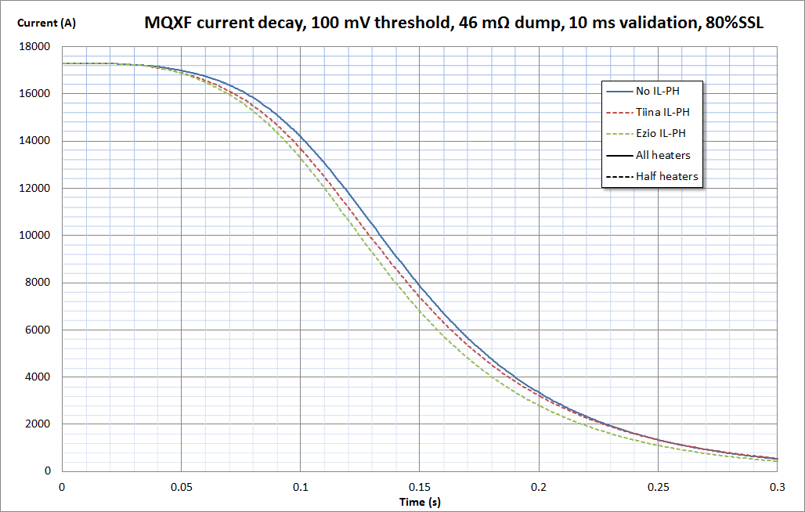
5.1 Redundancy
What if some protection heaters fail?
Simulations repeated considering only half of the magnet protected by quench heaters

Slide 23
5.2 Redundancy
 | No IL-PH All heaters | Tiina IL-PH Half heaters | Ezio IL-PH Half heaters
MIITs (MA²s) | 35.5 | 34.2 | 33.1
Hot spot temperature (K) | 330 | 311 | 294
Protection with IL and OL heaters covering only half magnet is easier than protection with only OL heaters covering the whole magnet
Failure of half heaters in all coils is a pessimistic case, so redundancy is provided

Slide 24
6.1 CLIQ
“CLIQ” is a new method for protecting magnets, based on a capacitor discharge when a quench is detected
LC current oscillations are generated, and the subsequent AC losses induce the quench
It can be used alternatively or together with protection heaters

Slide 25
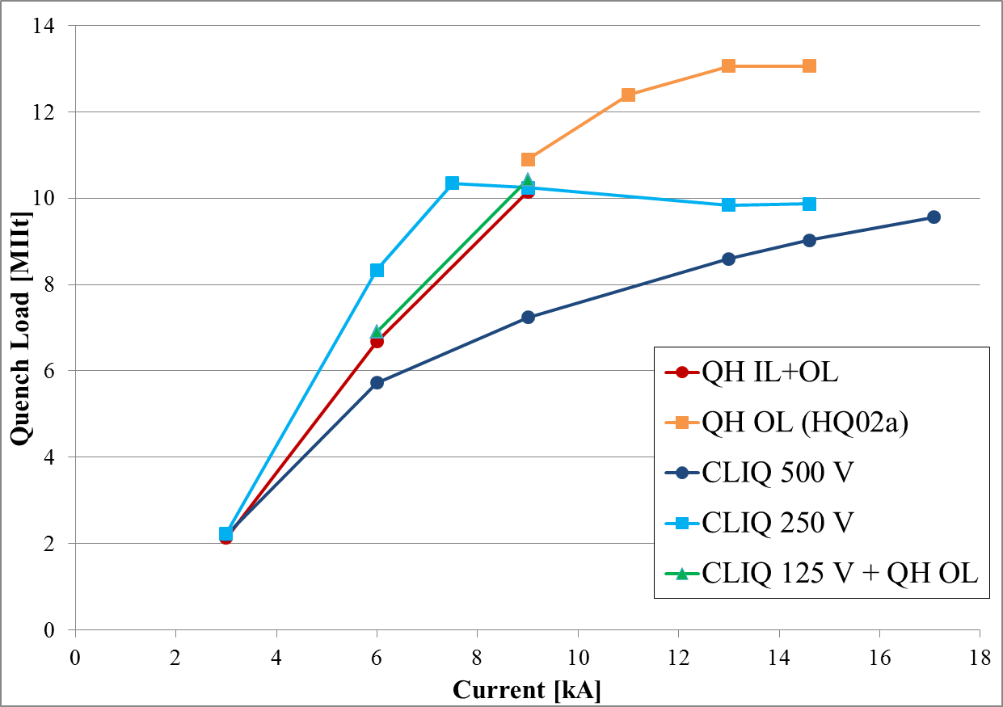
6.2 CLIQ
CLIQ performance during HQ02b tests are impressive:
the whole magnet is almost totally quenched in less than 5-10 ms
I assumed a similar behavior of CLIQ in MQXF:
whole magnet quenched 10 ms after validation

Slide 26
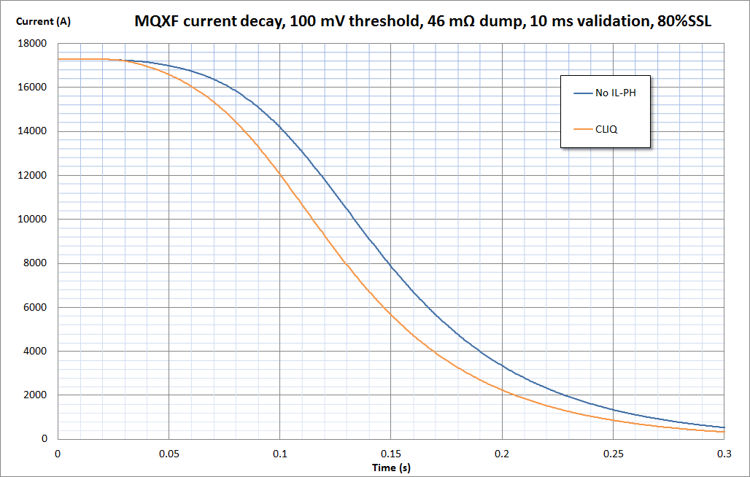
6.3 CLIQ
 | No IL-PH | Tiina IL-PH | Ezio IL-PH | CLIQ
MIITs (MA²s) | 35.5 | 32.8 | 31.7 | 30.2
Hot spot temperature (K) | 330 | 290 | 275 | 253

Slide 27
6.4 CLIQ
CLIQ provides a better protection than both IL and OL protection heaters
Anyway, it’s not obvious how CLIQ performances scale with magnet dimensions (MQXF has an inductance much bigger than HQ)

Slide 28
7.1 Conclusions and future plans
The MQXF protection presented at MT-23 can be considered very conservative, because comparisons with HQ02 experimental data showed a large difference (~16 %) with the simulations.
The difference is probably due to dynamic effects on the inductance (together with other conservative assumptions).
The inductance lowering can be explained by coupling with metallic components surrounding the magnet, or by inter-filament eddy currents, but only at the start of the decay. Quench back is under investigation as additional factor.
Finite elements calculations will be performed for a better understanding of these phenomena.
Two inner-layer protection heaters designs have been investigated, for providing a better magnet protection. Both the designs significantly improve the protection.
Ezio’s design study has to be improved with heaters delay time by CoHDA.
Simulations have to be improved with the new outer layer PH design
Protection at 90 % of SSL is challenging also with IL-PH
Redundancy is provided by the IL-PH
If CLIQ performance will be confirmed for the MQXF, several options will be available for MQXF protection.

