Slide 2
SMACC Twenty-first report
[15? min]
11/04/2014
Jean-Philippe Tock (TE-MSC)
On behalf of the SMACC project

Slide 3
Activities since last LSC (28/03/2014)
  Arc splices installation
    By Activities
    By sectors
  SIT
  DFBA
Dashboards
Specials
  Update on overheated splices
  Logistics, maintenance and mechanics
Activities for the next 3 weeks
Conclusions

Slide 4
SMACC Main activities for the last 2 weeks
From last LSC (28.03.2014)
Sector 56 :
  Final leak test and reconnection of DFBAK
Sector 67 :
  Final leak testing
Sector 78
  Work on NC
  Reconnection of DFBAO-SHM
Sector 81
  Pressure test on 8.04.2014
Sector 12 (Priority)
  Reclose last ICs
  Progress on insulation vacuum leak test
Sector 23
  Complete all M lines rewelding
  Complete M-lines leak testing
  Progress on reclosure of ICs
Sector 34
  Complete work on overheated splices
  Progress on M lines rewelding
Sector 45
  Complete installation of shunts but overheated splices
  Progress on electrical insulation
  Progress on consolidation of Q diodes
☑
17thCC/DFBA: Shunts resoldered, spool pieces busbars ready for reconnection // Last subsector to be leak tested
☑
All validated, ready for cool-down for SMACC
Completed except in Q7/DFBAO IC
☑
☑
Completed, one K hose to be replaced
☑
☺ Successful
☑
All ICs are reclosed
9/14 subsectors successfully leak tested, remaining ones under LT
☑
☑
Completed
☑
Completed
☑
> 90% ICs reclosed
☑
☺ 4 repaired 😐 a new one appeared
☑
> 95% rewelded
☑
3 ICs remain to be shunted
☑
>98 % of the insulations installed
☑
Completed yesterday

Slide 5
SEQUENCE AND STATUS
Completed
Install DN200
Completed
Completed
OK to open
Open ICs
Completed
Open M sleeves
Completed
Undo / Redo splices
ElQC (new splices)
Cancelled
Completed
Completed
ElQC (old splices)
Machine Cu
ElQC after Cu mach.
Completed
Completed
Consolidate Q diodes
Install shunts
ElQC
after shunt
Insulate splices
Weld M
Leak test M
Close IC
Final LT
3 ICs to do
3 ICs to do
6 ICs to do
≈ 7 sectors
≈ 6.5 sectors
≈ 6 sectors
≈ 4.5 sectors
Non-conformities (Before P Test)
Non-conformities
(After P Test)
2 completed
≈ 5 sec-eq
Completed in 1st sector (67)… so far

Slide 6
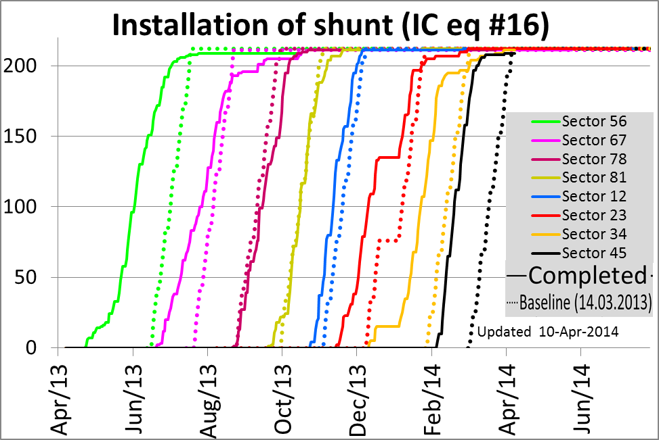
SMACC Progress report by activity
Shunts are installed in 1692/1695 ICs
Completed in 6 sectors
4 equipped in the last 2 weeks
Only 3 ICs remains in the whole LHC, only linked to overheated cables
Last shunt forecasted for end of April 14
Courtesy H Prin

Slide 7
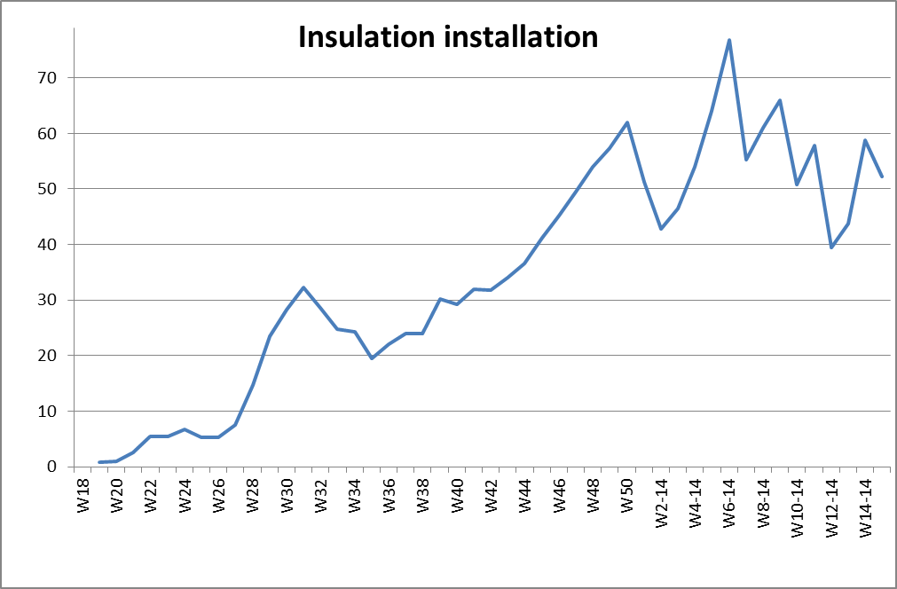
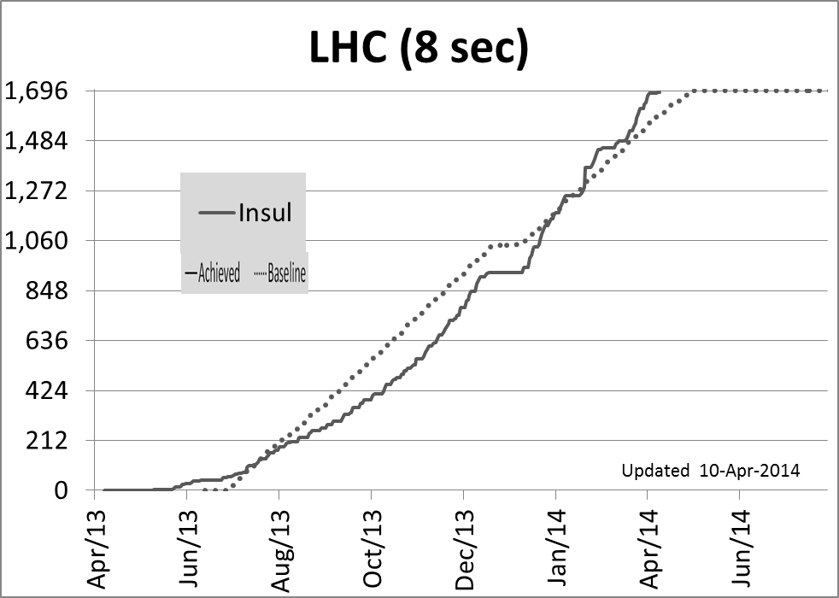
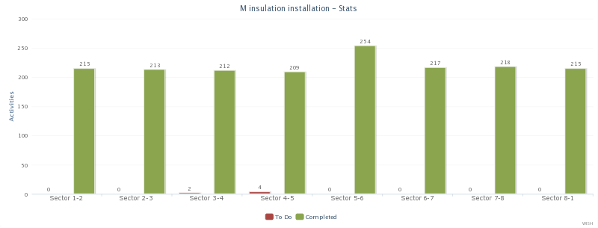
SMACC Progress report by activity
Insulation box: Installed in 1689/1695 ICs
(4 weeks sliding average)
*Estimate for W15
On the baseline
Won’t be on critical path
Only 6 ICs left for LHC
[Was 7 in 7 first sectors 2 weeks ago]
(<0.4 %)
Courtesy H Prin / G Maury

Slide 8
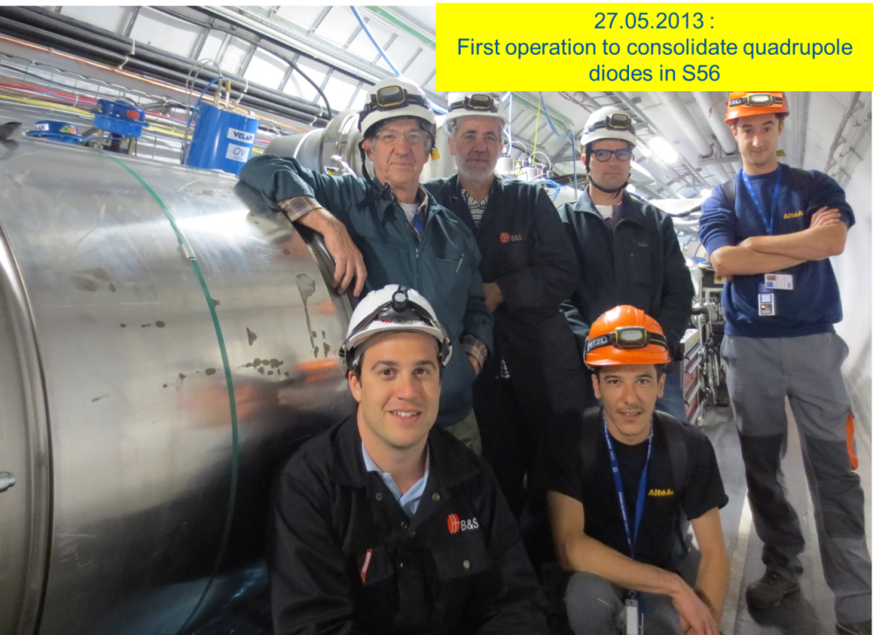
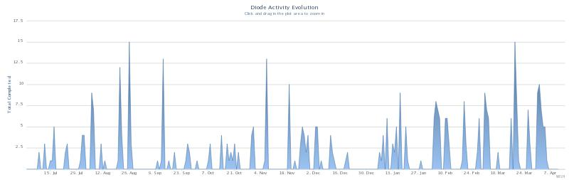
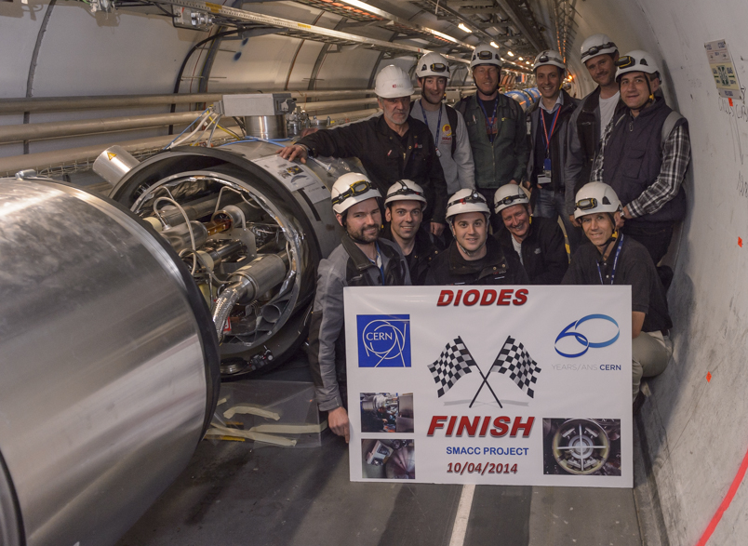
SMACC Progress report by activity
Consolidation of Q Diodes: Completed
Work optimised despite the lack of components
Impact on other activities was minimum
Courtesy L Grand-Clement
10.04.2013 : Consolidation of the last quadrupole diode

Slide 9
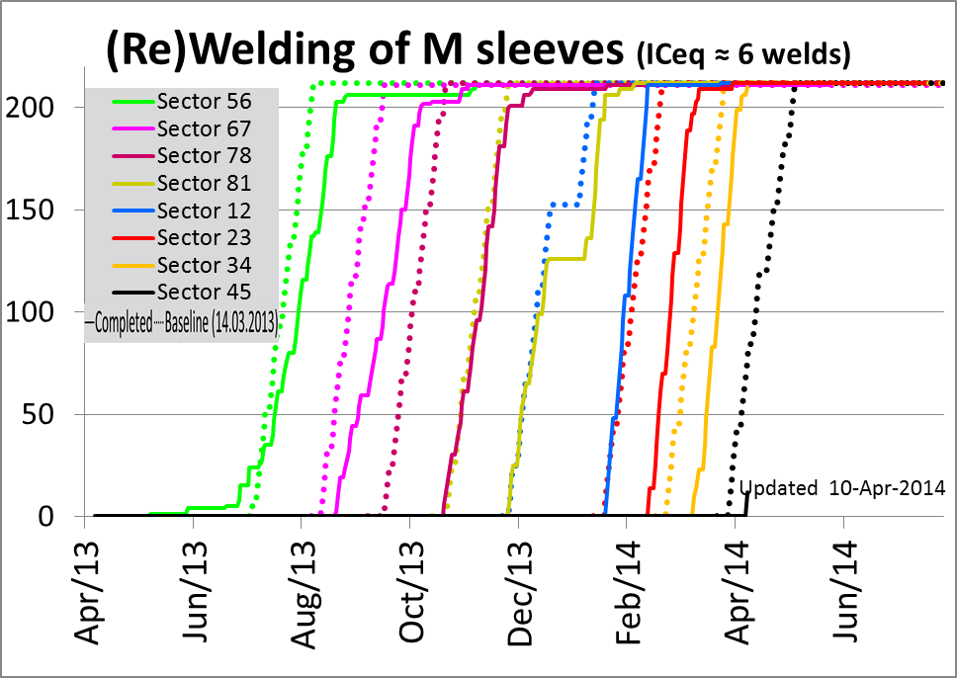
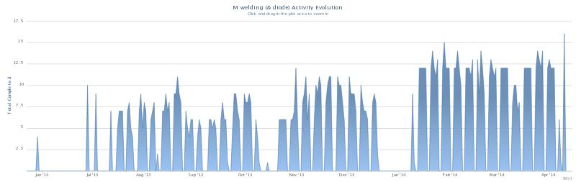
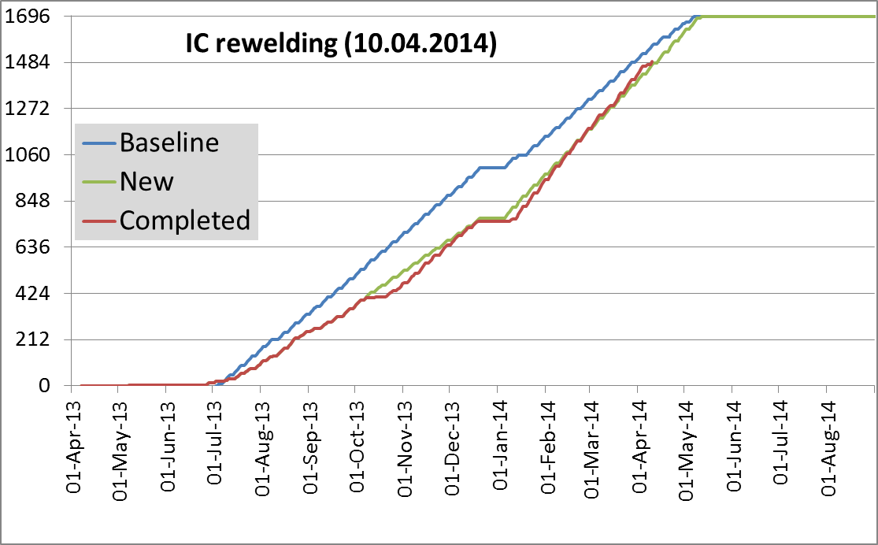
SMACC Progress report by activity
M Welding : Done in ≈ 7 sec-eq:
Routinely 60 ICs/week
Work concentrated in 1 sector, starting in 45, the last sector
No major disturbance
Exactly on the baseline presented on 4.10.2013
18 weeks @ 51
As presented LSC 4.10.2013
Slightly ahead of revised schedule
11 weeks @ 34
Courtesy S Atieh

Slide 10
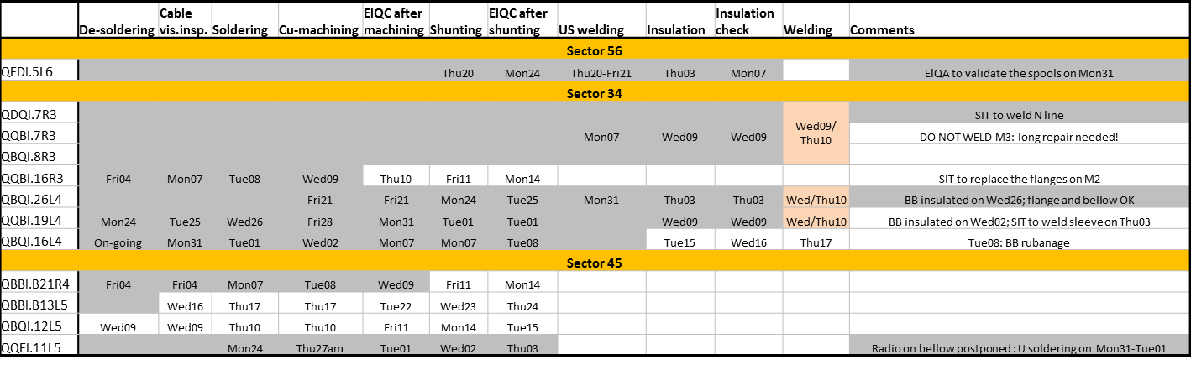
SMACC Progress report by activity
Excluding S45 welding , all remaining activities up to M welding fit on 12 lines !
Activities in production mode (other ones are targeted interventions):
M lines rewelding
M lines leak testing
Checks before closure
IC reclosure
Insulation vacuum leak testing
ElQA

Slide 11
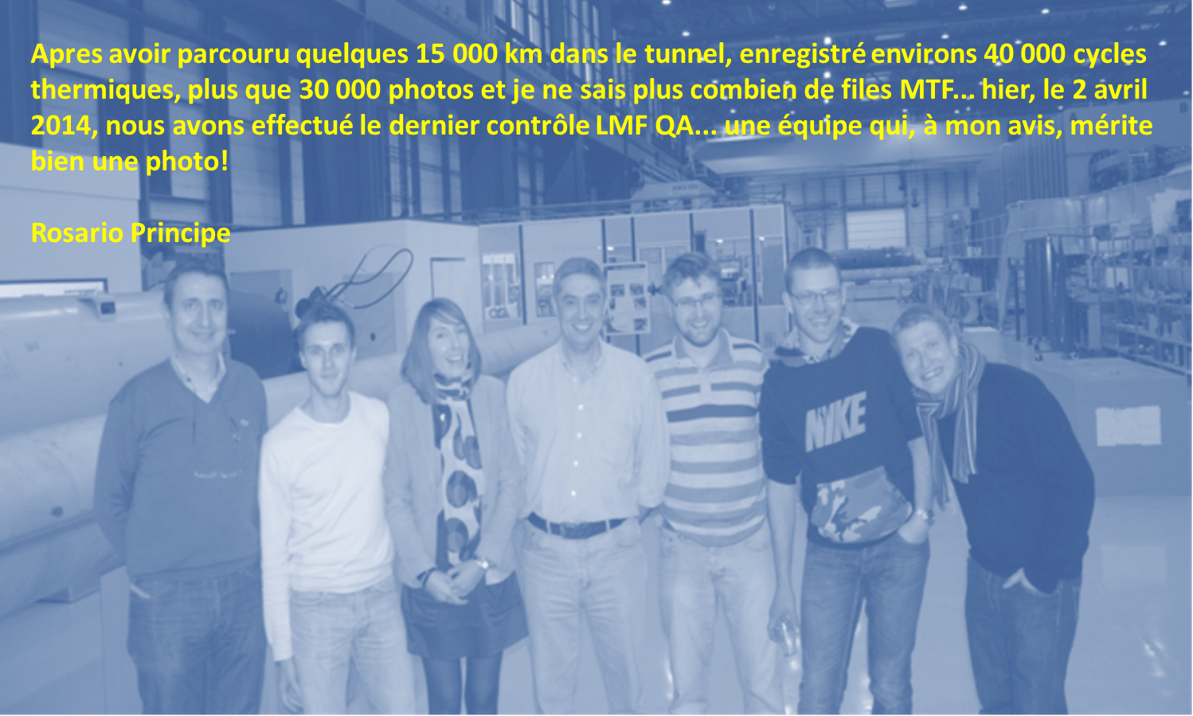
SMACC Progress report by activity : LMF-QA Main Splices consolidation

Slide 12
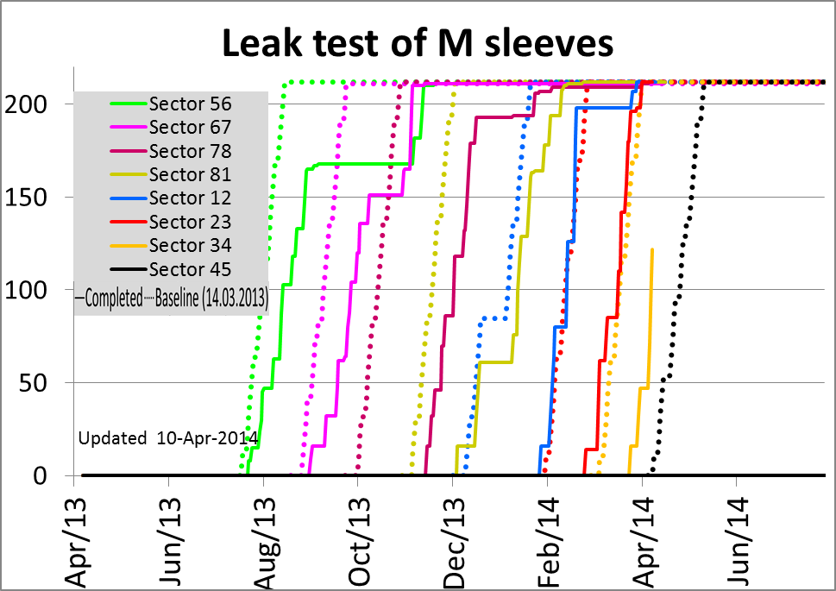
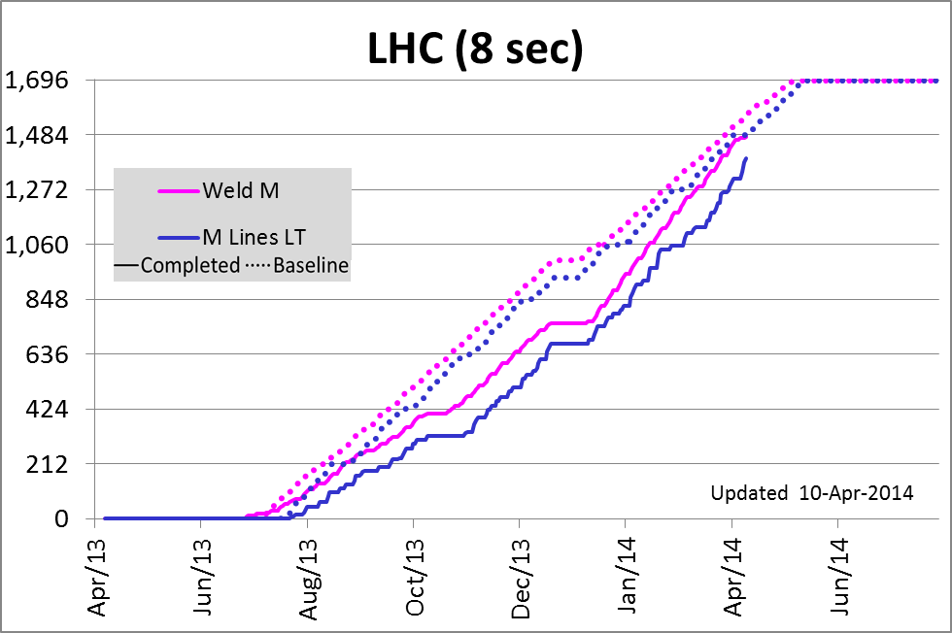
SMACC Progress report by activity
M sleeves leak testing : Completed in ≈ 6.5 sec-eq
Following the M lines rewelding, less regular by nature (sectorization)
≈ 2 weeks behind schedule, tendency to reduce
Under recovery as for the M welding
See next presentation (P Cruikshank / TE-VSC)
Courtesy P Cruikshank / L Mourier

Slide 13
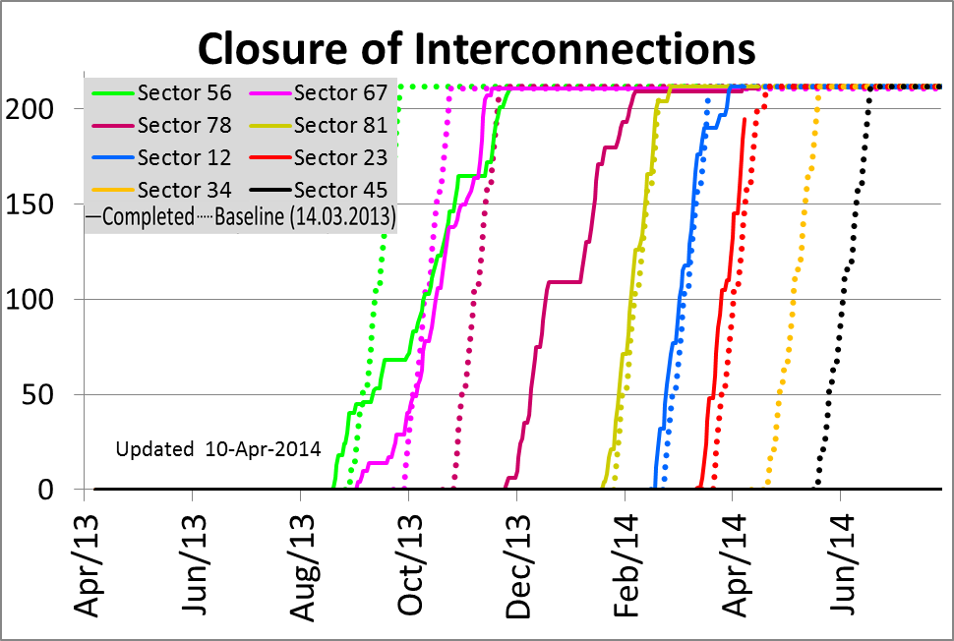
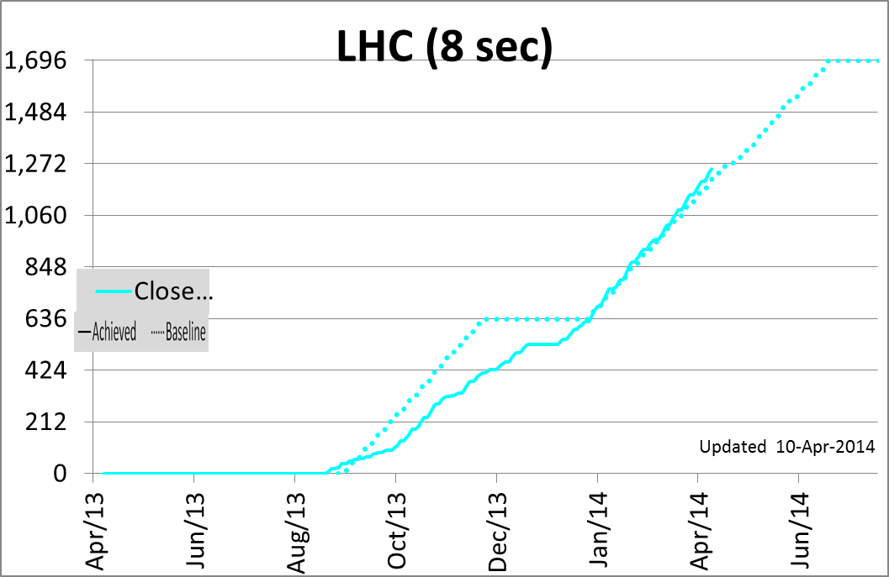
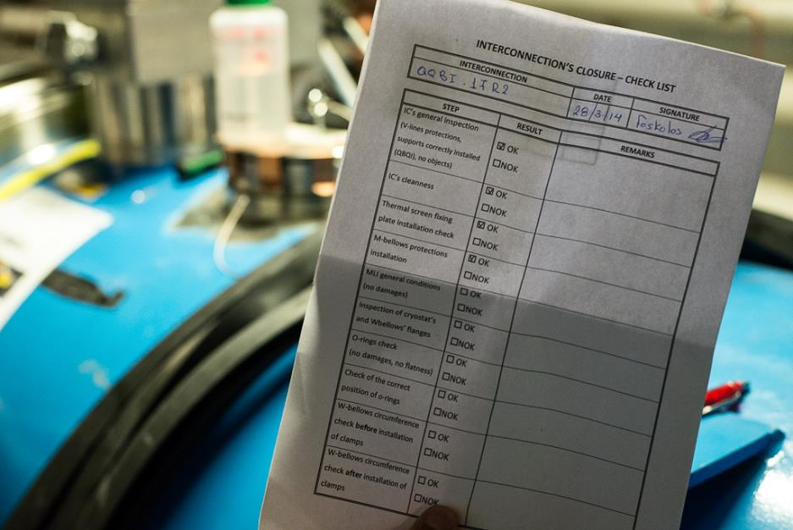
SMACC Progress report by activity
Reclosure of interconnections : ≈ 6 sec equivalent are reclosed
Baseline rate achieved despite openings for special interventions
Courtesy A Chrul / A Musso

Slide 14
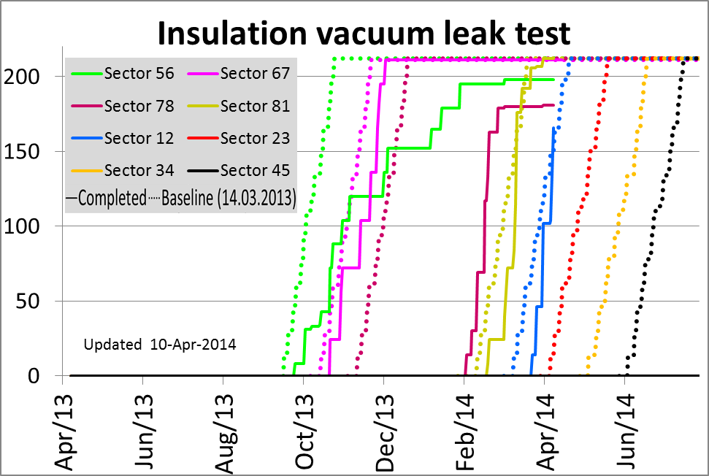
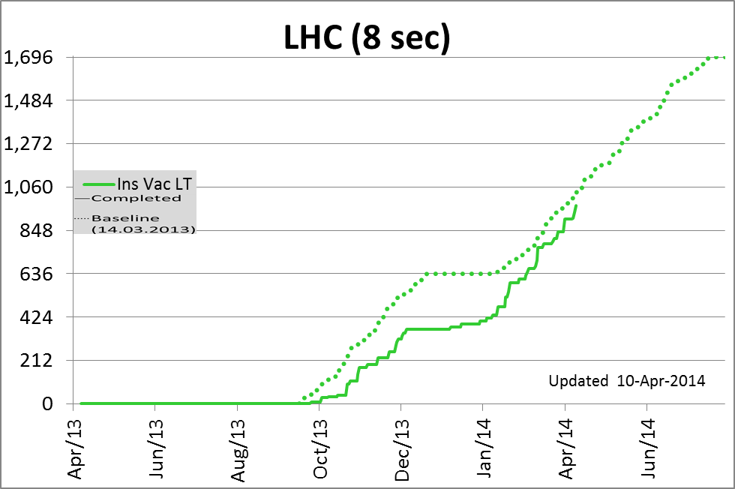
SMACC Progress report by activity
Final leak test: ≈ 4.5 sec equivalent
About 10 days behind schedule, reducing
See next presentation (P Cruikshank / TE-VSC)

Slide 15
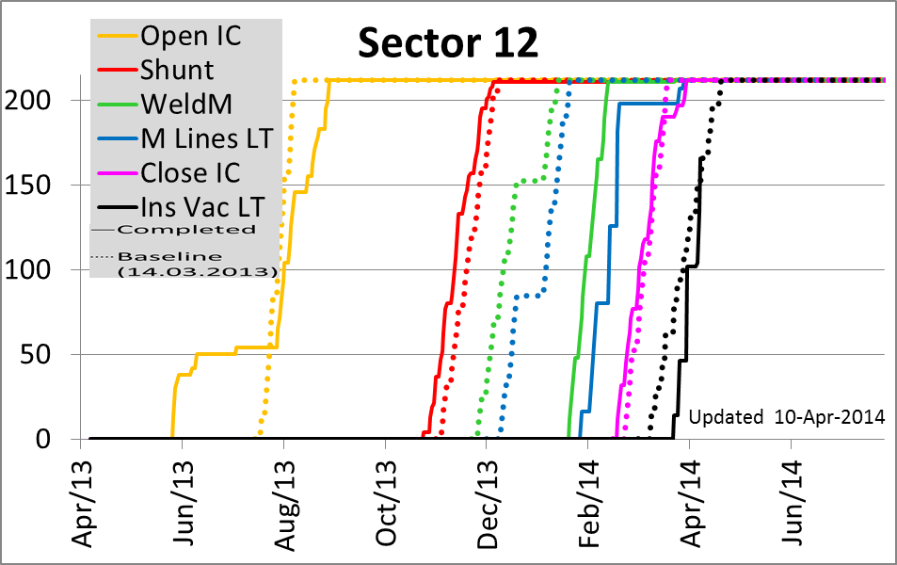
SMACC Sector 67
All ICs reclosed and validated; Ready for cooldown from SMACC point of view
  Cooldown planned on 5-7.05.2014
SMACC Sector 12
All ICs are reclosed
>75% ICs finally leak tested
(9/14 vac subsectors)
Some issues to be fixed after pressure test:
  Thermometer
  Leak(s)
Pressure test on 13.05.2014

Slide 16
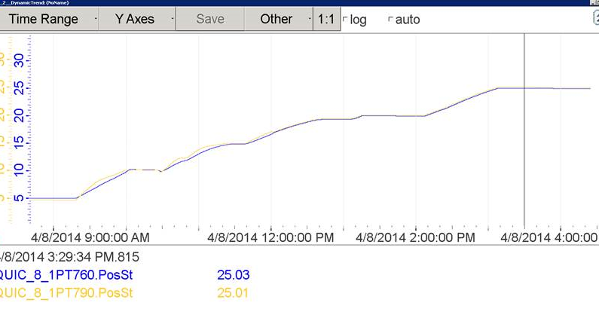
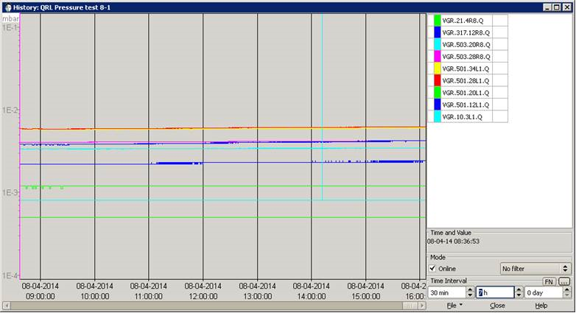
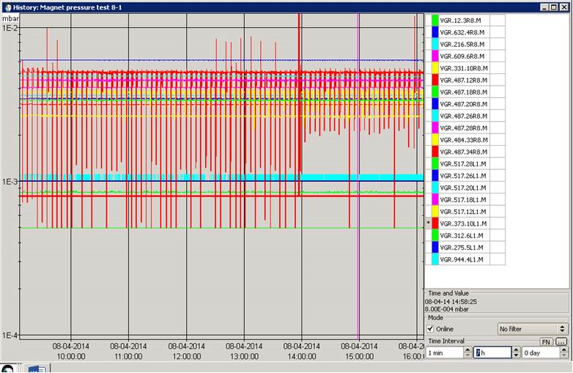
SMACC Sector 81
Successful pressure test on 8.04.2014
Courtesy O Pirotte (TE-CRG)
10 leaks to be treated after flushing (W21)

Slide 17
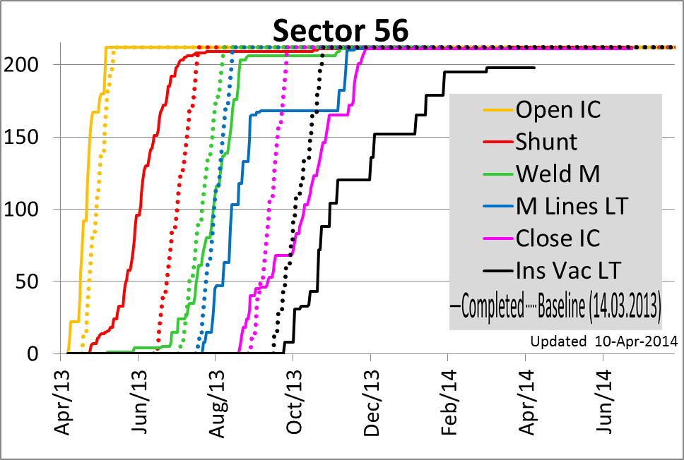
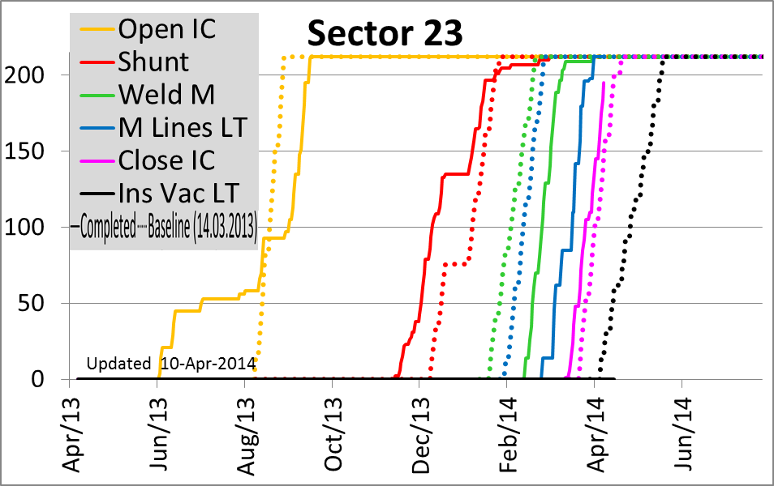
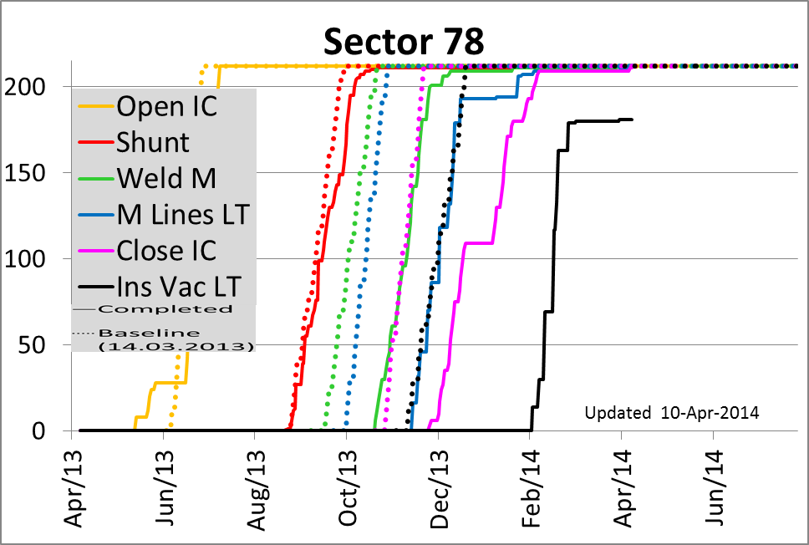
SMACC Progress report by sector
Sectors 56 & 78:
  Only activities linked to DFBA-SHM reconnection
  56: Leak to be repaired with a resin next week
Main activities are :
  Reclosure of Ics
  Preparation for insulation vacuum LT

Slide 18
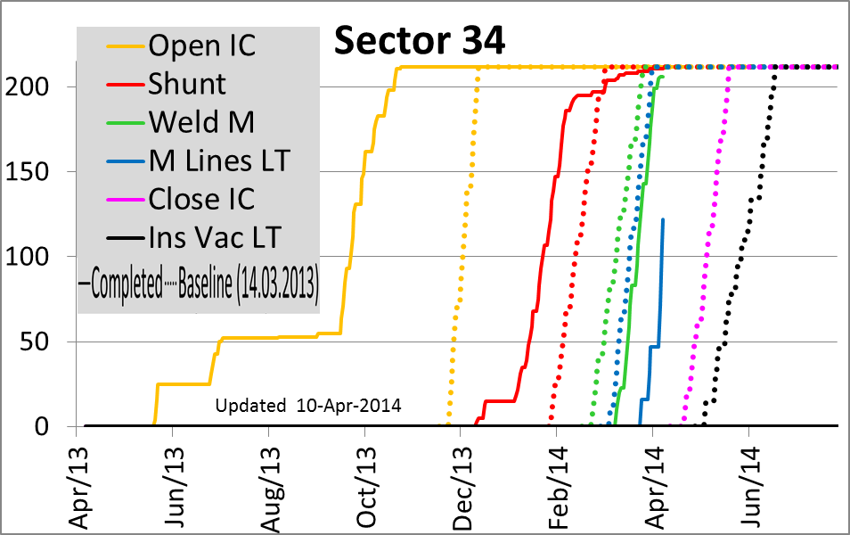
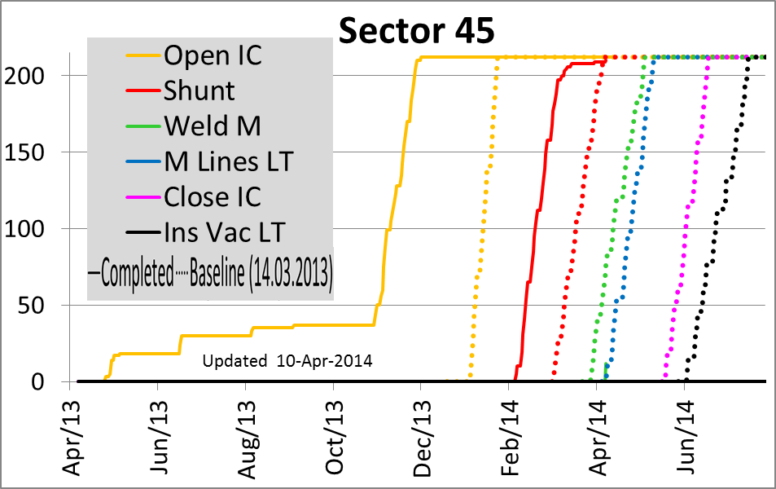
SMACC Progress report by sector
Main activities are :
  One NEW overheated splice to redo
  Leak test of M lines
  Start of reclosure of IC
Main activities are :
  Work on overheated splices
  Start of M lines rewelding

Slide 19
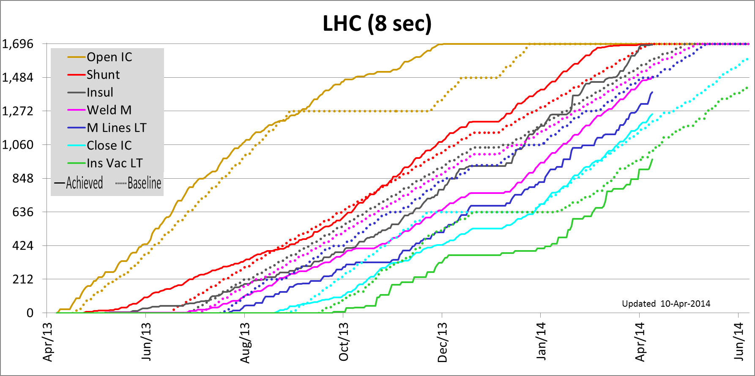
SMACC Dashboards
Shunting is nearing completion (3 ICs, < 0.2 %)
The installation of insulation boxes is nearing completion (6 ICs, < 0.4 %)
Welding and M leak test rates are recovering the baseline schedule in parallel
Reclosure: On baseline, nominal rate achieved
Insulation vacuum leak test : RECOVERING
Attention to put on facilitating the work of leak test teams
For activities linked directly to splices, only targeted interventions remain

Slide 20
☺ Completed
New
New
New
☺ Completed
New
New
New
New
New
☺ Completed

Slide 21
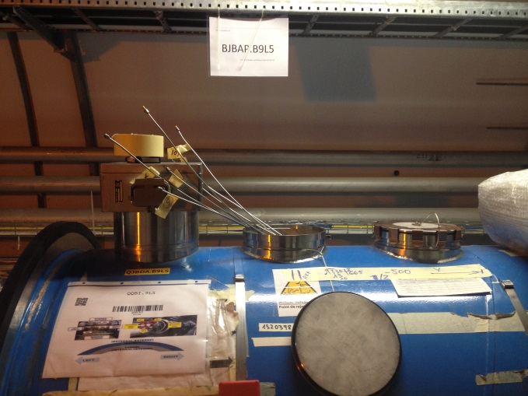
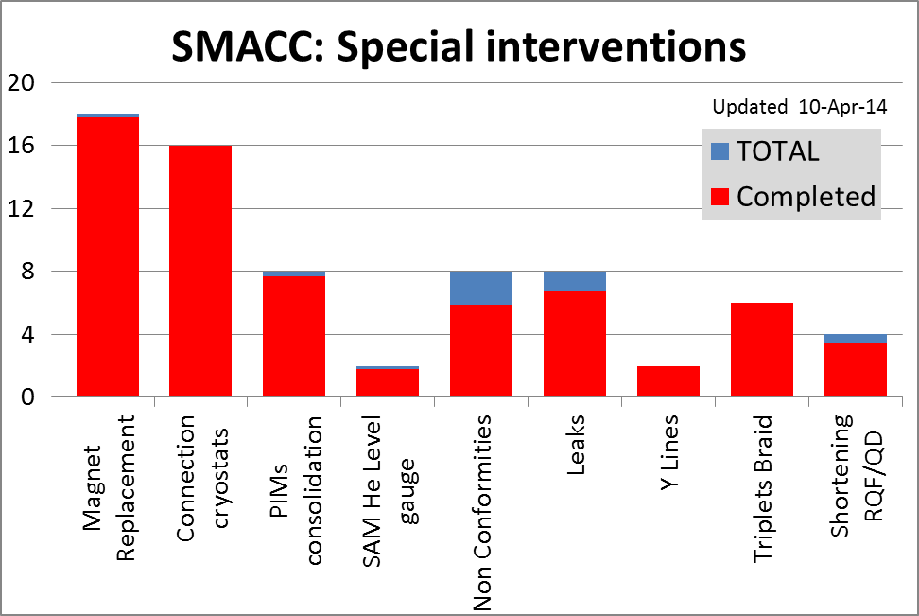
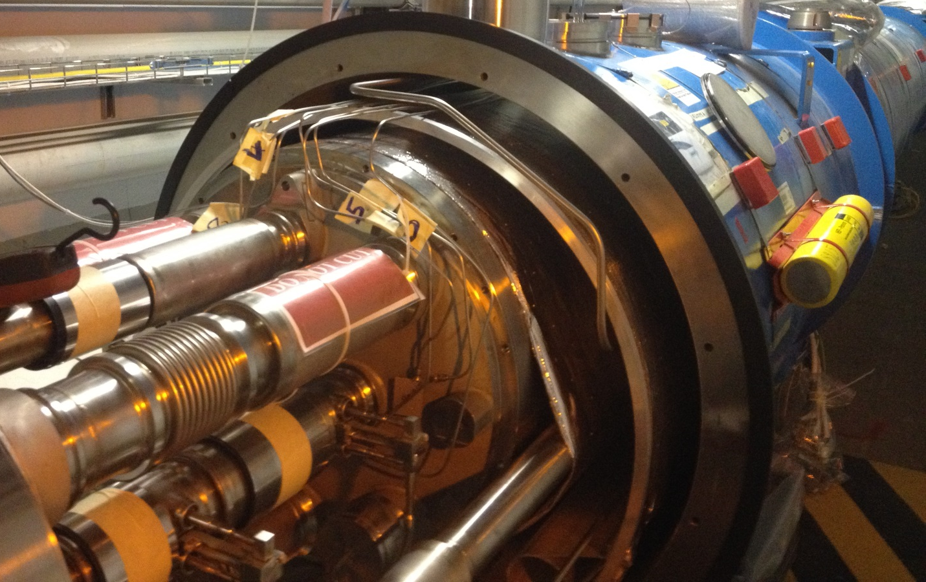
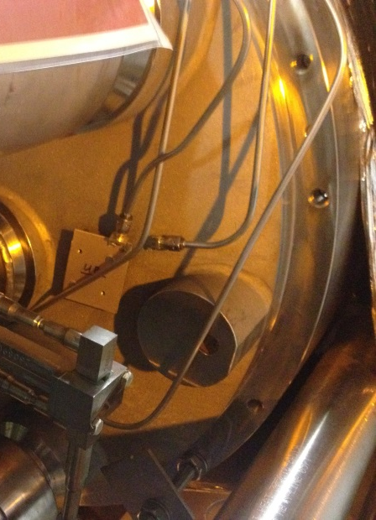
SMACC Progress report SIT
Team is reduced but can be remobilised very quickly
Activities linked to NC, leaks and overheated splices
Installation of the last RQF/D return on-going (L5)
Installation of the 2nd cryo BLM in L5
Leak in S56 : Test next week at the surface then in-situ
Courtesy N Bourcey, S Le Naour

Slide 22
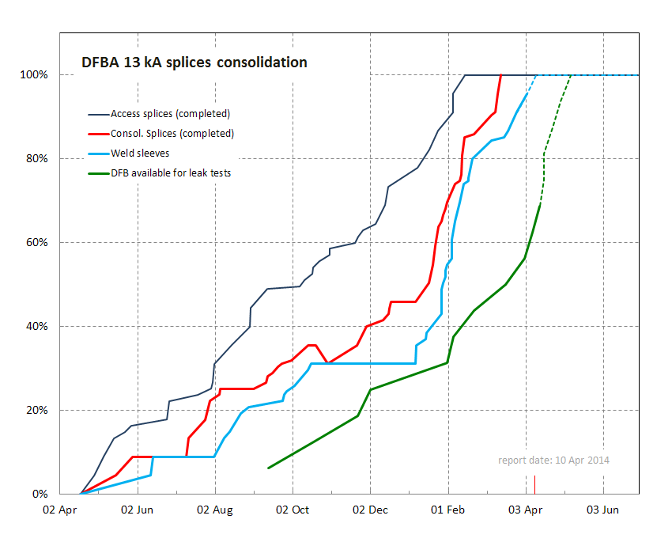
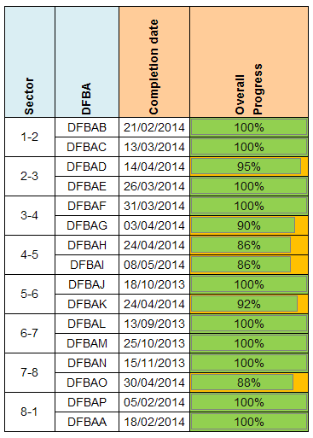
SMACC DFBA
100% of splices consolidated, 96% of sleeves welded
10/16 DFBAs re-closed, insulation vacuum leak tests to be done
4 DFBAs (sect. 6-7 & 8-1) pressure tested
Courtesy A Perin, E Vergara

Slide 23
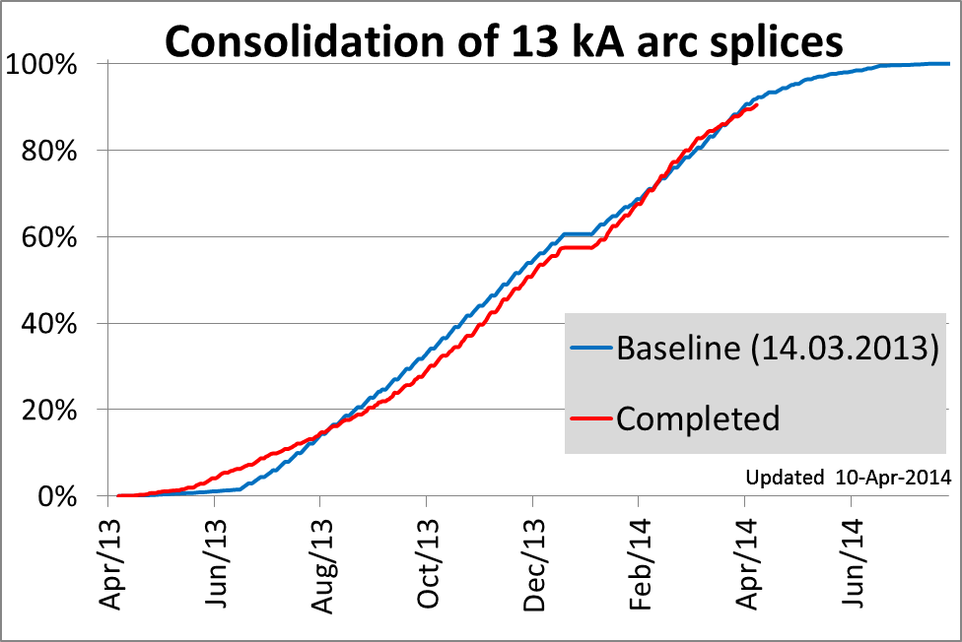
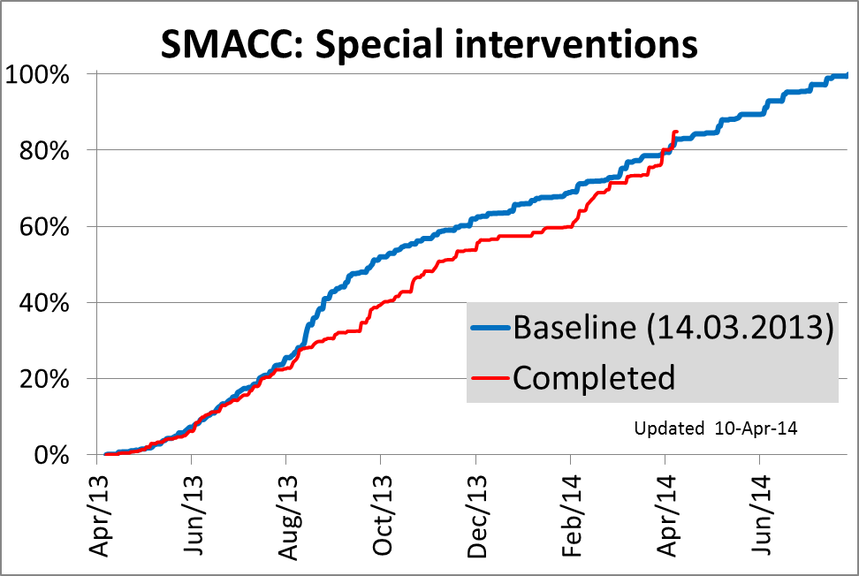
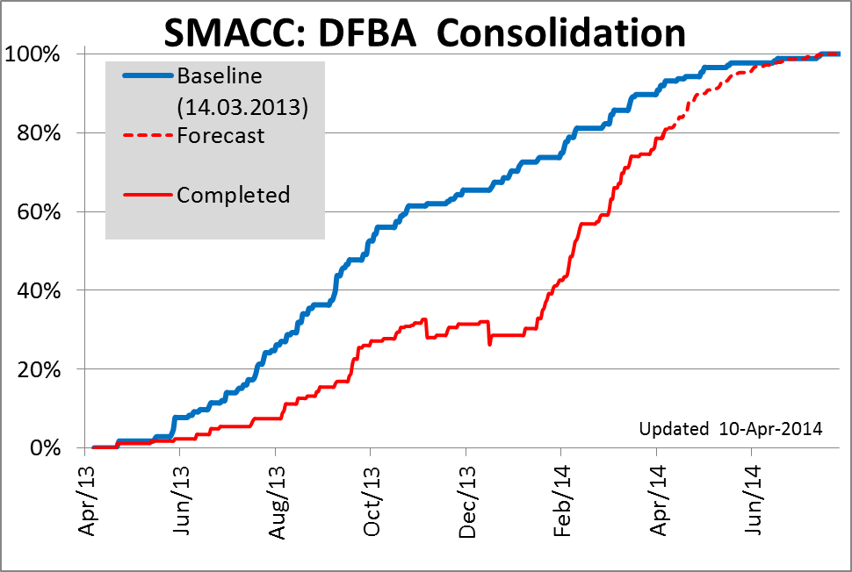
SMACC Dashboards
Baseline: 82.9 % (78.6 %)
Completed: 84.9 % (79.5 %)
Delay -20 (-3) days
Baseline: 92.0 % (87.3 %)
Completed: 90.5 % (87.1 %)
Delay 3 (1) days
😐 On schedule
☺ Ahead of schedule
Arc splices:
Just on schedule
SIT
Reactive
Ahead of schedule
DFBA:
All splices consolidated
Recovering
☺ Recovering
Baseline: 93.1 % (89.7 %)
Completed: 87.1 % (74.6 %)
Delay 1.5 (2.5) months

Slide 24
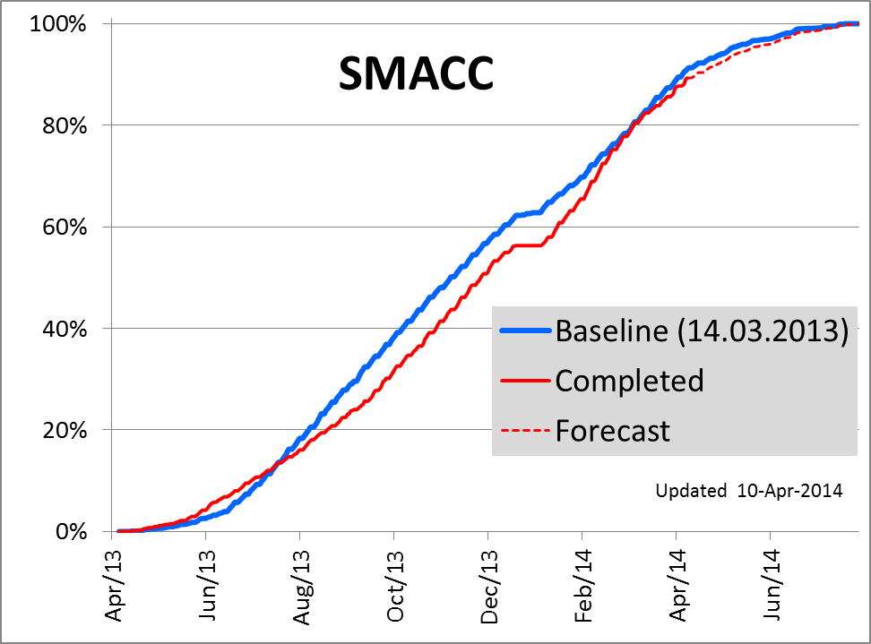
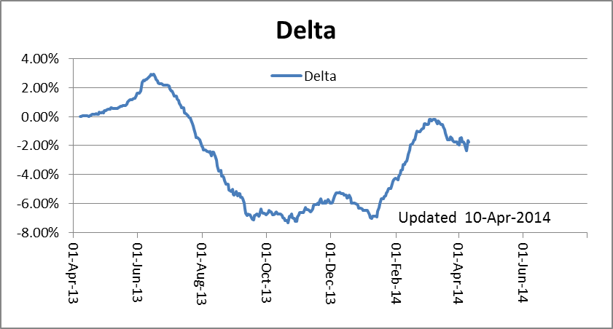
SMACC Dashboards
Progress:
Baseline: 91.0% (86.6 %)
Completed: 89.3% (85.5 %)
Delay 4 (3) days

Slide 25
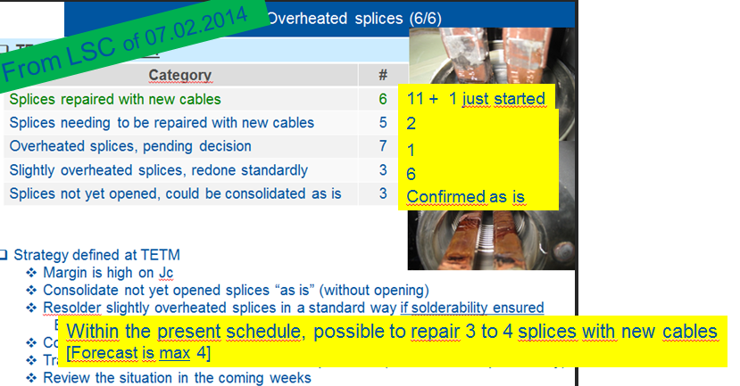
SMACC Overheated splices (1/2)
From LSC of 28.03.2014
13 + 1 on-going
1 + 1 NEW
0
6 5
Confirmed as is
Thanks to team reinforcement and learning effect, should not impact the overall schedule
Reminder: Very delicate operation
Courtesy C Scheuerlein, F Savary

Slide 26
SMACC Overheated splices (2/2)
Magnetisation result of sample extracted at the cable extremity shows a strong degradation.
Will be repaired with new cables, coherently with other cases
Normally the last one
Quality > Schedule
Courtesy C Scheuerlein, R Ostojic, F Savary

Slide 27
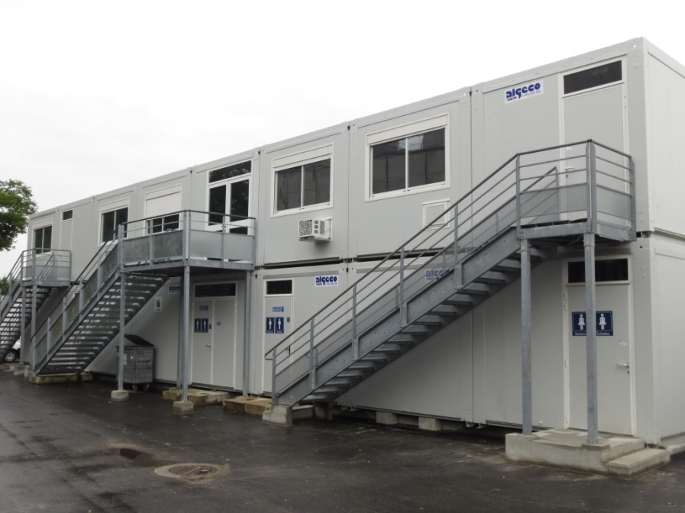
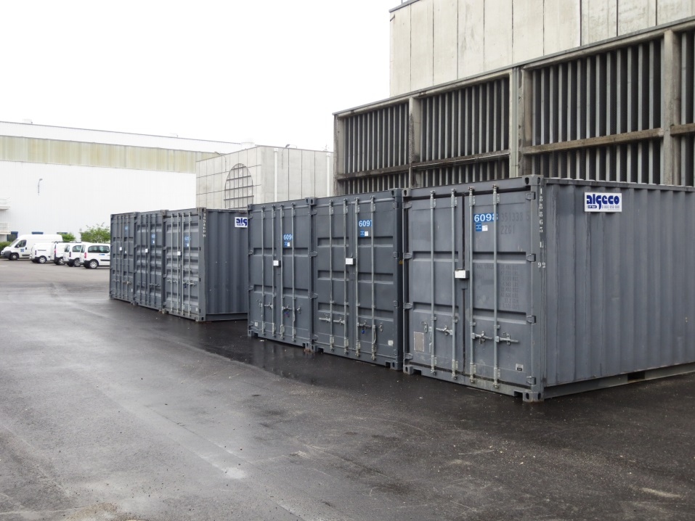
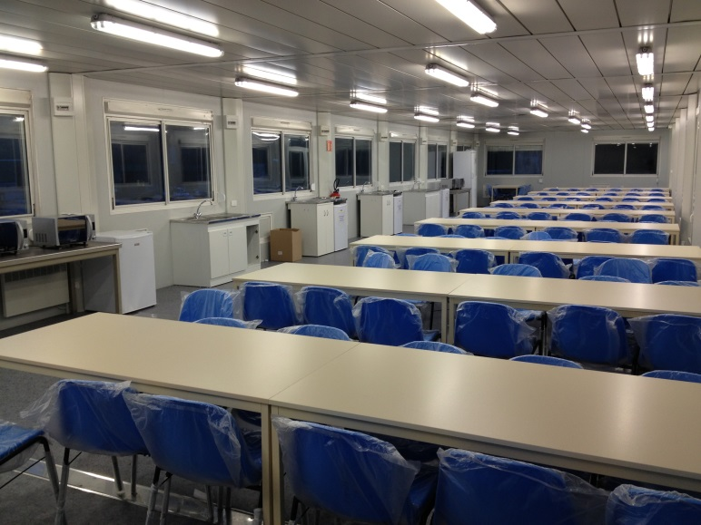
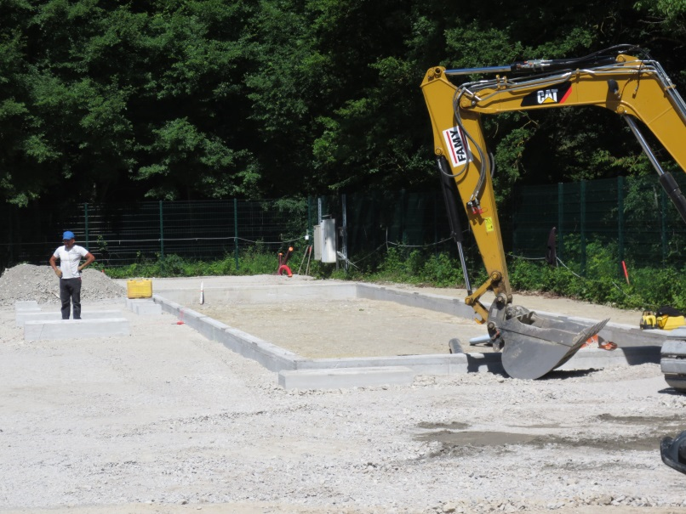
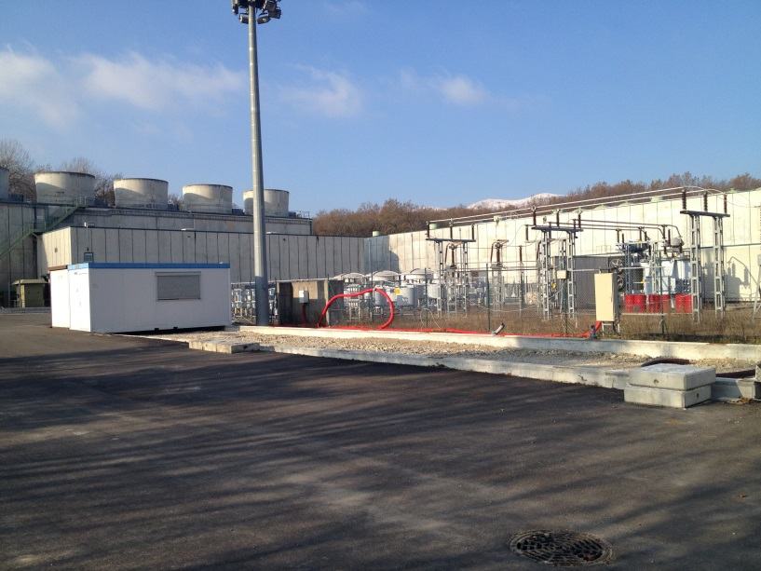
SMACC: Logisitcs, Maintenance, Mechanics (1/3)
Gestion Bases de chantier les sites
Pts
5
6
8
1
2
4
P6 Apr 2013
Thx GS
P2 June 2013
Thx EN-MEF
Courtesy Ph Canard, R Faes (CSI)
P6 Nov 2013

Slide 28
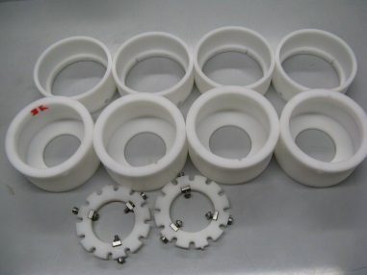
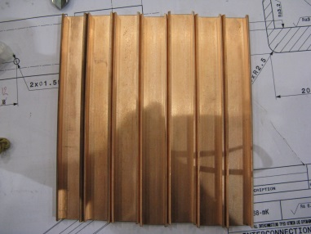
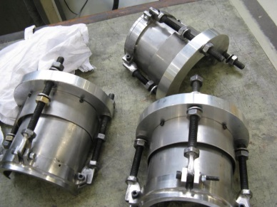
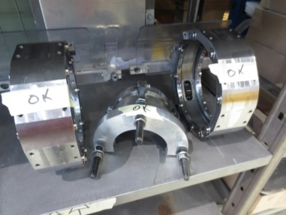










SMACC: Logisitcs, Maintenance, Mechanics (2/4)
Usinages, entretien materiel mecanique et electrique
Courtesy Ph Canard, R Faes

Slide 29






SMACC: Logisitcs, Maintenance, Mechanics (3/4)
Logistique Livraisons
Plus de 16000 kms parcourus
Plus de 1200 livraisons en surface et dans le tunnel
Courtesy Ph Canard, R Faes

Slide 30

SMACC: Logisitcs, Maintenance, Mechanics (1/3)
Courtesy Ph Canard, R Faes

Slide 31
SMACC Summary on progress
Main 13 kA Splices:
☺ On schedule
☺ Q Diodes consolidation : COMPLETED
😐 Overheated splices :
should be just OK within present schedule
Special Interventions:
☺ Ahead of schedule
☺ Almost all planned interventions are completed
⇨ Focus on NC
DFBA: ☺ Activities are back in the shadow of arc splices
SMACC:
☺ About 4 days of delay,
wrt schedule defined > one year ago !!

Slide 32

SMACC Main activities for the next 3 4-days weeks
Sector 56 :
  Final leak test and reconnection of Q7/DFBAK
Sector 67 :
  Ready for cool-down for SMACC
Sector 78
  Work on NC
  Final leak test
Sector 81
  Purge, ElQA, flushing,…
Sector 12
  Complete insulation vacuum leak test
  Pressure test for 13.05.2014
Sector 23
  Complete reclosure of Ics
  Insulation vacuum leak test
Sector 34
  Repair (hopefully) last splice
  Complete M lines rewelding (except NC)
  M lines leak test
  Start ICs reclosure
Sector 45
  Complete repair of overheated splices
  Start rewelding of M lines
Easter
Thursday 1st of May

Slide 33
Conclusions
Project is almost back on schedule (4 days delay)
  Mind the last X % effect
  Leak on vac vessel in S56 to be fixed and validated
Overheated splices :
Two more to do but still in the shadow of other activities
DFBA consolidation is nearing completion ☺
S67 is ready for ElQA before cool-down
S81 successfully pressure tested (8.04.2014)
But known leaks to be treated after
Activities directly linked to splices are in targeted interventions mode
Activities in production mode are mainly welding, leak tests, checks before closure, ICs reclosure, ElQA

