Slide 1
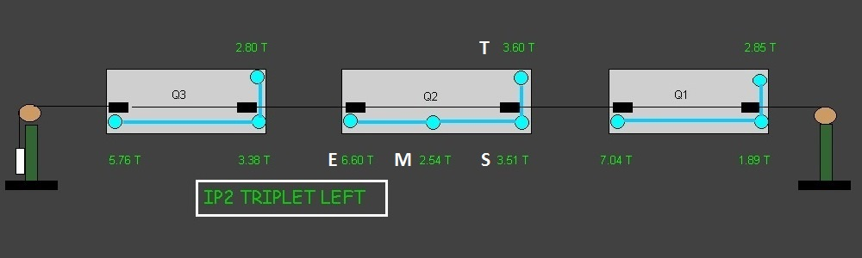
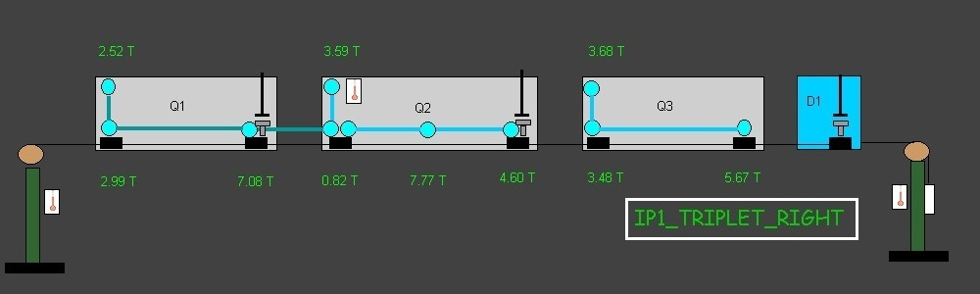
Load distribution over the jacks of Q2 low beta quadrupoles
Normal load distribution (case of lss2l)
High load on central jack (case of lss1r)

Slide 2
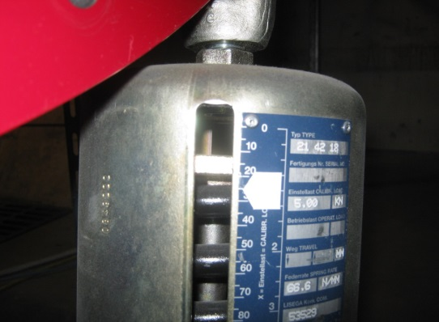
Load distribution over the jacks of Q2 low beta quadrupoles
This is a problem that was discovered during the SD 2008-2009
  To solve it, some springs were addded at each extremity of Q2 in the plane of the jacks
    fixed of the floor and pushing the magnet towards the floor
    therefore liberating some load on the central jack
    MME made the design and the installation
    Since 2011 some load sensors have been installed
    And the loads are visible remotely and are not ok even with the spring systems. Why ?
    Because the springs had some «relaxation» not pressing enough on the extremities of the quads
    And SU is requested to readjust them !!!
We don’t want to take the responsibility of this system and we request some HELP either from MME or MSC (equipment owner)

