Slide 1
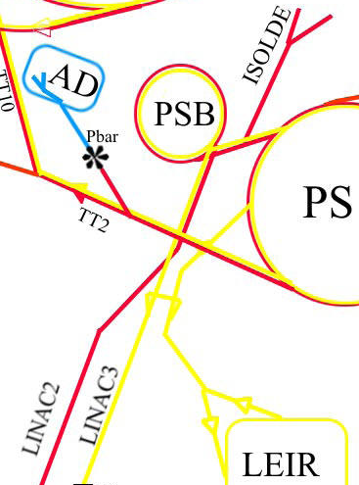
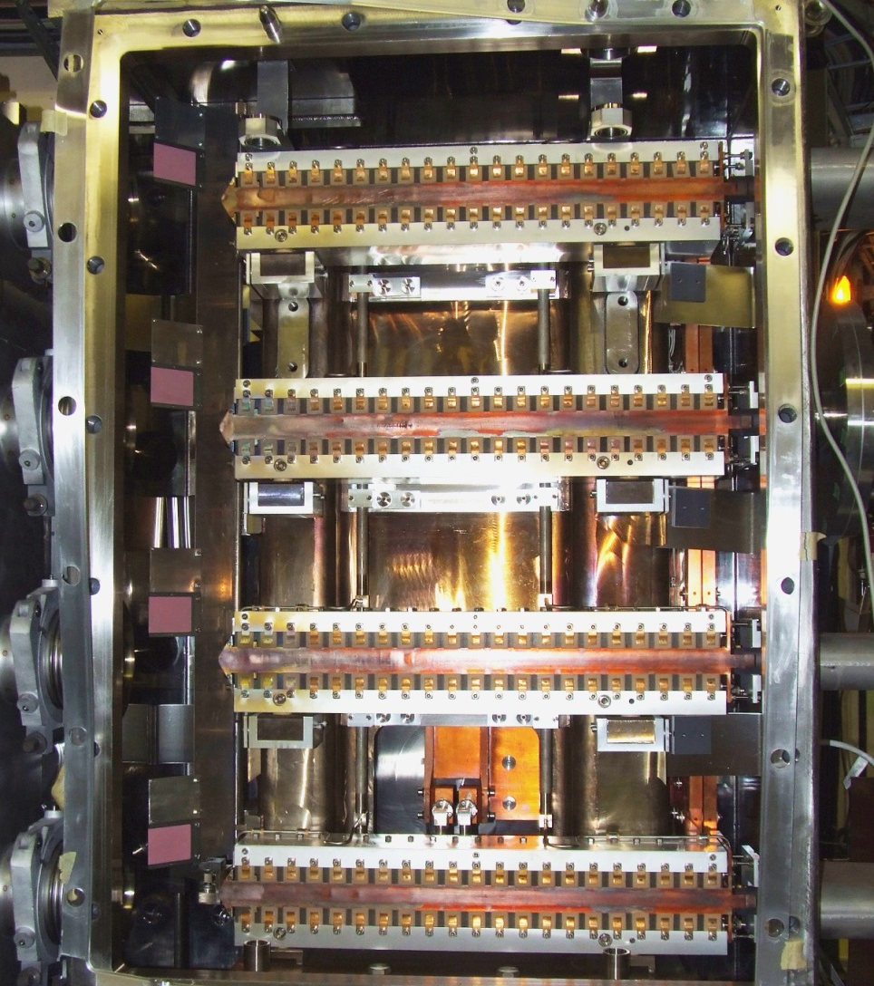
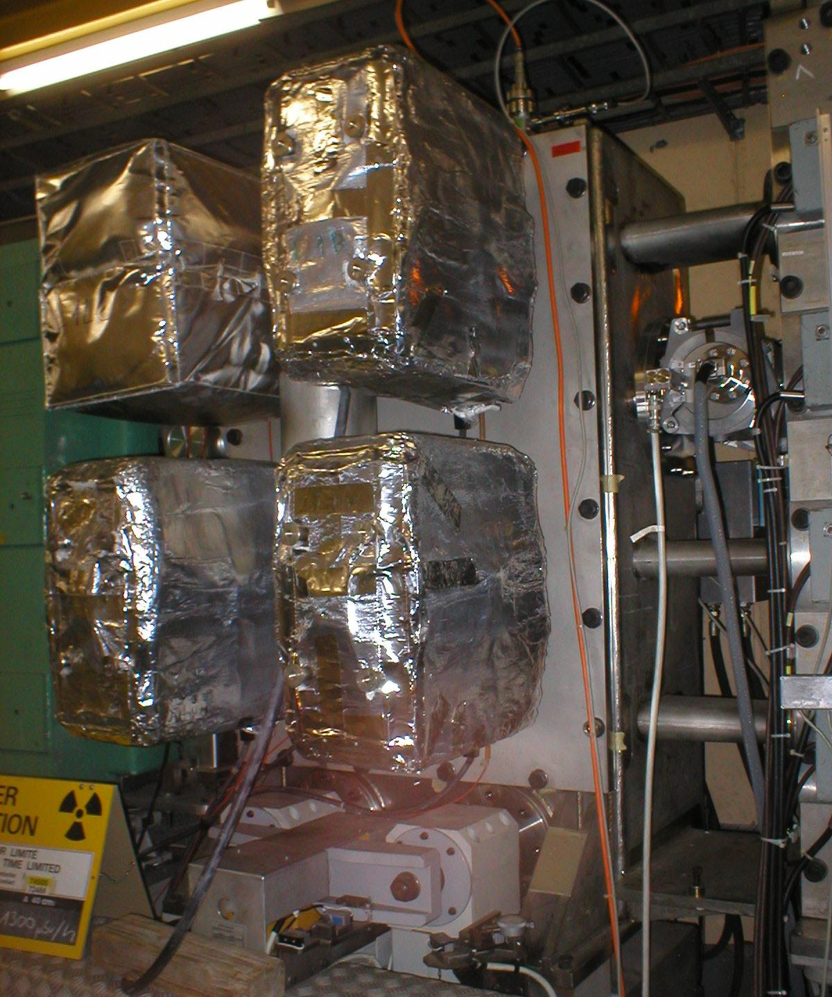
BI.SMH 2014 leak
M. Hourican, J. Borburgh

Slide 2
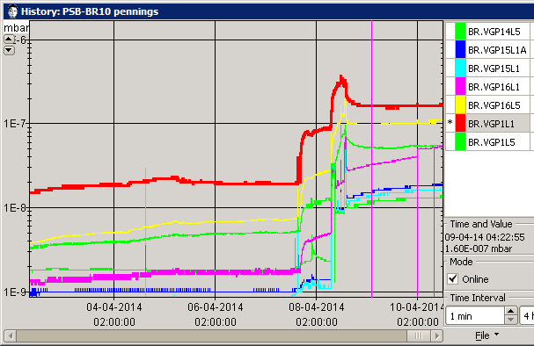
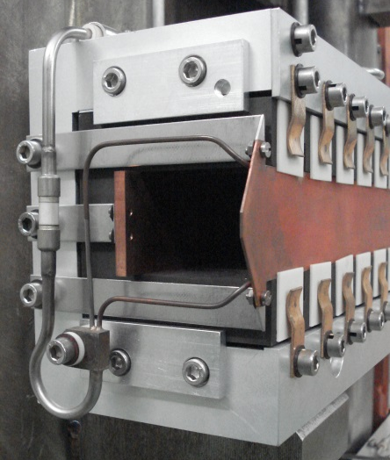
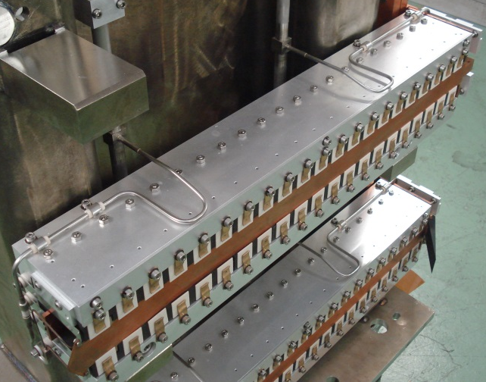
Latest Saga…
On 8th April during the final leak testing of the PSB a high pressure was noticed in the vicinity of the injection septa
Leak test on cooling circuit gave the bad news,
P_{He} at 3 bar gave leak rate of 2.5x10⁻⁵ mbar ltrs s⁻¹
Possible causes
Cooling circuit leak, insulator cracked, leak on electrical feedthrough,..other

Slide 3
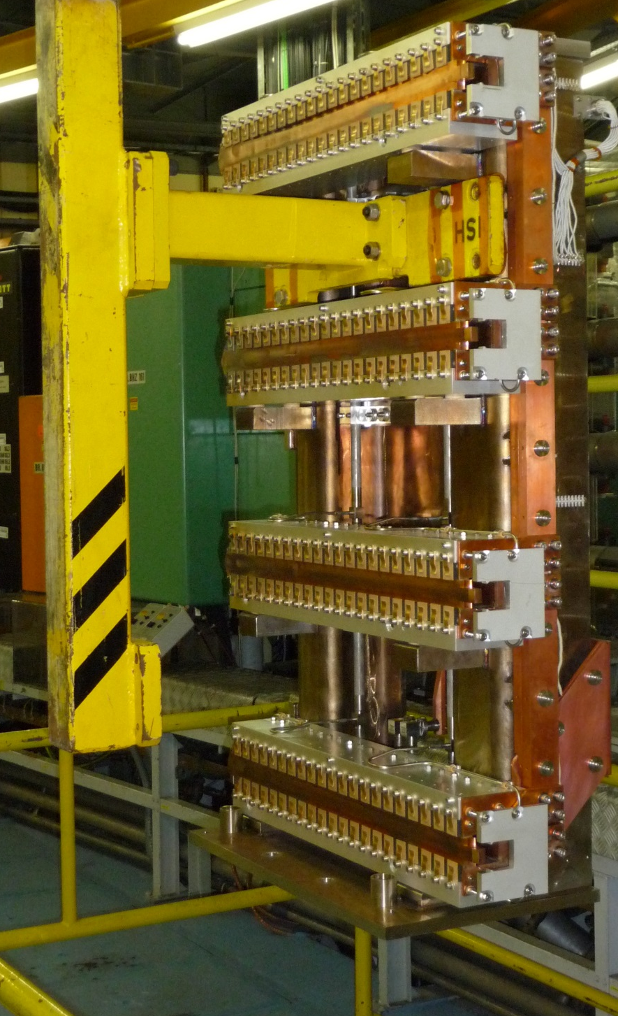
BI.SMH
A brief history of time..
Stack #1 failed May 2009, “stored“ in blg 151 (“condemned”)
Stack #2 Renovated with unused isolators, but 2 brazes per magnet were not redone. Currently installed in PSB and leaking (to be replaced when..?)
Stack #3, currently being renovated, (estimated ready for 29/4)
Refurbished 4 kA spare feedthrough spring 2013 (SI.3.47.1238.1)
4 spare coils available (upgraded to ‘77 spec in 2010), but brazes and ceramic insulators are still original (from 1973!)
New insulators delivered 10.04.2014
Note: strategy presented in LSC meeting on 24th January 2014

Slide 4
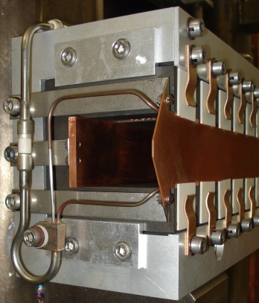
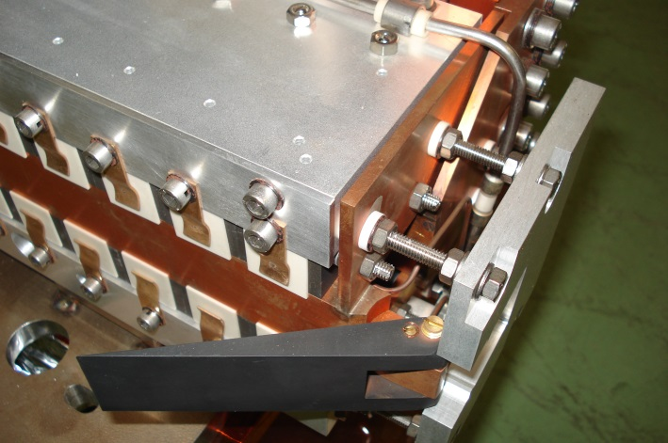
Potential fault locations
septum side view
cross-over made from braid
cooling circuit
cooling circuit
septum
rear conductor
top view
Under-vacuum brazes
ceramic insulator
coil drawing 1972 !

Slide 5
Planned Intervention for faulty BISMH in PSB
Open tank and leak test stack in-situ to try to determine the fault location
Remove stack and leak test electrical feedthrough in-situ
NO
Feedthrough OK
YES
Transport stack #2 to 867
Dismantle and renovate
Leak test magnets
Magnetic measurements
Leak test complete stack
Replace feedthrough
(Note: this has never been performed by current staff and this procedure is being investigated)
2. Install either the original Stack (#2) or install the newly renovated stack #3
3. Leak test BISMH

Slide 6
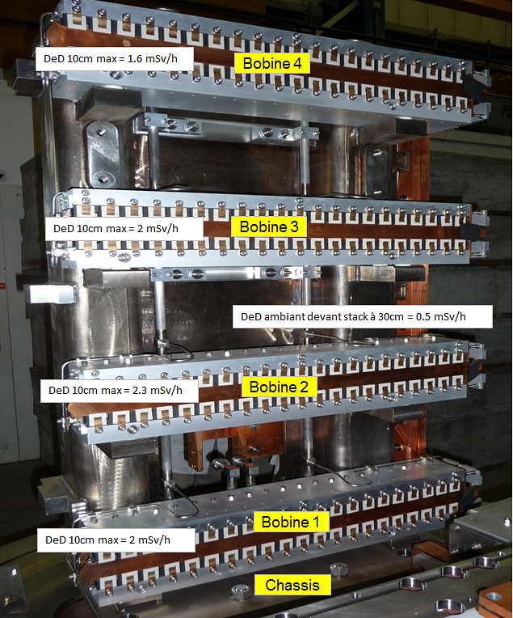
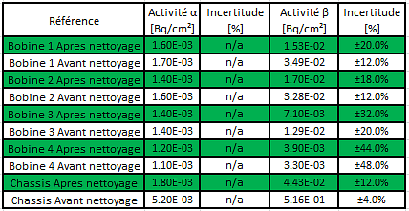
Stack No. 3 renovation
Impact has been created (45141)
WDR Work dose planning established and being followed up

Slide 7
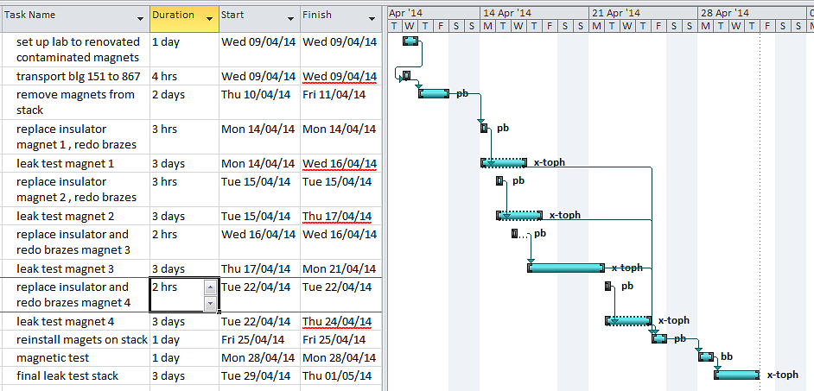
Proposed strategy Stack #3 in blg 867
1. Remove each magnet from stack and perform leak test (Diagnostics)
2. Replace ceramic insulators, redo brazes and verify leak tightness of each magnet individually
3. Reinstall magnets on stack
5. Magnetic measurements
6. Vacuum testing of complete stack
7. Transport to PSB
Vacs

Slide 8
Outstanding
Failure cause/location to be determined to assure reliable repair.
Which stack to use in case of feedthrough failure?
Feedthrough replacement procedure to be determined.
After PSB intervention, prepare operational spare stack.

Slide 9
Initial Planning
Refurbishment of the spare in bldg 867.
Aim for repair first half of 2014, for spare to be operational once PSB starts up ( 30 May 2014 with beam).
WDP to be prepared:
For stack #1 (2009)
https://espace.cern.ch/rpps/wdp/docs/PS%20Complex/Booster/2013-2014_LS1/2014_Renovation_stack-1_(2009)_BISMH.xlsx
working time estimated: 11.4 man.hours
collective dose estimated: not done (needs handling to establish dose rates)
radiation D_{moy}=250 µSv/h @ 40 cm
For stack #3 (2013)
https://espace.cern.ch/rpps/wdp/docs/PS%20Complex/Booster/2013-2014_LS1/2014_Renovation_stack-3_(2013)_BISMH.xlsx
working time estimated: 2.6 man.hours
collective dose estimated : 1.2 mSv
radiation D_{moy}=100 µSv/h @ 40 cm

Slide 10
October 2013 BISMH exchange
Fault indication on magnet stack
Stack #3 removed from tank and stack #2 installed
Work Dose planning anticipated collective dose: 1.9 mSv (worst scenario foresaw 3.1 mSv)
collective dose measured for intervention: 2.1 mSv
Misalignment of electrical connection → additionally 148 µSv
Transport container too big for truck → additionally 62µSv
For info:
collective dose taken for the first exchange in 2009: 4.8 mSv.

