Slide 1

FCC-ee physics studies : some news
FCC-ee physics VIDYO conferences (every month)
workshops
-- 19-21 June at CERN («7th FCC-ee» see next slide for topics.) Agenda in construction
note at least four presentations from LC community
machine reports and detector interface probably on Saturday 21
-- plans next in Paris in ~early November (S. Laplace + R. Aleksan)
and one elsewhere in jan/feb 2015 (Copenhagen candidate)
Conveners: complete
Patrick organized first very positive meeting on 30 April

Slide 2
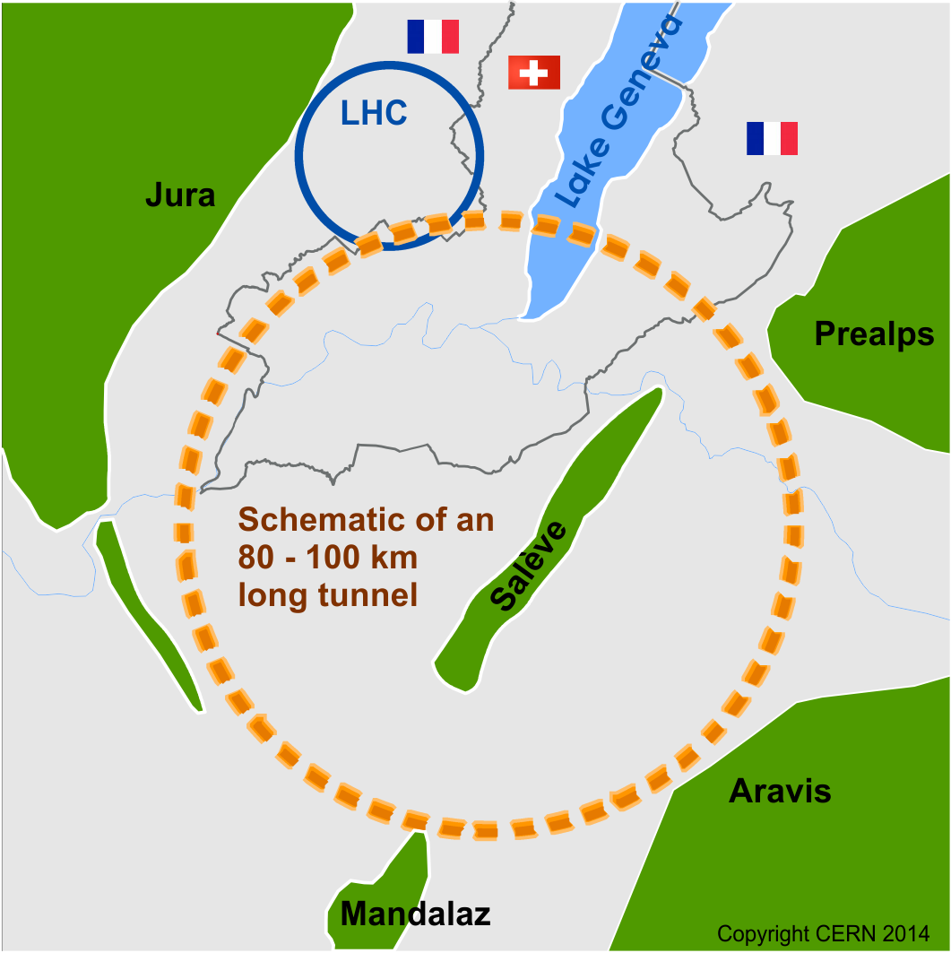
Future Circular Collider Study - SCOPE
CDR and cost review for the next ESU (2018)
Forming an international collaboration to study:
pp-collider (FCC-hh) Ultimate goal
→ defining infrastructure requirements
e⁺e⁻ collider (FCC-ee) as potential intermediate step
p-e (FCC-he) option
80-100 km infrastructure in Geneva area

Slide 3
possible long-term strategy
FCC-ee (80-100 km,
e⁺e⁻, 90-350 GeV
Interm. step
LEP
PSB
PS (0.6 km)
LHC (26.7 km)
HL-LHC
SPS (6.9 km)
FCC-hh
(pp, up to
100 TeV c.m.)
Ultimate goal
& e± (120 GeV)–p (7, 16 & 50 TeV) collisions FCC-eh)
≥50 years of e⁺e⁻, pp, ep/A physics at highest energies

Slide 4
The combination of TLEP and the FHC offers, for a great cost effectiveness, the best precision and the best search reach of all options presently on the market.
FCC-ee
FCC-hh
First look at The Physics Case of TLEP
arXiv:1308.6176v2 [hep-ex] 22 Sep 2013

Slide 5
The FCC design study is a HUGE enterprise
BUT: FCC-ee is *not* «a 30B€ project for 2050»!
-- it is an ILC-size project for 2030’s
-- paves the way to 100 TeV pp collisions
-- Study is by nature international, but based at CERN
-- Strong collaboration with IHEP, Beijing
-- Begin to establish collaborations with LCC^{*)} colleagues,
esp. CERN based group (They have done a lot!)
^{*)} Linear Collider Collaboration

Slide 6
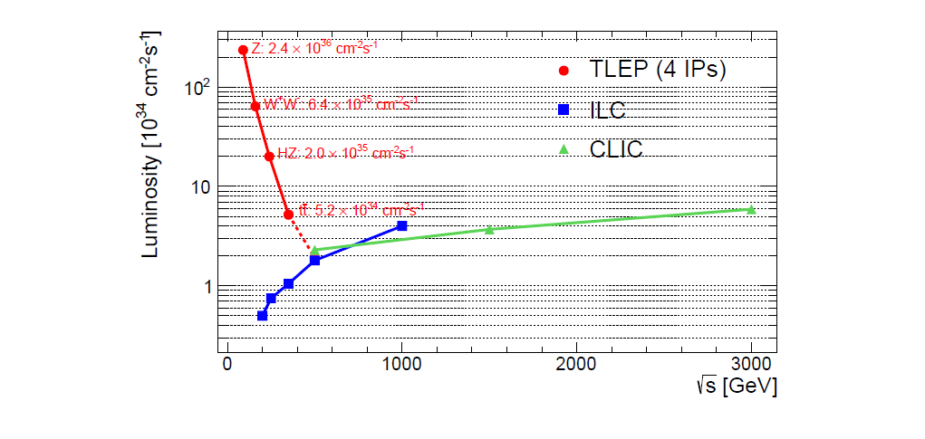
Goal performance of e+ e- colliders
WOW!
FCC-ee (4 IP)
ILC
CLIC
complementarity
    Luminosity : Crossing point between circular and linear colliders ~ 4-500 GeV
    As pointed out by H. Shopper in ‘The Lord of the Rings’ (Thanks to Superconducting RF…)
Combined know-how {LEP, LEP2 and b-factories} applied for large e+e- ring collider
High Luminosity + Energy resolution and Calibration ➔ precision on Z, W, H, t
CAN WE DO IT? Many accelerator and experimental challenges!

Slide 7
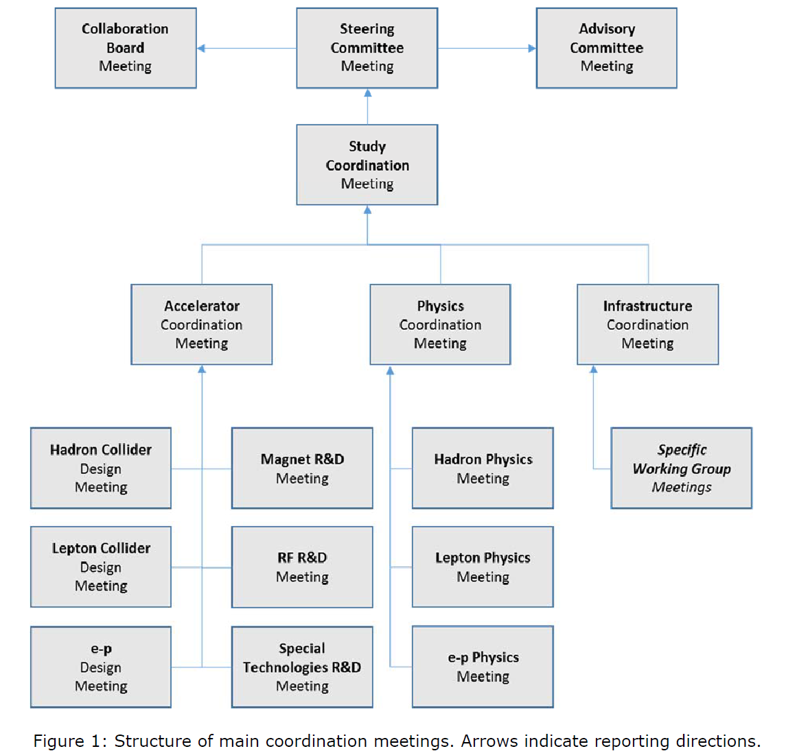
this meeting

Slide 8
FCC Coordination Team
Future Circular Colliders - Conceptual Design Study
Study coordination, M. Benedikt, F. Zimmermann
Hadron collider
D. Schulte
Hadron injectors
B. Goddard
e+ e- collider and injectors
J. Wenninger
Infrastructure, cost estimates
P. Lebrun
Technology
High Field Magnets
L. Bottura
Supercon-ducting RF
E. Jensen
Cryogenics
L. Tavian
Specific Technologies
JM. Jimenez
Physics and experiments
Hadrons
A. Ball, F. Gianotti,
M. Mangano
e+ e-
A. Blondel
J. Ellis, P. Janot
e- p
M. Klein
e- p option
Integration aspects O. Brüning
Operation aspects,
energy efficiency, safety, environment P. Collier
Planning (Implementation roadmap, financial planning, reporting)
F. Sonnemann, J. Gutleber

Slide 9
FCC Physics Coordination (Physco)
Meeting / activity | Present goals (as of April 2014) | who is present | Frequency
Physics Coordination Meeting (FCC-Physco) (Chair: A. Blondel until April 2015 Secretary: Mike Koratzinos) | • Ensure that all physics studies progress as one consistent endeavor • Define and align scope and milestones of physics studies • Propose physics topics to be used in the study of synergy/complementarity among experiments at FCC-hh/ee/eh • Track progress of individual physics study activities • Monitor/coordinate/promote talks on FCC physics at conferences and workshops • Identify technical and organizational questions which require further coordination Software platform theoretical calculations conference presentations repository of talks and papers, experimental R&D and infrastructures running scenarios and schedule general study management • Identify issues to be brought to attention to FCC coordination meeting | FCC Study leader and deputy; Hadron physics and experiments study leaders; Lepton physics and experiments study leaders; e-p physics and experiments study leader; others invited as required. ------------------------------ Accelerator: Benedikt Zimmermann FCC-hh: Gianotti Mangano Ball FCC-ee: Blondel Janot Ellis/Grojean FCC-eh: Klein/D’Onofrio | 1 / month or as needed (Thursdays 12:00-13:30) Next: 8 May 2014

Slide 10
Experiments team is complete!
Experimental Studies: A. Blondel, P. Janot
  Discovery through precision measurements, rare, or invisible processes.
  Develop the necessary tools Understand the experimental conditions
  Set constraints on the possible detector designs to match statistical precision
  well done Patrick!
Electroweak Physics at the Z pole
R. Tenchini
Di-boson Physics m_{W} measurement
R. Tenchini
H(126) Properties
M. Klute
K. Peters
Top Quark Physics
P. Azzi
QCD and γγ Physics
D. d’Enterria
P. Skands
Flavour Physics
S. Monteil
New Physics
M. Pierini
C. Rogan
Offline Software
P. Janot
F. Gianotti
B. Hegner (PH-sft)
Online Software
C. Leonidopoulos
Experimental Environment
N. Bacchetta
Synergy with FCC-hh
coordination with accelerator team
(Wenninger, Burkhardt, etc)
Detector Designs
A. Cattai
G. Rolandi
Synergy with linear collider detectors

Slide 11
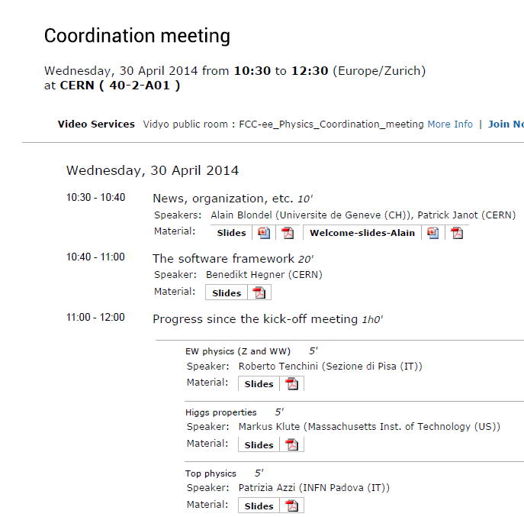
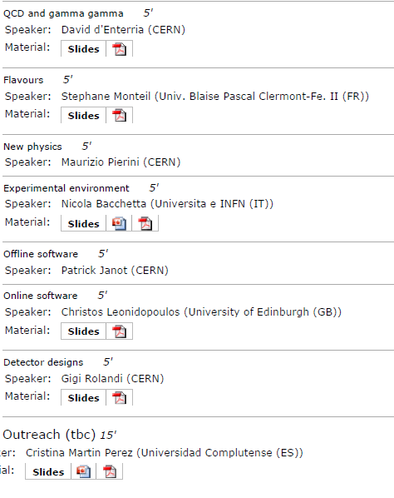

Slide 12
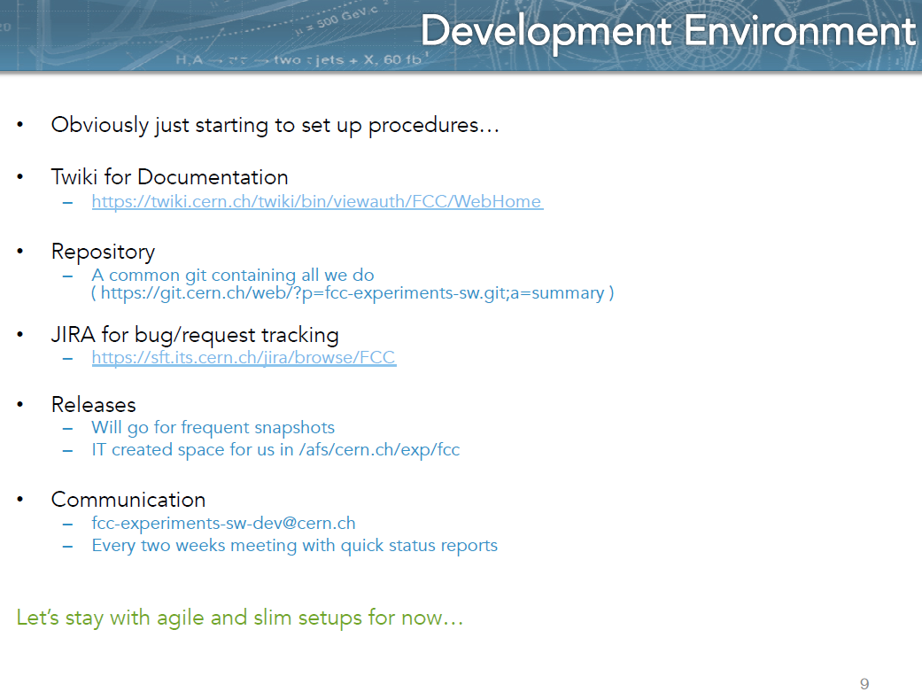
Benedikt Hagner

Slide 13
Phenomenology Studies
Phenomenology Studies: J. Ellis, C. Grojean
  Match theory predictions to FCC-ee experimental precisions
  How to discover new physics in precision measurements, in rare decays (Z, W, t, H, b, c, τ, …) in rare or invisible processes (RHASnu’s ^{*)})
  Set up the framework for global fits and understand the complementarity with other colliders (LHC, FCC-hh, in particular)
QCD and γγ Physics
(Joint exp/th)
P. Skands
Precision EW calculations
S. Heinemeyer
Flavour Physics
(Joint exp/th)
Jernej Kamenik
Flavour Physics
(Joint exp/th)
TBA
Model Building and New Physics
Andreas Weiler
Synergy with
FCC-hh physics
Linear collider physics,
LEP physics
HF physics
:
Global Analysis, Combination, Complementarity
J. Ellis
RHASnu’s ^{*)} = “Right-handed almost sterile neutrinos”

Slide 14
ICHEP talks and poster
mostly good news:
we submitted 5 physics abstracts to ICHEP and obtained 4 talks and one poster.
talks:
Higgs Physics at the FCC-ee (#845) in the Higgs session
Precision Electroweak measurements at FCC-ee (#847) in the Top and Electroweak session
Search for rare phenomena at FCC-ee (#848) in the BSM session
Heavy neutrino hunting in Higgs- and Z decays (#851) in the neutrino session
poster:
Strong coupling constant measurements at the FCC-ee (#853) is considered part of
‘future colliders’ session.(???) Plan to get in touch with organizers
will call for volunteers
Other conferneces are coming up: → Mike Koratzinos

Slide 15
Horizon 2020
1. design study proposal (concerns accelerator and infrastructure) in preparation
main concern : get approved!
2. Detector and software
AIDA2 work for FCC within the context of software developments packages
networking for FCC within the context of the dissemination of the work,
which is mostlydone with LHCupgrade and LLC detector R&D

Slide 16
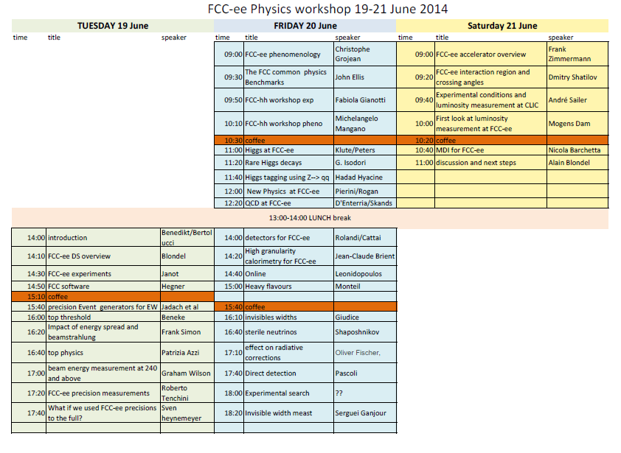
VERY
PRELIM-
INARY

Slide 17
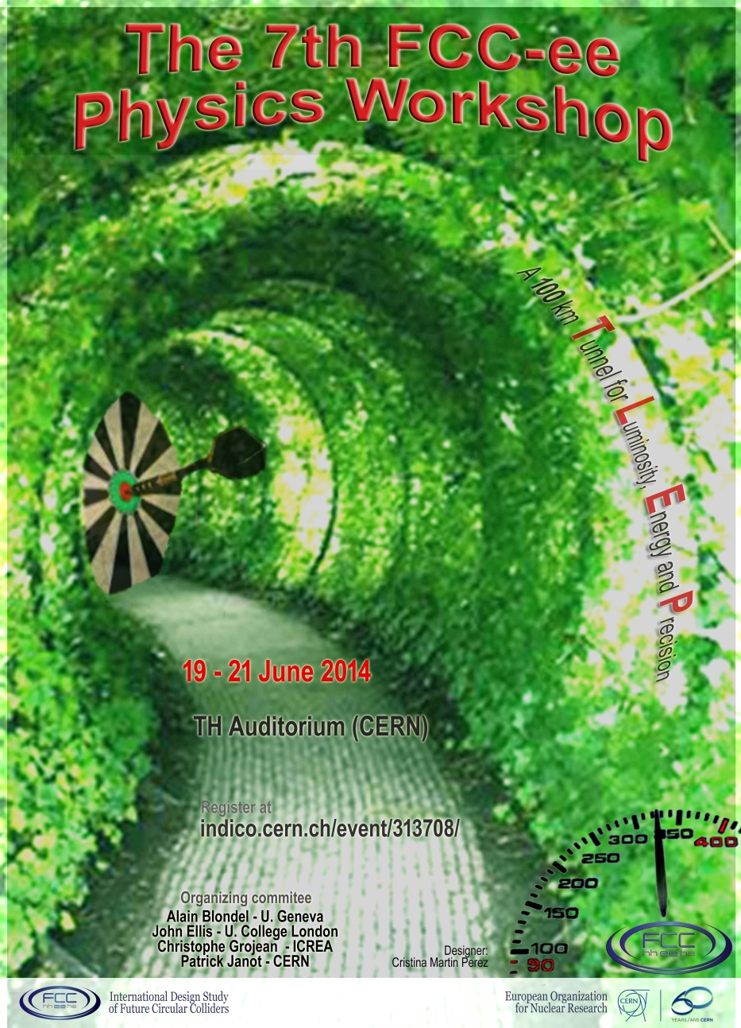
REGISTER!

