Slide 1
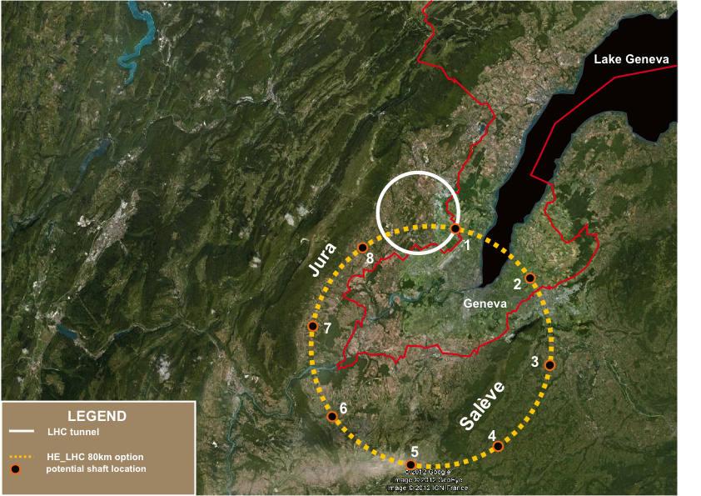
Search for Heavy Neutrinos at FCC-ee

Slide 2
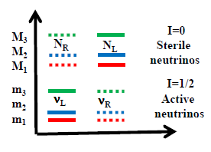
Neutrinos : the New Physics there is… and a lot of it!
forgive the confusion between fields and particle notations
SM | Dirac mass term only ≡ «Yukawa» | Majorana mass term only | Dirac AND Majorana mass terms
ν_{L} ‾ν_{R} I= ½ ½ | ν_{L} ν_{R} ‾ν_{R} ‾ν_{L} ½ 0 ½ 0 | ν_{L} ‘‾ν_{R} ‘ ½ ½ | N_{R} N_{L} 0 0 ν_{L} ν_{R} ½ ½
X 3 Families | X 3 Families | X 3 Families | X 3 Families
6 massless states | 3 masses 12 states 3 active neutrinos 3 active antinu’s 6 sterile neutrinos… 3 mixing angles 1 CP violating phase 0vββ = 0 | 3 masses 6 active states No steriles 3 mixing angles 3 CP violating phases 0vββ ≠ 0 | 6 masses (Majorana) 12 states 6 active states 6 sterile neutrinos… More mixing angles and CPV phases 0vββ ≠ 0 (different than pure Majorana case if m_{N}<100 MeV) ➔ Leptogenesis and Dark matter
wrong
Mass hierarchies are all unknown except m₁ < m₂
Preferred scenario has both Dirac and Majorana terms …
… many physics possibilities and experimental challenges

Slide 3


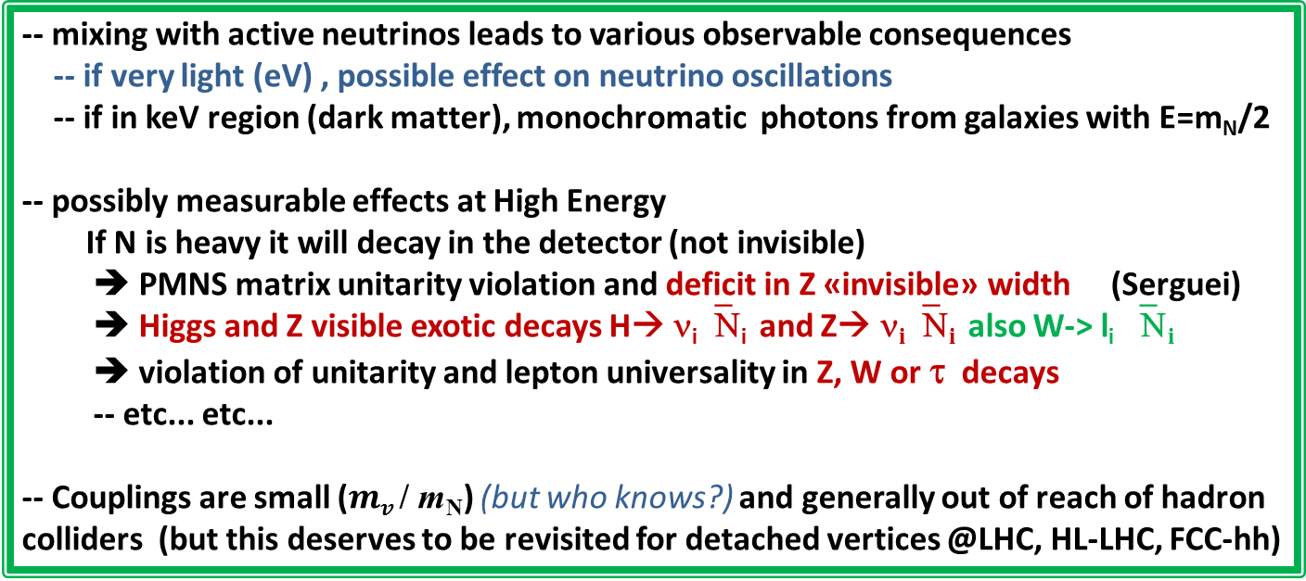
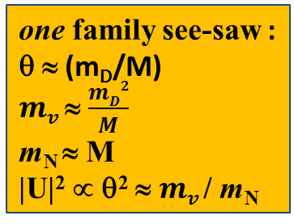
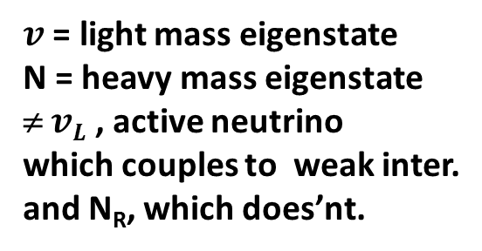

Manifestations of right handed neutrinos
$v$ = light mass eigenstate
N = heavy mass eigenstate
≠ $vL$ , active neutrino
which couples to weak inter.
and N_{R}, which does’nt.
one family see-saw :
θ ≈ (m_{D}/M)
$mv$ ≈ $\frac{mD2}{M}$
m_{N} ≈ M
|U|² ∝ θ² ≈ $mv$/ m_{N}
$v= vL$ cosθ - ${Nc}_{R }^{} sin$θ
$N=N_{R}^{} \text{cos}\text{θ}+ vL$ ^{c} sinθ
what is produced in W, Z decays is:
$vL= v$ cosθ + $N_{ }^{}sin$θ
-- mixing with active neutrinos leads to various observable consequences
-- if very light (eV) , possible effect on neutrino oscillations
-- if in keV region (dark matter), monochromatic photons from galaxies with E=m_{N}/2
-- possibly measurable effects at High Energy
If N is heavy it will decay in the detector (not invisible)
➔ PMNS matrix unitarity violation and deficit in Z «invisible» width (Serguei)
➔ Higgs and Z visible exotic decays H→ ν_{i}‾Ν_{i} and Z→ ν_{i}‾Ν_{i} also W-> l_{i} ‾Ν_{i}
➔ violation of unitarity and lepton universality in Z, W or τ decays
-- etc... etc...
-- Couplings are small ($mv$/ m_{N}) (but who knows?) and generally out of reach of hadron colliders (but this deserves to be revisited for detached vertices @LHC, HL-LHC, FCC-hh)

Slide 4
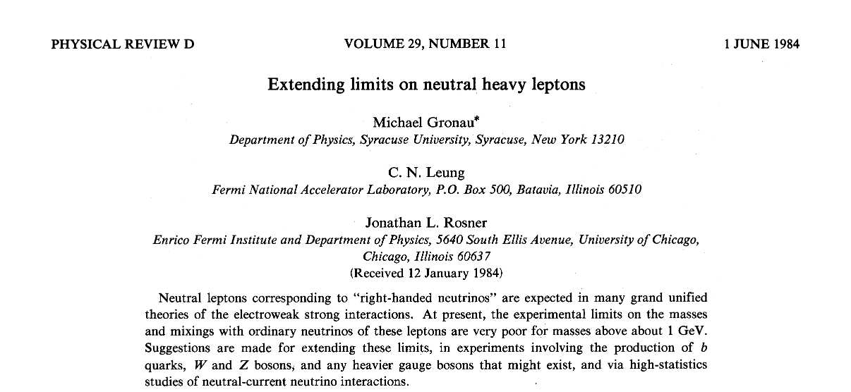
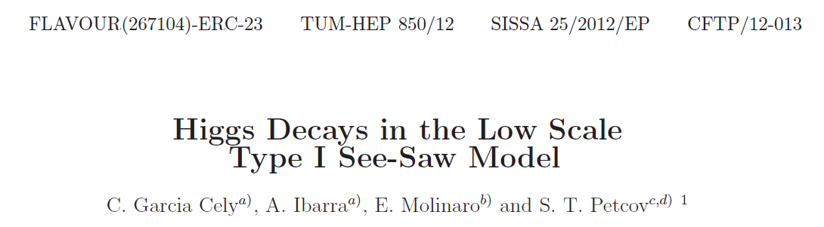
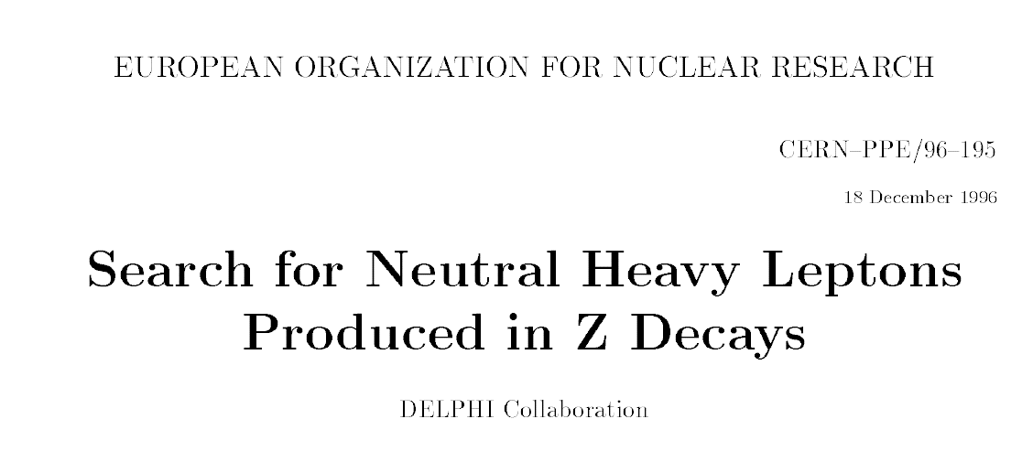
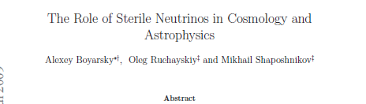
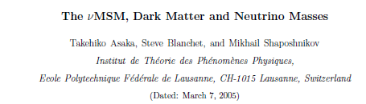
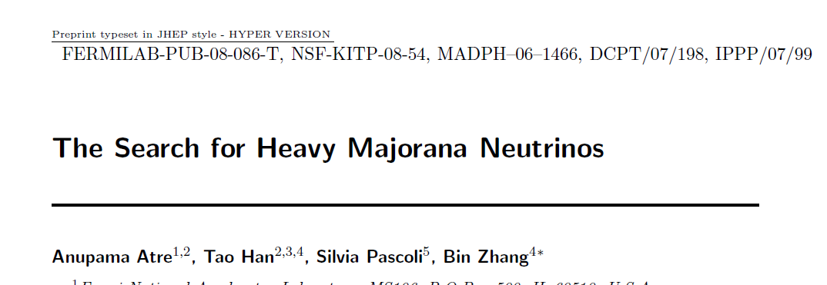
some REFERENCES
arxiv:1208.3654
Phys.Lett.B631:151-156,2005
arXiv:hep-ph/0503065

Slide 5
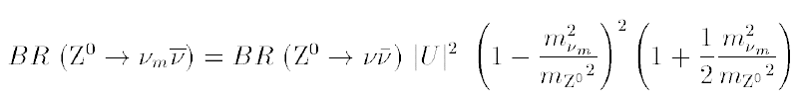
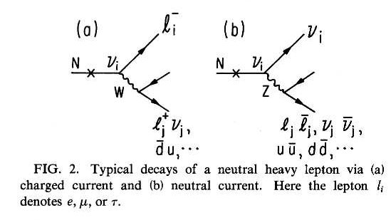

RHASnu’s production in Z decays
Production:
multiply by 2 for anti neutrino and add contributions of 3 neutrino species (with different |U|² )
Decay
Decay length:
cm
NB CC decay always leads to
≥ 2 charged tracks
Backgrounds : four fermion: e+e- → W*⁺ W*⁻ e+e- → Z*(vv) + (Z/γ)*

Slide 6
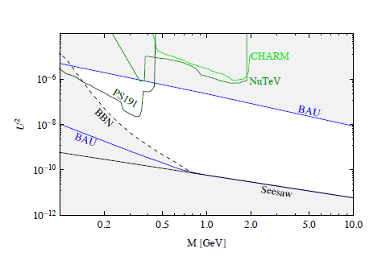
Typical Interesting Region (from Shaposhnikov)
➔ |U|² ~ 10⁻⁹ to 10⁻¹² @ 50 GeV
Shaposhnikov says:
these are straight lines
my extrapolations:
20 50 100
heavy neutrino mass ~ M

Slide 7
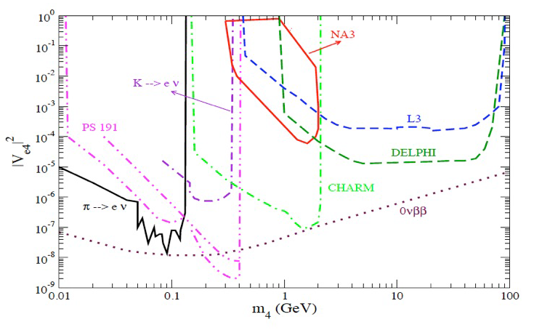
Existing limits

Slide 8
Order-of-magnitude extrapolation of existing limits
4 10^6 Z decays
BAU
maybe achievable with
10¹⁰ ⁻ 10¹³ Z decays?
see-saw

Slide 9
Decay length
Interesting region
|U|² ~ 10⁻⁹ to 10⁻¹² @ 50 GeV
L=1mm
L=1m
L=10m
20 50 100
heavy neutrino mass ~ M
IFF this is correct, a large part of the interesting region will lead to detached vertices
... ➔very strong reduction of background!

Slide 10
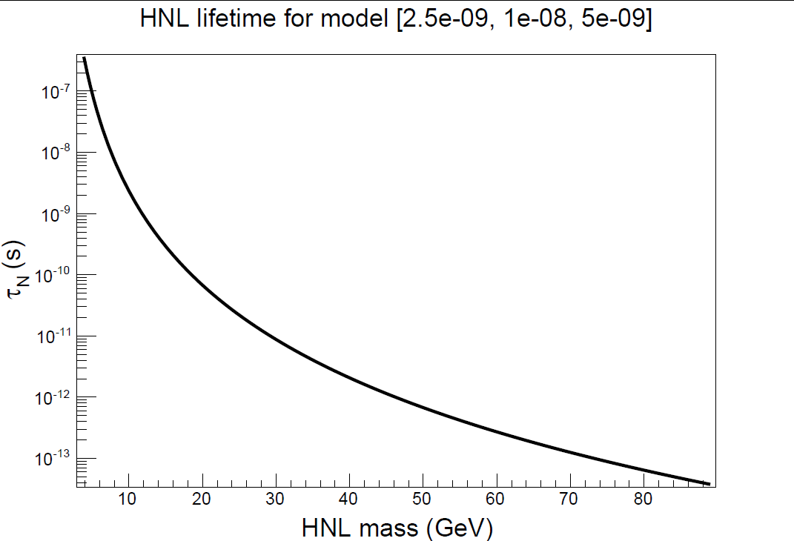
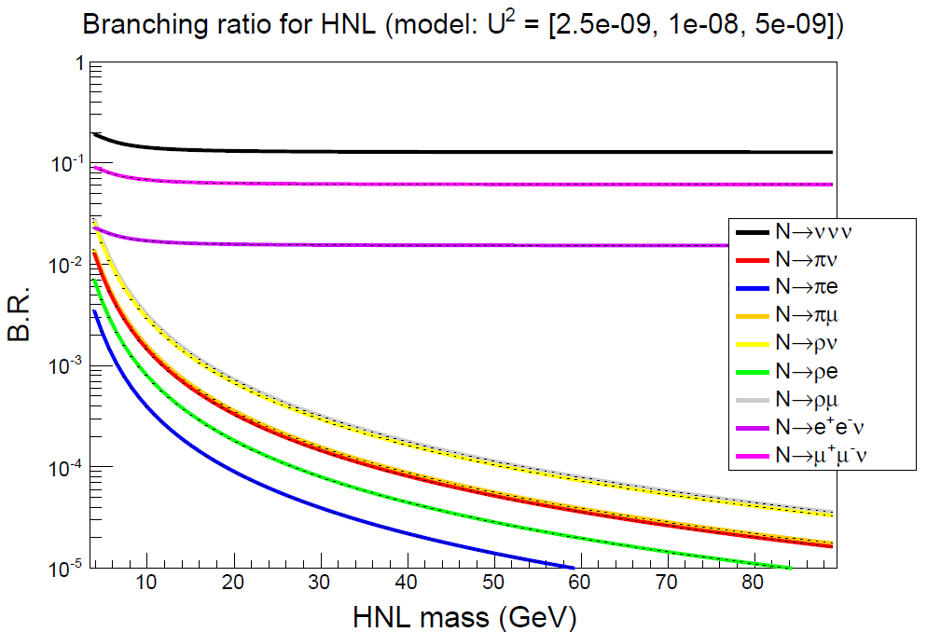
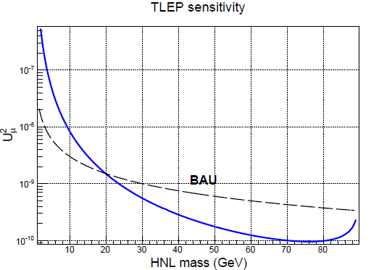
More ‘professional’ study started this morning (Nicola Serra)
with 3 neutrino scenario (first plots for fun with 10¹² Z decays)
Very Preliminary
Very Preliminary
Very Preliminary
Indicates one would be able to
enter BAU region with FCC-ee

Slide 11
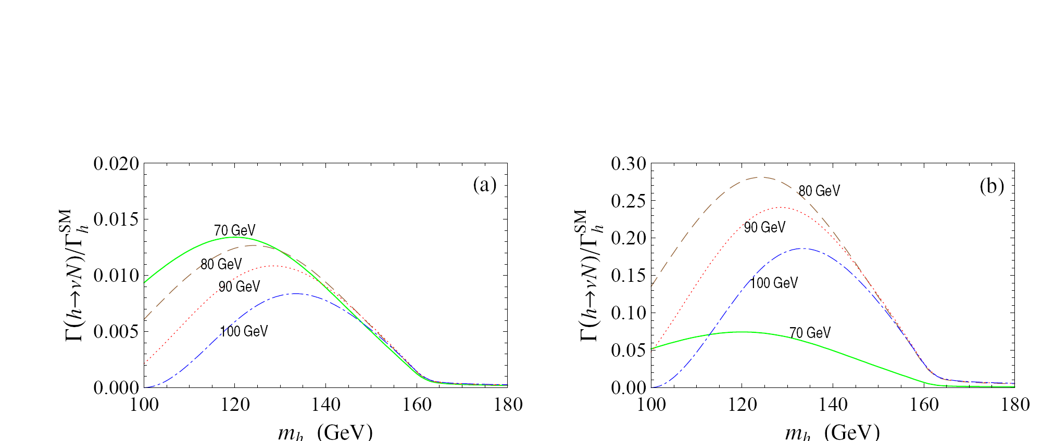
Higgs Decay into nu + N
NB neutrino is the only particle that does not couple prop. to its mass!
Chen, He, Tandean, Tsai (2011)

Slide 12
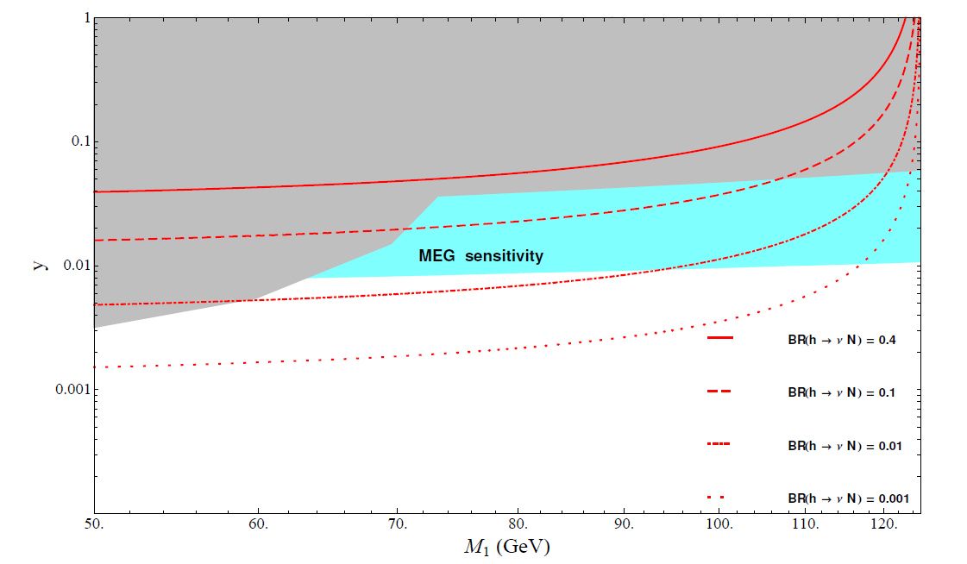
arxiv:1208.3654
LEP1 & LEP2 limits (DELPHI)
(projected)
Also directly in e+e- annihilations for higher masses, and related to μ→eγ , and μ→e

Slide 13
Conclusion and suggestion
The direct search for Heavy Neutral Leptons decays seems promising at FCC-ee !
In particular may lead to spectacular ‘detached vertex’ signatures in Z-> neutrino decays
needs
firm up the numbers taking into account neutrino mixing
simulate the signal and the 4 fermion background at Z peak
see what is the effect of known neutrino mixing (was not known in 1997)
include study in H → vN decays (not helicity-suppressed)
May motivate running at Z peak for longer than just one year.
What about an ‘invisible’ phenomenology/exp (sub)working group for the FCC study?

