Slide 1
LHC IP2 inside injection
W. Bartmann, B. Goddard, M. Meddahi
FHI-Meeting, 15th April 2014

Slide 2
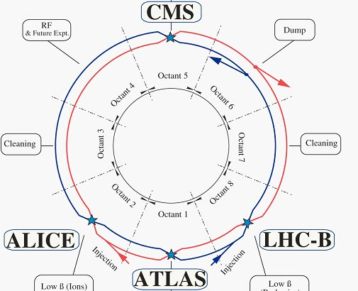
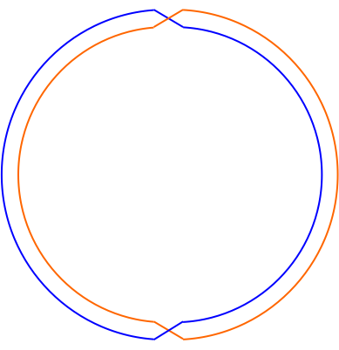
Inside injection in P2
Injection
Injection

Slide 3
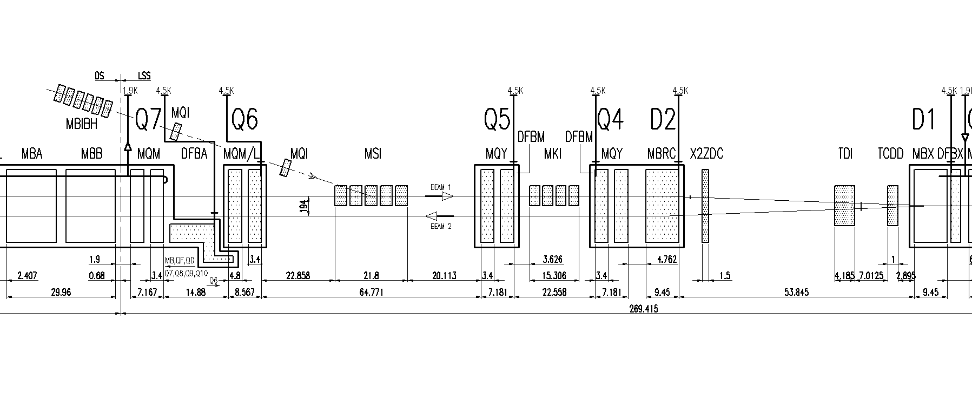
P2 injection layout
0.84 mrad V
12 mrad H
0.35 mrad V

Slide 4
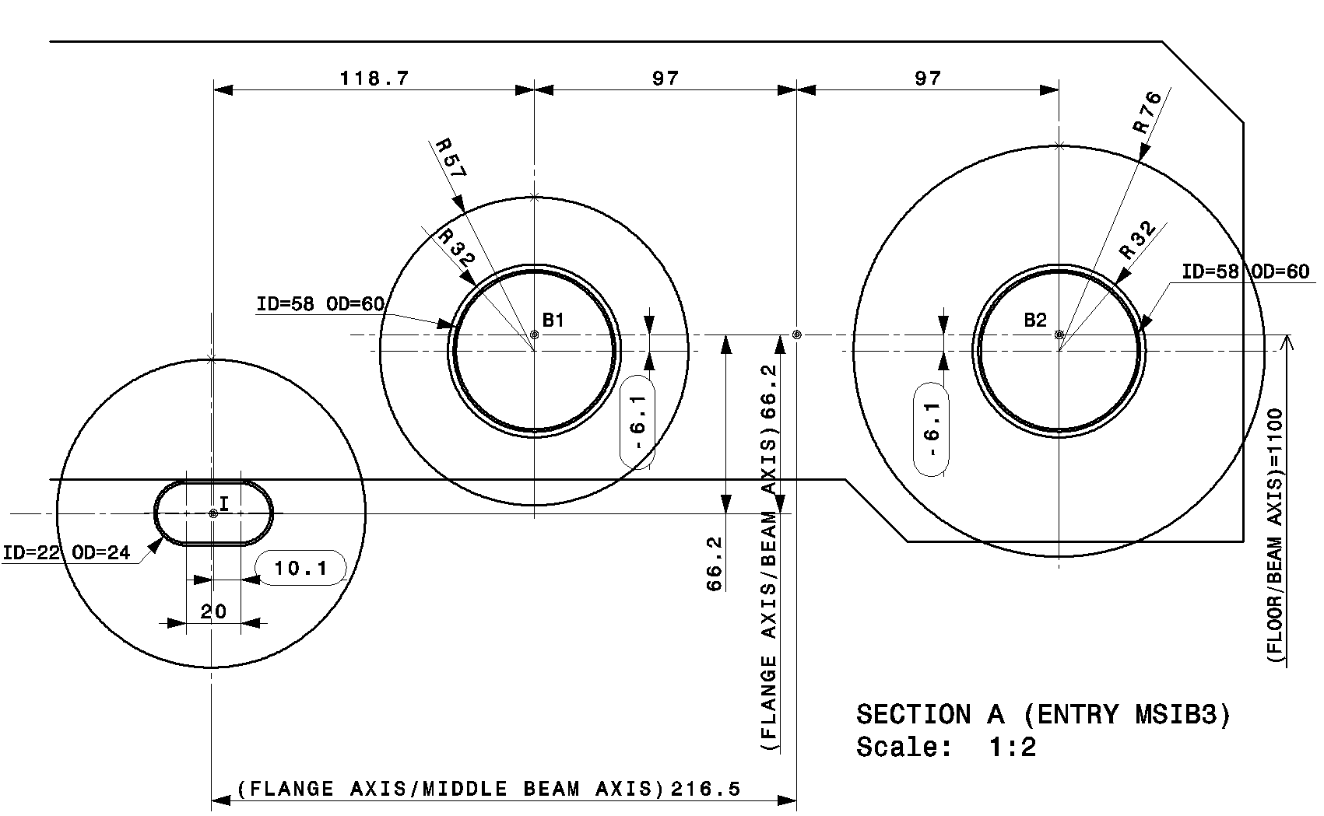
Vacuum chamber at MSI entrance

Slide 5
Option 1
Move existing MSI

Slide 6
Vacuum chamber at MSI entrance

Slide 7
Vacuum chamber at MSI entrance

Slide 8
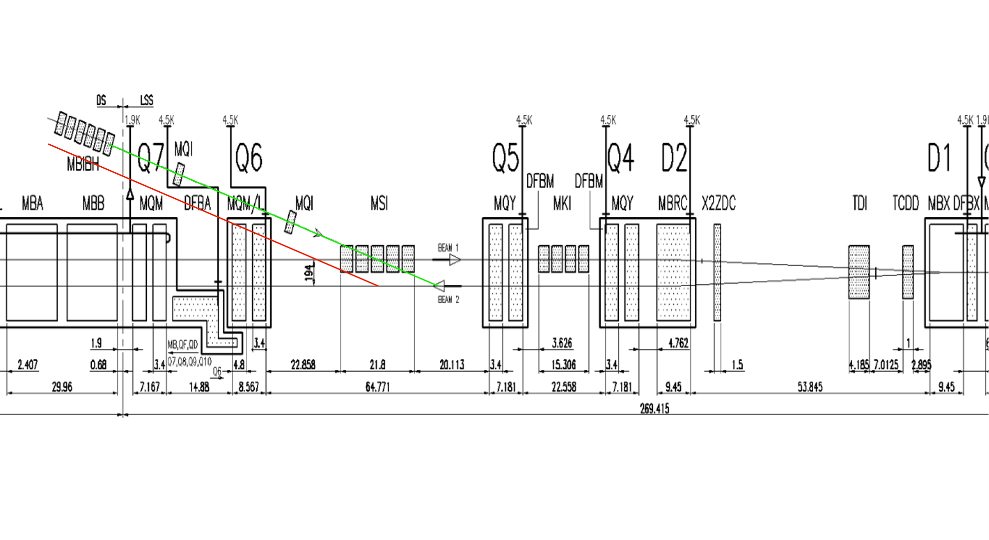
Move MSI
Move MSI horizontally from B1 to B2 and shift longitudinally to get clearance of Q6

Slide 9
Move existing MSI magnets
Move existing MSI horizontally from B1 to B2 – OK
For clearance of Q6 need to move downstream by 194 mm/12 mrad = 16.2 m - OK
  20.1 m available between MSIA1 and Q5
  Still 3.9 m drift between MSI and Q5 for eg. vacuum equipment and maybe shielding (limited aperture at MSI → losses at injection)
Can TI 2 deliver the beam?
  Existing MSI magnets impose a change in vertical trajectory through Q5
  Problem is aperture in Q5, presently inj beam is 21 mm displaced wrt orbiting beam; 11.1 mm vertical beam stay clear → NEW Q5 needed if MSI kept
  MKI might need to be moved to recover vertical angle together with Q5
  Trajectory matching in horizontal plane aggravated by wrong Q5 kick
Very likely not feasible even with newly designed Q5

Slide 10
Option 2
Move redesigned MSI

Slide 11
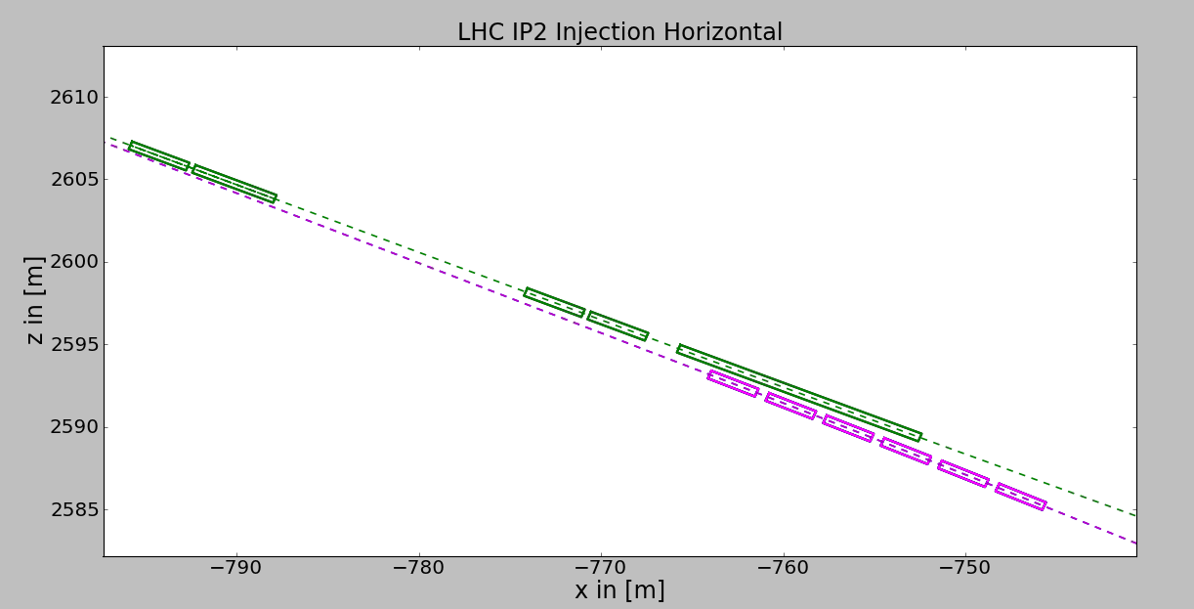
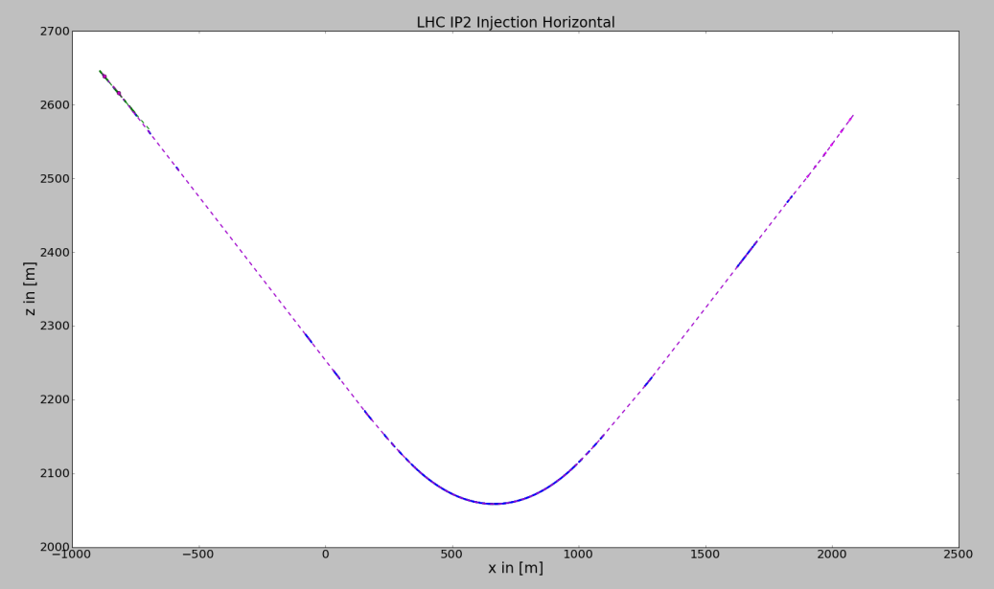
TI2 geometry
MBIB
Green: LHC ring
Blue: present TI 2
Magenta: proposed TI 2

Slide 12
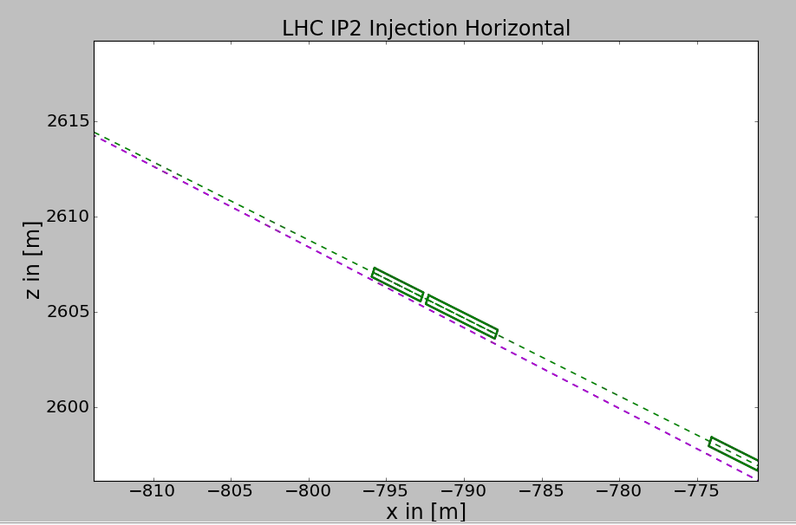
Q6

Slide 13
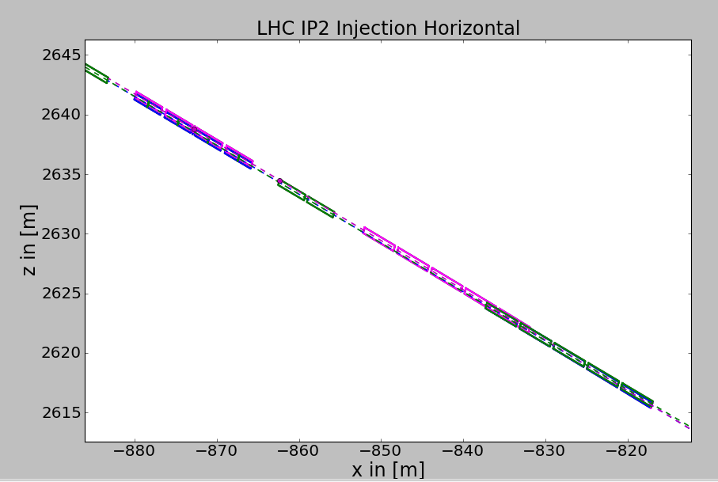
MKI and MSI

Slide 14
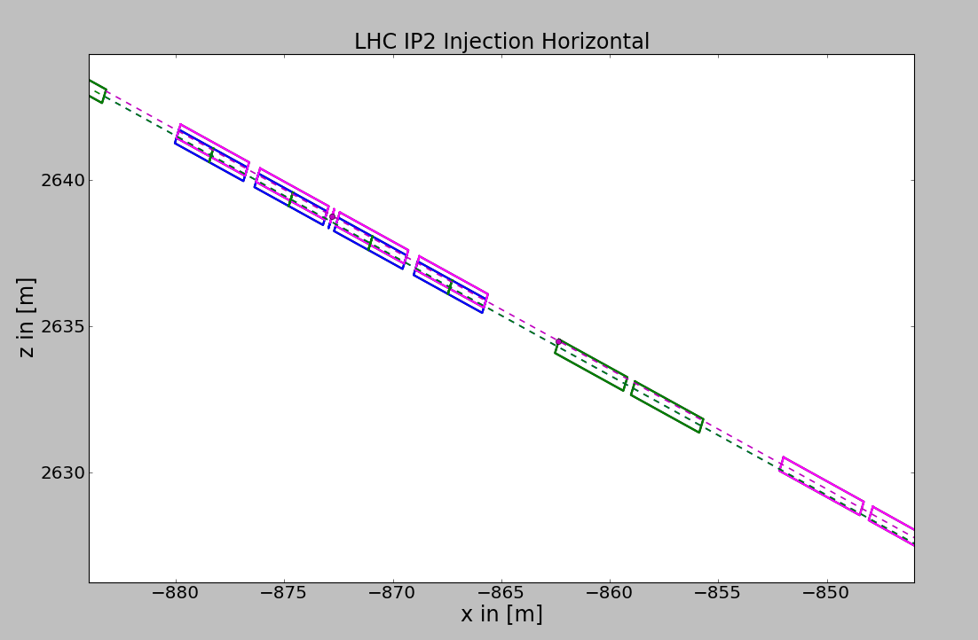
New MSI design, moved
Matched at Q5 and MKI

Slide 15
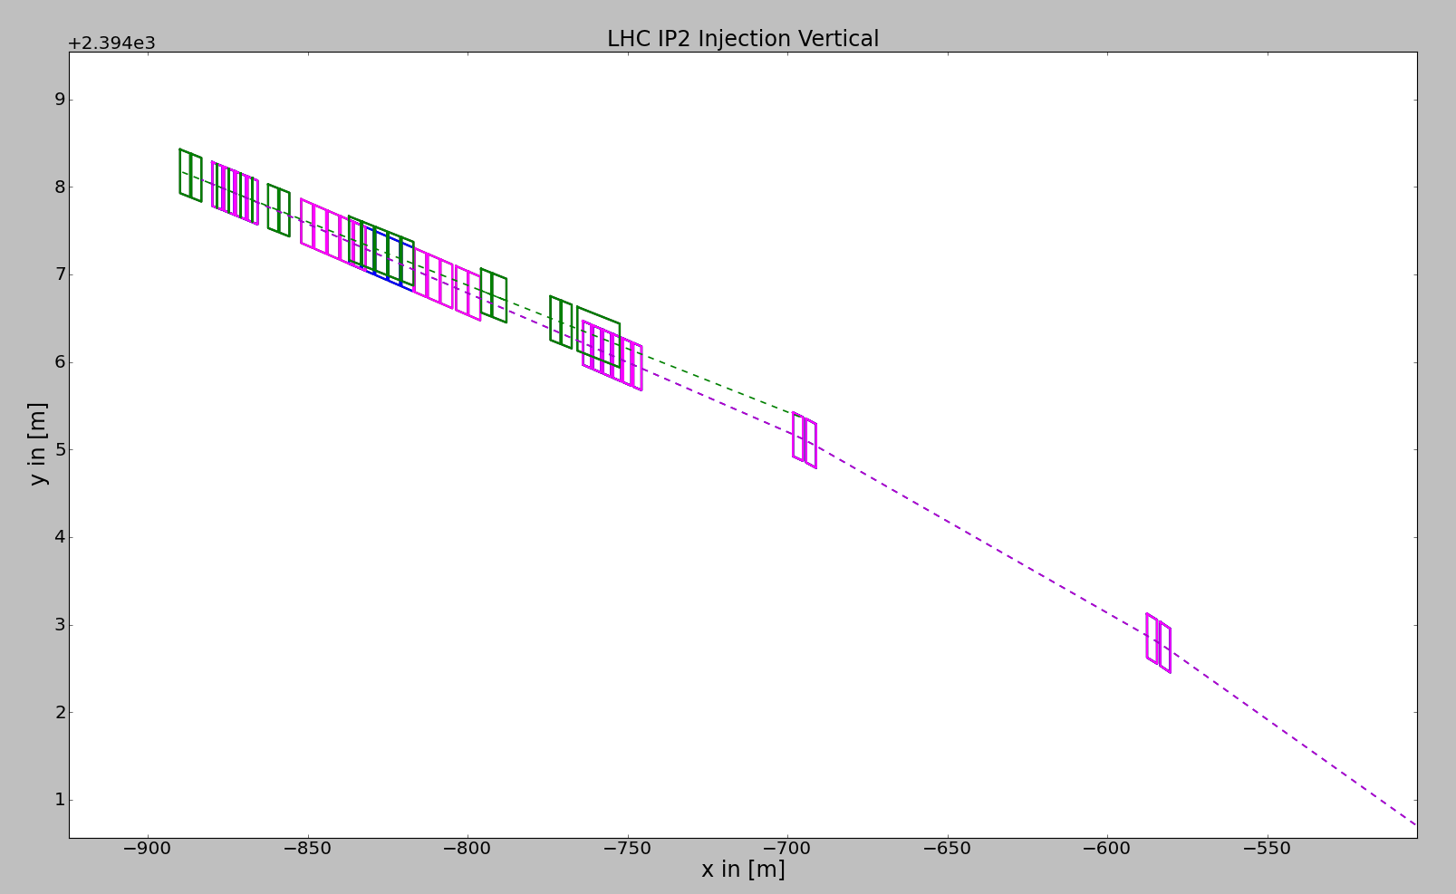
New MSI design, moved
Vertically same trajectory as now

Slide 16
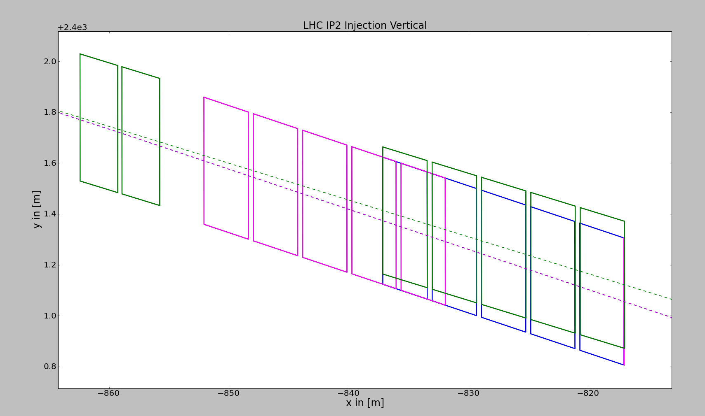
Thinner ‘blade’
40 mm beam separation
20 mm beam separation

Slide 17
Move redesigned MSI
New MSI design:
  requires smaller ‘blade’ due to smaller vertical displacement between beams from long. Shift
  From 40 mm to 20 mm beam separation
No change for Q5 trajectory
No change for TI 2 trajectory

Slide 18
Option 2
Mirror injection

Slide 19
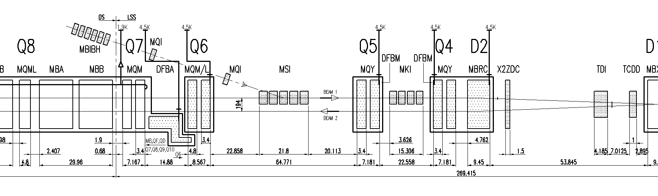
Mirror injection
Keep same longitudinal position →
no changes downstream of MSI

Slide 20


Use existing MSI magnets
Roll existing MSI by 180 deg
Tilt existing MSI by 180 deg and redesign vacuum chamber of injected beam
Chamber should be here!

Slide 21
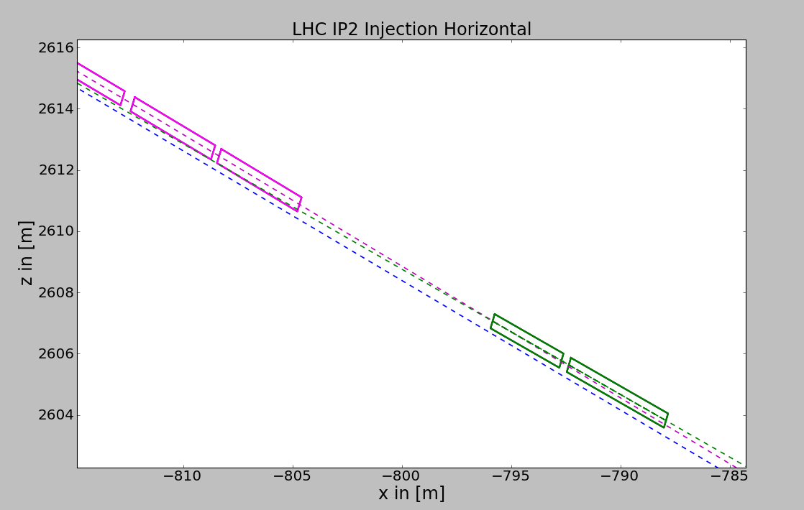
S-shape in MSI straight
Q6 – TI 2 collision even with extremely strong bends

Slide 22
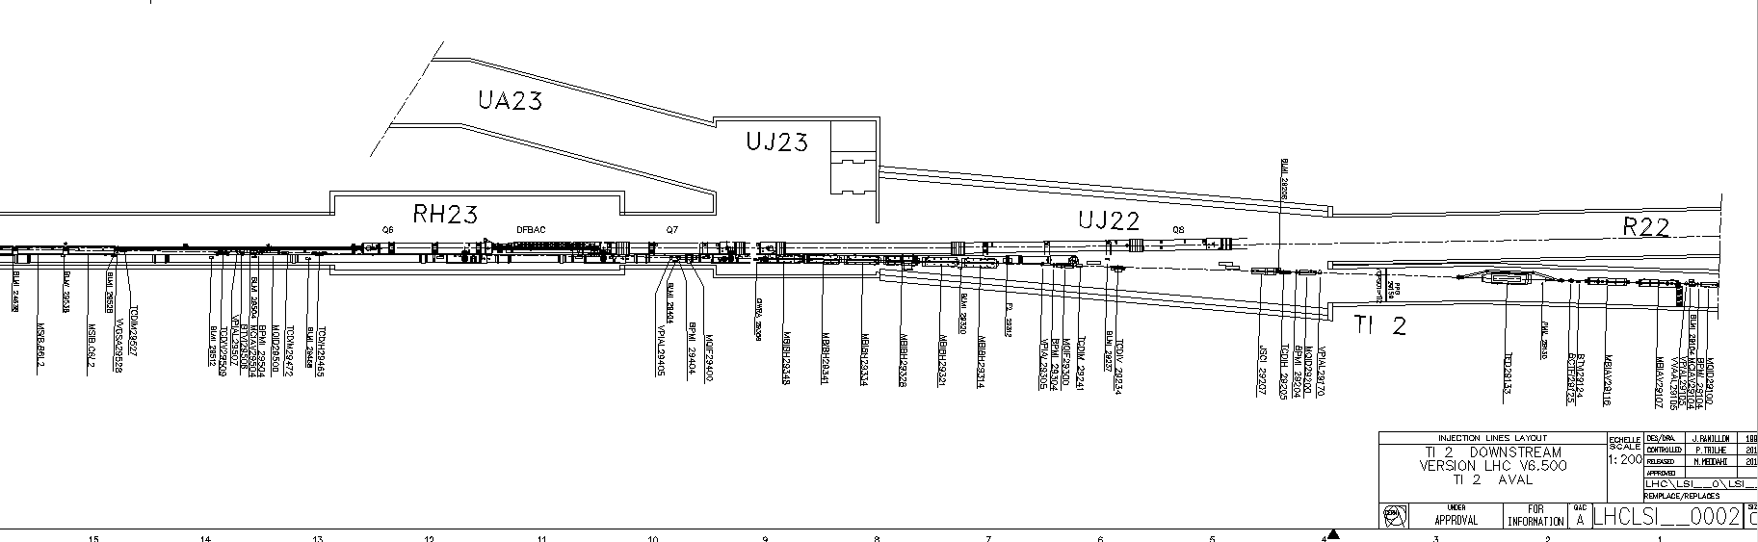
Use UJ22 and cross before Q8

Slide 23
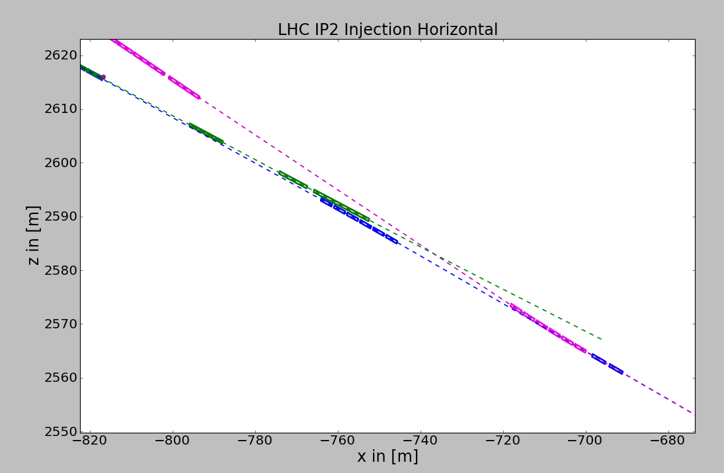
Use UJ22 and cross before Q8
MBIBs 3 x stronger than present ones

Slide 24
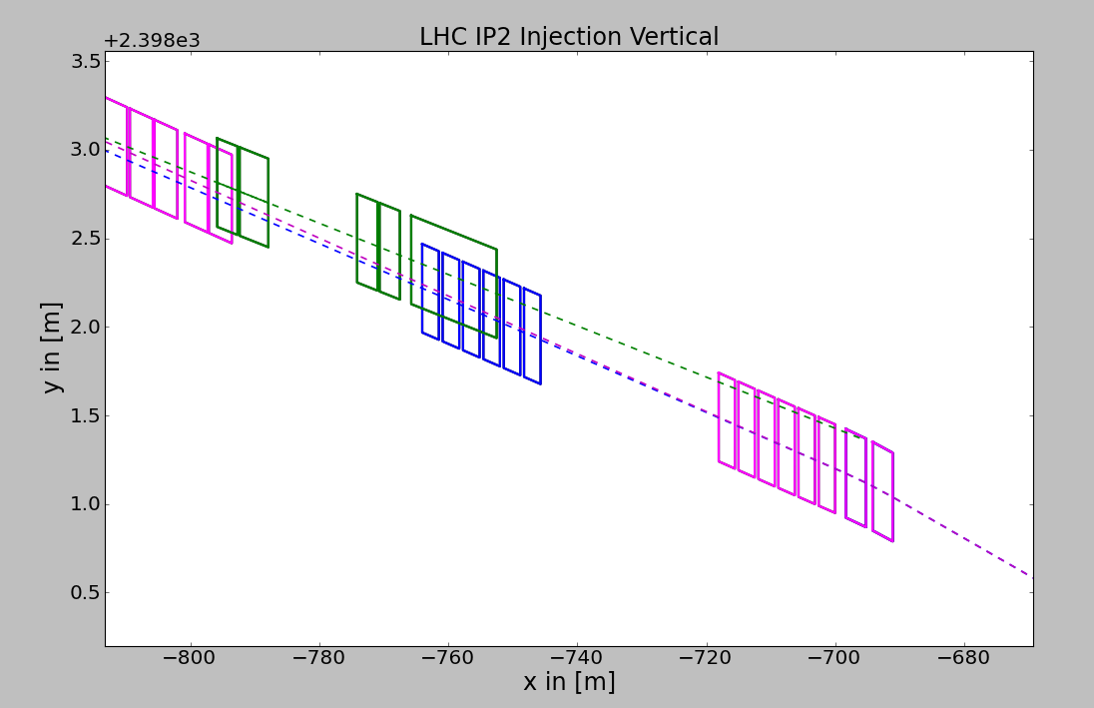
Use UJ22 and cross before Q8
Still no sufficient vertical separation at H-crossing

Slide 25
Conclusions
Option 1 – Move existing MSI
  Move MSI transversely onto the other beam and long. closer to Q5
  With existing MSI magnets seems not feasible
Option 2 – Move redesigned MSI
  Smaller beam separation requires thinner blade (40 → 20 mm)
  If septum design possible least impact on overall injection region
Option 3 – Mirror injection
  Tilt MSI by 180 deg and mirror the injection to the inside of the ring
  Existing MSI can only be used if vacuum chamber can be modified (invert horizontal angle)
  TI 2 needs to pass below the ring and bend the beam back into the MSI aperture (S-shape)
  Crossing inside MSI straight impossible with reasonable bending radii
  UJ22 and Q8 crossing: requires tremendously strong bends or change of tunnel geometry; to be further studied
For all options MKI modifications to be checked

Slide 26
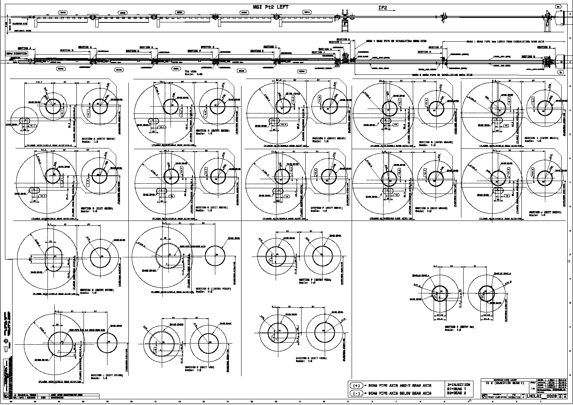

Slide 27
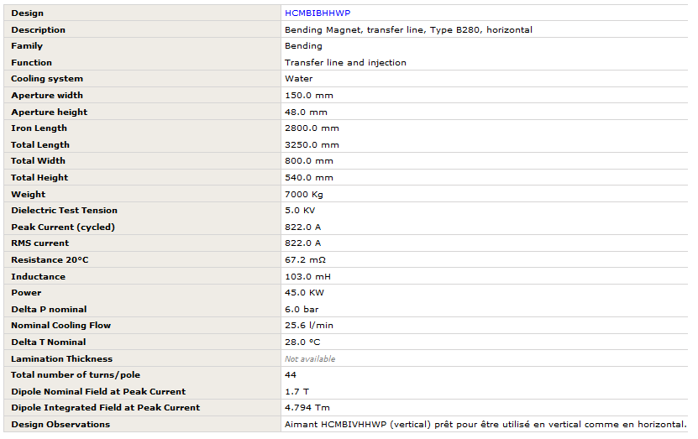
MBIB data sheet

