Slide 1
IBS considerations for 100km HEB
Michaela Schaumann
(CERN, RWTH Aachen)
In collaboration with J.M. Jowett
15th April 2014
FCC Hadron Injectors WG

Slide 2
Outline
Assumed Beam Parameters
Initial FODO Cell Lattice for HEB
Variation Cell Length at Injection Energy
Variation Phase Advance at Injection Energy
IBS during Ramp
Conclusions

Slide 3
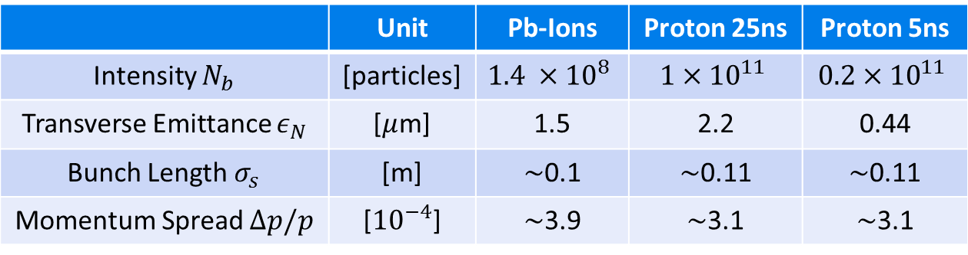
Assumed Injected Beam Conditions
Baseline Beam Parameters as they arrive in HEB.
Longitudinal Parameters: SPS injection into LHC
Emittance and Intensity:
  Ions: 2013 LHC performance
  Protons: Reference FCC-ACC-SPC-0001
 | Unit | Pb-Ions | Proton 25ns | Proton 5ns
Intensity $N_{b}$ | [particles] | $$1.4 ×{10}^{8}$$ | $$1×{10}^{11}$$ | $$0.2×{10}^{11}$$
Transverse Emittance $ε_{N}$ | [$μ$m] | 1.5 | 2.2 | 0.44
Bunch Length $σ_{s}$ | [m] | $\sim$0.1 | $\sim$0.11 | $\sim$0.11
Momentum Spread $Δp/p$ | [${10}^{−4}$] | $\sim$3.9 | $\sim$3.1 | $\sim$3.1

Slide 4
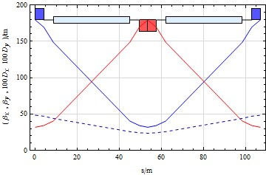
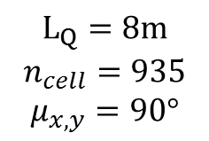
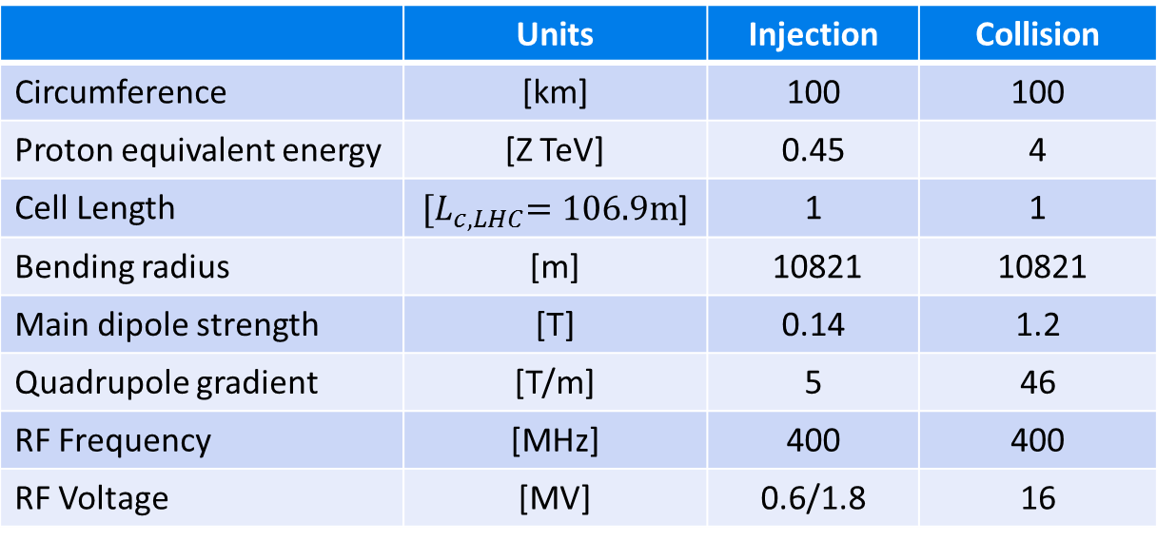
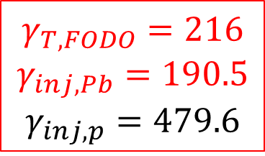

Starting HEB Parameters
Assume HEB is a normal conducting, fast cycling synchrotron
consisting of a chain of equal FODO cells only.
 | Units | Injection | Collision
Circumference | [km] | 100 | 100
Proton equivalent energy | [Z TeV] | 0.45 | 4
Cell Length | ${[L}_{c,LHC}=106.9m$] | 1 | 1
Bending radius | [m] | 10821 | 10821
Main dipole strength | [T] | 0.14 | 1.2
Quadrupole gradient | [T/m] | 5 | 46
RF Frequency | [MHz] | 400 | 400
RF Voltage | [MV] | 0.6/1.8 | 16
FODO cell optics for $L_{c,LHC}$
$$γ_{T,FODO}=216$$
$$γ_{inj,Pb}=190.5$$
$$γ_{inj,p}=479.6$$
$$L_{Q}=8m$$
$$n_{cell}=935$$
$$μ_{x,y}=90°$$
Ions cross transition!

Slide 5
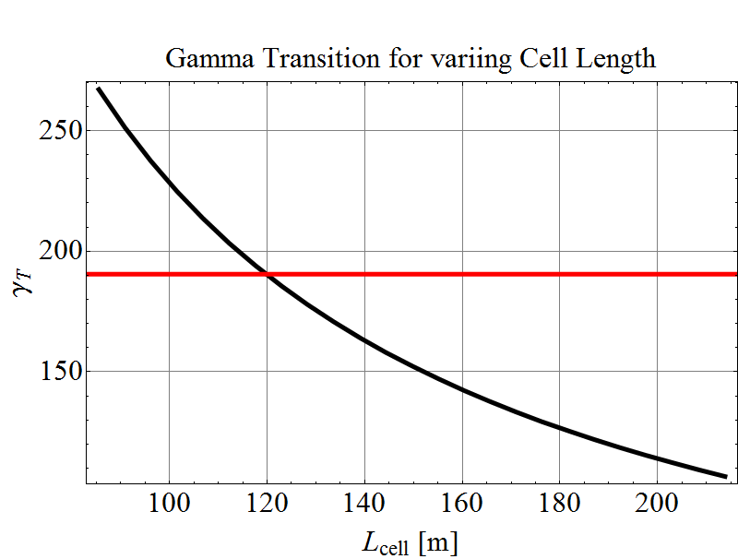
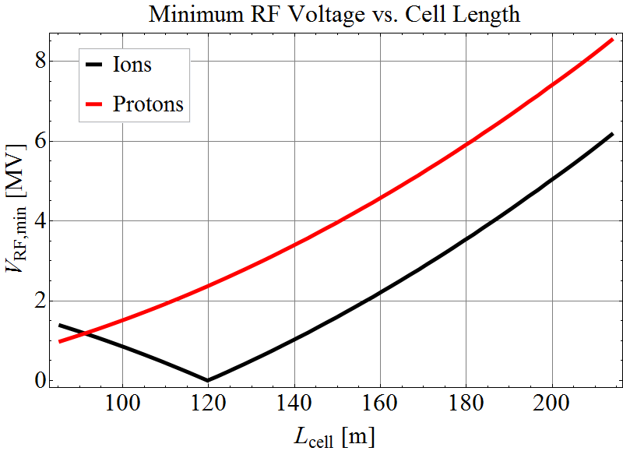


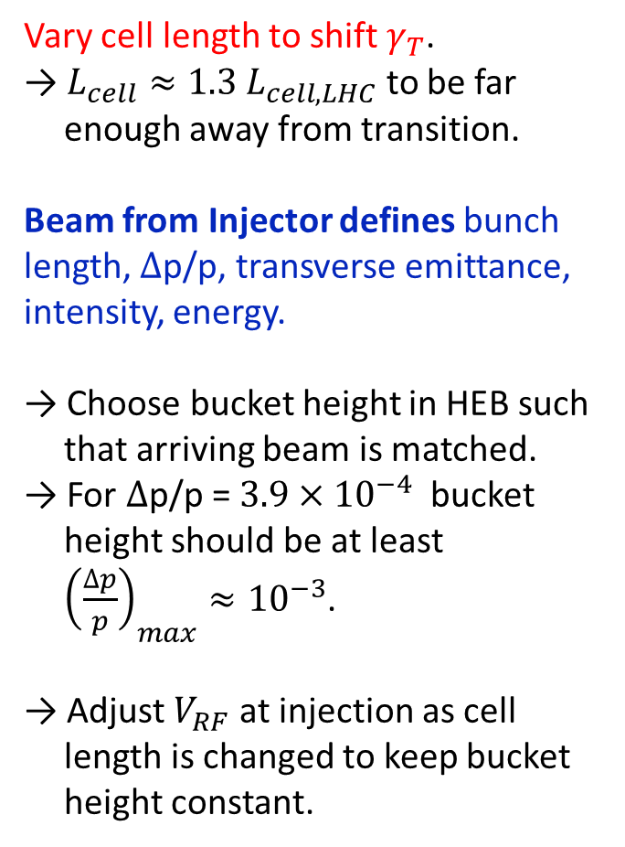


Matched Beam Requirements vs. Cell Length
$$L_{c}=\left[0.8, 2\right]L_{c,LHC}$$
Vary cell length to shift $γ_{T}$.
→ $L_{cell}≈1.3 L_{cell,LHC}$ to be far enough away from transition.
Beam from Injector defines bunch length, $∆$p/p, transverse emittance, intensity, energy.
→ Choose bucket height in HEB such that arriving beam is matched.
→ For $∆$p/p = $3.9×{10}^{−4}$bucket height should be at least ${\left(\frac{∆p}{p}\right)}_{max}≈{10}^{−3}$.
→ Adjust $V_{RF}$ at injection as cell length is changed to keep bucket height constant.
$$γ_{T}$$
$$γ_{inj,Pb}$$
Pb Transition
$V_{RF}→0$

Slide 6
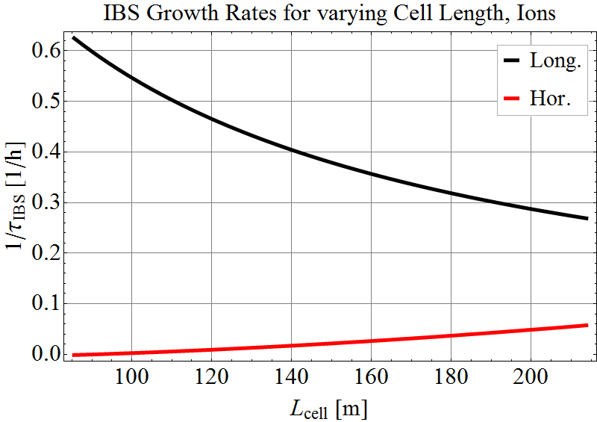
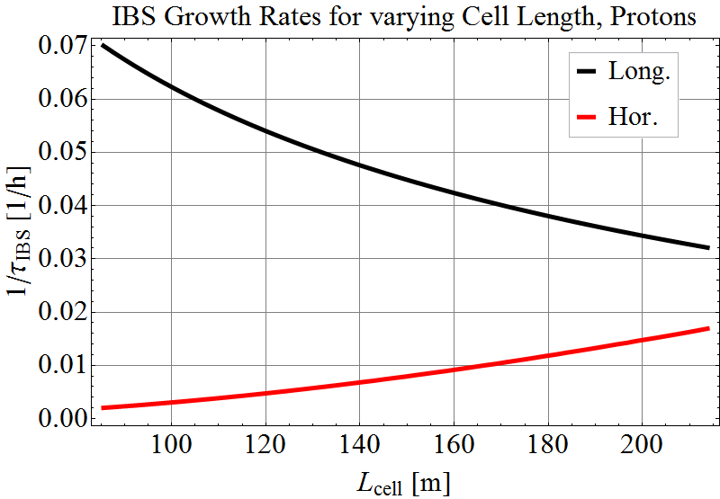
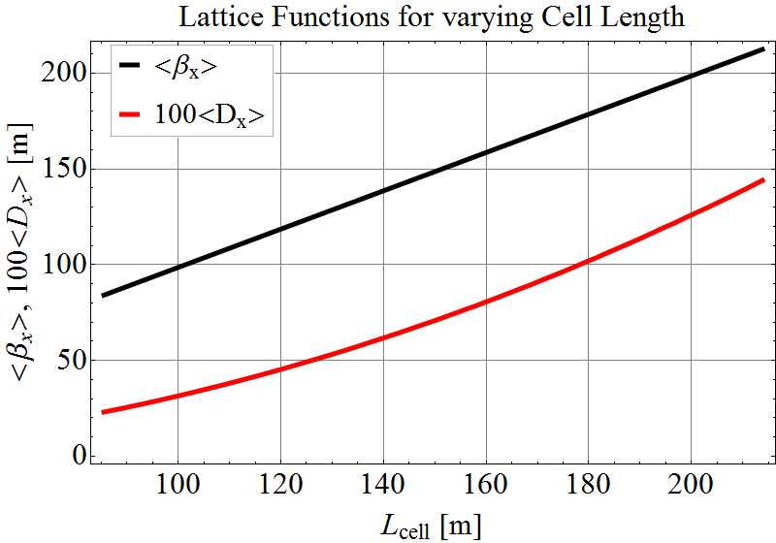




Optics and IBS vs. Cell Length
With $L_{c}$ varies: number of cells, magnet strength, optical functions, aperture requirements, transition energy, IBS growth rates, …
$$L_{c}=\left[0.8, 2\right]L_{c,LHC}$$
1.6h
14h
IBS Ions
IBS Protons (25ns)
Different Scale!
17h
60h
Beam parameters are kept constant:
IBS calculation done with min. RF voltage from previous slide.
IBS growth rates change due to optic changes.
→ IBS negligible for protons and in transverse plane for ions at injection energy.
$$β∝L_{c}$$
$$D_{x}∝L_{c}^{2}$$

Slide 7
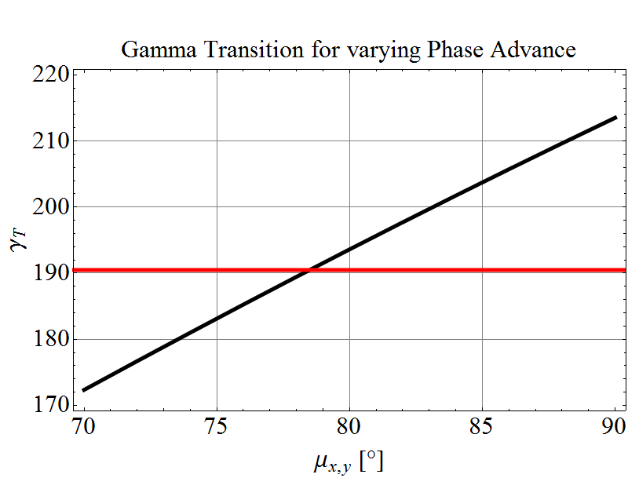
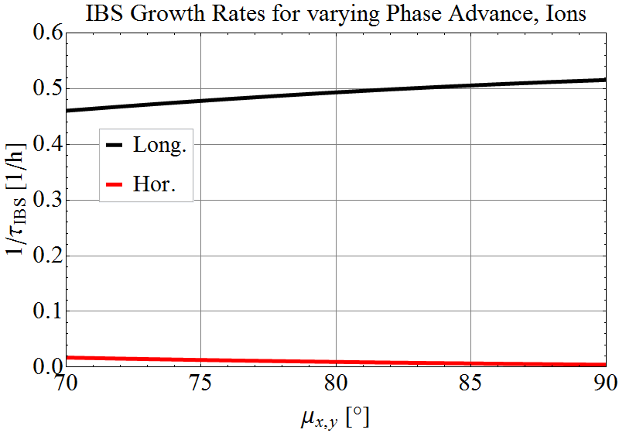
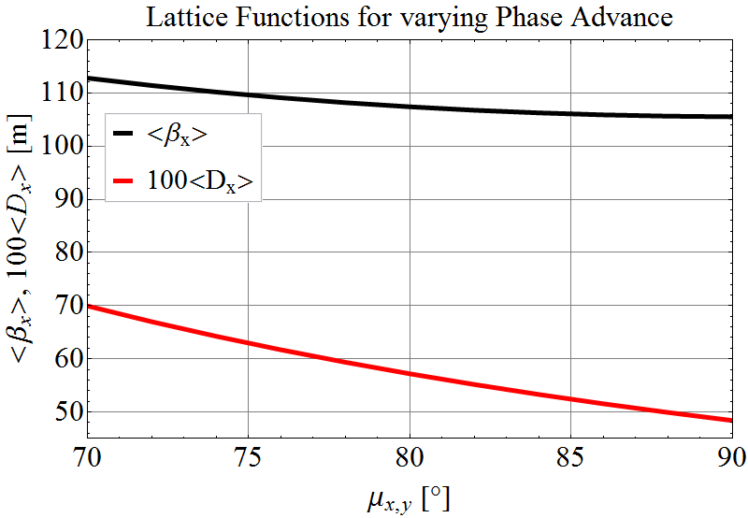
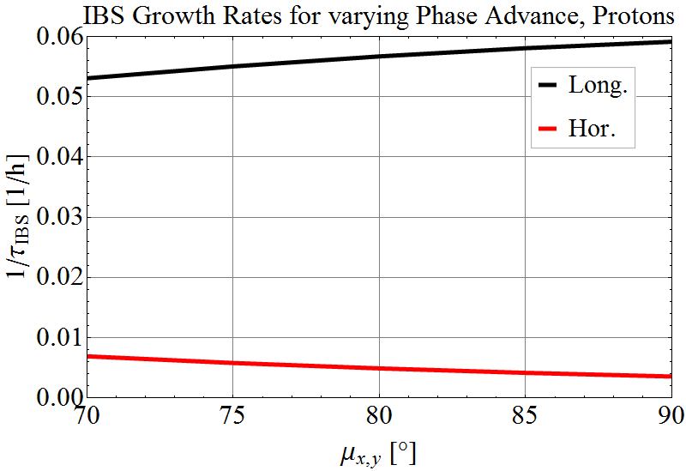





Vary Phase Advance to keep $L_{c}$=$L_{c,LHC}$
Decreasing the $γ_{T}$ by decreasing the phase advance per cell.
$$γ_{T}$$
IBS rates
Ions
$$γ_{inj,Pb}$$
transition at 78.5$°$
Choose $μ<77°$ to provide low IBS rates.
<β>
IBS rates
Protons (25ns)
<$D_{x}$>

Slide 8
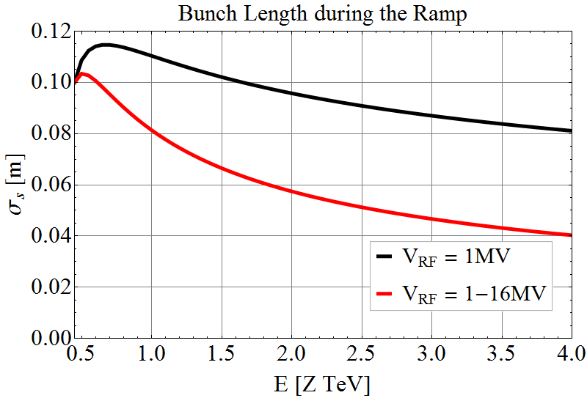
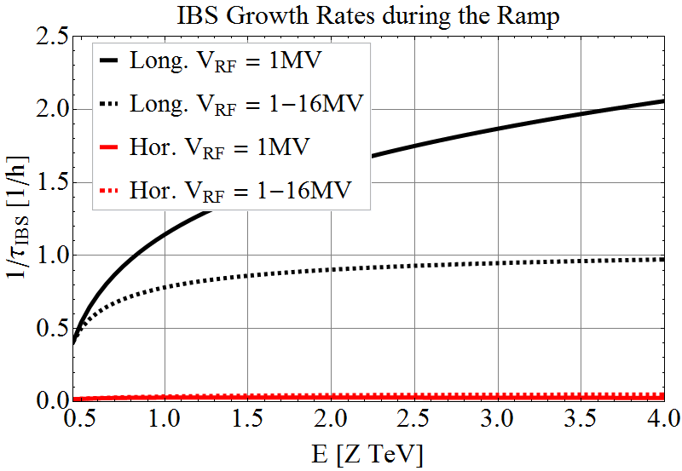
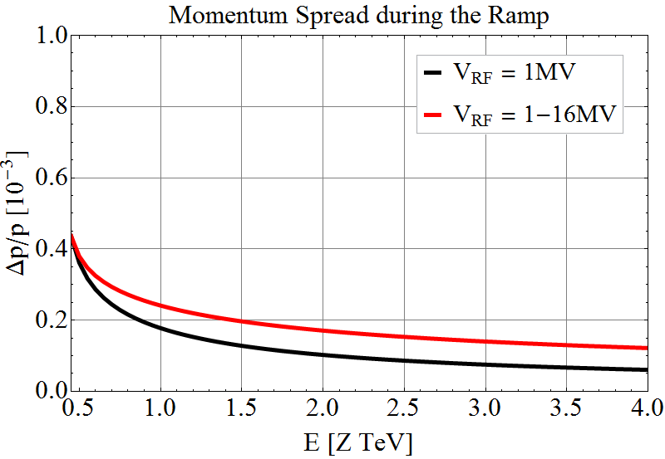
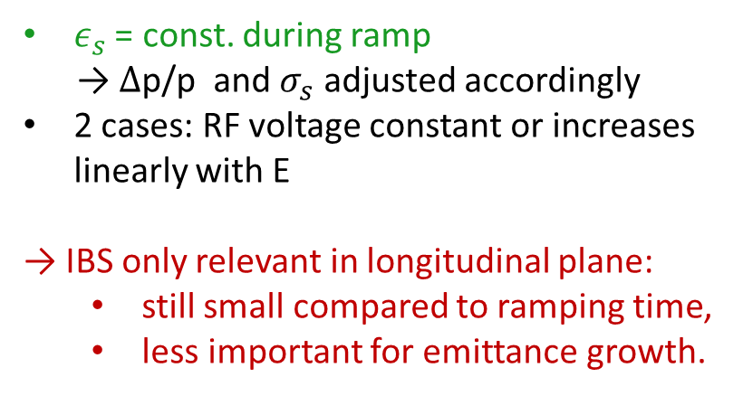

Energy Ramp Pb, $L_{c}$=${1.3 L}_{c,LHC}$
E $=\left[0.45, 4\right]$Z TeV
$ε_{s}$ = const. during ramp
→ $∆$p/p and $σ_{s}$ adjusted accordingly
2 cases: RF voltage constant or increases linearly with E
→ IBS only relevant in longitudinal plane:
  still small compared to ramping time,
  less important for emittance growth.
0.5h
Ions
1h
2.5h
60h
39/20 h

Slide 9
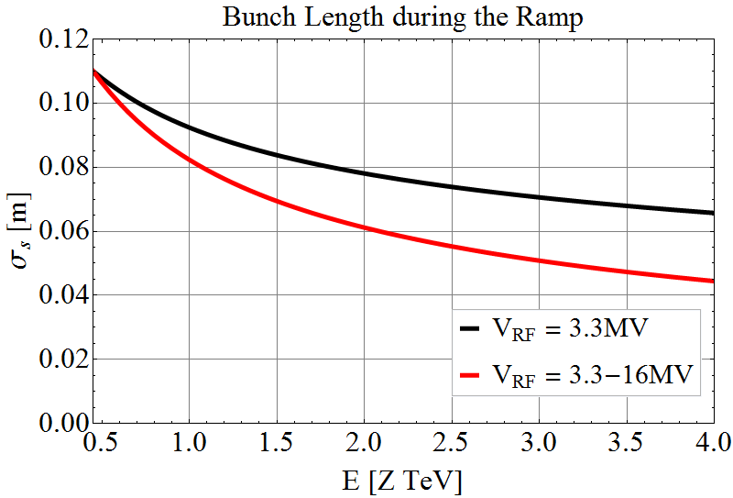
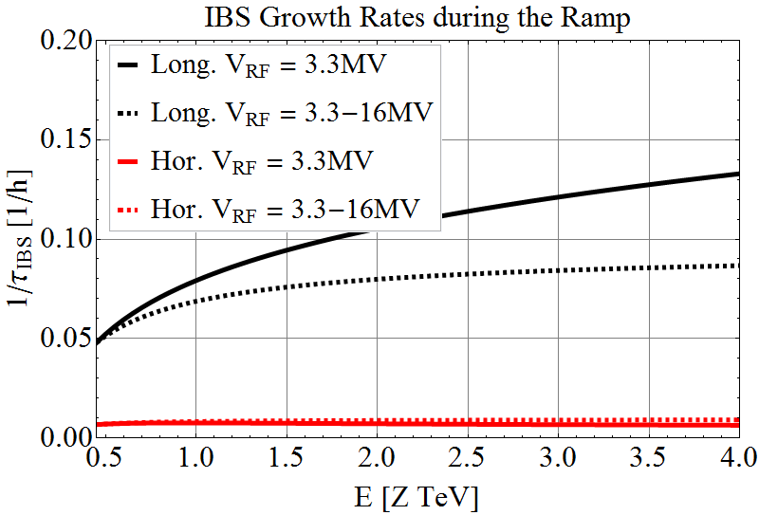
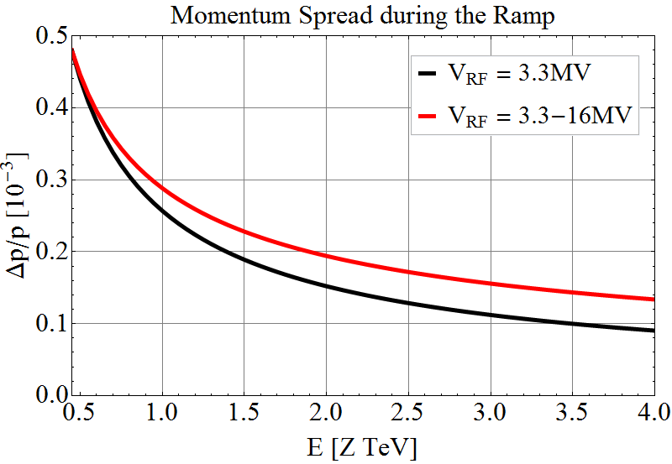
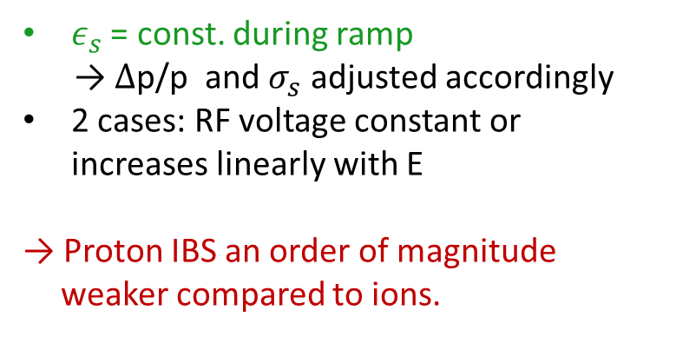

Energy Ramp Protons, $L_{c}$=${1.3 L}_{c,LHC}$
E $=\left[0.45, 4\right]$Z TeV
$ε_{s}$ = const. during ramp
→ $∆$p/p and $σ_{s}$ adjusted accordingly
2 cases: RF voltage constant or increases linearly with E
→ Proton IBS an order of magnitude weaker compared to ions.
Protons
(25ns)
7.5h
11h
21h
149h
158/110 h

Slide 10
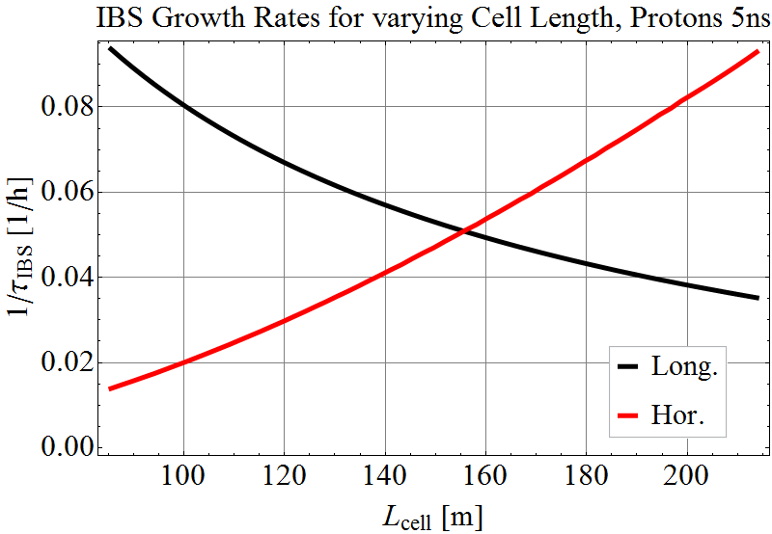
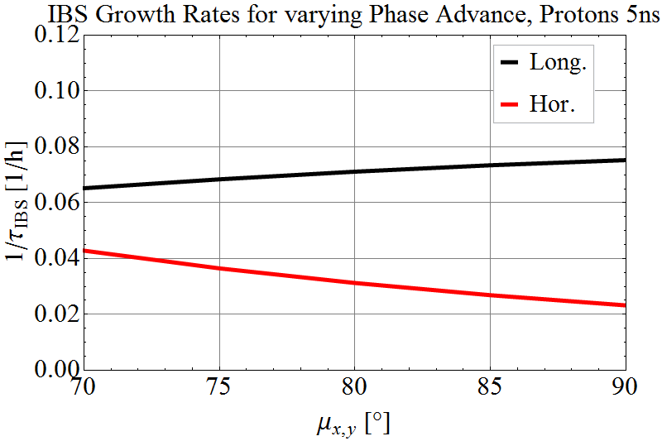
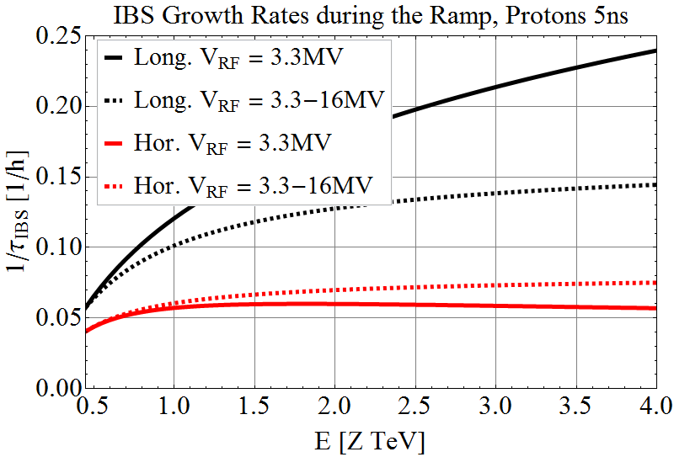
IBS Growth Rates Protons (5ns)
Horizontal IBS growth in the order of the longitudinal growth.
7h
13h
17h
24h

Slide 11
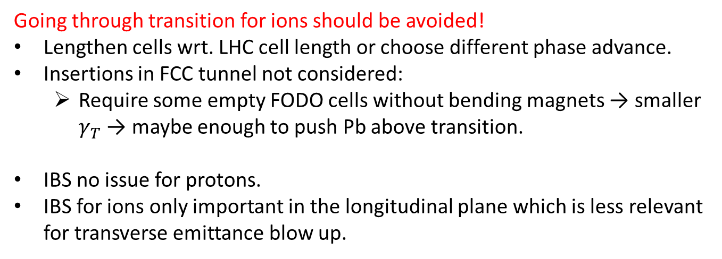
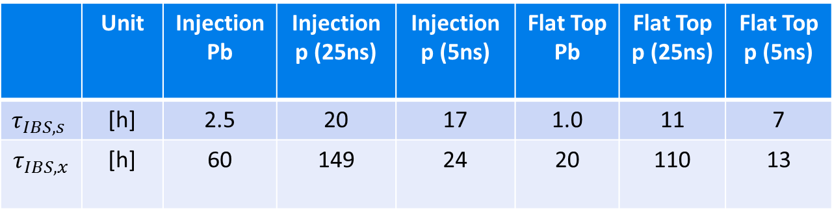
Conclusions
Going through transition for ions should be avoided!
Lengthen cells wrt. LHC cell length or choose different phase advance.
Insertions in FCC tunnel not considered:
  Require some empty FODO cells without bending magnets → smaller $γ_{T}$ → maybe enough to push Pb above transition.
  IBS no issue for protons.
  IBS for ions only important in the longitudinal plane which is less relevant for transverse emittance blow up.
 | Unit | Injection Pb | Injection p (25ns) | Injection p (5ns) | Flat Top Pb | Flat Top p (25ns) | Flat Top p (5ns)
$$τ_{IBS,s}$$ | [h] | 2.5 | 20 | 17 | 1.0 | 11 | 7
$$τ_{IBS,x}$$ | [h] | 60 | 149 | 24 | 20 | 110 | 13

Slide 12
Thank you
for your attention

Slide 13
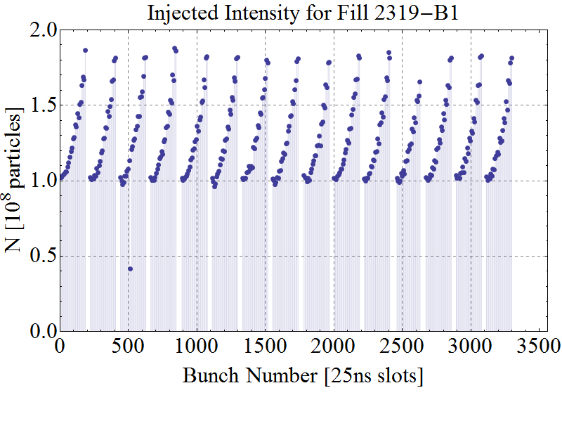
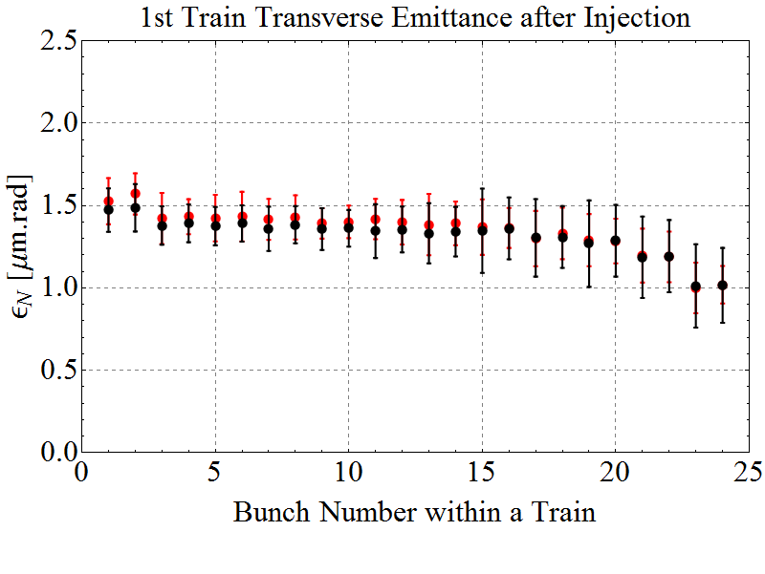
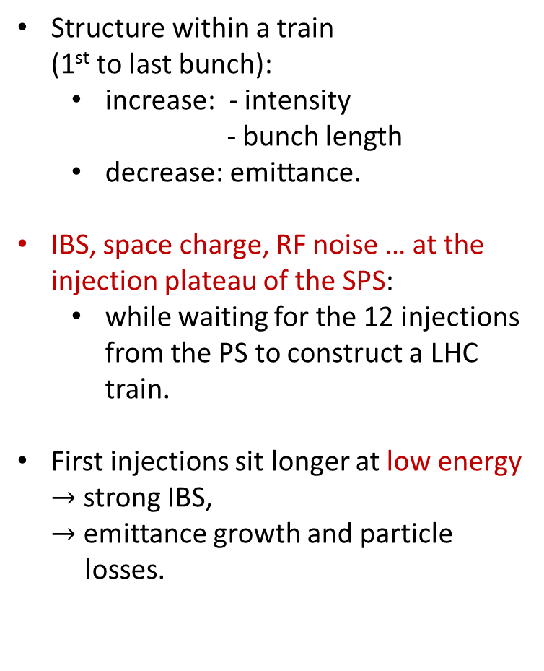
Bunch-by-Bunch Differences after Injection in the LHC
E = 450 Z GeV
Structure within a train
(1st to last bunch):
  increase: - intensity
  - bunch length
  decrease: emittance.
IBS, space charge, RF noise … at the injection plateau of the SPS:
  while waiting for the 12 injections
  from the PS to construct a LHC
  train.
First injections sit longer at low energy
$→$ strong IBS,
$→$ emittance growth and particle
losses.
Design
1 train
Intensity
Design
Horizontal / Vertical
Emittance

Slide 14
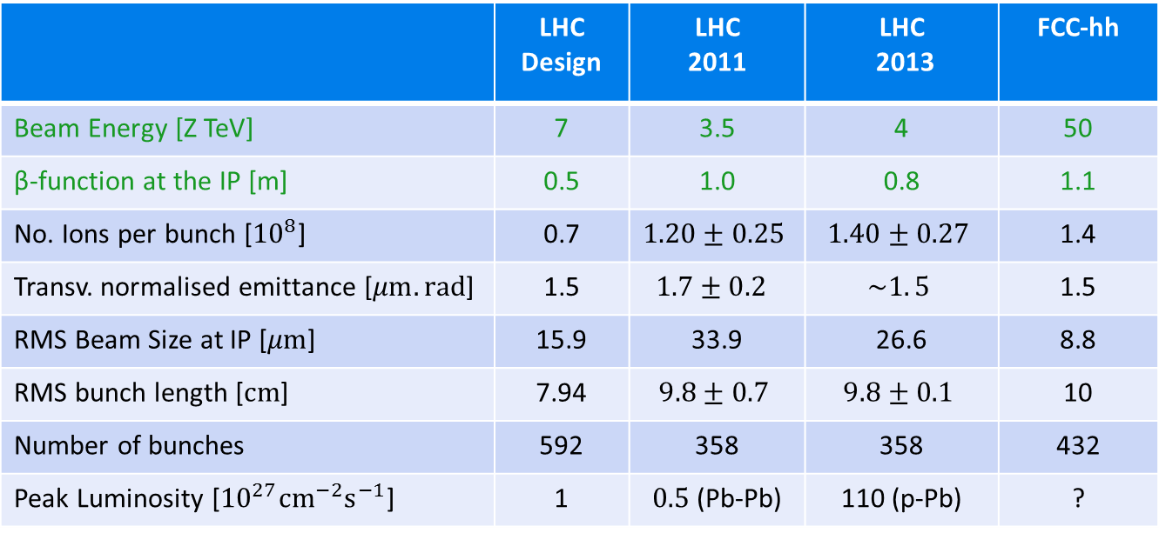
Pb Beam Parameters in LHC and FCC-hh
Best injector performance achieved in 2013 p-Pb run.
Average beam parameters from 2013 are assumed as VERY conservative baseline for FCC-hh!
→ Improvements are already under study for HL-LHC!
 | LHC Design | LHC 2011 | LHC 2013 | FCC-hh
Beam Energy [Z TeV] | 7 | 3.5 | 4 | 50
β-function at the IP [m] | 0.5 | 1.0 | 0.8 | 1.1
No. Ions per bunch [${10}^{8}$] | 0.7 | $$1.20±0.25$$ | $$1.40±0.27$$ | 1.4
Transv. normalised emittance [$μm.rad$] | 1.5 | $$1.7±0.2$$ | $$\sim 1. 5$$ | 1.5
RMS Beam Size at IP [$μm$] | 15.9 | 33.9 | 26.6 | 8.8
RMS bunch length [$cm$] | 7.94 | $$9.8±0.7$$ | $$9.8±0.1$$ | 10
Number of bunches | 592 | 358 | 358 | 432
Peak Luminosity [${10}^{27}{cm}^{−2}s^{−1}$] | 1 | $0.5$(Pb-Pb) | 110 (p-Pb) | ?

Slide 15
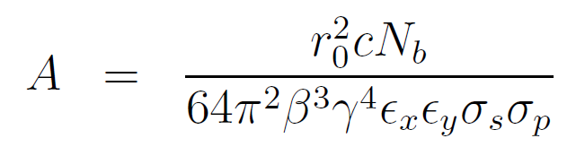
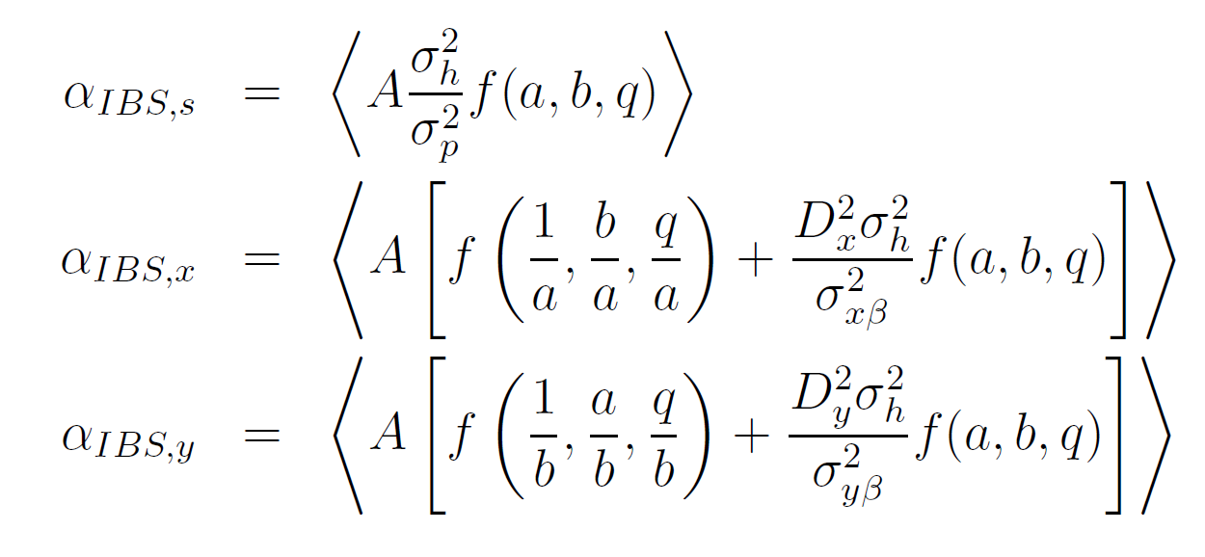
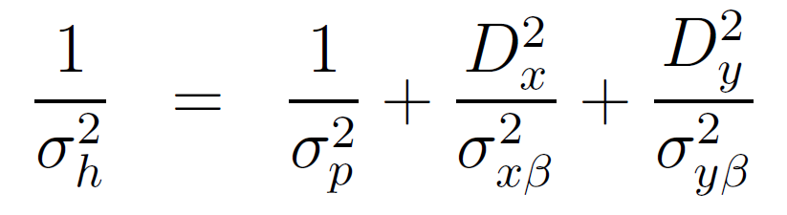
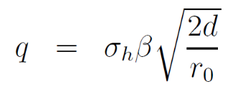
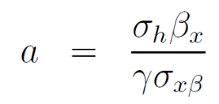
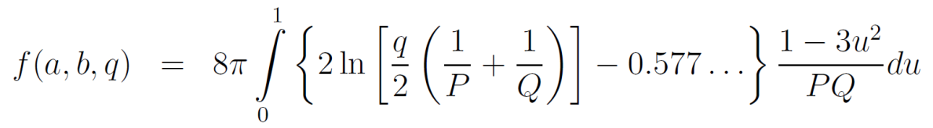
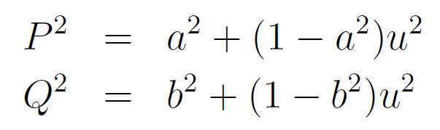
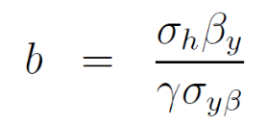
Intra-Beam Scattering
A. Piwinski Formalism for IBS growth rates:
Particle Type
Beam
properties
Energy
IBS strength changes dynamically with beam properties.
Lattice and beam sizes
Handbook of Accelerator Physics and Engineering, 1st Edition, 3rd Print, pp. 141

Slide 16
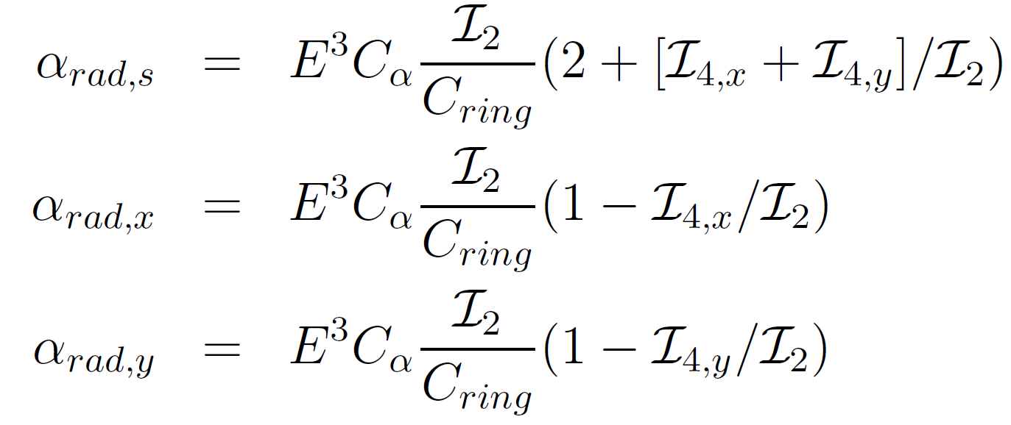
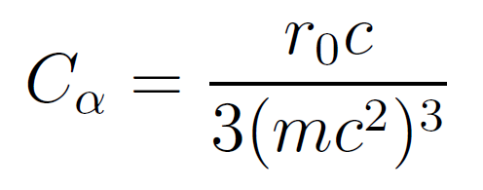
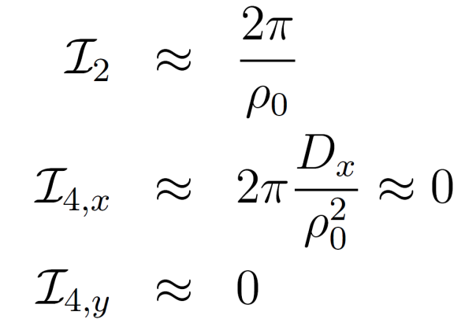
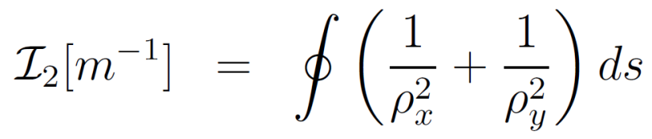
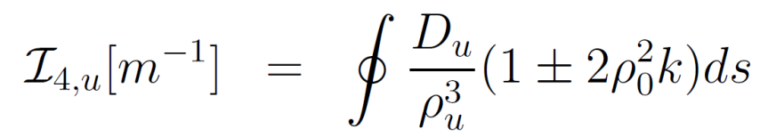

Radiation Damping
Damping Rates
Handbook of Accelerator Physics and Engineering, 1st Edition, 3rd Print,
pp. 210
Energy
Particle Type
Ring
Constant depending on particle’s mass and charge
Radiation Integrals
Isomagnetic ring with separated function magnets & $D_{y}=0$

Slide 17
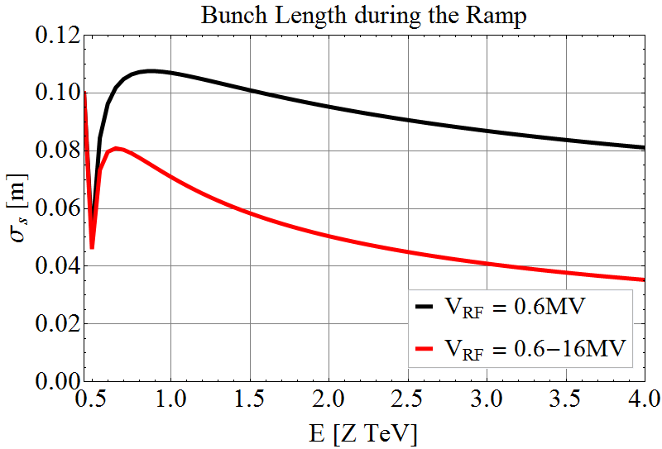
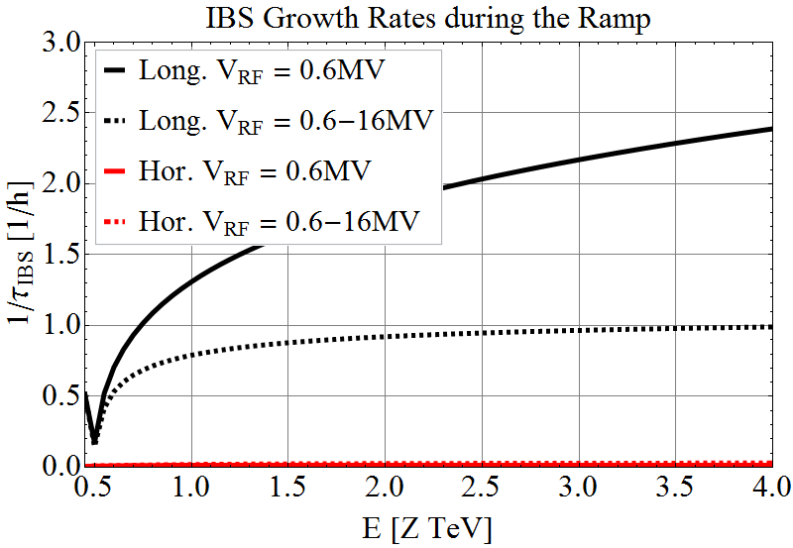
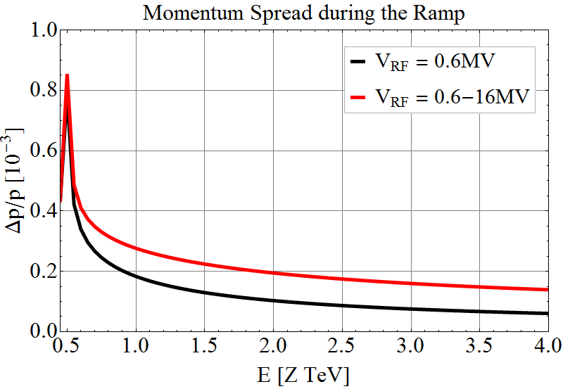

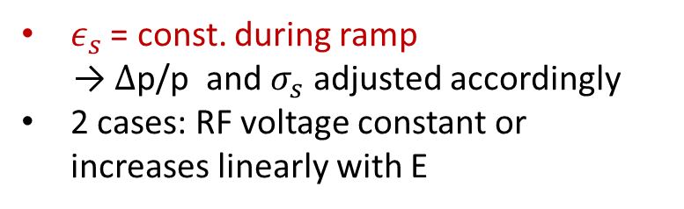
Energy Ramp Pb, $L_{c}$=$L_{c,LHC}$
E $=\left[0.45, 4\right]$Z TeV
$ε_{s}$ = const. during ramp
→ $∆$p/p and $σ_{s}$ adjusted accordingly
2 cases: RF voltage constant or increases linearly with E
Singularity at Transition
0.4h
1h
2h
225h
74/33 h

Slide 18





Energy Ramp p, $L_{c}$=$L_{c,LHC}$
E $=\left[0.45, 4\right]$Z TeV
$ε_{s}$ = const. during ramp
→ $∆$p/p and $σ_{s}$ adjusted accordingly
2 cases: RF voltage constant or increases linearly with E
6h
11h
17h
278h
301/180 h

Slide 19



Longitudinal Beam Parameters
S.Y.Lee, Accelerator Physics, 3rd edition
at 50Z TeV
 | Unit | LHC Design | FCC
Synchrotron frequency $f_{s}$ | [Hz] | 23.0 | 1.9
Momentum spread $σ_{p}$ | [${10}^{−4}]$ | 1.1 | 1.1
Longitudinal emittance $ε_{s}$ | [eVs/charge] | 2.5 | 23

