Slide 1
WLCG Service Report
4 weeks June 17 – July 15
WLCG Management Board, 15th July 2014
Andrea Sciabà
IT/SDC

Slide 2
Selected items from Ops Coordination
Middleware issues
  Job submission fails with proxies generated by VOMS servers with a SHA512 certificate
    Blocks the adoption of the new CERN VOMS servers
    Fix made available in UMD, to be deployed ASAP by sites for ARGUS, CREAM, UI, WN
  Needed to remove latest updates to CREAM and LB as they broke WMS submission (used by SAM)
Central services
  LFC for ATLAS has been decommissioned
  On track to decommission FTS-2 in August
Middleware officer role (covered by Andrea Manzi) is now fully active
  Maintains list of open middleware issues
  Maintains list of baseline versions
  Overviews the middleware readiness validation with the task force

Slide 3
Selected items from Ops Coordination
ATLAS DC14 started
  No visible differences for sites
CMS started CSA14 one week ago
  All sites will receive analysis jobs via CRAB3
CMS removed most CE tags
  Significant reduction in the information volume in the BDII
Middleware readiness TF will also track HTCondor versions together with OSG
Validation of Condor-G SAM probe progressing well
  Failures being understood and fixed
Continuing the deployment of the latest CVMFS client
  Still 50% of sites still not ready

Slide 4
Selected items from operations
OSG plans to make Condor-C the default CE around Oct-Nov
  SAM tests will need to be adapted
GridFTP transfer problems to SARA-MATRIX due to some T2’s not jumbo-frame capable (GGUS:106397)
  Solved by a router reconfiguration at NIKHEF
ATLAS transfers to KIT failed due to a misconfiguration after a downtime (GGUS:106398)
Intermittent Xrootd read errors on EOS for CMS
  Still under investigation

Slide 5
Status of security-related components
Input from C. Aiftimiei
  CANl-c++ (Jon Kerr Nilsen): part of ARC, supported
  CANl-java (UWAR/ICM): no major release planned, support until end of 2014
    CREAM depends on it!
  CANl-c, GridSite (CESNET): proactive maintenance
  ProxyRenewal (CESNET): reactive maintenance
  gLExec, LCAS & LCMAPS, Argus C-PEP plugin, ARGUS-EES (NIKHEF): continued support till at least mid-2015
References
  https://twiki.cern.ch/twiki/bin/view/EMI/EmiProductTeams

Slide 6
Situation about ARGUS
SWITCH will discontinue all ARGUS support and development very soon
  Now already at best effort, several open tickets in GGUS
Other institutes asked if they can contribute
  INFN is expected to soon provide an official answer
  CSC and HIP not available due to manpower issues
The need to find a solution is becoming increasingly urgent
  Would it be possible e.g. to share the effort on code changes, release preparation and user support until someone provides official support?

Slide 7
GSTAT support
GSTAT is de facto unsupported
  No replies from the developers for a long time
  Not officially used by WLCG any more (e.g. for Nagios probes)
  Still, several sites use it
Should we advertise that the tool is officially unsupported even if it appears to be functional?

Slide 8
GGUS summary (4 weeks 16/6/14 -13/7/14)
VO | User | Team | Alarm | Total
ALICE | 4 | 1 | 0 | 5
ATLAS | 25 | 82 | 1 | 108
CMS | 128 | 0 | 1 | 129
LHCb | 0 | 24 | 1 | 25
Totals | 157 | 107 | 3 | 267

Slide 9
Significant events
GGUS release on 16th July. Important changes announced multiple times in ops meetings:
  GGUS host certificate change: transparent
  Decommission of the GGUS ticket submission by email. Ticket update by email remains possible
3 real alarms (ATLAS, CMS, LHCb) during this period

Slide 10
Current inter-operation issues
Some ticketing systems interfaced to GGUS,
i.e. BNL RT (via OSG Footprints) and CERN SNOW, under some internal assignment conditions, won't accept GGUS setting tickets to status 'solved‘. This leads to automatic re-opening loops. Mutual workflow review is on-going
  https://ggus.eu/?mode=ticket_info&ticket_id=106821

Slide 11
ATLAS ALARM GGUS:106366
FTS3 issues at CERN-PROD
What time UTC | What happened
2014/6/20 7:11 | Initial submission. Type of Problem: File transfer Site: CERN-PROD
2014/6/20 7:15 | Service manager acknowledges the alarm
2014/6/20 7:23 | Issue caused by the auto update of one rpm (gfal2)
2014/6/20 7:59 | Service manager announces that the problem has been solved.
2014/6/20 9:43 | Ticket closed
2014/6/12 9:48 | Ticket verified

Slide 12
LHCb ALARM GGUS:106368
dCache file: access protocol enabled in error
What time UTC | What happened
2014/6/20 7:28 | Initial submission. Type of Problem: File access Site: IN2P3-CC Issue: after a recent update, the ‘file’ protocol was announced by the server as enabled, although it was not.
2014/6/20 7:34 | Service manager announces that the issue should be solved
2014/6/20 8:51 | Ticket verified

Slide 13
CMS ALARM GGUS:106789
Voms-proxy-init fails on SL5
What time UTC | What happened
2014/07/10 18:18 | Initial submission. Type of Problem: Middleware Site: CERN Email notification worked. SNOW ticket successfully created. Operators notified.
2014/07/18 18:28 | Grid expert finds the problem cause: outdated CRL on the AFS UI.
2014/07/18 18:29 | Operators acknowledge the ALARM reception.
2014/07/18 18:35 | Service manager manually updates the CRL.
2014/07/14 08:08 | Submitter was happy already 15 mins after the ALARM submission. Ticket now set to status ‘solved’ with the note that the afs UI support issues must be examined off-line.

Slide 14
Analysis of the reliability plots :
Week 16/06/2014
ALICE: NTR
ATLAS: NTR
CMS:
3.1 FZK: WN-gLExec was failing.
3.2. CCIN2P3: WN-gLExec was failing.
LHCb : NTR

Slide 15
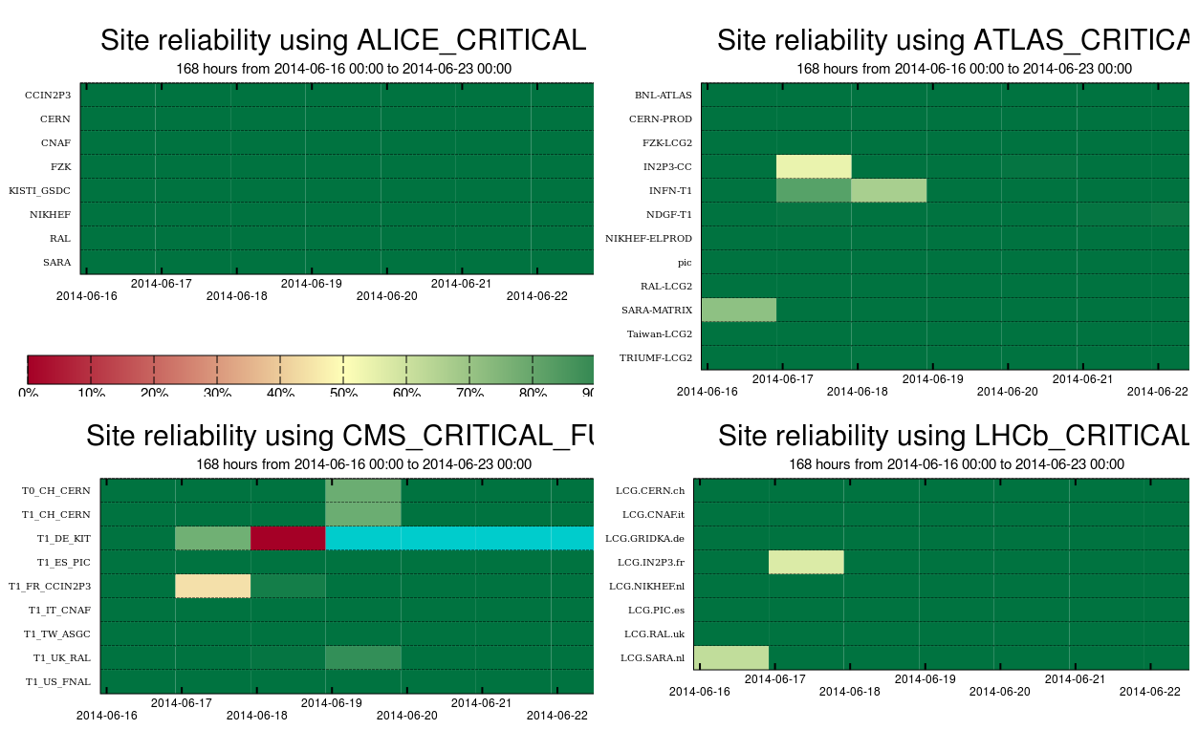
3.1
3.2

Slide 16
Analysis of the reliability plots :
Week 23/06/2014
ALICE: NTR
ATLAS: NTR
CMS:
3.1 KIT : unscheduled outage from 25-Jun 08:00 until 09:00: “Shutdown of the storage element in order to check on file system issues” (Downtime 14737). WN-glexec test was missing
LHCb : NTR

Slide 17
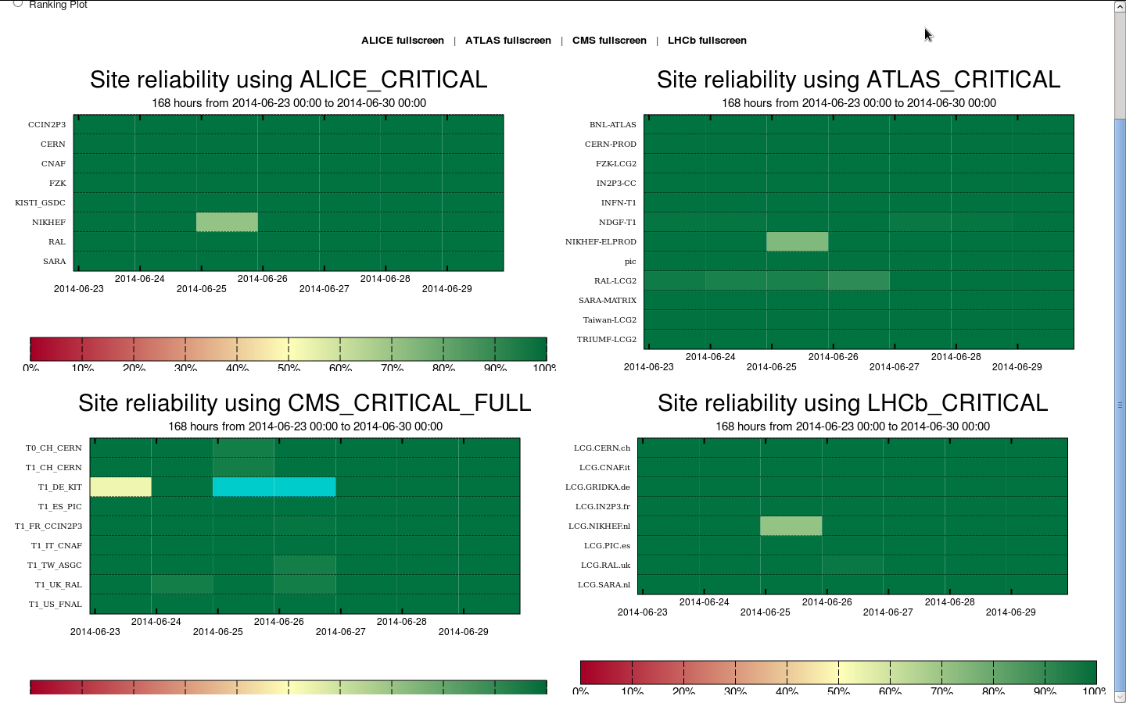
3.1

Slide 18
Analysis of the reliability plots :
Week 30/06/2014
ALICE: NTR
ATLAS: NTR
CMS: NTR
LHCb : NTR

Slide 19
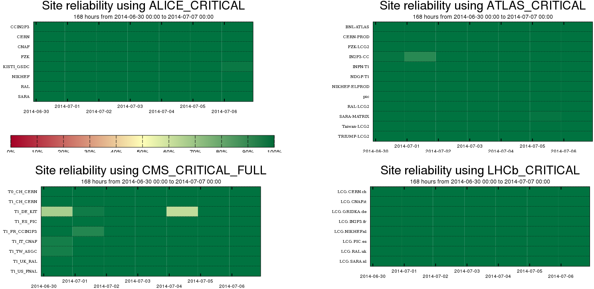

Slide 20
Analysis of the reliability plots :
Week 07/07/2014
ALICE: NTR
ATLAS:
2.1 RAL: File transfer issue GGUS:106753 (timeouts in put done).
2.2. TAIWAN: File transfer issue GGUS:106736.
CMS:
3.1 T1_TW_ASGC: SAM CE and SAM SRM problems GGUS:106763.
LHCb : NTR

Slide 21
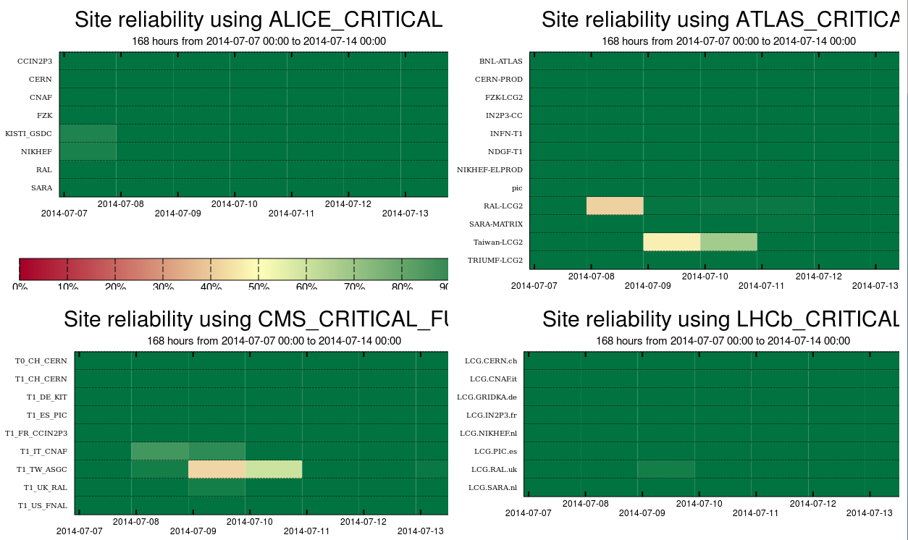
2.1
2.2
2.3

