Slide 1


Design and Fabrication of an Optimal Peripheral Region for the LGAD
Pablo Fernández-Martínez, M. Baselga, V. Greco, D. Flores, S. Hidalgo, G. Pellegrini
IMB-CNM, Barcelona (Spain)

Slide 2
Talk Outline
Critical aspects of the LGAD design
Junction edge termination
Protection of the periphery
Design of the peripheral region in the new production run
Conclusions

Slide 3
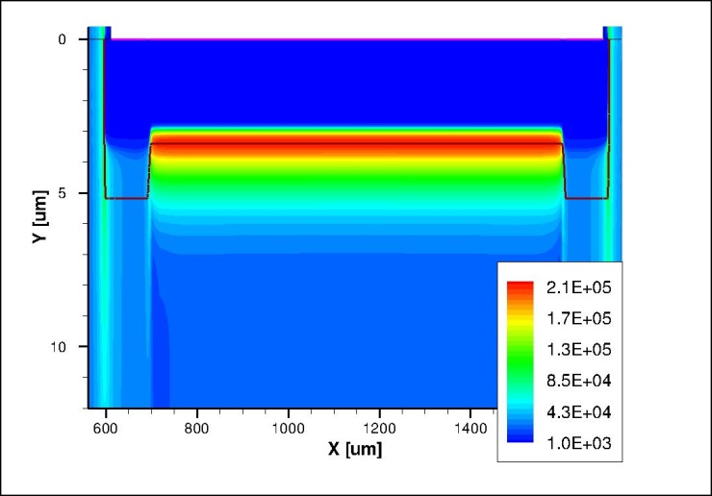
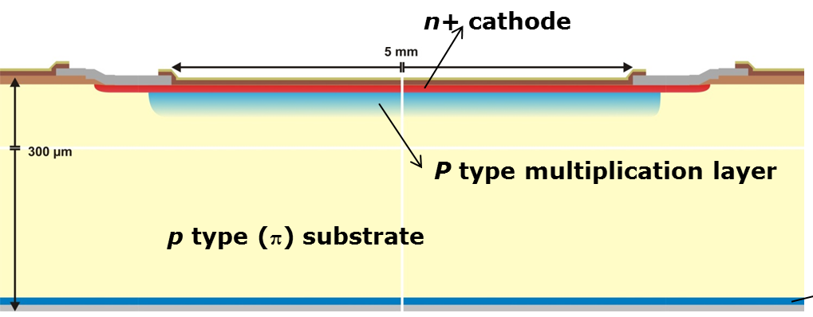

Critical aspects of the LGAD design
Two regions → different junctions:
  Central area → uniform electric field, high enough to activate mechanism of impact ionization (multiplication)
  Termination
Electric Field @ 400 V
N⁺
P
π
→ High electric field confined in the central region
$$V_{BD}|_{Termination}≫V_{BD}|_{Central}$$
3rd Region
  Periphery
  → Reduction of the leakage currents

Slide 4
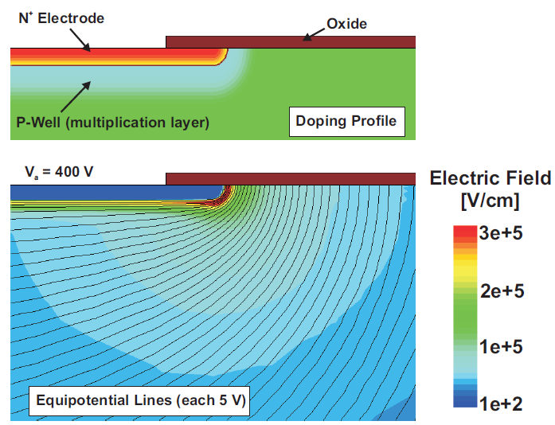
Edge Termination: Why is needed?
The N⁺ shallow contact and the P-multiplication layers have to be locally created with a lithography mask
  The electric field at the curvature of the N⁺/P junction is much higher than that of the plane junction (where Gain is needed)
  Avalanche at the N⁺/P curvature at a very low reverse voltage (premature breakdown)
Shallow N⁺ and P-multiplication layers self aligned
High electric field peak at the curvature
Notes:
Ruptura prematura, porque se alcanza el campo crítico de ruptura en la curvatura.

Slide 5
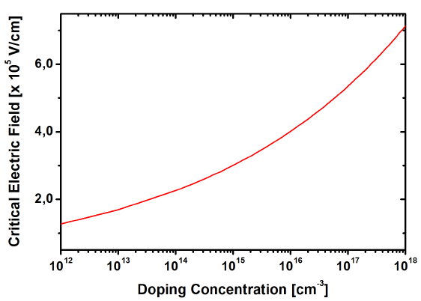
Design of the Edge Termination: Critical Electric Field
P-Multiplication layer
Extrapolated values
P-Substrate
B. Jayant Baliga (2008): Fundamentals of Power Semiconductor Devices

Slide 6
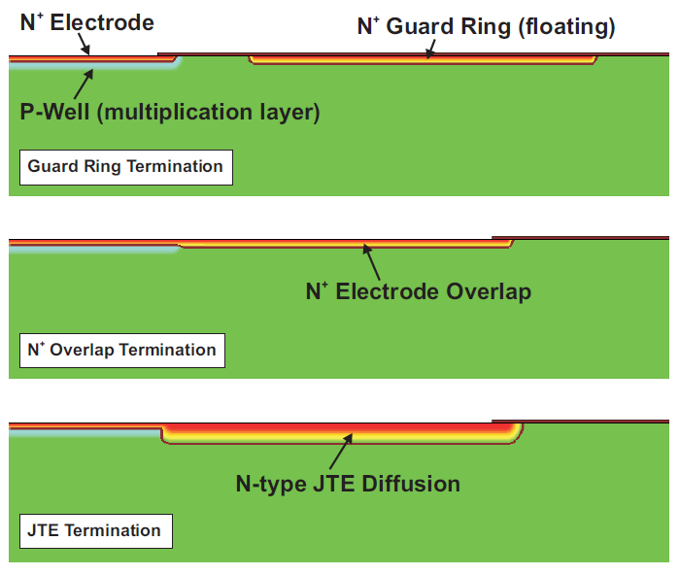
Junction Edge Termination: Analyzed Designs
The optimization of the edge termination is ruled by the electric field at the multiplication layer (not by the maximum voltage capability, as in power devices).
Goal: V_{BD_1D} < V_{BD_Edge}
3 Designs have been analyzed
Notes:
En esta tesis se han evaluado tres estrategias para implementar la terminación.

Slide 7
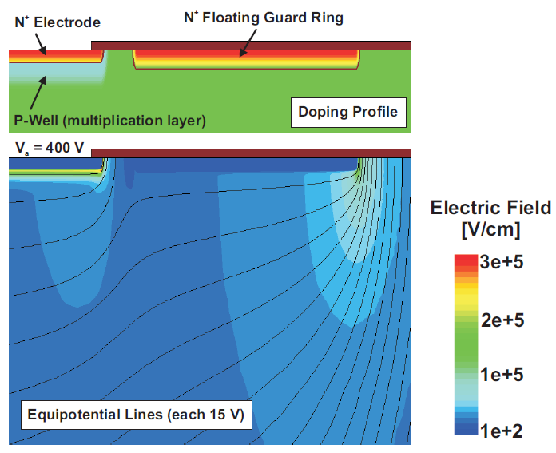
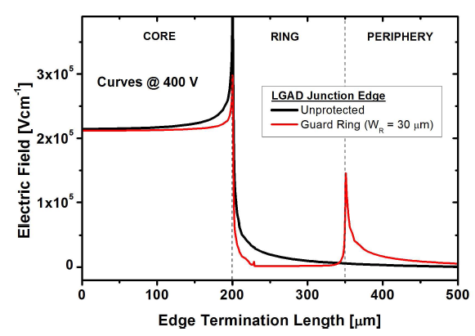
Junction Edge Termination: Floating Guard Ring
The N+ shallow diffusion is used to implement a floating guard ring.
  The lateral electric field distribution is smoothed leading to two peaks (main junction and floating guard ring)
  The electric field peak and the risk of avalanche breakdown at the curvature of the main junction is reduced. Optimization of the guard ring location is needed.
The lower Ec value at the ring junction can lead the termination to breakdown

Slide 8
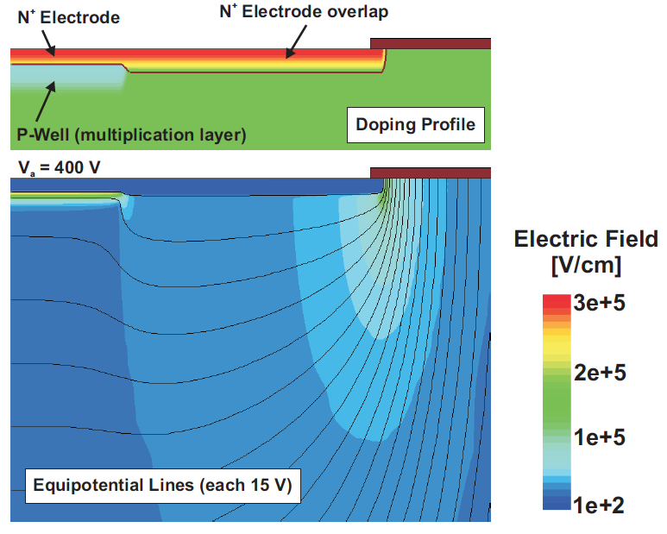
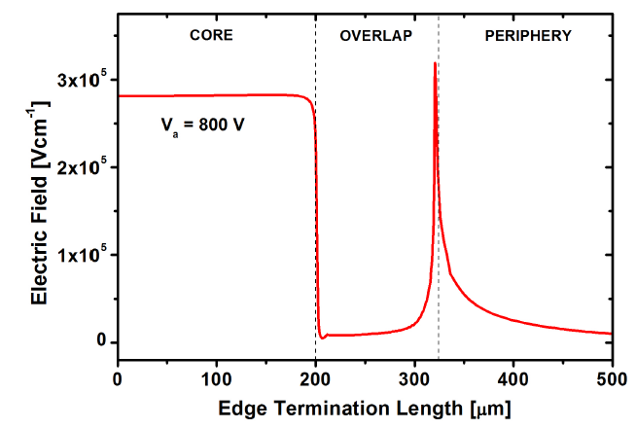
Junction Edge Termination: N⁺ Extension
The N⁺ is used to extend the N+ beyond the edge of the multiplication layer
  Phosphorous diffuses more in the very lowly doped substrate (higher curvature radius and voltage capability).
  The electric field rapidly increases at the plain junction (multiplication).
The lower Ec value at the overlap junction can lead the termination to breakdown

Slide 9
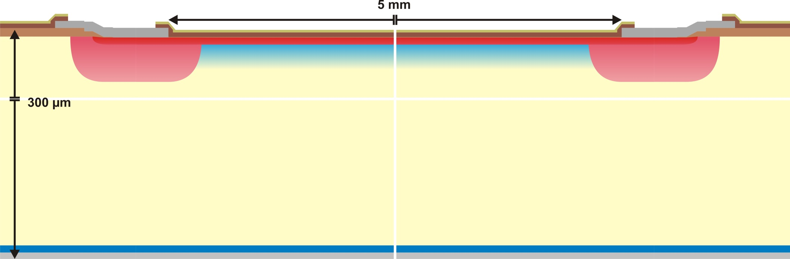
Junction Edge Termination: Junction Termination Extension
Lowly doped N-type Deep diffusion (JTE) around the curvature of the main junction
  Additional (specific) photolithographic step
  The addition of a Field Plate moderates the electric field at the JTE curvature
Field Plate
N⁺ electrode
P type multiplication layer
N Diffusion (JTE)
P type (π) substrate
Resistivity ~ 10 KΩ·cm
P⁺ electrode
Notes:
Finalmente, la terminación JTE es la que mejores resultados nos ha dado

Slide 10
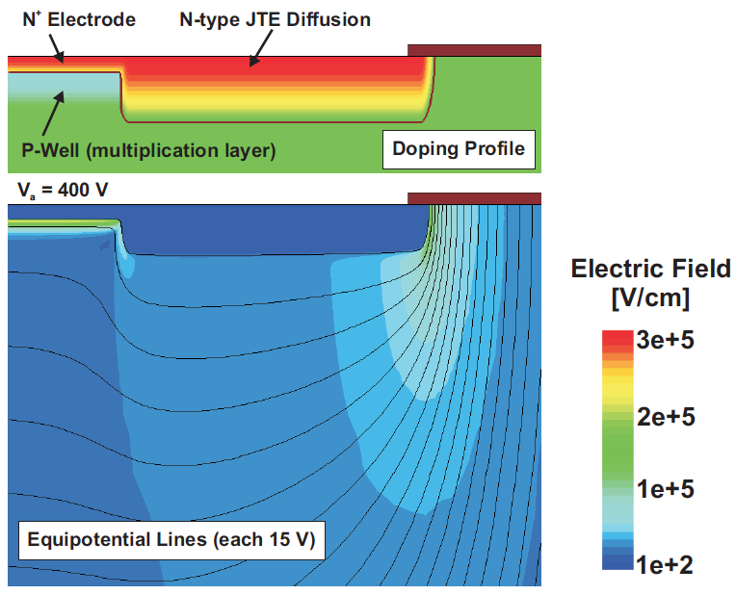
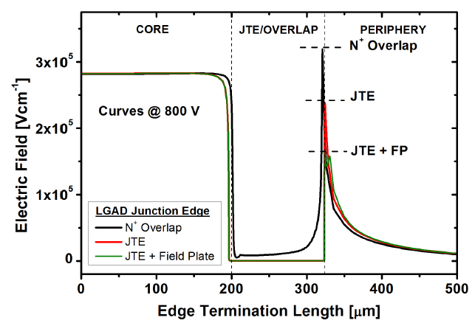
Junction Edge Termination: Junction Termination Extension
  The electric field peak is reduced at the JTE curvature
  The highest electric field value is located at the main junction (1D)
  → multiplication control
Ec value at the JTE junction is not as low, so the breakdown can be localized at the main junction

Slide 11
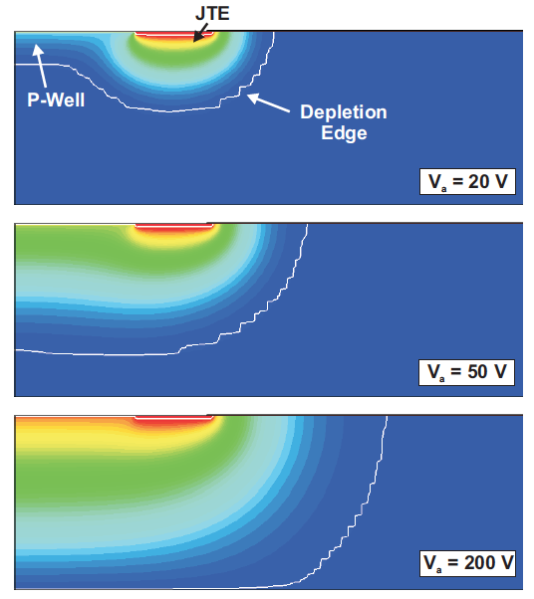
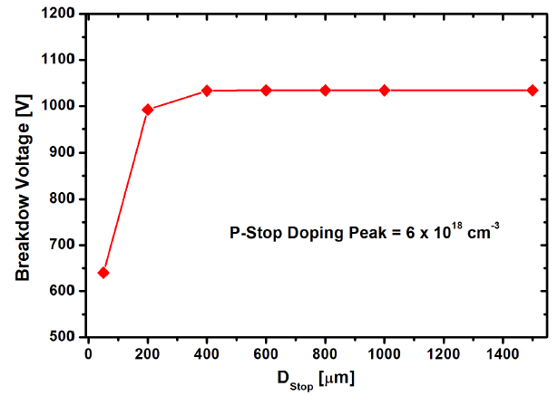
Design of the Device Periphery
Peripheral region should ensure the voltage capability as well as limiting the leakage current.
  After the full (vertical) depletion is reached, a fast lateral depletion of the lowly doped substrate takes place.
A deep P+ diffusion (C-Stop) is needed in the die periphery to avoid the depletion region reaching the unprotected edge
C-Stop
C-Stop
A C-Stop located too close to the edge termination can degrade the voltage capability
C-Stop

Slide 12
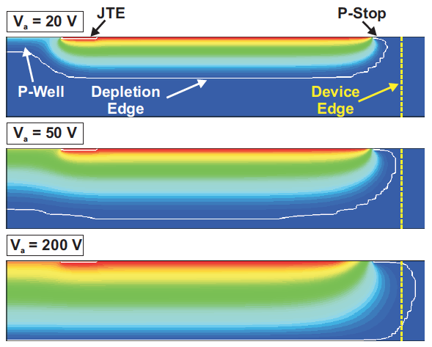
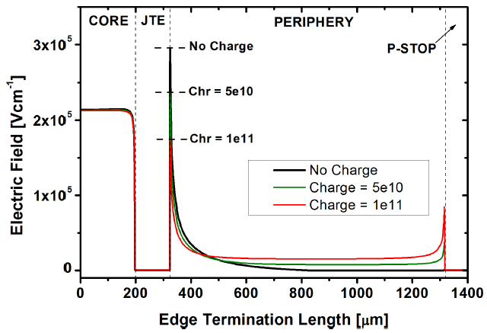
Optimization of the periphery: Positive oxide charges
Field oxides grown in wet conditions (H₂ + O₂) typically have a positive charge density in the range of 5e10 cm⁻²
  Surface inversion of the substrate and modification of the depletion dynamics.
Surface leakage currents

Slide 13
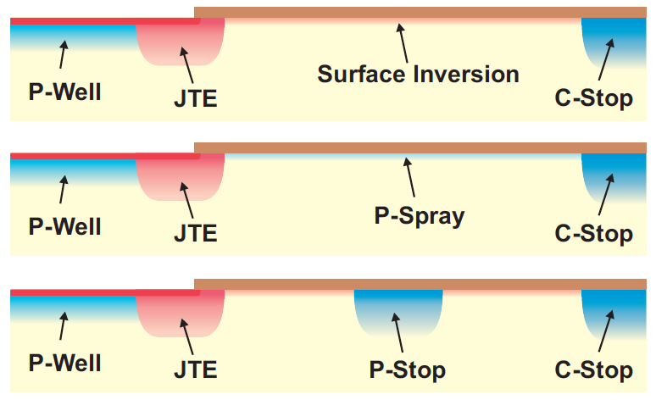
Optimization of the periphery: Strategies
Positive oxide charges (radiation induced or technologically originated) induce surface inversion of the substrate → Current path towards the collector electrode.
Boron blanket implant
P-Spray: Counteracts the inversion
P-Stop: cut the current path off
Same implant

Slide 14
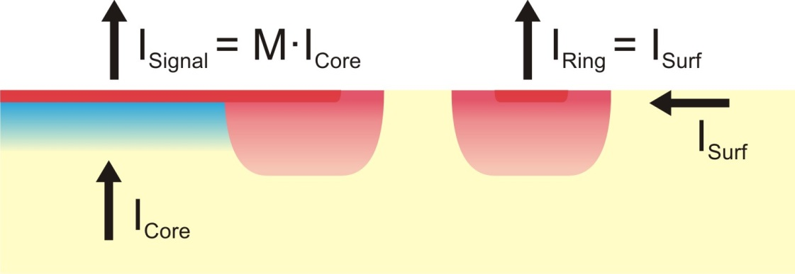
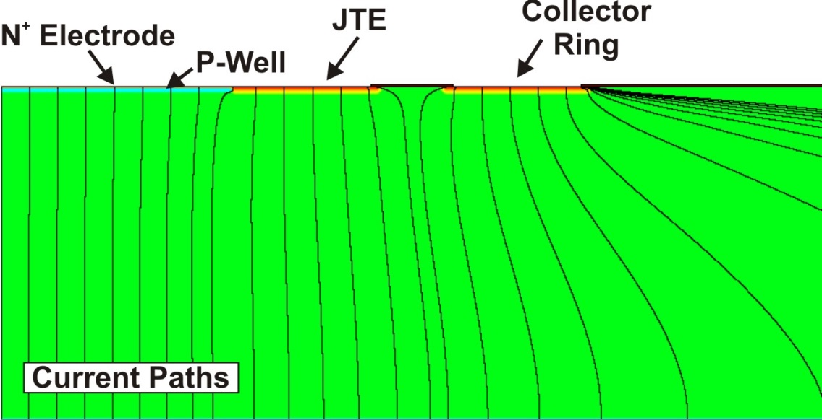
Optimization of the periphery: Guard Ring
Biased guard Ring around the detection region.
  The ring is independently biased to extract the surface component of the current
  Voltage capability is preserved (same curvature as JTE)
Guard ring confines the detection area
Good isolation should be ensured

Slide 15
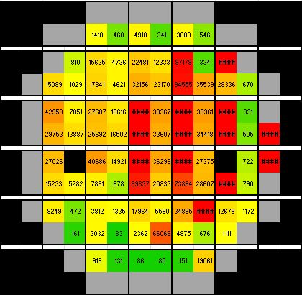
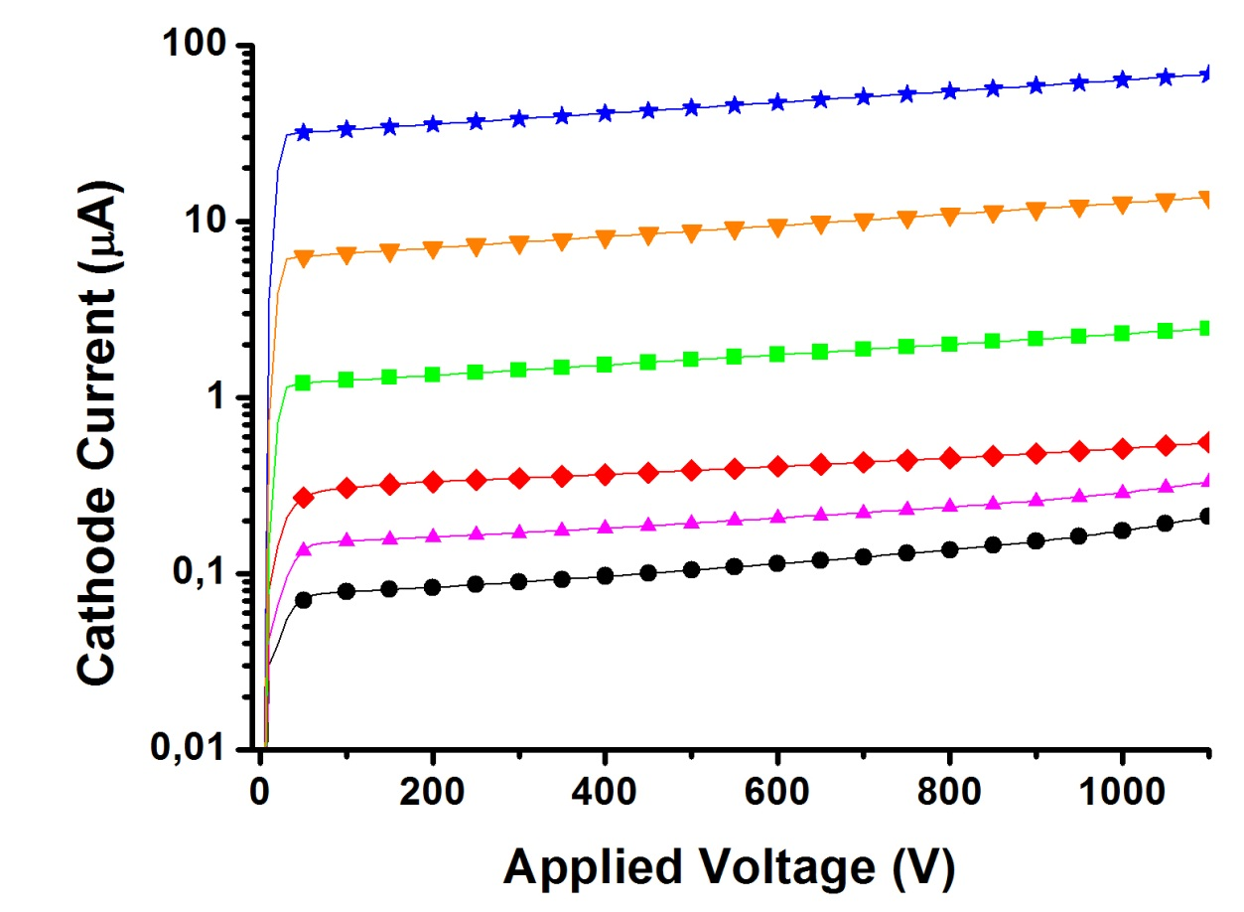
Implementation: Problems at the peripheral region
High Voltage Capability (Breakdown > 1100 V) in all wafers
Leakage current varies from some 10 nA to more 100 µA in devices within the same wafer
Run 6474
High Current Devices
V_{BD} > 1100 V
Low Current Devices
LGAD Wafer (W8 – High Boron Implant)
Guard Ring is short-circuited with N⁺ electrode (inefficient P-Spray)

Slide 16
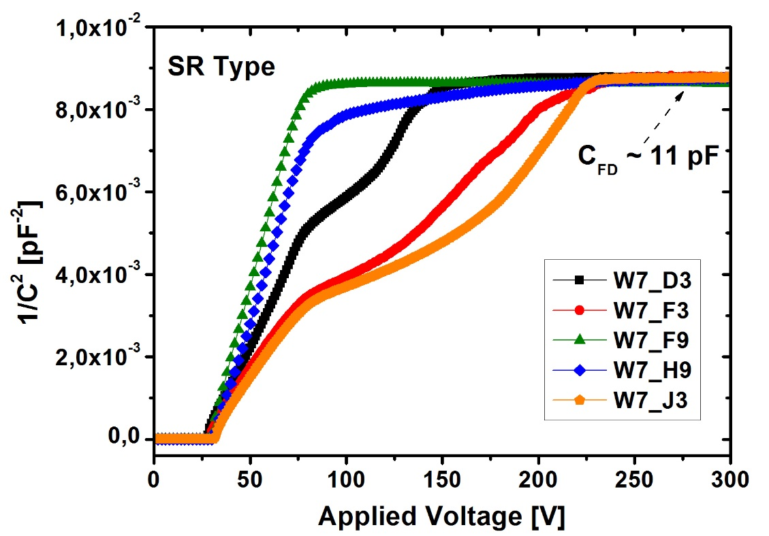
Implementation: Problems at the peripheral region
Run 7062
Leakage current is mostly generated at the periphery
Run 6474
Moderate reduction
Capacitance humps are related with the depletion of the periphery

Slide 17
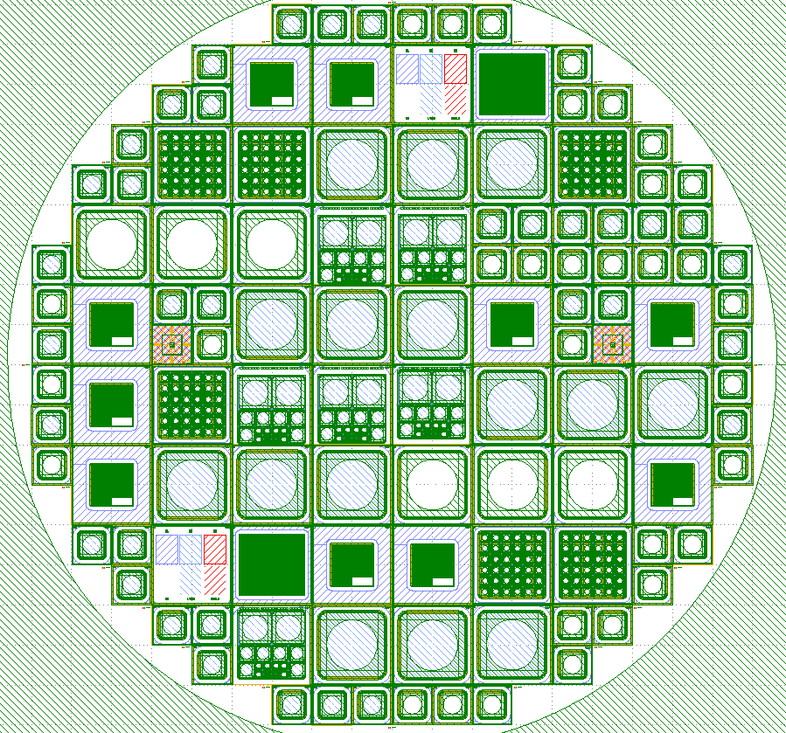
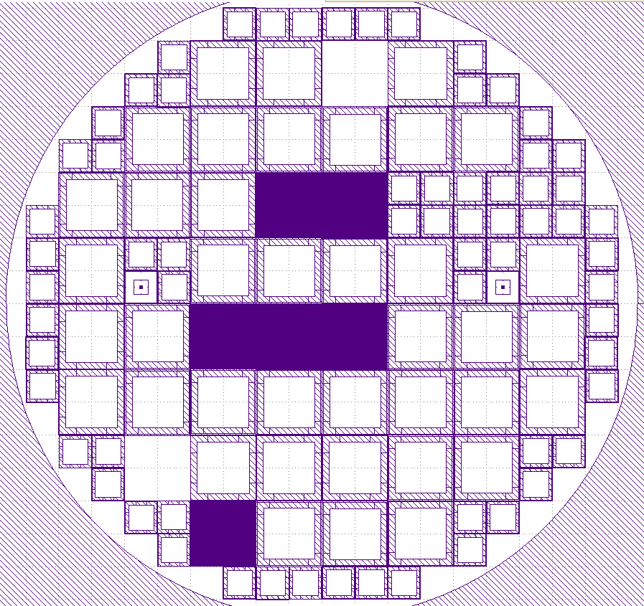
New Fabrication Run
Top Distribution
Back Metallization

Slide 18
New Fabrication Run
9 LGAD Pad Detectors
  3 (8 x 8 mm multiplication area)
  6 (3 x 3 mm multiplication area)
9 PiN Detectors
  3 (8 x 8 mm active area)
  6 (3 x 3 mm active area)
4 LGAD pStrips Detectors
  32-160-50-06-24
  32-160-62-06-12
  64-80-10-06-24
  64-80-22-06-12
2 PiN pStrips Detectors
  32-160-50-06-24
  64-80-10-06-24
1 Pixelated LGAD Detector (6 x 6 pixels)
1 Pixelated PiN Detector (6 x 6 pixels)
3 LGAD for Timing Applications
  200 um to chip edge
  250 um to chip edge
  800 um to chip edge
1 FEI4 compatible pStrip Detector
1 Specific Test Structure (SPR,SIMS,XPS)
113 Structures
  47 (10 x 10 mm, total area)
  66 (5 x 5 mm, total area)

Slide 19
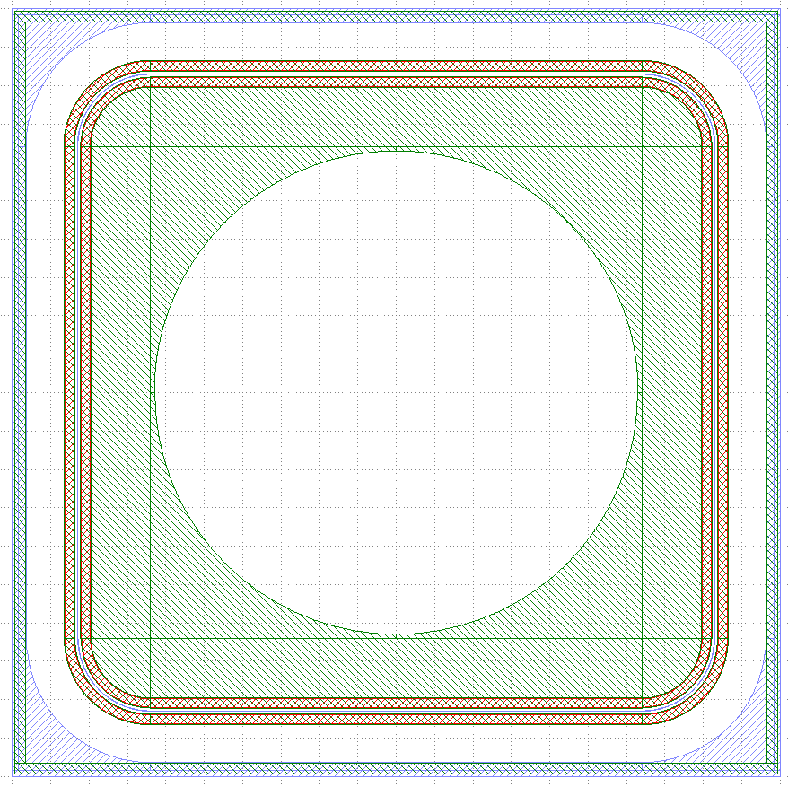
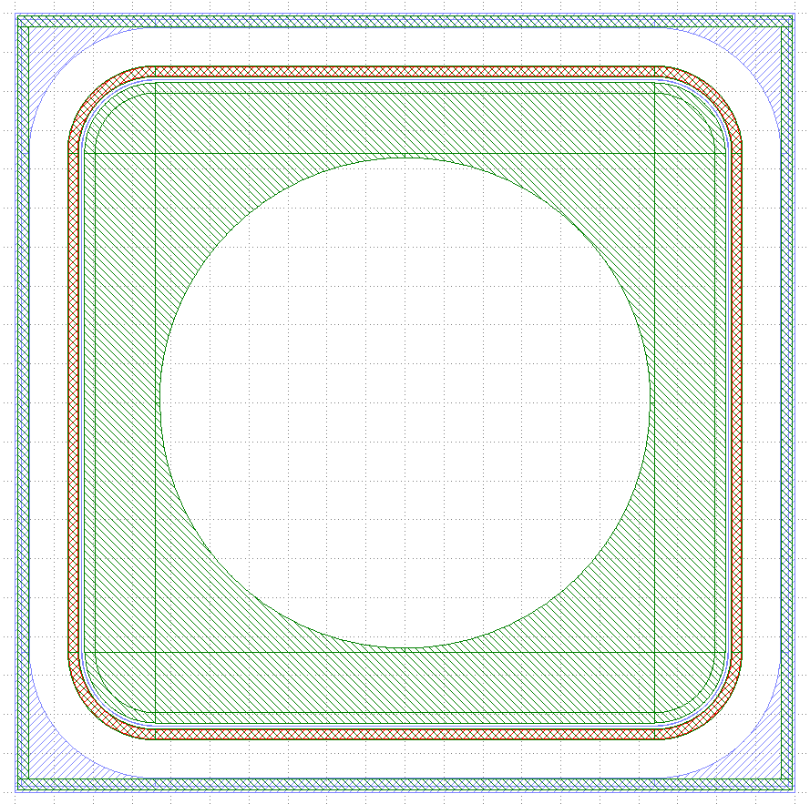
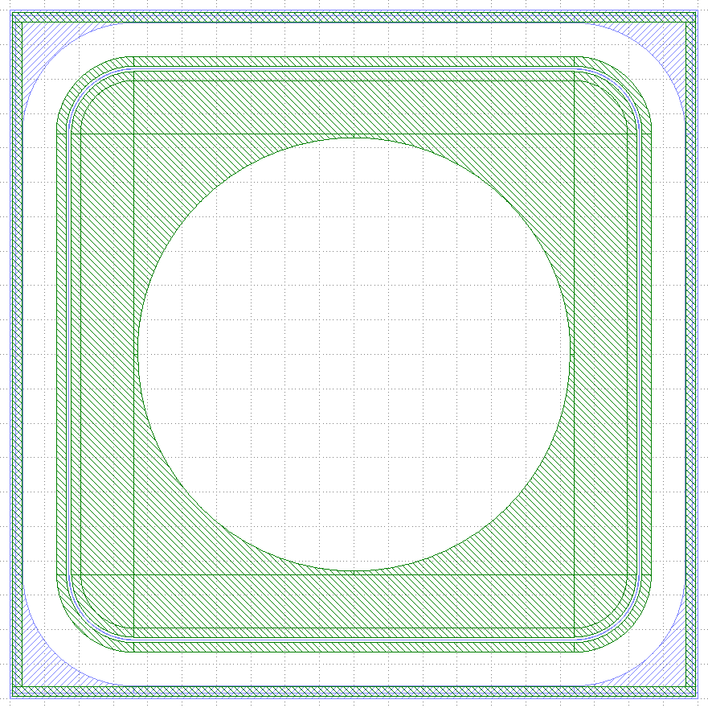
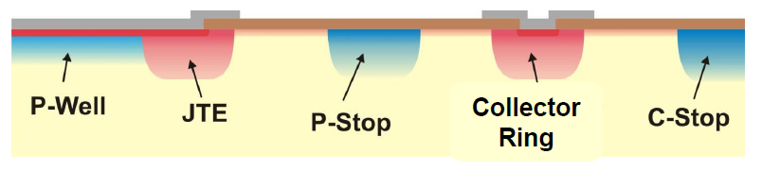
New Fabrication Run: LGAD pad Detectors
LGAD 1,4,7
LGAD 2,5,8
LGAD 3,6,9
Field Plate
Field Plate
LGAD Pad Detectors
  Multiplication Area
    8 x 8 mm (Type 1, 2, 3)
    3 x 3 mm
    Termination: * P-Stop + N-Guard Ring (Type 3, 6, 9)
    * P-Stop + N-Guard Ring with JTE (Type 2, 5, 8)
    * JTE + P-Stop + N-Guard Ring with JTE (Type 1, 4, 7)
    * Field Plate 10 µm, 0 µm (Type 7, 8, 9)

Slide 20
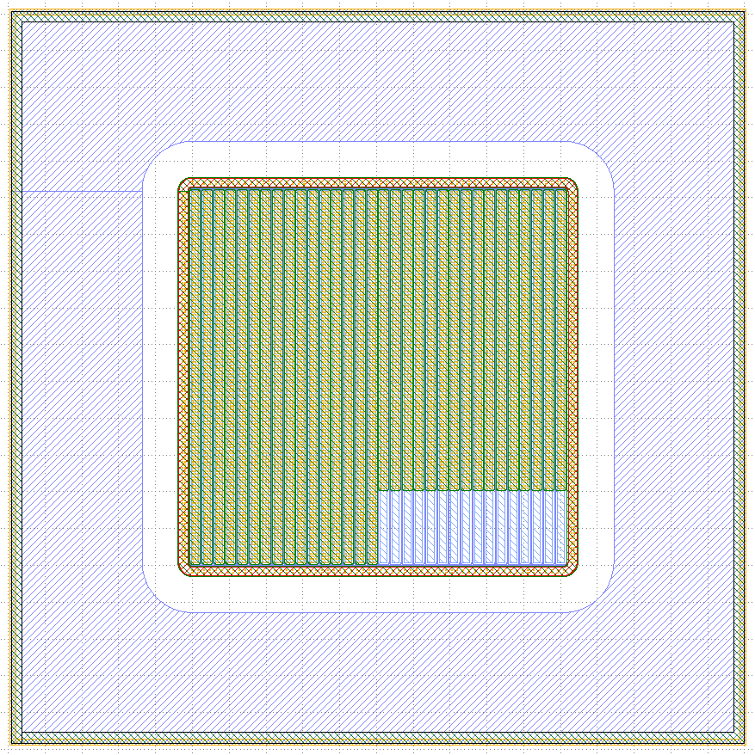
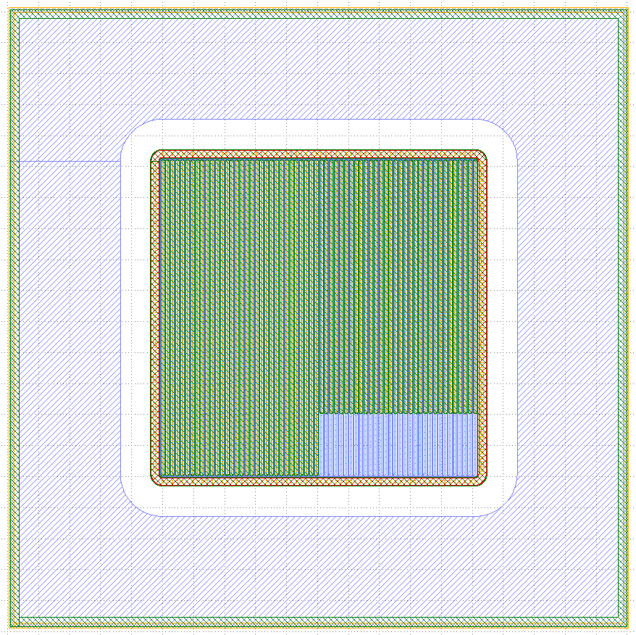
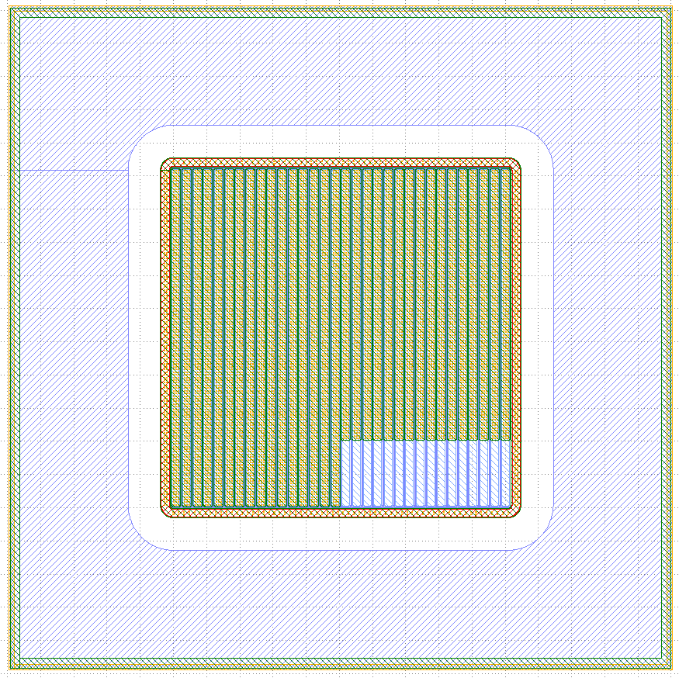
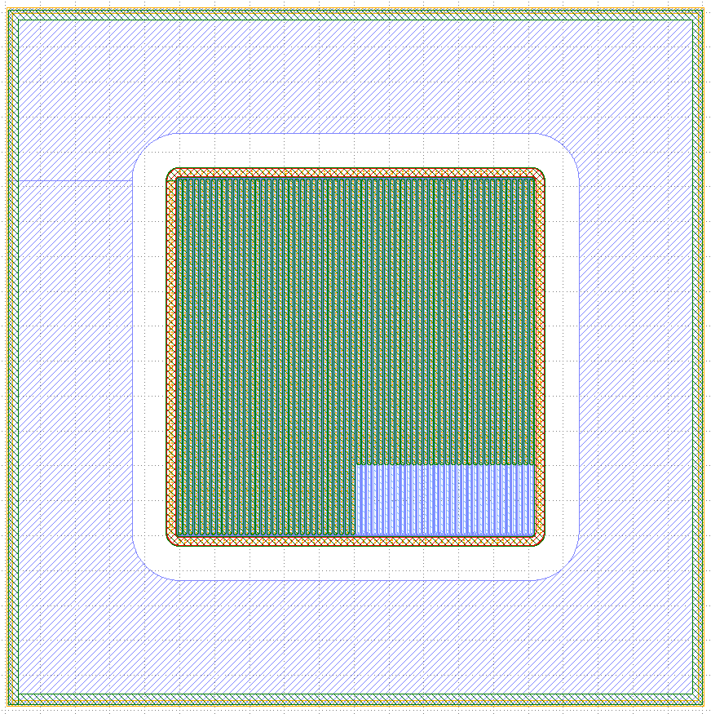
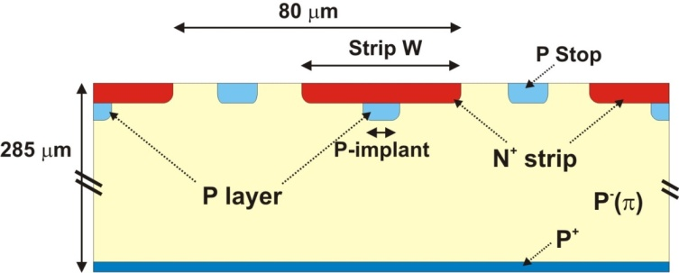
New Fabrication Run: LGAD strip Detectors
4 LGAD pStrips Detectors
  32-160-50-06-24
  32-160-62-06-12
  64-80-10-06-24
  64-80-22-06-12
2 PiN pStrips Detectors
  32-160-50-06-24
  64-80-10-06-24
Key Legend
  AA-BB-CC-DD-EE
  AA, Channels Number
  BB, Pixel Size
  CC, Multiplication Width
  DD, P-Stop Width
  EE, P-Stop Position
32.160.50.06.24
64.80.10.06.24
32.160.62.06.12
64.80.22.06.12

Slide 21
Conclusions
Optimization of the LGAD peripheral region is crucial for the detector performance
  Edge termination techniques confine the high electric field into the multiplication area and give voltage capability to the detector
  Structures within the peripheral region avoid high leakage currents and degradation
JTE termination technique has proved good performance
P-Spray technique has shown poor effectiveness
New production run at the IMB-CNM include pad and segmented (strip and pixel) designs with an optimized peripheral region based on the P-Stop technique.

Slide 22
Thank you
Questions?

Slide 23
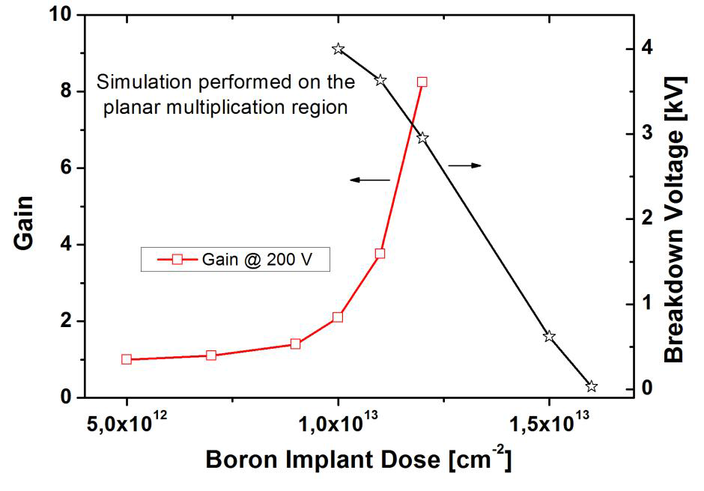
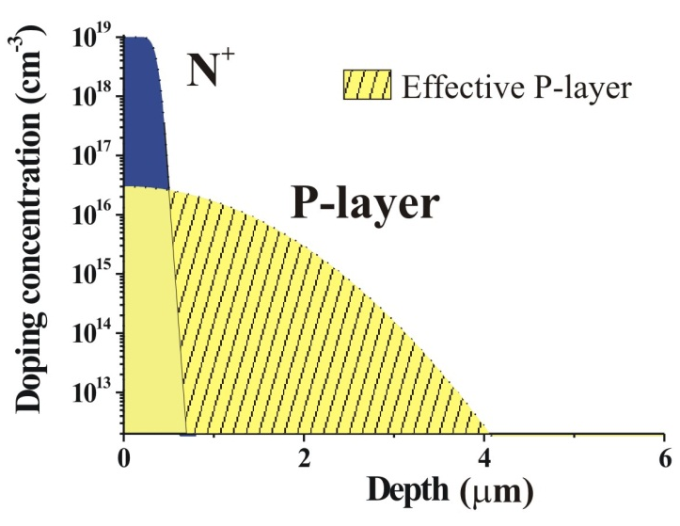
Optimization of the Multiplication layer
P-type multiplication layer determines both Gain and Breakdown
Higher Boron implant Dose:
  Higher Gain
  Lower Breakdown
Small variations in the Boron implant dose (~ 2 × 10¹² at/cm²) lead to large changes in Gain and Breakdown values
Effective charge and doping value at the junction determine the Gain

