Slide 1


Design of Solenoid Field
Benoit CURE,
CERN
CERN, 10 June 2014
CLIC Detector optimisation

Slide 2
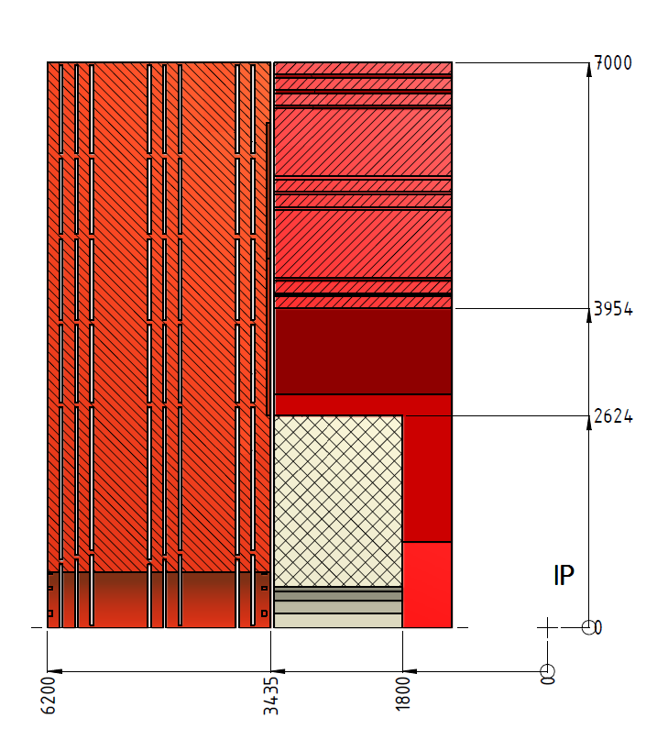
CLIC Detector optimisation – Design of solenoid field
Reference design layout : initial CLIC_SiD layout with detector half length L=6.2m
    End cap iron thickness is 2445mm.
    8 muon chamber stations in the yoke end cap.
Longitudinal section :
quarter view,
detector axis horizontal,
only end cap and one barrel shown.
R
Z

Slide 3
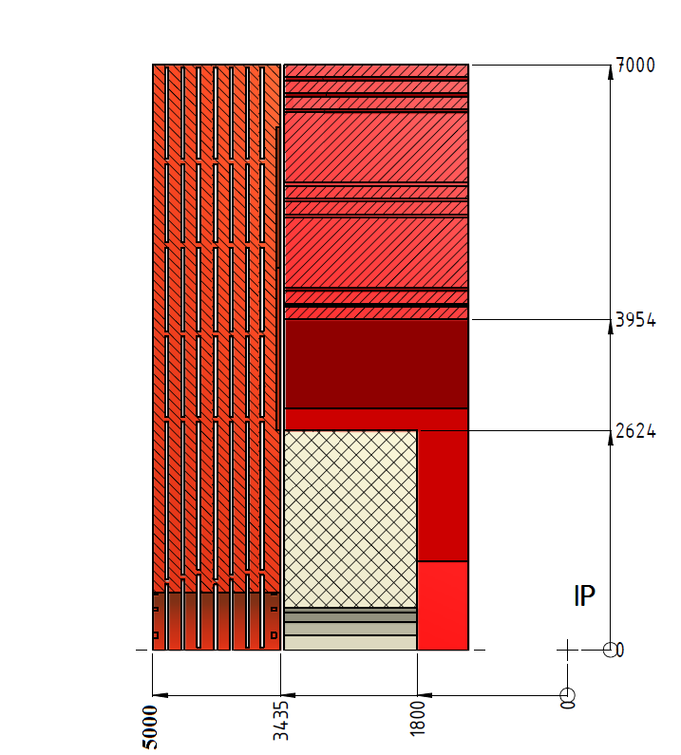
CLIC Detector optimisation – Design of solenoid field
New design layout : reduced detector half-length to L=5m
    End cap iron thickness reduced by 1160mm (2445mm to 1285mm).
    7 muon chamber stations in the yoke end cap.
Longitudinal section :
quarter view,
detector axis horizontal,
only end cap and one barrel shown.
Solenoid length kept at 6.23m,
External radius identical,
No modification of barrel yoke.
R
Z

Slide 4
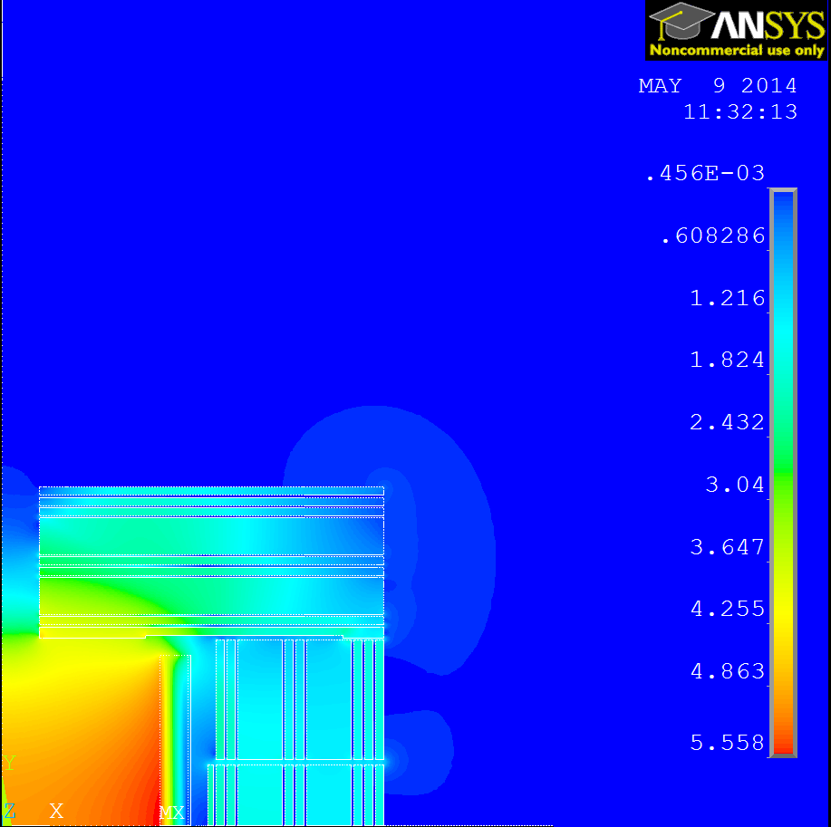
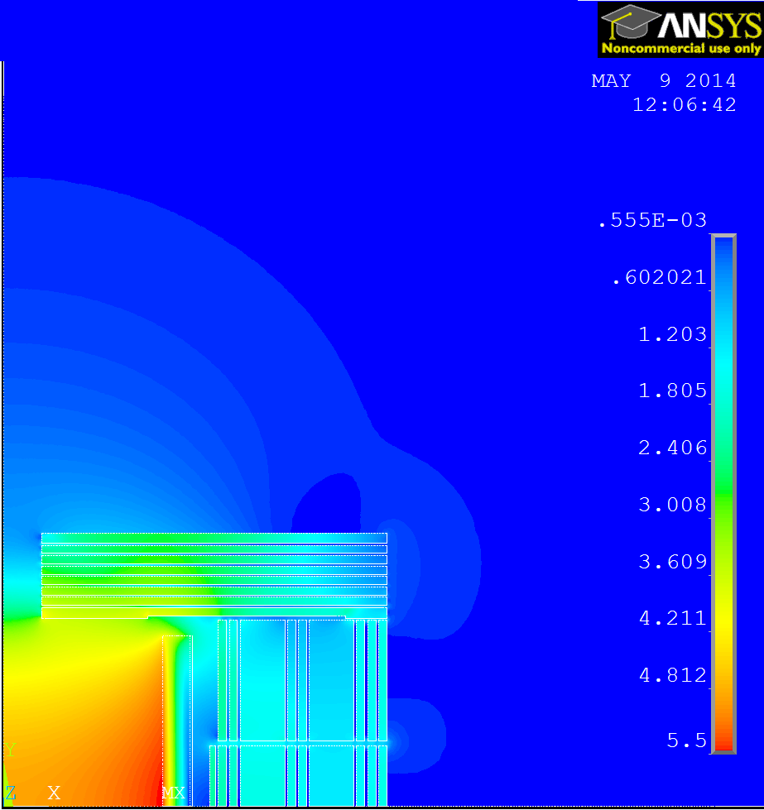
CLIC Detector optimisation – Design of solenoid field
Comparison of the two layouts (no ring coils): B field vector sum map
(Detector axis is vertical on the maps !)
L=6.2m
L=5m no RC
B = 5.06 T at IP
B = 4.896 T at IP
Z
Z
R
R
B-field 2D map : Area most affected is around the detector axis and outside the yoke.
Far region : Less significant effect, Bmax=9mT at R=15m.

Slide 5
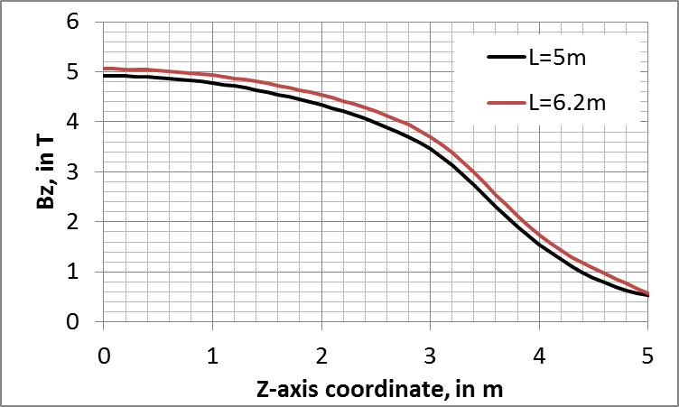
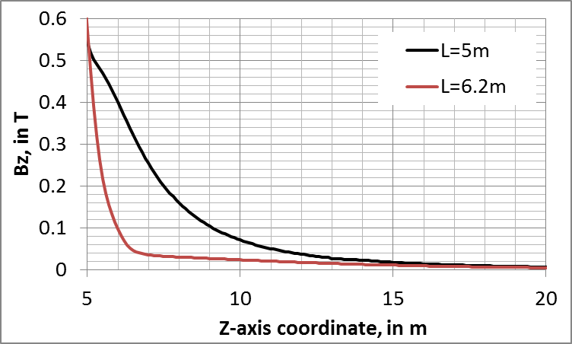
CLIC Detector optimisation – Design of solenoid field
Comparison of the two layouts (no ring coils):
Axial B-field component Bz(R=0) on coil axis:
0.46e-3
0.56e-3
⇒ Improve the design with reduced length by implementing ring coils to :
  lower the stray field,
  lower the field near the beam line outside the yoke end cap.

Slide 6
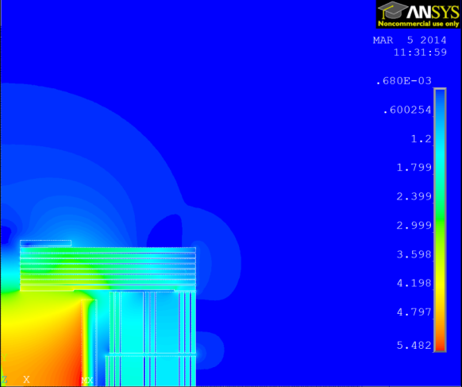
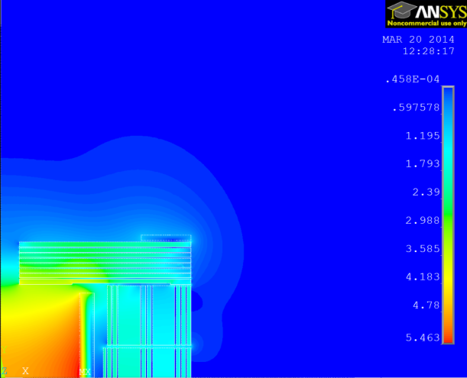
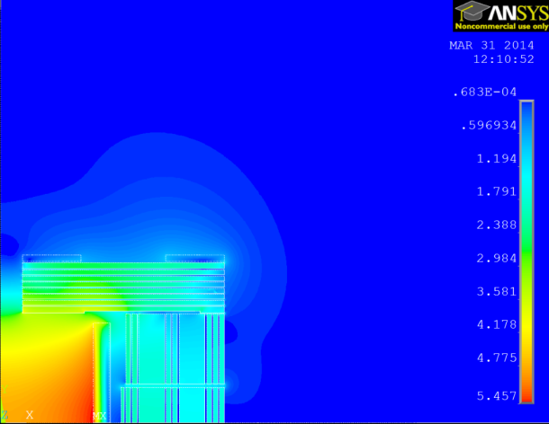
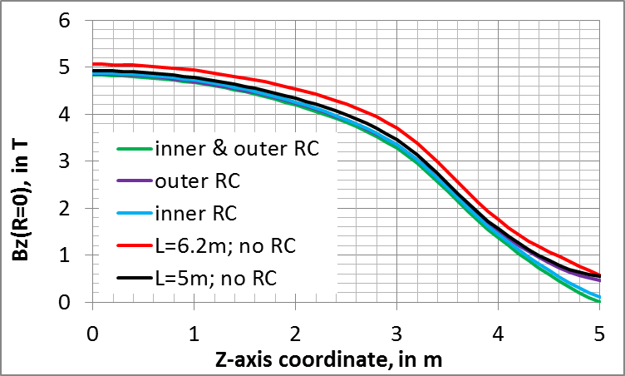
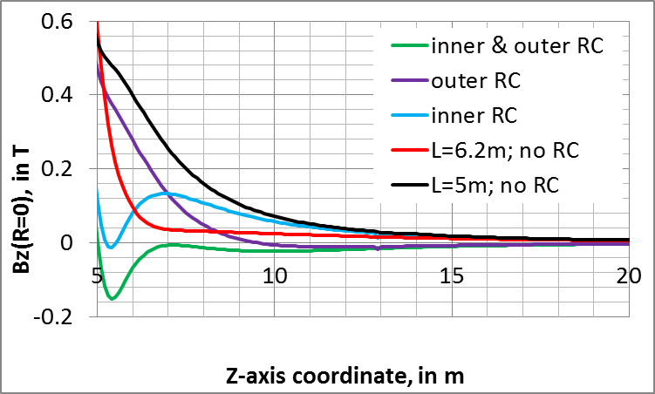
CLIC Detector optimisation – Design of solenoid field
Effect of ring coils on B-field with L=5m: 3 configurations: J=3A/mm², same cross section.
1 RC on inner radius
1 RC on outer radius
2 RC on inner and outer radius
B = 4.874 T at IP
B = 4.85 T at IP
B = 4.828 T at IP
Z
Z
Z
R
R
R
Axial B-field component
Bz(R=0) on coil axis:

Slide 7
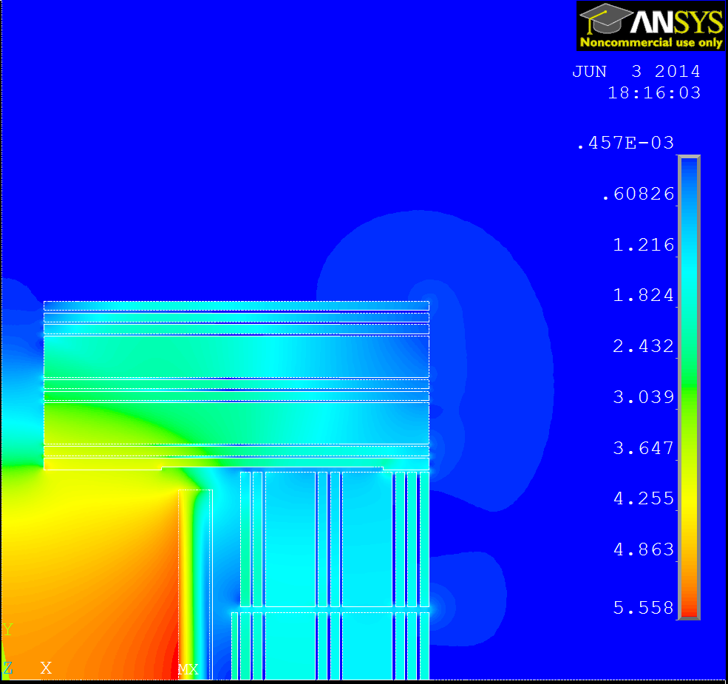
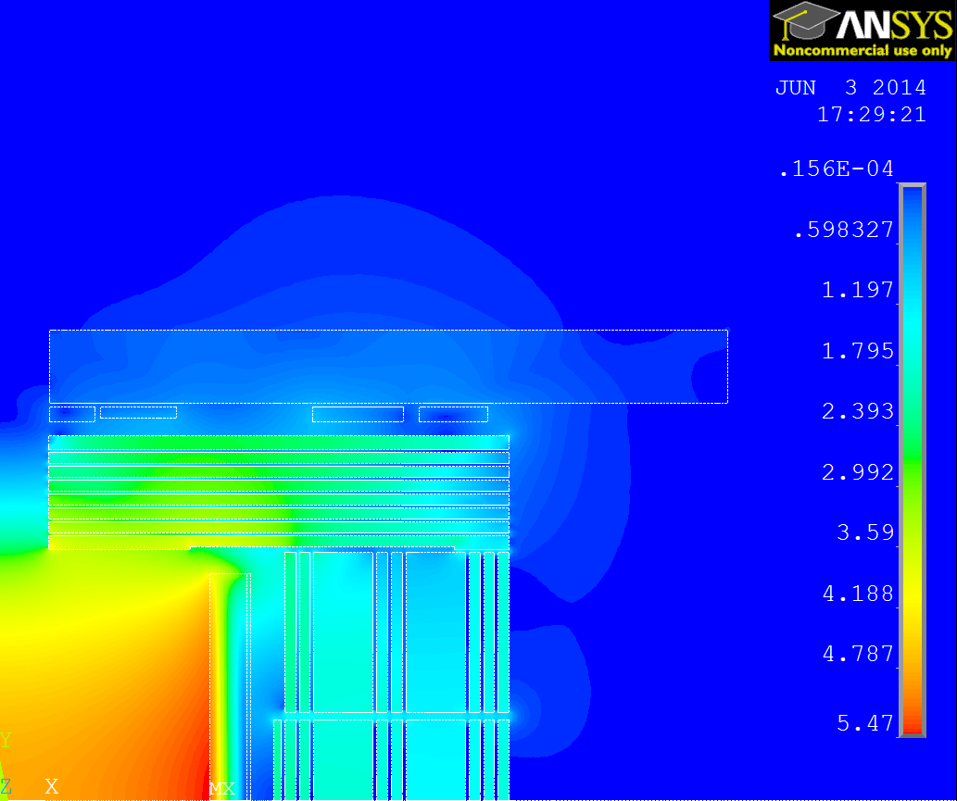
CLIC Detector optimisation – Design of solenoid field
Ring coils with L=5m: Configuration giving a lower field on Z-axis.
  Effect of iron in concrete cavern wall (B-H curve = 10% of iron),
  4 RCs with resistive conductor and Jrc=3A/mm²,
  Assumption to have the ring coils attached to the cavern wall (increased gap).
L=6.2m
L=5m + RC
B = 5.06 T at IP
B = 4.869 T at IP
Z
Z
R
R
B-field magnetic flux density vector sum maps
Field at IP is 3.8% lower wrt L=6.2m.

Slide 8
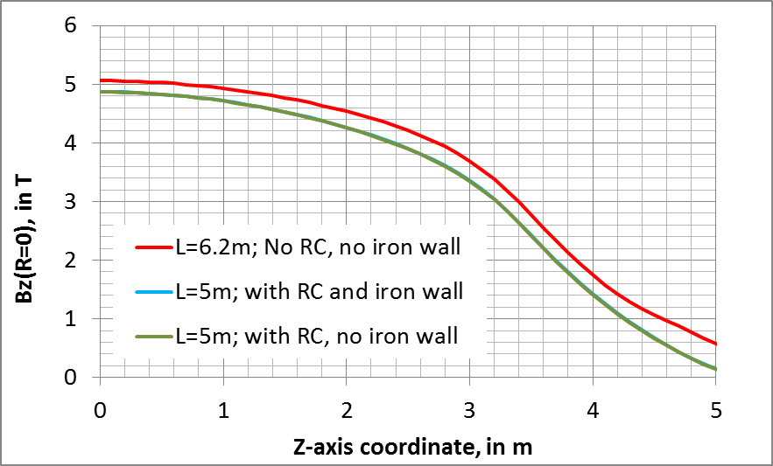
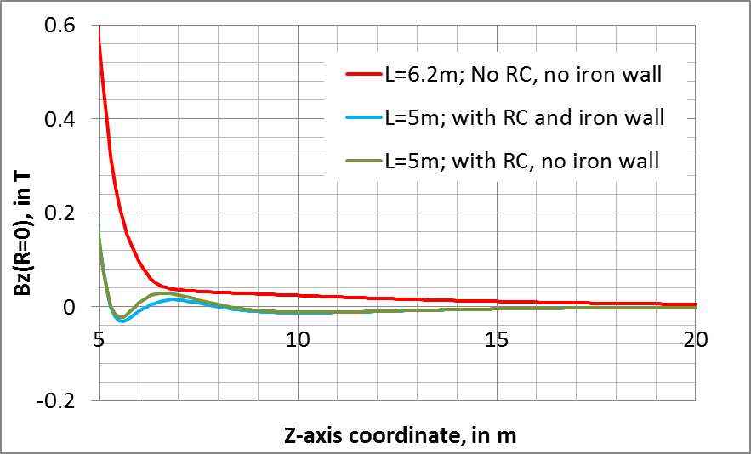
CLIC Detector optimisation – Design of solenoid field
Ring coils with L=5m:
Axial B-field component on the detector axis
B = 4.827 T at IP
B = 4.869 T at IP
0.93e-5
Bfield on detector axis at Z=5m: 150 mT
Forces on end cap and yoke:
Attractive axial force on end cap : 100 MN (170 MN with L=6.2m),
Compressive axial force on main coil : 207 MN (164 MN with L=6.2m).

Slide 9
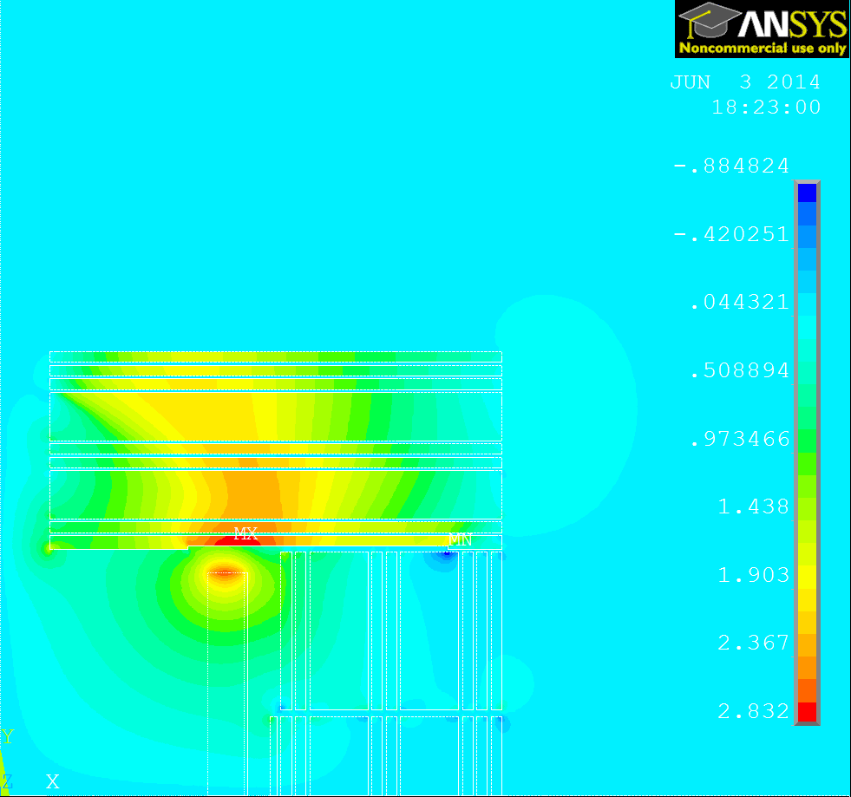
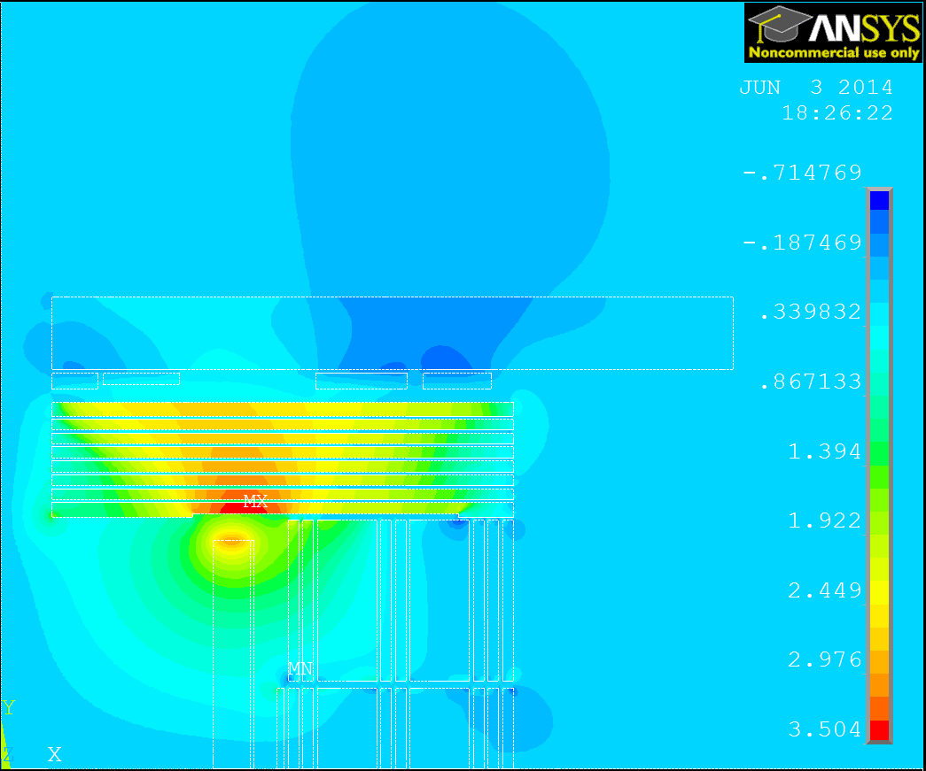
CLIC Detector optimisation – Design of solenoid field
Ring coils with L=5m:
Radial B-field component
L= 6.2m
L= 5m + ring coils
B = 4.827 T at IP

Slide 10
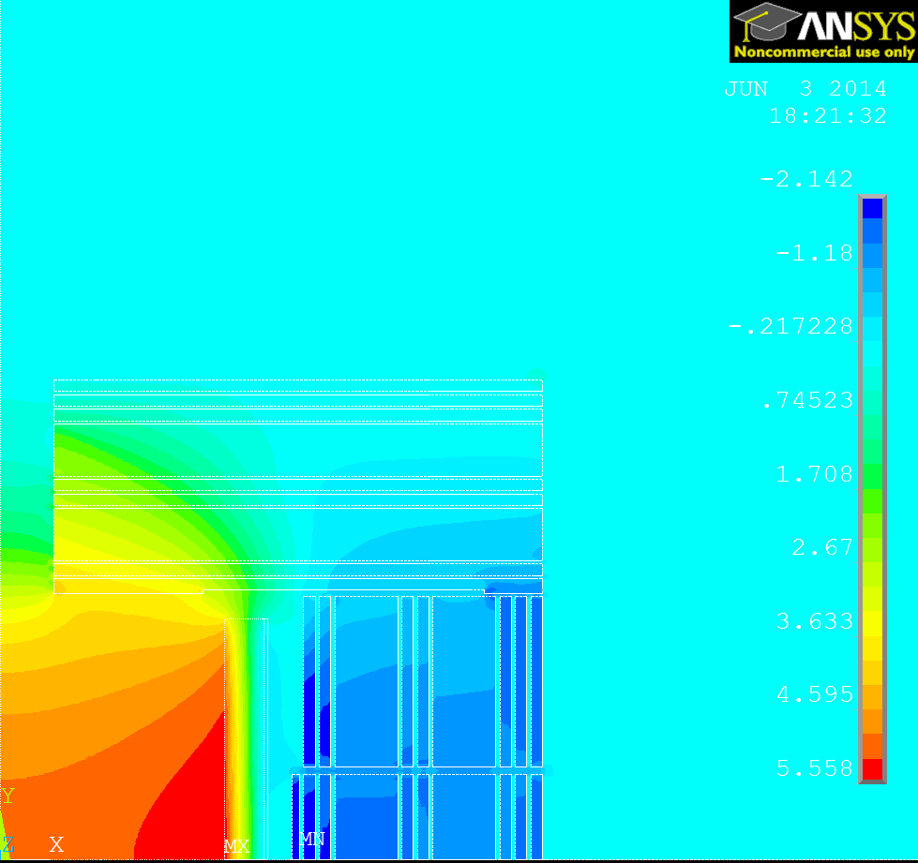
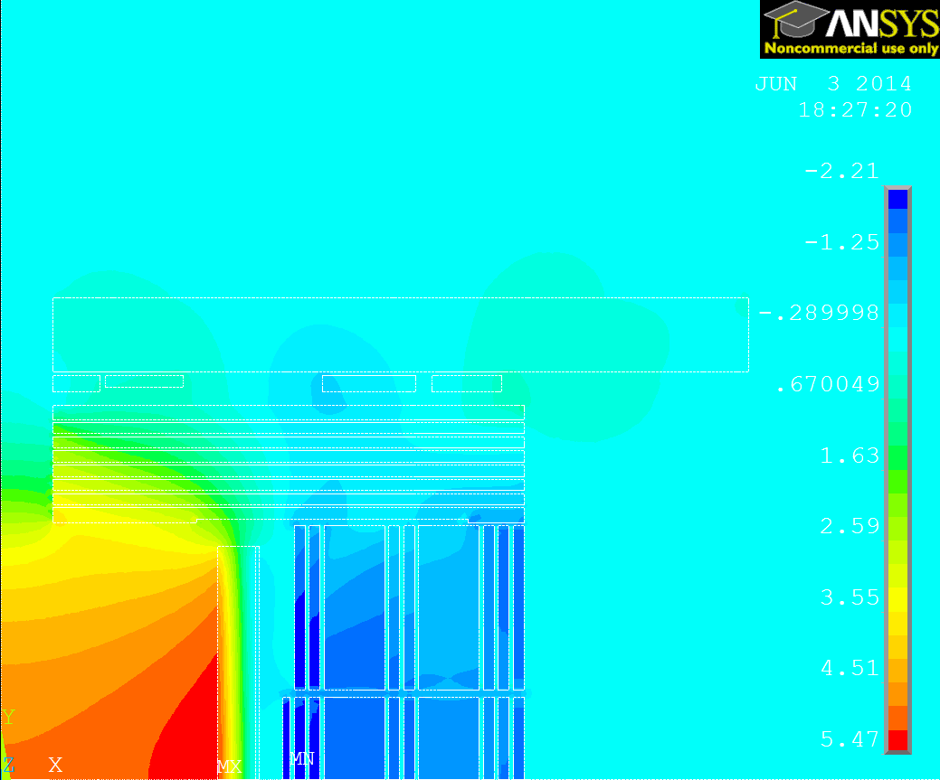
CLIC Detector optimisation – Design of solenoid field
Ring coils with L=5m:
Axial B-field component
L= 6.2m
L= 5m + ring coils
B = 4.827 T at IP

Slide 11
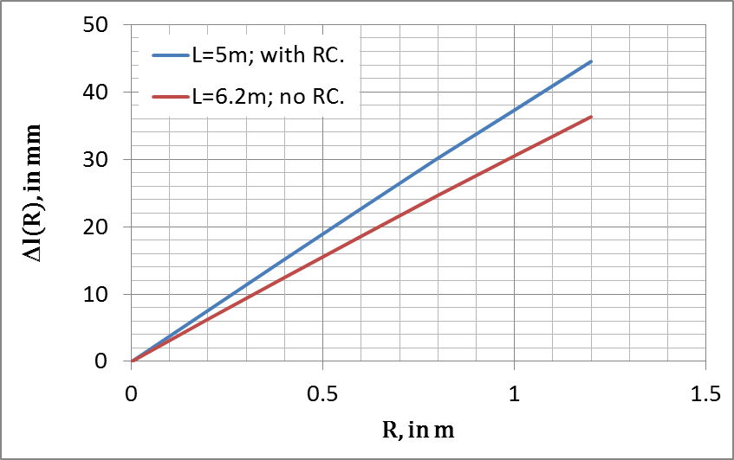

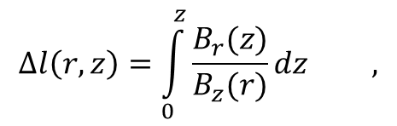
CLIC Detector optimisation – Design of solenoid field
Ring coils with L=5m:
Magnetic field distortion in barrel tracker volume :
Increase 23% wrt L=6.2m.
$$∆l\left(r,z\right)=\int_{0}^{z}{\frac{B_{r}(z)}{B_{z}(r)}dz ,}$$
$$z∈\left[0 , 1.54\right]$$

Slide 12
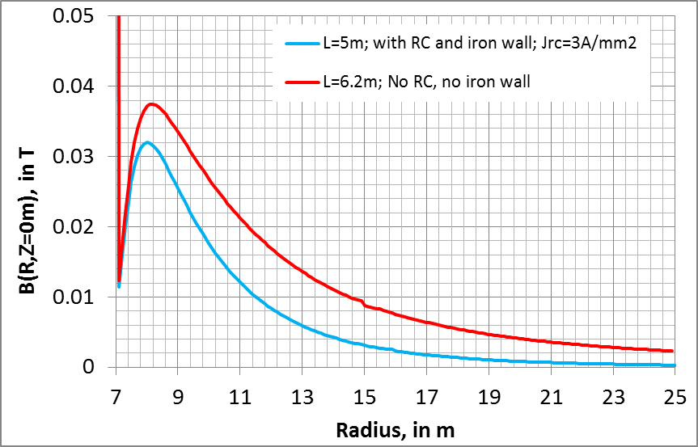
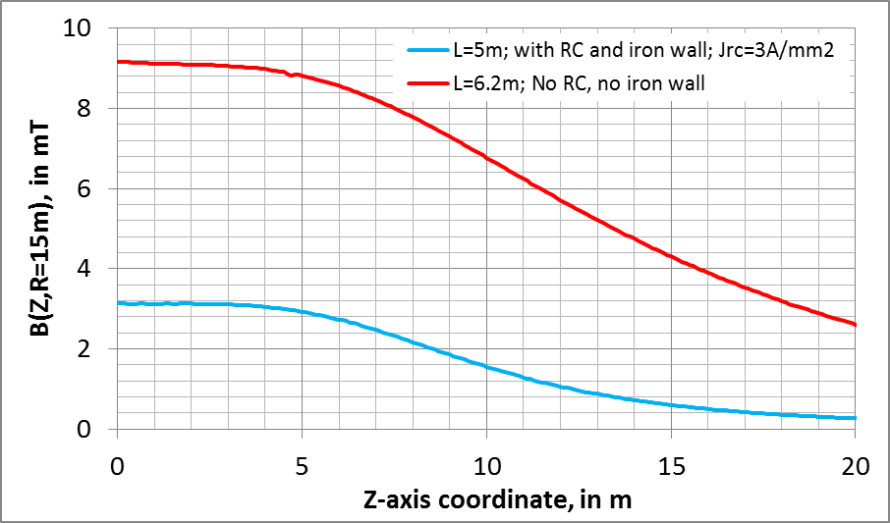
CLIC Detector optimisation – Design of solenoid field
Ring coils with L=5m:
→ Stray field lower than 3.2mT at R=15m.
B = 4.827 T at IP
B-field vector sum :
Transverse plane Z=0m
At radius R=15m , parallel to Z-axis

Slide 13
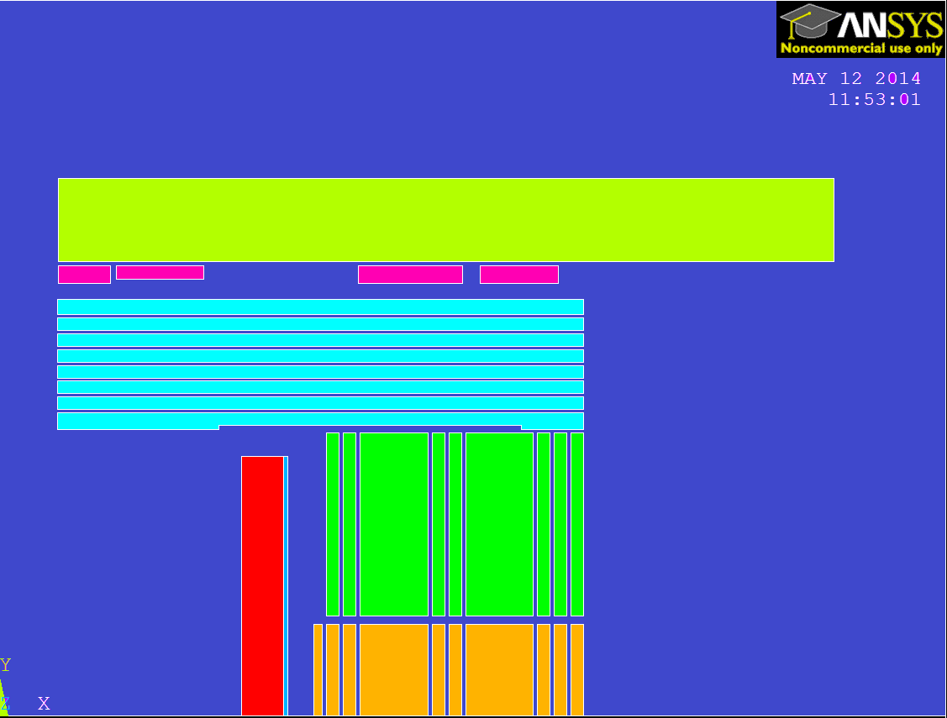
CLIC Detector optimisation – Design of solenoid field
Characteristics of the ring coils on the cavern wall with L=5m :
Arbitrary gap from RC to yoke end cap: 192mm (RC1, RC3 & RC4) and 244mm (RC2),
Space available for radiation chicane,
Same copper conductor for all RCs,
Total copper weight : 250 tons (for 2 end caps). Suppressed steel mass wrt. L=6.2m (2 end caps)≈ 2800 tons,
Total electrical power of RCs (2 end caps): 2 x 2260 kW.
Water cooling system characteristics:
Estimated temperature increase ≈ 45°C,
Total water flow (2 end caps): 2 x 57 m³/hour.
Coil | Nb. turns | Copper mass (ton) | Resistance (1e-3 ohm) | Voltage drop (V) | Power (kW)
RC1 | 4x12 | 5.6 | 2.7 | 16.5 | 101
RC2 | 3x20 | 13.3 | 6.4 | 39.1 | 240
RC3 | 4x24 | 54.4 | 26.2 | 160.4 | 984
RC4 | 4x18 | 51.7 | 24.8 | 152.2 | 934
RC1
RC2
RC3
RC4
Z
R

Slide 14
CLIC Detector optimisation – Design of solenoid field
Characteristics of the ring coils on the cavern wall with L=5m :
Parameters obtained are (coincidentally) very similar to LHCb dipole ones (*) !
 | LHCb dipole (*) | CLIC (L=5m + RC)
Conductor | 50x50mm² aluminum 99.7, ∅24mm | 50x50mm² copper, ∅24mm
Excitation | 2 x 1.3 MA.turns | 2 x 1.7 MA.turns
Total power | 4.2 MW | 4.5 MW
Stored energy | 32 MJ | 2 x 16.8 MJ
Inductance | 2 H | 2 x 0.9 H
Current density | 2.9 A/mm² | 3 A/mm²
Current in conductor | 5.8 kA | 6.1 kA
Total resistance | 125 mΩ | 2 x 60mΩ
Total water flow | 125 m³/hour | 115 m³/hour
(*) LHCb Magnet, TDR, CERN/LHCC/2000-007, 1999.

Slide 15
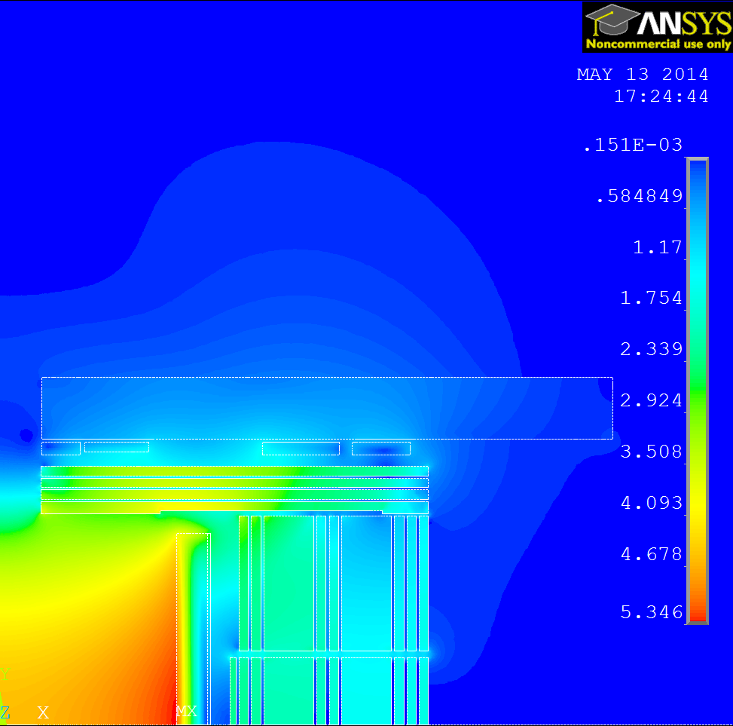
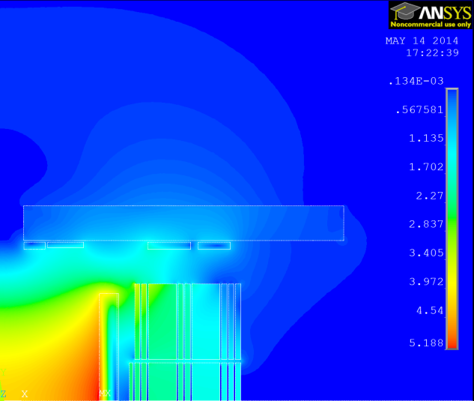
CLIC Detector optimisation – Design of solenoid field
Other cases:
1- Reducing the iron thickness to 4 disks then L=5m to 4.205m,
2- No end cap iron yoke.
As a first approach, only the current density was increased. The RCs are identical and in same positions in both models.
With resistive ring coils, the ring coil sizes would have to be increased to keep a realistic conductor and current density. SC coils would be more appropriate.
Case 1
Case 2
Jrc= 6A/mm²
0.15e-3
Jrc= 9A/mm²
0.13e-3
B = 4.608 T at IP
Axial force on coil = 260 MN
B = 4.265 T at IP
Axial force on coil = 320 MN
Z
Z
R
R

Slide 16
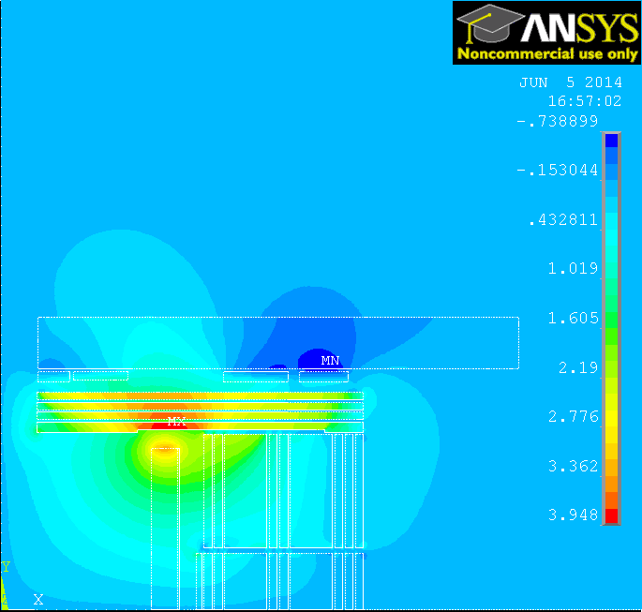
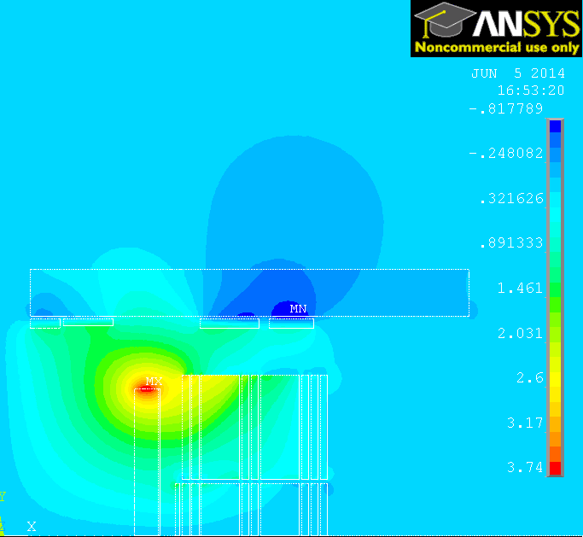
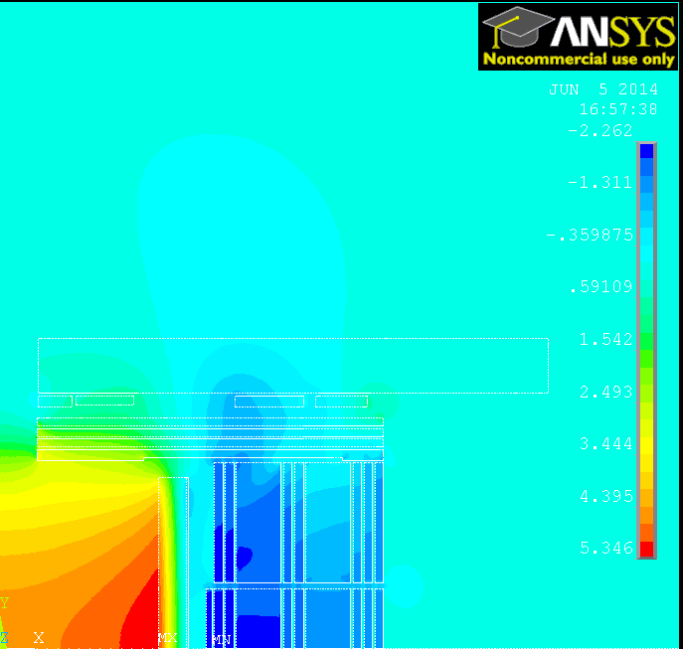
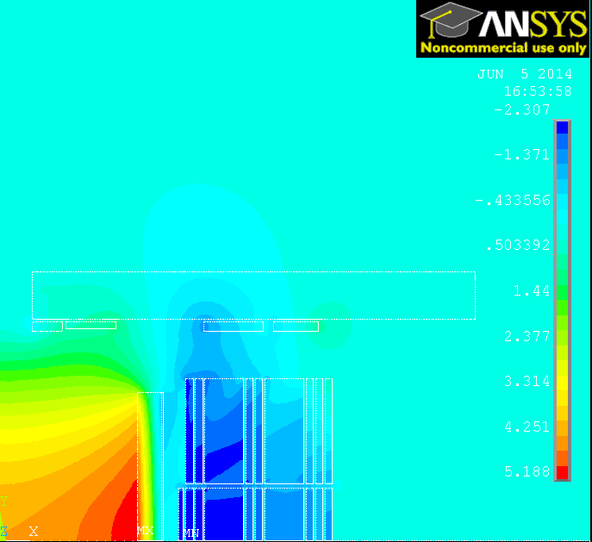
CLIC Detector optimisation – Design of solenoid field
Case 1: L=4.205m
Case 2: no end cap
0.56e-3
Br component
Z
Z
R
R
Bz component
Z
Z
R
R

Slide 17
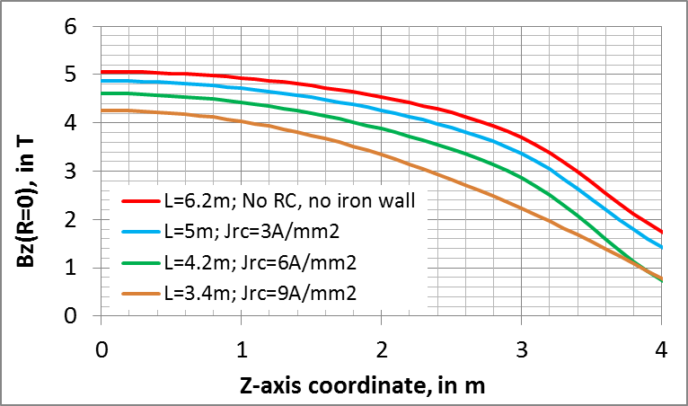
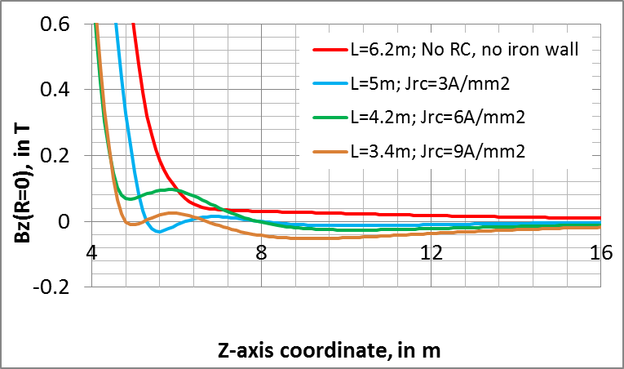
CLIC Detector optimisation – Design of solenoid field
Wrt the ring coils defined for L=5m:
Case 1- Resistive ring coils x2 in size, total power x2.
Case 2- Resistive ring coils x3 in size, total power x3.
The magnetic field at IP is reduced (resp. 8.9% and 15.7% wrt L=6.2m) and the field distortion in the inner detector volume increases.
The EC iron yoke helps to shape the field.
Axial B-field component on the detector axis

Slide 18
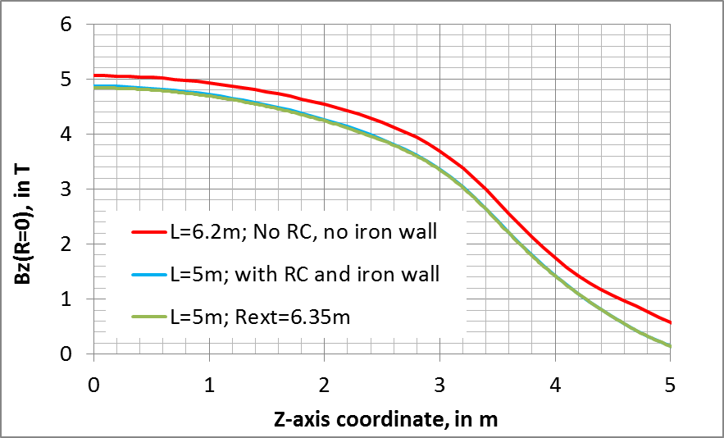
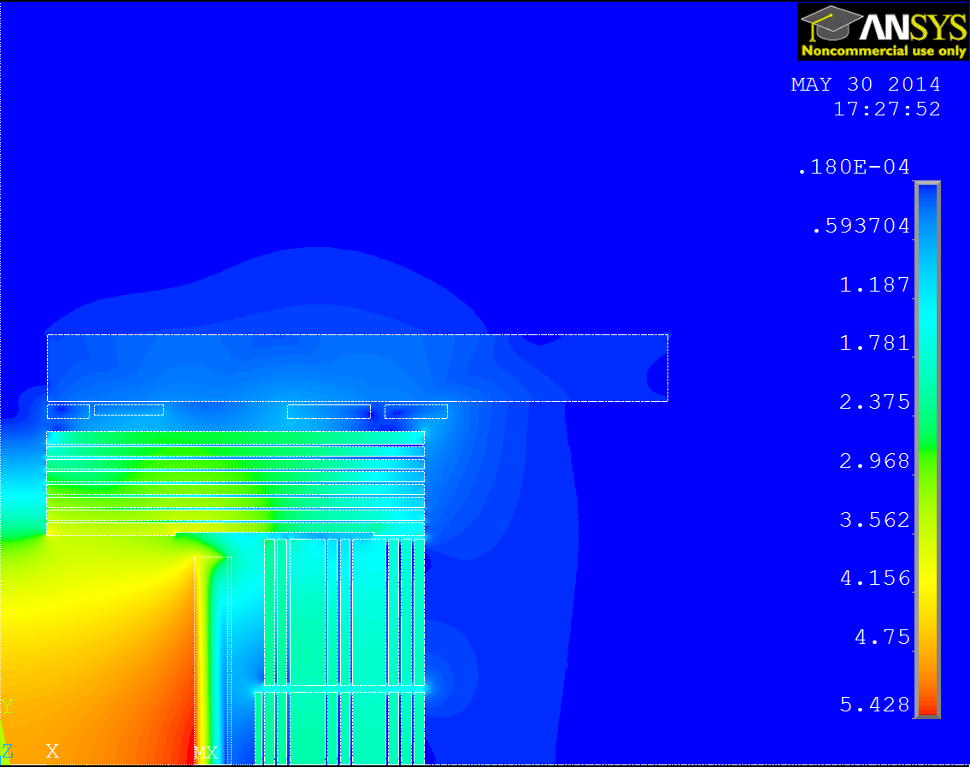
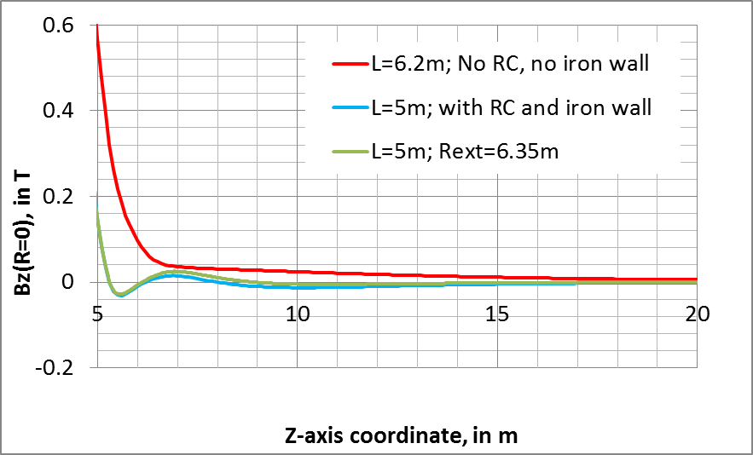
CLIC Detector optimisation – Design of solenoid field
Reduction of external diameter of both end cap and barrel yoke:
Modified parameter: External radius Rext = 6.35m.
All other parameters unchanged :
  RCs at same position, same current density,
  Detector half length L=5m.
Field at IP is 4.4% lower wrt {L=6.2m; Rext=7m}.
Axial B-field component on the detector axis
B = 4.827 T at IP
B = 4.838 T at IP
Z
R

Slide 19
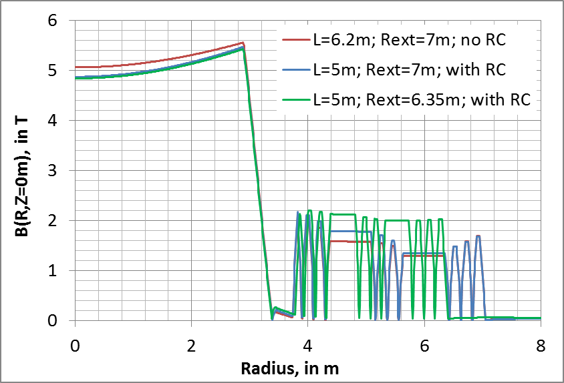
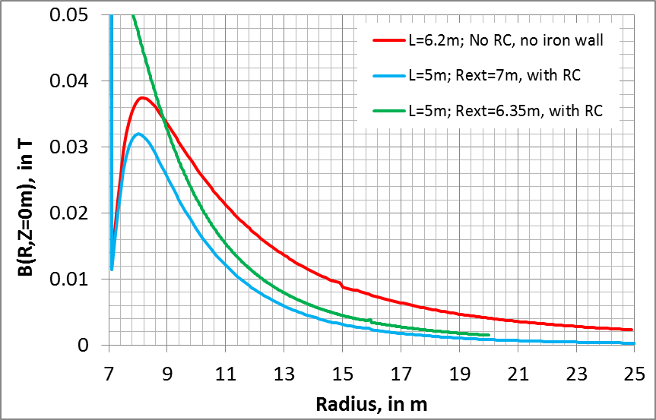

CLIC Detector optimisation – Design of solenoid field
Reduction of external diameter of both end cap and barrel yoke:
With external radius of 6.35m and L=5m + RC:
barrel yoke iron saturation is more uniform (around 2T!).
$$\int_{R_{int}}^{R_{ext}}{B_{z}.dr=4 T.m}$$
B-field vector sum in central transverse plane:
B = 4.838 T at IP
Stray field lower than 4.5mT at R=15m.
Total reduction on iron mass (reduced length + radius)≈ 4700 tons wrt CLIC_SiD L=6.2m.

Slide 20
CLIC Detector optimisation – Design of solenoid field
Conclusions:
Reduced end cap in length is feasible with ring coils, provided the field homogeneity in the central volume is acceptable for physics.
The end cap is still useful to provide support for muon stations, radiation shielding, and magnetic field shaping.
The yoke material + manufacturing budget can be considerably reduced with ring coils.
The cost estimate for manufacturing, infrastructure and operation of the ring coils should be compared to the saving on the yoke cost.
The barrel yoke could also be reduced in diameter:
the fringe field is reduced by the ring coils,
If there is only one detector in the experimental cavern (no access to cavern during beam run), then it can be compatible with radiation due to accidental beam loss.

