Slide 1
Some CLIC News
D. Schulte for the CLIC team

Slide 2
Main Activities in the Next Phase
Staged implementation plan: Rebaselining, cost, power and risk optimisation
Moving from theory to practice, industrialisation, system tests, …
X-band RF
Drive beam
Modules
Beam performance
Structures
Test stations
Industrialisation
FELs
CTF3
Drive beam frontend
Klystron development
Design verification
Design for cost reduction
Industrialisation
PACMAN
ATF2
FACET, FERMI
Damping ring tests
Simulations
Technical basis development of key components
Infrastructure and civil engineering, power consumption

Slide 3
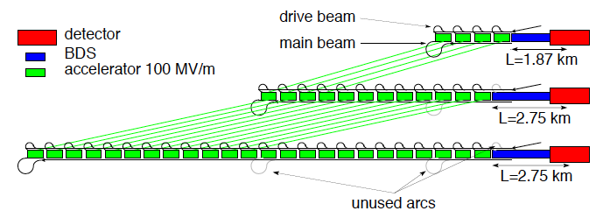
Rebaselining Conclusions
Updated RF limit model to agree with latest experimental results
  And a bit of margin
Improved beam models
Improved cost model
  E.g. includes structure length
  …
Identified cost savings
  E.g. no predamping ring
  Better understanding of DB klystron design and cost
  Less infrastructure at first energy stage
  …
Klystron-based alternative studied for first stage has similar cost
  Structures exist that are good solutions for klystrons or drive beam
Determined solutions for 3TeV
  Likes shorter structures at higher gradient
  Structures would lead to slightly more expensive first energy stage (% level)
Uncertainties
  Energy stages (LHC findings)
  Luminosity goals
  Development of technology
=> Will make flexible temporary baseline decision

Slide 4
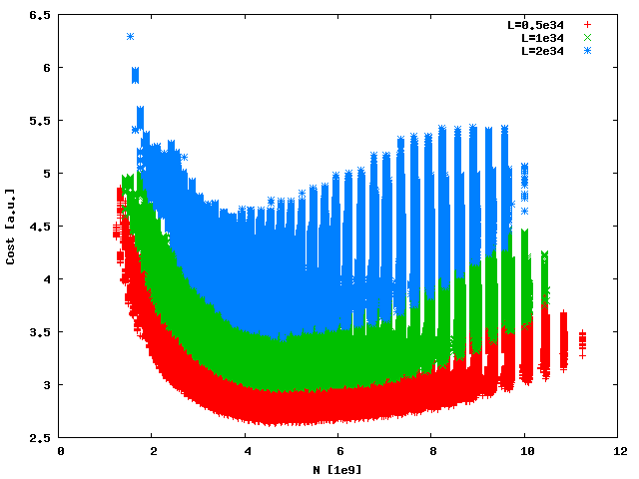
Example: 360GeV Cost vs. Bunch Charge
Automatic procedure scanning over many structures (parameter sets)
Structure design fixed by few parameters
a₁,a₂,d₁,d₂,N_{c},φ,G
Beam parameters derived automatically
Cost calculated
6.5
L=0.5x10³⁴cm⁻²s⁻¹
L=1x10³⁴cm⁻²s⁻¹
L=2x10³⁴cm⁻²s⁻¹
S=1.1
Cost [a.u.]
Luminosity goal significantly impact minimum cost
For L=1x10³⁴cm⁻²s⁻¹ to L=2x10³⁴cm⁻²s⁻¹ costs 0.5 a.u.
2.5
2.5
0
12
N [10⁹]

Slide 5
Good Structures at 350GeV
Highest gradient design (< 1% overcost)
Cheapest design
Longest structure design (< 1% overcost)
L=1x10³⁴cm⁻²s⁻¹ , S=1.1

Slide 6
Some Examples (L=1x10³⁴cm⁻²s⁻¹ , S=1.1)
 | long | High gradient | cheap
L [10³⁴cm⁻²s⁻¹] | 1 | 1 | 1
a₁/λ | 0.1575 | 0.1425 | 0.155
a₂/λ | 0.095 | 0.0975 | 0.095
D₁/L_{cell} | 0.22 | 0.253 | 0.266
D₂/L_{cell} | 0.135 | 0.178 | 0.11
N_{cell} | 42 | 26 | 36
G [MV/m] | 70 | 87.5 | 75
P [MW] | 60.1 | 55.7 | 59.7
N [10⁹] | 4.47 | 4.44 | 4.51
Δz [λ] | 6 | 6 | 6
n_{b} | 290 | 280 | 283
τ_{RF} [ns] | 231.4 | 215.9 | 217
R_{DB}/N_{DB} | 3.98/4 | 3.42/4 | 3.96/4
P_{wall} [MW] | 153 | 163 | 156
C [a.u.] | 3.042 | 3.042 | 3.013

Slide 7
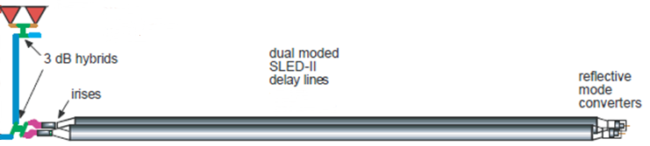
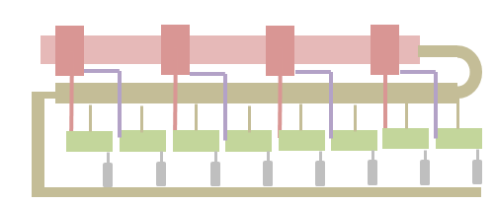
Note on Klystron-based First Stage
Preliminary RF unit design (for CLIC_G)
Would need about 30,000 klystrons for CLIC at 3TeV
-> much more expensive than drive beam
But could be interesting at low energies
-> is being explored for first stage
2-pack solid state modulator
PPM klystrons
460 kV, 2 μs flat top
59 MW
1.95 μs
118 MW
1.95 μs
x 4.64
~17.7 m, ∅16.3 cm
TE01 transfer line (? m)
TE01 90⁰ bend
Inline RF distribution network
492 MW
244 ns
Common vacuum network
x 8 accelerating structures,
100 MV/m loaded gradient
2 m, 1.83 active
Have developed improved cost model for klystron based design

Slide 8
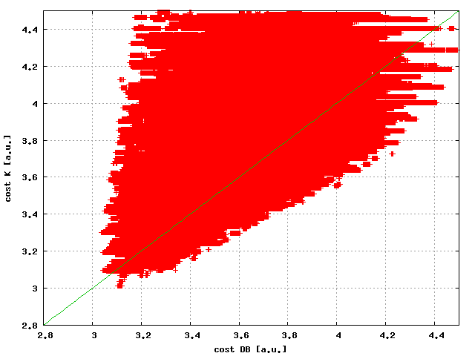
Cost at L=1x10³⁴cm⁻²s⁻¹
4.4
Cost Klystron [a.u.]
2.8
2.8
4.4
Cost with drive beam [a.u.]
Solutions that are good for klystrons and drive beam
Little cost overhead if carefully chosen

Slide 9
Optimisation at 3 TeV
First attempt is to use 100MV/m
  To stay consistent with the developed site
The 3Tev cost is dominated by the linac not the drive beam
  All designs at 100MV/m have similar cost (within O(10%)
  Lower gradient is more expensive, higher would be cheaper
  But not much space to increase gradient
Power consumption is a concern
  Explore this first

Slide 10
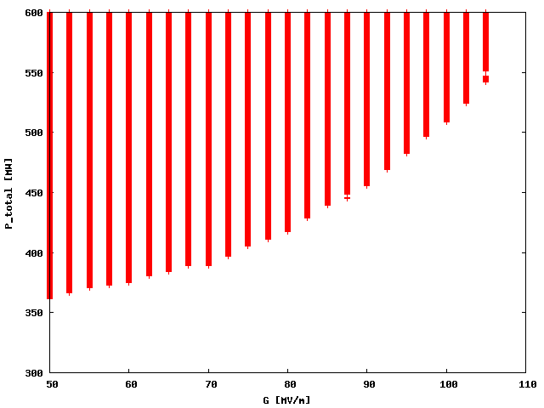
Power Consumption at 3TeV
600
No surprise:
Lower gradients are more efficient
Could save O(100-150MW)
But would increase cost and site length drastically
Total power [MW]
300
50
120
G [MV/m]

Slide 11
Upgrade Options
Use the same structure at 3TeV as at 360GeV, with same gradient and pulse length
Use the same structure at 3TeV as at 360GeV, with different gradient/different pulse length
Replace the 360GeV structures
  But unlikely that we can keep the pulse length the same
  Also will need to change drive beam energy/power
Add different structures to the existing linac
  360GeV structure has to be consistent with new beam pulse
    Enough bunches
    High enough charge per bunch

Slide 12
A: Same Structure, Same Pulse
For 3TeV we need 100MV/m on our site
No solution for 360GeV and L>=10³⁴ cm⁻²s⁻¹
Allow for a lower gradient (longer site or lower energy, higher cost per GeV)
Or allow for a reduced luminosity target at 360GeV (O(L=0.5x10³⁴ cm⁻²s⁻¹))
Makes structure short
Also requires that we already know which structure to take
And requires constant S
=> No room for improvement
=> Not a very good option

Slide 13
B: Use Same Structure, Change Gradient
Upgrade with the same structure and change the gradient everywhere
Need to increase power into the main linac accelerating structure
  Increase drive beam current
    Change drive beam accelerating structure or klystron
  Or change PETSs
    Costly
Need to shorten the pulse length
  Need to add turn-arounds in existing tunnel
    Or foresee them from the beginning
    Tricky to add return arcs to a filled tunnel
  Need to change combiner ring and delay loop circumference
    Mainly a problem of the building, could probably reuse components if foreseen from the beginning
Need to adjust the drive beam energy to match the higher current and the reduced pulse length
      Relatively straightforward

Slide 14
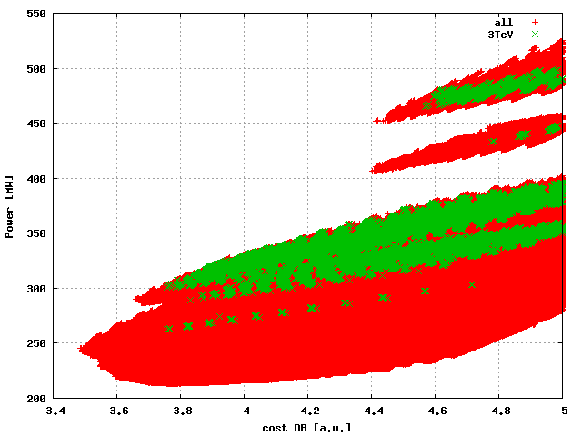
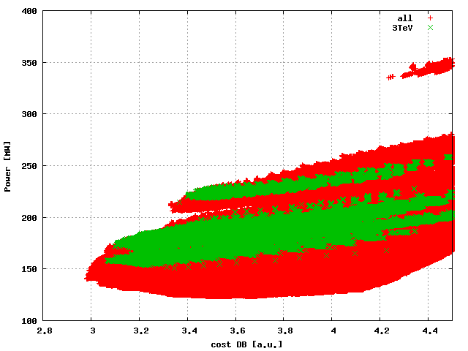
B: Cost and Power Consumption
550
Calculate cost and power consumption at 360 GeV for designs with structure that is suitable for 3TeV
Power [MW]
400
200
3.4
5.0
Cost DB [a.u.]
Power [MW]
Slight increase in cost
Significant increase in power consumption
100
2.8
4.4
Cost DB [a.u.]

Slide 15
C: Replace Old Modules During the Upgrade
Very simple concept
RF pulse length could change
  Need to additional turn-around loops
  The same issue as in scenario B
  Or find pairs of structures with the same pulse length
Drive beam current can potentially stay the same at all energy stages
  Do not need to change drive beam klystrons or structures
Drive beam energy likely will change
  Could be handled by changing the number of RF units in drive beam accelerator
Cost of replacing modules is high

Slide 16
D: Use Different Structures for New Part
Use the old and new structures together
  Run old structure at least at previous gradient
  May be able to reduce pulse length and increase gradient somewhat
Constraints for structure
  The number of bunches at 3TeV must be smaller than at 360GeV
  The charge per bunch must also be smaller
Need to harmonise power production for both structures
Run the old structure at the old gradient and pulse-length
  Requires additional
  Or reduce pulse length and increase gradient
Two different pulse lengths requires two drive beam combination complexes
  Could even have two drive beam linacs
    Allows for different currents

Slide 17
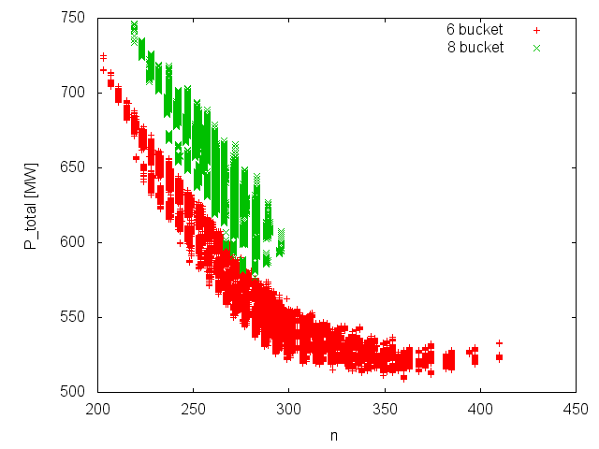
Power as Function of Bunches per Pulse
Low power consumption at 3TeV means 300+ bunches
Can determine bunch charge similarly

Slide 18
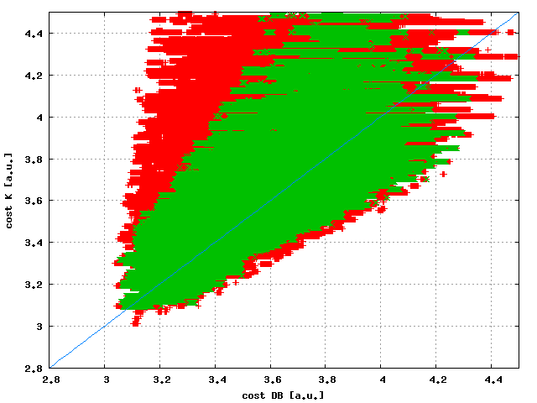
Cost at L=1x10³⁴cm⁻²s⁻¹
Require:
n @ 360GeV > 300
N @ 360GeV > 4e9
4.4
Cost Klystron [a.u.]
2.8
2.8
4.4
=> Many of the good solutions remain valid
Cost with drive beam [a.u.]

Slide 19
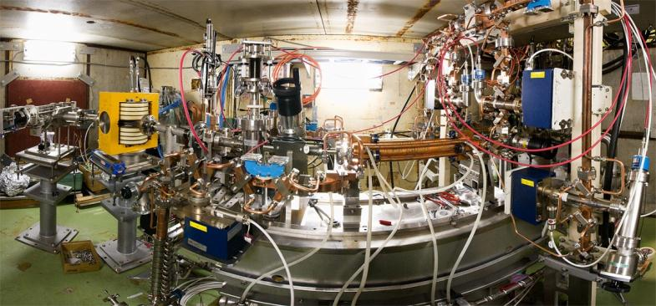
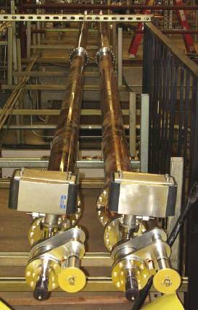
Structure Test Infrastructure (X-boxes)
Previous (at 11.4GHz):
NEXTEF at KEK, ASTA at SLAC
X-box 1 ready again (with new CPI klystron), 1 slot in CTF3
X-box 2 soon (July) to be ready using old SLAC klystron, 2 slots
X-box 3 planned for 2016, 4 slots

Slide 20
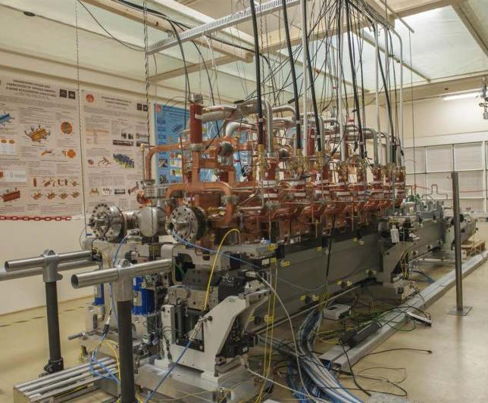
Module Verification
Tests in laboratory (3 modules)
  Integration
  Temperature variations and mechanics
  …
Tests in CTF3 (1 module)
Transport test
First module is under test
  data under evaluation
For second and third module many components have been received
Tunnel environment modeled in experimental hall

Slide 21
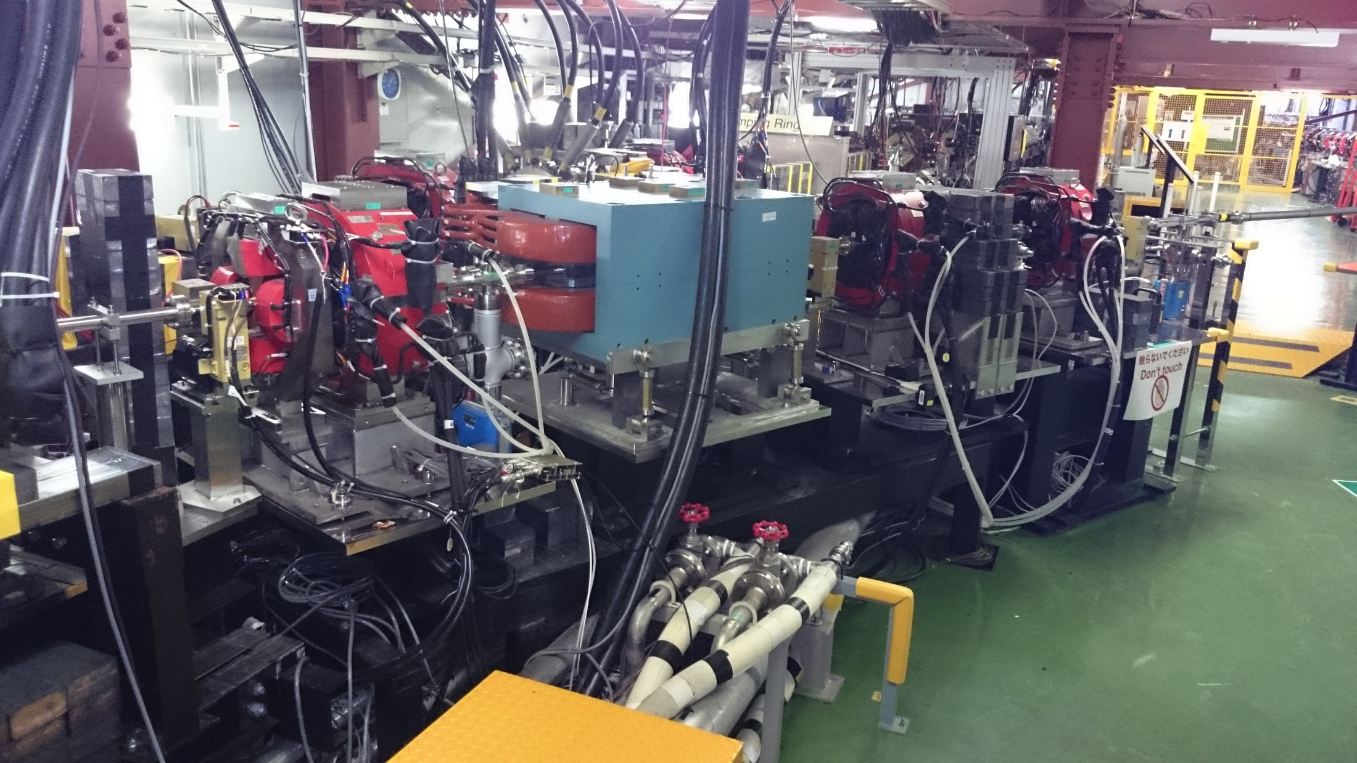
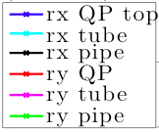
Orbit Jitter Reduction at ATF2 After Detecting Excitation Sources
J. Pfingstner et al.
Cooling water pipes
Vibrating tube
Beam jitter
Strong excitation of quadrupole motion was detected via motion sensors.
An inspection showed that water cooling pipes and tubes were touching the girder.
After removing the excitation, orbit jitter was reduced from 20% to 14% (half the power).
Similar excitation detected further upstream. Further reduction is expected!

Slide 22
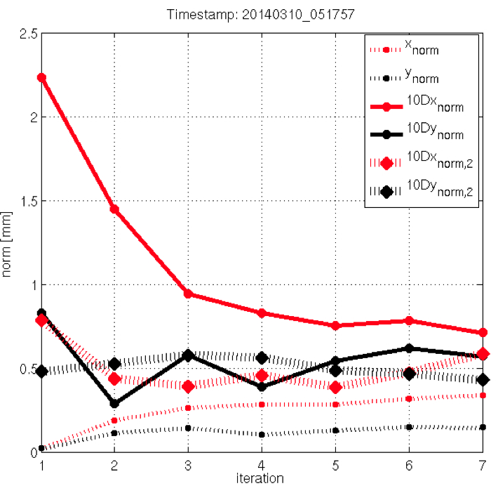
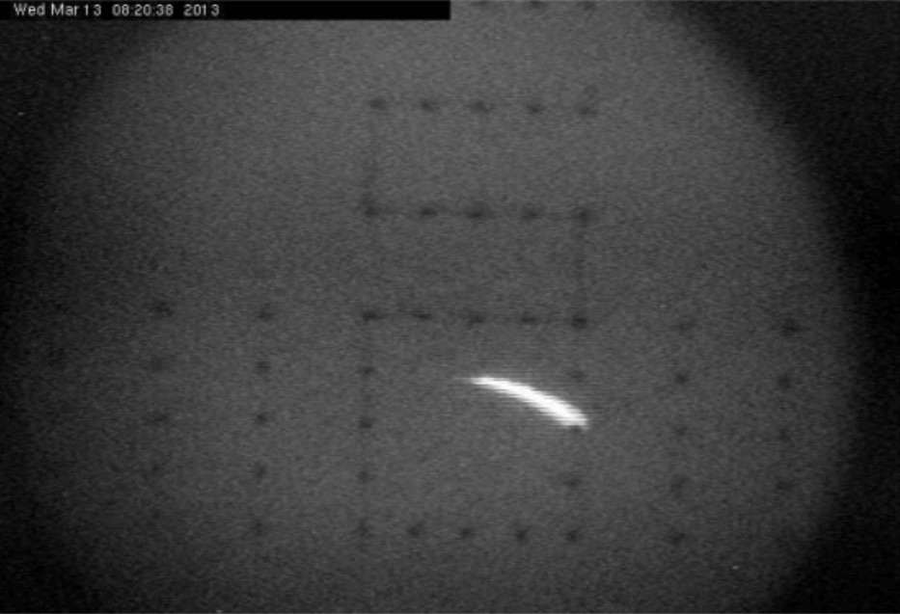
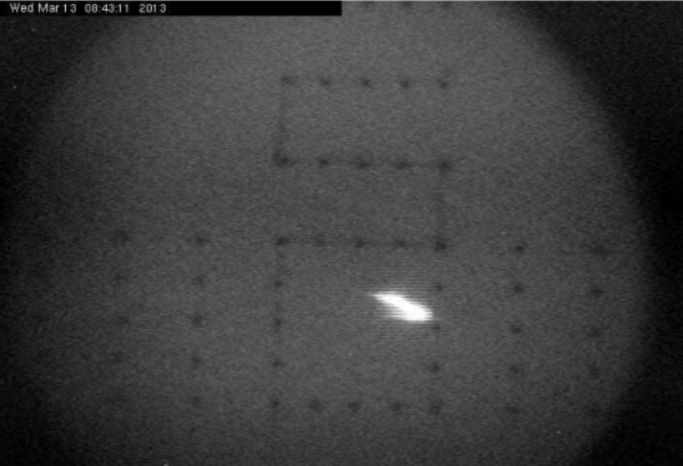
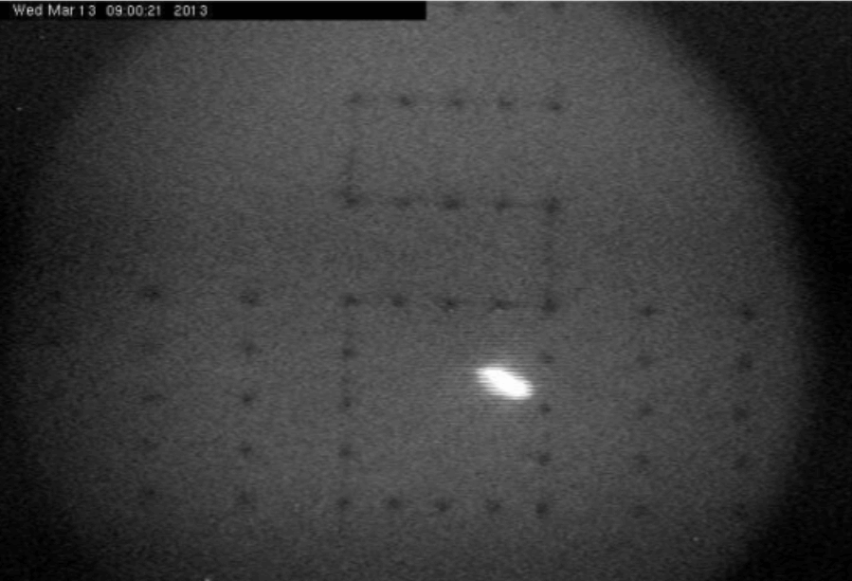
Beam-based Steering Tests at FACET
(1) Sectors 02-04, first 200 meters of SLAC linac
(3) First tests of simultaneous
Orbit + Dispersion + Wakefield correction
in sectors S05-11, 700 meters of SLAC linac
Emittance before correction (S04)
X = 2.79 x 10⁻⁵ m
Y = 0.54 x 10⁻⁵ m
After:
X = 3.38 x 10⁻⁵ m
Y = 0.14 x 10⁻⁵ m
Vertical emittance got reduced by a factor ~3.8.
Considerable incoming jitter on the H-axis jeopardized the X-axis
E. Adli, A.Latina, J.Pfingstner, D. Schulte
Convergence plot
(2) Vertical emittance vs. weight scan:
It matches the expected behavior
measured data
Vertical emittance got reduced from
from 1.58 x 10⁻⁵ m
to 0.40 x 10⁻⁵ m
(factor ~4)
Very bad at very large weights
To be redone to find optimum
Beam transverse profile per iteration step (DFS correction)

Slide 23
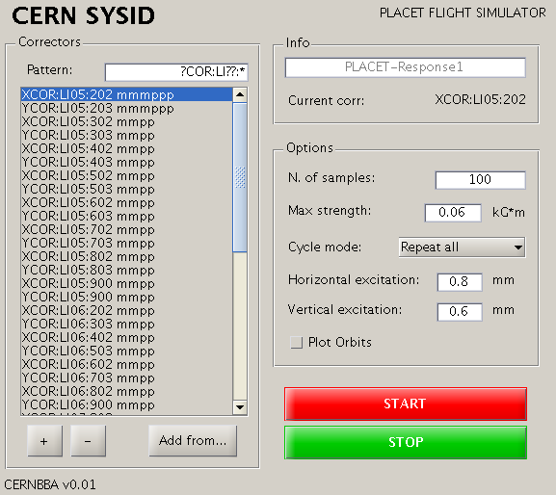
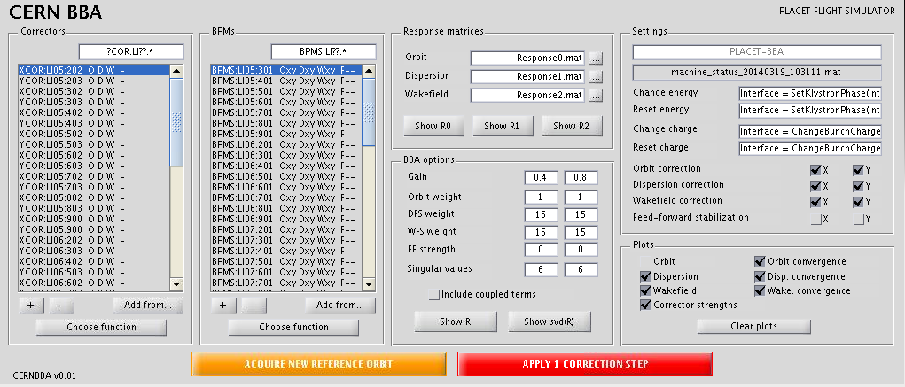
Steering Tools and Further Tests
E. Adli, A.Latina, J.Pfingstner, D. Schulte, D. Pellegrini
Set of robust automatic “CERN-BBA” tools developed
Tests performed at FACET and Fermi (Elettra)
Others might come (ATF2, FACET2?, FELs, …)
(top) System Identification (bottom) Beam-Based Alignment

Slide 24
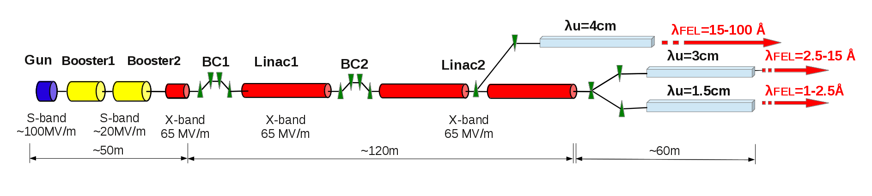
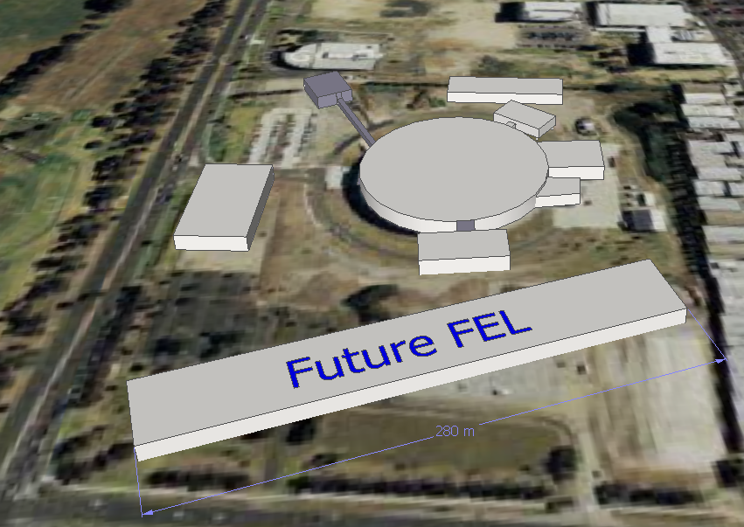
Outreach and FEL
Example: M.Boland
X-band technology appears interesting for compact, relatively low cost FELs
  Logical step after S-band and C-band
  Example similar to SwissFEL: E=6 GeV, Ne=0.25 nC, σ_{z}=8μm
Use of X-band in other projects will support industrialisation
  They will be klystron-based, additional synergy with klystron-based first energy stage
Great potential for collaboration

Slide 25
Collaboration
Started to collaborate on use of X-band in FELs
  Australian Light Source
  Turkish Accelerator Centre
  Elettra
  SINAP
  Cockcroft Institute
  TU Athens
  U. Oslo
  Uppsala University
  CERN
Share common work between projects
  Cost model and optimisation
  Beam dynamics, e.g. beam-based alignment
  Accelerator systems, e.g. alignment, instrumentation…
Define common standard solutions
  Common RF component design, -> industry standard
  High repetition rate klystrons (500Hz soon to be ordered for CLIC)
EU Design Study proposal in preparation

Slide 26
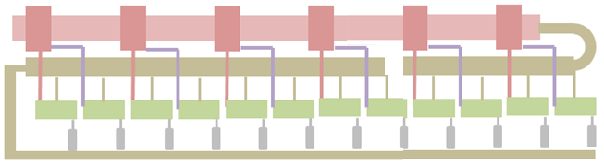
Electron linac RF unit layout based on the existing (industrialized) RF sources (klystron and modulator)
2x ScandiNova solid state modulators
2x CPI klystrons
410 kV, 1.6 μs flat top
50 MW
1.5 μs
(Operated
@45MW)
I. Syratchev,
modified by me
X 5.2
90 MW
1.5 μs
TE01 transfer line (η_{RF}=0.9)
~11 m, ∅16.3 cm
TE01 90⁰ bend
Inline RF distribution network
Common vacuum network
Preliminary
418 MW
150 ns
x 10 accelerating structures
@65MV/m
41.8MW input power
10 m, 7.5 active
This unit should provide ~488 MeV acceleration
Need 12 RF units.
Cost 51.7 a.u., 4% more than optimum

Slide 27
Examples for Basic Parameters
Preliminary
 | unit | CLIC_502 |  | Opt. | Swiss
Structures per RF unit |  | 12 | 16 | 10 | 4
Klystrons per RF unit |  | 2 | 2 | 2 | 1
Structure length | m | 0.23 | 0.23 | 0.75 | 1.98
a/lambda |  | 0.145 | 0.145 | 0.125
Allowed gradient | MV/m | 100 |  | 80+
Operating gradient | MV/m | 77 | 67.5 | 65 | 27.5
Energy gain per RF unit | MV | 213 | 248 | 488 | 203
RF units needed |  | 27 | 23 | 12 | 26
Total klystrons |  | 54 | 46 | 24 | 26
Linac active length | m | 74 | 85 | 88 | 206
Cost estimate | a.u. | 76.2 | 71.5 | 51.7

Slide 28
FCC Impact
EU strategy wants Europe to be able to propose ambitious post-LHC project at CERN in 2018; two options:
  CLIC, a high energy lepton collider
  FCC, high energy hadron collider with a potential ee intermediate stage and an eh option
Activity on FCC is starting
  International collaboration is forming
  Aim is CDR in 2018
Obviously resources are required for FCC
  However little impact on CLIC overall resources
  Required expertise is often different
    FCC-hh most critical items are the magnets, for CLIC the RF
  Some areas need similar expertise
    E.g. beam physics
  Need to balance contributions to both projects
  But can also exploit synergies
    E.g. FCC-hh synchrotron radiation is similar to lepton damping ring
    Civil engineering and infrastructure
Impact on CERN LC activities currently limited, positive new focus on future machines

Slide 29
Conclusion
CLIC is progressing well
Rebaselining tools are ready
  But can fix staging scenario only with LHC input
  Explore options and define some scenarios
Structure test capacity is increasing significantly
Beam-based alignment tests are promising
FEL collaboration opens the gate to industrialisation
Impact of FCC activity on resources is limited, positive new focus on future machines

Slide 30
Reserve

Slide 31
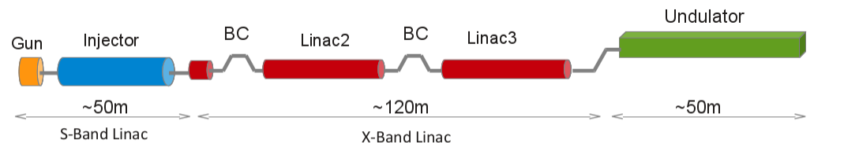
Example: Longitudinal Dynamics
A. Latina
E [MeV]
E [MeV]
E [GeV]
Example structure: a/λ=0.14 and G=67.5MV/m
σ_{z} = 7.96 μm, σ_{E} = 0.0071%, σ_{E,slice} = 0.0027%
(Swiss FEL: σ_{z}=7μm, σ_{E,slice} = 0.006%)
Looks promising but detailed studies needed
realistic figure of merit for final beam distribution
radiation in compressors
operational margins
…

Slide 32
Transverse Dynamics
(Strong) CLIC lattice and simplified wakefield
Stability of beam with initial jitter
requires to stay above red line
Emittance growth with 100um tolerances:
We need dispersion free steering or
CLIC-style alignment for FEL

Slide 33
Example Structure Choice
Preliminary
a₁/λ=0.15, a₂/λ=0.1
d₁/λ=0.9mm, d₂/λ=1.7mm
L=0.75m, G=65MV/m
P_{in}=41.8MW, τ=149.6ns
11 RF units
11 structure per unit?
Cost=49.7 a.u.
This structure has happened to be the cheapest
Should we use it as a GUINEA-PIG to set up the simulations?

Slide 34
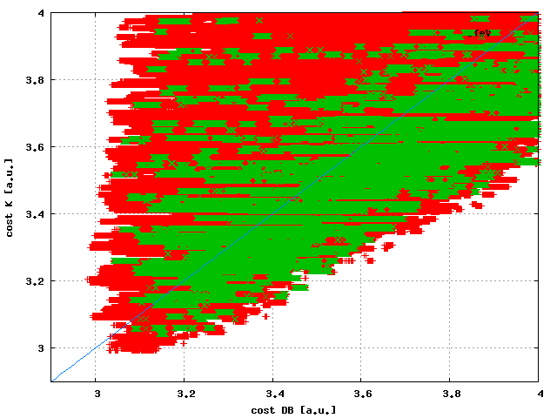
Scenario B: Cost at 360GeV
4.0
Significant reduction of choices
Some cost increase @ 360 GeV
Need to evaluate cost increase for overall project
Maybe we can find clever combinations
Cost Klystron [a.u.]
2.9
2.9
4.0
Cost with drive beam [a.u.]

Slide 35
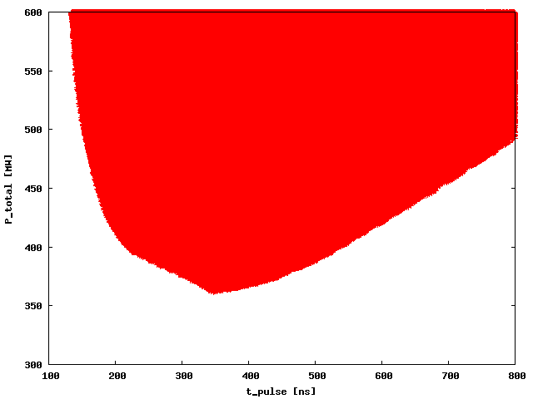
Power Consumption at 3TeV
600
All gradients between 50 and 110MV/m considered
Power could be below 400MW
Ideal pulse length is around 350ns
Total power [MW]
300
100
800
Pulse length [ns]

Slide 36
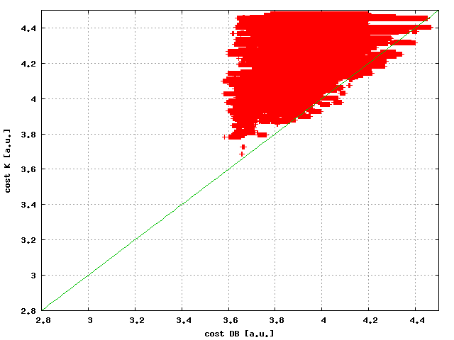
Cost at L=2x10³⁴cm⁻²s⁻¹
4.4
Cost Klystron [a.u.]
2.8
2.8
4.4
Cost with drive beam [a.u.]
Solutions that are good for klystrons and drive beam
Little cost overhead if carefully chosen
Cost increase 0.5-0.6 a.u., klystrons a bit higher than drive beam

Slide 37
Stabilisation Experiment
A. Jeremie, K. Artoos, R. Tomas et al.

