Slide 1


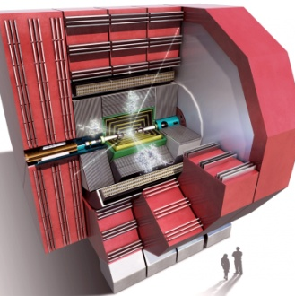
Status of the Validation of the CLIC_SID_CDR Tracker Geometry in DD4hep
N. Nikiforou
CERN/PH-LCD
CLICdp Collaboration Meeting
CERN, June 10th, 2014

Slide 2
Introduction
We have been working on validating the geometry description of the CLIC_SID_CDR detector model with DD4hep
Use DD4hep/examples/CLICSiD
Study limited on the tracker for now (also decreases the complexity of the validation problem)
Performing various checks against the geometry provided by the existing GeomConverter chain
compact.xml (for CLIC_SID_CDR)
DD4hep
(C++ Core and Driver Libraries)
LCDD file, GDML file, …
SLIC
(Geant4)
GDML file, HepRepXML file, SLCIO file (hits)
Using Trunk
?
compact.xml (for CLIC_SID_CDR)
GeomConverter
(Java Core and Driver Libraries)
LCDD file, GDML file, …
SLIC
(Geant4)
GDML file, HepRepXML file, SLCIO file (hits)
Basic checks Performed to check code correspondence

Slide 3
Checks on compact.xml
Compact.xml for DD4hep based on definition for GeomConverter -> Both very similar
Verified by visual inspection/ diff
Not backward compatible. Changes in DD4hep compact file:
  Changes in segmentation definitions
  Require/assume explicit use of units
  Require explicit use of reflect=“true” if detector reflection about z=0 plane is required (was assumed by default true in GeomConverter chain)
A few instances of discrepancies wrt the above were discovered and corrected (to be propagated to the DD4hep/examples/CLICSiD driver)

Slide 4
Checks on Driver Code
DD4hep driver code was based on/influenced by the GeomConverter java driver code
Performed basic visual inspection/comparison of classes
Verified/checked cases where rotations/placements were ambiguous
In DD4hep: moving towards using “assemblies” instead of “envelope volumes” of “vacuum” (aka very dilute air or H)
  Envelope volumes can create overlaps and confuse Geant4
  Need to use latest revision of Slic:
    GDML_version = "v03-00-02“ , LCDD_version = "v03-02-00“, SLIC_version = "v03-01-03"
  Initially not able to see hits from muons in Slic. Cause tracked down to use of envelope volumes
Changes to be propagated to the example driver code

Slide 5
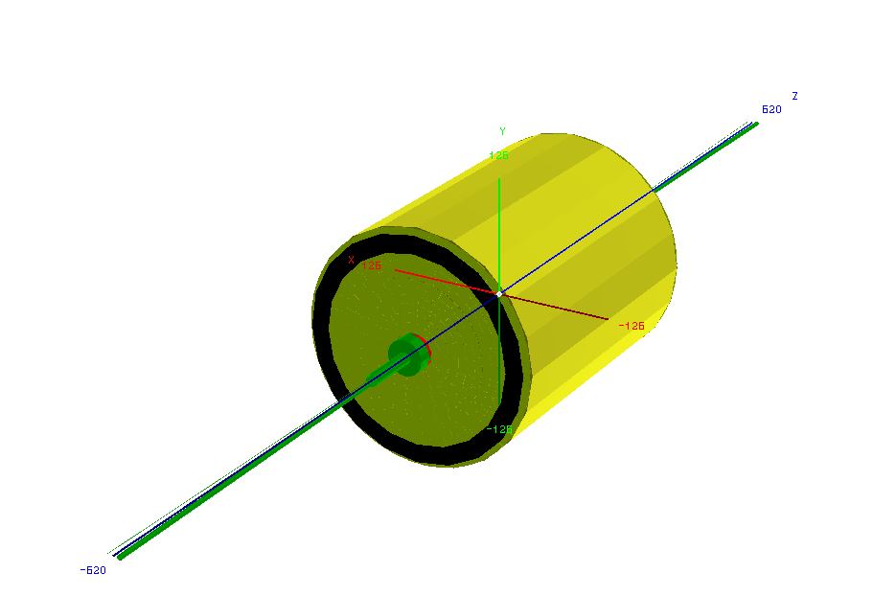
CLIC_SID_CDR Tracker with the DD4hep geoDisplay
Removed coil, calorimeters and muon system

Slide 6
Comparison of Geometry Visualizations
Used Slic as a common processor to produce visualizations of the detector using the two different chains
  Dumped HepRepXML files to be viewed with JAS/Wired
  Dumper GDML files for viewing with ROOT (, …)
  Inspection of model in G4 OpenGL viewer
Files are several tens of thousands of lines long
  Diff comparison/inspection infeasible/inefficient
    Still was useful to track down specific discrepancies
Employed visual inspection/overlay (especially wireframe)
  Allowed to track down cases of misalignment or discrepancies in orientation
The next few slides show and compare global tracker views
  During the inspection we looked and compared individual subdetectors and modules as well

Slide 7
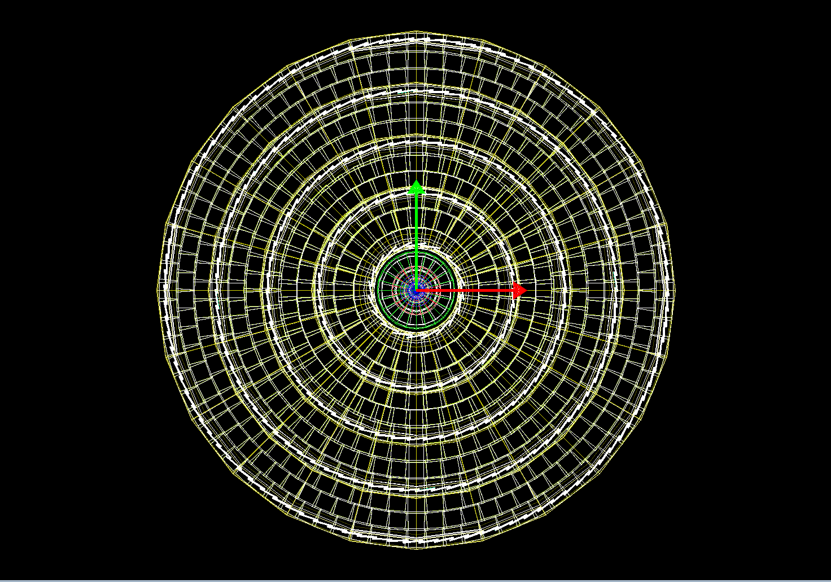
Compact.xml->DD4hep->slic->HepRepXML
Visualized using JAS/Wired

Slide 8
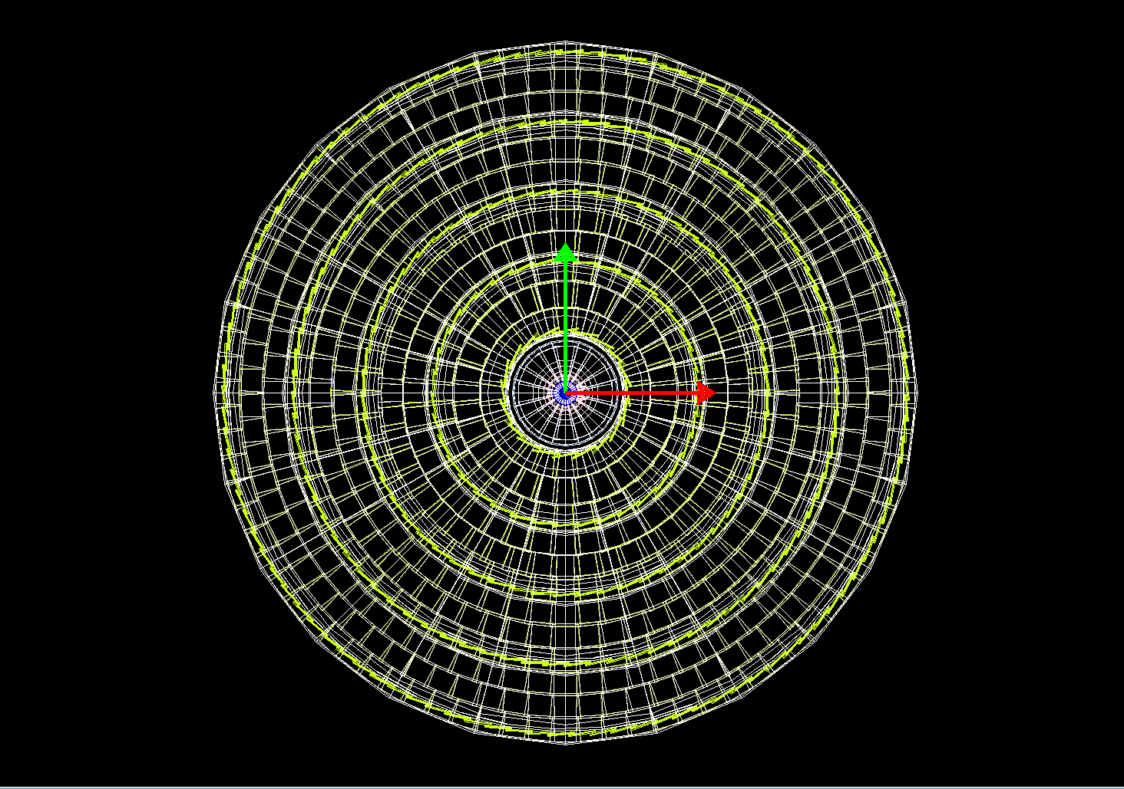
Compact.xml->GeomConverter->slic->HepRepXML
Visualized using JAS/Wired

Slide 9
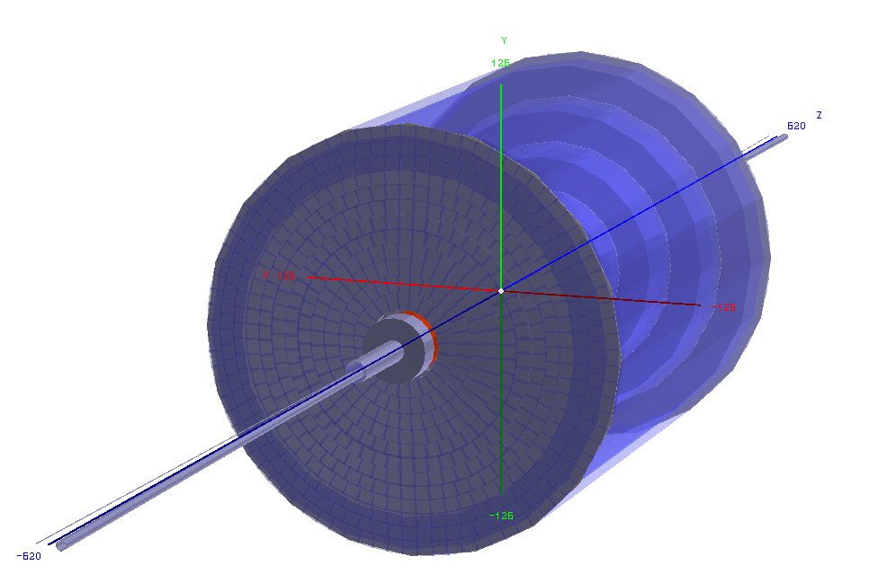
Compact.xml->DD4hep->slic->GDML
GDML Visualized using ROOT’s Geometry Manager

Slide 10
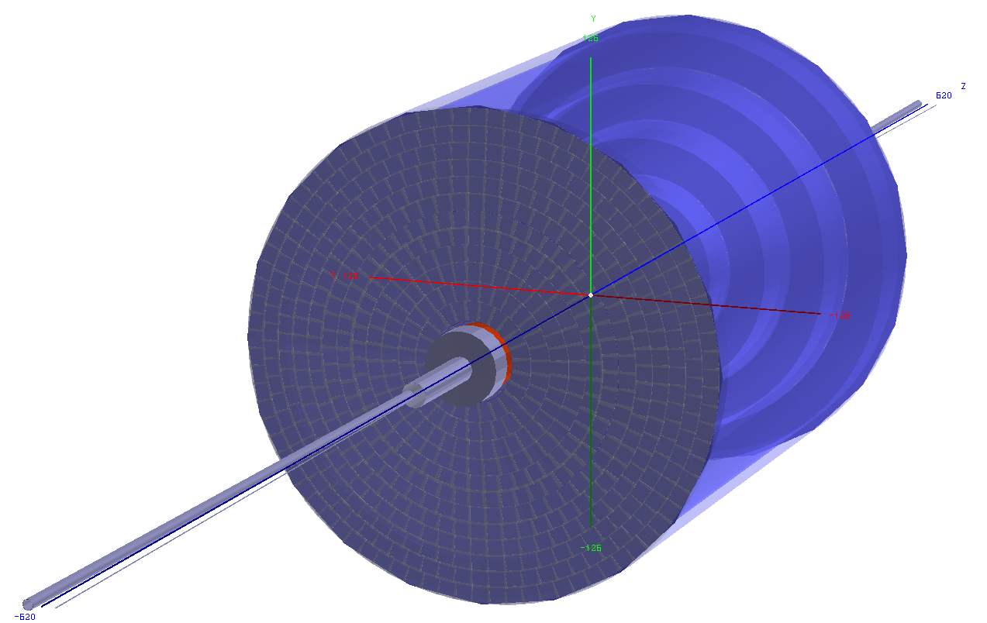
Compact.xml->GeomConverter->slic->GDML
GDML Visualized using ROOT’s Geometry Manager

Slide 11
Check on Position of Simulated Hits
Used Slic/Geant4 to generate Muons with exactly the same parameters and compared the properties of the simulated hits in the two realizations of the model
Observing the same number of hits but with differences in their positions
  Differences appear to depend on muon energy and Magnetic field -> possibly differences in the field definition (?)
DD4hep
Printing hits in SiVertexBarrelHits
0. x=0.000098, y=26.877269, z=-49.9999, R=26.877, φ=1.57
1. x=0.000142, y=37.934349, z=-49.9999, R=37.934, φ=1.57
2. x=0.000196, y=50.789984, z=-49.9998, R=50.790, φ=1.57
3. x=0.000263, y=64.622135, z=-49.9998, R=64.622, φ=1.57
4. x=0.000329, y=77.559984, z=-49.9997, R=77.560, φ=1.57
Printing hits in SiTrackerBarrelHits
5. x=0.001046, y=224.254509, z=-49.9993, R=224.255, φ=1.57
6. x=0.002344, y=474.488246, z=-49.9984, R=474.488, φ=1.57
7. x=0.003805, y=720.527110, z=-49.9976, R=720.527, φ=1.57
8. x=0.005287, y=970.903662, z=-49.9973, R=970.904, φ=1.57
9. x=0.005357, y=980.096554, z=-49.9973, R=980.097, φ=1.57
10. x=0.006977, y=1218.43834, z=-49.997, R=1218.44, φ=1.57
  With the field OFF there are still some discrepancies -> Investigating
GeomConverter
Printing hits in SiVertexBarrelHits
0. x=0.000100, y=27.329005, z=-49.9999, R=27.329, φ=1.57
1. x=0.000127, y=38.355969, z=-49.9999, R=38.356, φ=1.57
2. x=0.000157, y=51.210000, z=-49.9998, R=51.210, φ=1.57
3. x=0.000194, y=65.042294, z=-49.9999, R=65.043, φ=1.57
4. x=0.000231, y=77.980000, z=-49.9997, R=77.980, φ=1.57
Printing hits in SiTrackerBarrelHits
5. x=0.000629, y=226.579967, z=-49.9990, R=226.578, φ=1.57
6. x=0.001219, y=476.796534, z=-49.9977, R=476.797, φ=1.57
7. x=0.001440, y=722.833060, z=-49.9962, R=722.833, φ=1.57
8. x=0.001796, y=973.200726, z=-49.9946, R=973.201, φ=1.57
9. x=0.001773, y=982.415081, z=-49.9946, R=982.415, φ=1.57
10. x=0.000884, y=1220.739507, z=-49.994, R=1220.74, φ=1.57

Slide 12
Summary - Conclusions
Validation of CLIC_SID_CDR geometry ongoing
  Study presented limited to tracker -> can provide the starting point for a CLICdp detector Silicon Tracker geometry model
Visual validation complete
  Any discrepancies were fixed/resolved and will be propagated to the CLICSiD example driver
Currently checking position of hits from Simulated muons
A good exercise in implementing a detector geometry in DD4hep
Study also serves in identifying and fixing possible issues in the compact->DD4hep->LCDD->SLIC chain

Slide 13
Backup material

Slide 14
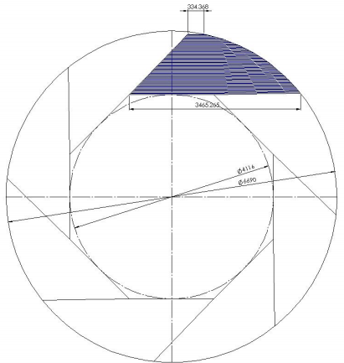
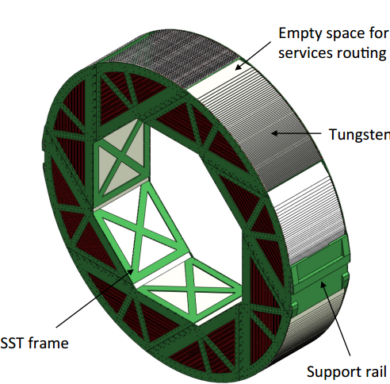
Tangential Sector HCal for CLIC_ILD_CDR [5,6]
Tungsten Plates
Designed to accommodate 75 layers per drawer
  Together with available tungsten plate sizes, drives octagon shape)
Three rings for a total length of 4.7 m
$R_{in}= 2058 mm$ (1st tungsten layer), $R_{out}=3345 mm$.
Total thickness: 1345 mm (incl 20 mm steel support and 3.5 gap before 1st layer)
Provides ease of assembly, structurally sound, takes into account material availability and limitations
Provides support with minimal additional material

Slide 15
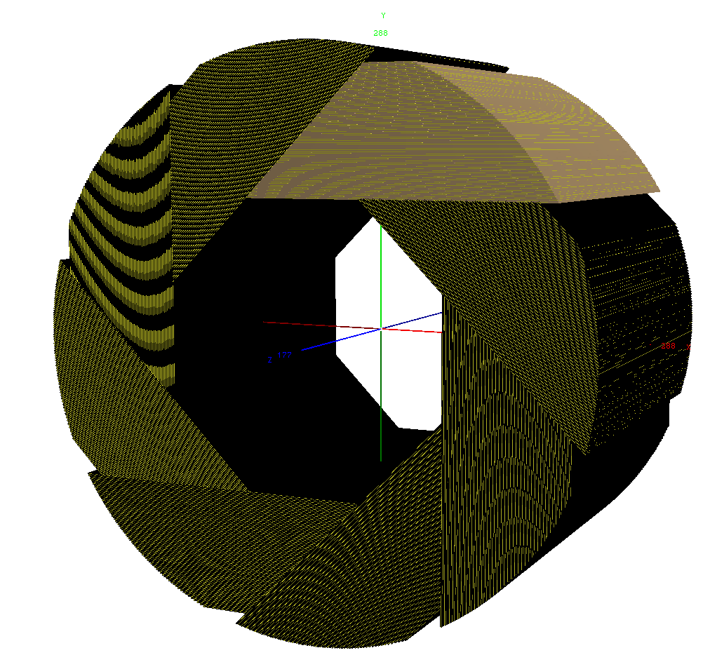
Model with DD4hep (based on CLIC_SID_CDR)
Primarily an exercise οn DD4hep and a way to study the material vs φ
  Probably no single φ-position “sees” 75 layers
  Effective “visible” material should still be close to nominal
  However, sampling fraction changes with φ (calibration?)
Started with CLIC_SID_CDR model dimensions
  $R_{min}=R_{in}=1419 mm$
  Actually had to increase $R_{max}=R_{out}$ from the Wedge model ($R_{out}^{wedge}=2656.5$) in order to accommodate 75 layers
  Used $R_{out}=2875 mm$ (HCalEndcap_rmax)
  Did not include support frame
  Only one cylinder (not three rings)

Slide 16
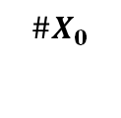
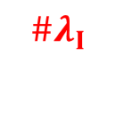
Material Scan in φ of “Tangential Sector” HCal
No cracks
φ-average of #λΙ: 7.9
  Cf. CLIC_SID_CDR: 7.4
  Cf. CLIC_ILD_CDR: 7.3
  (all according to my scans)
Probably can have same depth with fewer layers
  But would mean fewer samplings of course

