Slide 1
CMS plans for Endcap Calorimetry at HL-LHC
Motivations for change and requirements
Proposals under consideration
  Shashlik and HE rebuild
  High Granularity Calorimeter
Conclusions

Slide 2
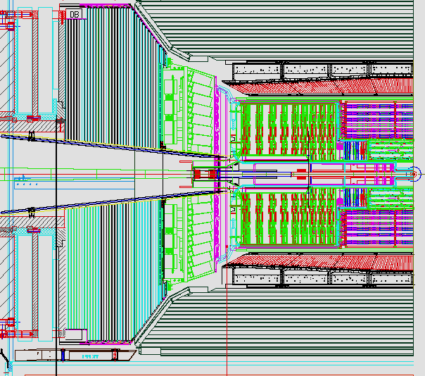
Present CMS Endcap
HE
Brass
Scintillator
EE
PWO
ES
preshower

Slide 3
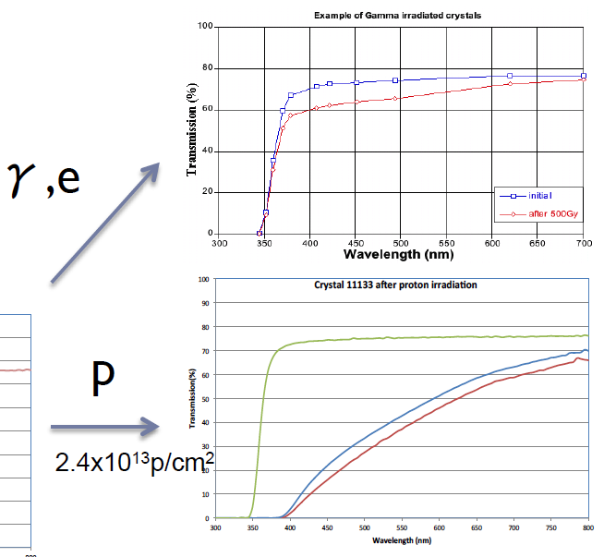
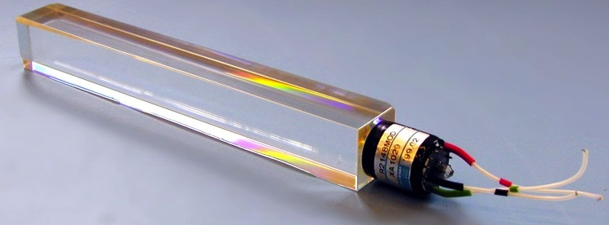
Radiation damage on crystals
Gamma irradiation creates color centers which reduce the crystal transparency up to a saturation level, which depends on the dose rate. The damage is spontaneously recovered at room temperature.
Hadron damage creates clusters of defects which cause light transmission loss. The damage is permanent and cumulative at room temperature.

Slide 4
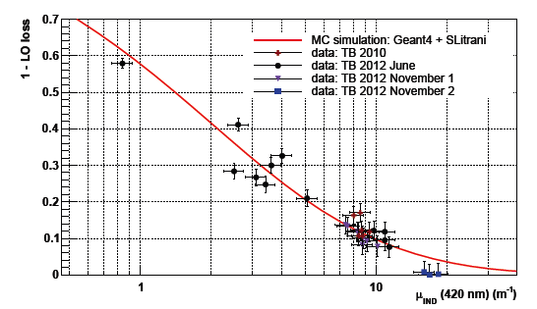
Expected Light loss in Endcaps (EE)
Simulation
50 GeV e-
Fraction of ECAL response
In addition, longitudinal non-uniformity builds up and creates a constant term.
The EE crystals were chosen to survive
the nominal LHC 500 fb⁻¹ , with the precision region up to η < ~ 2.5

Slide 5
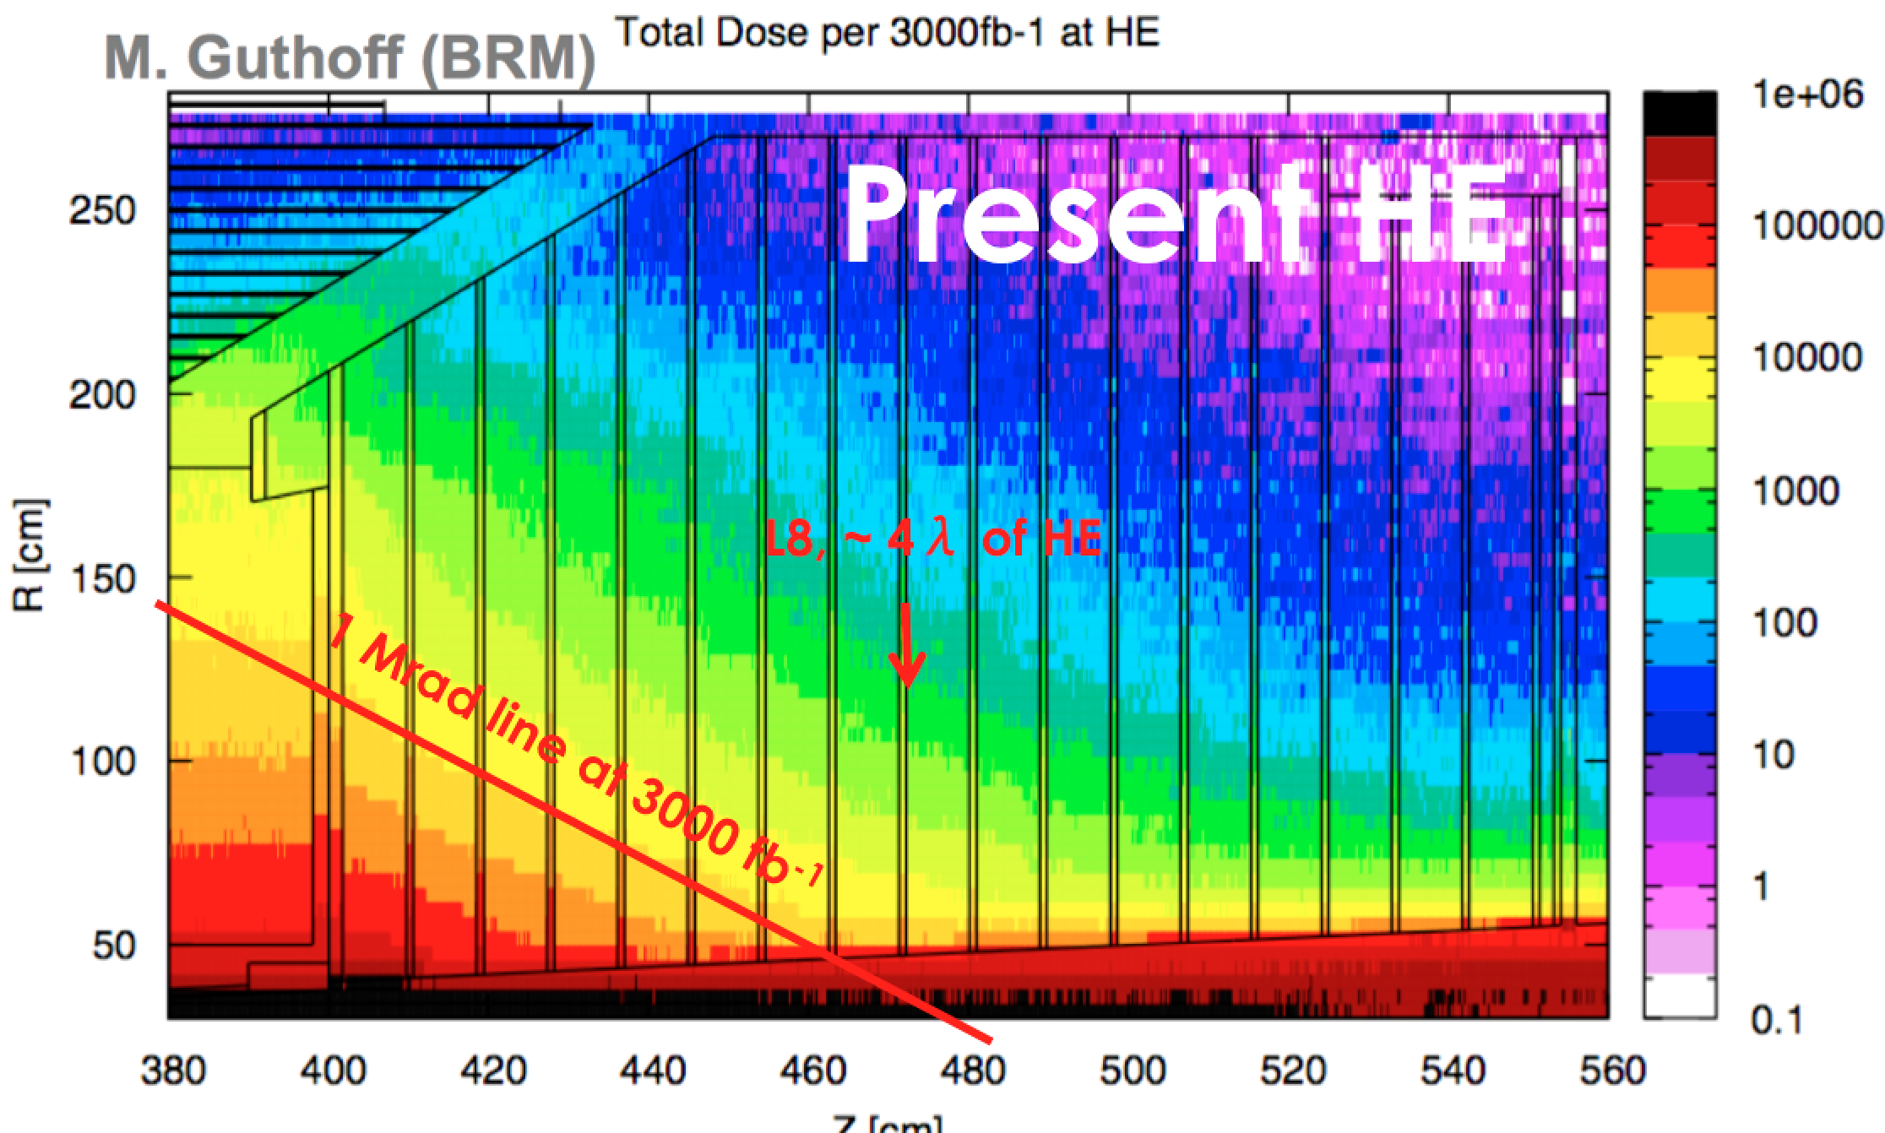
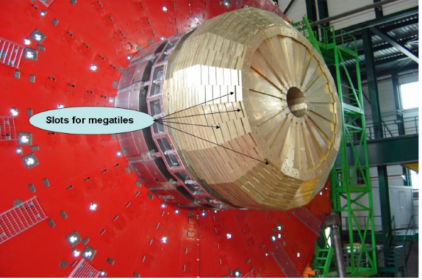
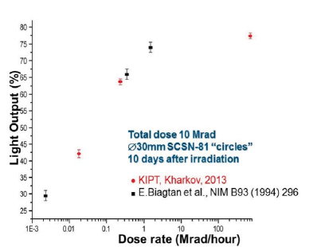
Radiation damage End Cap Hadronic Calorimeter
Radiation damage is enhanced by low dose rate.
Extrapolations show that after 500 fb⁻¹, the high η corner (first layers) will have <5% signal left.
Need to replace ~ 20% of the current Sci. tiles

Slide 6
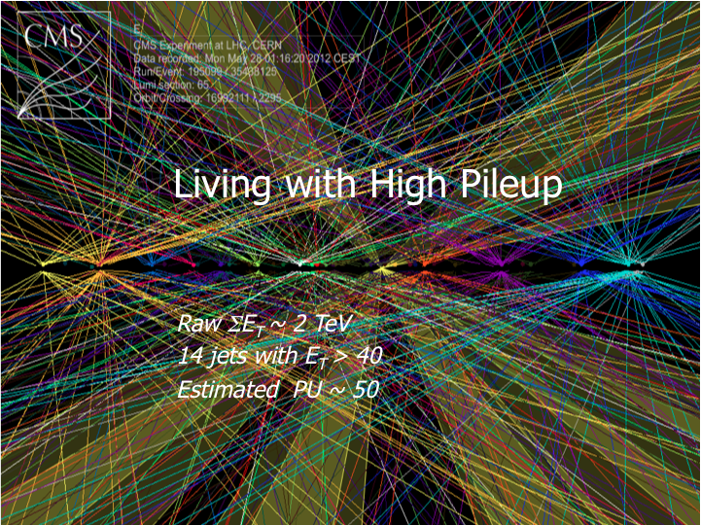
Pileup
Pileup will dramatically increase from <20-30> today to an average of <140> simultaneous interactions (in-time pileup) , or more if performance allows
both in-time and out of time (previous/following bunches)
increase of occupancy and “background” under physical objects (jets, electrons, photons)
This calls for high granularity & short Moliere radius
Electronics will have to be replaced anyhow, to allow for longer Trigger latency (-> ≥10 μs) and higher L1 trigger rate.

Slide 7
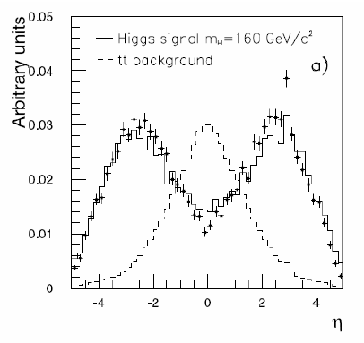
Physics (examples)
Forward jet tagging
Hadronic tau reconstruction
Electron / muon id
Missing E_{T}
Low P_{T} threshold
VBF H➔ττ
HH➔bbττ or bbγγ
Wants good em resolution
W_{L}W_{L} scattering (low p_{T})
CMS needs to replace the Endcap electromagnetic calorimeter and replace/improve the hadron calorimeter due to radiation damage.
If anything, the HL-LHC physics is as demanding in the high η region
and at low p_{t} than for LHC.
Maintain or improve the current performance in a much harsher environment

Slide 8
Calendar
Review March 2014: aim is to reduce the three options to two, to focus effort and R&D resources
Technical Proposal September 2014 with the two remaining options
Selection of single option by ~ April 2015
TDR first half of 2017
Installation 2023-2024.
  LS3 shut down is planned to be 36 months, a lot of work on the Barrel (New Tracker, new ECAL FE electronics etc..), so one endcap of new EE+HE should be ready to install ~ at the start of the shutdown, the second whenever convenient.

Slide 9
3 proposals internally reviewed in March 2014
Shashlik with crystal as active medium + HE-rebuilt :
  device with very good em resolution, with higher granularity and rad hardness than present EE, followed by a rebuilt HE using the same concept as now with enhanced rad hardness and segmentation.
Combined Forward Calorimeter (CFC)
  Unique device with best hadron energy resolution, based on the dual readout DREAM/RD52 concept. Brass absorber with fibres (Č or Sci) every 2mm. Longitudinal segmentation by timing. Electron id by lateral shower shape and timing.
High Granularity Calorimeter (HGCAL)
  Silicon-based device “a la CALICE” with “extreme” granularity both transverse O(cm²) and longitudinal (read independently every layer).
  Em and Had sections (total ~ 5λ) followed by a tail catcher
Decision was to de-select CFC
Although none of the concepts is yet mature and has proven to give best performance in the CMS environment: estimated to present more risk to demonstrate performance and feasibility on expected time scale.

Slide 10
Reminder on radiation environment
hadronic
em
Shower max at η=3 : 10¹⁶ n/cm² 150 Mrad
Behind em section : 10¹⁵ n/cm² ~10 Mrad
Behind had section : 10¹² n/cm² ~10 krad
(recessed photosensors
+ electronics)
3000 fb⁻¹

Slide 11
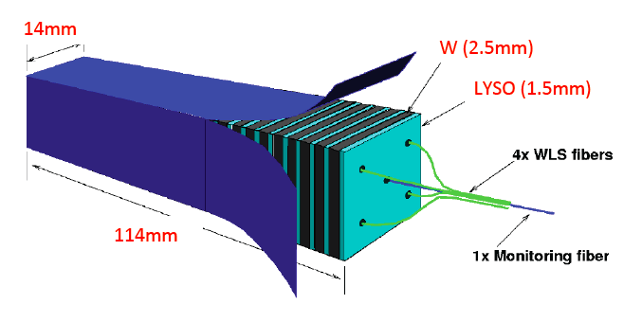
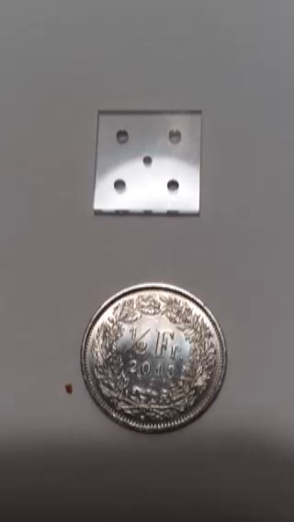
Shashlik Module
  Materials:
  Absorber: W
  Active Material: LYSO(Ce) (primary)
  Active material: CeF₃ also under study\
  Structure:
  2.5 mm W plates (28 per module)
  1.5 mm LYSO(Ce) plates (29 per module)
  Module Dimensions:
  Transverse Size: Front Face 14 x 14 mm²
  Length 114 mm
  Readout:
  WLS Capillaries (4 per module)
  Calibration Fiber (1 per module)
  3x3 mm² GaInP Photosensors 4 per module
    or SiPM in recessed position
  Segmentation in depth: Unsegmented except for the proposed extraction of
  a signal near shower max

Slide 12
Parametric Comparison
W/LYSO Shashlik and PbWO₄ EE
 | W/LYSO(Ce) | PbWO₄
Length (mm) | 114 | 220
Transverse size (mm) | 14 | 28.6
# modules for 2 endcaps | 61,000 | 14,648
Average Moliere Radius (mm) | 13.7 | 21
Average Radiation Length Xo (mm) | 5.1 | 8.9
Light Yield (relative to NaI) | 85 | 0.3
Emission Wavelength | 420 | 425
Decay time (ns) | 40 | 25
Light Output (p.e./MeV) depending on QE | 8-10 | 2
Temp Dependence (%/C) | -0.2 | -2.2

Slide 13
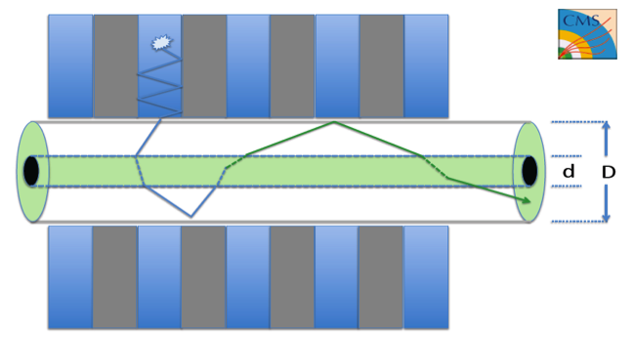
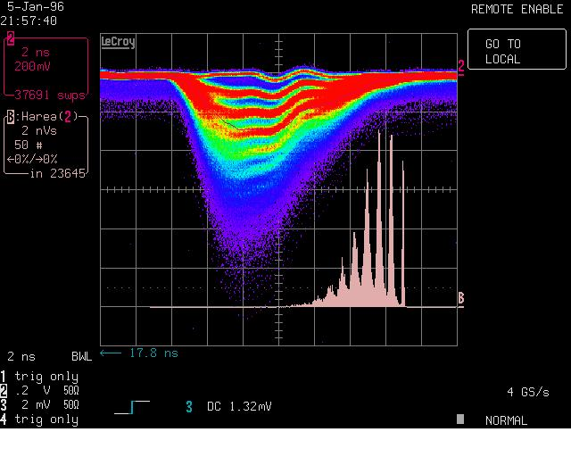
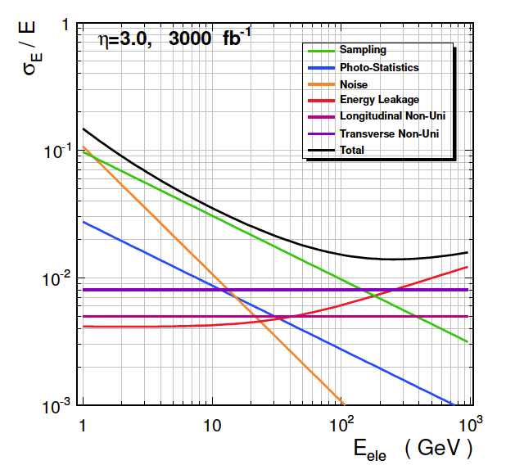
Shashlik Main Challenges
1) Confirm crystal rad. hardness
2) Develop rad-hard WLS capillary
3) GaInP photosensors
4) Confirm performance in CMS environment (pileup…)
η = 3.0 at 3000 fb⁻¹
expected e/γ resolution ∼ 10%/√E + 1%

Slide 14
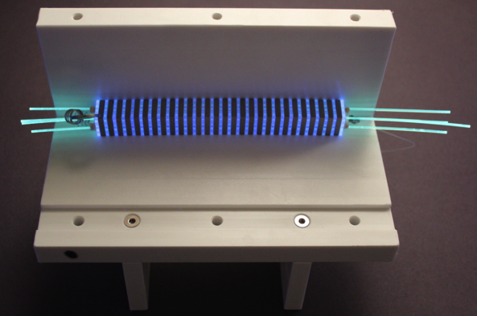
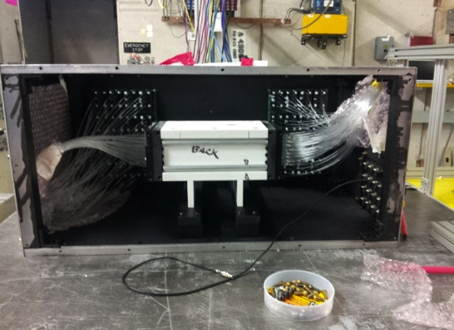
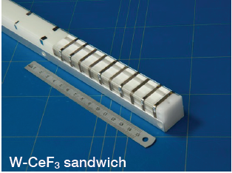
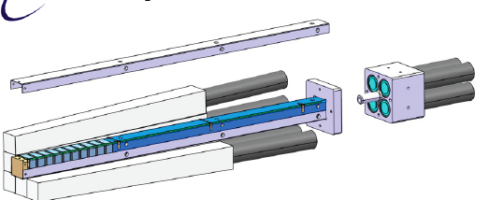
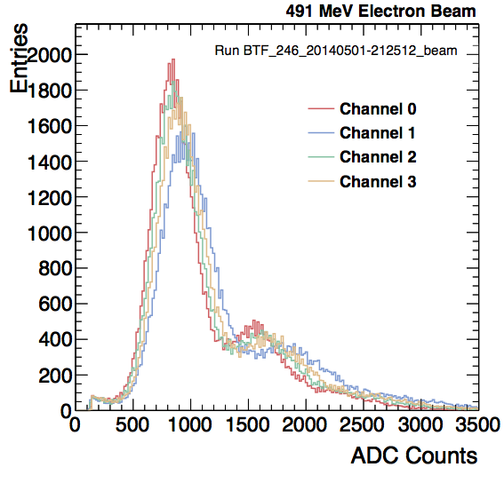
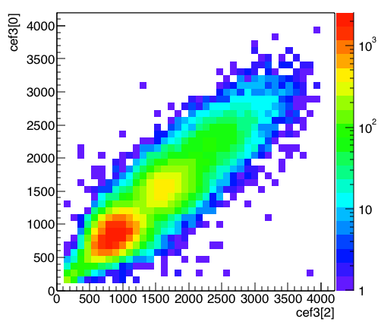
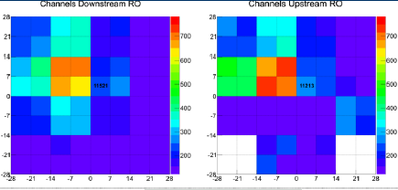
EE Shashlik beam tests
First test of a 4x4 modules prototype
  364 LYSO crystals (final configuration)
  WLS readout at both ends with SiPMs
  Laser calibration in central fiber
First test of a CeF₃ modules
  10 x (3.1 mm W + 10 mm CeF₃)
  Scintillating fibers readout with PMTs
120 GeV protons
500 MeV electrons
1 e
2 e
Downstream and upstream signals
Analysis of data in progress
Raw signal (left) and correlation (right)
Analysis of data in progress

Slide 15
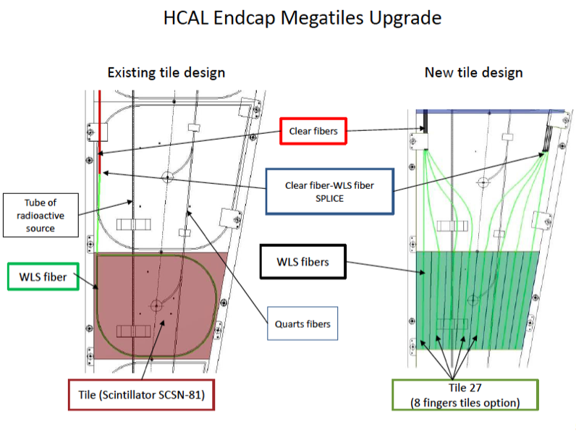
HE re-build
Current
New
HE re-build
  Higher granularity in (η/φ) x 2 & longitudinal & extension towards EE Shashlik (resolution)
  Scintillating tiles in brass with finger WLS to reduce light path (80%)
  Investigating new plastic and liquid
  scintillators or radiation tolerant scintillating
  fibers quartz/glass/crystals doped with Ce3
  for innermost region

Slide 16
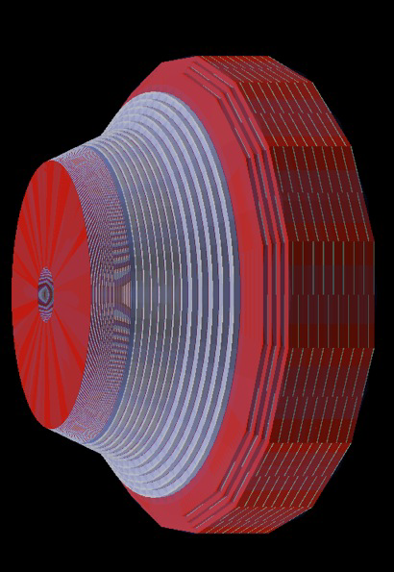
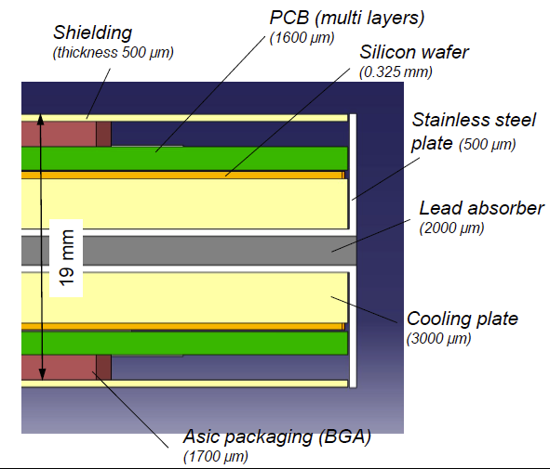
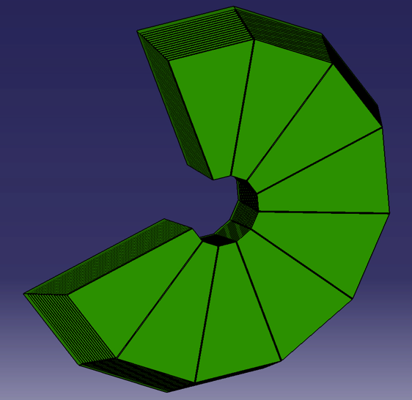
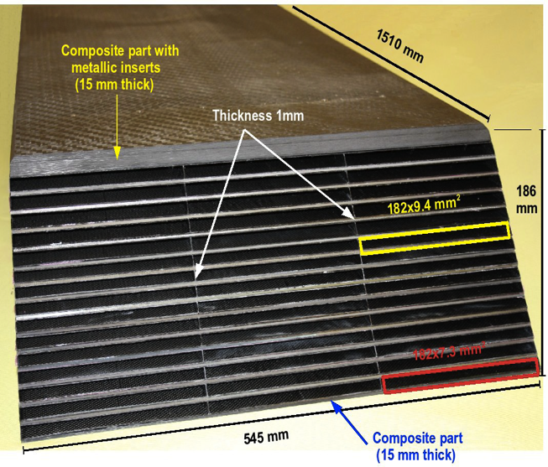
High Granularity Calorimeter (HGCAL)
  Fine depth segmentation
  ECAL: ~33 cm, 25 X_{0,} 1λ, 31 layers:
    11 planes of Si separated by 0.5 X₀ of lead/Cu
    10 planes of Si separated by 0.8 X₀ of lead/Cu
    10 planes of Si separated by 1.2 X₀ of lead/Cu
    HCAL: ~66 cm, 4λ:
12 planes of Si separated by 40 mm of brass
  Fine grain pads 0.9 cm² to 1.8 cm²
  3.7/1.4 Mch & 420/250 m² Si in E/H
  30000 modules
Back HCAL as HE re-build 5λ
  With increased transverse granularity

Slide 17
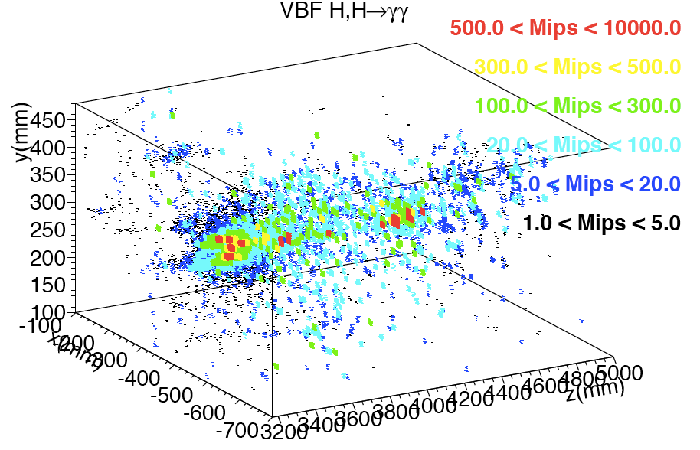
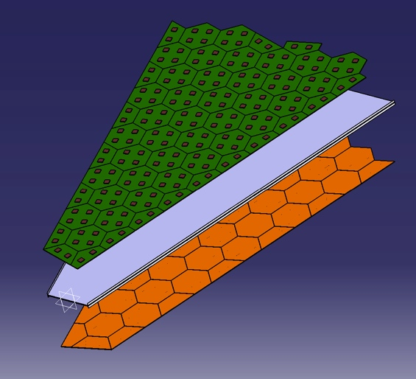
High Granularity Calorimeter (HGCAL)
3D measurement of the shower topology
  25 mm Moliere radius (shower narrower before max)
  Expected e/γ resolution ∼ 20%/√E + ≤ 1%
Tiling of 8” hexagonal Si-sensors modules
VBF Jet no PU

Slide 18
Challenges for HGCAL
Verify radiation hardness of Silicon sensors. Similar fluence as innermost pixel but:
  Tracker dominated by charged hadrons -> extend studies to neutrons
  Verify if p-on-n suitable (the less expensive option)
  Prototype partial implant (100μ or 200 μ on 300μ wafer) for high η region

Slide 19
Challenges for HGCAL(2)
2) Engineering studies
module design and thermal properties
keeping longitudinal compactness
thermal screen and exit of services through cold/warm transition
3) Readout and Trigger definition
FE electronics characteristics
dynamic range
optimisation in noise/power/peaking-time
Energy threshold vs occupancy & mip visibility
Powering
Data flow and data concentration
Trigger primitive
…
    4) Demonstrate benefit of high granularity in physics performance

Slide 20
Conclusions
CMS needs to change its Endcap Calorimeters for the HL-LHC phase
Two concepts are being currently proposed:
Shashlik with HE rebuild
more in the line of the existing CMS
challenges are mostly in establishing the radiation hardness of the proposed components
High Granularity Calorimeter “a la CALICE”
but the LHC environment is very different from ILC: radiation (-> low T), continuous powering, high rate
challenges are mostly in finding proper engineering solutions
In both cases, performance assessment in the CMS environment is going-on in view of the Technical Proposal.
Decision between the two solutions expected in ~ 1 year.

