Slide 1


Status of scintillator scans
CLICdp collaboration meeting
June 11th 2014, CERN
Samir Arfaoui, Damiano Celeste

Slide 2
Introduction, outline
Goal: R&D on CLIC ScECal with tiles at CERN
Phase I: use scintillator scan setup to characterise various tile geometries, packaging, and SiPM couplings
In this talk:
  assess scintillator tiles response uniformity to MIPs
  determine temperature correction coefficients
  apply T-correction to full scans

Slide 3
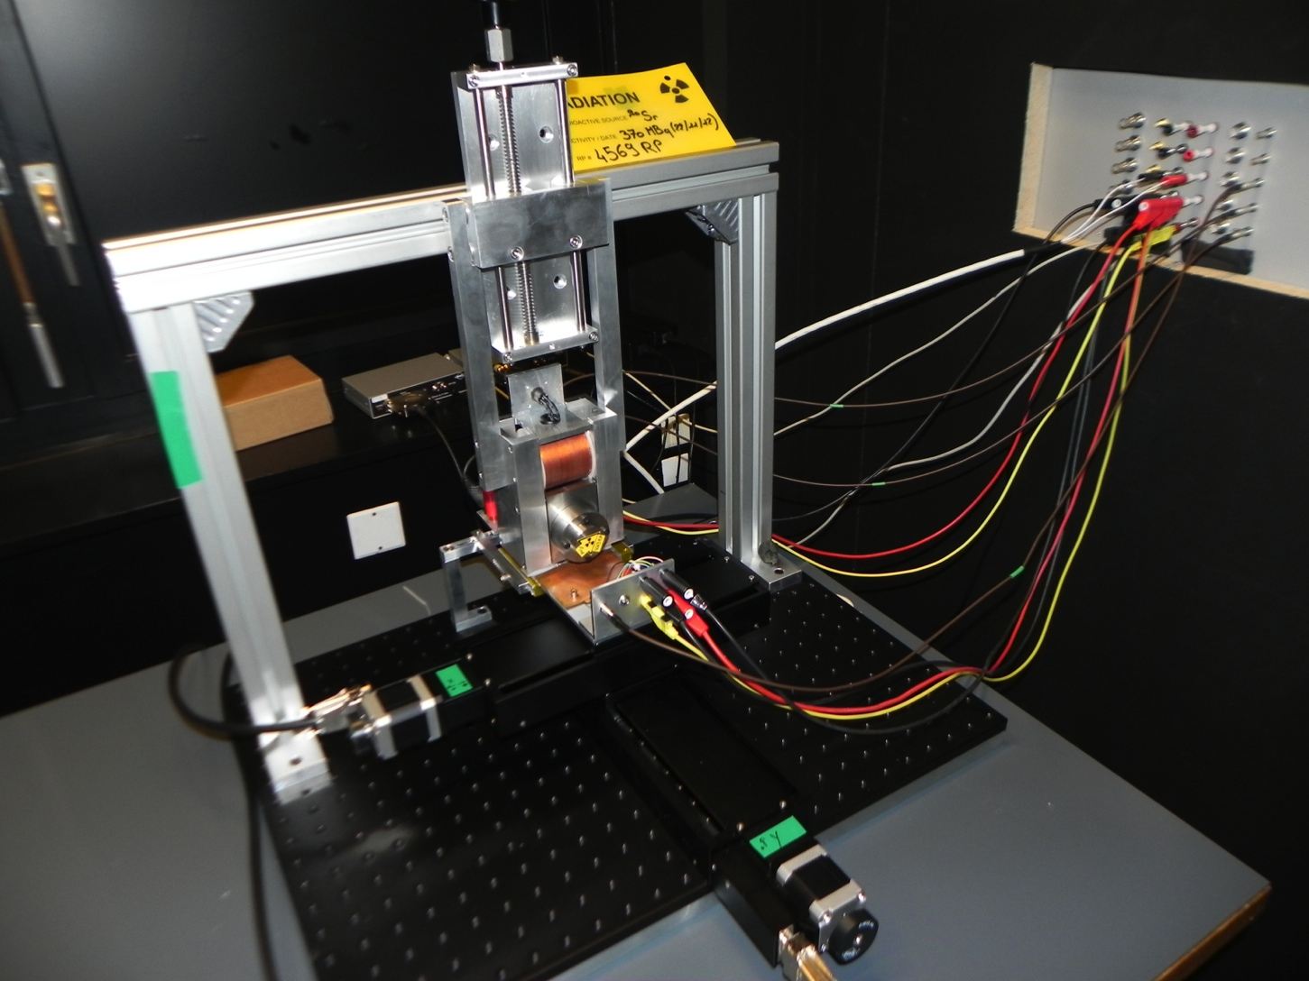
Setup
Electron gun
Inside AC regulated dark room
Feedthrough to lab next door
DUT
Translation axes

Slide 4
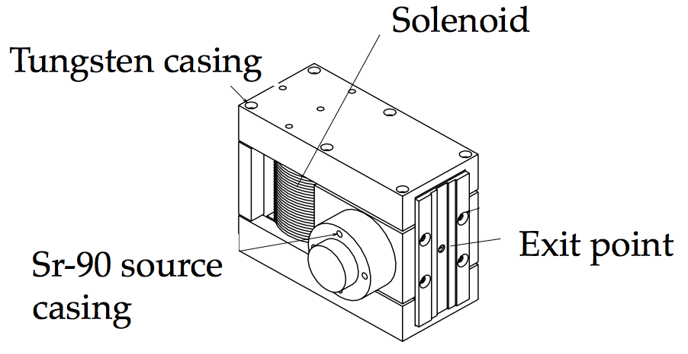
Electron gun
~350 MBq ⁹⁰Sr source
Double beta emission
Selectable energy up to ~2 MeV
Momentum characterisation has been performed
CLICdp note under review

Slide 5
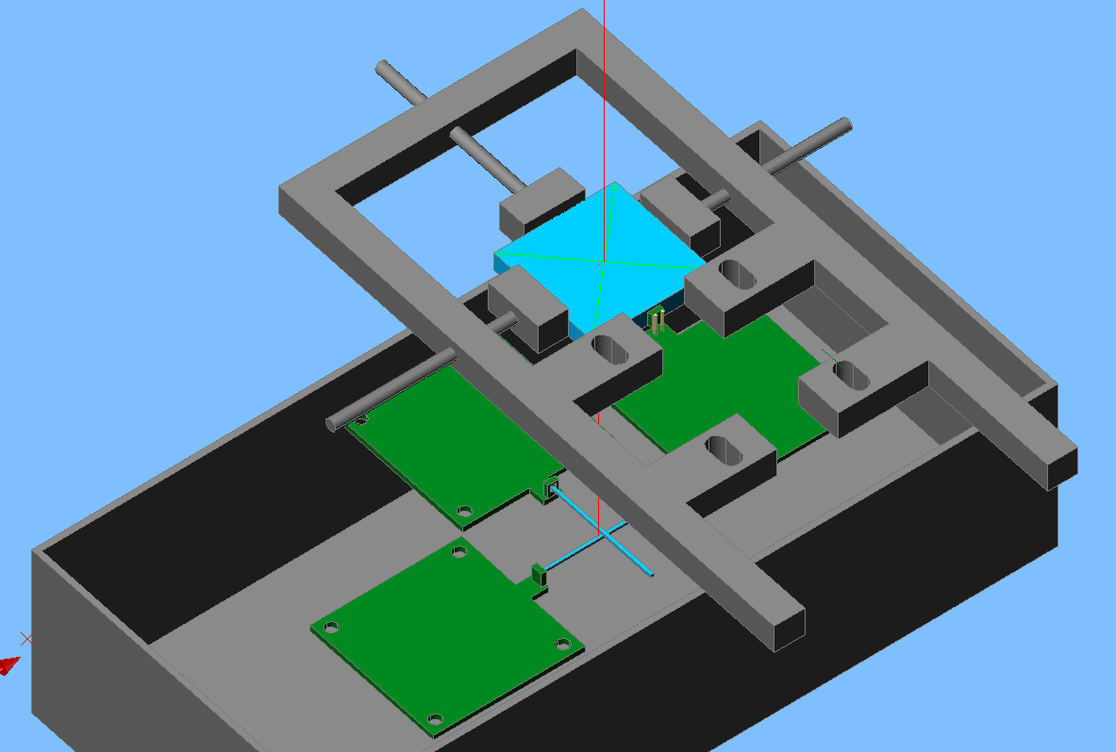
Readout, Trigger, and DAQ
SiPM connection
Bias V
Signal
5V
Readout
Custom-made PCB (S. Veneziano, Rome) with amplification (~10) as well as temperature monitoring with PT1000 probe. Second version in development (better PCB design, 2-stage amplification).
DUT signal is read through USB oscilloscope (Picoscope)
  Trigger
  Crossed scintillating fibers (20x1x1 mm³) as trigger, fixed underneath DUT
Hamamatsu MPPC (50 um pitch) glued to painted fibre
Trigger signals are put in coincidence (NIM) and signal goes to Picoscope
LabVIEW DAQ
Software for calibration (auto-trigger) and data-taking (with eletron source)
Control of the step-motors for scintillator scans
Temperature monitoring with NI DAQ Crate

Slide 6
Measurements performed
Two identical batches of four scintillators.
Same MPPC, same bias voltage, same electron gun current (MIPs).
Batch | Run | Size [mm³] | Packaging | MPPC | Bias [V] | I (eGun) [A]
1 | 14 | 20x20x2 | 3M ESR | 50μm pitch | 71.3 | 1.4
1 | 13 | 20x20x2 | Paint | 50μm pitch | 71.3 | 1.4
1 | 15,28 | 15x15x2 | 3M ESR | 50μm pitch | 71.3 | 1.4
1 | 16 | 15x15x2 | Paint | 50μm pitch | 71.3 | 1.4
2 | 25,26 | 20x20x2 | 3M ESR | 50μm pitch | 71.3 | 1.4
2 | 27 | 20x20x2 | Paint | 50μm pitch | 71.3 | 1.4
2 | 17,29 | 15x15x2 | 3M ESR | 50μm pitch | 71.3 | 1.4
2 | 18 | 15x15x2 | Paint | 50μm pitch | 71.3 | 1.4
+ a series of measurements at the centre of the scintillators in order to investigate temperature sensitivity issues ==> next few slides

Slide 7
Old results
Batch | Run | Size [mm³] | Packaging | <#p.e.> | ± 5 % [%] | ± 10 % [%] | ± 20 % [%]
1 | 14 | 20x20x2 | 3M ESR | 31 | 70.5 | 95 | 100
1 | 13 | 20x20x2 | Paint | 11 | 22.9 | 59.5 | 85.4
1 | 15 28 | 15x15x2 | 3M ESR | 50 97 | 83.1 90.8 | 99.6 100 | 100 100
1 | 16 | 15x15x2 | Paint | 21 | 45.3 | 75.1 | 83.6
2 | 25 26 | 20x20x2 | 3M ESR | 77 68 | 77.0 77.5 | 95.2 94.8 | 100 99.8
2 | 27 | 20x20x2 | Paint | 15 | 31.5 | 67.0 | 79.5
2 | 17 29 | 15x15x2 | 3M ESR | 67 89 | 68.4 92.9 | 91.1 100 | 100 100
2 | 18 | 15x15x2 | Paint | 25 | 39.6 | 72.0 | 84.4
Large non-reproducibility observed, caused by:
- SiPM-scintillator coupling ==> should not touch them between measurements
- ~ -4%/K temperature correction coefficient not enough ==> determine new one

Slide 8
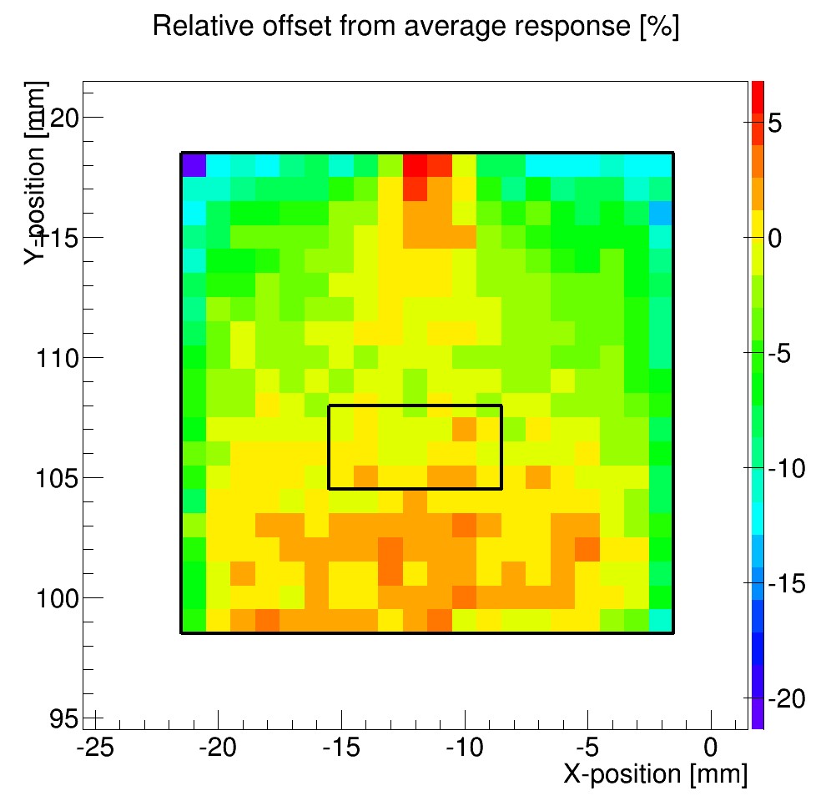
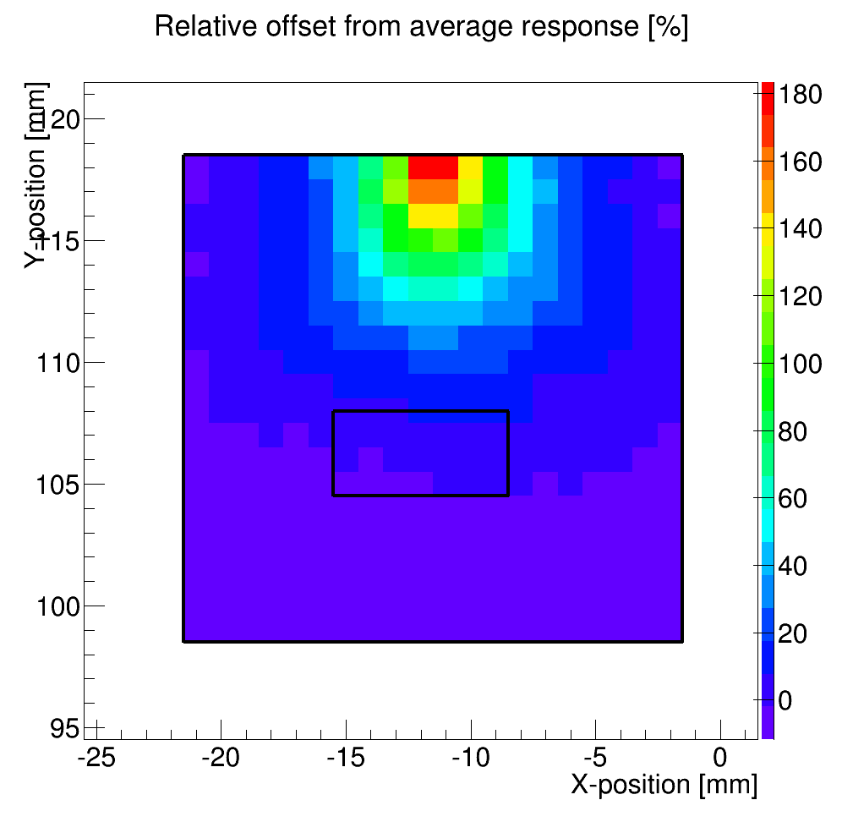
What we learned: ESR vs. Paint
ESR¹
Paint²
Reflective foil from 3M, held by teflon tape
Saint-Gobain BC-620 diffusive paint

Slide 9
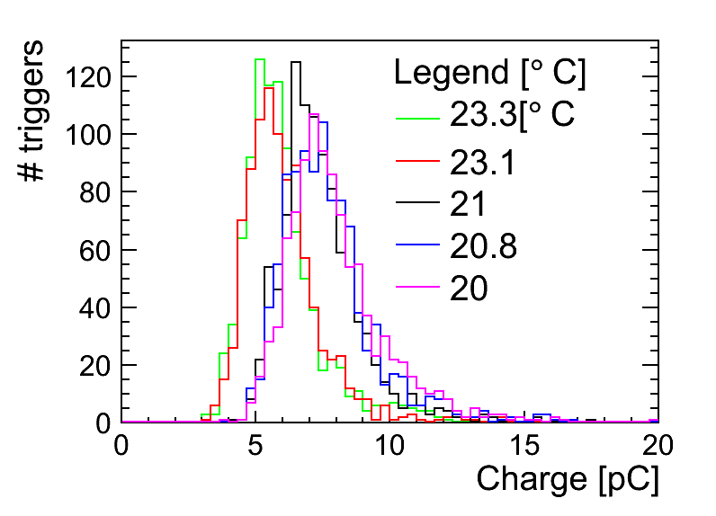
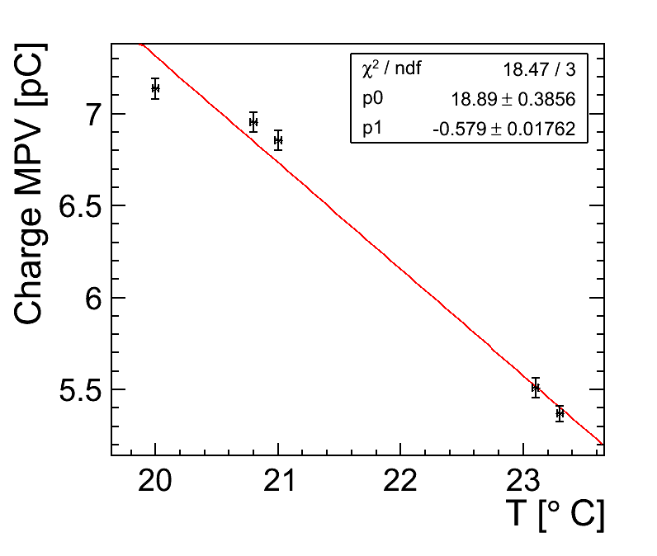
Extracting T-correction (20x20)
Procedure:
- record mutiple MIP distrubtions from electron gun [left plot]
- same position (central), different temperatures
- fit each distribution with Landau-Gauss convolution
- linear fit of Landau MPV vs. T [right plot]

Slide 10
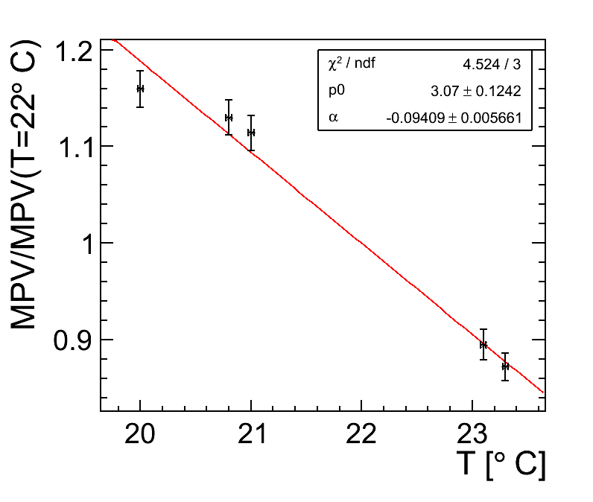
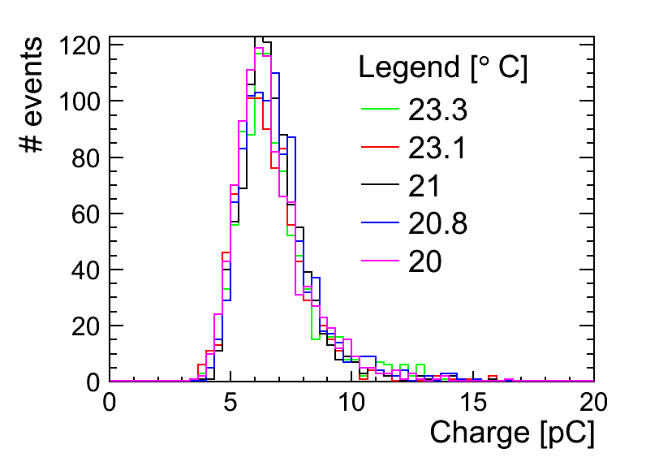
Extracting T-correction (20x20)
To extract temperature correction coefficient, need to define a reference temperature, we chose T_{ref} = 22 deg.

Slide 11
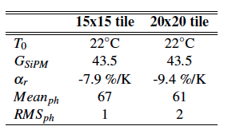
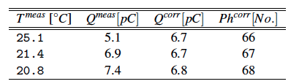
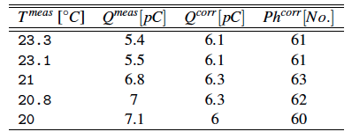
Results after correction
15 x 15 mm²
3M wrapping
20 x 20 mm²
3M wrapping

Slide 12
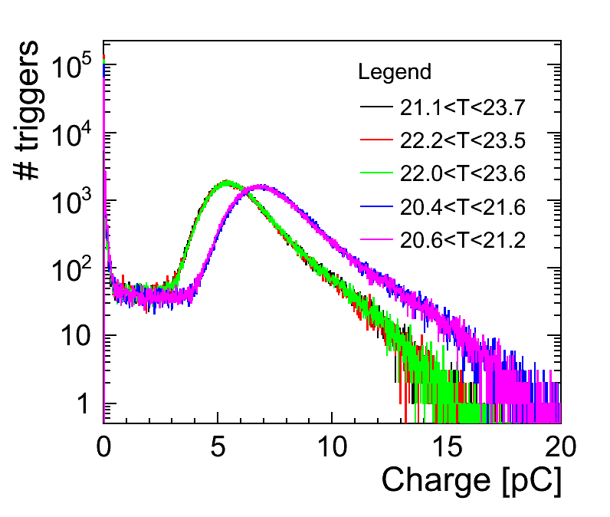
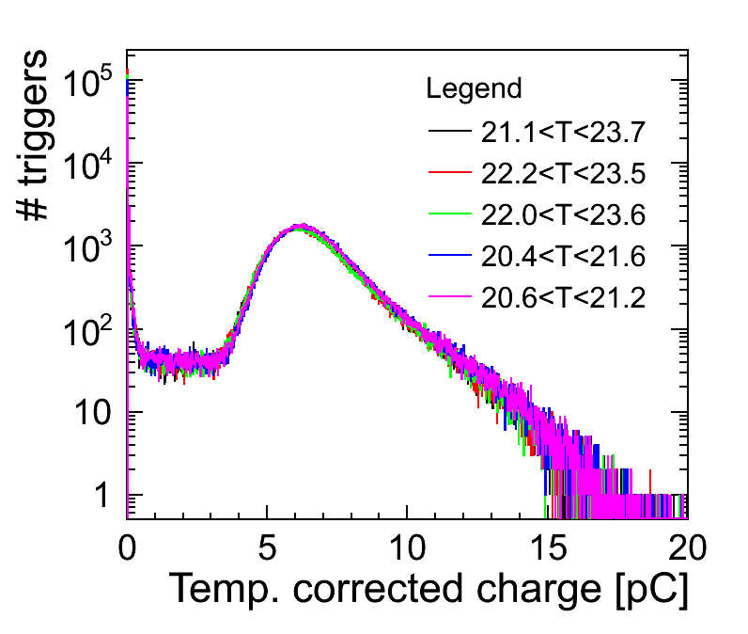
Testing the correction
Applied previously determined temperature correction coefficients to full scintillator scans.
Here: 20 x 20 mm² wrapped with 3M reflective foil

Slide 13
Summary
A tile-scan setup has been assembled at CERN in view of performing scintillator and SiPM studies for the CLIC ECAL R&D
Scintillator samples of various sizes have been scanned, their uniformity assessed
  with reflective foil and paint
  with direct SiPM coupling to side face
MIP response is lower with paint, but much less uniform
SiPM coupling to scintillator shows non-reproducibility issues
Temperature correction coefficients have been extracted and applied to full scans, reproducibility OK if we do not touch the SiPM-scintillator coupling
Next steps:
  quantify light yield and uniformity for new batches of 10x10, 15x15, and 20x20 mm² scintillators [this summer]
  study readout electronics for layer prototype [FCAL AGH-UST electronics, studies have started]
  complete hardware studies with light transport simulaions in Geant4 [contributions welcome]
  document current results as CLICdp note [ongoing]

Slide 14
Measurement and analysis procedures
Measurement
  Place selected tile in setup, coupled to the SiPM by direct contact to side face using optical grease
  Perform self-triggered calibration run to measure gain at reference temperature
  Switch electron gun ON, start automated tile scan with pre-selected positions
  At each scan step (~60 sec):
    Measure temperature (surface-mounted PT1000)
    Record DUT SiPM waveform integral for each crossed-fibres coincidence signal
Analysis
  Correct each waveform integral by relative temperature offset w.r.t. calibration run
  Convert waveform integral into #p.e.
  Define tile area at the centre to calculate average response
  For each scan position, compute deviation from <#p.e.>
  Estimate effective tile areas within +/- 5, 10, and 20% of the average response to assess response non-uniformity

