Slide 2

Big Data Analytics for Improving the CERN’s Large Hadron Collider operations
Manuel Martin Marquez
Data Analytics

Slide 3
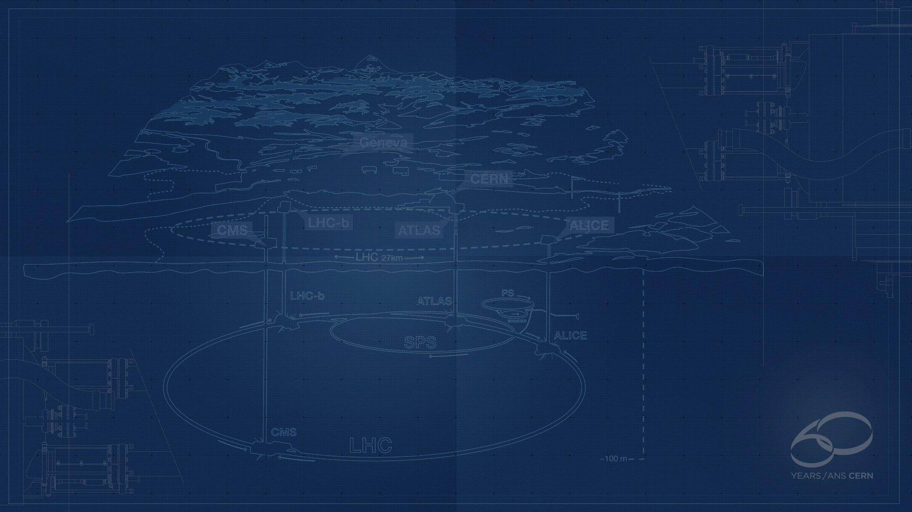
CERN - European Laboratory for Particle Physics
Founded in 1954 by 12 Countries for fundamental physics research in a post-war Europe
Today is the global effort of 21 member states
  About 1 billion CHF yearly budget
  2’300 personnel, 10’000 users
Support the research activities of scientists from 110+ nationalities

Slide 4
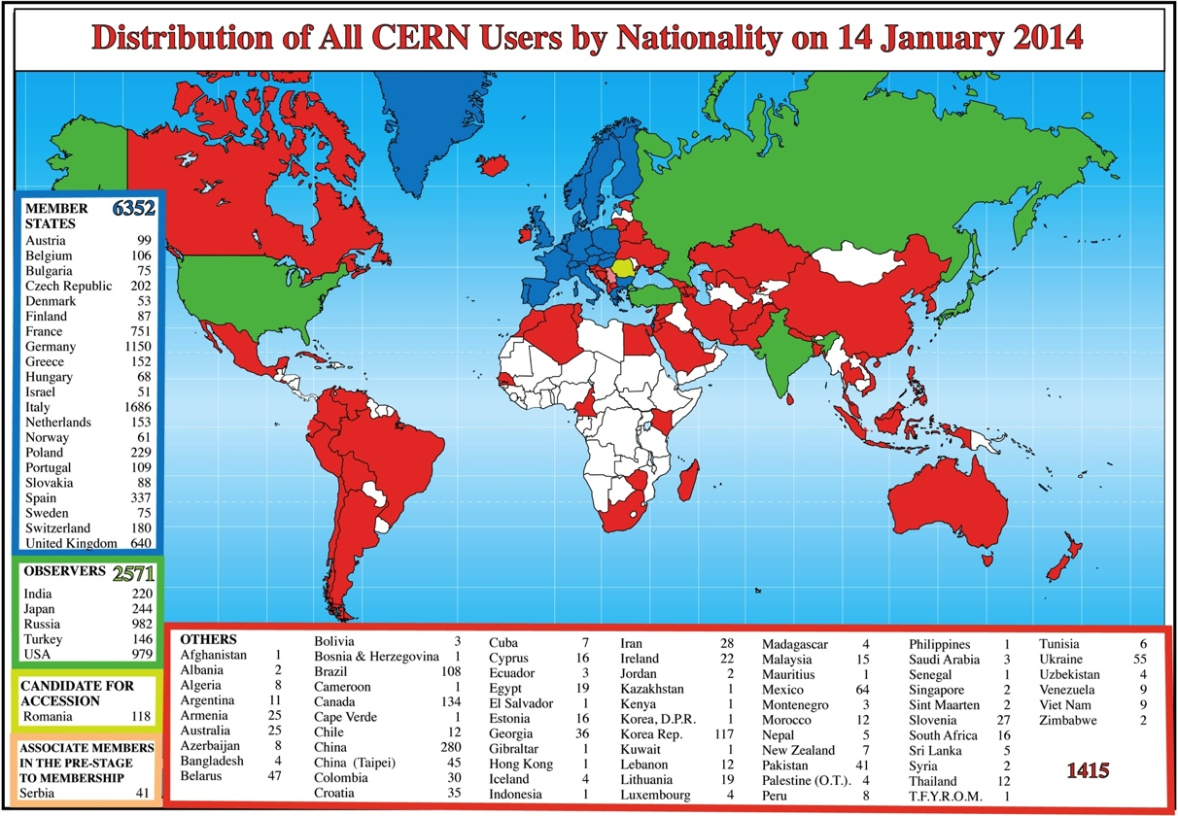
Global Science

Slide 5

How the Universe works
and what is made of…

Slide 6
Fundamental Research
Why do particles have mass?
  Newton could not explain it – the Higgs mechanism seems now to be the answer
Why is there no antimatter left in the Universe?
  Nature should be symmetrical
What was the state of the matter just after the “Big Bang”

Slide 7
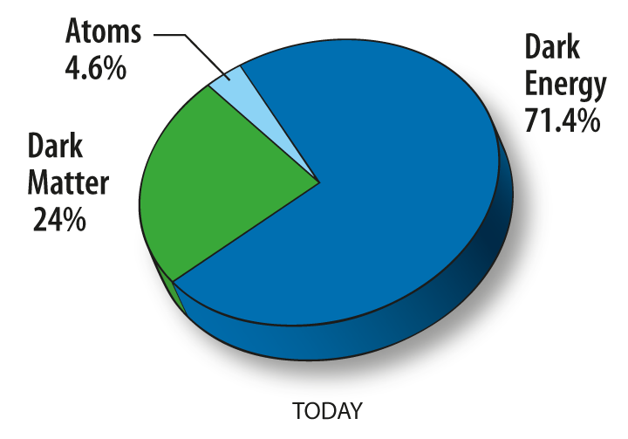
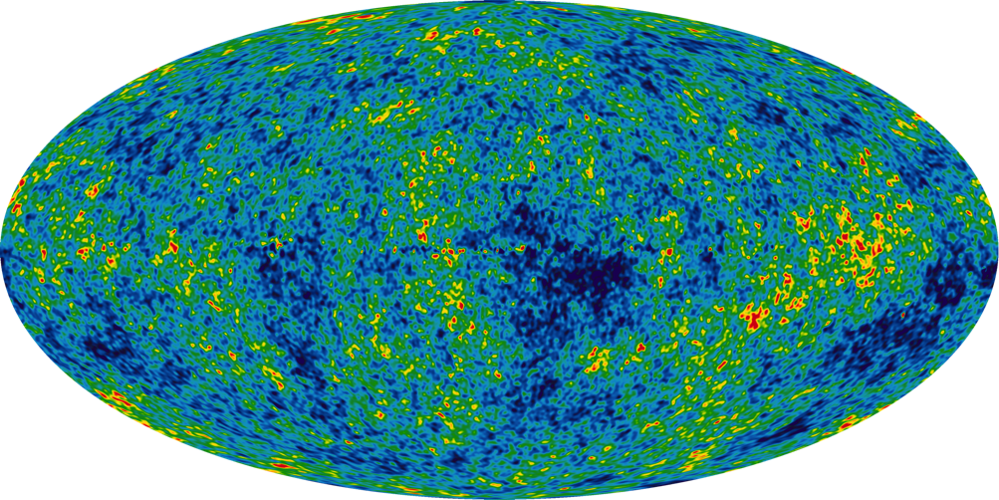
Fundamental Research
What is 95% of the Universe made of?

Slide 8
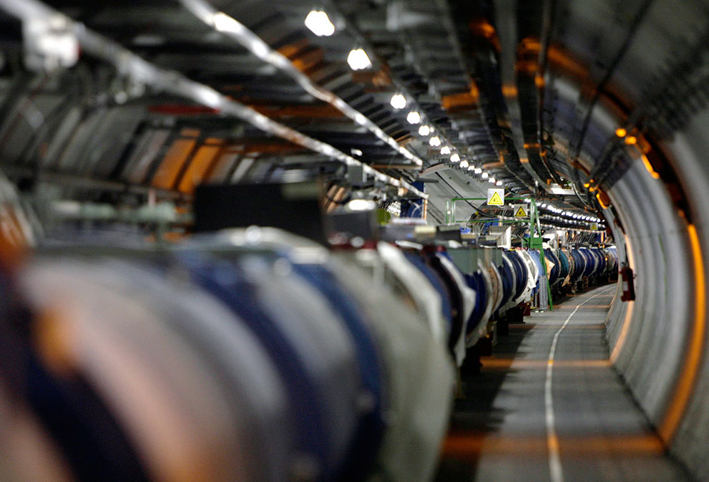
The Large Hadron Collider (LHC)

Slide 9

Largest machine in the world
27km, 6000+ superconducting magnets
Fastest racetrack on Earth
Protons circulate 11245 times/s (99.9999991% the speed of light)
Emptiest place in the solar system
High vacuum inside the magnets
Hottest spot in the galaxy
During Lead ion collisions create temperatures 100 000x hotter than the heart of the sun;

Slide 10
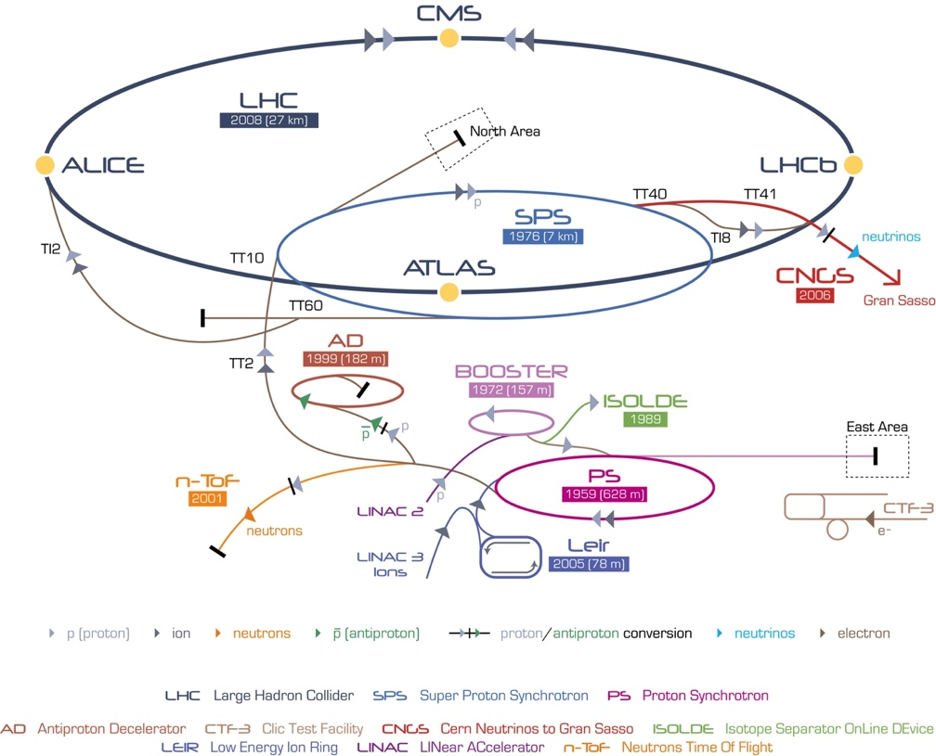
CERN Accelerator Complex

Slide 11
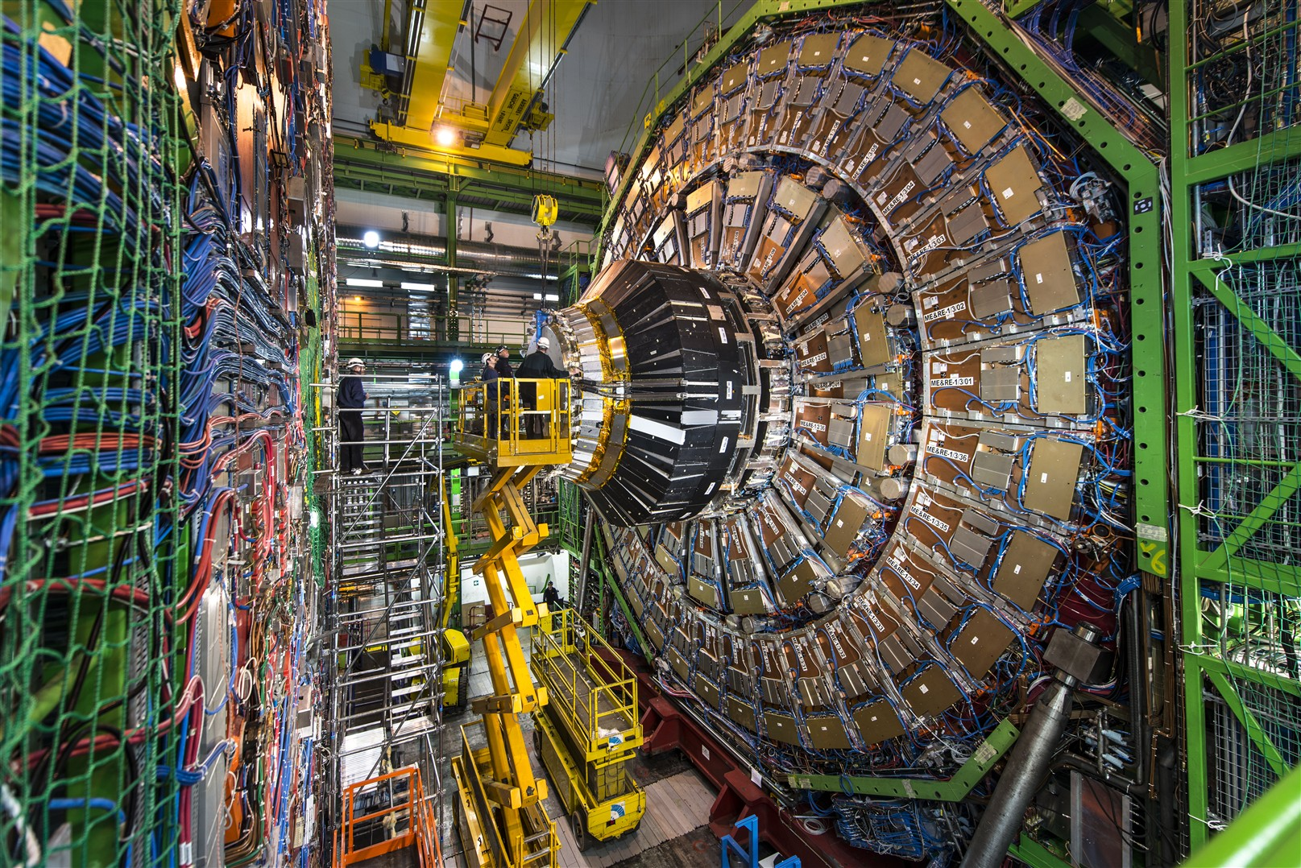
CMS Detector

Slide 12
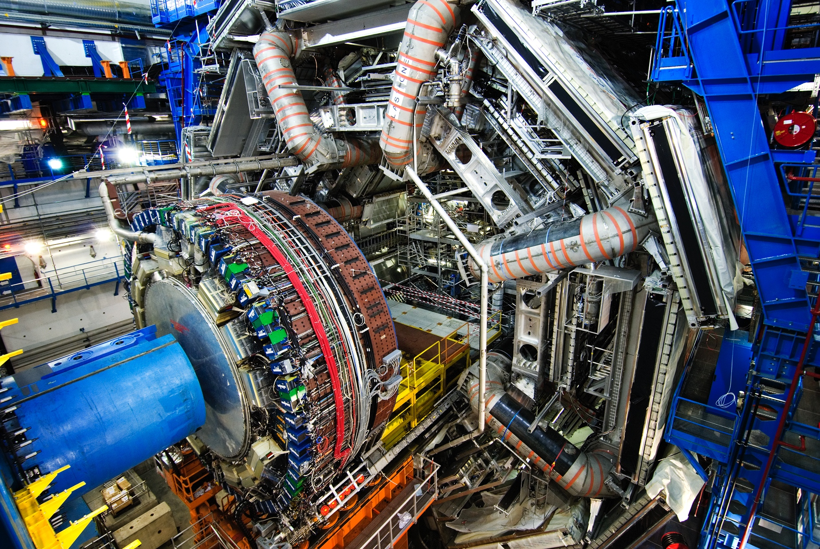
ATLAS Detector
150 Million of sensor
Control and detection sensors
Massive 3D camera
Capturing 40+ million collisions per second
Data rate PB per second

Slide 13
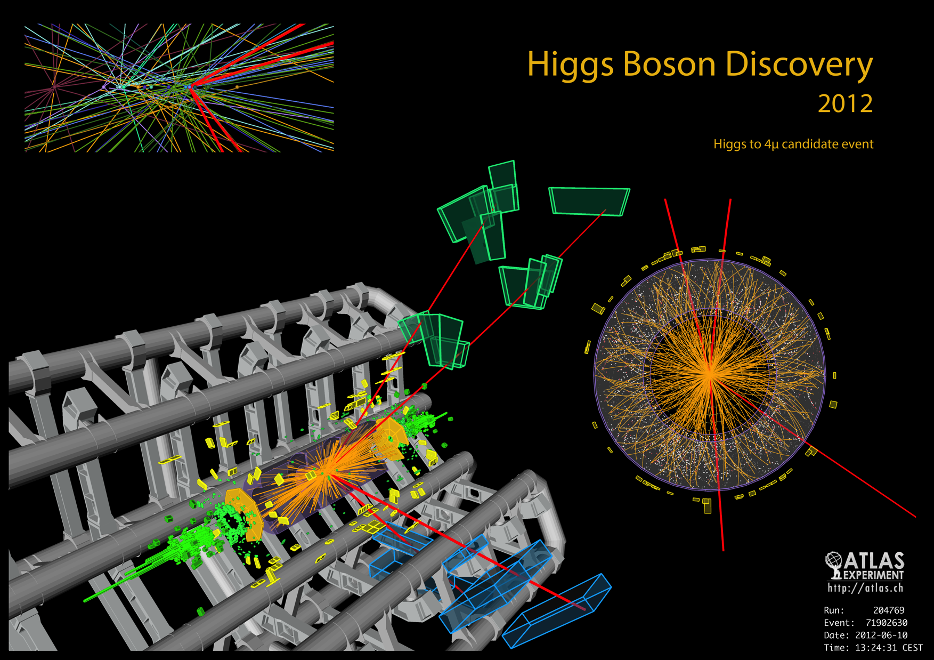

Slide 14
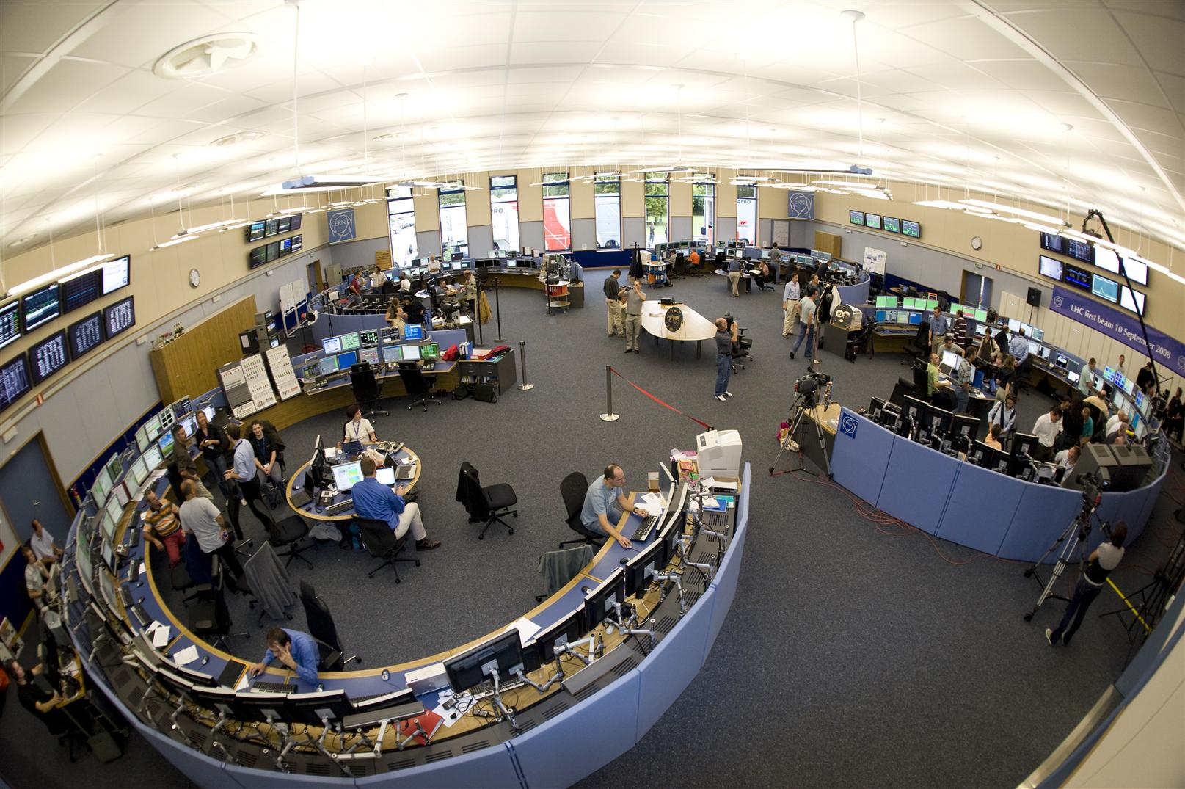
CERN Control Centre
CERN Accelerator Complex is unique installation
Therefore, we have to face unique challenges
Control and operations
Million of sensors, large number of control devices, front-end equipment, etc.
Many critical systems: Cryogenics, Vacuums, Machine Protection, etc.

Slide 15
Data Analytics Challenges
LHC Availability – Estimated VS Observed

Slide 16
Data Analytics Challenges
LHC Corrective Intervention: 3087 / year

Slide 17
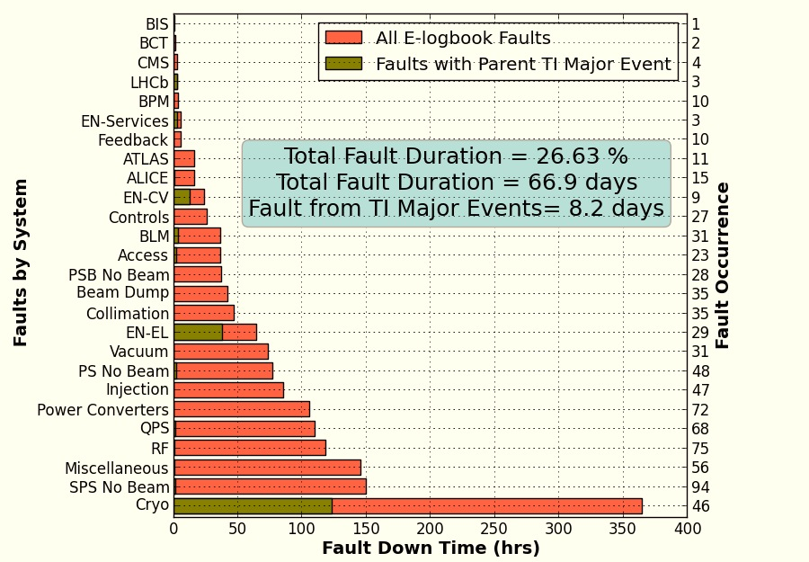
Data Analytics Challenges
Fault Drivers

Slide 18
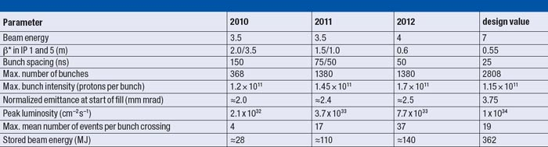
Data Analytics Challenges
A look into the near Future
  LHC run 2 (2015)
2015

Slide 19
Data Analytics Challenges
Profit from our data investment
  Extracting knowledge.
Optimize our systems is mandatory
  Reducing and predicting faults and corrective interventions
  Increase the availability and operations efficiency
Control and Monitoring Systems
  Proactive
  Predictive
  Intelligent

Slide 20
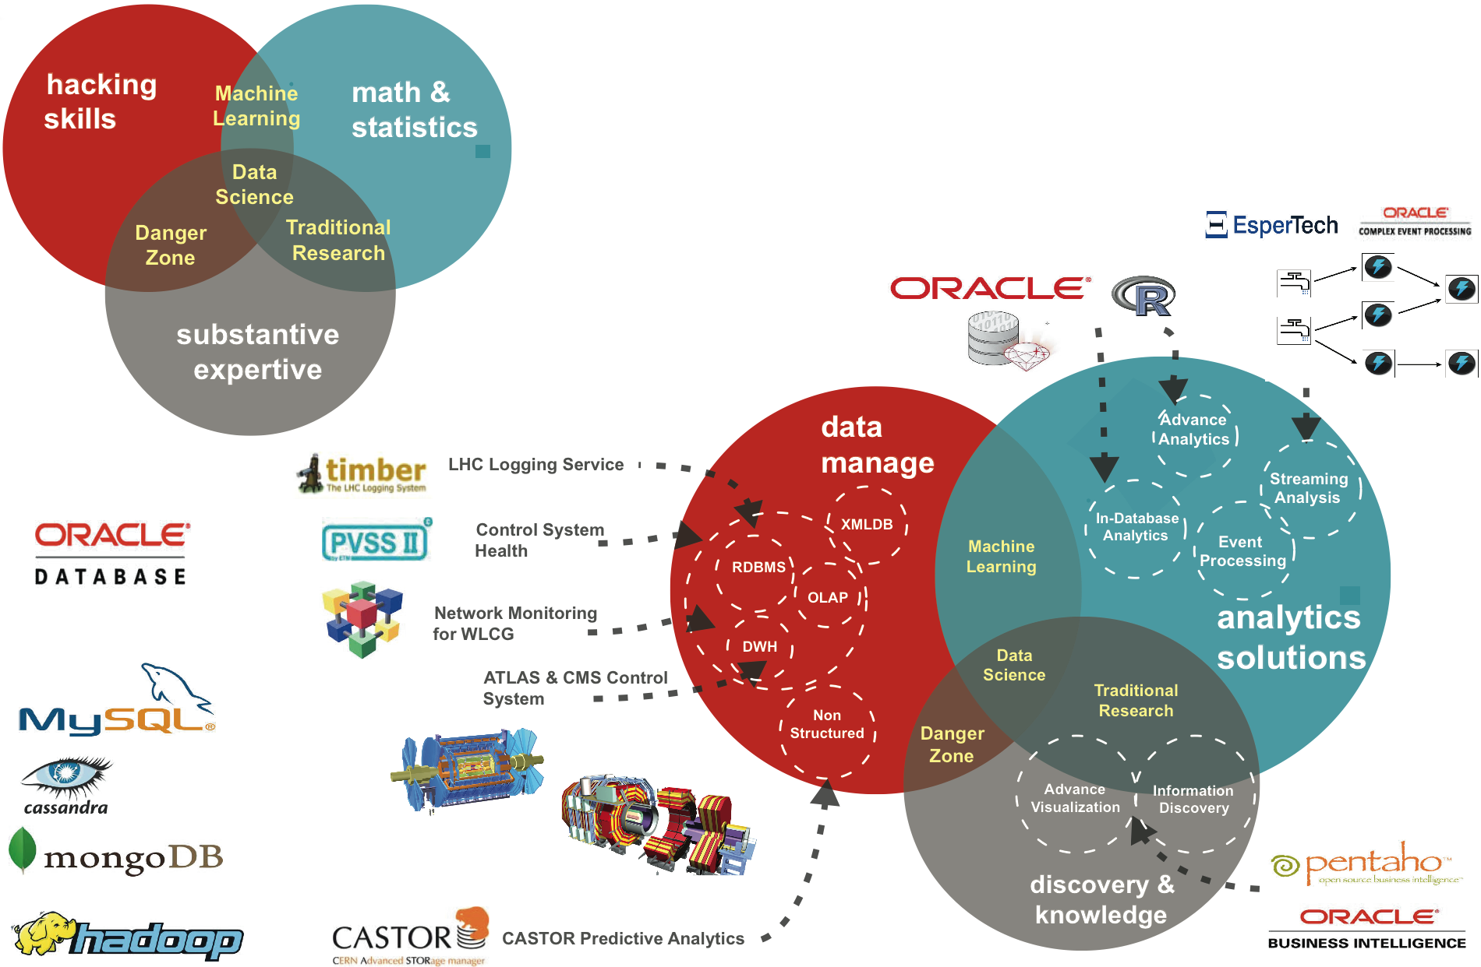
Data Analytics Use Cases

Slide 21
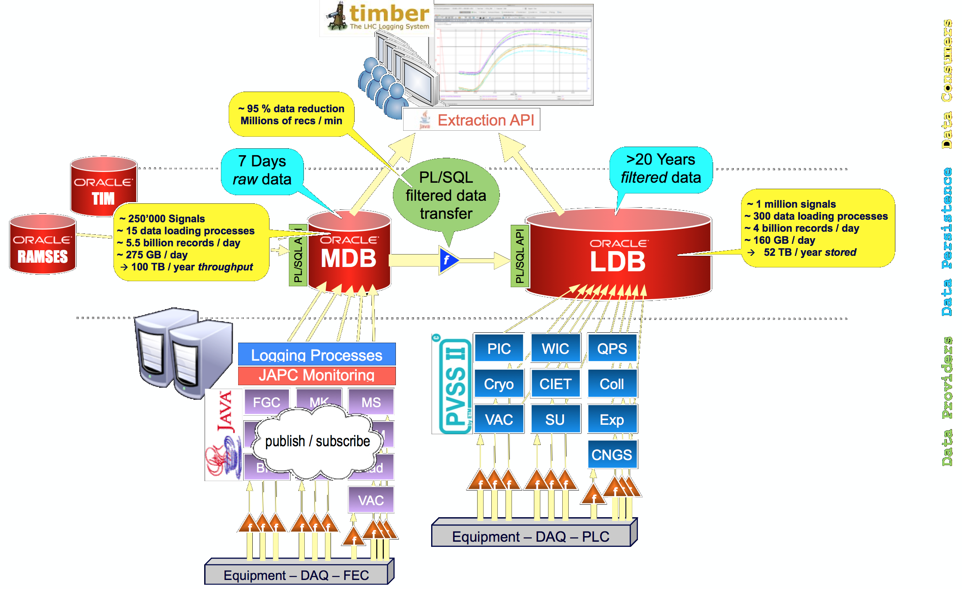
Cryogenics Use Case: Faulty Valves Detection
  CERN Accelerator Logging Service

Slide 22
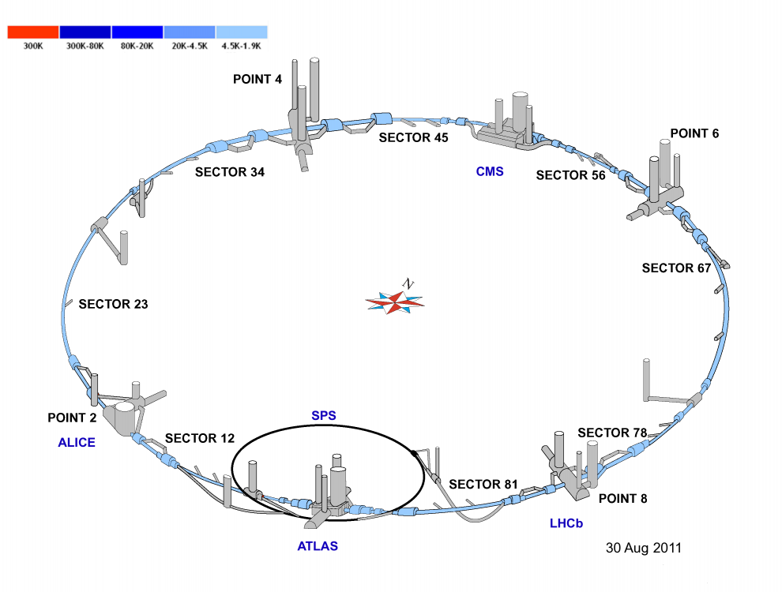
Cryogenics Use Case: Faulty Valves Detection
Study based on sectors
  L4, R4, L8 and R8.
The learning set composed of 44 valves
  aperture order (%)
  aperture measured (%)
Three different status:
  Faulty,
  Not faulty
  Unknown

Slide 23
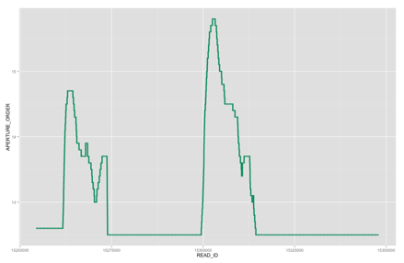
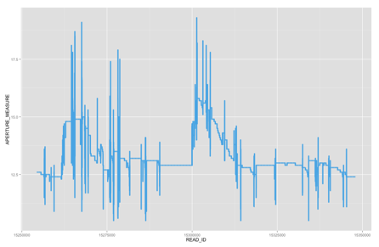
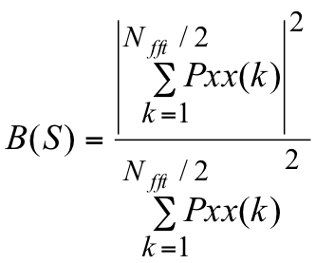

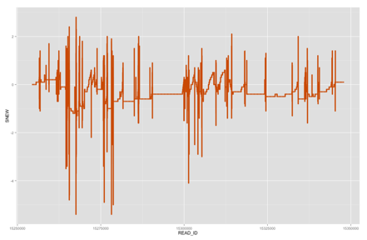
Cryogenics Use Case: Faulty Valves Detection
  Signals used:
    S = aperture order - aperture measured
  Features extractions based on S
    Variance
    Percentile 99.9
    Rope distance – R(S)
    Noise Band – B(S)
  Automatic Faulty Valves Detection System
    SVM - Support Vector Machine

