Slide 1
Short circuit tests and post-LS1 powering test campaign
- Motivation for the re-commissioning
- The test of the warm part of the machine in short circuit
- The powering tests
Mirko Pojer & Matteo Solfaroli
on behalf of all teams involved
(TE-MPE, TE-EPC, TE-MSC, EN-EL, EN-CV, EN-ICE, EN-MEF, BE-CO, BE-OP)

Slide 2
What has been changed in LS1…(apart all ICs in the arcs)…
Power converters (courtesy of V. Montabonnet and H. Thiesen)
Ordinary maintenance:
  Consolidation of the internal water cooling of the IPD, IPQ circuits: change of all flexible hoses
  Change of water hoses used for the connection of the LHC600A-10V converter rack to the CERN water cooling circuit when find defective
  Calibration campaign of all converters
  Maintenance campaign of all converters : check of connections, cleaning of the converters
  Software update
Extraordinary interventions
  R2E relocation in Points 1, 5 and 7
  Consolidation of the output modules of the 1-Quadrants converters (RQD, RQF, IPD, IPQ circuits) : change of rectifier diodes and add air forced ventilation
  Consolidation of the Auxiliary Power Supply of all LHC60A converters : exchange of electrolytic capacitors
  Consolidation of the Auxiliary Power Supply of all LHC600A-10V converters : change of a MOSFET sensitive to SEU
  Addition of FWT_aux on the RB converters (ECR being written)
  Change of DCCTs on the RD4 converters at point 4 (old ECR)
  Addition of a DC cable on the circuits RQ4 at point 5 (ECR Totem)
  Change of the DC cables of RQX and RTQX2 in USC55

Slide 3
What has been changed in LS1_cont
QPS (courtesy of R. Denz)
Substantial upgrade & revision of QPS (and LHC …)
  Main dipole protection systems (all yellow racks have been removed from the tunnel)
  R2E related upgrades:
    Relocation in point 1 & 5
    IPQ and 600 A protection hardware upgrade
  QPS firmware revision & upgrade (DAQ systems + protection systems)
  QPS supervision upgrade (field-bus, gateways, libraries …)
  QPS instrumentation
    Almost all cables have been accessed
    New cables & connectors, re-routed cables
  UPS upgrade
  Protection units for IPQ, IPD protection after revision and upgrade
    68 protection units housing up to 15 circuit boards each
    Instrumentation cabling for the IPQ circuits has been modified to achieve better EMC immunity especially during power outages
  Protection systems for inner triplet protection
    Relocation of systems currently installed in UJ14,16, 56 within R2E upgrade
    Only 8 systems (+ IT corrector protection) but a catastrophic failure could have very serious consequences for LHC operation (no IT spares!)
  Protection systems for 600 A
    Most sophisticated quench detection systems in LHC
    114 protection units housing up to 17 circuit boards each
    28 units to be equipped with newly developed radiation tolerant quench detection systems
    “Some faults, e.g. related to improper assembly of cables and connectors may ‘sleep’ for quite a long time …” R.D.

Slide 4
What has been changed in LS1_cont
EE
Major maintenance on the 13 kA EE
  Circuit breaker contact cleaning
  New relays
Addition of snubbers on the Main Quads
Major maintenance campaign also on the 600 A EE systems
PIC
Relocation of several racks due to R2E
Change of the firmware
Electrical distribution
New WCC cables pulled in few points and sheaths changed in many locations
New UPS, with full redundancy (tests being organized by V. Cheareyre and I. Romera)
…..
QPS is a brand new system (but very detailed and systematic IST procedures)
PCs should have fixed some weaknesses shown in March’13
The WCC and their connections have to be revalidated
Many modifications all around the LHC…

Slide 5
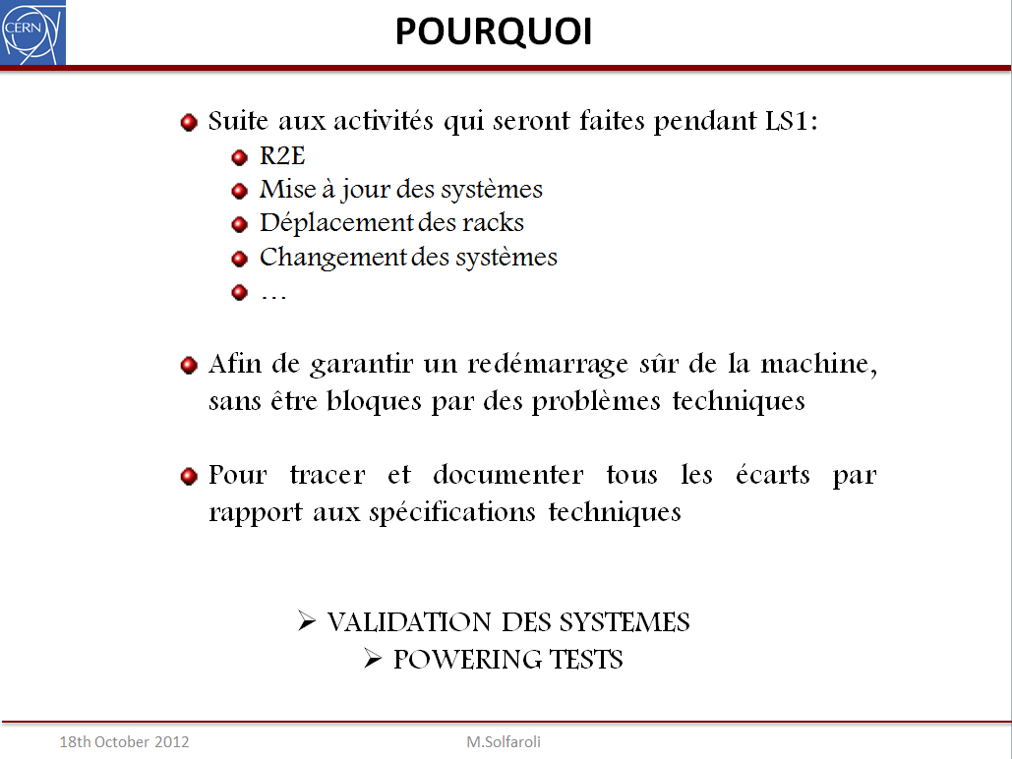
Aim of the test of the LHC technical system
Most of the above modifications will be tested by the owners with the Individual System Tests
The final validation only comes with the test with current
Notes:
To guarantee a safe and above all reliable restart of the machine

Slide 6
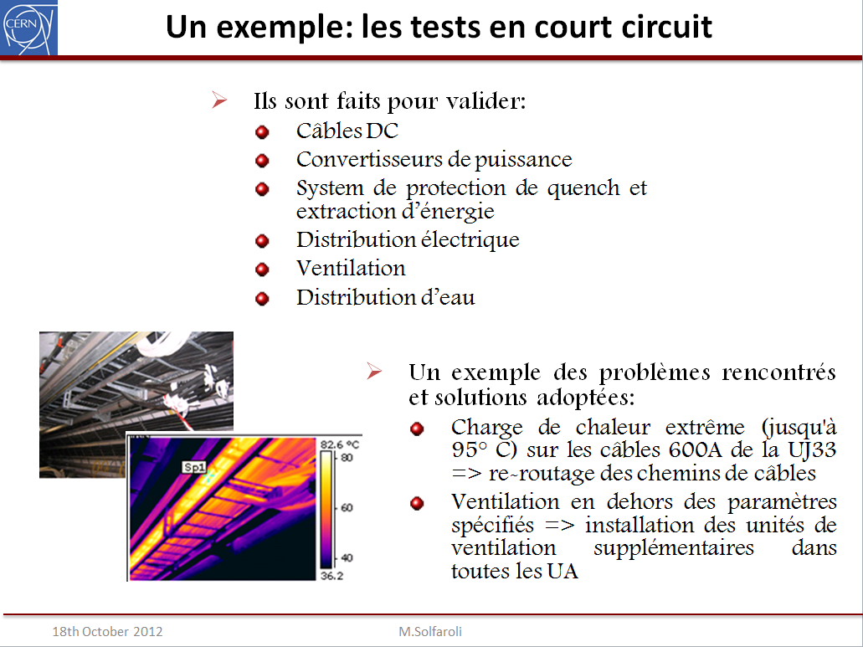
The Short-circuit tests

Slide 7
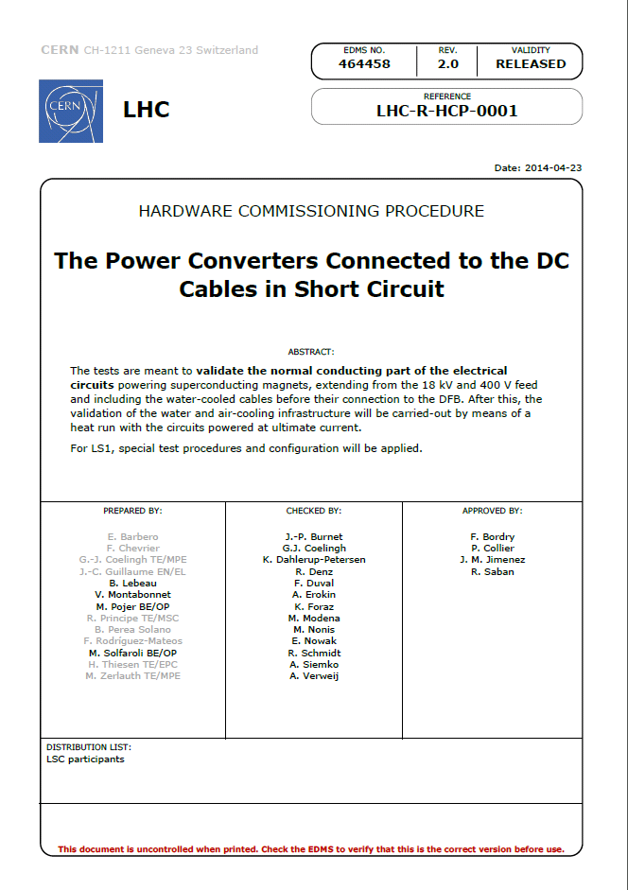
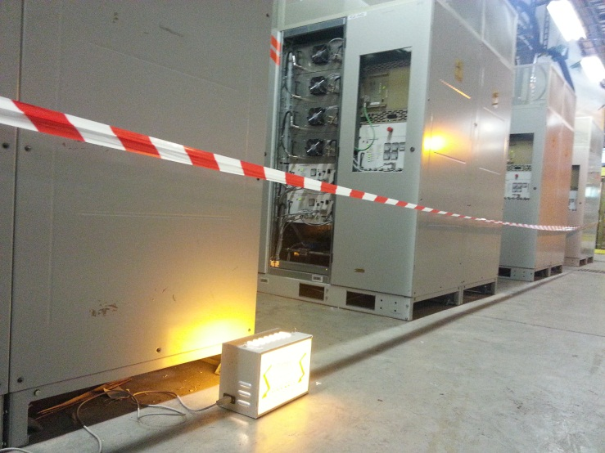
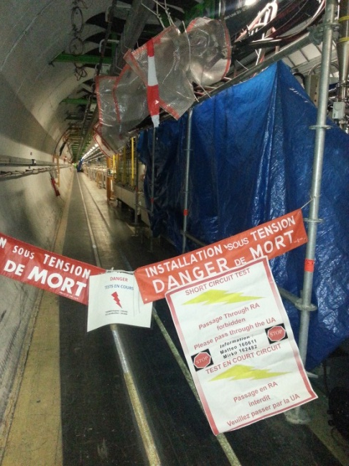
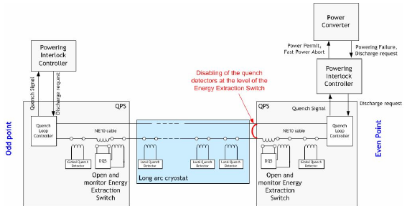
SCT: where and why; how
Change of the WCC sheaths (UA47, UA63, UA67, UA83, UA87, RA32)
Replacement of the WCC (IT main circuit in IP5L)
Power converters and/or PIC racks relocation, due to the LHC availability improvement in the frame of R2E project (IT circuits of IP1L/R and IP5R)
Modification of the EE system of the 13 kA circuits (all points)
Maintenance/upgrade of the 600 A EE systems (all points)
For Main circuits
Courtesy of G.H. Hemelsoet and E.Veyrunes

Slide 8
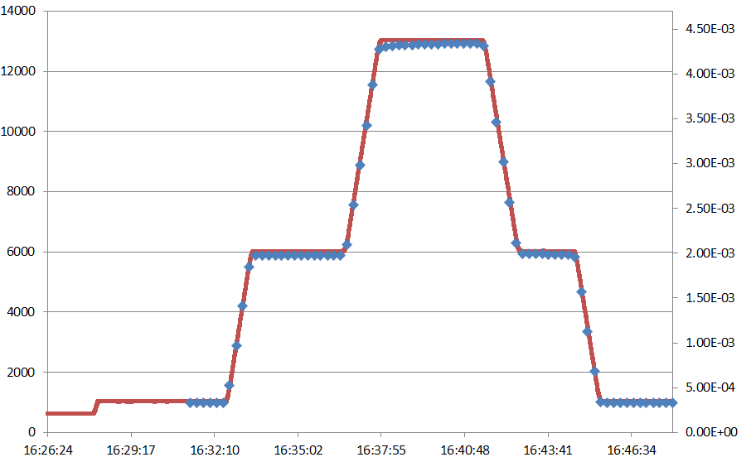
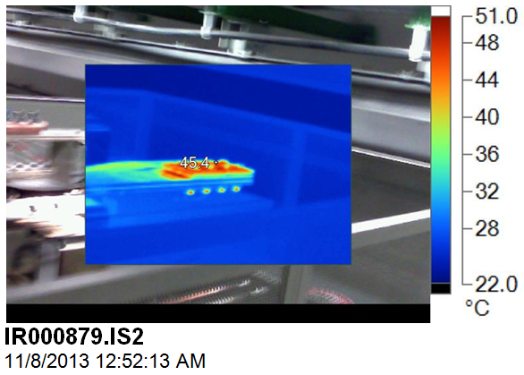
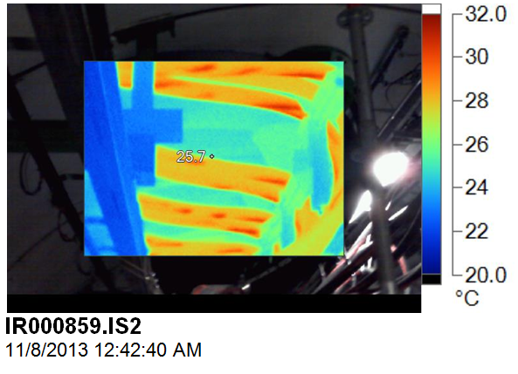
The test sequence
13 kA circuits:
  Energy Extraction high voltage qualification
  EE Individual System Test
  Interlock signals verification:
    Water cable cooling
    FPA @different current levels
  Conical connection R verification
  EE current sharing verification
  Heat run (12h or 24h)
6 kA
  Heat run
600 A
  EE IST
  EE validation and current sharing verification
  In order to avoid the disconnection of the cables from the DFB (potential risk for the V-taps connectors) the PC is short-circuited on the EE system via additional 3.5 m long 120 mm² cables
+ SC installation few days before and PC setup for all, before test with current
Current[A]
One RB conn.
Current
0.3 μΩ
Voltage

Slide 9
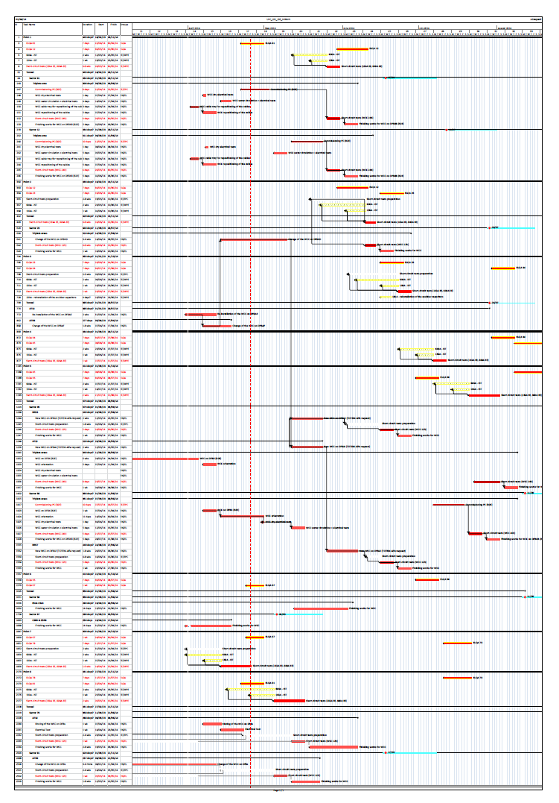
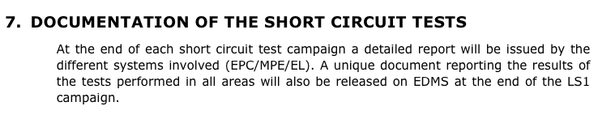
Where are we?
We are here
August
UA47:
  13 kA and 6 kA PCs validated
  EE HV test still to be done
  EE IST still to be done
  600 A circuit have not been tested
UA63 + UA67
  13 kA and 6 kA PCs fully validated (wrong water interlock cabling has been corrected). Problem with conical connection of RQF.A63 found and solved
  RQ4.R6 and RQ4.L6 not included in the test campaign as no change occurred
  600 A circuits with EE have been fully validated (the circuits located in the UA67 went through a long heat run to validate the status after the flood occurred in the area)
RR73 + RR77
  RB cables and EE systems validated (by connection of RQTL7 PC)
  600 A circuits with EE validated. A special configuration was used as the installation of short circuit between the EE and the PC was not possible in this area

Slide 10
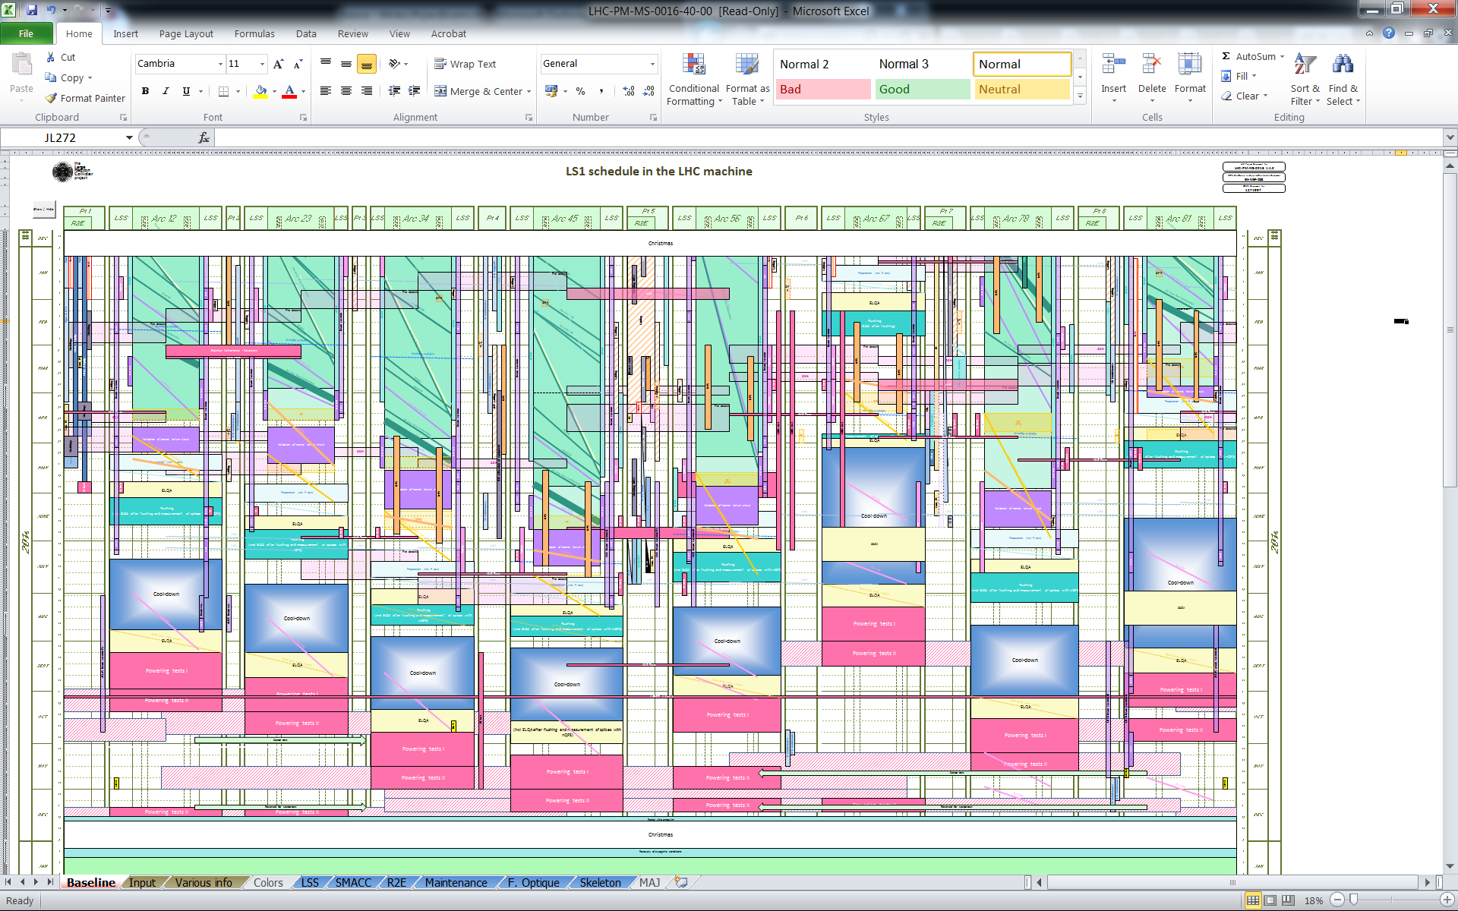
The powering tests: planning
Start of post-LS1 powering test

Slide 11
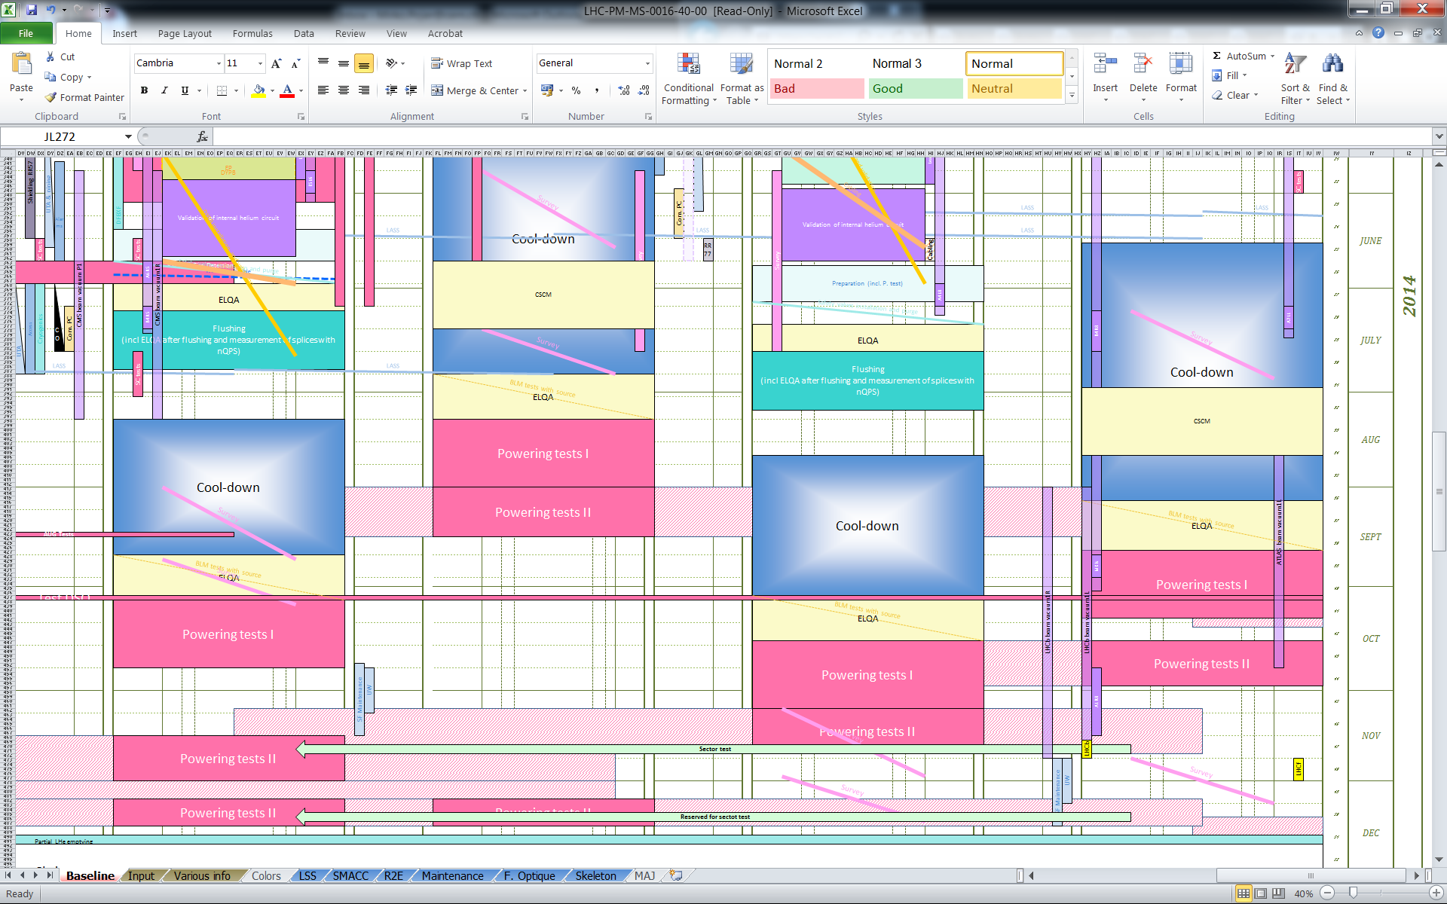
Zooming: 56 to 81
Sector 56
Sector 67
Sector 78
Sector 81
Start of post-LS1 powering test

Slide 12
Highlights
Powering tests will start in August (many people on holydays)
There will be the cohabitation (above all in the first sectors) with other LS1 activities (mainly ElQA, geometers and BLM testing)
  Phase I and Phase II are completely separated to allow maximum flexibility at the beginning → can fully test all circuits ≤ 600 A and can start the high current circuits without blocking half machine (discussions on-going on Phase I current levels…)
  3 weeks for Phase I powering and 2 weeks for Phase II
  Might be obliged to test outside normal working hours
At the end of the powering in each sector, other activities are scheduled → tight boundaries!
For S67, we’ll be doing the CSCM in S81 at the same time (CSCM requires for support of many experts, QPS mainly)
S67 will be the test bench, after which we will have to commission 7 sectors in 3 months!
Definition of powering phases
  LHC-MPP-ES-0002, EDMS 1001985: “Access and powering conditions for the superconducting circuits in LHC”
Phase I is defined as the phase when “the current in a sector is limited to a value with negligible risk of massive accidental helium release due to powering”. Access limitations only in the sector under powering. Phase II is beyond this limit (almost half machine closed at a time).

Slide 13
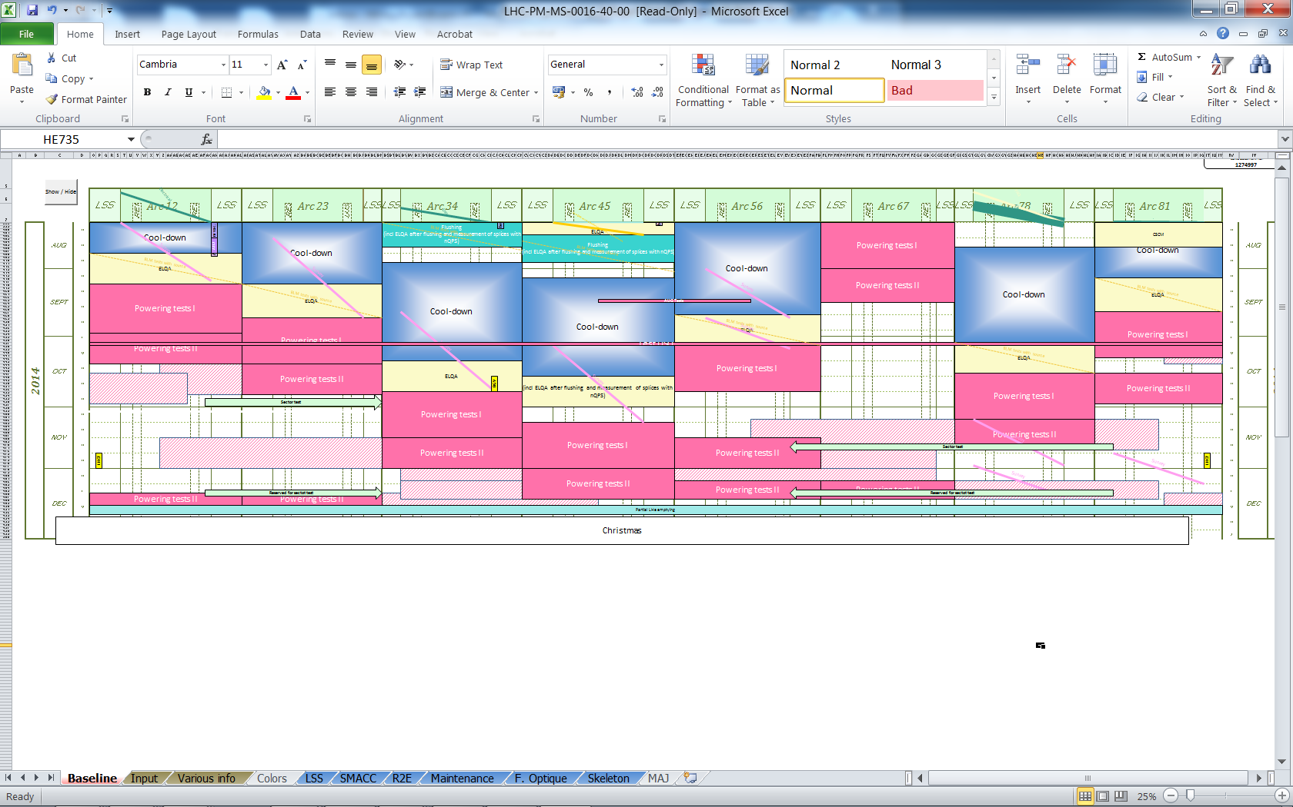
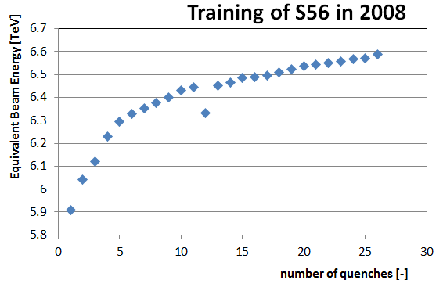
“Levelling”
One additional week was added on mid-December for sector levelling:
  The training strategy of the 13 kA circuits considers in fact a maximum number of quenches as acceptable (in a first stage) to reduce commissioning time and minimize the risk of a failure (MP3 is working on that strategy)
  According to the results of all sectors, an extension of the training on some sectors could be agreed
  (in addition, the training should be possibly done
  up to a current slightly higher than the one used
  in operation to guarantee a stable run)
Only one sector will be trained before Chamonix
Possible conflict with sector test proposed dates:
  End of October
  Mid November
  Mid December

Slide 14
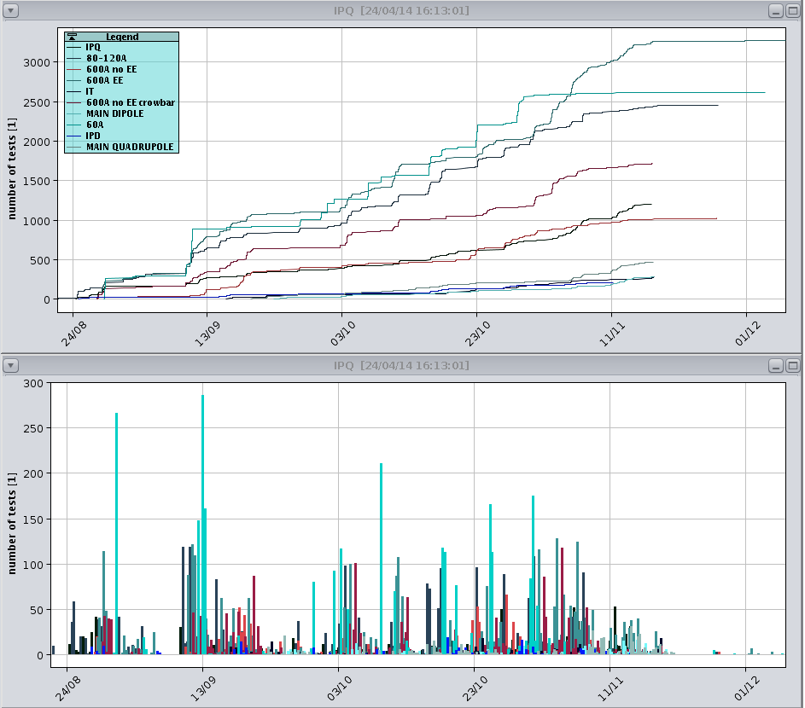
Some numbers
What do we have to test?
Almost 1600 circuits
24 Main circuits
  8 RBs
  16 RQs
8 ITs
94 Individually Powered 4-6 kA circuits
  78 IPQs
  16 IPDs
410 x 600 A circuits
  202 with EE
  72 w/o EE
  136 w/o EE, with crowbar
284 x 80-120A circuits
752 x 60 A circuits
With a total of more than 10000 powering test steps to be executed in less than 4 months
We have done it already (2009), even if we stopped at half energy at that time
Other similarities: in 2009 the QPS was completely changed, after the forced “LS0”
Cumulative number of powering test steps performed between August and December 2009 (divided per circuit)

Slide 15
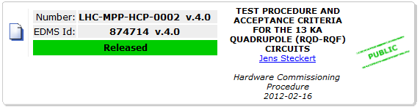
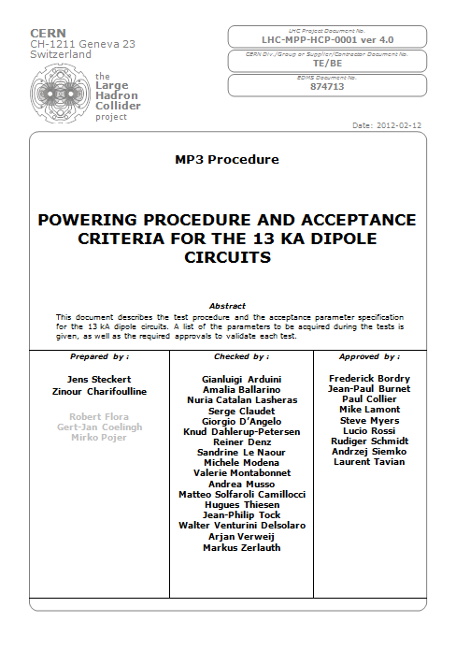
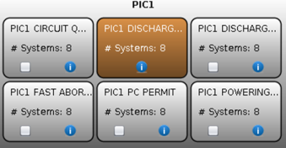
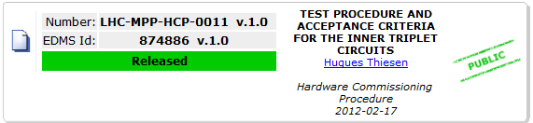
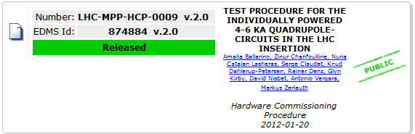
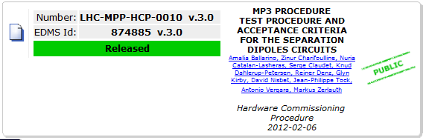
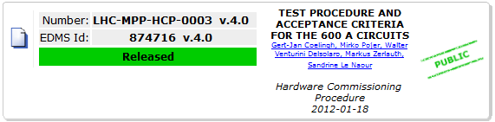
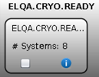
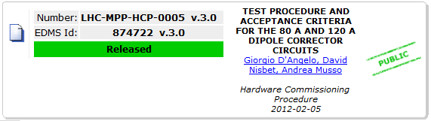
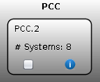
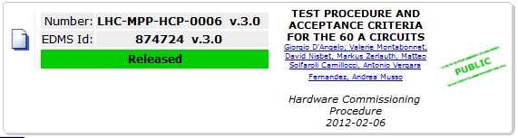
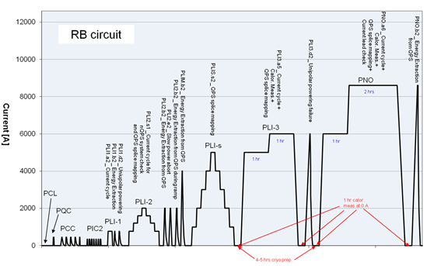
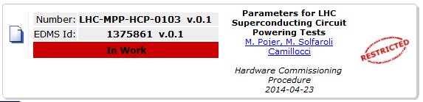
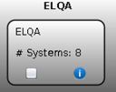
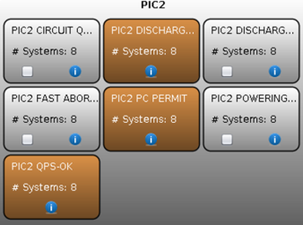
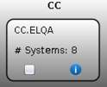
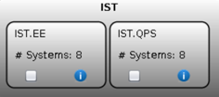
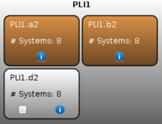
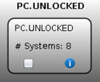
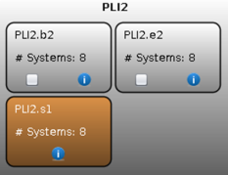
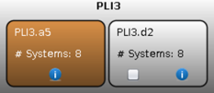
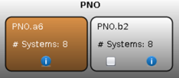
How is it done
Old procedure – given as an example only
Powering to nominal
Preparation and setup
MP3 is doing a big effort of revision and optimization of all powering procedures
Revision process to be completed by the beginning of June (need time to implement all changes in the testing sequence/r)
Example of the testing flowchart for the RB circuits

Slide 16
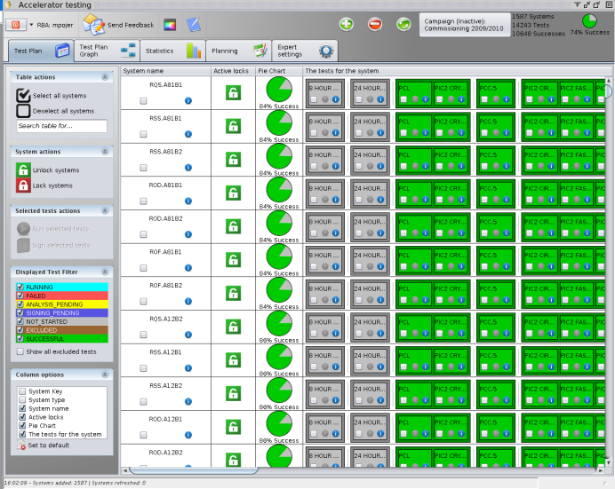
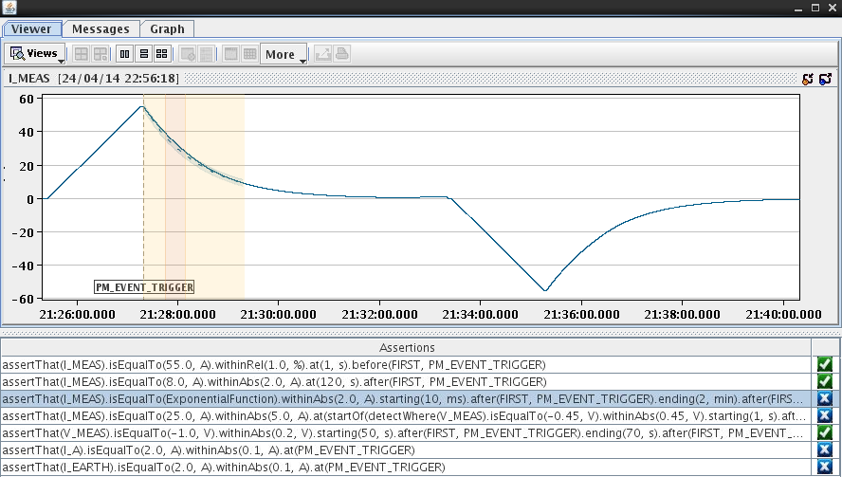
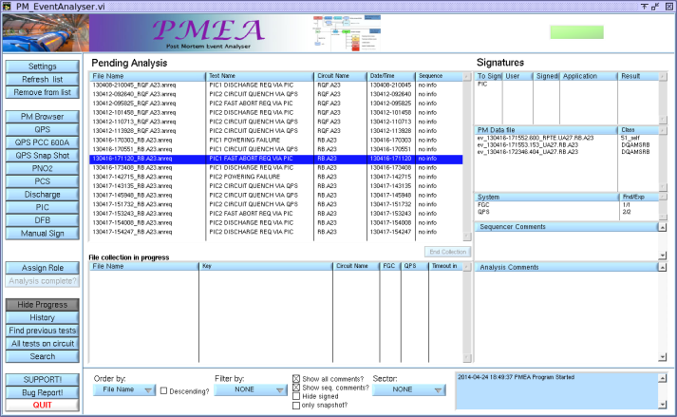
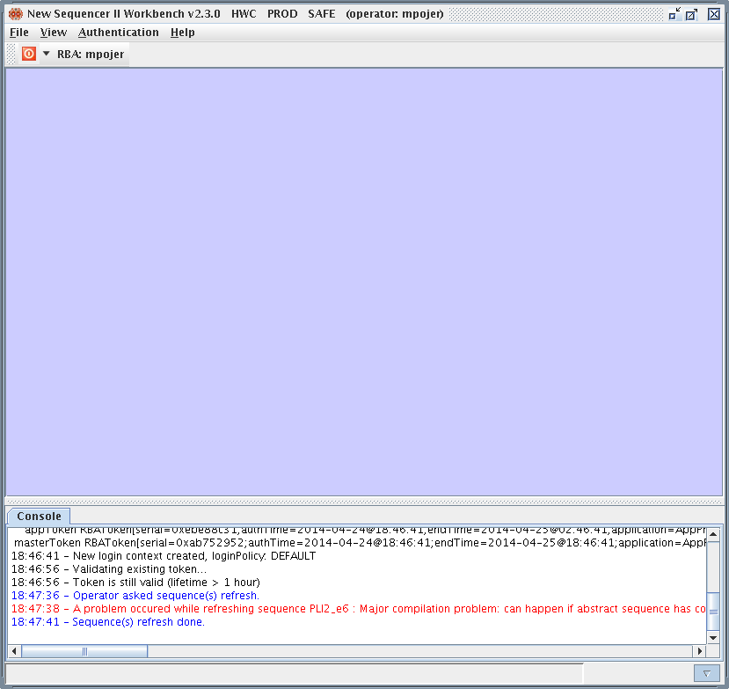
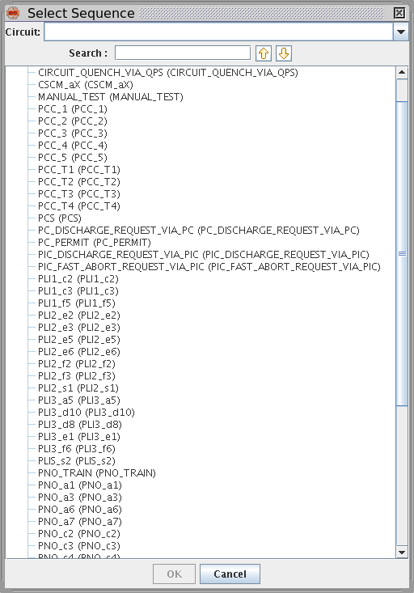
Automation: testing and analysis tools
Analysis modules defined in clear English-like syntax. These modules can then be automatically executed by the framework. 60A circuits are completely automated (to be tested with the test benches). More circuits and tests will possibly follow.
Accelerator testing Framework
by J.C. Garnier&Co
Heavily upgraded in the last months, it has now enhanced functionalities (new campaign creation, test steps activation, etc.). It allows to reduce the testing time, by automatizing their execution and selecting the simultaneous powering constraints.
Post-Mortem Event Analyser
by O. Andreassen & EN-ICE
Sequences will have to be updated and extensively tested
(test benches will be prepared for the 120 and 60 A)
Also LSA database is being updated
Maintenance and adaptations have been done to make it compatible with the new ACCTEST framework introduced in LS1. All PCC, Discharge and PIC tests can be automated.
It will certainly profit from the test benches to test all possible communication issues
HWC Sequencer
by R. Gorbonosov
In addition, a new MTF campaign will be created

Slide 17

Concluding remarks
The short-circuit test campaign is progressing well
  After several iterations, we have now clear objectives and a well defined modus operandi
  Some problems have been already discovered and solved
  The planning is tight and there is not much space for errors
Concerning the preparation of the powering tests
  The IST preparation and execution is a fundamental premise for the success!
  MP3 is finalizing the powering procedures
  The testing and analysis tools are in a very mature state
  We will start soon implementing the changes in the sequencer
  Periodic meetings are being organized and will become denser towards Summer
  Daily meetings from the beginning of the powering tests
  Topic seminars are being organized, to show the major changes in LS1, their impact on the powering tests (but also operation) and the new tools available
Thanks for the attention!

