Slide 1
Injectors & LHC report
K. Foraz
on behalf of OSS members

Slide 2
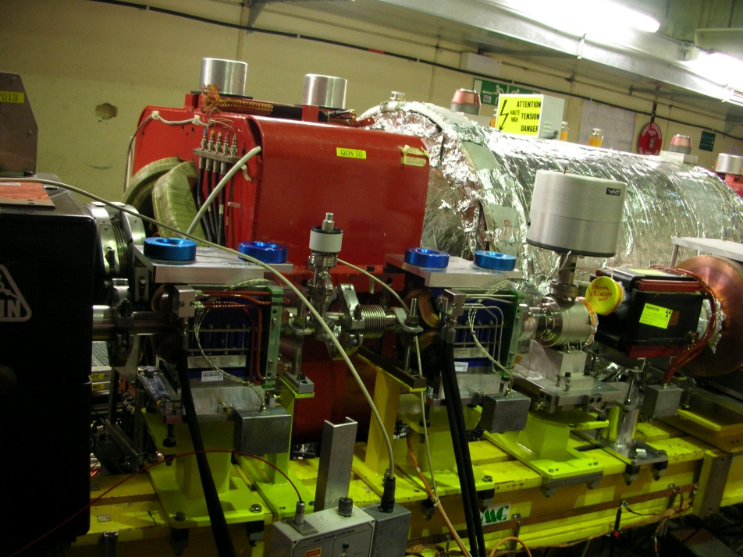
AD &LEIR
AD
  Bakeout sector 1B (last sector !) completed on 9/04
    Small leak around SC tanks –
    under investigation
  Installation of magnets on
  line 7000 girder in progress
  Commissioning of Access system OK,
  but interlock with RF cavity C02
  needs to be repaired.
  Installation orbit correctors around
  e-cooler : 1 magnet still on test
  magnetic bench.
  Installation postponed in week 20.
LEIR
  New control system for kickers – tests in progress
  Magnet maintenance started
700 girder

Slide 3
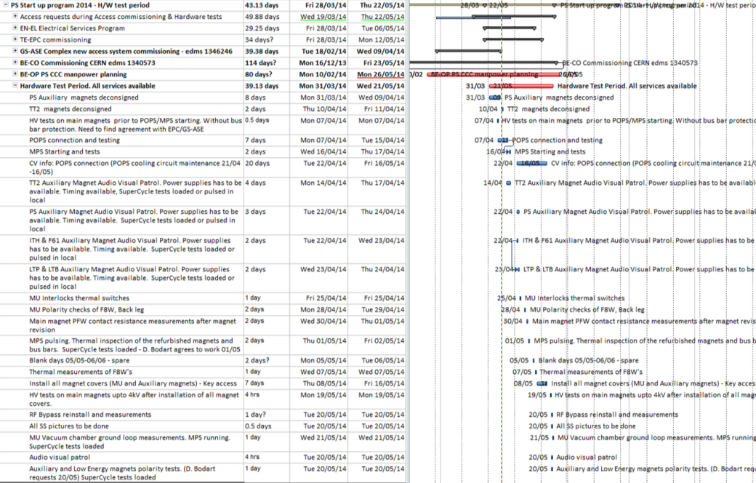
PS
Hardware tests in progress
  MPS tested, POPS tests completed POPS restarting, the system has now 3 working modes validate.
  90 % Interlocks fully validated for powering
  70 % Power supply tests completed
  CO, EPC, RF, Septa, Magnets tests are on-going
  Access procedure under approval
From 08/05 to 16/05
  PS ring and TT2 will be consigned in order to install all magnet covers – Access allowed to fix problem seen
External shielding, & new transformer in progress

Slide 4

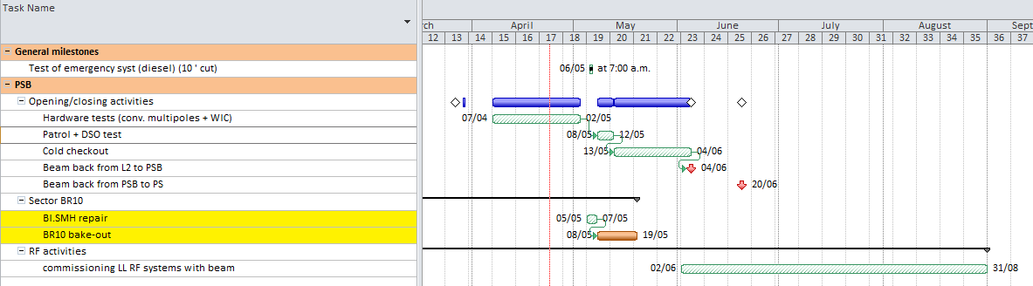
PSB
  Hardware tests in progress
  Multipole commissioning finished
  Next week : commissioning of all the other converters
  Dry run progressing well
  BI.SMH repair on May 5th to May 7th
    ALARA meeting this afternoon
    DSO tests postponed by 3 days
    Bake-out in parallel with DSO test and cold check-out

Slide 5
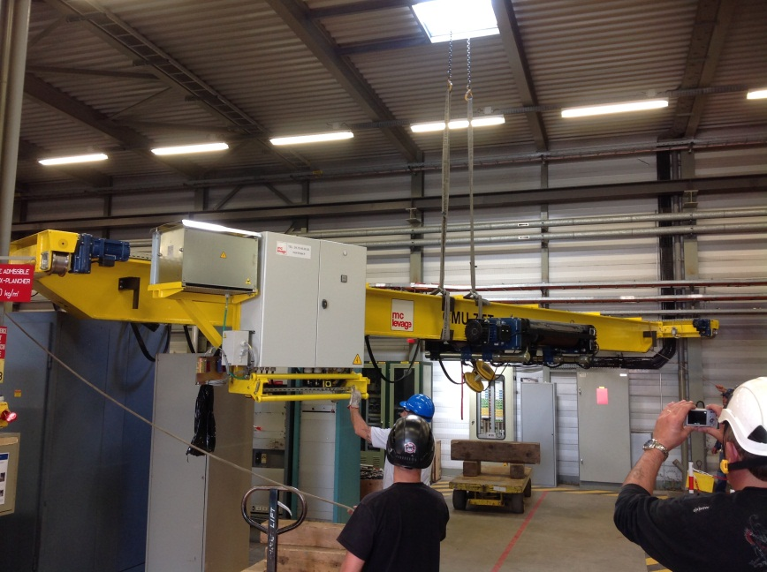
SPS
BA1:
  Re-installation phase in progress
    Sec 142: BPC, Sec 143: vac. Pump & MKP, Sec 143: QFA
BA2:
  Cabling campaign – On schedule (end April14)
  TE/MSC replaced the faulty magnet in TT20 last week
BA4:
  BE/RF are in the process of installing 2 helium pumps in the alcove region of SPS Point 4. (Work to be complete by the end of April)
BA5
  Transport are now in the process of moving all the equipment that was stored in ECX5 back to LSS1
    This will continue until late May.
Other works:
  EN/HE have replaced one of the “rolling” cranes in BA1 and BA6 surface buildings.

Slide 6
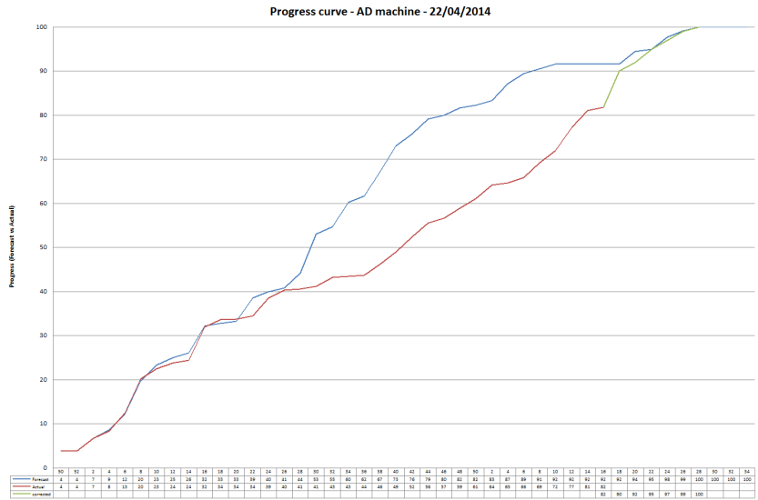
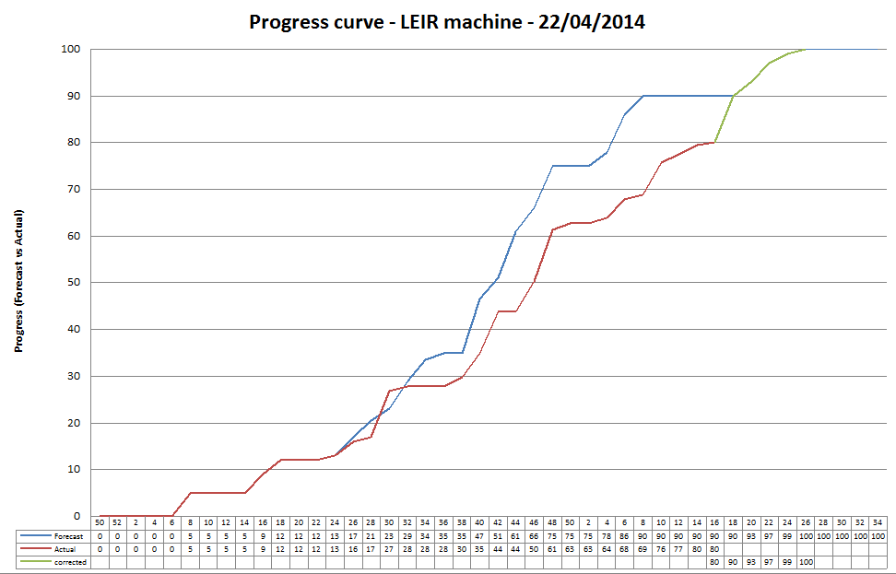
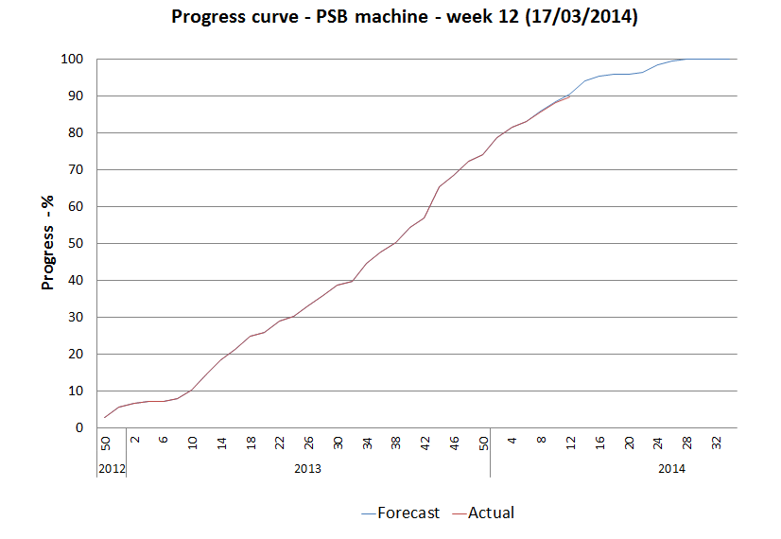
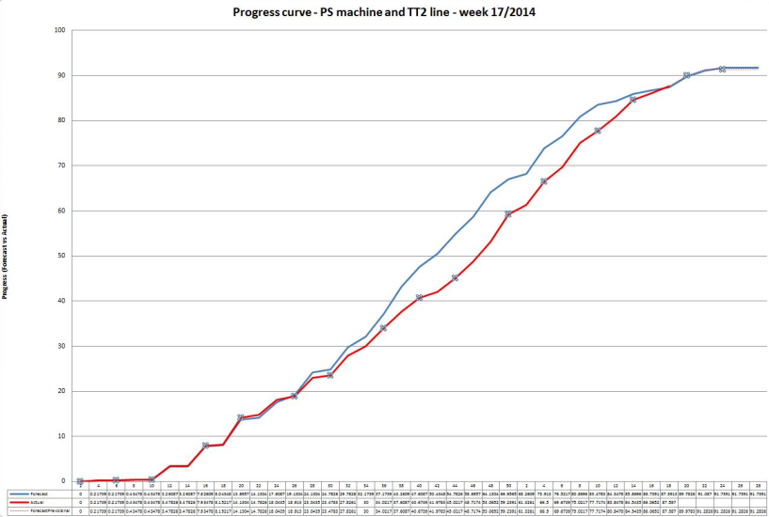
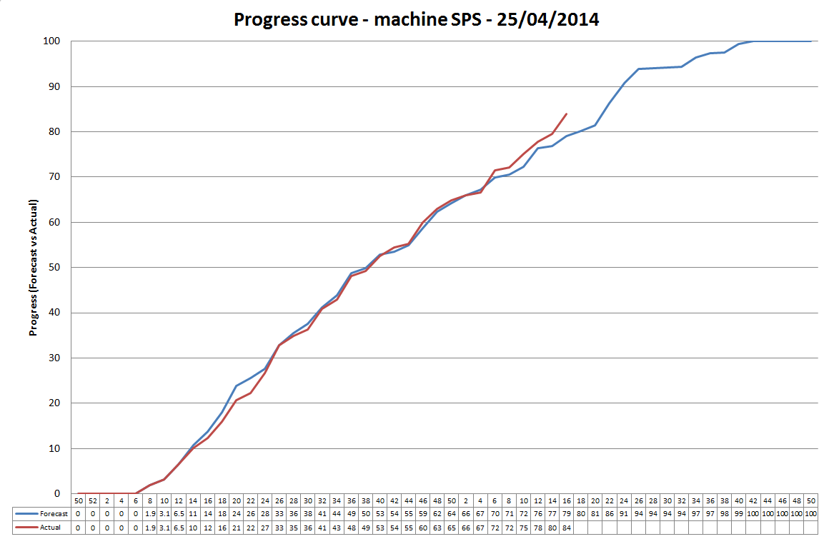
Injectors progress

Slide 7
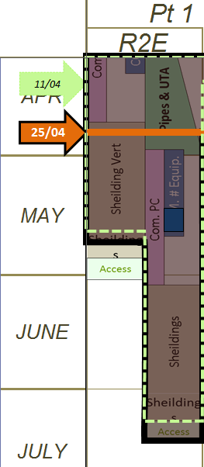
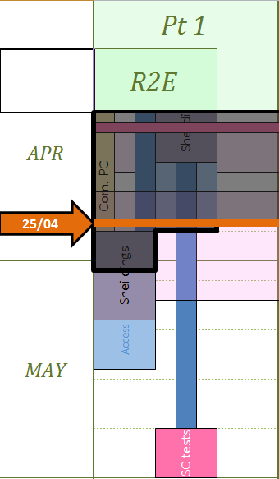
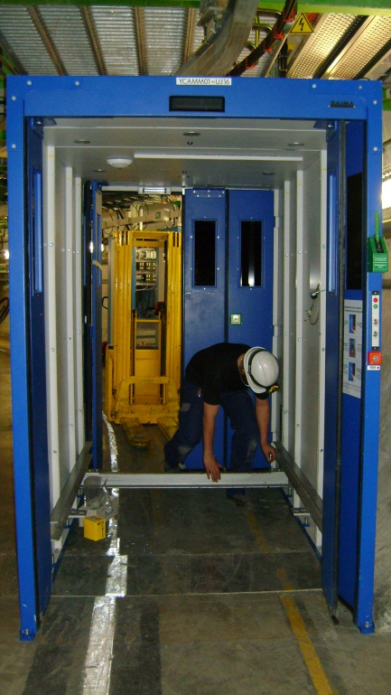
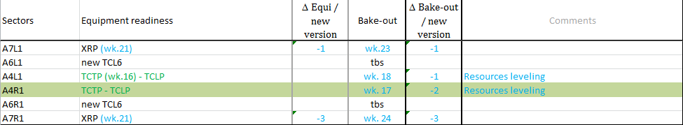
LHC - P1
R2E – Pt1:
  Done
    Access system re-installation in UJ16
  In progress
    Commissioning of power converters
    Shielding in UJ14
    Short circuit test (Inner Triplets)
LSS1:
  Vacuum work in progress
    A4L1 (TCTP), A4R1

Slide 8
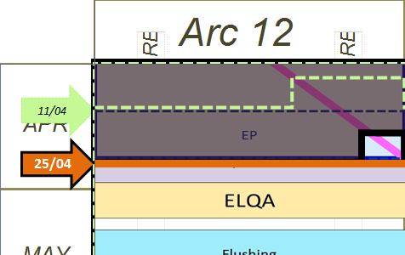
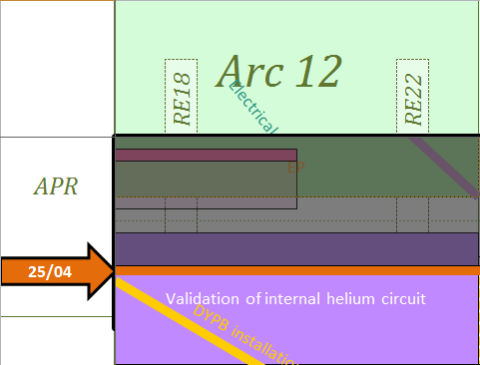
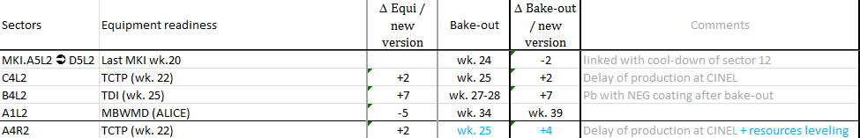
LHC – P1  P2
Arc 12 :
  SMACC - W leak tests
    13 vacuum sub-sectors validated
    5 external leaks
    A27R1 – internal leaks solved & c’k flexible replaced – being validated
  Forecast
    Pressure test – wk. 20
    ELQA – wk. 22-23
    Flushing wk.24-25
Point 2
  Cryogenic maintenance in progress
  UW & SF maintenance in progress
  Pumping station consolidation in progress
  Optical fibers – blowing in progress
LSS2
  Survey – maintenance of Inner triplets
  Vacuum mechanical work in stand-by (waiting for TCTP)
  Consolidation of inner triplets in progress

Slide 9
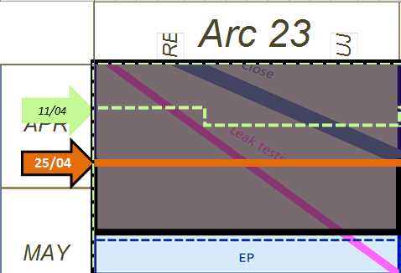
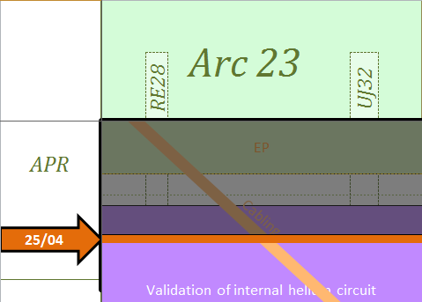
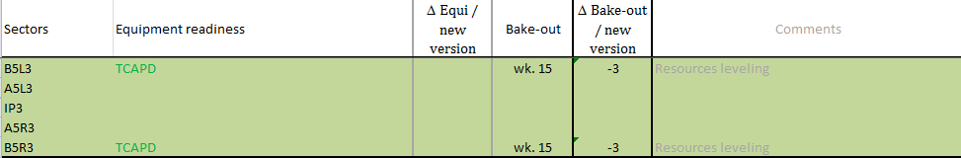
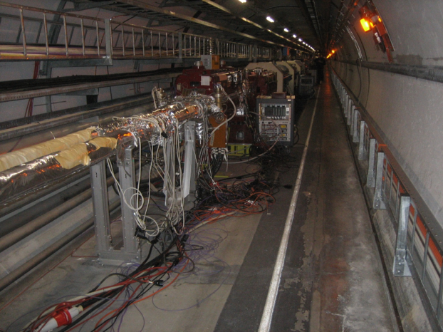
LHC - P2  P3
Arc 23
  In progress
    SMACC
      W closure finished
      11/14 vacuum sectors validated
LSS3
    Vacuum activities: B5L3&R3 baked-out
    Water cooled cables on DFBAF done
    Replacement of PLC diesel in progress – no access
All vac. Subsectors ready

Slide 10
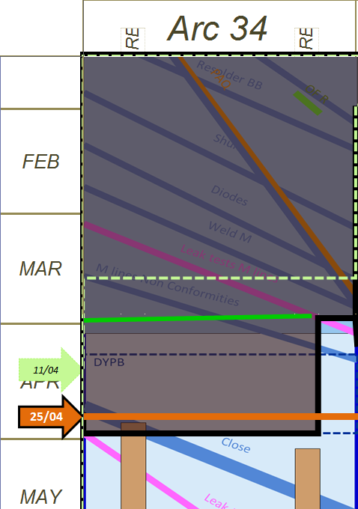
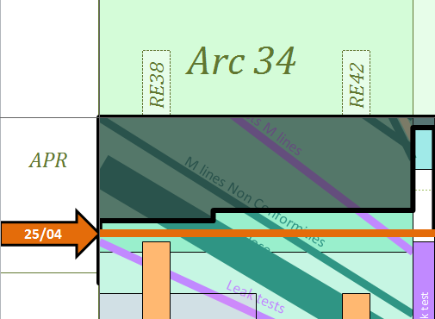
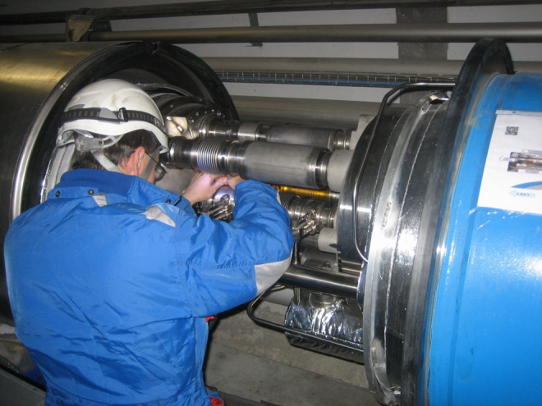
LHC - P3P4
Arc 34
  In progress
    DFBA consolidation:
      DFBAF – done
      DFBAG – almost complete, Re-installation of MLI to be done
    SMACC:
      M weld finished
      M leak tests in progress ~85%
      Closure in progress ~20%
28L4 – consolidation of nested bellow

Slide 11
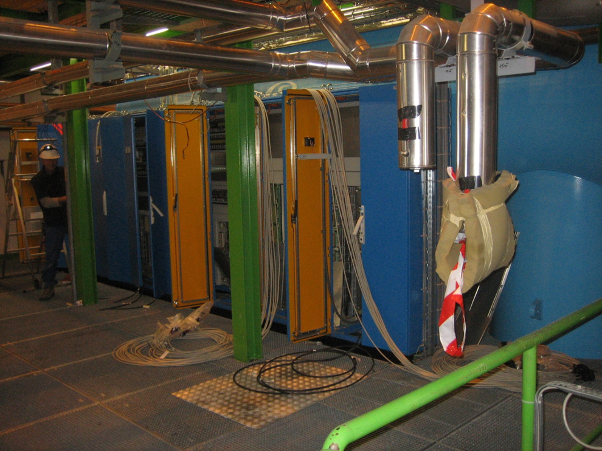
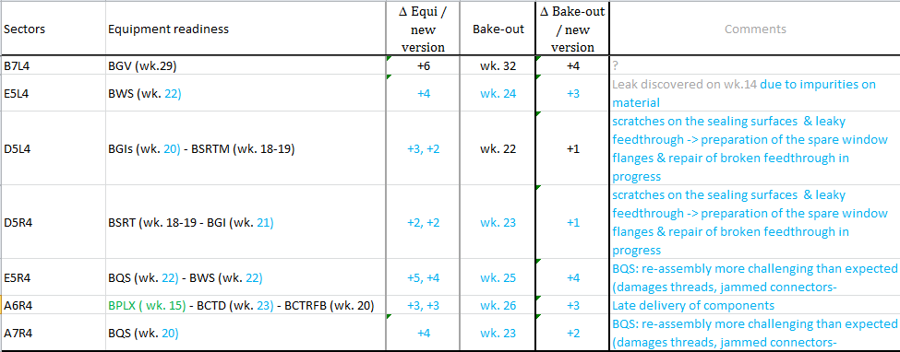
LHC – P4
LSS4 & P4
  Finished
    New cooling tower
    SF & UW maintenance
  In progress
    Cryogenic maintenance
    RF maintenance
    UPS installation
    Vacuum activities in stand-by (waiting for BI equipment's)
    R2E cabling campaign in progress
UX45 – R2E cabling

Slide 12
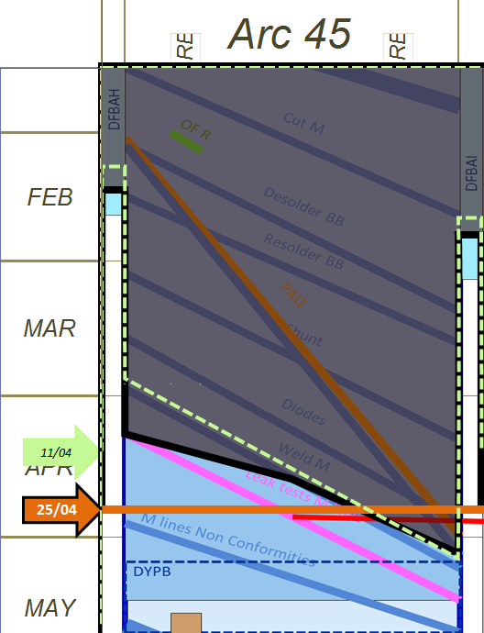
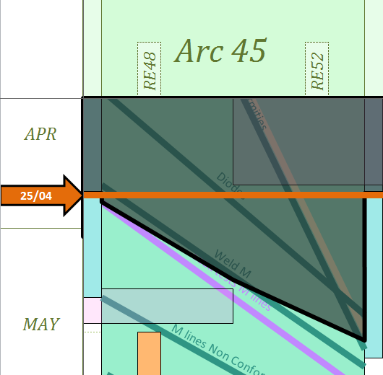
LHC – P4  P5
Arc 45
        SMACC
          Diodes installed
          M welding in progress ~ 50%
        DFBA
          H : in progress (end = wk 22  22)
          I : in progress (end = wk 23  22)

Slide 13
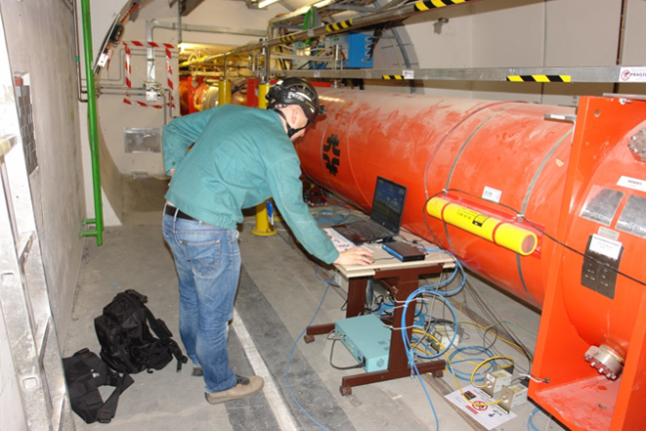
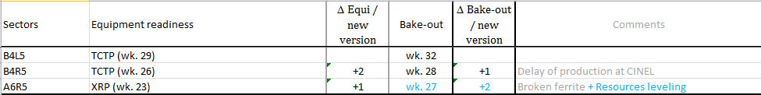
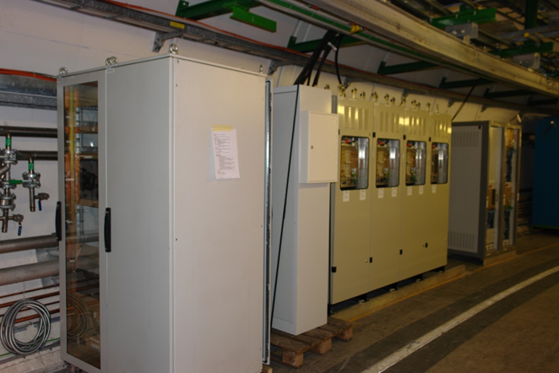
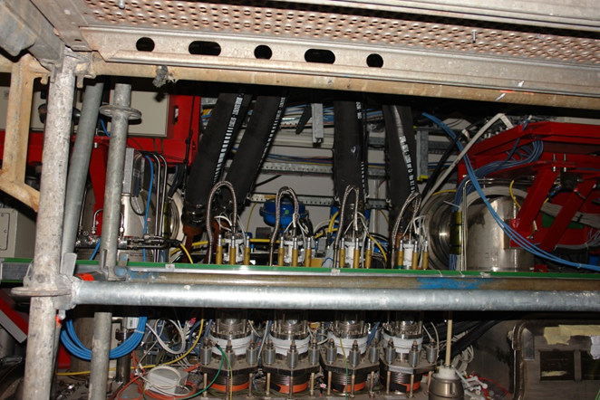
LHC – P5
LSS5:
  Cabling campaign in progress on both sides
  Vacuum work in stand-by (waiting for TCTP and TOTEM)
  Survey and alignment of intermediate components in progress
R2E – P5
  Power converters installed
  Cabling finished
  WWC on Inner triplets re-installed – orientation in progress
  Safe room
    Ventilation being installed
    Relocation of equipment
Q2R5 -Survey
UL557 – power converters installation
RB57 – Water Cooled cables oriented

Slide 14
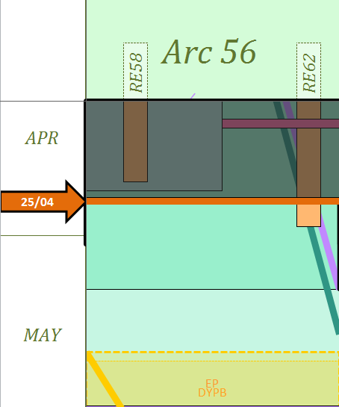
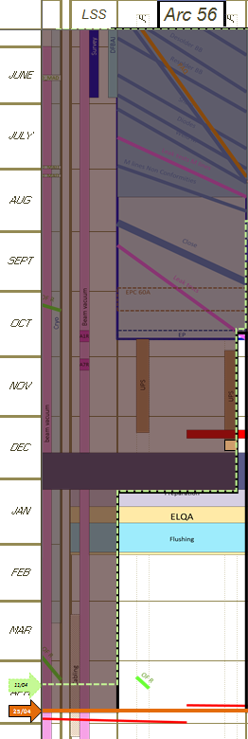
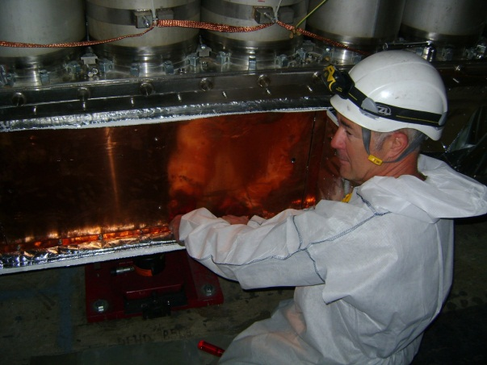
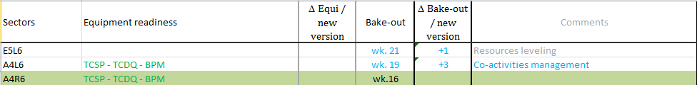
LHC – P5  P6
Arc 56
  SMACC
    DFBAK consolidation done
    Leak status
      2 external leaks:
        external leak 7R5, repaired, to be validated
        1 Leak on a dipole magnet (pied) 23L6 @ 10⁻² mbar l/s, solution validated – will be implemented next week
      1 Internal Leak on vacuum SS 7L6, to be localised (10⁻⁶ mbar l/s);
  Forecast
    Pressure test: June 17th
LSS6 & P6
  In progress
    Survey measurement of magnets
    and intermediate elements
    Vacuum activities: A4L6, A4R6
DFBAK closure ☺

Slide 15
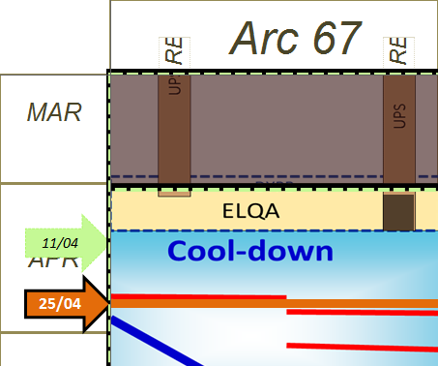
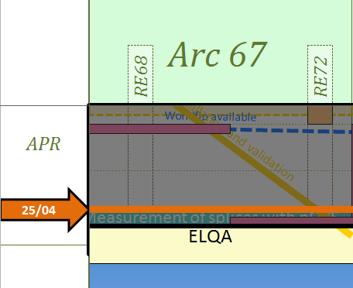
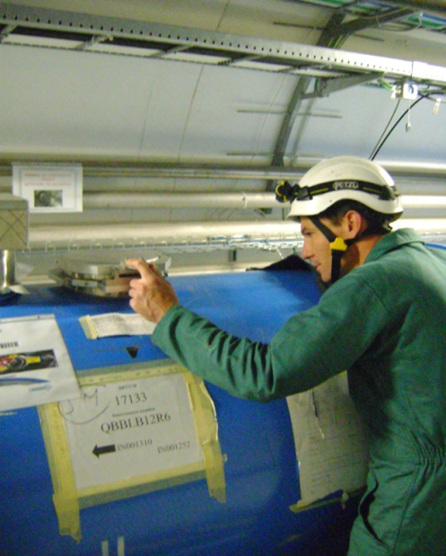
LHC – P6  P7
Arc 67
    UPS type test done
    DYPB reconnection and validation in progress
    Preparation for cool-down in progress
      QRL valves installation
      Cryogenic system re-commissioning
      ELQA from next week
    nQPS tests cancelled (material unavailable)
    Cool-down will start on May 7th
Insulation vac. last control

Slide 16
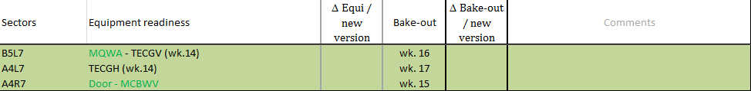
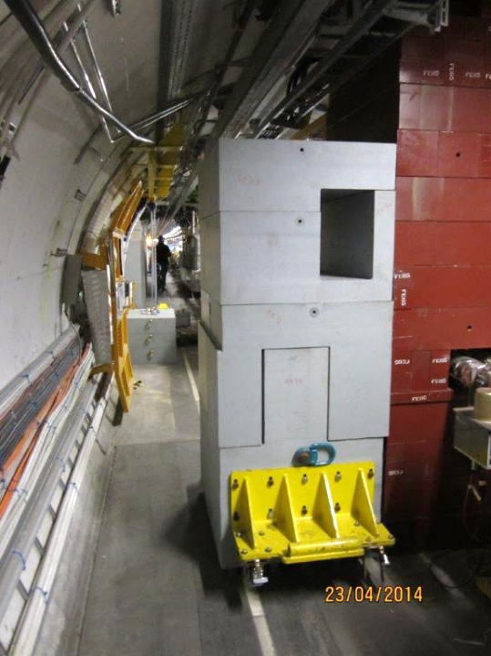
P7
LSS7
  Vacuum activities in progress:B5L7, A4L7
  Short circuits tests done
  P7 enclosure in progress
    Doors commissioning in progress
    Airtightness finishes
R2E – P7:
  Cabling campaign finished
  RR73 shielding in progress
  Ventilation installation just started
  Commissioning of equipment in progress
RR73 shiedling

Slide 17
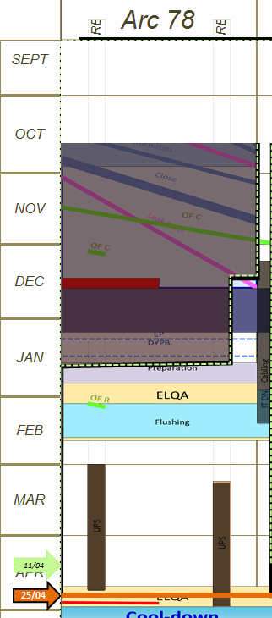
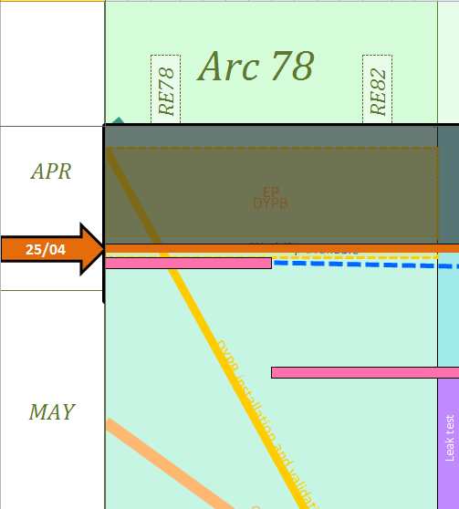
LHC - P7 P8
Arc 78
  SMACC consolidation in progress
    W leak tests 13/14 validated
      1 internal leak in A27L8 (4*10⁻⁸ mbar l/s) on c’k circuit
      No external leaks
    DFBA consolidation in progress
      DFBAO.8L (end = wk21  wk18)
  Forecast
    Pressure test: June 30th

Slide 18
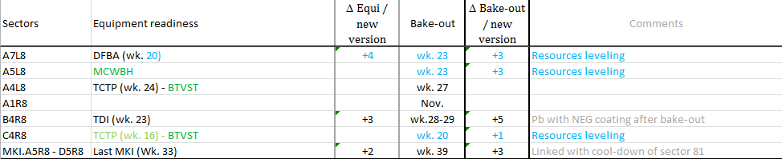
LHC - P8
LSS8 &P8
  Finished
    Water cooled cables
    TCP installation
    Survey and alignment of intermediate components
  In progress
    Survey on Inner Triplets
    Vacuum activities: C4R8 (TCP)
    Short circuit tests preparation

Slide 19
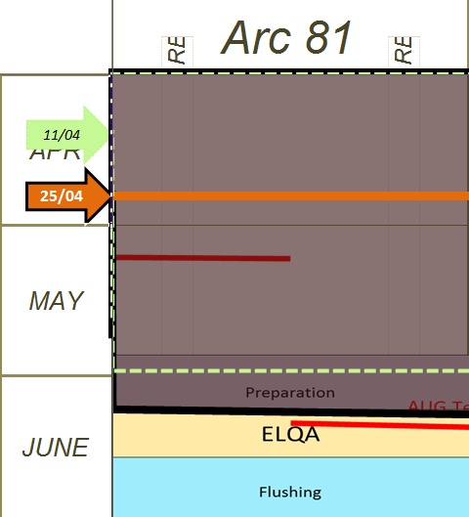
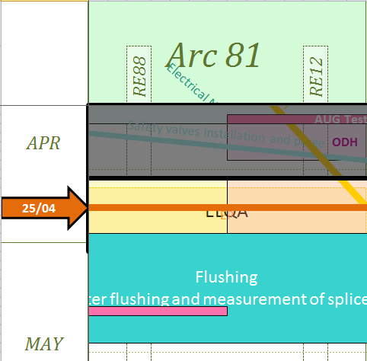
LHC – arc 81
Arc 81
  Pressure test successful
  Purge in progress
  ELQA from next week
  Leak status
    5 external leaks
    4 internal leaks
      Leak chimney DFBA
      A23R8 Internal Leak: on c’k, 1.0 E-5 mbarls/ @ 10 bar,
      1.2 10⁻⁶ mbarl/s @ 1 bar, confirmed on c’k circuit
      A31L1, A7L1, A15R8 Internal Leak > 10⁻⁸ @ 1 bar, circuit c’k – Use as is
    QRL -leaks on header D
      QRL Vacuum subsector G - 10⁻⁸ mbar l/s @1 bar, use as is.
      QRL Vacuum subsector A – 10⁻⁷ mbar l/s @ 1bar, use as is.
      QRL Vacuum subsector D - 10⁻⁶ mbar l/s, longitudinal pre-localisation ~60m from QRL vacuum barrier Examination of XRays in progress & new Xrays next week - if leak correlates with deformed compensator Repair

Slide 20
Marzia’s Summary table

Slide 21
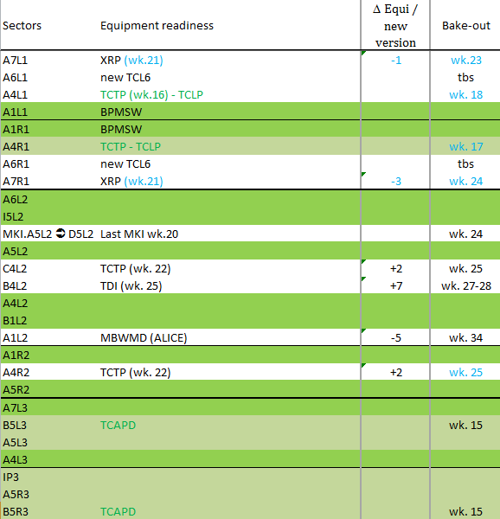
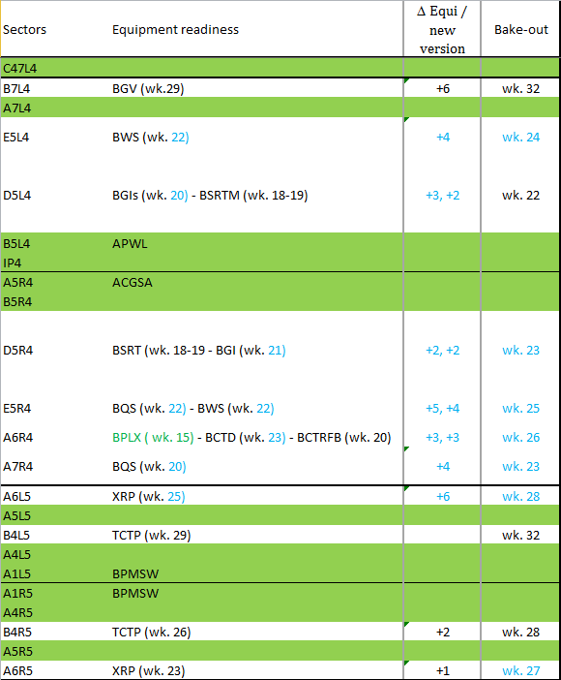
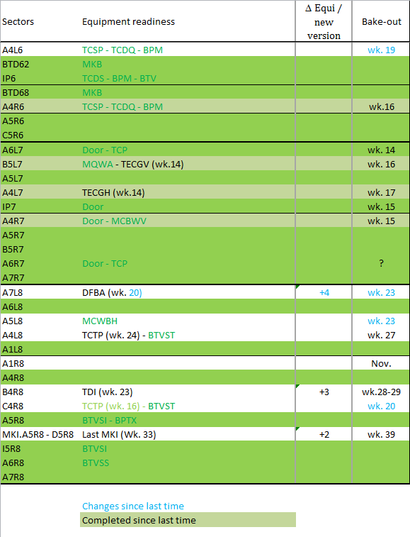
LHC – Vacuum status in LSS
83 vacuum sub-sectors concerned
  52 complete
  33 to be done (45%  39%)

Slide 22
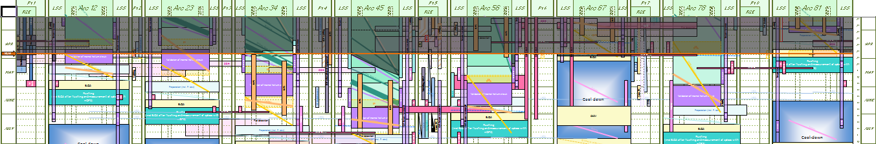
Conclusions
Injectors
  PS and PSB: end of LS1 works…hardware tests will start on wk.14
LHC
  Good progress of all activities
  Some delay in readiness of instrumentation at point 4
  First cool-down will start on May 5th
  Many thanks to voluntary guides. Thanks to their efforts, around 500 of your colleagues have had the pleasure of exploring the machine.

Slide 23
LHC overall progress - baseline

Slide 24
LHC overall progress – New schedule version

