Slide 1


Reducing the Iron in the Endcap Yoke of CLIC_SiD
Benoit Curé, Konrad Elsener, Hubert Gerwig,
CERN
CERN, June 2014
Linear Collider Detector Magnet Meeting

Slide 2
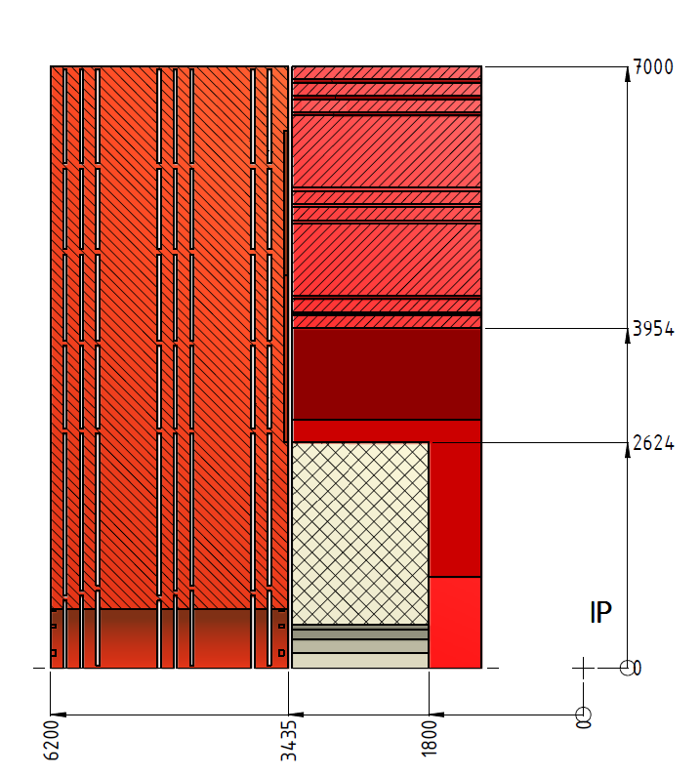
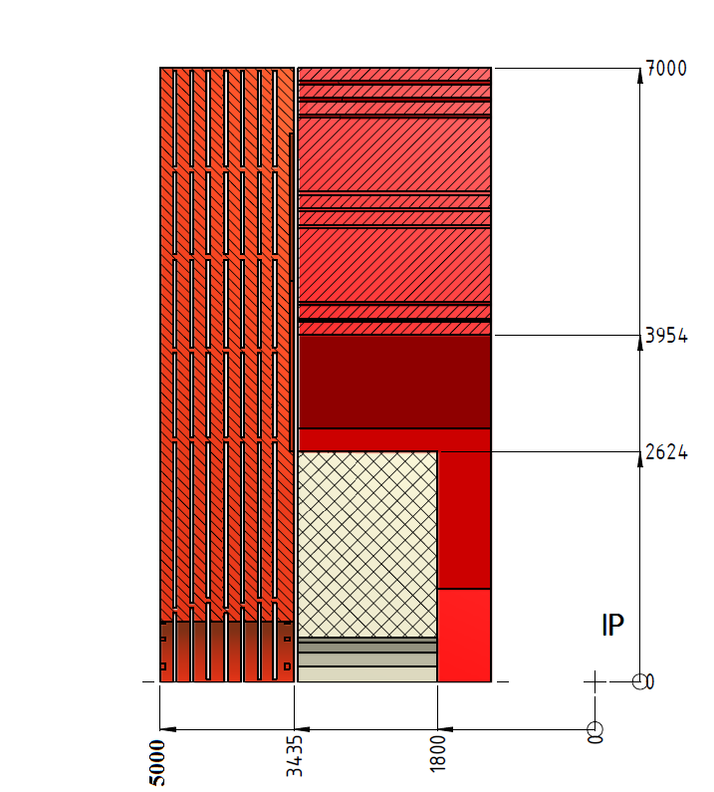
Linear Collider Detector Magnet Meeting
Layout : reduced detector half-length to L=5m (was L=6.2m)
    End cap iron thickness reduced by 1160mm (2445mm to 1285mm).
    7 muon chamber stations in the yoke end cap (8 with L=6.2m).
Longitudinal sections : (solenoid length kept at 6.23m, no modification of barrel yoke).
R
R
Z
Z
  Former configuration, wide end-cap New configuration, reduced end-cap

Slide 3
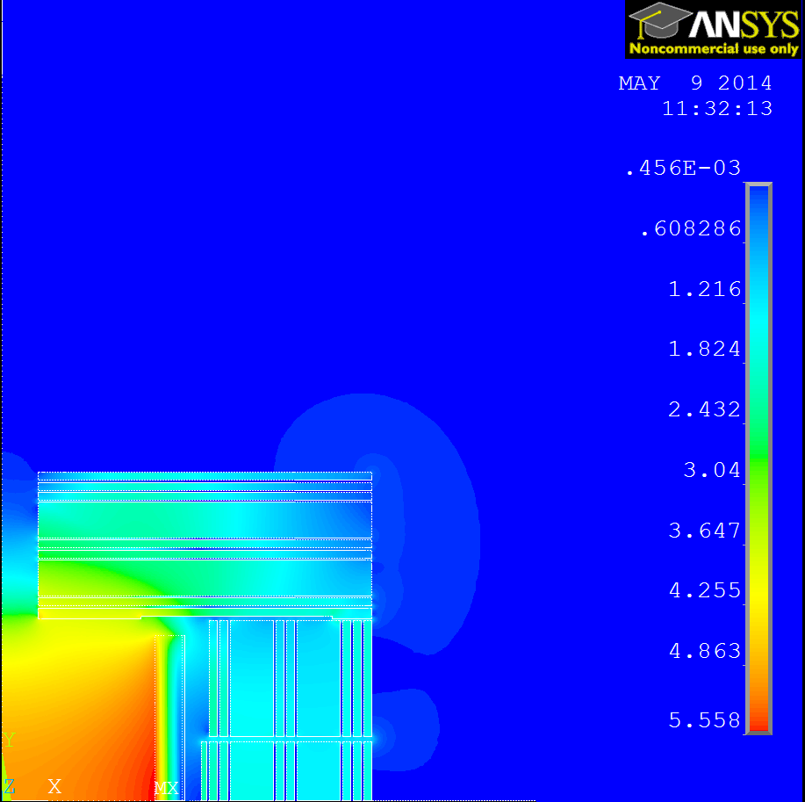
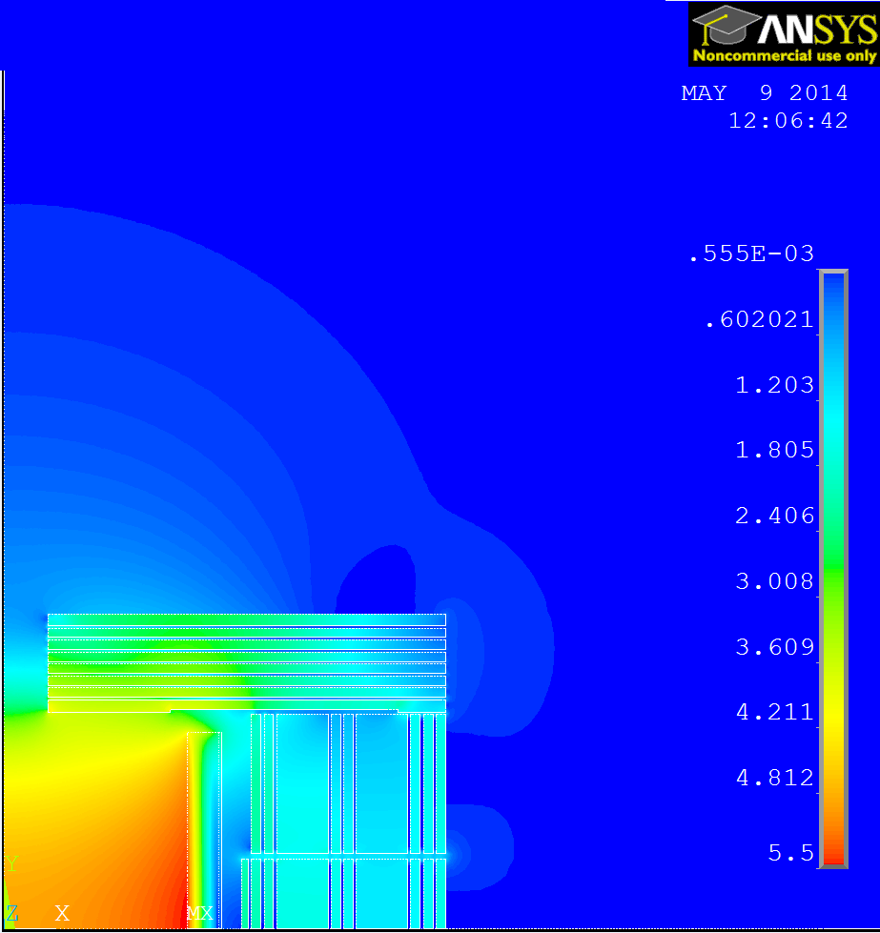
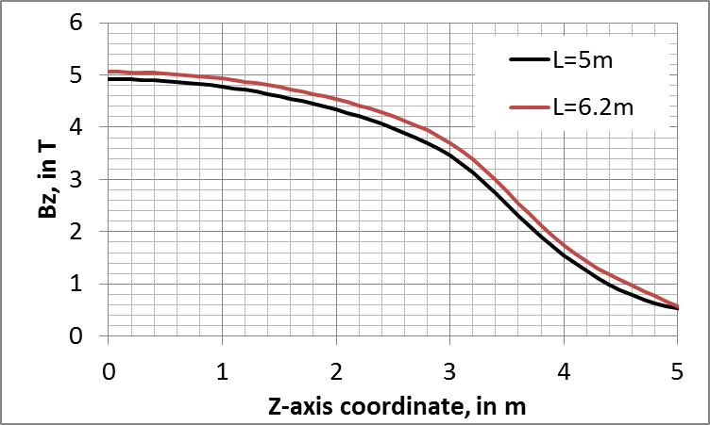
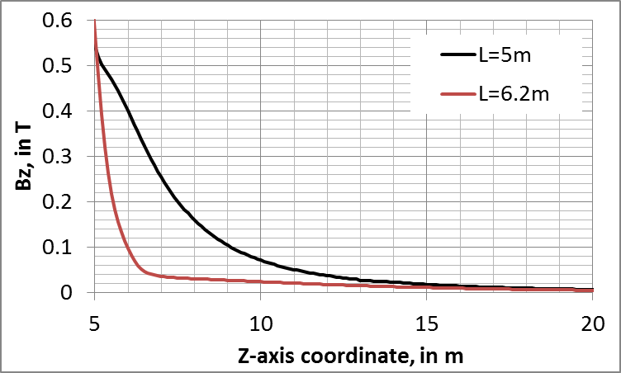
Linear Collider Detector Magnet Meeting
Comparison (no ring coils):
B-field 2D map :
Area most affected is around the detector axis outside the yoke.
Far region :
Less significant, Bmax=9mT at R=15m.
L=6.2m
L=5m
B = 5.06 T at IP
0.46e-3
B = 4.896 T at IP
0.56e-3
Z
Z
R
R
Bz(R=0) on coil axis:

Slide 4
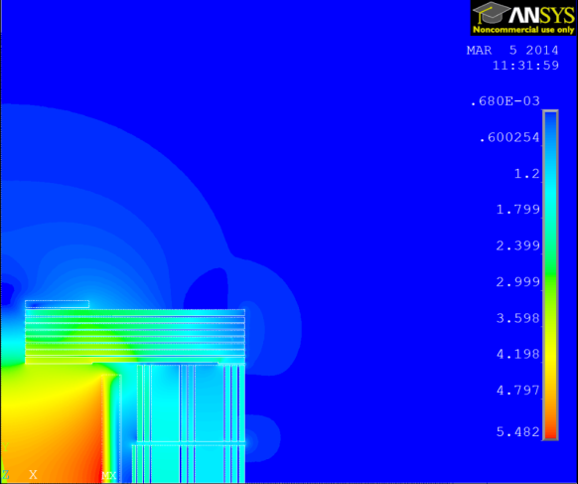
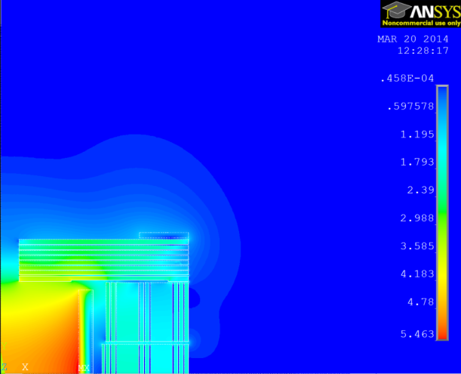
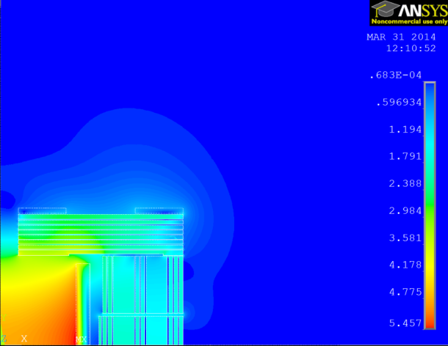
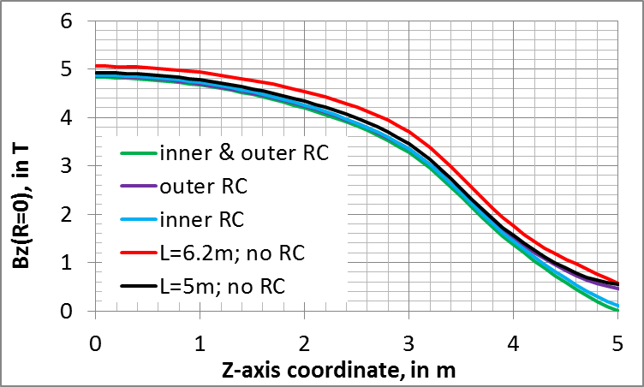
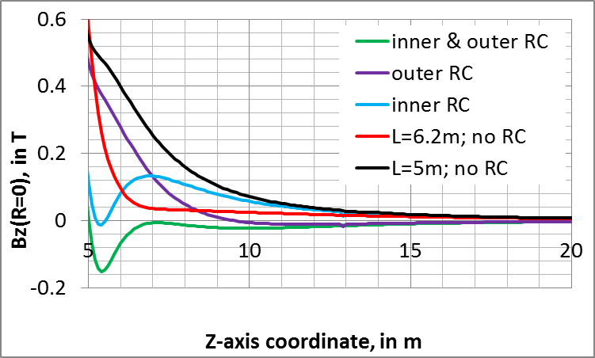
Linear Collider Detector Magnet Meeting
Ring coils on the end cap with L=5m:
J=3A/mm² on RC section, same cross section.
1 RC on inner radius
1 RC on outer radius
2 RC on inner and outer radius
B = 4.874 T at IP
B = 4.85 T at IP
B = 4.828 T at IP
0.68e-3
0.46e-4
0.68e-4
Z
Z
Z
R
R
R

Slide 5
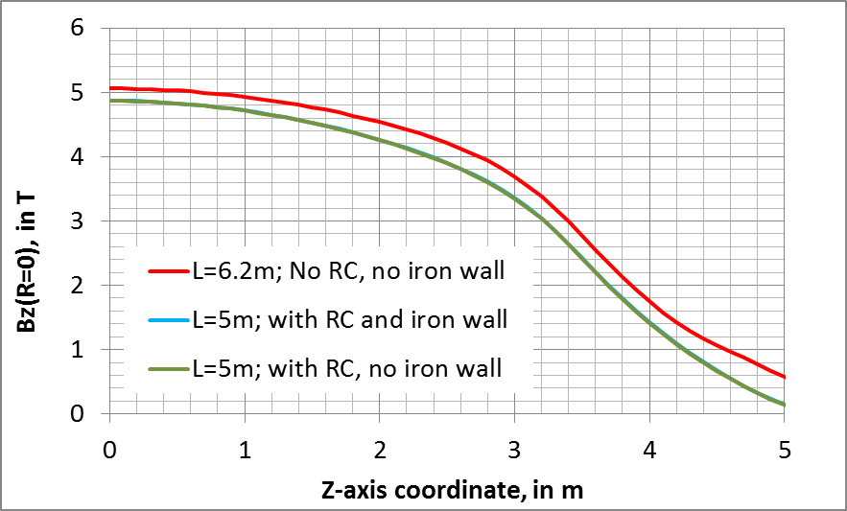
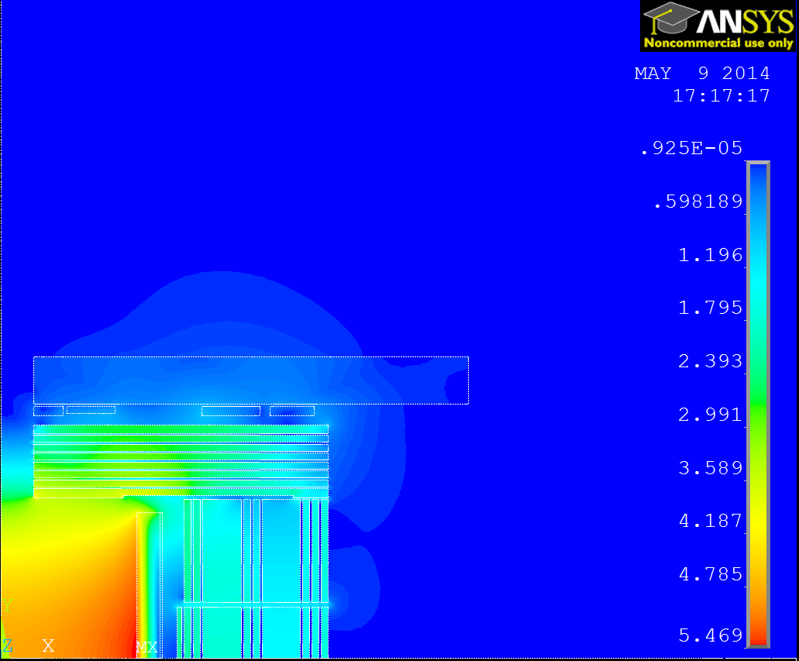
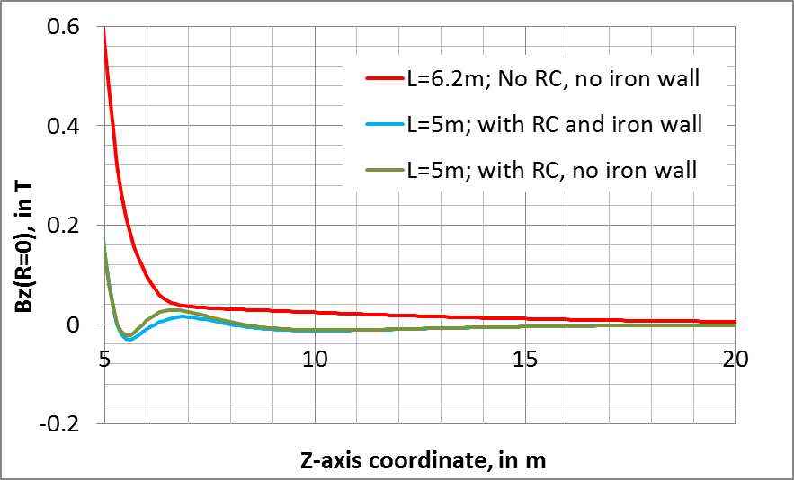
Linear Collider Detector Magnet Meeting
Ring coils on the cavern wall cap with L=5m: Configuration giving a lower field on Z-axis.
Effect of iron in concrete cavern wall (B-H curve = 10% of iron). 4 RCs with resistive conductor and Jrc=3A/mm².
Field at IP is 3.8% lower wrt L=6.2m.
Attractive axial force on end cap :
100 MN (170 MN with L=6.2m),
Compressive axial force on main coil :
207 MN (164 MN with L=6.2m).
B = 4.827 T at IP
B = 4.869 T at IP
0.93e-5
Z
R

Slide 6
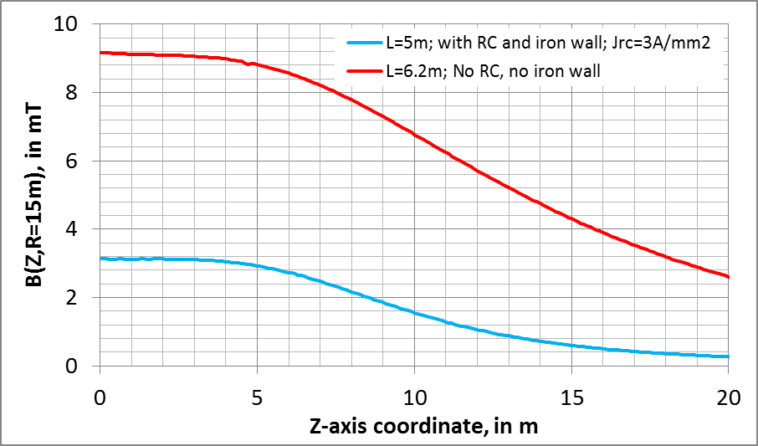
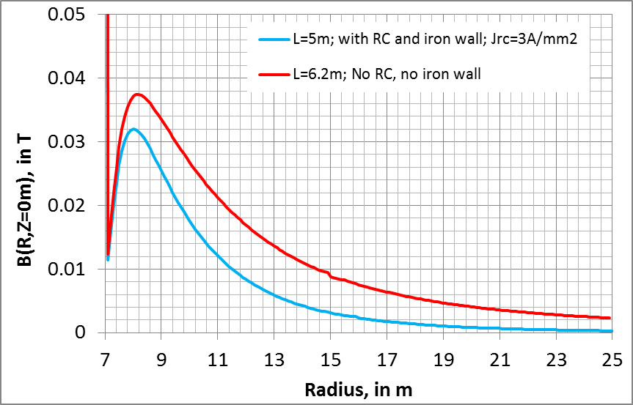
Linear Collider Detector Magnet Meeting
Ring coils on the cavern wall cap with L=5m:
Effect of iron in concrete cavern wall included (B-H curve = 10% of iron).
Current density Jrc=3A/mm² in all ring coils.
→ Stray field lower than 3.2mT at R=15m.
B = 4.827 T at IP

Slide 7
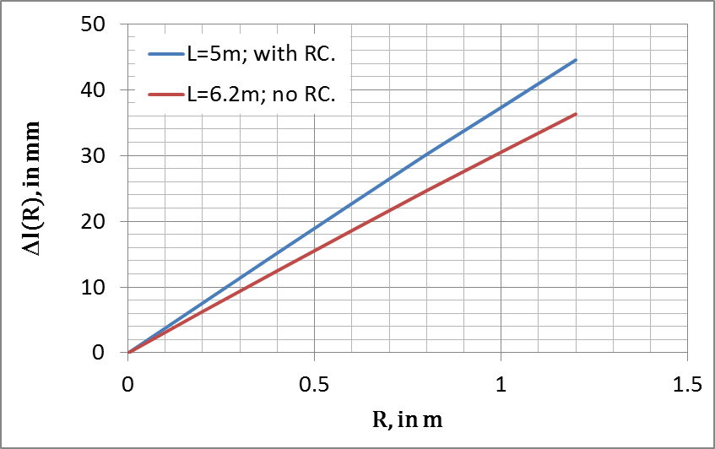

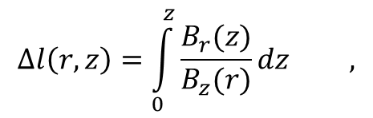
Linear Collider Detector Magnet Meeting
Ring coils on the cavern wall cap with L=5m:
Magnetic field distortion in barrel tracker volume :
Increase 23% wrt L=6.2m.
$$∆l\left(r,z\right)=\int_{0}^{z}{\frac{B_{r}(z)}{B_{z}(r)}dz ,}$$
$$z∈\left[0 , 1.54\right]$$

Slide 8
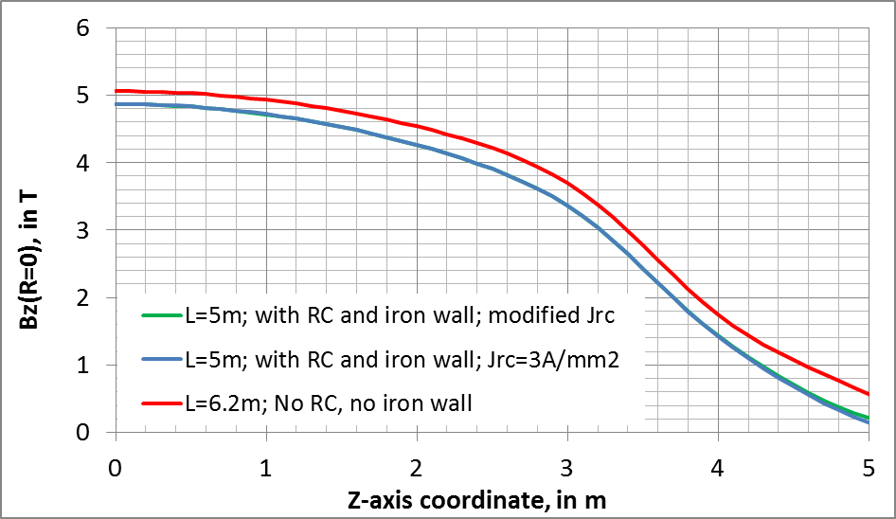
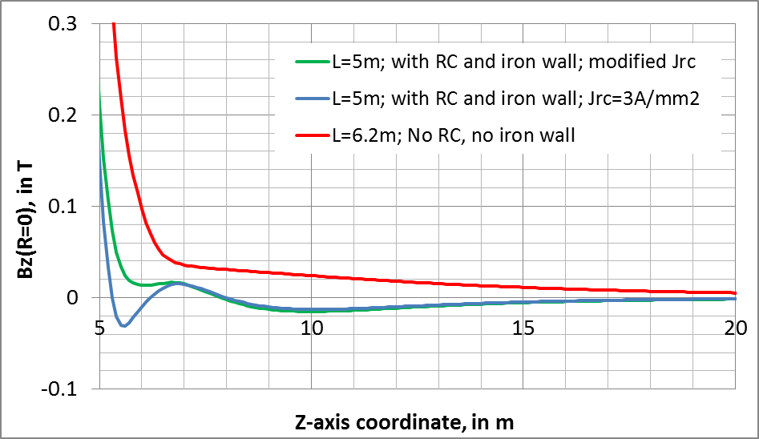
Linear Collider Detector Magnet Meeting
Ring coils on the cavern wall cap with L=5m:
Another configuration with same geometry,
Modified current densities (Jrc1=2A/mm², Jrc2=3A/mm², Jrc3=3.1A/mm², Jrc4=3.1A/mm²).
Effect of iron in concrete cavern wall included (B-H curve = 10% of iron).
→ Reduced variation on Z-axis, but slightly higher B-field at Z=5m (212mT against 150mT).

Slide 9
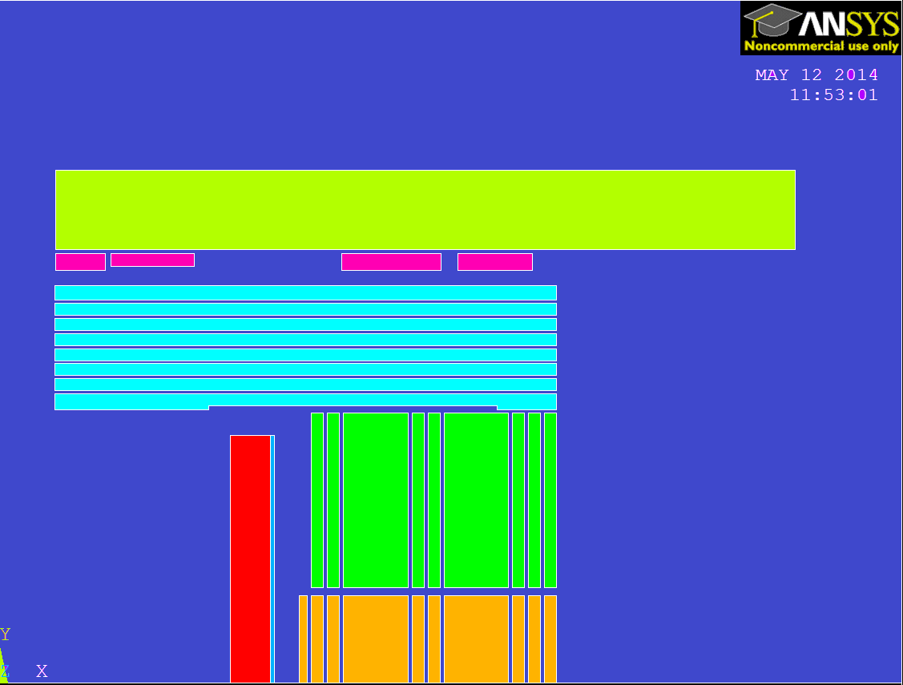
Linear Collider Detector Magnet Meeting
Characteristics of the ring coils on the cavern wall cap with L=5m :
Arbitrary gap from RC to yoke end cap: 192mm (RC1, RC3 & RC4) and 244mm (RC2).
Space available for radiation chicane.
Same conductor for all RCs, insulation thickness 1mm.
Total copper weight : 250 tons (for 2 end caps). Suppressed steel mass wrt. L=6.2m (2 end caps): 2600 tons.
Total electrical power of RCs (2 end caps): 2 x 2260 kW.
Water cooling system characteristics:
Estimated temperature increase ≈ 45°C,
Total water flow (2 end caps): 2 x 57 m³/hour.
Coil | Nb. turns | Copper mass (ton) | Resistance (1e-3 ohm) | Voltage drop (V) | Power (kW)
RC1 | 4x12 | 5.6 | 2.7 | 16.5 | 101
RC2 | 3x20 | 13.3 | 6.4 | 39.1 | 240
RC3 | 4x24 | 54.4 | 26.2 | 160.4 | 984
RC4 | 4x18 | 51.7 | 24.8 | 152.2 | 934
RC1
RC2
RC3
RC4
Z
R

Slide 10
Linear Collider Detector Magnet Meeting
Characteristics of the ring coils on the cavern wall cap with L=5m :
Parameters obtained are (coincidentally) very similar to LHCb dipole ones !
 | LHCb (*) | CLIC_SiD
Conductor | 50x50mm² aluminum 99.7, ∅24mm | 50x50mm² copper, ∅24mm
Excitation | 2 x 1.3 MA.turns | 2 x 1.7 MA.turns
Total power | 4.2 MW | 4.5 MW
Stored energy | 32 MJ | 2 x 16.8 MJ
Inductance | 2 H | 2 x 0.9 H
Current density | 2.9 A/mm² | 3 A/mm²
Current in conductor | 5.8 kA | 6.1 kA
Total resistance | 125 mΩ | 2 x 60mΩ
Total water flow | 125 m³/hour | 115 m³/hour
(*) LHCb Magnet, TDR, CERN/LHCC/2000-007, 1999.

Slide 11
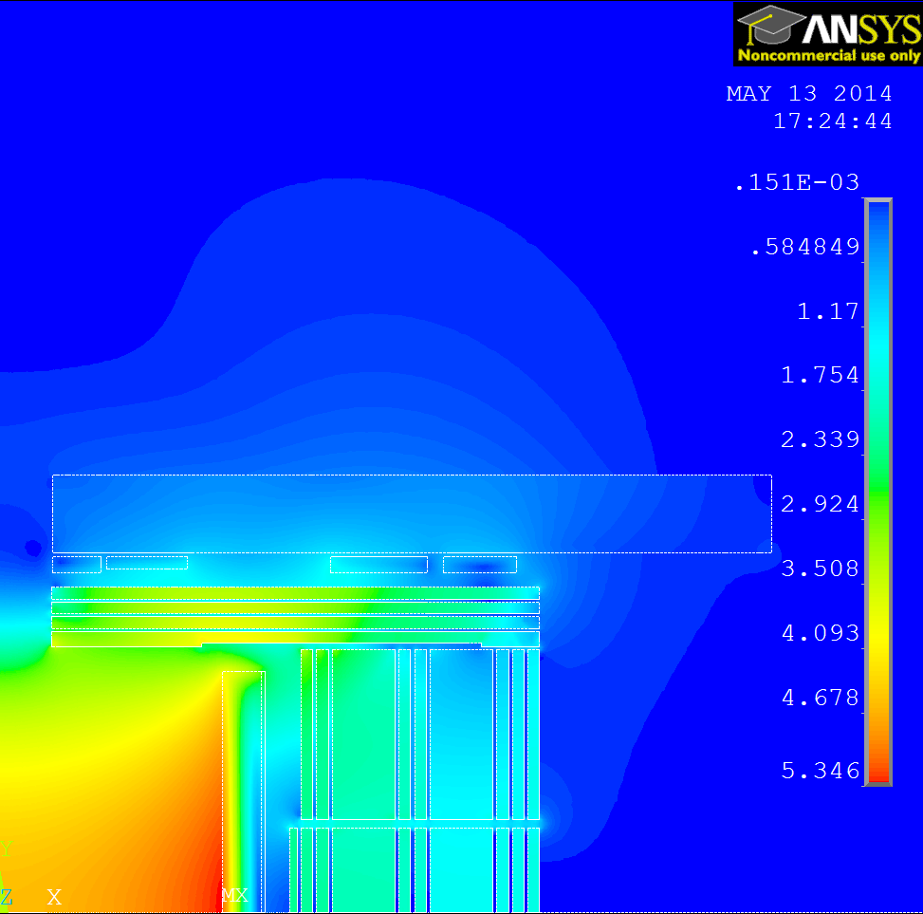
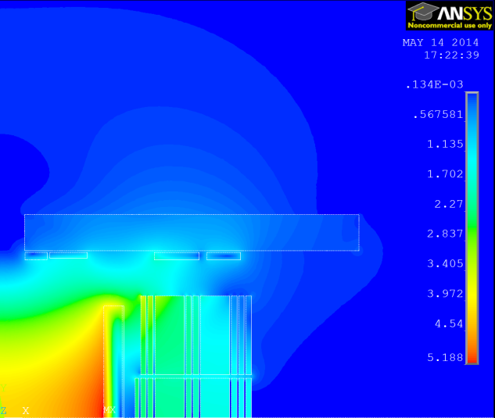
Linear Collider Detector Magnet Meeting
Other cases:
1- Reducing the iron thickness to 4 disks then L=5m to 4.205m,
2- No end cap iron yoke.
As a first approach, only the current density was increased (same RCs).
With resistive ring coils, the ring coil sizes have to be increased to keep a realistic conductor and current density.
The RCs are in same positions in both models. SC coils would be more appropriate.
Case 1
Case 2
Jrc= 6A/mm²
0.15e-3
Jrc= 9A/mm²
0.13e-3
B = 4.608 T at IP
Axial force on coil = 260 MN
B = 4.265 T at IP
Axial force on coil = 320 MN
Z
Z
R
R

Slide 12
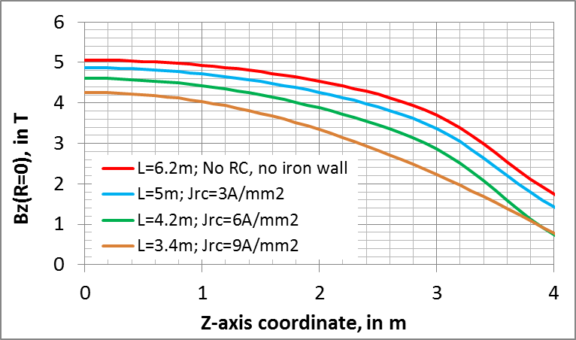
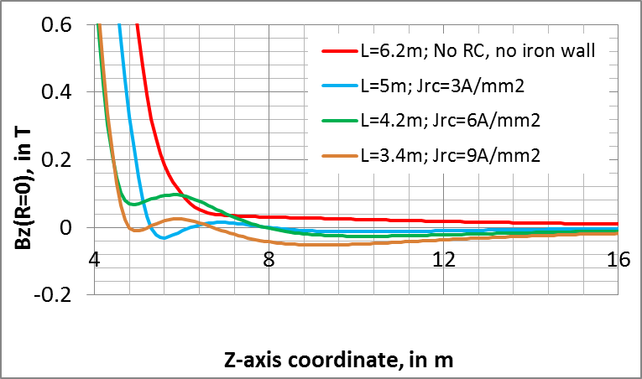
Linear Collider Detector Magnet Meeting
Other cases:
Wrt the ring coils defined for L=5m:
Case 1- Resistive ring coils x2 in size, total power x2.
Case 2- Resistive ring coils x3 in size, total power x3.
The magnetic field at IP is reduced (resp. 8.9% and 15.7% wrt L=6.2m) and the field distortion in the inner detector volume increases.
The EC iron yoke helps to shape the field.

Slide 13
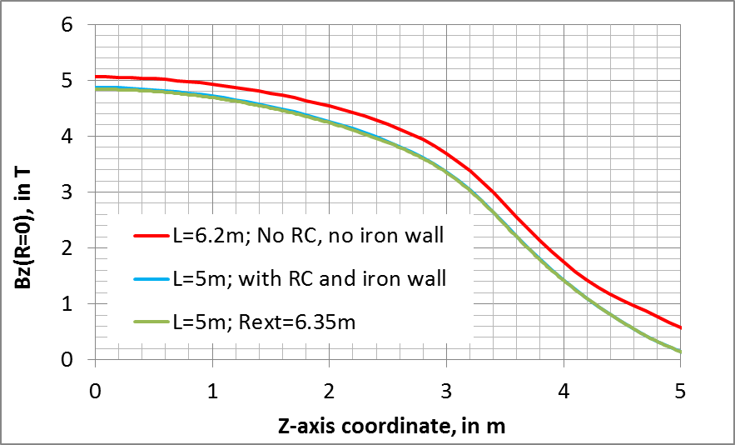
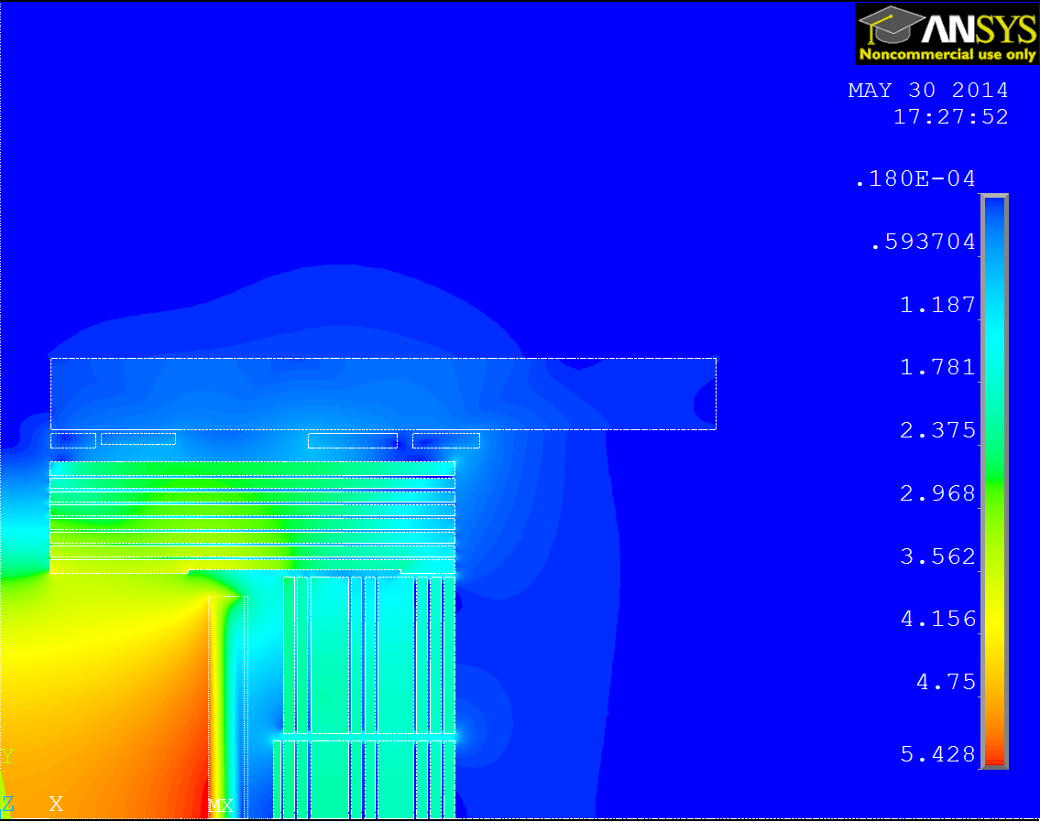
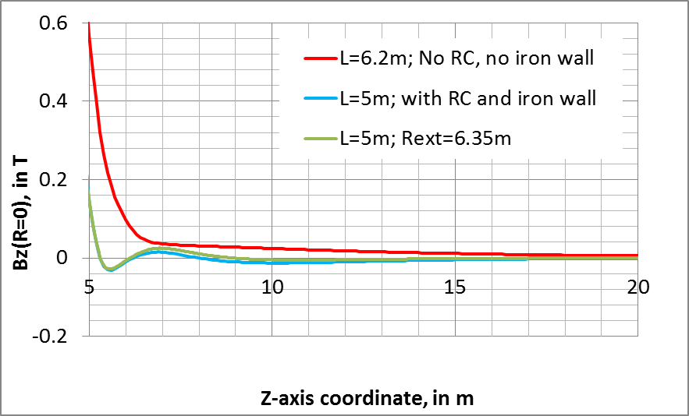
Linear Collider Detector Magnet Meeting
Reduction of external diameter of both end cap and barrel yoke:
External radius Rext = 6.35m. RCs at same position. Detector half length L=5m.
Field at IP is 4.4% lower wrt {L=6.2m; Rext=7m}.
Total reduction on iron mass: 3800 tons wrt L=6.2m.
B = 4.827 T at IP
B = 4.838 T at IP
Z
R

Slide 14
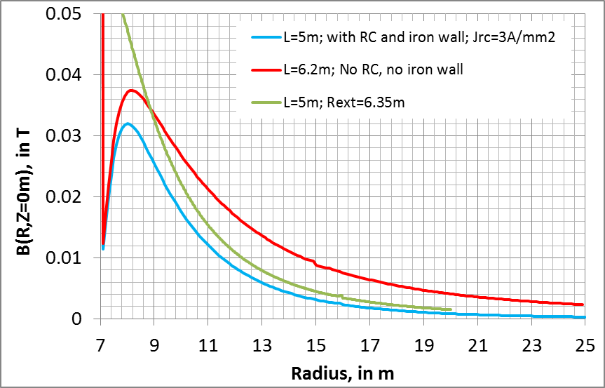
Linear Collider Detector Magnet Meeting
Reduction of external diameter of both end cap and barrel yoke:
Effect of iron in concrete cavern wall included (B-H curve = 10% of iron). Current density Jrc=3A/mm² in RC.
Comparison yoke barrel radius 7m and 6.35m
→ Stray field lower than 4.5mT at R=15m.
B = 4.827 T at IP

Slide 15
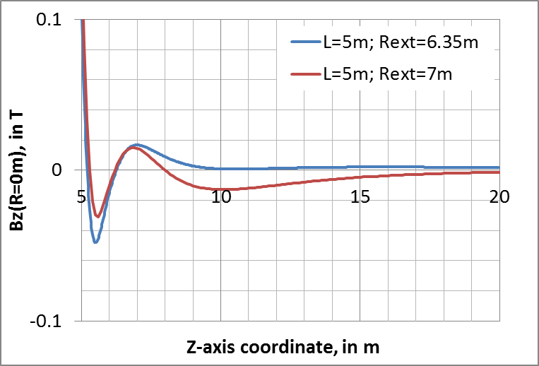
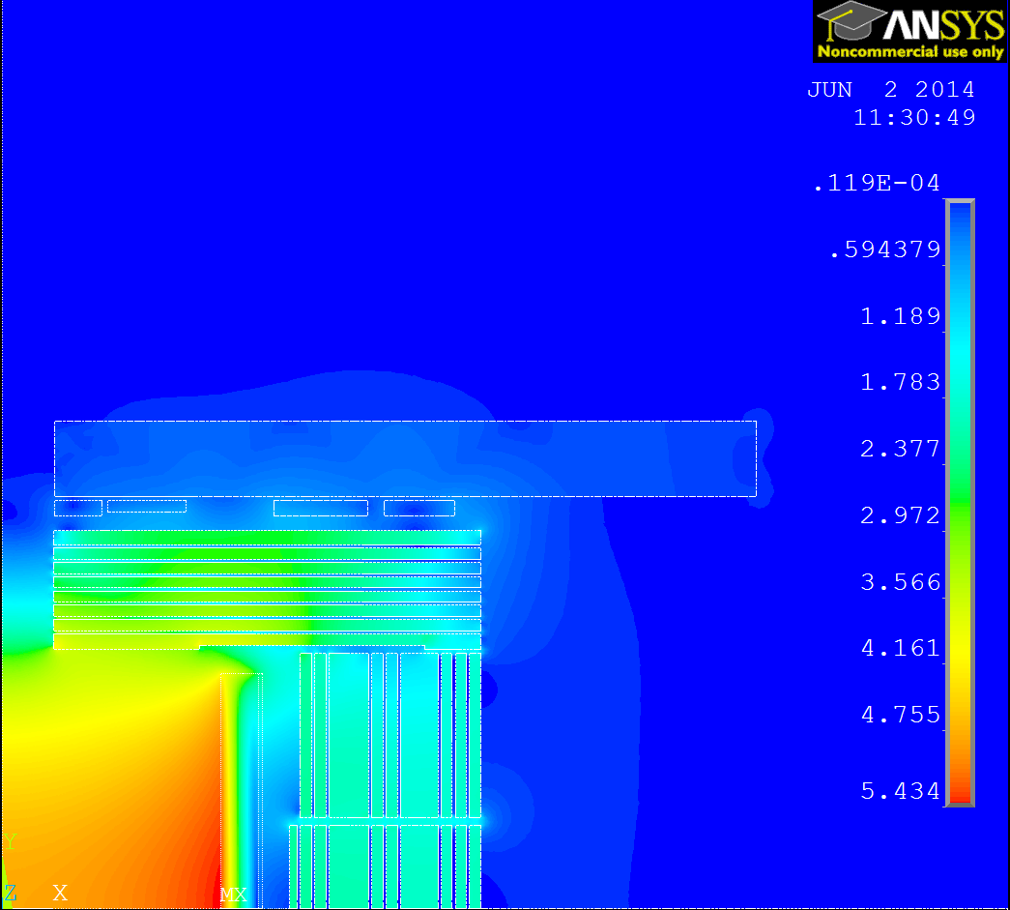
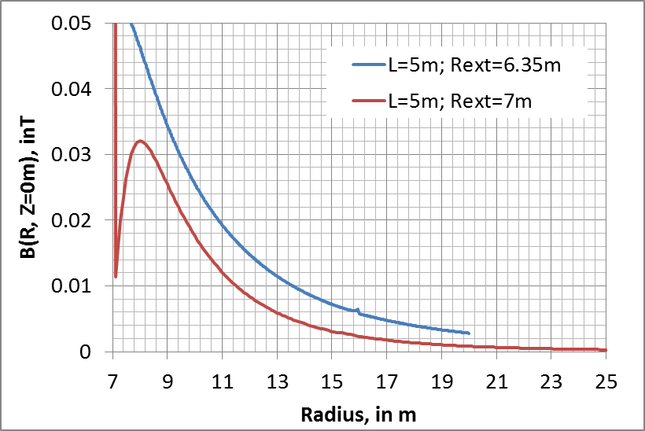
Linear Collider Detector Magnet Meeting
Reduction of external diameter of both end cap and barrel yoke:
External radius Rext = 6.35m. RC 3&4 with reduced diameter, same amp.turns. L=5m.
Field at IP is 4.4% lower wrt {L=6.2m; Rext=7m}. Stray field lower than 7.2mT at R=15m.
Total reduction on iron mass: 3800 tons wrt L=6.2m.
Ring coils copper mass: 225 tons.
B = 4.827 T at IP
B = 4.838 T at IP
Z
R

Slide 16
Linear Collider Detector Magnet Meeting
Conclusions:
Reduced end cap in length is feasible with ring coils, provided the field homogeneity in the central volume is acceptable.
The end cap is still useful to provide support for muon stations, radiation shielding, and magnetic field shaping.
The yoke material + manufacturing budget can be considerably reduced with ring coils.
The cost estimate for manufacturing, infrastructure and operation of the ring coils should be compared to the saving on the yoke cost.
The barrel yoke could also be reduced in diameter:
the fringe field is reduced by the ring coils,
If there is only one detector in the experimental cavern (no access to cavern during beam run), then it can be compatible with radiation due to accidental beam loss.

