Slide 1
Selected topics in Heavy Ion Physics
Primorsko 2014
Peter Hristov

Slide 2
Lecture 4: dileptons, quarkonia, melting
Based on the lectures of
F.Antinori, E.Scomparin

Slide 3
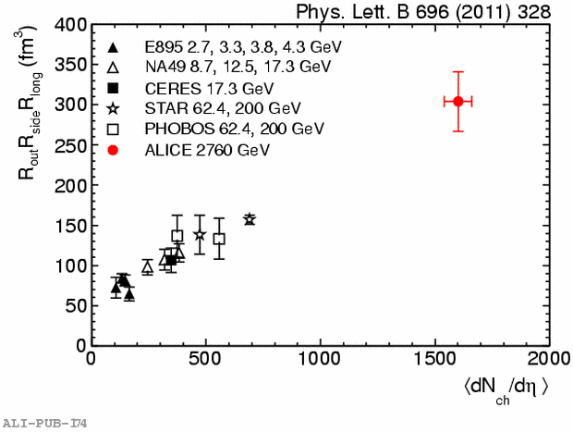
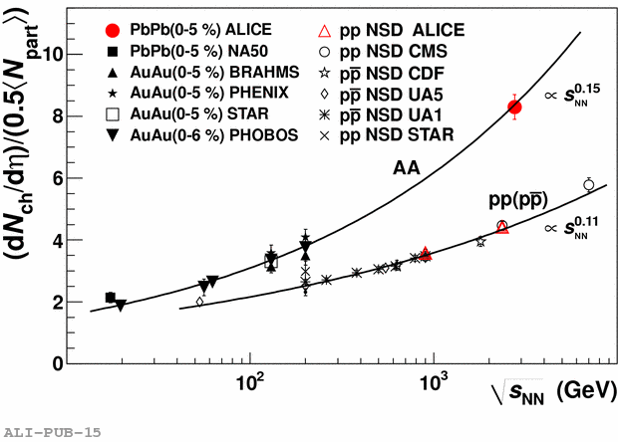
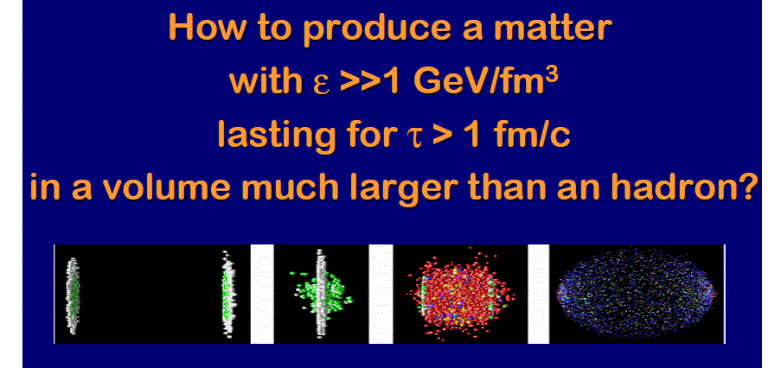
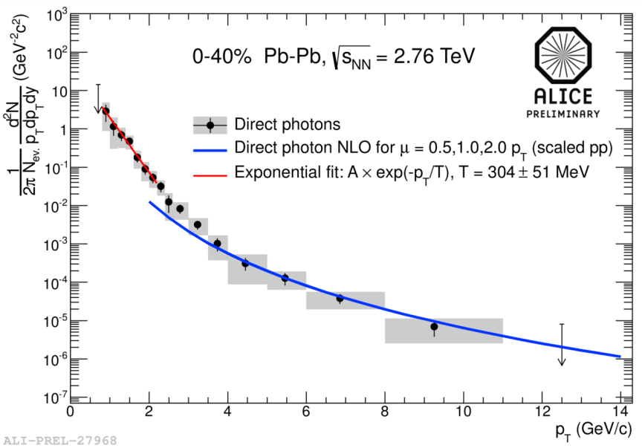
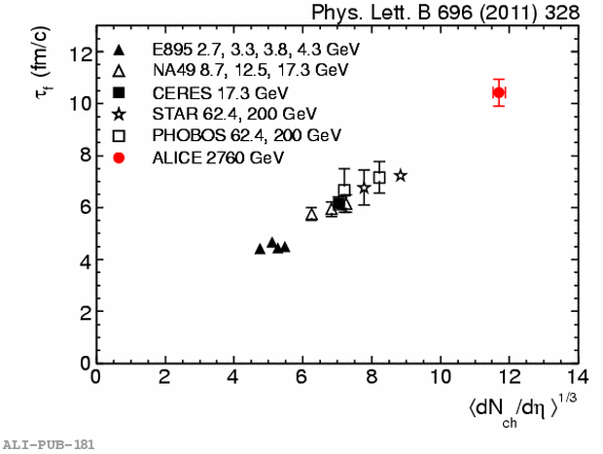
PbPb: Global characteristics
PRL 105, 252301 (2010)
Energy density~ 3xRHIC
~ 10 GeVfm³
Volume ~ 2 x RHIC (R³ ~ 300 fm³)
T = 304±51 MeV ~ 1.4 x T_{RHIC}
Lifetime: +20% wrt RHIC
~ 10 fm/c
@LHC: higher temperature, bigger volume, longer lifetime

Slide 4
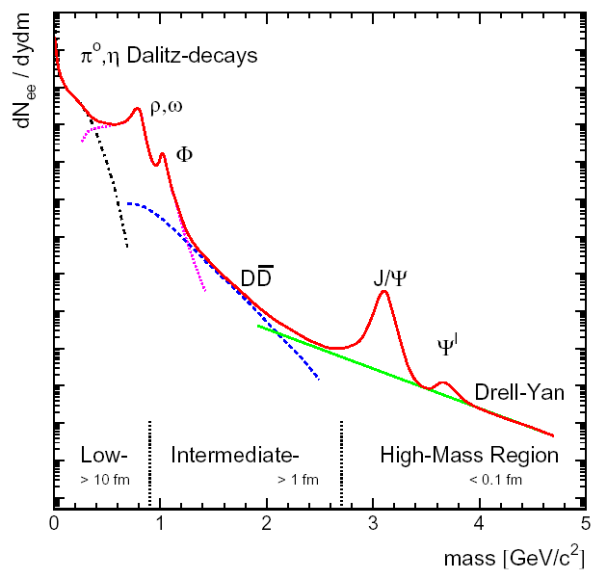
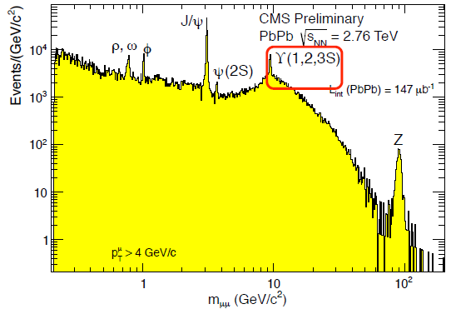
The dilepton invariant mass spectrum
“low” √s version
“high” √s version
The lepton (e+e-, +-) pairs provide important information on the early stages of the collision
Dileptons do not interact strongly, once produced can cross the system without significant re-interactions (not altered by later stages)
Several resonances can be “easily” accessed through the dilepton spectrum

Slide 5
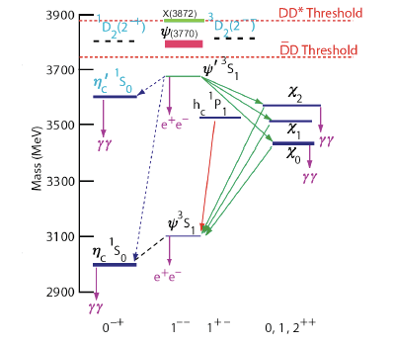
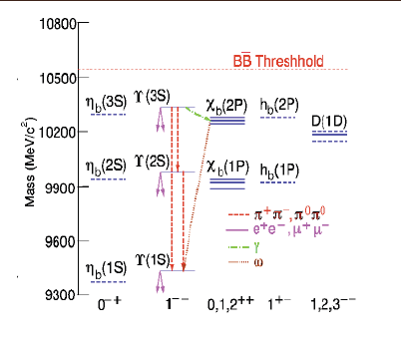
Heavy quarkonium states
Quarkonium: bound state of q-qbar pair with mass smaller than 2m_{D}(m_{B})
Several quarkonium states exists, distinguished by their quantum numbers (J^{PC})
q
q
Charmonium (c-cbar) family
Bottomonium (b-bbar) family

Slide 6
Quarkonia: probes of the QGP
Ideal properties of a QGP probe
  Created early in the history of the collision and sensitive to the short-lived QGP phase
  Production in elementary NN collisions under control (accessible reference)
  Interaction with cold nuclear matter under control
  Not (or slightly) sensitive to the final-state hadronic phase
  High sensitivity to the properties of the QGP phase
VACUUM
HADRONIC
MATTER
QGP

Slide 7
Color Screening
At T=0 the binding between the quarks can be described by the Cornell potential
The QGP contains deconfined color charges => color screening
  The “confinement” contribution disappears
  The high color density induces a screening of the coulombian term of the potential
q
confinement term
q
Coulombian term due to
gluon exchange
q
q

Slide 8
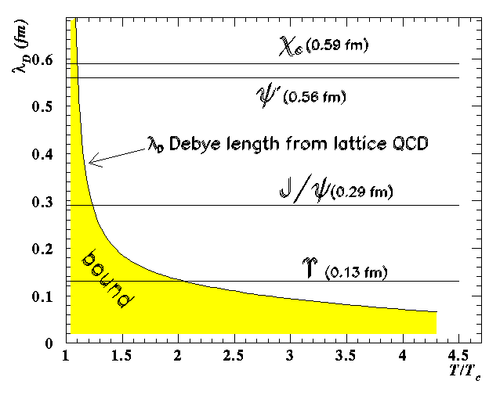
Resonance “melting”
Screening of
strong interactions
in QGP
Screening stronger at high T
_{D} => maximum size of a bound state, decreases when T increases
Different states, different sizes
Resonance melting
=> QGP thermometer

Slide 9
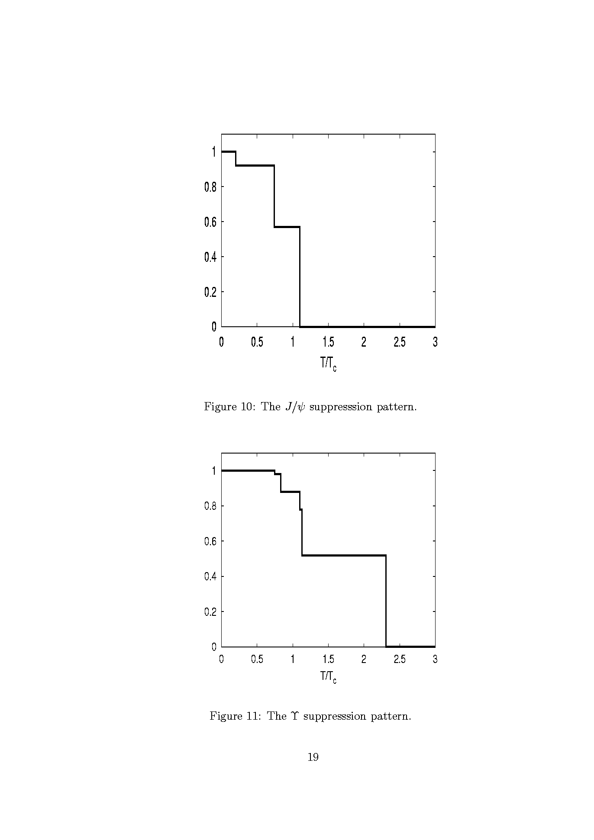
Feed-down and suppression pattern
Feed-down process: charmonium (bottomonium) “ground state” resonances can be produced through decay of larger mass quarkonia => Effect : ~30-40% for J/, ~50% for ○(1S)
Due to different dissociation temperature for each resonance, one should observe «steps» in the suppression pattern of measured J/ or ○(1S)
ψ(2S)
ϒ(3S)
χ_{b}(2P)
χ_{c}(1P)
ϒ(2S)
χ_{b}(1P)
Digal et al.,
Phys.Rev. D64(2001)
094015
J/ψ
ϒ(1S)
J/ψ
ϒ
Ideally, one could vary T
  by studying the same system (e.g. Pb-Pb) at various s
  by studying the same system for various centrality classes

Slide 10
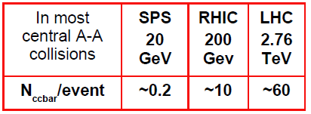
Quarkonium regeneration
At sufficiently high energy, the cc pair multiplicity becomes large
Statistical approach:
  Charmonium fully melted in QGP
  Charmonium produced, together with all other hadrons, at chemical freeze-out, according to statistical weight
Kinetic recombination:
  Continuous dissociation/regeneration over QGP lifetime
Contrary to the suppression scenarii described before, these approaches may lead to a J/ enhancement

Slide 11
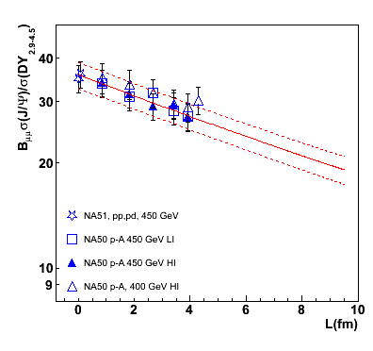
Effect of cold nuclear matter
NA50, pA 450 GeV
There is suppression of the J/ already in pA! This effect can mask a genuine QGP signal. Needs to be calibrated and factorized out
Commonly known as Cold Nuclear Matter Effects (CNM)
Effective quantities are used for their parameterization (, _{abs}, …)

Slide 12
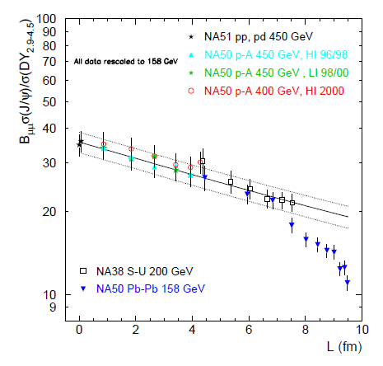
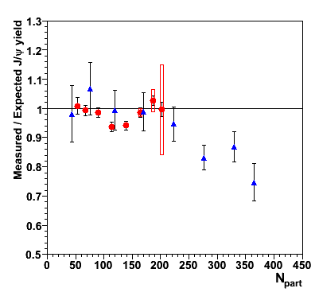
SPS: the anomalous J/ψ suppression
In-In 158 GeV (NA60)
Pb-Pb 158 GeV (NA50)
Drell-Yan used
as a reference here!
Anomalous
suppression
After correction for EKS98 shadowing
In semi-central and central Pb-Pb collisions there is suppression beyond CNM => anomalous J/ suppression
Maximum suppression ~ 30%. Could be consistent with suppression of J/ from c and (2S) decays (sequential suppression)
B. Alessandro et al., EPJC39 (2005) 335
R. Arnaldi et al., Nucl. Phys. A (2009) 345

Slide 13
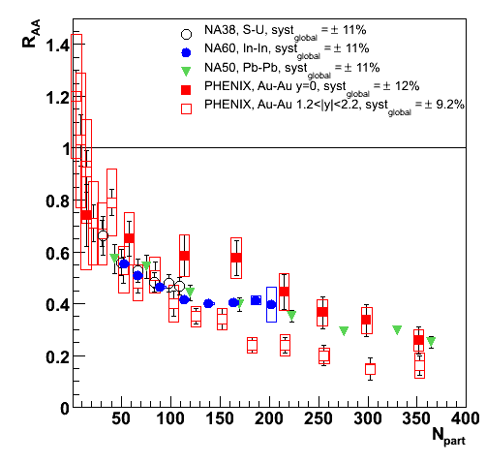
J/ψ @ RHIC
Using RAA, no cold nuclear effects taken into account
Qualitatively, very similar behavior at SPS and RHIC!
  Do we see (as at SPS) suppression of (2S) and _{c}?
  Or does (re)generation counterbalance a larger suppression at RHIC?
PHENIX: comparison between RAA at central and forward rapidity

Slide 14
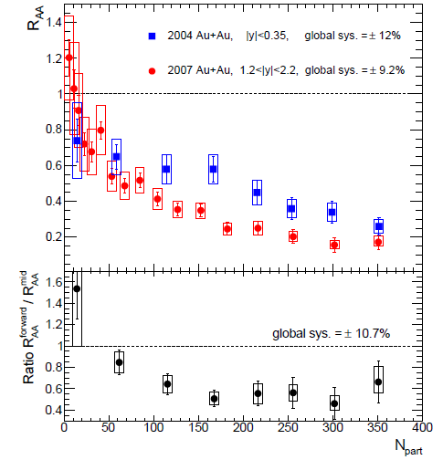
J/ψ @ RHIC: forward vs central y
Stronger suppression at forward rapidities
Not expected if suppression increases with energy density (which should be larger at central rapidity)
Are we seeing a hint of (re)generation, since there are more pairs at y=0?
Comparisons with theoretical models tend to confirm this interpretation, but the LHC results should clarify the situation

Slide 15
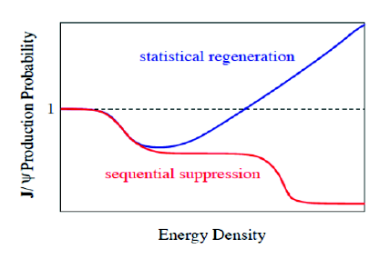

Quarkonia @ LHC: Advantages
Higher charmonium states are accessible => study of regeneration
Possibility for detailed study (for the first time) of bottomonium suppression
ϒ(3S)
χ_{b}(2P)
ϒ(2S)
χ_{b}(1P)
Mass
r₀
ϒ(1S)
ϒ

Slide 16
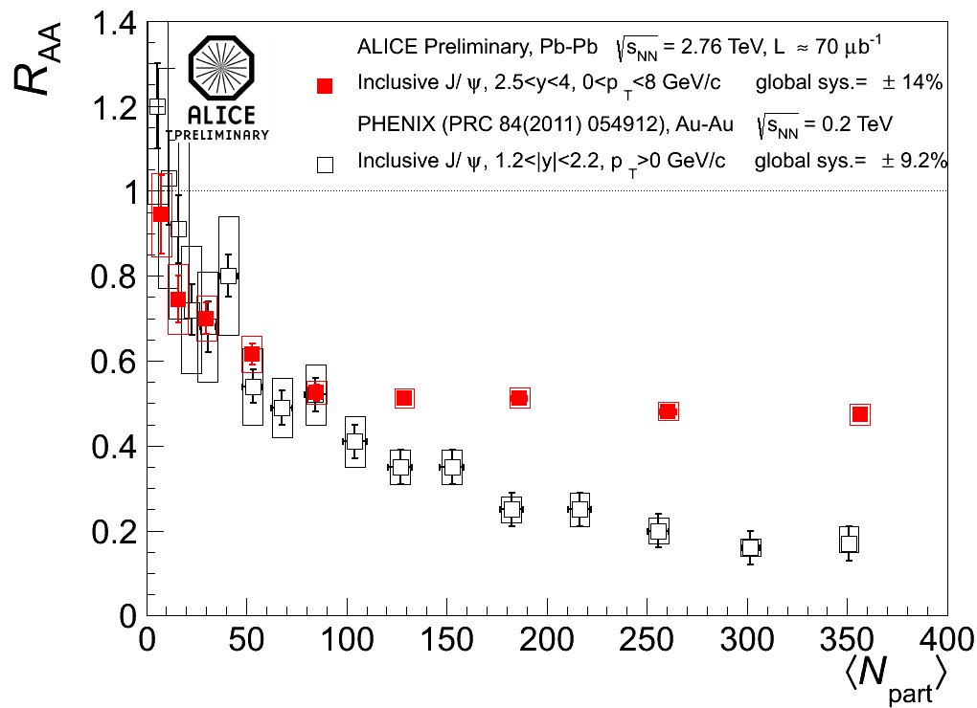
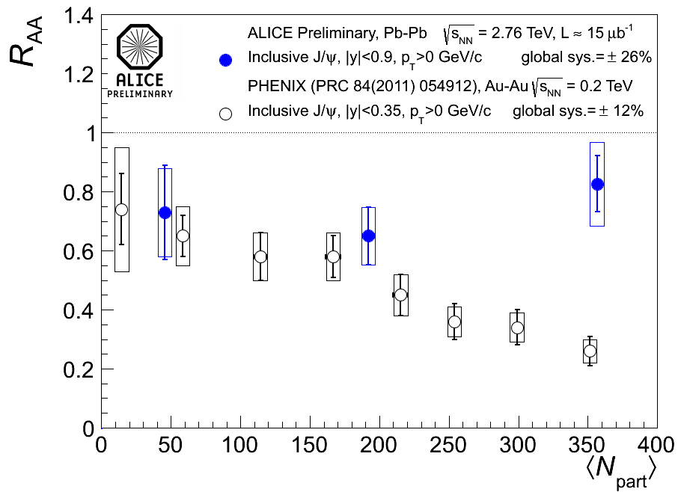
J/ψ, ALICE vs PHENIX
Even at the LHC, NO rise of J/ yield for central events, but….
Compare with PHENIX
  Stronger centrality dependence at lower energy
  Systematically larger RAA values for central events in ALICE
First possible evidence for (re)combination

Slide 17
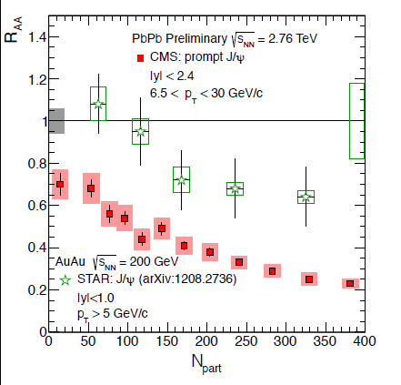
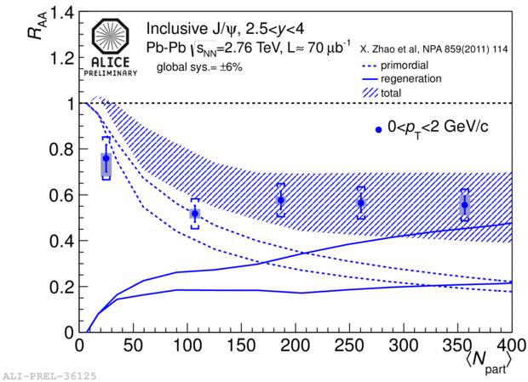
p_{T} dependence of the suppression
Large pT: compare CMS with STAR
Small pT: compare ALICE with models
At high pT no regeneration expected: more suppression at LHC energies
At small pT ~ 50% of the J/ should come from regeneration

Slide 18
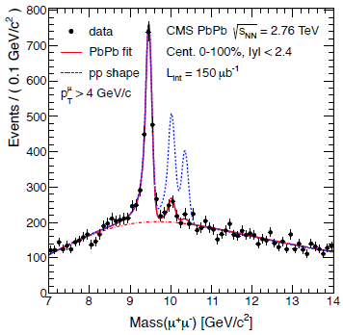
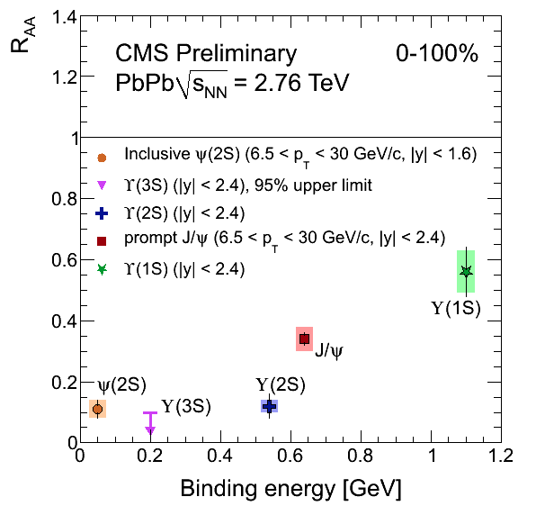
Initial temperature: “melting” of heavy resonances (ϒ)
T > 1.5Tc ~ 300 MeV PRL 109 (2012) 2223

Slide 19
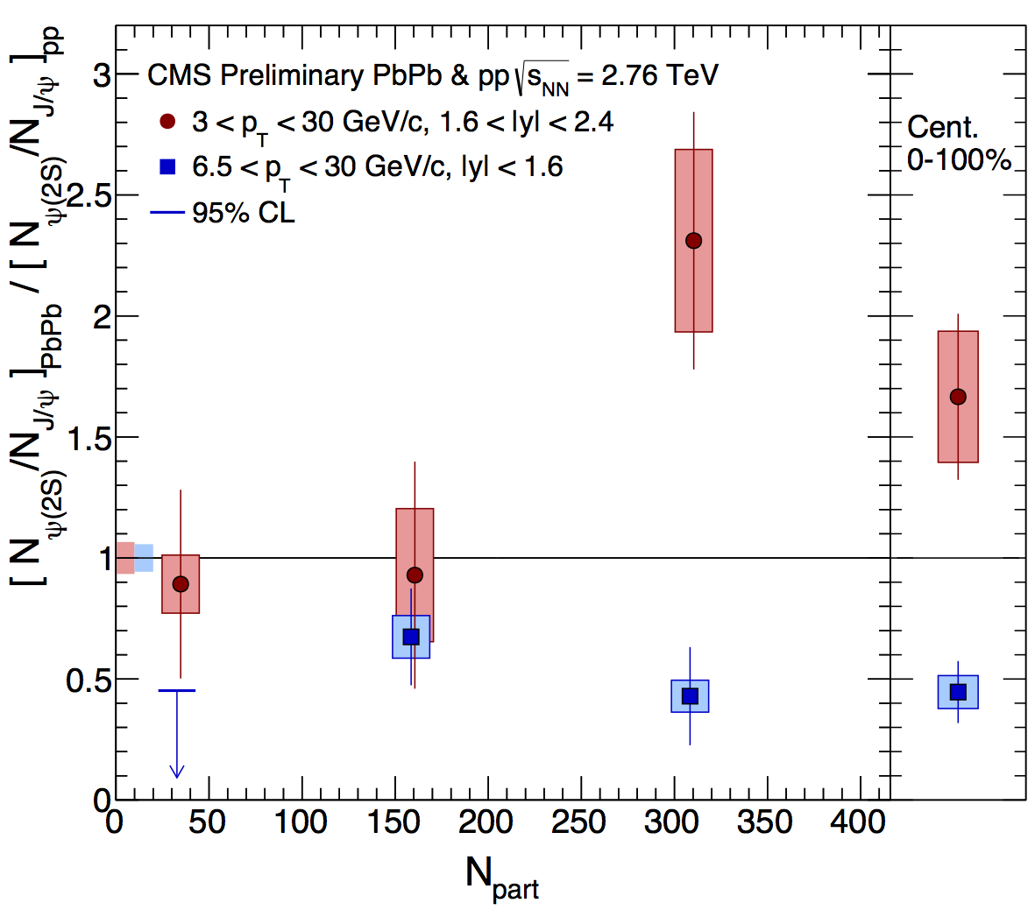
CMS: ψ’ in PbPb collisions
Surprisingly large (ψ’/ψ)_{PbPb} / (ψ’/ψ)_{pp} ratio confirmed:
  new pp reference, 20 times larger, now negligible uncertainty
  non-prompt component subtracted
ψ’ very suppressed at high p_{T} (more than ψ)
  → R_{AA}(ψ’) = 0.13 ± 0.05
Much less at lower p_{T}
  → R_{AA}(ψ’) = 0.67 ± 0.19
40–100%
20–40%
0–20%
(Centrality-integrated R_{AA})
  Talk by Moon, HIN-12-007
  to be submitted soon
Could some regeneration models favour lower p_{T}?
RGdC@QM2014

Slide 20
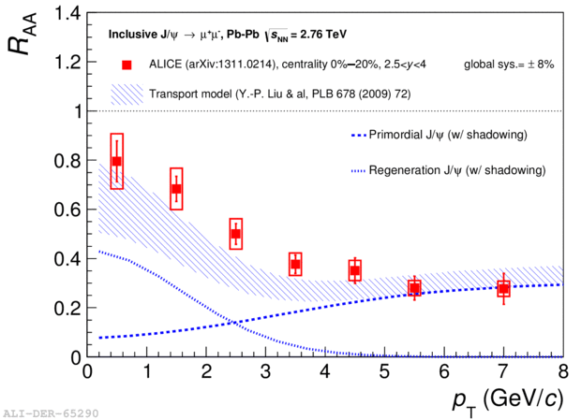
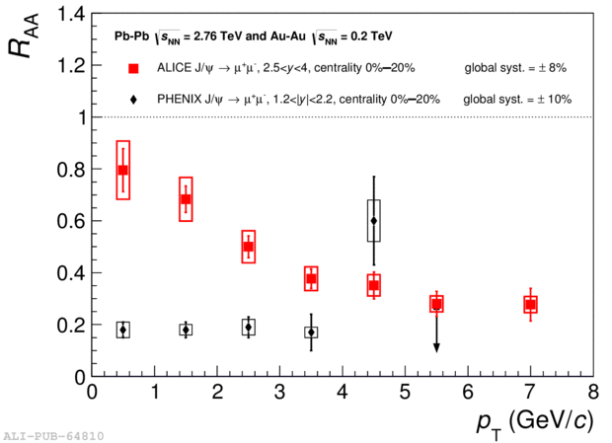
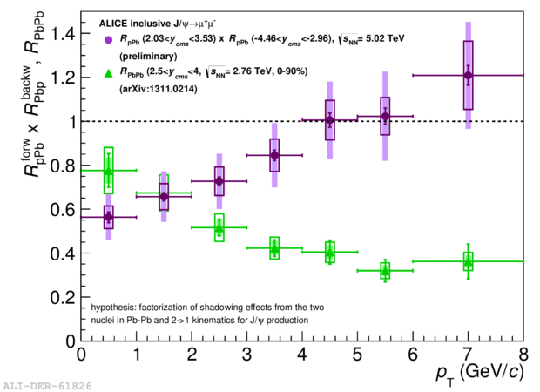
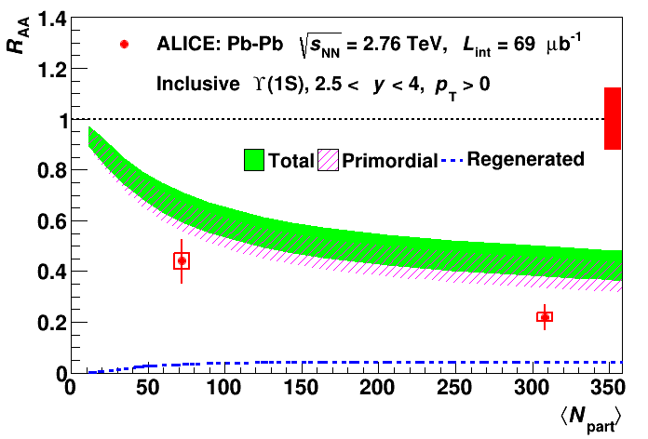
ALICE:J/ψ and Υ R_{AA}
Pb-Pb
J/ψ R_{AA} vs p_{T}
final
ALICE
PHENIX
J/ψ R_{AA} shows strong p_{T}
dependence
  Contrary to RHIC
  Suggests contribution from (re)combination
  p-Pb (R_{pA} x R_{Ap}) (anti)shadowing expectation
Υ(1S) R_{AA}
  R_{AA} with LHCb reference about 50% smaller wrt interpolated reference
  More suppression in data than in transport models (Emerick et al., suppression + regeneration)
arXiv:1311.0214, accepted by PLB
J/ψ R_{AA}/R_{pA} vs p_{T}
→ J. Book (Tue AM)
R_{pA} x R_{Ap}
R_{AA}
final
Υ R_{AA} vs N_{part}
→ J. Castillo (Wed AM)
arXiv:1405.4493
JFGO@QM2014
Υ
Notes:
Recombination there where there are lots of charm: low pT, central, mid-rapidity
transport model: "kinetic rate-equation approach in an evolving QGP and includes both suppression and regeneration effects. CNM effects are taken into account by means of an effective absorption cross section varied between 0 and 2mb, resulting in a band for the predicted RAA . " (Model: EPJA48(2012))

Slide 21
Conclusions on quarkonia
Very strong sensitivity of quarkonium states to the medium created in heavy-ion collisions
Two main mechanisms at play in AA collisions
  Suppression by color screening/partonic dissociation
  Re-generation (for charmonium only!) at high s
can qualitatively explain the main features of the results
Cold nuclear matter effects are an important issue (almost not covered here and in these lectures): interesting physics in itself and necessary for precision studies => study pA at the LHC

Slide 22
Hard probes, jets, energy losses
Based on the lectures of
M. van Leeuwen, P. Jacobs, G. Salam
and the talks of
R. Grannier de Cassagnac,
B.Cole

Slide 23
Soft QCD matter and hard probes
Heavy-ion collisions produce
QCD matter
Dominated by soft partons
p ~ T ~ 100-300 MeV
Hard-scatterings produce ‘quasi-free’ partons
⇒ Initial-state production known from pQCD
⇒ Probe medium through energy loss
‘Hard Probes’: sensitive to medium density, transport properties

Slide 24
Hard processes in QCD: Reminder
Hard process: scale Q >> Λ_{QCD}
Hard scattering High-p_{T} parton(photon) Q ~ p_{T}
Heavy flavour production m >> Λ_{QCD}
Factorization
Cross section calculation can be split into
Hard part: perturbative matrix element
Soft part: parton density (PDF), fragmentation (FF)
parton density
matrix element
FF
QM interference between hard and soft suppressed (by Q²/Λ² ‘Higher Twist’)
Soft parts – PDF, FF are universal: independent of hard process

Slide 25
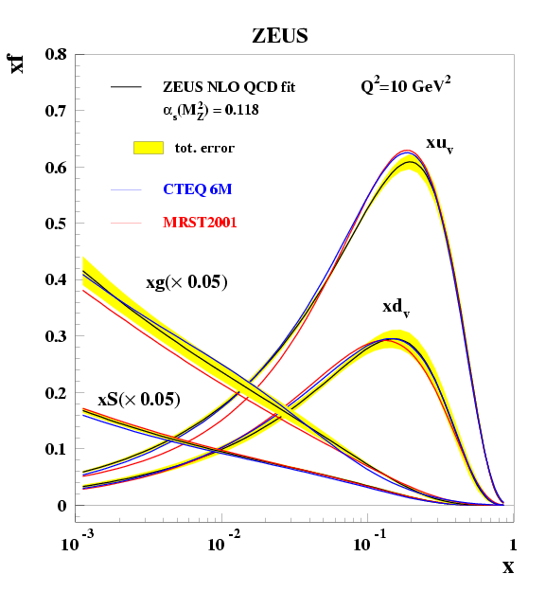
Parton density distribution
Low Q²: valence structure
Q² evolution (gluons)
Soft gluons
Gluon content of proton rises
quickly with Q²
Valence quarks (p = uud)
x ~ 1/3

Slide 26
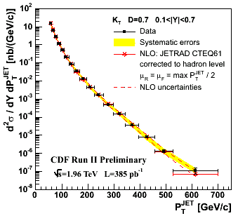
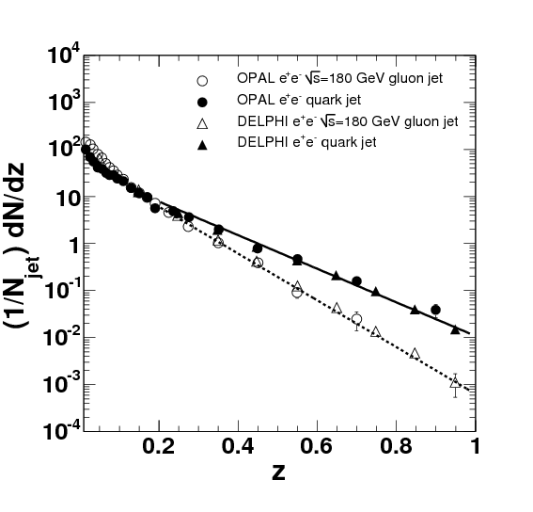
pQCD illustrated
fragmentation
jet spectrum ~ parton spectrum
CDF, PRD75, 092006

Slide 27
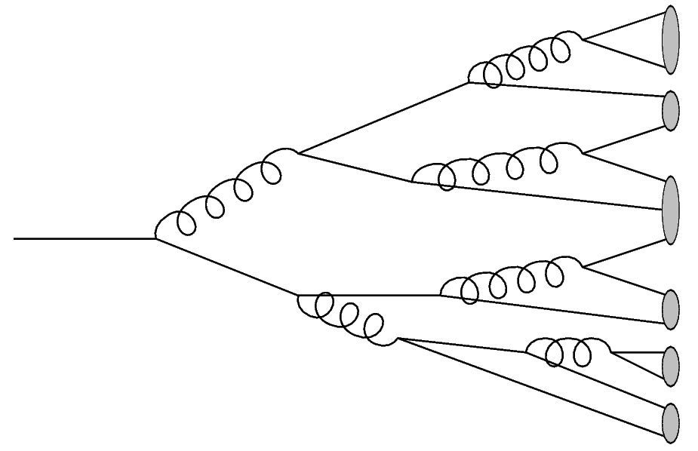
Fragmentation and parton showers
MC event generators
implement ‘parton showers’
Longitudinal and transverse dynamics
High-energy
parton
(from hard scattering)
Hadrons
large Q²
μ_{F}
Q ~ m_{H} ~ Λ_{QCD}
Analytical calculations: Fragmentation Function D(z, μ) z=p_{h}/E_{jet}
Only longitudinal dynamics

Slide 28
Nuclear modification factor R_{AA} (again)
‘Energy loss’
‘Absorption’
1/N_{bin} d²N/d²p_{T}
p+p
Downward shift
Shifts spectrum to left
Au+Au
p_{T}
Measured R_{AA} is a ratio of yields at a given p_{T}
The physical mechanism is energy loss; shift of yield to lower p_{T}

Slide 29
Components of a realistic E_{loss} model
Energy loss is a distribution
Geometry: density profile; path length distribution
Energy loss is partonic, not hadronic
  Full modeling: medium modified shower
  Simple ansatz for leading hadrons: energy loss followed by fragmentation
  Quark/gluon differences

Slide 30
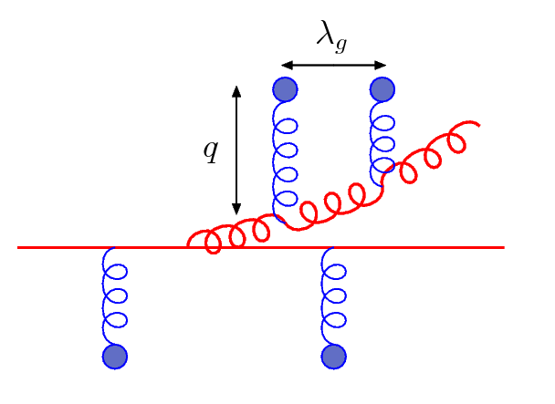
Medium-induced radiation
Landau-Pomeranchuk-Migdal effect:
the quantum interference between successive scatterings leads to suppression
Formation time important
Energy loss
radiated
gluon
propagating
parton
C_{R}: color factor (q, g)
: medium density
L: path length
m: parton mass (dead cone eff)
E: parton energy
Radiation sees
length ~τ_{f} at once
Energy loss depends on density:
and nature of scattering centers
(scattering cross section)
Path-length dependence L^{n}
n=1: elastic
n=2: radiative (LPM regime)
n=3: AdS/CFT (strongly coupled)
Transport coefficient

Slide 31
Energy loss theory: four formalisms
Multiple gluon emission
Hard Thermal Loops (AMY)
  Dynamical (HTL) medium
  Single gluon spectrum: BDMPS-Z like path integral
  No vacuum radiation
Multiple soft scattering (BDMPS-Z, ASW-MS)
  Static scattering centers
  Gaussian approximation for momentum kicks
  Full LPM interference and vacuum radiation
Opacity expansion ((D)GLV, ASW-SH)
  Static scattering centers, Yukawa potential
  Expansion in opacity L/λ
  (N=1, interference between two centers default)
  Interference with vacuum radiation
Higher Twist (Guo, Wang, Majumder)
  Medium characterised by higher twist matrix elements
  Radiation kernel similar to GLV
  Vacuum radiation in DGLAP evolution
Fokker-Planck
rate equations
Poisson ansatz
(independent emission)
DGLAP
evolution
See also: arXiv:1106.1106

Slide 32
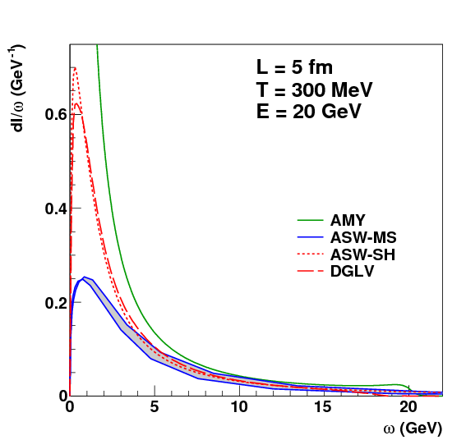
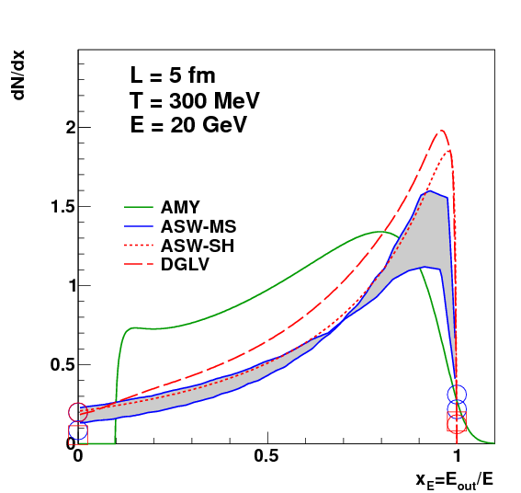
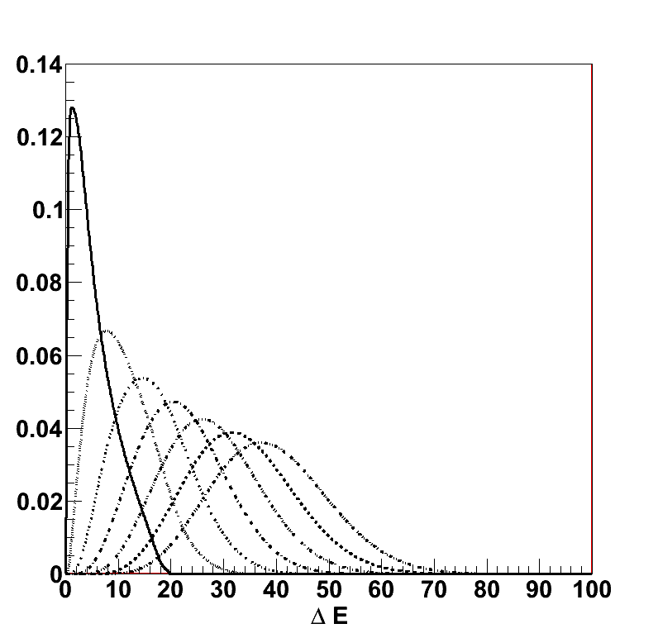
Energy loss distributions
Multiple gluon emission:
Poisson Ansatz
Radiated gluon distribution
Energy loss probability distribution
Main theory uncertainty:
Large angle radiation
Broad distribution
Significant contributions at ΔE=0, ΔE=E

Slide 33
Energy loss formalisms
Large differences between formalisms understood
  Large angle cut-off
  Length dependence (interference effects)
Mostly ‘technical’ issues; can be overcome
  Use path-integral formalism
  Monte Carlo: exact E, p conservation
    Full 2→3 NLO matrix elements
    Include interference
Next step: interference in multiple gluon emission
Plenty of room for interesting and relevant theory work!

Slide 34
Energy loss: a simplified approach
Parton spectrum
Energy loss distribution
Fragmentation (function)
known
pQCDxPDF
extract
`known’ from e⁺e⁻
This is where the information about the medium is
P(ΔE) combines geometry
with the intrinsic process
– Unavoidable for many observables
Notes:
This is the simplest ansatz – most calculation to date use it (except some MCs)
Jet, γ-jet measurements ‘fix’ E, removing one of the convolutions

Slide 35
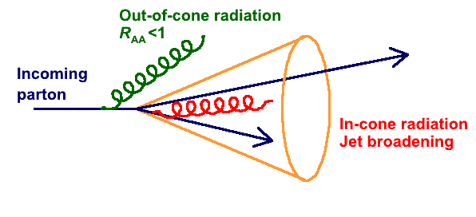
Jets and parton energy loss
Motivation: understand parton energy loss by tracking the gluon radiation
Qualitatively two scenarios:
In-cone radiation: R_{AA} = 1, change of fragmentation
Out-of-cone radiation: R_{AA} < 1

Slide 36
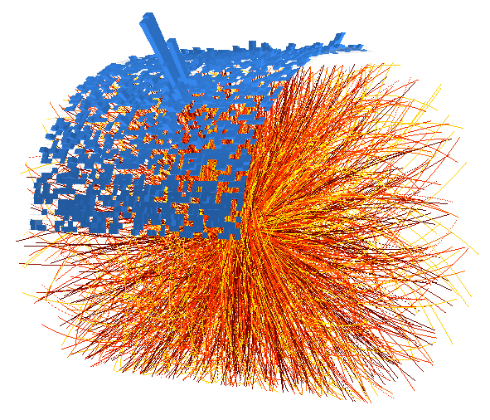
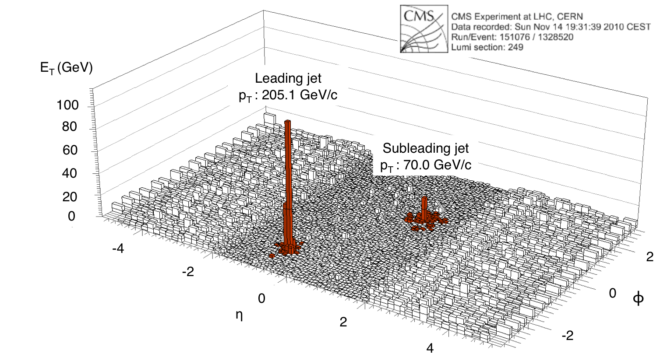
Jets at LHC
ALICE
Transverse energy map of 1 event
ϕ
η
Clear peaks: jets of fragments
from high-energy quarks and gluons
And a lot of uncorrelated ‘soft’ background

Slide 37
Jet reconstruction algorithms
Two categories of jet algorithms:
Sequential recombination
  Define distance measure
    kT/Durham (LEP): d_{ij}=2min(E²_{i},E²_{j})(1-cosθ_{ij})
    kT: d_{ij} = min(p²_{ti}, p²_{tj}) ΔR²_{ij}/R², ΔR²_{ij} = (y_{i} – y_{j})² + (ϕ_{i} – ϕ_{j})²
    Cambrige/Aachen: d_{ij} = ΔR_{ij}
    Anti-kT: dij = 1/min(p²_{ti}, p²_{tj}) ΔR²_{ij}/R²
  Cluster closest (until given threshold)
Cone
  Draw Cone radius R around the hardest particle (collinear unsafe)
  Sum the momenta and use it as new seed direction
  Iterate until stable η,ϕ_{jet} = <η,ϕ>_{particles}
Sum particles inside jet
Different prescriptions exist, most natural: E-scheme, sum 4-vectors
Jet is an object defined by jet algorithm
If parameters are right, may approximate parton
For a complete discussion, see: http://www.lpthe.jussieu.fr/~salam/teaching/PhD-courses.html

Slide 38
Infrared & Collinear safe algorithms
kt | sequential recombination hierarchical in relative pt | Catani et al ‘91 Ellis, Soper ‘93 | NlnN
Cambridge/ Aachen | sequential recombination hierarchical in angle | Dokshitzer et al ‘97 Wengler, Wobish ‘98 | NlnN
anti-kt | sequential recombination gives perfectly conical hard jets | MC, Salam, Soyez ’08 (Delsart) | N^{3/2}
SISCone | Seedless iterative cone with split-merge gives ‘economical’ jets | Salam, Soyez ‘07 | N2lnN

Slide 39
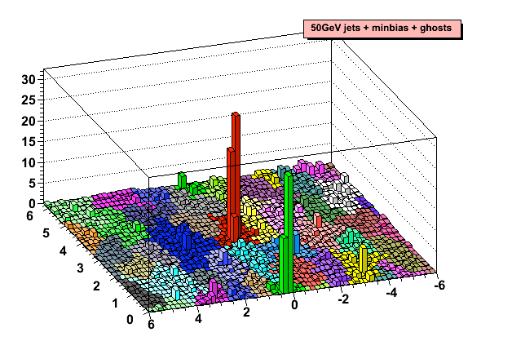
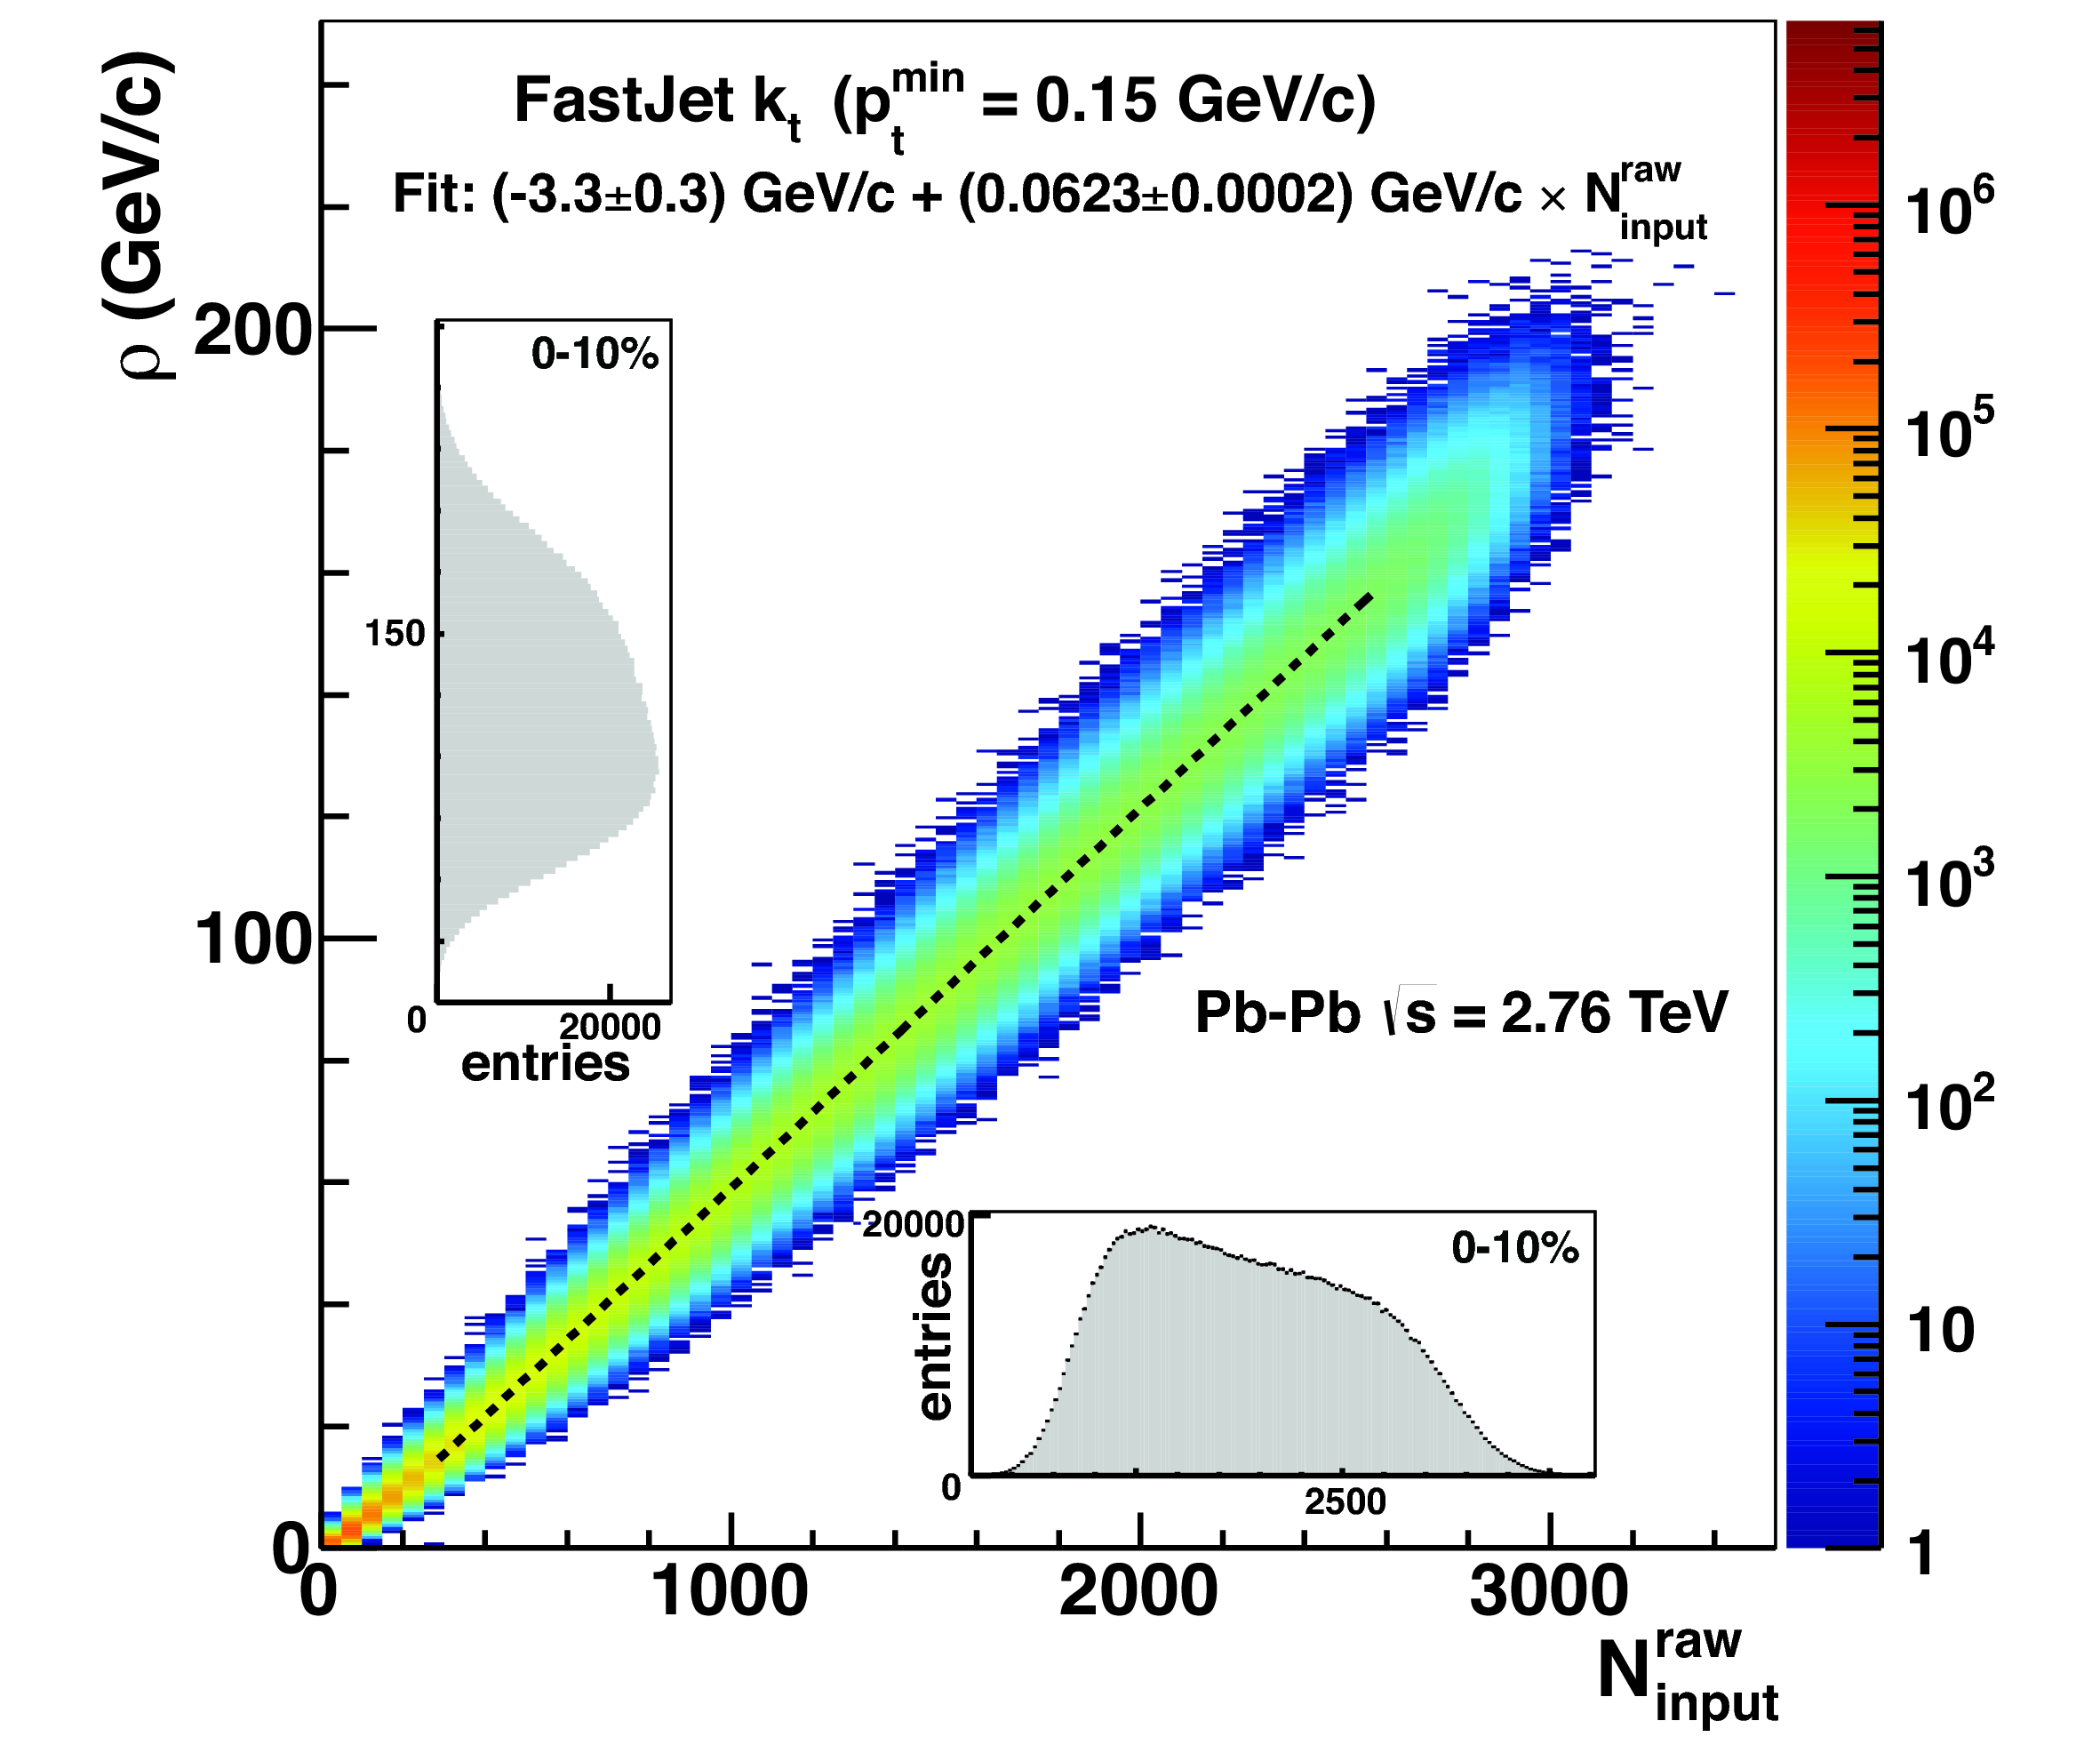
PbPb jet background
Background density vs multiplicity
Jet finding illustration
Cacciari et al
η-ϕ space filled with jets
Many ‘background jets’
Background contributes up to ~180 GeV per unit area
Subtract background:
Statistical fluctuations remain after subtraction

Slide 40
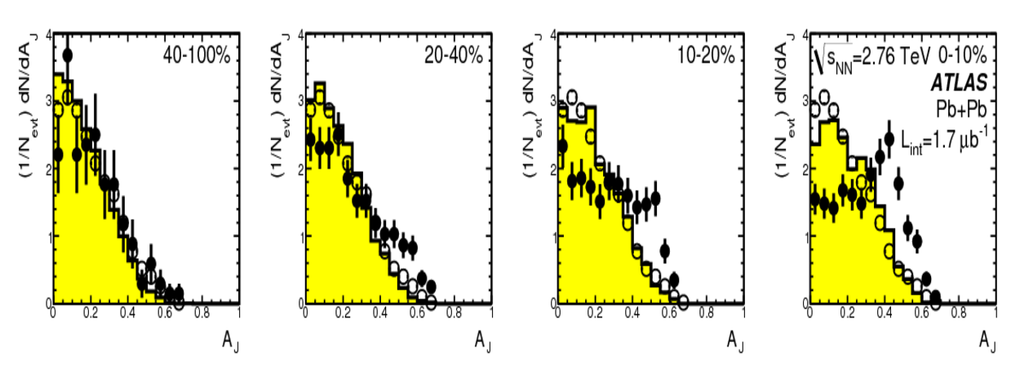
Jet energy asymmetry
Centrality
ATLAS, arXiv:1011.6182 (PRL)
Jet-energy asymmetry
Large asymmetry seen
for central events
Suggests large energy loss: many GeV
~ compatible with expectations from RHIC+theory
However:
Only measures reconstructed di-jets (don’t see lost jets)
Not corrected for fluctuations from detector+background
Both jets are intereracting – No simple observable

Slide 41
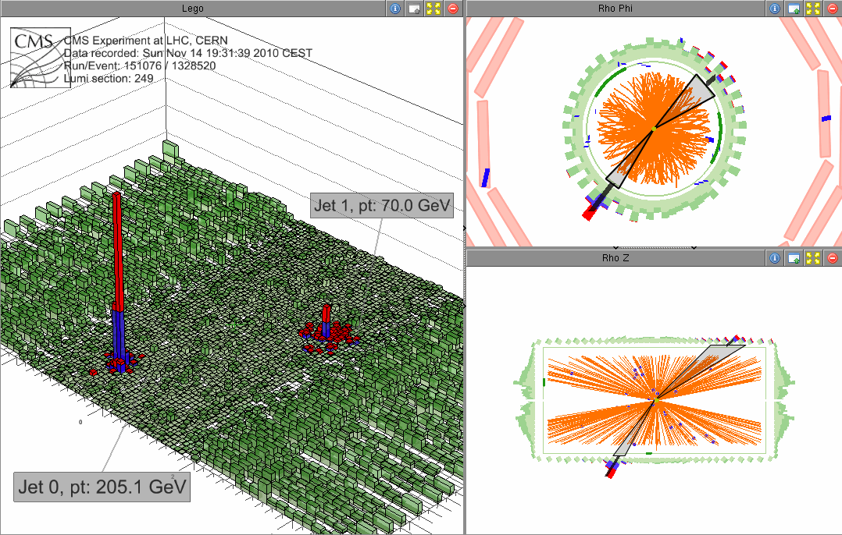
Jets @ LHC
Pb-Pb event with high energy asymmetry
the second jet looses a lot of energy, but is in the expected direction!
CMS: arXiv:1102.1957

Slide 42
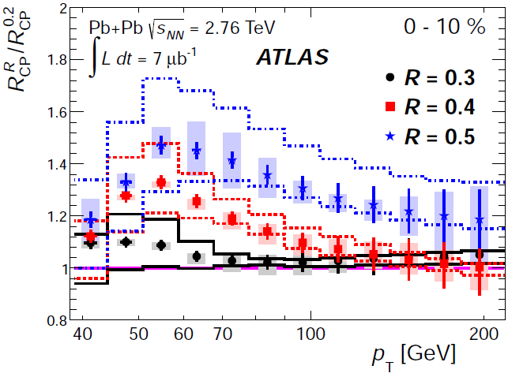
Jet broadening: R dependence
Ratio of spectra with different R
Larger jet cone:
‘catch’ more radiation
→ Jet broadening
ATLAS, A. Angerami, QM2012
However, R = 0.5 still has R_{AA} < 1
– Hard to see/measure the radiated energy

Slide 43
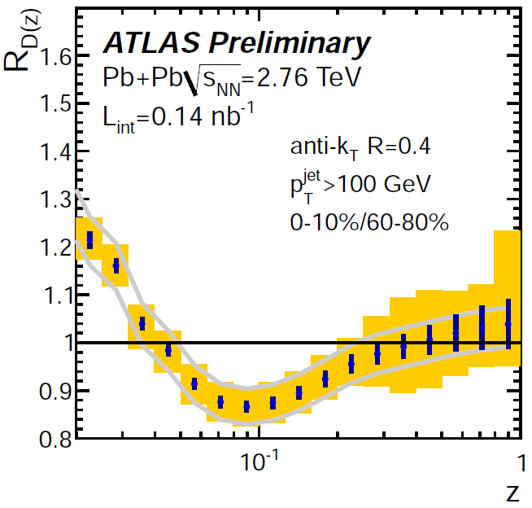
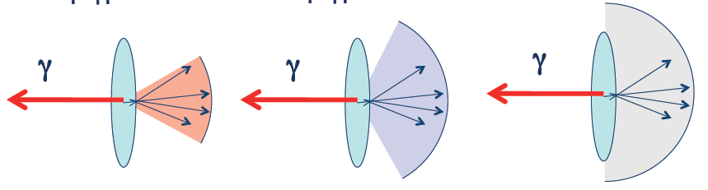
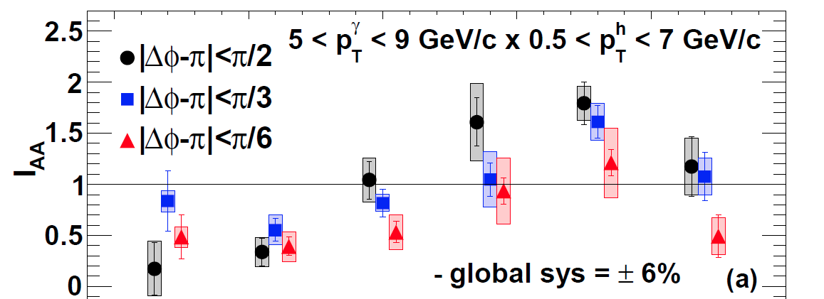
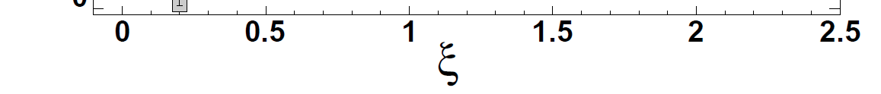
Where is the energy of the “missing” jet?
Z = Epart/Ejet, PbPb to pp
γ-hadron correlations
|Δϕ-π|<π/2
|Δϕ-π|<π/6
|Δϕ-π|<π/3
M. Rybar@QM2012
The “missing” particles with high
energy are found as many particles
with low energy
Increase @ low Z:
soft radiation
Decrease @ intermediate Z:
energy loss in QGP

Slide 44
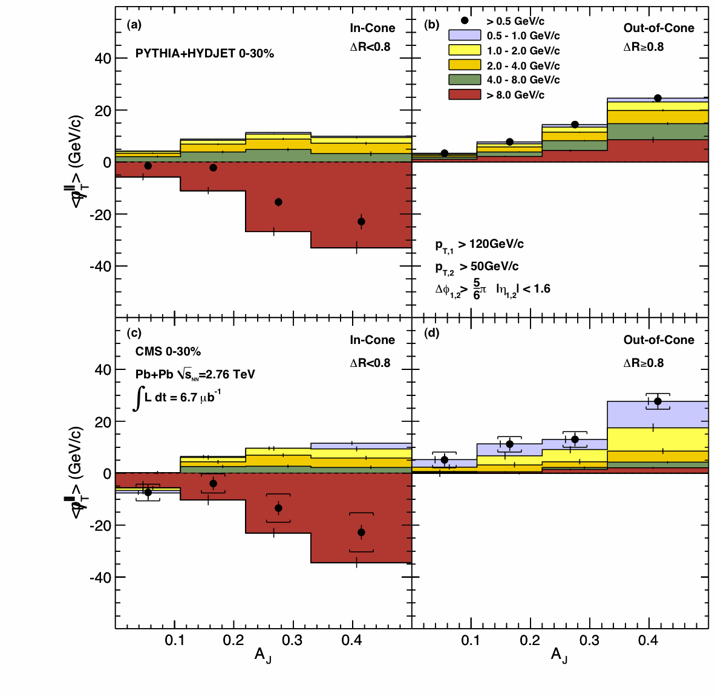

Tracing back the lost energy…
Since early 2011 we know the (subleading) jet energy is moved from high p_{T} to lower p_{T} and from small to large angles
  PRC 84 (2011) 024906
ΔR<0.8
ΔR>0.8
ΔR
dijet asymmetry = (p_{T1} – p_{T2}) / (p_{T1} + p_{T2})
RGdC@QM2014

Slide 45


Tracing back the lost energy…
Detailed (ΔR,p_{T}) distributions
  Summing charged particles for unbalanced (A_{J}>0.22) dijets in central (0–30%) collisions…
  35 GeV missing at ΔR<0.2, mmlarge p_{T} particles (>8GeV)
  Talk by Gulhan, PAS-HIN-14-010
PbPb
ΔR
ΔR
RGdC@QM2014

Slide 46


Tracing back the lost energy…
Detailed (ΔR,p_{T}) distributions
  Summing charged particles for unbalanced (A_{J}>0.22) dijets in central (0–30%) collisions…
  35 GeV missing at ΔR<0.2, large p_{T} particles
  Balanced by low p_{T} particle up to very large ΔR
  Talk by Gulhan, PAS-HIN-14-010
PbPb
ΔR
RGdC@QM2014

Slide 47
Tracing back the lost energy…
Detailed (ΔR,p_{T}) distributions
  Summing charged particles for unbalanced (A_{J}>0.22) dijets in central (0–30%) collisions…
  35 GeV missing at ΔR<0.2, large p_{T} particles
  Balanced by low p_{T} particle up to very large ΔR
  Subtracting the same from pp shows a different p_{T} mix
  Talk by Gulhan, PAS-HIN-14-010
PbPb
PbPb–pp
RGdC@QM2014

Slide 48

Tracing back the lost energy…
Detailed (ΔR,p_{T}) distributions
  Summing charged particles for unbalanced (A_{J}>0.22) dijets in central (0–30%) collisions…
  35 GeV missing at ΔR<0.2, large p_{T} particles
  Balanced by low p_{T} particle up to very large ΔR
  Subtracting the same from pp shows a different p_{T} mix
  But a similar p_{T}-integrated ΔR distribution
  Talk by Gulhan, PAS-HIN-14-010
PbPb
PbPb–pp
± 1 GeV
RGdC@QM2014

Slide 49

Unmodified jet energy in pPb
Jet energy is essentially unmodified in pPb
  As seen for instance in gamma-jet correlations
  R_{Jγ} = fraction of photons with a jet of p_{Tjet} > 30 GeV
R_{Jγ}
pPb PbPb 30-100% PbPb 0-30%
(Complementary p_{T} imbalance available)
(PbPb results updated with new pp reference)
  Talk by Barbieri
  PAS-HIN-13-006
RGdC@QM2014

Slide 50

Pb+Pb modified jet fragmentation
Ratios of D(z) vs centrality to 60-80% bin
In addition to features previously seen
⇒ Indication of an enhancement at large z
B.Cole@QM2014

