Slide 1

Managing, Preserving & Computing with Big Research Data
Challenges, Opportunities and Solutions(?)
Jamie.Shiers@cern.ch
EU-T0 F2F, April 2014
International Collaboration for Data Preservation and
Long Term Analysis in High Energy Physics

Slide 2
Introduction
For Scientific, Educational & Cultural reasons it is essential that we “preserve” our data
This is increasingly becoming a requirement from FAs – including in H2020
A model for DP exists (OAIS), together with recognised methods for auditing sites
Work in progress (RDA) to harmonize these – some tens to ~hundred of certified sites

Slide 3
WLCG Storage Experience
We have developed significant knowledge / experience with offering reliable, cost-effective storage services – “pain” documented (SIRs)
“Curation” a commitment from WLCG Tier0 + TIer1 sites (aka “EU-T0”) – WLCG MoU
HEPiX survey shows a very (10⁴) wide range in “results” – encourage sharing of best practices as well as issues involving loss or “near miss”
All this in parallel with / funding from major e-infrastructure projects (EGEE, EGI, etc.)

Slide 4
DP (“Data Sharing”) & H2020
OAIS+DSA maps well to EINFRA-1-2014
  Points 1 & 2 in particular
Does anyone else have the same (technical, financial) experience as us?
  IEEE MSST 2014: “large” = 65PB@NERSC (yes, we know there are larger)
  DPHEP “cost model” very warmly received
Could make significant contribution to realisation of “Riding the Wave” vision
“Our” solutions have short-comings in terms of Open Access optimisation – plenty of work to do!

Slide 5
Generic e-if vs VREs
We have also learned that attempts to offer “too much” functionality in the core infrastructure does not work (e.g. FPS)
This is recognised (IMHO) in H2020 calls, via “infrastructure” vs “virtual research environments”
There is a fuzzy boundary, and things developed within 1 VRE can be deployed to advantage for others (EGI-InSPIRE SA3)

Slide 6
SA3 Objectives
Transition to sustainable support:
  Identify tools of benefit to multiple communities
  Migrate these as part of the core infrastructure
  Establish support models for those relevant to individual communities

Slide 7
EINFRA-1-2014-DP & Other Players
EUDAT claim that they address “the long tail” of science
  Not addressing the multi-PB to few-EB scale AFAIK
  No clear funding model for sustainability (e.g. after project funding)
  Over-lap between HEP and key EUDAT storage sites:
  SARA (NL-T1), FZK, RZG
  Interest (verbal) from above in working together (& on RDA WGs)
EGI + APARSEN + SCIDIP-ES also planning to prepare a proposal
Can we agree on a common approach?
  Did not manage over the past 6 months with “EGI” holding separate events close in time to other “joint DP” workshops
IMHO none of us has the knowledge / experience to “go it alone”
Key issue to resolve asap

Slide 8
2020 Vision for LT DP in HEP
Long-term – e.g. LC timescales: disruptive change
  By 2020, all archived data – e.g. that described in DPHEP Blueprint, including LHC data – easily findable, fully usable by designated communities with clear (Open) access policies and possibilities to annotate further
  Best practices, tools and services well run-in, fully documented and sustainable; built in common with other disciplines, based on standards
  DPHEP portal, through which data / tools accessed
Agree with Funding Agencies clear targets & metrics

Slide 9
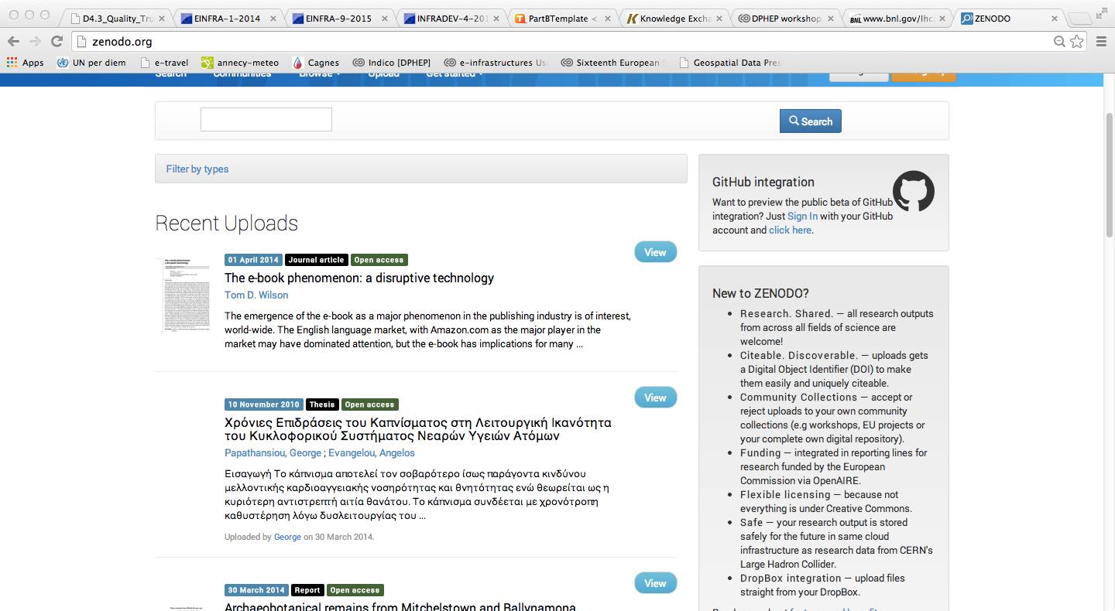
DPHEP Portal – Zenodo like?

Slide 10
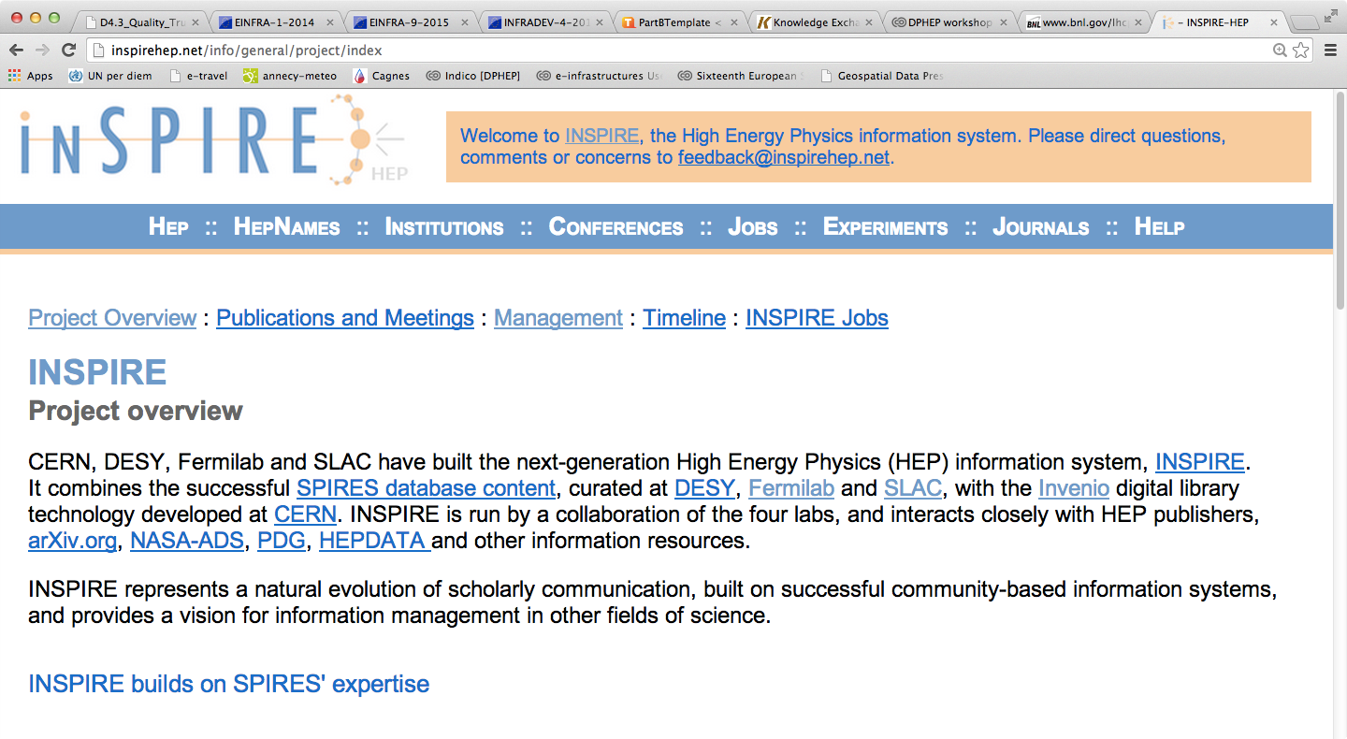
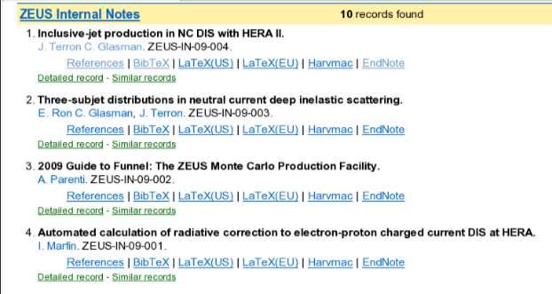
Documentation projects with INSPIREHEP.net
Internal notes from all HERA experiments now available on INSPIRE
  A collaborative effort to provide “consistent” documentation across all HEP experiments – starting with those at CERN – as from 2015
  (Often done in an inconsistent and/or ad-hoc way, particularly for older experiments)

Slide 11
Additional Metrics (Beyond DSA)
Open Data for educational outreach
  Based on specific samples suitable for this purpose
  MUST EXPLAIN BENEFIT OF OUR WORK FOR FUTURE FUNDING!
  High-lighted in European Strategy for PP update
Reproducibility of results
  A (scientific) requirement (from FAs)
  “The Journal of Irreproducible Results”
Maintaining full potential of data for future discovery / (re-)use

Slide 12
Additional Services / Requirements
The topics covered by EINFRA-1, whilst providing a solid basis, are not enough
Nor (IMHO) is it realistic to try to put services that are likely to have VRC-components in generic infrastructure (incl. SCIDIP-ES services)
Hence the VRE calls (TWO OF THEM)
Use our existing multi-disciplinary contacts to build a multi-disciplinary, multi-faceted project?
Probably more important (for DP) than EINFRA-1

Slide 13
Looking beyond H2020-2014
The above ideas are “evolution” rather than “revolution” and as such rather short-term
A more ambitious, but more promising approach is being draft by Marcello Maggi
  Open Data, not just Open Access (to proprietary formats not maintained in the long term)
It is not clear to me that this fits in the currently open calls, but we should start to sow seeds for the (near) future, including elaborating further the current proposal & evangelising

Slide 14
A Possible Way Ahead
EINFRA-1-2014-DP
  Try to identify / agree on a core set of “data service providers” out of WLCG / EU-T0 / EUDAT / EGI set
  Try to agree (with EUDAT?) on relevant WPs
VRE-DP (EINFRA-9, INFRADEV-4)
  Ditto, but for higher level services, including those developed by SCIDIP-ES, those in preparation by “DPHEP” and other high profile communities
Timeline: mid-May to mid-July for writing proposals; mid-July to mid-August “dead”, top priority corrections late August + repeated submission prior to 2 Sep close
  I would do test submissions much earlier…

Slide 15
The Guidelines 2014-2015
Guidelines Relating to Data Producers:
The data producer deposits the data in a data repository with sufficient information for others to assess the quality of the data and compliance with disciplinary and ethical norms.
The data producer provides the data in formats recommended by the data repository.
The data producer provides the data together with the metadata requested by the data repository.

Slide 16
Guidelines Related to Repositories (4-8):
The data repository has an explicit mission in the area of digital archiving and promulgates it.
The data repository uses due diligence to ensure compliance with legal regulations and contracts including, when applicable, regulations governing the protection of human subjects.
The data repository applies documented processes and procedures for managing data storage.
The data repository has a plan for long-term preservation of its digital assets.
Archiving takes place according to explicit work flows across the data life cycle.

Slide 17
Guidelines Related to Repositories (9-13):
The data repository assumes responsibility from the data producers for access and availability of the digital objects.
The data repository enables the users to discover and use the data and refer to them in a persistent way.
The data repository ensures the integrity of the digital objects and the metadata.
The data repository ensures the authenticity of the digital objects and the metadata.
The technical infrastructure explicitly supports the tasks and functions described in internationally accepted archival standards like OAIS.

Slide 18
Guidelines Related to Data Consumers (14-16):
The data consumer complies with access regulations set by the data repository.
The data consumer conforms to and agrees with any codes of conduct that are generally accepted in the relevant sector for the exchange and proper use of knowledge and information.
The data consumer respects the applicable licences of the data repository regarding the use of the data.

Slide 19
DSA self-assessment & peer review
Complete a self-assessment in the DSA online tool. The online tool takes you through the 16 guidelines and provides you with support
Submit self-assessment for peer review. The peer reviewers will go over your answers and documentation
Your self-assessment and review will not become public until the DSA is awarded.
After the DSA is awarded by the Board, the DSA logo may be displayed on the repository’s Web site with a link to the organization’s assessment.
http://datasealofapproval.org/

Slide 20
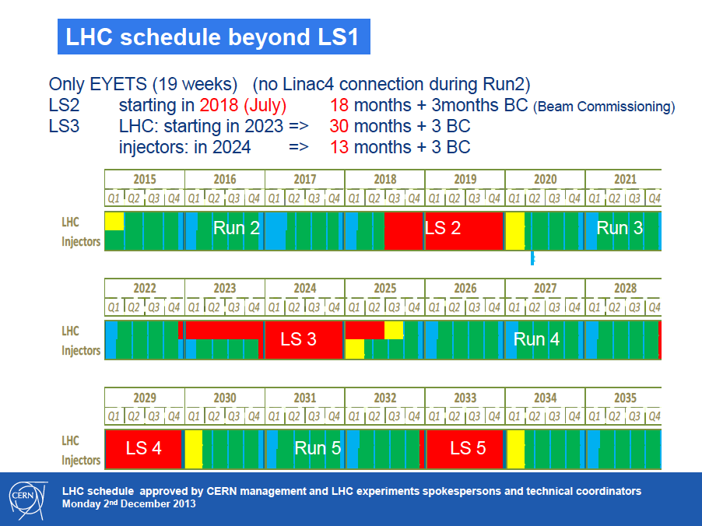
Run 1 – which led to the discovery of the Higgs boson – is just the beginning.
There will be further data taking – possibly for another 2 decades or more – at increasing data rates, with further possibilities for discovery!
We are here
HL-LHC

Slide 21
Data: Outlook for HL-LHC
PB
Very rough estimate of a new RAW data per year of running using a simple extrapolation of current data volume scaled by the output rates.
  To be added: derived data (ESD, AOD), simulation, user data…
0.5 EB / year is probably an under estimate!

Slide 22
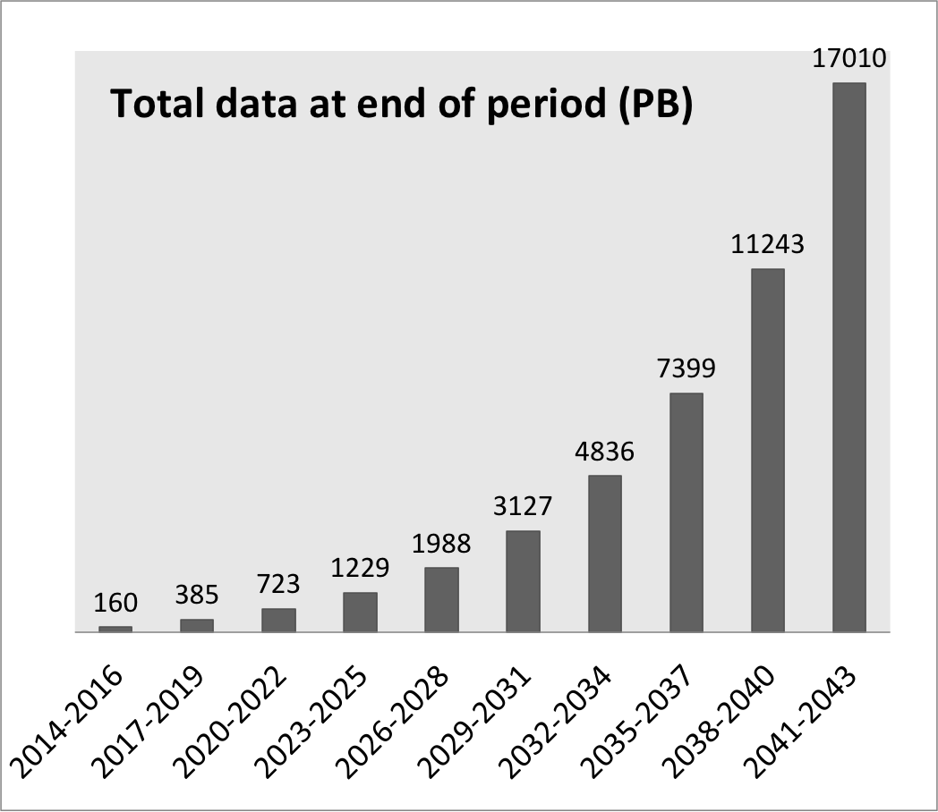
Cost Modelling: Regular Media Refresh + Growth
Start with 10PB, then +50PB/year, then +50% every 3y (or +15% / year)

Slide 23
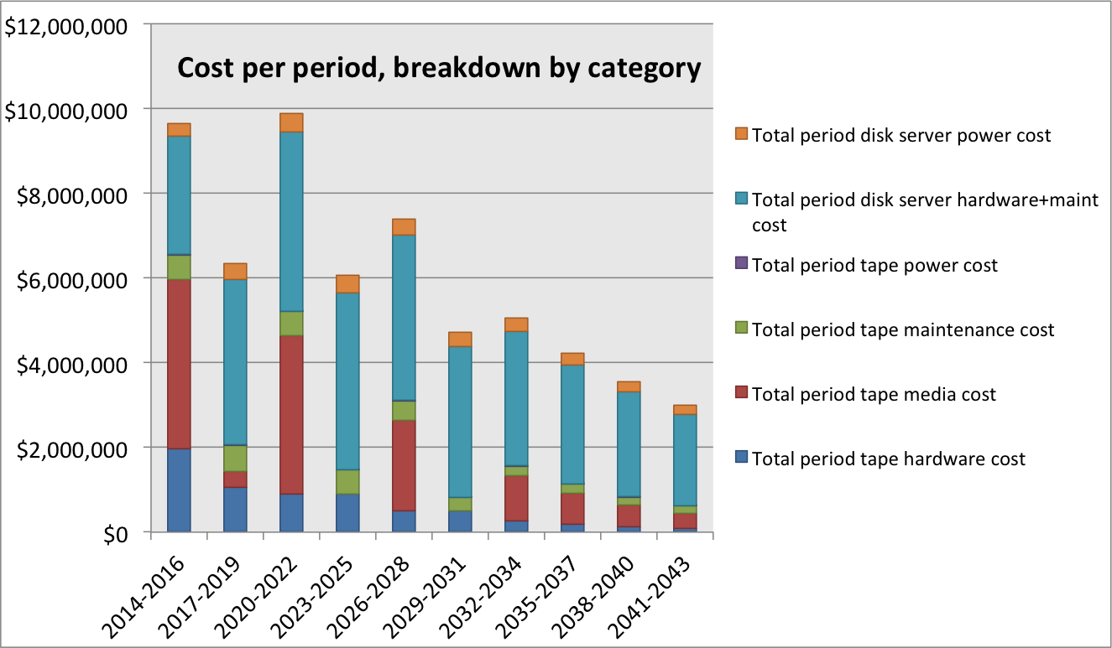
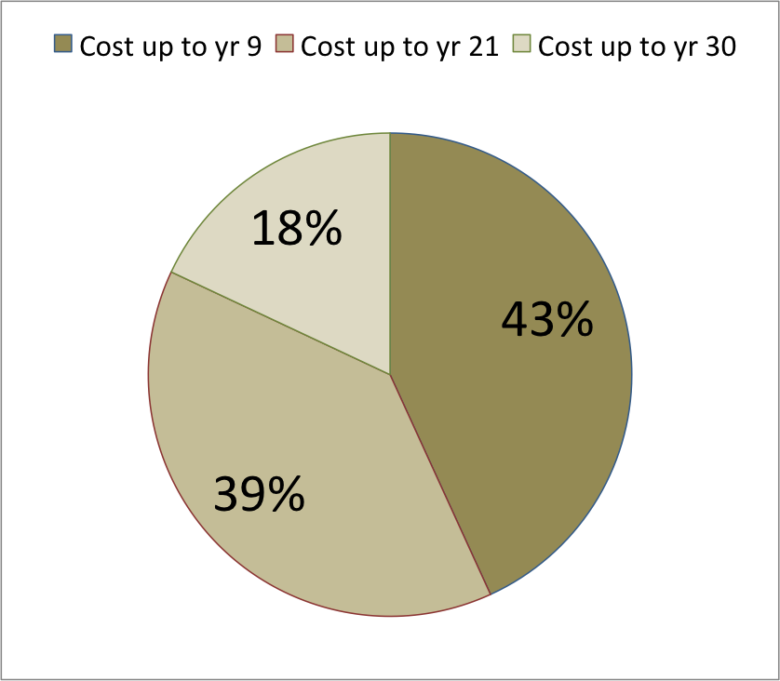
Case B) increasing archive growth
Total cost: ~$60M
(~$2M / year)

Slide 24
2020 Vision for LT DP in HEP
Long-term – e.g. LC timescales: disruptive change
  By 2020, all archived data – e.g. that described in DPHEP Blueprint, including LHC data – easily findable, fully usable by designated communities with clear (Open) access policies and possibilities to annotate further
  Best practices, tools and services well run-in, fully documented and sustainable; built in common with other disciplines, based on standards
  DPHEP portal, through which data / tools accessed
Agree with Funding Agencies clear targets & metrics

Slide 25
Volume: 100PB + ~50PB/year
(+400PB/year from 2020)

Slide 26
Requirements from Funding Agencies
To integrate data management planning into the overall research plan, all proposals submitted to the Office of Science for research funding are required to include a Data Management Plan (DMP) of no more than two pages that describes how data generated through the course of the proposed research will be shared and preserved or explains why data sharing and/or preservation are not possible or scientifically appropriate.
At a minimum, DMPs must describe how data sharing and preservation will enable validation of results, or how results could be validated if data are not shared or preserved.
Similar requirements from European FAs and EU (H2020)

Slide 27
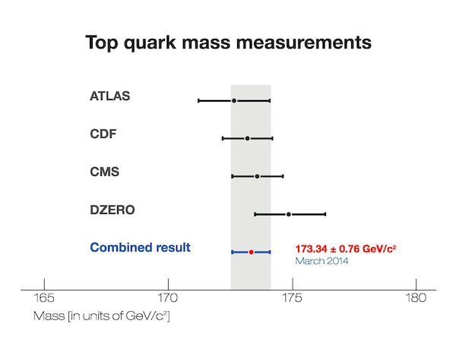
20 Years of the Top Quark

Slide 28


Slide 29
How?
How are we going to preserve all this data?
And what about “the knowledge” needed to use it?
How will we measure our success?
And what’s it all for?

Slide 30
Answer: Two-fold
Specific technical solutions
  Main-stream;
  Sustainable;
  Standards-based;
  COMMON
Transparent funding model
Project funding for short-term issues
  Must have a plan for long-term support from the outset!
Clear, up-front metrics
  Discipline neutral, where possible;
  Standards-based;
  EXTENDED IFF NEEDED
Start with “the standard”, coupled with recognised certification processes
  See RDA IG
Discuss with FAs and experiments – agree!
(For sake of argument, let’s assume DSA)

Slide 31
Additional Metrics (aka “The Metrics”)
Open Data for educational outreach
  Based on specific samples suitable for this purpose
  MUST EXPLAIN BENEFIT OF OUR WORK FOR FUTURE FUNDING!
  High-lighted in European Strategy for PP update
Reproducibility of results
  A (scientific) requirement (from FAs)
  “The Journal of Irreproducible Results”
Maintaining full potential of data for future discovery / (re-)use

Slide 32
LHC Data Access Policies
Level (standard notation) | Access Policy
L0 (raw) (cf “Tier”) | Restricted even internally Requires significant resources (grid) to use
L1 (1st processing) | Large fraction available after “embargo” (validation) period Duration: a few years Fraction: 30 / 50 / 100%
L2 (analysis level) | Specific (meaningful) samples for educational outreach: pilot projects on-going CMS, LHCb, ATLAS, ALICE
L3 (publications) | Open Access (CERN policy)

Slide 33
1. DPHEP Portal
  Digital library tools (Invenio) & services (CDS, INSPIRE, ZENODO) + domain tools (HepData, RIVET, RECAST…)
  Sustainable software, coupled with advanced virtualization techniques, “snap-shotting” and validation frameworks
  Proven bit preservation at the 100PB scale, together with a sustainable funding model with an outlook to 2040/50
  Open Data
(and several EB of data)

Slide 34
DPHEP Portal – Zenodo like?

Slide 35
Documentation projects with INSPIREHEP.net
Internal notes from all HERA experiments now available on INSPIRE
  A collaborative effort to provide “consistent” documentation across all HEP experiments – starting with those at CERN – as from 2015
  (Often done in an inconsistent and/or ad-hoc way, particularly for older experiments)

Slide 36
The Guidelines 2014-2015
Guidelines Relating to Data Producers:
The data producer deposits the data in a data repository with sufficient information for others to assess the quality of the data and compliance with disciplinary and ethical norms.
The data producer provides the data in formats recommended by the data repository.
The data producer provides the data together with the metadata requested by the data repository.

Slide 37

Some HEP data formats
Experiment | Accelerator | Format | Status
ALEPH | LEP | BOS | ?
DELPHI | LEP | Zebra | CERNLIB – no longer formally supported
L3 | LEP | Zebra | “
OPAL | LEP | Zebra | “
ALICE | LHC | ROOT | PH/SFT + FNAL
ATLAS | LHC | ROOT | “
CMS | LHC | ROOT | “
LHCb | LHC | ROOT | “
COMPASS | SPS | Objy | Support dropped at CERN ~10 years ago
COMPASS | SPS | DATE | ALICE online format – 300TB migrated
Other formats used at other labs – many previous formats no longer supported!

Slide 38
Work in Progress…
By September, CMS should have made a public release of some data + complete environment
  LHCb, now also ATLAS , plan something similar, based on “common tools / framework”
By end 2014, a first version of the “DPHEP portal” should be up and running
“DSA++” – by end 2015???
More news in Sep (RDA-4) / Oct (APA)

Slide 39
Mapping DP to H2020
EINFRA-1-2012 “Big Research Data”
  Trusted / certified federated digital repositories with sustainable funding models that scale from many TB to a few EB
“Digital library calls”: front-office tools
  Portals, digital libraries per se etc.
VRE calls: complementary proposal(s)
  INFRADEV-4
  EINFRA-1/9

Slide 40
The Bottom Line
We have particular skills in the area of large-scale digital (“bit”) preservation AND a good (unique?) understanding of the costs
  Seeking to further this through RDA WGs and eventual prototyping -> sustainable services through H2020 across “federated stores”
There is growing realisation that Open Data is “the best bet” for long-term DP / re-use
We are eager to collaborate further in these and other areas…

Slide 41
Key Metrics For Data Sharing
(Some) Open Data for educational outreach
Reproducibility of results
Maintaining full potential of data for future discovery / (re-)use
“Service provider” and “gateway” metrics still relevant but IMHO secondary to the above!

Slide 42


Data Sharing in Time & Space
Challenges, Opportunities and Solutions(?)
Jamie.Shiers@cern.ch
Workshop on Best Practices for Data Management & Sharing
International Collaboration for Data Preservation and
Long Term Analysis in High Energy Physics

