Slide 1


Data processing of the LHC experiments: a simplified look
Student lecture
24 April 2014
Latchezar Betev

Slide 2
Who am I
Member of the core Offline team of the ALICE experiment
Data processing coordinator
Grid operations coordinator
This presentation – covers the basics for the data processing, Grid and its use in the 4 large LHC experiments - ATLAS, ALICE, CMS, LHCb

Slide 3
Basic terminology - the LHC
The size of an accelerator is related to the maximum energy obtainable
In a collider - a function of the R and the strength of the dipole magnetic field that keeps particles on their orbits
The LHC uses some of the most powerful dipoles and radiofrequency cavities in existence
From the above => the design energy of 7TeV per proton => E=2E_{beam}= 14TeV Center Of Mass (CMS) at each experiment

Slide 4
Basic calculus - energies
Proton-Proton collisions
  7 TeV = 7·10¹² eV · 1,6·10⁻¹⁹ J/eV = 1,12·10⁻⁶ J
Pb-Pb collisions
  Each ion of Pb-208 reaches 575 TeV.
  Energy per nucleon = 575/208 = 2,76 TeV
Mosquito 60 mg @20 cm/s:
  E_{k} = ½ m·v² ⇒ E_{k} = ½ 6·10⁻⁵·0,2 ² ~ 7 TeV

Slide 5
…and a bit more on collisions
Energy present in a bunch:
  7 TeV/proton x 1,15·10¹¹ protons/bunch ~ 1,29·10⁵ J/bunch
Motorbike 150 kg @150 km/h
  E_{k} = ½ x 150 x 41,7² ~ 1,29·10⁵ J
Number of bunches in one beam: 2808
  1,29·10⁵ J / bunch x 2808 bunches ~ 360 MJ
  Equivalent to 77,4 kg of TNT *
*The energy content of TNT is 4.68MJ/kg

Slide 6
What happens with all this data
RAW data and how it is generated
Basics of Distributed Computing
The processing tool of today - Worldwide LHC Computing Grid (WLCG)
Slight ALICE bias ☺

Slide 7
The origin of the LHC data
LHC produces over 600 millions proton-proton collisions per second in ATLAS or CMS detectors
Data/event = 1 MB (1 Mb) => 10¹⁵ bytes/s = 1 PB/s
BluRay DL = 50 GB, 20000 disks/sec => 24 m stack/sec
Several orders of magnitude greater than what any detector data acquisition system can handle
Enter the trigger - designed to reject the uninteresting events and keep the interesting ones
  ATLAS trigger system collects ~200 events/sec
200 events/s x 1 Mbyte = 200 MB/s
Yearly triggered (RAW data) rate ~4 PB
The 4 large LHC experiments collect ~15 PB RAW data per year to be stored, processed, and analyzed

Slide 8
More on triggering
More complex trigger systems further select interesting physics events
Level 1 - hardware based trigger using detectors and logic functions between them (fast)
Level 2 - software based, event selection based on a simple analysis of Level-1 selected events
Level-3 trigger – software-based, usually in a dedicated computing farm – High Level Trigger (HLT) - preliminary reconstruction of the entire event

Slide 9
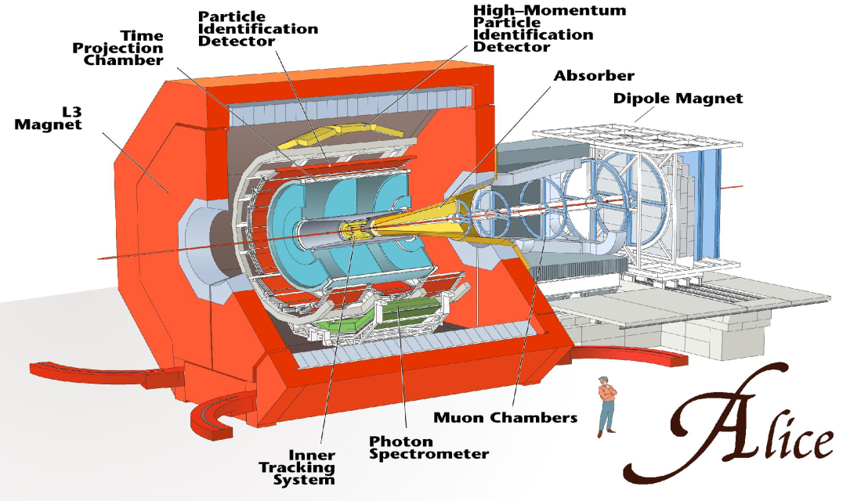
Specifically in ALICE
ALICE Collaboration
~ 1/2 ATLAS, CMS, ~ 2x LHCb
1200 people, 36 countries, 131 Institutes
Total weight 10,000t
Overall diameter 16.00m
Overall length 25m
Magnetic Field 0.4Tesla
8 kHz (160 GB/sec)
level 1 - special hardware
200 Hz (4 GB/sec)
level 2 - embedded processors
30 Hz (2.5 GB/sec)
level 3 - HLT
30 Hz
(1.25 GB/sec)
data recording &
offline analysis
Notes:
Get the right numbers for ALICE

Slide 10
Why distributed computing resources
Early in the design concept for computing at LHC
  Realization that all storage and computation cannot be done locally (at CERN), as with the previous large experiments generation (i.e. LEP)
  Enter the concept of the distributed computing (the Grid) as a way to share the resources among many collaborating centres
  Conceptual design and start of work: 1999-2001

Slide 11
Data Intensive Grid projects
GIOD - Globally Interconnected Object Databases
MONARC (next slide) - Models of Networked Analysis at Regional Centres for LHC Experiments
PPDG – Particle Physics Data Grid
GriPhyN – Grid Physics Network
iVDGL – international Virtual Data Grid Laboratory
EDG – European Data Grid
OSG – Open Science Grid
NorduGrid – Nordic countries colaboration
… and other projects, all contributing to the development and operation of the
WLCG – Worldwide LHC Computing Grid (today)

Slide 12
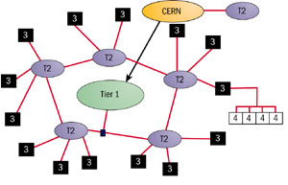
MONARC model (1999)
Models of Networked Analysis at Regional Centres for LHC Experiments
CERN - Tier0
Large regional centres - Tier1s
Institute/university centres - Tier2
Smaller centres - Tier3
Red lines – data paths

Slide 13
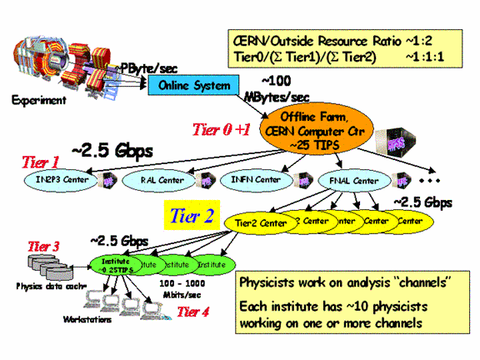
CMS MONARC model

Slide 14
Building blocks (layers)
Network connects Grid resources
Resource layer is the actual grid resources: computers and storage
Middleware (software) provides the tools that enable the network and resources layers to participate in a Grid
Application (software) which includes application software (scientific/engineering/business) + portals and development toolkits to support the applications

Slide 15
Grid Architecture
“Coordinating multiple resources”: ubiquitous infrastructure services, app-specific distributed services
Application
Appli-
cation
Internet Protocol Architecture
Collective
“Sharing single resources”: Negotiating access,
controlling use
Resource
“Talking to things”: Communication (Internet protocols) & security
Connectivity
Transport
“Controlling things locally”: Access to, & control of
resources
Internet
Fabric
Link
Notes:
We define Grid architecture in terms of a layered collection of protocols.
Fabric layer includes the protocols and interfaces that provide access to the resources that are being shared, including computers, storage systems, datasets, programs, and networks. This layer is a logical view rather then a physical view. For example, the view of a cluster with a local resource manager is defined by the local resource manger, and not the cluster hardware. Likewise, the fabric provided by a storage system is defined by the file system that is available on that system, not the raw disk or tapes.
The connectivity layer defines core protocols required for Grid-specific network transactions. This layer includes the IP protocol stack (system level application protocols [e.g. DNS, RSVP, Routing], transport and internet layers), as well as core Grid security protocols for authentication and authorization.
Resource layer defines protocols to initiate and control sharing of (local) resources. Services defined at this level are gatekeeper, GRIS, along with some user oriented application protocols from the Internet protocol suite, such as file-transfer.
Collective layer defines protocols that provide system oriented capabilities that are expected to be wide scale in deployment and generic in function. This includes GIIS, bandwidth brokers, resource brokers,….
Application layer defines protocols and services that are parochial in nature, targeted towards a specific application domain or class of applications. These are are are … arrgh

Slide 16
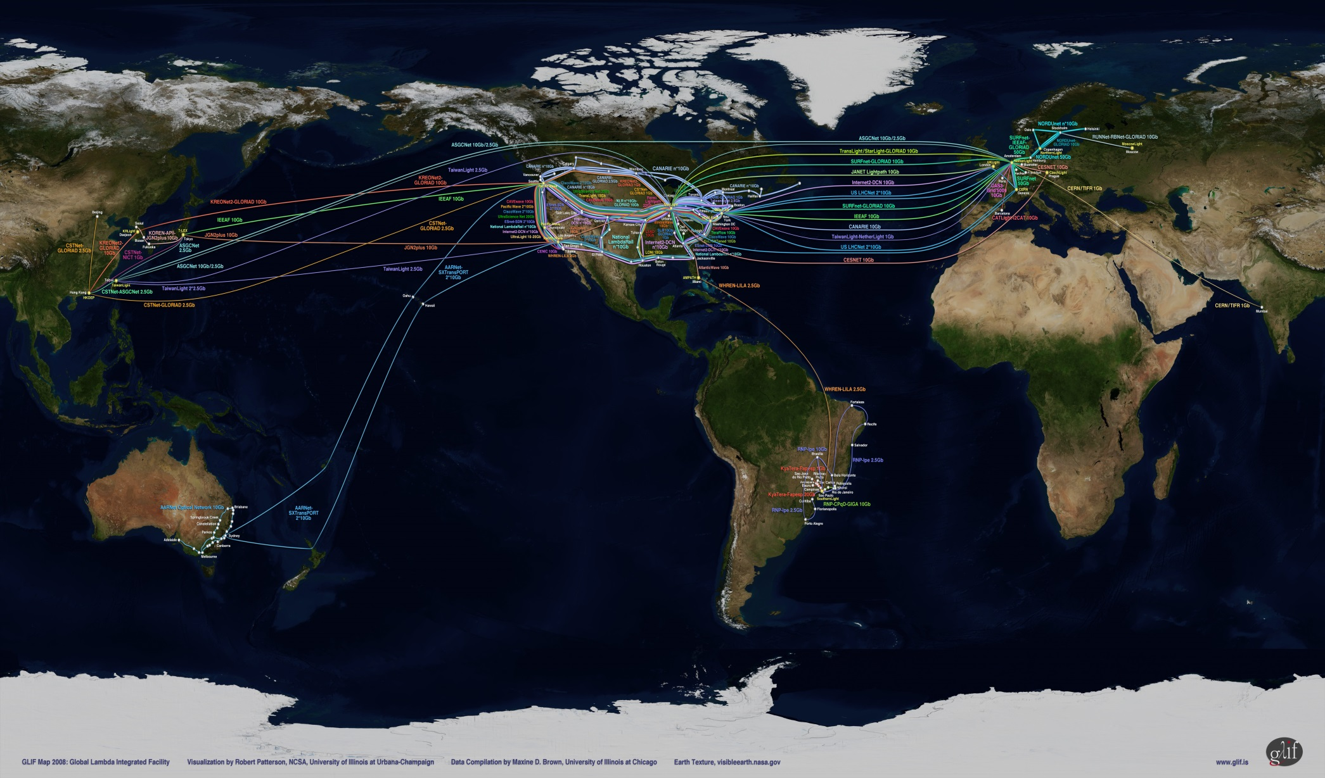
A world map
This is just the network

Slide 17
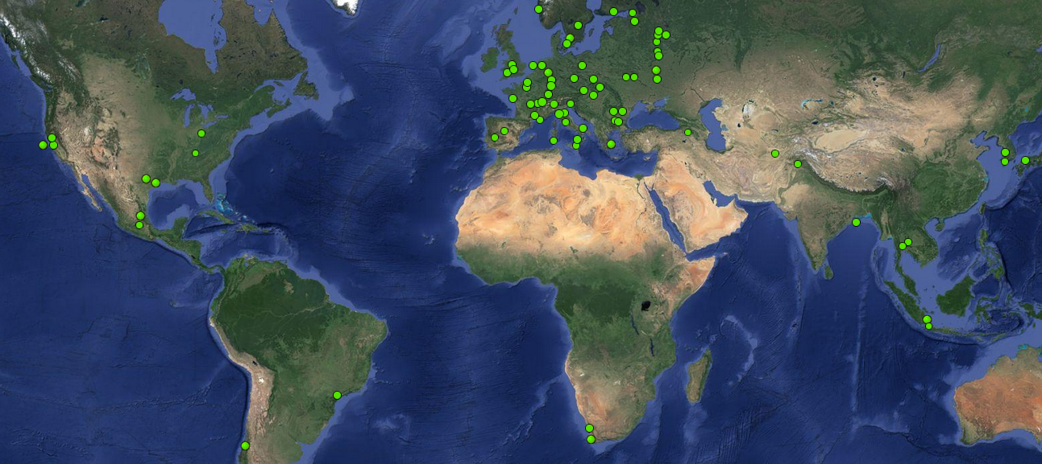
The ALICE Grid sites
8 in North America
53 in Europe
10 in Aisa
2 in Africa
2 in South America

Slide 18
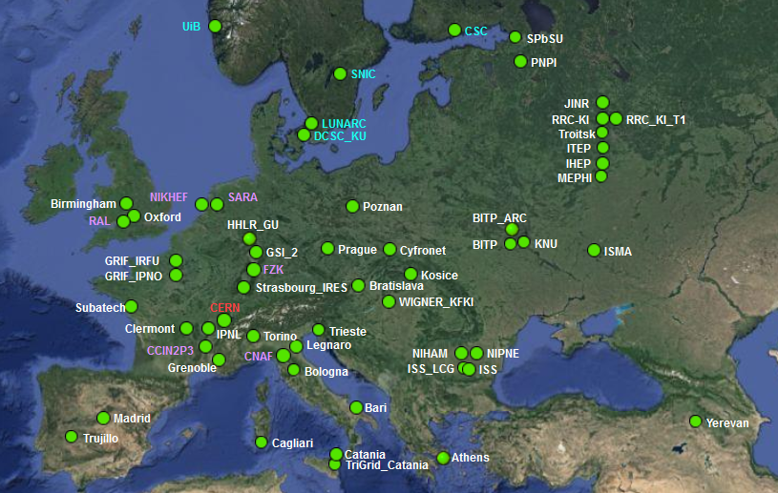
Zoom on Europe

Slide 19
Grid sites (resources layer)
The Grid sites usually provide resources to all experiments, but there are exceptions
ATLAS and CMS have more sites and resources than ALICE and LHCb – larger collaborations, more collected data, more analysis
The sites use fair-share (usually through batch systems) to allocate resources to the experiments
In general – the Grid resources are shared

Slide 20
Offline data processing
RAW data collection and distribution
Data processing
Analysis objects
Analysis

Slide 21
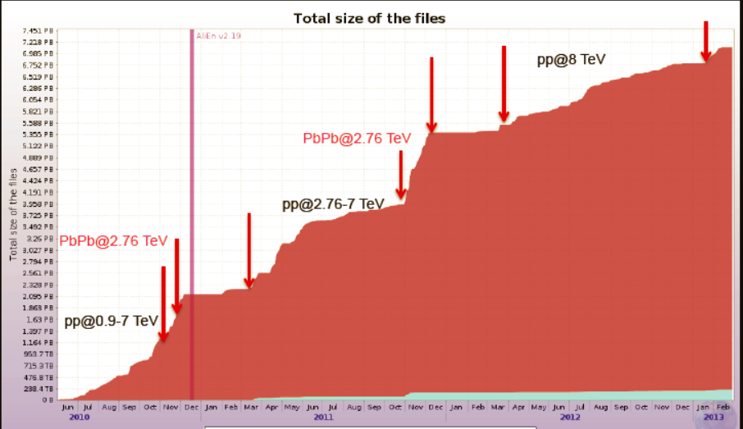
RAW data collection
RAW data from epxeriment’s DAQ/HLT, similar data
accumulation profile for other LHC experiments

Slide 22
RAW Data distribution
T1
DAQ/HLT
of the
experiment
RAW data is first collected
at the T0 centre (CERN)
One or two copies are made to
the remote T1s with custodial
storage capabilities
Custodial (MSS) usually means
tape system (reliable, cheaper
than disk media)
The RAW data is irreplaceable,
hence multiple copies
T0
MSS
MSS
T1
MSS

Slide 23
RAW data processing
RAW data is read from the
T0/T1s storage locally and
processed through the
experiment’s applications
These are complex algorithms
for tracking, momentum fitting,
particle identification, etc..
Each event takes from few secs
to minutes to process (depending
on complexity, collision type)
The results are stored for analysis
Processing
(reconstructon)
application
T1
Processing
(reconstructon)
application
T0
MSS
T1
MSS
Processing
(reconstructon)
application
MSS

Slide 24
Processing results
The RAW data processing results in (usually) analysis-ready objects
  ESDs – Event Summary Data (larger)
  AODs – Analysis Object Data (compact)
  These may have different names in the 4 experiments, however the same general function
Common is that these are much smaller than the original RAW, up to a factor of 100
The processing is akin to data compression

Slide 25
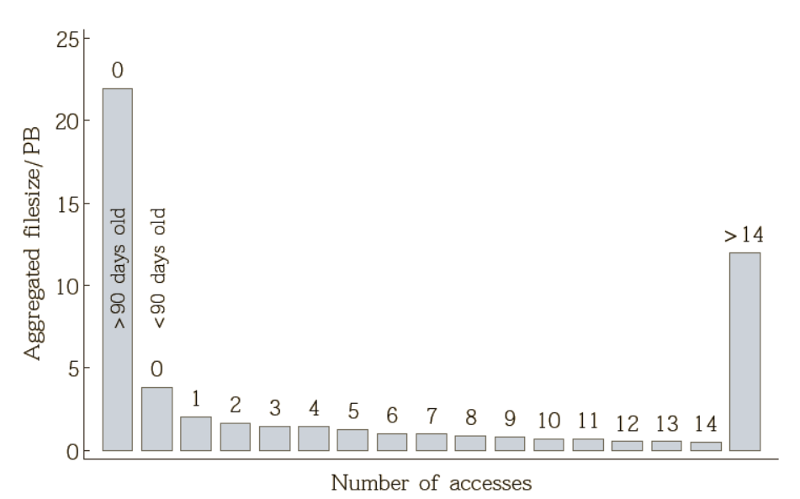
Processing results distribution
The ESDs/AODs are distributed to several computing cenres for analysis
  Rationale – allows for multiple access; if one centere does not work, the data is still accessible
  Allows for more popular data to be copied to more places
  Conversely for less popular data, number of copies is reduced

Slide 26
Monte-Carlo production
Simulation of detector response,
various physics models
Corrections of experimental
results, comparison to theoretical
predictions
MC has little input, output is the
Same type of objects (ESDs/AODs)
Processing time is far greater
Than RAW data processing
MC runs everywhere
Physics gener.+
Transport MC+
Processing
application
T2
Physics gener.+
Transport MC+
Processing
application
T0
T1
Physics gener.+
Transport MC+
Processing
application

Slide 27
Distributed analysis – data aggregation
Physicits
Input data selection
Optimization
Sub-selection 1
Sub-selection 2
Sub-selection n
Grouped by data locality
Job output
Brokering to proper location
Computing centre 1
partial analysis
Executes user code
Computing centre 1
partial analysis
Executes user code
Computing centre n
partial analysis
Executes user code
File merging

Slide 28
Workload management
Submits job
User
ALICE Job Catalogue
ALICE File Catalogue
Job 1 | lfn1, lfn2, lfn3, lfn4
Job 2 | lfn1, lfn2, lfn3, lfn4
Job 3 | lfn1, lfn2, lfn3
Job 1.1 | lfn1
Job 1.2 | lfn2
Job 1.3 | lfn3, lfn4
Job 2.1 | lfn1, lfn3
Job 2.1 | lfn2, lfn4
Job 3.1 | lfn1, lfn3
Job 3.2 | lfn2
lfn | guid | {se’s}
lfn | guid | {se’s}
lfn | guid | {se’s}
lfn | guid | {se’s}
lfn | guid | {se’s}
Optimizer
Registers output
Execs agent
Env OK?
Die with grace
Yes
No
Asks work-load
Close SE’s & Software
Matchmaking
Updates TQ
Receives work-load
Retrieves workload
Sends job result
Appl.
Computing
Agent
CE
WN
Submits
job agent
Sends job agent to site
GW

Slide 29
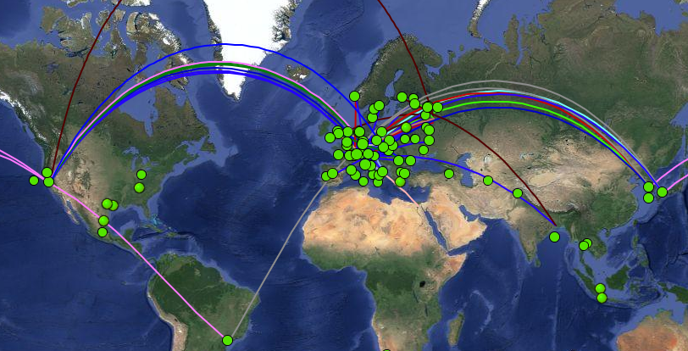
Sites interaction
Snapshot of job activities

Slide 30
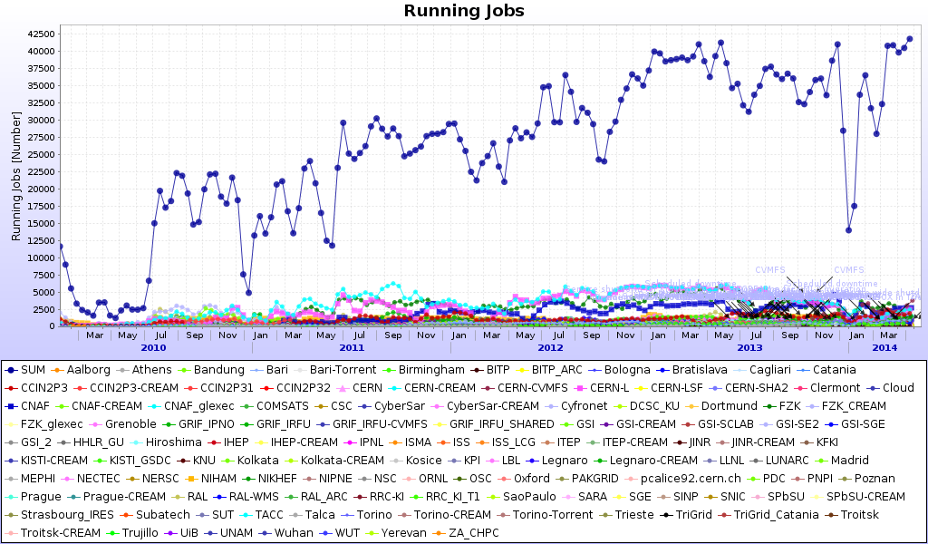
Grid resources since 2010 - ALICE
Every 2 years the power of the Grid ~doubles

Slide 31
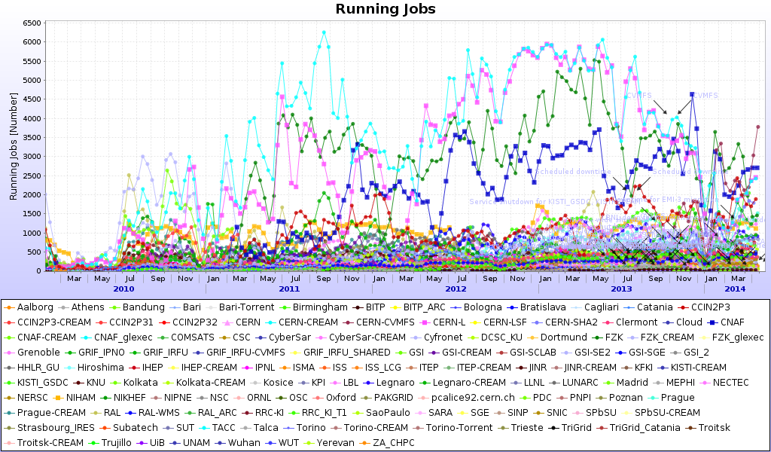
Contribution of individual sites

Slide 32
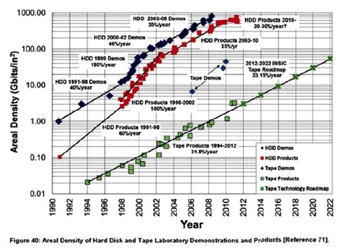
Size of the Grid
The number of cores per site vary from 50 to tens of thousands
In total, there are about 200K CPU cores in the WLCG Grid
Storage capacity follows the same pattern – few tens of TBs to PBs
The growth of the Grid is assured by Moore’s law (CPU power, 18 months) and Kryder’s law (disk storage density, 13 months)

Slide 33
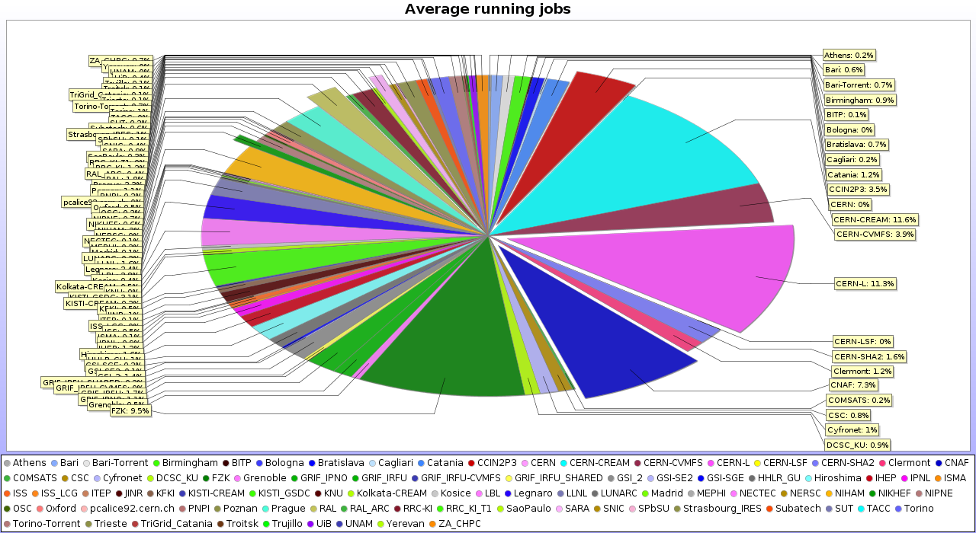
Resources distribution
Remarkable 50/50 share between large (T0/T1) and smaller computing centres

Slide 34
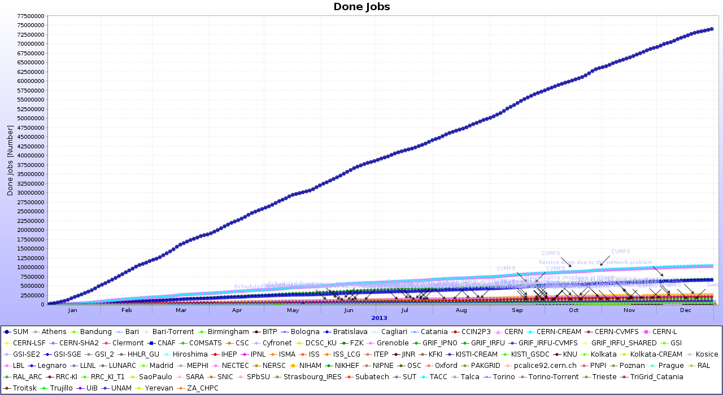
Computational tasks in numbers
~250K job per day (ALICE)
~850K completed jobs/day (ATLAS)

Slide 35
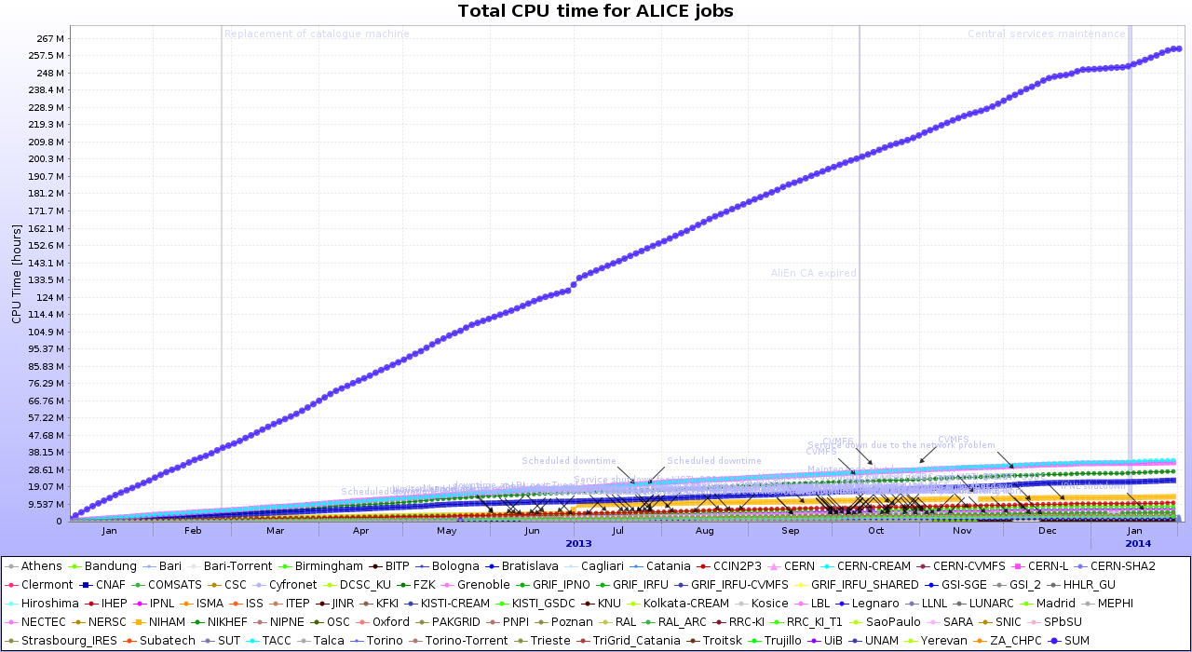
CPU time
~270M hours per year
…or 1 CPU working for 30K years

Slide 36
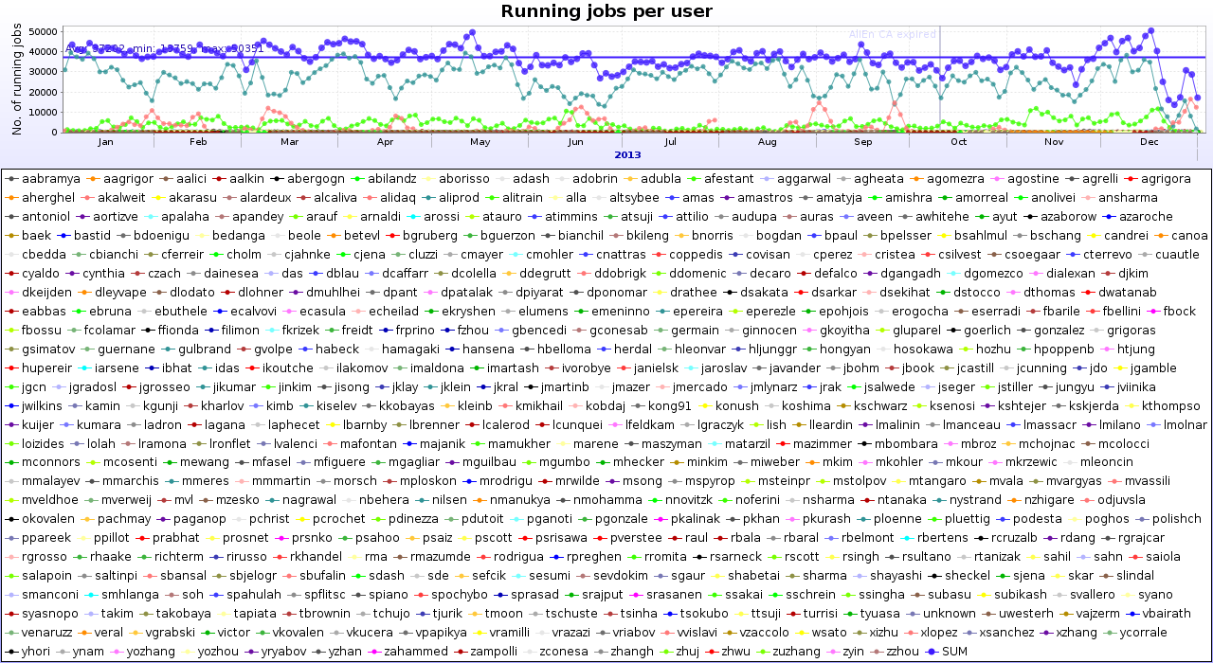
Who is on the Grid
69% MC, 8% RAW, 22% analysis, ~500 individual users (ALICE)

Slide 37
Data processing actors
Organized productions
  RAW data processing – complex operation, set up and executed by dedicated group of people for the entire experiment
  MonteCarlo simulations – similar to the above
Physics analysis
  Individuals or groups (specific signals, analysis types) activities
  Frequent change of applications to reflect the new methods and ideas

Slide 38
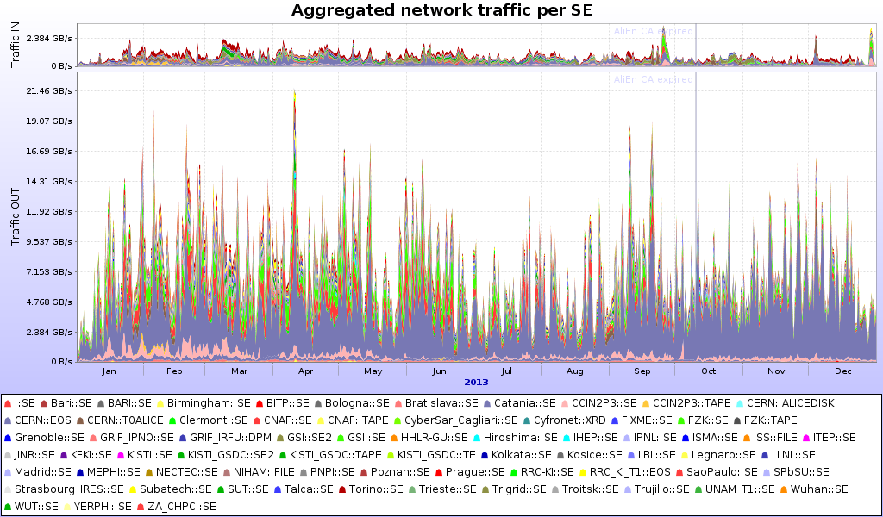
Data access (ALICE)
69 SEs, 29PB in, 240PB out, ~10/1 read/write

Slide 39
Data access trivia
240 PB are ~4.8 Million BluRay movies
Netflix uses 1GB/hour for streaming video => LHC analysis is ~240 Million hours or ~27 thousand years of video
2 Billion hours spent by Netflix members watching streamed video (29.2 Million subscribers)
Multiply the ALICE number by ~4… actually ATLAS is already in the Exabyte data access territory

Slide 40
What about Clouds
The Grid paradigm predates the Cloud
  However LHC computing is flexible, the methods and tools are constantly evolving
The Clouds are resource layer (CPU, storage) and the principles of cloud computing are actively adopted… this is a topic for another lecture
A major difference between the early Grid days and today is the phenomenal network evolution
  Better network allows for making the Grid look like a large cloud – individual site boundaries and specific functions dissolve

Slide 41
Summary
Three basic categories of the LHC experiments data processing activities
  RAW data processing, MonteCarlo simulations, data analysis
The data volumes and complexity of these require PBs of storage, hundred of thousands CPUs and GB networks + teams of experts to support them
The data storage and processing is mostly done on distributed computing resources, known as the Grid
To seamlessly fuse the resources, the Grid employs complex software for data and workload management, known as Grid middleware
The Grid allows the LHC physicists to analyze billions of events collected over 3 ½ years of data taking, spread over hundreds of computing centres all over the world

Slide 42
Summary - contd
In 2015 LHC will restart with higher energy and luminosity
  The collected data volume will triple, compared to the 2010-2013 run
The computing resources will increase and Grid middleware is constantly being improved to meet the new challenges
  New technologies are being introduced to simplify the operations and to take advantage of the constantly evolving industry hardware and software standards
Guaranteed: the period 2015-2018 will be very exiting

Slide 43
Thank you for your attention
Questions?

