Slide 1


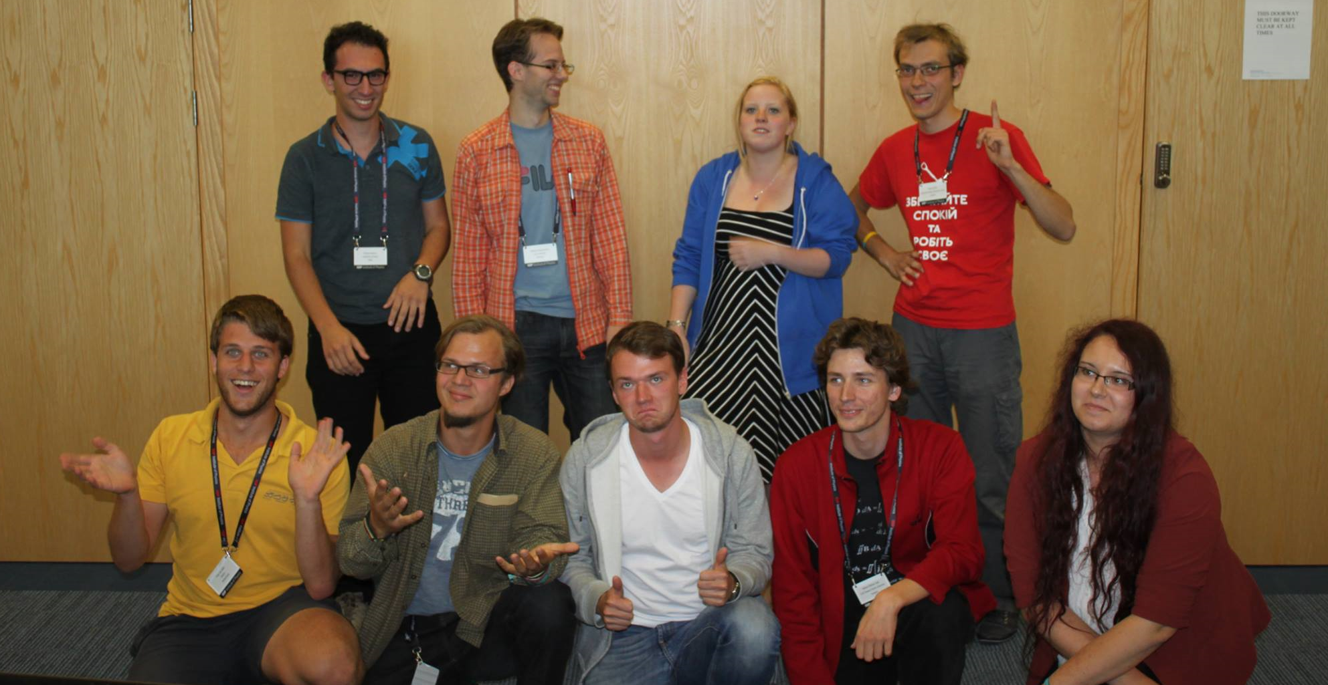
Peter van Arkel, IAPS2CERN, 22-04-2014

Slide 2

What is IAPS
International umbrella organization
Non profit, non political
Run by students (Executive Committee)
Registered in France (EPS HQ)
Found in 1987 in Hungary

Slide 3
Aims of IAPS
Encourage & enable international ambitions
Represent physics students on an international level
Promote physics around the globe

Slide 4
Structure
IAPS
NC - the Netherlands
LA - Utrecht
LC - Craiova
Student - A
Student - B
IM - A
Student - A
Student - B
IM - B

Slide 5
Members
Status 22-04-2014
-NC’s: 14
-LC’s: 8
-IM’s + provisional: 211

Slide 6

Events
ICPS
PLANCKS
IAPS 2 CERN
Season Schools

Slide 7







Collaborations

Slide 8

Other activities
Grants
  IMAP
  World Wide
  jIAPS article contest
jIAPS

Slide 9
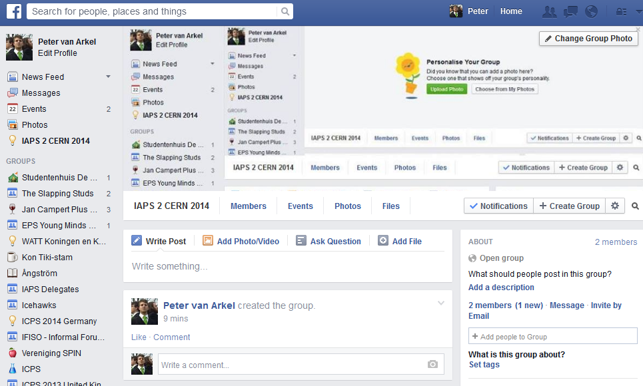

Slide 10
Contact
Website: www.iaps.info
Email: ec@iaps.info
Like us on facebook
Follow IAPS on twitter
Sign up to our newsletter

