Slide 1
Status of the design of triplet BPMs
Thibaut Lefevre on the behalf of the BI group
HL-LHC WP2– 23rd May 2014

Slide 2
Outline
Status of the current LHC triplet BPMs
  Current performance and known limitations
  Post LS1 operation..
Design for HL-LHC
  Specifications and constraints
  Pick-up design
Future plans, milestones & conclusions

Slide 3
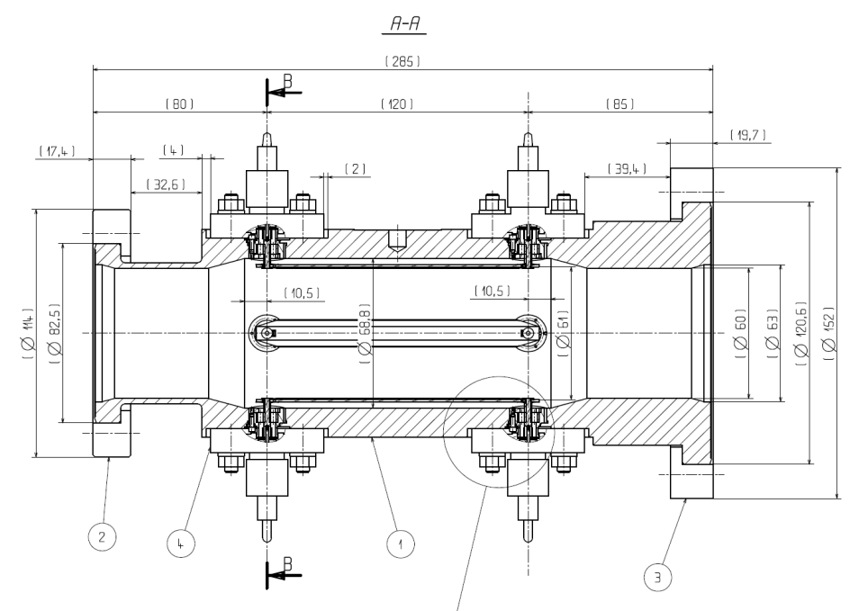
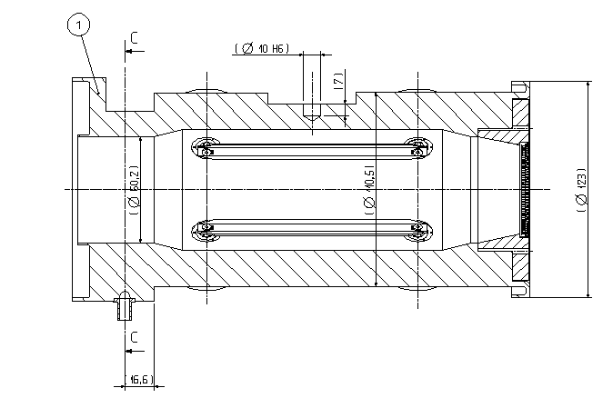
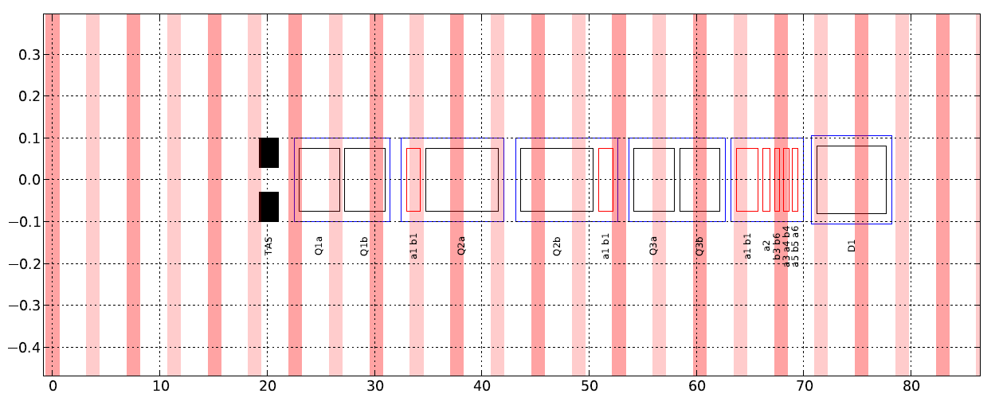
LHC triplet BPMs (1)
BPMSW – Warm BPM in front of Q1
BPMS – Cold BPM in Q2
Current BPM locations

Slide 4
LHC triplet BPMs (3)
Performance and Known Limitation
  Limited number of BPMs : no redundancy..
  Limited Accuracy: BPMSW @Q1 very difficult to align properly: large uncertainty of the alignment procedure : not better than 1mm
  Stability issue due to Tp dependence in the acquisition system
  Limited directivity of the present strip-line design: worse than 20dB full bandwidth
    Cross-talk between the two beams
    Error depends of the bunch intensity and position
  Resolution of the order of 100um in B/B and better than 10um in Orbit mode
    Linked to the current electronic design

Slide 5
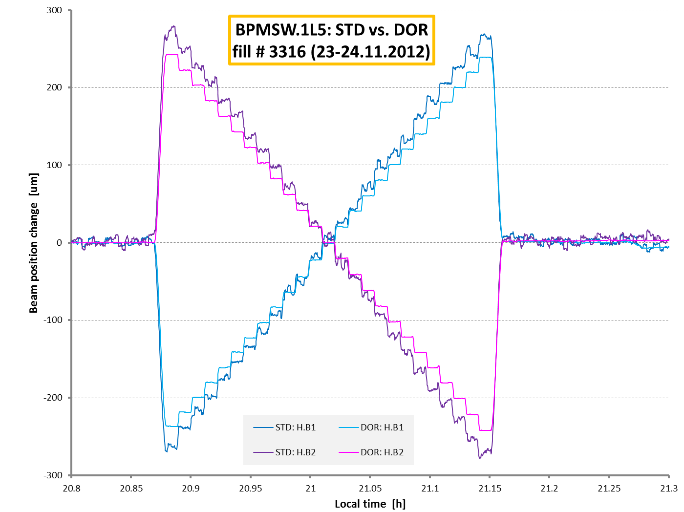
Post LS1 (1)
Improving the cross-talk between two beams
  Using the Synchronous orbit mode which only measures non colliding bunches: Tested on one BPM in 2012 – Need to be deployed possibly on all BPMs
  New high resolution electronic (<100nm), DOROS, being installed in parallel to WBTN on Q1: option for gating on specific bunch

Slide 6
HL-LHC constrains
Inermet shielding for absorbing collision debris
  Need to rotate BPM by 45 degrees & insert shielding on mid-planes
  Add weight, design complexity (transition from beam screen to BPM) and probably quite costly
  Add. heat deposition that need to be estimated
Cryo BPM : Cold to warm implies using sliding contact for strip-line
Larger aperture
  less signal & lower final resolution
Heat deposition from pick-up (<100mW)
  The static heat load for the BPM cables was estimated in 2003 to be 58 mW per cable for a 1.25m cable going from the cold BPM at 25K to the cryostat flange. (for a 0.141” Outer jacket°)
  The dynamic heat load added by BPM signal was estimated to 32mW/cable for Ultimate bunch intensities

Slide 7
HL-LHC BI proposal
Proposed BPM Layout
  7 monitors for better tuning and redundancy
  Rotated by 45 degrees with Inermet shielding
Proposed BPM locations
Current BPM locations
BPMs located in the interconnects – Integration and alignment to be worked out carefully

Slide 8
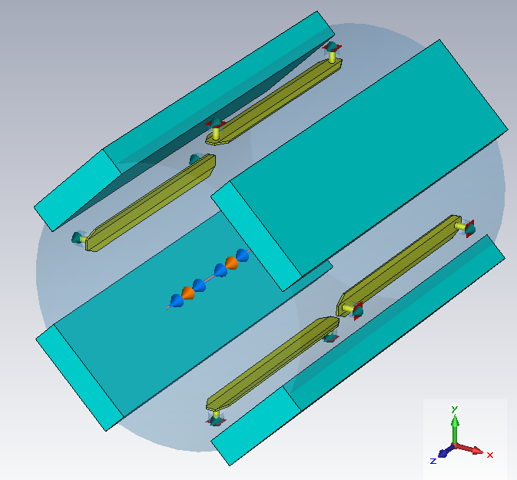
HL-LHC Strip-line design (1)
Design with standard 120mm electrode shape
fitted into a 148.8mm pipe and Added Tungsten-Inermet absorbers
CST PS Wakefield simulations with and without Tungsten-Inermet (Electric conductivity 1.2e7 S/m), 16mm thick absorbers, small bunch (beam_sigma 50mm)
Simulated with different pipe dimensions
Decrease in voltage signal level (pipe diam.148mm -30%, pipe diam. 100mm -35%)
As both Vu and Vd levels are decreasing, change in directivity is small.
Drasko Draskovic

Slide 9
HL-LHC Strip-line design (2)
pipe diam.148mm
Vp1=51.9V
Vp2=39.9V
Vp1/Vp2=1.3
Decrease in voltage signal level (pipe diam.148mm -30%, pipe diam. 100mm -35%)
  Anyway voltage levels too high for existing pick-up - electronic: We have attenuators before the electronic
As both Vu and Vd levels are decreasing, change in directivity is small.
Drasko Draskovic

Slide 10
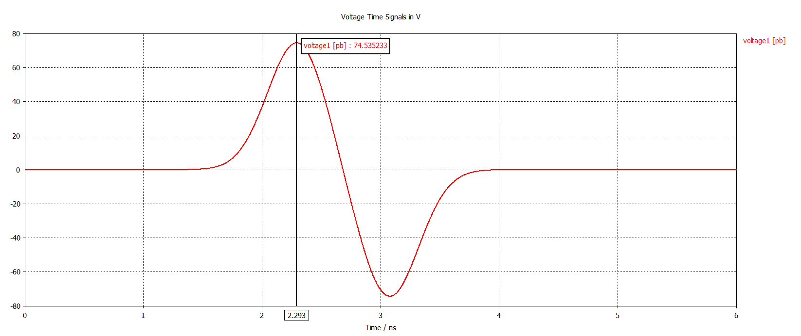
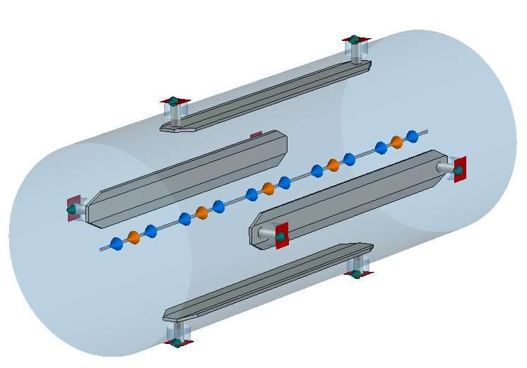
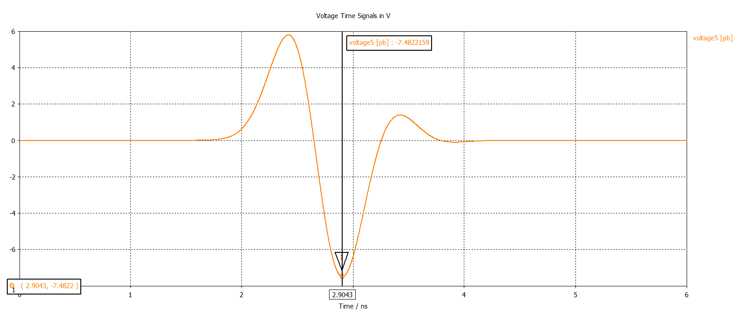
HL-LHC Strip-line design (3)
Vu=74.5V
‘Old’ BPMSW
Vd=7.5V
Directivity : 20dB full bandwidth
Drasko Draskovic

Slide 11
HL-LHC Strip-line design (4)
Maintaining the high degree of directivity requires that:
  The velocity of the beam and the signal be matched fairly well. For highly relativistic beams this requires a minimum amount of dielectric material in the vicinity of the stripline
  A matching of the stripline impedance to the transmission line or termination impedance at both ends. i.e. impedance mismatch of 10% will reflect 25% of the power to the wrong port. This would limit the directivity (theoretically) to 26 dB
  Minimization of the coupling between the striplines. If the interelectrode capacitance per unit length is too high, then one stripline can induce signals in the other
Drasko Draskovic

Slide 12
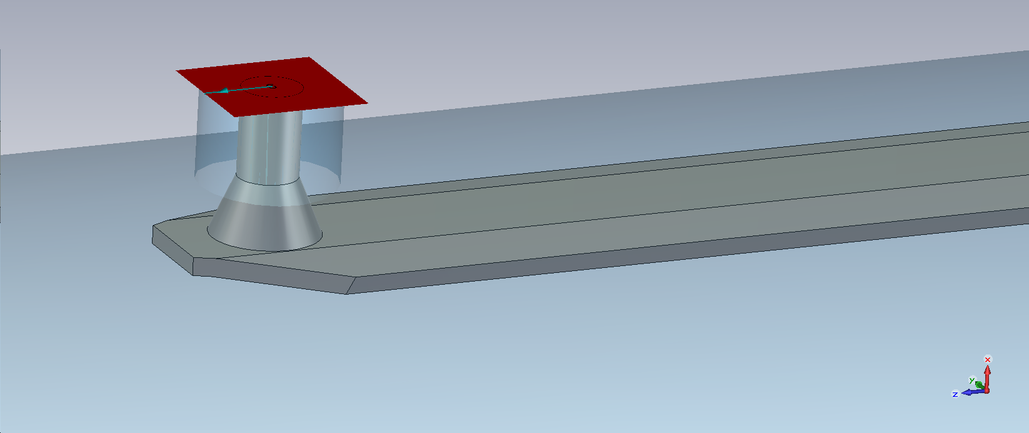
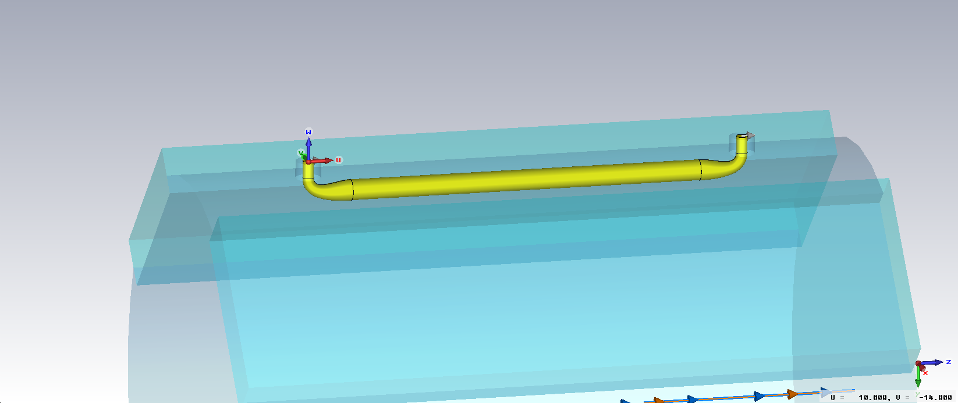
HL-LHC Strip-line design (5)
Currently trying different approaches:
  Redesign transitions (smoother, conical)
  Redesign electrode shape (i.e;cylindrical, exponential stripline)
  Change shape of the pipe by adding sub-cavities (the idea is to make smooth transition between the connector and the electrode by aligning them on the z-axis)
Drasko Draskovic

Slide 13
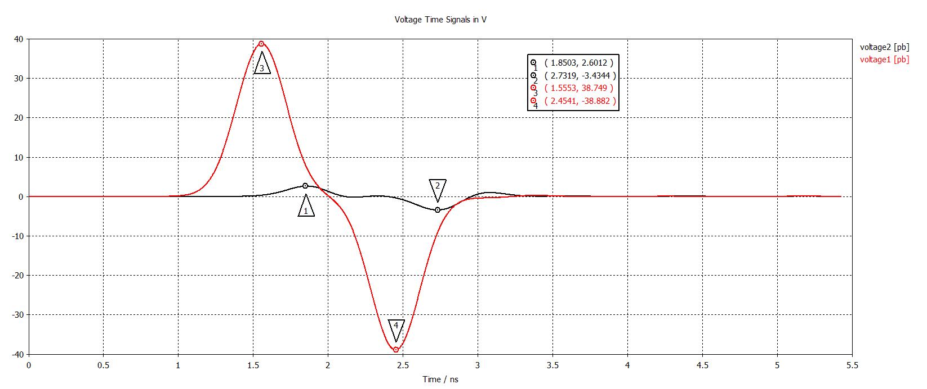
HL-LHC Strip-line design (6)
Vu (red)
peak=38.8V
Vd (black)
peak = 2.6V
Directivity : 23.5dB

Slide 14
HL-LHC BPM Layout
Impedance and number of BPMs
  BPM@Q1 bad for impedance but may be crucial for beam tuning
  Preferably sacrifying BPMs at non-optimized position where two beams overlaps
  Keep redundancy for cold BPMs
Proposed BPM locations
Current BPM locations

Slide 15
Plans and Milestones
Pick-up design: RF optimization completed by mid 2015
Pick electronic: Comparison between DOROS and WBTN: End of 2015
Pick-up Mechanical design by end 2015 – prototype design
Electronic development: possibly other system using fast sampling – mid 2016
Mechanical integartion in the Cryostat – end 2016
Prototype production (Beam test) by End 2016 (2017)
Launch production in 2018

Slide 16
Conclusions
Improved Pick-up design started
  Aiming for higher directivity
Electronic performance in terms of resolution to be assessed on LHC after LS1
Converge on Engineering specifications by 2016-17 (both pick-up and electronic)
Impedance/number of BPMs to be agreed

Slide 18
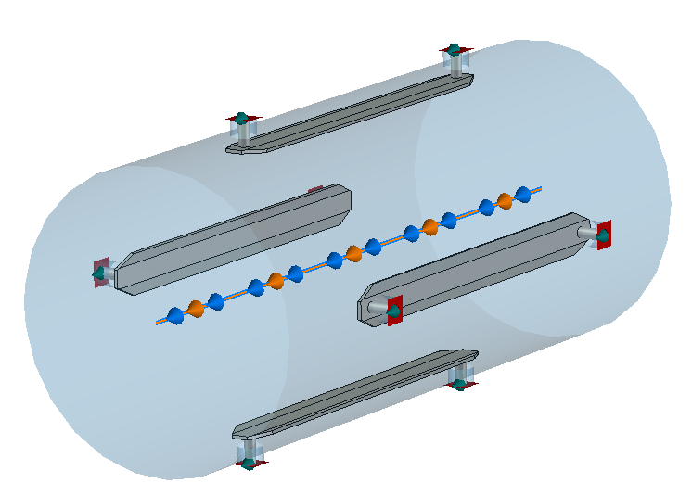
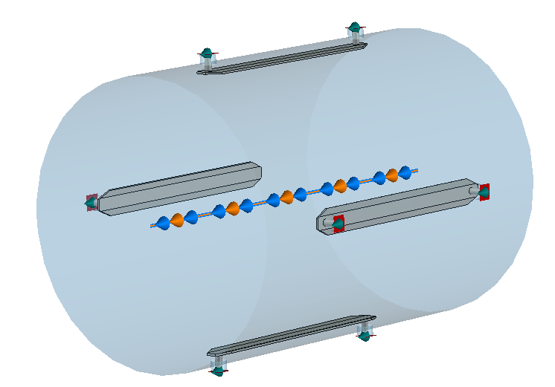
LHC triplet BPMs (2)
BPM Aperture & Length
  Aperture
    NOT related to length
    Can adapt the same BPM for any aperture
    Larger aperture ⇒ less signal & lower final resolution
BPMSW/S BPMSX BPMD/BPMSE
Beam pipe diameter (mm) 68.8 88.8 138.8
Aperture (mm) 61 81 131
Electrode length (mm) 120 120 120

Slide 19
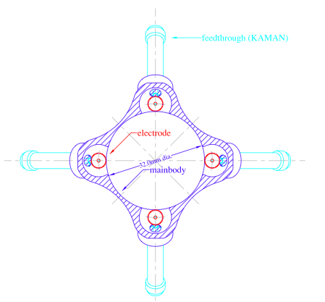
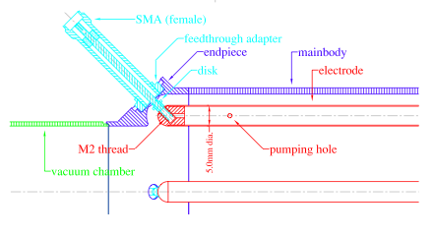
TESLA DESY stripline BPM example
W.Radloff, M.Wendt, “Beam Monitors for the S-Band Test Facility”
C.Magne, M.Wendt “Beam position monitors for the TESLA accelerator complex” (2000)

