Slide 1
IT BPM tolerances for HL-LHC orbit correction
Miriam Fitterer, R. De Maria
Acknowledgments: S. Fartoukh, M. Giovannozzi, J. Wenninger

Slide 2
Studies
Orbit correction target:
using triplet BPM to find collisions (e.g. beam-beam separation <3σ)
using triplet BPM to keep collisions (beam-beam separation < 0.2σ)
Studies:
Correct orbit by using perfect model and perturbed BPM readings:
  for accuracy needed to find collisions,
  for precision needed to keep collision.
Introduce perturbation in the model:
  for finding the conditions that would separate beams in collision.
Correct orbit by using perturbed model and perturbed BPM readings:
  for max. allowed perturbations between fills to find collisions by using same settings,
  for max allowed perturbation that does not increase beam-beam separation without corrections.

Slide 3
Some general definitions for BPM specifications
See “J-J. Gras, J.-P. Koutchouk, Concepts and Glossary for the Specification of the Beam Instrumenation” and J.-P. Koutchouk “Measurment of the beam position in the LHC main rings”.
BPM error model:
    the error of a measurement, e.g. for a BPM measurement:
    uncertainty: usually the standard deviation σ of the error distribution (in case of numerous sources the Gaussian distribution is a good approximation, for which 2σ correspond to 95.5% confidence level)
resolution: smallest increment that can be induced or discerned by the measurement device within given conditions (e.g. noise)
accuracy: closeness of the agreement between the result of a measurement and the value of the measured quantity
precision: closeness of the agreement between consecutive measurements for the same measured quantity. It can be also referred with slightly different meaning as repeatability or reproducibility.
offset
role error
noise
non-linearity
scale error

Slide 4
Imperfection considered so far
BPM imperfections:
  adding random noise errors in µm assuming an ideal transverse position;
  longitudinal displacement of the BPMs;
  Impact of disabling some BPMs.
Model imperfections:
  transfer function errors in the correctors (relevant when evaluating the reproducibility of a presetting obtained by arbitrary excitation history);
  transfer function errors in the triplets (relevant to evaluate the sensitivity to nominal orbit vs real orbit);
  orbit error from the arc (ground motion, orbit feedback residual imperfections).

Slide 5
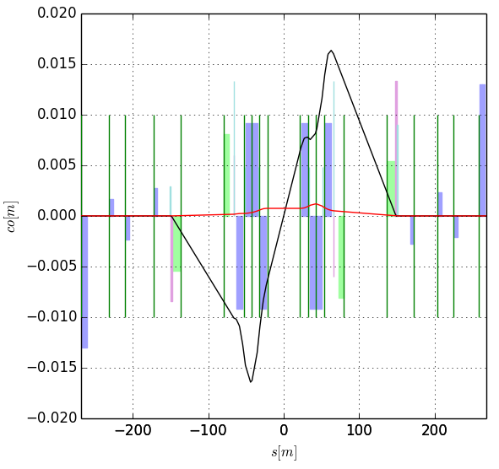
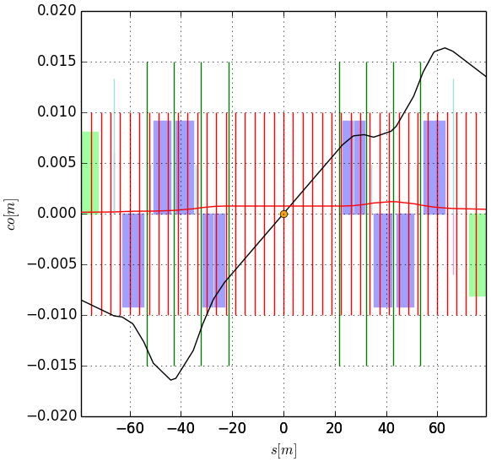
BPMs in IR1/5
5
4
3
2
1
1
2
3
4
5
BPMs
parasitic bb encounters
IR5, beam 1
Suboptimal location of BPMs:
at parasitic bb encounters it is difficult to measure the individual signal of each beam
BPM candidates :
BPM4 and BPM 5(parasitic bb encounter)

Slide 6
Specifications and Simulations
Simulation setup:
treat IR1/5 as line -> only IR5 as IR1/5 are fully “symmetric”
orbit deviations in the arc are treated as (uniformly distributed) error in initial/final conditions (maximum value of +/-100 μm at BPM at Q6/Q7 is assumed which is then tracked to the beginning/end of the DS)
BPM precision is treated as (uniformly distributed) error in matching constraints (reference value: +/-1 μm)
errors considered: transfer function of triplet and correctors, long. misalign. of BPMs
What can we conclude from the simulations?
consider only orbit deviation in the arc and error on BPM matching constraints
      required precision to find collisions from fill to fill
      required precision to stay in collision
case 1. plus in addition transfer function errors of the IT and correctors
      influence of a perturbed machine (note that the matching constraints at the BPMs are varied around the position of the ideal machine, while the perturbed machine is used for the SVD)
case 2. plus longitudinal misalignment of BPMs
      as the divergence of the orbit is large in the IT region a longitudinal misalignment of the BPMs could have a big influence
All simulations done for round optics (β*=0.15 m)

Slide 7
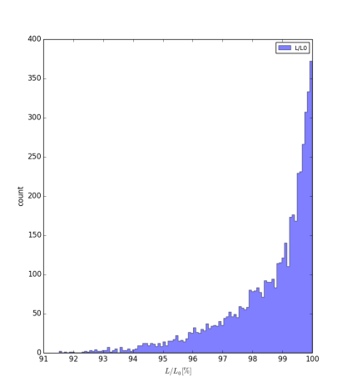
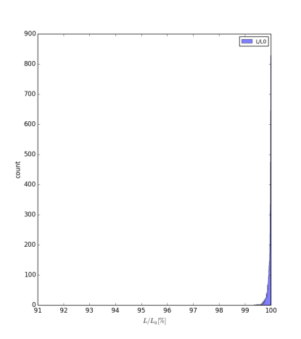
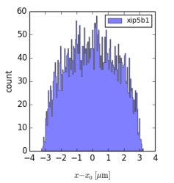
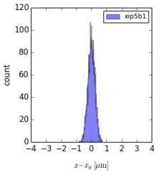
Correction strategy
use orbit correctors at Q5 and Q6/Q7:
exactly the 8 variables needed to match x/p_{x}/y/py at the IP for Beam 1 and Beam 2
Avoid using strong MCBX and D2/Q4 orb. corr.) to act separately on Beam 1 and Beam 2 and avoid large time constants.
increased weight of the BPMs between D1L and D1R (possible as orbit at crab cavities is always controlled well enough <0.01mm).
no weights
with weights

Slide 8
BPM precision
assuming +/-100 μm max. orbit deviation from arc, +/-1 μm BPM precision as reference value (note: linear scaling with BPM precision), no model errors, all BPMs.
orbit at IP5 z=max(x,y) | max(|z-z0|) [μm] | rms(z-z0) [μm]
x(b1)-x₀(b1) | 0.809 | 0.230
x(b2)-x₀(b2) | 0.814 | 0.234
y(b1)-y₀(b1) | 0.872 | 0.233
y(b2)-y₀(b2) | 0.740 | 0.232
x(b1)-x(b2) | 1.139 | 0.326
y(b1)-y(b2) | 1.119 | 0.332
Luminosity loss assuming:
β*=0.15 m, E_{b}=7.00 TeV, ε_{n}=2.50 μm,
σ_{s}=7.50 cm, x-angle=295.0 μrad
=> σ(IP5)=7.09 μm
BPM precision needed during one fill (e.g. 1% luminosity loss = 0.14 σ, 2 rms(z_{b1}-z_{b2})):
precision _{one} _{fill} = +/-1.5 μm
BPM accuracy for finding collisions (e.g. 99% luminosity loss = 3.0 σ, 2 rms(z_{b1}-z_{b2})):
precision _{one} _{fill} = +/-30 μm

Slide 9
Selecting the efficient BPMs
Study:
Removing one BPMs at the time.
orbit at IP5 z=max(x,y) | max(|z-z0|) [μm] | rms(z-z0) [μm] | 2rms(z-z0)/σ_{z}
all BPMs | 1.14 | 0.33 | 0.094
no BPM1 | 1.44 | 0.41 | 0.115
no BPM2 | 1.55 | 0.39 | 0.111
no BPM3 | 1.48 | 0.38 | 0.106
no BPM4 | 1.43 | 0.35 | 0.100
no BPM5 | 1.19 | 0.34 | 0.095
efficiency decreases
In general:
BPMs closest to the IP are best for orbit control at the IP.

Slide 10
Selecting the efficient BPMs
orbit at IP5 z=max(x,y) | max(|z-z0|) [μm] | rms(z-z0) [μm] | 2 rms(z-z0)/σ_{z}
all BPMs | 1.14 | 0.33 | 0.094
no BPM3/4 | 1.49 | 0.41 | 0.116 | only BPMs closest to IP (BPM1/2)
no BPM4/5 | 1.40 | 0.36 | 0.102
no BPM3/4/5 | 1.47 | 0.42 | 0.117
no BPM1/3/4 | 1.72 | 0.59 | 0.169 | case of failure of BPM1 or BPM2
no BPM2/3/4 | 1.80 | 0.58 | 0.163
no BPM1/3/4/5 | 1.72 | 0.61 | 0.172
no BPM2/3/4/5 | 1.84 | 0.58 | 0.163
no BPM1/2 | 2.09 | 0.52 | 0.152 | case of failure of BPMs closest to the IP (BPM1/2)
no BPM1/2/3/4 | 35.88 | 11.73 | 3.309
Main conclusion:
at least one of the BPMs closest to the IP (BPM1/2) is required to ensure a luminosity loss smaller than 1-2% assuming a BPM precision of 1 μm, while BPM3/4/5 are considerable less efficient

Slide 11
Influence of errors – long. misalignment
Due to large divergence in triplet region the x-scheme could be sensitive to already small longitudinal misalignments
orbit at IP5 Z=max(x,y) | ds(BPM) [mm] | max(|z-z0|) [μm] | rms(z-z0) [μm] | 2rms(z-z0)/σ_{z}
all BPMs | 0 | 1.14 | 0.33 | 0.092
all BPMs | 1.0 | 1.34 | 0.35 | 0.097
all BPMs | 10.0 | 4.43 | 1.29 | 0.363
Main conclusion:
BPM should be longitudinally aligned or known in 1-2 mm range.

Slide 12
Influence of errors – transfer function errors
influence of transfer function errors of the IT and correctors
influence of a perturbed machine (the matching constraints at the BPMs are varied around the position of the ideal machine, while the perturbed machine is used for the SVD)
orbit at IP5 z=max(x,y) | k_{err} [10⁻⁴] | acb* [10⁻⁴] | max(|z-z0|) [μm] | rms(z-z0) [μm] | 2 rms(z-z0)/σ_{z}
all BPMs | 0 | 0 | 1.14 | 0.33 | 0.092
all BPMs | 1.0 | 0 | 1.67 | 0.42 | 0.117
all BPMs | 0 | 1.0 | 1.21 | 0.33 | 0.094
all BPMs | 1.0 | 1.0 | 1.70 | 0.42 | 0.119
Main conclusion:
Triplet transfer function errors starts to play a role from 1 unit.

Slide 13
Specifications and Simulations
What do we need to specify?
from fill to fill:
    min precision: required to find collisions at the beginning of a fill
    ideal precision: should allow to find 95% of the luminosity by using only the BPMs (no lumiscan)
during one fill (after recalibration at the beginning of the fill):
    precision: required to keep the beams in collision without loss of luminosity
Simulation method:
ideal case:
optics model including all errors, in particular misalignment errors
try to correct orbit similar to the correction as done currently in the LHC: global SVD for each beam individually using the orbit response matrix of the “idealized” optics model (no errors)
but: misalignment errors are not known well enough

Slide 14
Conclusion
For the HL-LHC β*-leveling in IR1/5 is foreseen resulting in continuous optics changes.
Frequent lumiscans not affordable due to time and emittance losses in the process.
Ideally triple BPM could provide measurements to:
      find collisions at the beginning of the fill (e.g. obtain 1% luminosity signal);
      keep the beams in collision without loss of luminosity (e.g. keep 99% luminosity).
If using all BPMs and no errors a precision of +/- 1.5 μm is precision is needed to keep beam in collision, and a factor 20 more is sufficient to find collisions.
Only a selection of BPMs is sufficient, where the two BPMs closest to the IP are most efficient (other BPMS should both be kept for statistics and redundancy).
Influence of errors:
    the BPMs should be longitudinally aligned or know up to about mm;
    transfer function errors of the triplet and corrector up to 10⁻⁴ are acceptable.
Future work:
    introduce more realistic BPM imperfection models (input from BI needed);
    perform correction with perturbed model using the ideal response matrix as done in reality;
    validate simulation setup by producing LHC orbit correction features;
    plan MD in run II to validate the ability to control orbit in the D2 Q4 region as required by crab cavity and at IP as allowed by present and foreseen instrumentation.

Slide 15
Backup slides

Slide 16
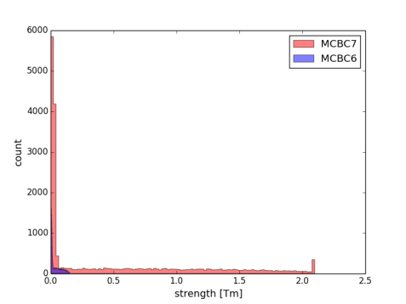
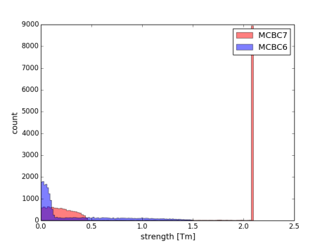
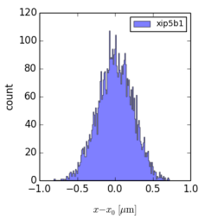

Arc imperfections
An increase of the imperfections in the arc only results in an increase of the MCBC7 corrector strength (which needs to be sufficient), but does not influence the orbit at the IP
1000 mum
100 μm
1 mm
orbit at IP5 (x/y) | max(|z-z0|) [μm] | rms(z-z0) [μm] | 2rms(z-z0)/σ_{z}
100 μm | 1.14/1.12 | 0.33/0.33 | 0.092/0.094
1 mm

Slide 17
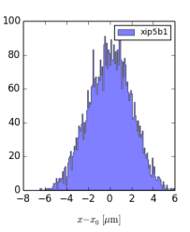
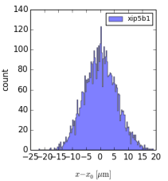
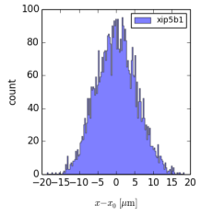
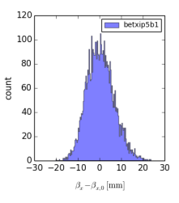
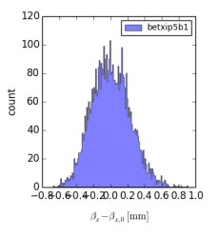
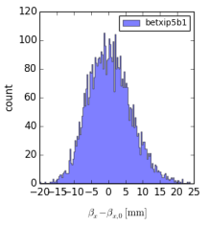
Influence of errors
influence of transfer function errors of the IT and correctors:
    no correction
    closed orbit of complete ring (no only IR1/5)
k_{err}=10⁻⁴
acb=10⁻³
k_{err}=10⁻⁴, acb=10⁻³

Slide 18
Orbit correction in the nominal LHC
Following discussion with J. Wenninger
Orbit correction method:
orbit correction for each beam individually using SVD and limiting the number of eigenvalues (see J. Wenninger, LBOC 11.02.2014). Explicitly global orbit correction and no individual correction of IRs. Orbit response matrix of injection optics used for SVD also in collision optic.
200-300 μm orbit drift (+/-10 μm at the IP – see Stability of Luminosity Optimizations, J.Wenninger, LBOC 30.10.2012) from fill to fill and ground motion like behavior of the orbit drift
⇒ orbit distortion mainly due to misalignment caused by ground motion
BPMs in IT region (3 per side/beam/plane) currently not used in operation
BPMs closest to the IP are best to correct the orbit at the IP. Correction possible with 2 out of 3 BPMs.
Orbit correction strategy:
correct to golden orbit of previous fill at the end of the squeeze
lumiscan to optimize luminosity -> redefinition of “golden orbit”
orbit correction to the golden orbit defined by the initial lumiscan
note: BPMs at IT are NOT included in the correction
in case of relevant drop of luminosity, additional lumiscan

Slide 19
Orbit correction in the HL-LHC
Similarities and main differences to nominal LHC:
β*-leveling over several hours -> continuous orbit changes.
Two cases should be distinguished:
        leveling using the pre-squeeze optics (for β*>0.44 m) -> change of magnet strength in IR1/5
        leveling using the squeeze optics (for β*<0.44 m) -> no change of magnet strength in IR1/5 + adjacent arcs
      case b) might be easier to control as IR1/5 stay unchanged (this case would be similar to the nominal LHC, assuming that the orbit at the entrance and exit of IR1/5 can be controlled sufficiently well)
orbit deviations (thinking in mm) due to ground motion are expected to be similar as for the LHC as the machine stays unchanged except the IT. As k*l of the nominal and the HL-LHC triplet is approximately the same, the same orbit deviation in terms of mm is expected.
smaller beam size – round optics and ε_{N}=2.5 μm: 7 μm beam spot size (thus smaller orbit deviation already result in a considerable loss of luminosity)
Orbit correction strategy:
correct to golden orbit of previous fill at the end of the squeeze
lumiscan to “recalibrate BPMs”-> redefinition of “golden orbit”
orbit control using the BPMs, explicitly no further lumiscans
-> high repeatability, reliability and precision of BPM readings during one fill needed

Slide 20
Some general definitions for specifications
See “J-J. Gras, J.-P. Koutchouk, Concepts and Glossary for the Specification of the Beam Instrumenation” and J.-P. Koutchouk “Measurment of the beam position in the LHC main rings”:
sensitivity: change of the beam observable divided by the corresponding change of the primary observable
dynamic range: range of values of the beam observable which can be measured with a given precision goal
Time dependence:
repeatability: closeness of the agreement between the results of successive measurements of the same measurand carried out under the same repeatability conditions (‘short’ period of time)
reproducibility: closeness of the agreement between the results of successive measurements of the same measurand carried out under conditions which have been restored after a change (except time obviously) The systematic part of the reproducibility error is generally called the drift.

Slide 21
Short term effect of ground motion
Ground motion model used for simulations:
Real spectrum for short time scales (<1min) [1]:
CMS: measurement [1]
Annecy: measurement [2]
model A/B/C: ground motion models [3]
model B10 (black): model B with
10x more noise for the
range >2 Hz (D. Schulte)
ATL law for long time scales (>1min) [4]:
with T=time interval between measurements, L=distance between measurement points
[1] A. Kuzmin, Technical Report EDMS Nr. 1027459, CERN, 2009
[2] B. Bolzon, PhD Thesis, Université de Savoie, 2007
[3] International Linear Collider Technical Review Committee: Second Report, SLAC Report-606 (2003)
[4] V. Shiltsev, PRSTAB 13, 094801 (2010)

Slide 22
Misalignment of IT due to ground motion
Simulation results:
nom. LHC, 4 TeV, β*=60 cm
HLLHCV1.0, 7 TeV, β*=15 cm
offset at IP
and
  similar effects for nominal LHC than
  HL-LHC
ε_{n,LHC}=2.5 μm
ε_{n,HLLHC}=1.6 μm
J. Pfingstner
luminosity loss
and
  larger effect for HL-LHC than nominal LHC
  more than 1% luminosity loss after 10³ s = 17 min

Slide 23
HL-LHC BPMs
BPM | s | d par | betx | bety | mux | muy
Q1
Q1-Q2a
Q2a-Q2b
Q2b-Q3
Q3-CP
CP-D1
D1
D2
Q4
Q5
Q6

