Slide 1
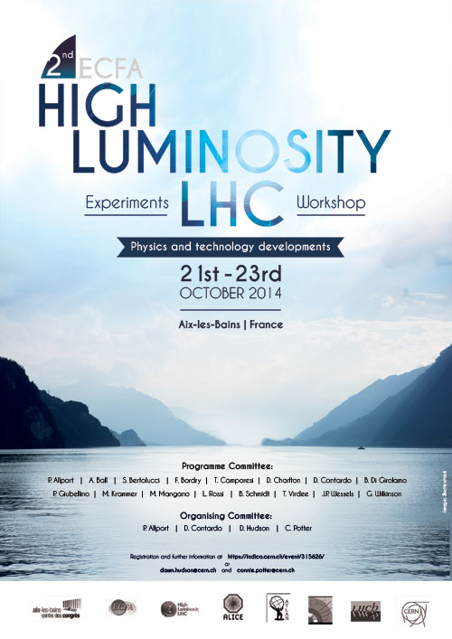
2nd ECFA HL-LHC… Concluding Remarks
D. Contardo, P. Allport
Aix-les-Bains, 23rd October 2014
Reminder of major steps for the project
Few comments on progress & perspective since last year
Thanks to everyone who helped prepare this workshop

Slide 2
2nd ECFA HL-LHC… Major steps in the HL-LHC project
When we first met last year, the HL-LHC was recommended as the top priority in the Update of the European Strategy for Particle Physics
In May 2014, the report of the US Particle Physics Project Prioritization Panel (P5) made a similar recommendation
  In June 2014, the Council discussed the CERN plan up to 2025, and approved the mid-term plan 2015-2019, including for the first time expenses for the HL-LHC construction

Slide 3
2nd ECFA HL-LHC… Highlight of progress since last year
  We hope you enjoyed this 2nd meeting, the preparatory groups worked hard again to provide cross-community discussions of physics perspective, accelerator and experiment upgrades
    Only quick summary of many progress and trends presented here - not making justice to the richness of the resource available
    A comprehensive summary of the workshop will be published in a report to ECFA, possibly with an arXiv reference
      Timeline to prepare is about a month
      Instructions to PGs will be circulated next week

Slide 4
2nd ECFA HL-LHC… HL-LHC Schedule
This schedule followed 1st ECFA and HL-LHC RLIUP workshops
ALICE & LHCb upgrades
Run 2
LS 2
Run 3
Longevity of IP triplets
LS 3
Run 4
LS 4
Run 5
LS 5
ATLAS & CMS Phase 2 upgrades

Slide 5
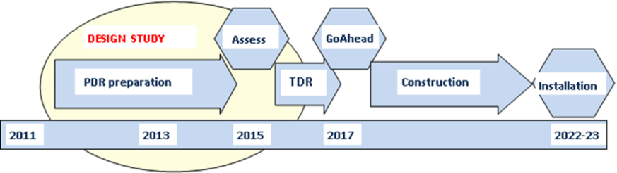
2nd ECFA HL-LHC… Accelerator and Experiments planning
Similar tight timelines for different steps for Accelerator, ATLAS &CMS
- R&D needs to be mostly completed in ≤ 3 years (TDRs)
HL-LHC planning
Example of the CMS planning for major upgrade work - it is similar for ATLAS
LHCb & ALICE TDRs approved or in process to be - construction soon starting

Slide 6
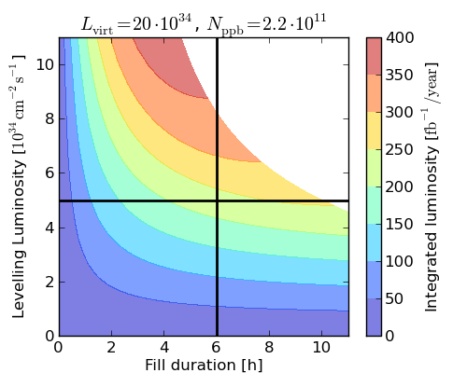
2nd ECFA HL-LHC… Beam conditions & integrated luminosity
Several progress demonstrating feasibility of the HL-LHC upgrade - new magnet apertures, low β*, Crab cavities…
Reaching 3000 fb⁻¹ by 2036 sets severe constraints on operation of the HL-LHC with luminosity leveling at 5x10³⁴ Hz/cm²
Leveling can be tuned ATLAS & CMS upgrades need to allow operation and to maintain good performance at PU beyond 140
Preliminary studies of different luminous region scheme were presented

Slide 7
2nd ECFA HL-LHC… Accelerator and experiments interface
Preparation of work in LS3 needs considerably more planning than previous LS due to scale of work and activation levels
    Planning HI and low luminosity runs at the end of run 3 will reduce cooling time in LS3
    Anticipating some infrastructure & upgrade work in LS2 maybe needed to ensure a 30 months shutdown
Substantial progress in activation studies with improved operation scenario
    Good agreement of estimates from Accelerator, ATLAS and CMS
    Model is validated with data although discrepancies need to be tracked down to material understanding
ATLAS
CMS
Dose LS#/LS1 | 1 wk | 4 wks | 6 wks | 8 wks | 16 wks | 1 year
LS2 | 1.9 | 1.9 | 1.9 | 2.0 | 2.3 | 2.7
LS3 | 2.9 | 2.9 | 3.0 | 3.1 | 3.3 | 4.0
LS4 | 15 | 16 | 16 | 17 | 18 | 21
3000 fb⁻¹ | 15 | 16 | 16 | 17 | 21 | 27
Dose LS#/LS1 | 1 wk | 4 wks | 6 wks | 8 wks | 16 wks | 1 year
LS2 | 2.0 | 2.0 | 2.1 | 2.2 | 2.5 | 3.4
LS3 | 3.1 | 3.2 | 3.3 | 3.4 | 3.8 | 5.0
LS4 | 17 | 18 | 18 | 19 | 20 | 26
3000 fb⁻¹ | 17 | 18 | 18 | 19 | 23 | 34

Slide 8
2nd ECFA HL-LHC… Physics goals and performance reach
Several areas of progress shown at the workshop - a unique opportunity for common theory and experiments community discussions - general filling that this should continue
    Substantial effort proceeding in full simulation to optimize upgrades
      ATLAS and CMS to assess PU mitigation capabilities and develop motivation for new scope (high eta tracking - muon tagging - timing measurement…)
    Improvements of performance reach projection studies with detector parameterization
    Progress of work to reduce theory errors, long endeavour but prospect to halve the errors - following the increase in statistics
    Proposals to investigate new physics channels
    Implementation of theoretical models in performance reach studies and studies of model interpretation if discoveries

Slide 9
2nd ECFA HL-LHC… R&D on solid state devices
Trackers for all experiments are at good state of progress although with different timelines and techniques - RD50, RD53 are great assets to develop technical solutions and rationalize resource investment
    R&D sufficiently advanced for OT sensors to proceed finalizing (n-in-p) specifications with potential vendors - common ATLAS & CMS approach to Market Survey - production could reach ∼ 1000 m² in case of a HGC
    ATLAS & CMS Pixels are least defined - sensors need more R&D to decide technology (planar, 3D, layout …) - construction effort allows more time
    Sensor for HGC (high fluence, large size…) needs further R&D but benefit largely from tracker studies
    MAPS (fluence up to ~10¹³) offer small pitch & light weight for ALICE ITS
    Pixel chip radiation tolerance needs to be demonstrated, digital logic is complicated & output rates are high - 20 Gb/s in LHCb velo in LS2
    Encouraging R&D on-going on HR/HV-CMOS but short timeline for current projects to demonstrate feasibility and develop full concepts

Slide 10
2nd ECFA HL-LHC… R&D for Scintillating devices
Radiation tolerance is the major issue for these devices - good progress in understanding and modeling the damage and developing radiation tolerant solutions
Radiation damage to crystal in CMS EM calorimeter are well understood while plastic scintillating tiles of Hadron Calorimeter exhibit substantially more damage than expected, without recovery - not the case of ATLAS TileCal - effect is largely tracked to the low rate dose exposure at LHC - LHCb prepare test for fiber tracker (although lower doses anticipated)
Promising results with new crystals LYSO/CeF3 and LuAG fibers for largest doses ≥ 100 Mrad
Liquid or new plastic scintillators may be sufficient at doses ≤ 50 Mrad
WLS capillaries with liquid scintillators exhibit good behaviour up to ≥ 100 Mrad γ-irradiation
Options with cooled SiPM (LHCb) and GaInP (CMS) for photosensors
And invited presentations: LAr (ATLAS) showing proper undersanding of space charge effect at high rate in FCAL - Fast timing option to further mitigate PU effects for neutrals

Slide 11
2nd ECFA HL-LHC… R&D for Muon detectors
Preparation of upgrades is progressing well for all technologies Collaborations are established within RD51 and experiments and through the common issues (gas mixture) and tests (GIF++)
Resistive Plate Chambers
Many possibilities to increase rate capability to ∼ kHz/cm² and provide time resolution ∼ 100 ps - ATLAS & CMS prototypes under construction for tests in 2015
MMs and GEMs
Now mature technologies for large scale aplication ∼ 100m² with demonstrated construction techniques - ATLAS MMs production starting - CMS GEMs ready to start production - GEMs baseline for ALICE TPC readout and LHCb 2nd muon station
Wire Chambers
Established plans to keep performance stable in harsher environments - CMS DTs and CSCs electronics upgrades - ATLAS TGCs and DTs improvements of detector themselves
Quest for eco-gas mixtures
First promising candidate(s) - tethrfloropropane - tested

Slide 12
2nd ECFA HL-LHC… R&D for Mechanics and cooling
For HL-LHC detectors, particularly for Trackers or HGC, high power dissipation makes the thermo-mechanical design a challenge - although designs are different, material & techniques are mostly similar in all experiments
Mechanical & thermal design are strongly coupled and shall proceed in parallel - new material or techniques (3D printing) being investigated in all aspects including radiation tolerance - need updated DB
With the trend to lower temperature, to lighten cooling structures and to achieve a “greener” system, CO₂ evaporative cooling is becoming a standard technology. Work ongoing to standardize all system aspects and develop common prototype for future ∼ 50 kW ∼ -35∘ plants
Micro-channel cooling presents further advantages in material reduction & thermal expansion mismatch - ALICE (ITS) and LHCb (VELO) are leading the developments
QA, integration and environmental aspects need to be addressed at an early stage to keep system simple and reliable

Slide 13
2nd ECFA HL-LHC… R&D for Electronics systems
Several FE ASIC chips already available as prototypes - this is more advanced than it was for construction of current detectors - R&D focus on 65 nm technology supported by TSMC contract (IBM 130 nm situation to be monitored)
ALICE: ITS (ALPIDE & MISTRAL) & TPC (SAMPA, FEERIC) prototypes available
ATLAS: Strips ABC130 prototype available, HCC submitted - Calorimeters (ADC) & Muon (VMM, ART and TDS) prototypes available
CMS: Strips (CBC) prototype available - Pixel-strips (MPA & SSA) under design (65nm), Muons (GEM, VFAT3) under design
LHCb: Velo (VELOPIX) prototype (= Timepix3), Fibres (PACIFIC) & Tracker (SALT) prototypes available
RD53: 65 nm - common ATLAS & CMS architecture defined - extensive radiation tests - developing IP blocks

Slide 14
2nd ECFA HL-LHC… R&D for Electronics systems
Optical data transfer - GBT & Versatile Link is a crucial (common) development to all experiments and all detectors
GBT chipset and VTTX/VTRX ready for production
Low power GBT (65 nm) and Versatile Link + started development
Also testing of some photonics devices
Powering scheme development, especially for pixel detectors, would benefit from new contributions
Radiation-hard point of load DC-DC first version in production (>200 Mrad & 8 10¹⁴ 1 MeV.n.cm⁻²)
Serial power and DC-DC successfully tested
Some progress on HV switches (silicon sensors bias)
Interconnection
First positive results for TSV last techniques
Modular electronics
Progress made (µTCA in CMS), xTCA in the others
First “CERN specification” for procurement

Slide 15
2nd ECFA HL-LHC… R&D for Trigger, DAQ and computing
ALICE & LHCb proceeding with computing trigger architectures while ATLAS & CMS still need a hardware trigger selection to allow full data readout
  Need to implement track trigger and increase L0/L1 rates in ATLAS & CMS is well motivated by trigger object rates and physics menu studies
    Current BW for data transfer becomes limiting factor for acceptable power consumption and material weight, particularly for inner OT and pixel layers
  Track trigger involves modification of calorimeter & muon readouts (longer latency, higher rates) - trend is to readout at 40 MHz - also allowing full granularity & resolution usage at L1
  Higher rates require fast online software processing - fully exploiting new many-core architectures, and based on new algorithms
  Progress in network switches & high speed links should be sufficient for future DAQ system requirements
  The experience of ALICE and LHCb on these two last aspects will greatly benefit ATLAS and CMS

Slide 16
2nd ECFA HL-LHC… R&D for Trigger, DAQ and computing
Natural CPU and disk growth resources will fall short by x 3-5 (at least) for HL-LHC requirements - this must be gained from proper usage of new technologies
Costs of disk and speed of I/O are a concern
  New network technologies and on-demand data distribution
Diversification of resources (Era of Xeon x86 mono-culture is over)
  Kernels of reconstruction and simulation code must be portable
Efficient memory access is the key to optimal use of clock cycles
  Data Oriented Design
Multi-threaded code is a requirement
  Framework evolution is advancing well, algorithmic code to follow
Simulation must get faster, ex. track triggers simulation is difficult
  Mix fast and full simulation for best physics results within budget
This work needs to establish dedicated expertise

Slide 17
2nd ECFA HL-LHC… Follow-up
  HL-LHC is now acknowledged as the next crucial step in any future for collider particle physics
  Funding is yet to be agreed - 2015 will be critical for discussion with Funding Agencies
  ECFA workshops are good opportunities to discuss upgrade goals and key techniques to fully exploit the HL-LHC physics potential in a common approach of the whole community - this also proceeds through several dedicated forums and workshops
  In 2015 experiments will be busy with RUN 2 data taking & analysis, a new workshop in 2016 when ATLAS & CMS will approach TDRs & ALICE & LHCb will be experiencing upgrades construction appears suitable - this will be an opportunity to review the format of the workshop, we encourage you to send suggestions

Slide 18
Thank you:
To the Workshop Steering Committee for all their support
P. Allport, A. Ball, S. Bertolucci, F. Bordry, P. Campana, T. Camporesi, D. Charlton, D. Contardo, B. Di Girolamo, P. Giubellino , M. Krammer, M. Mangano, L. Rossi, B. Schmidt, J. Virdee, J.P. Wessels
To Preparatory Groups & Speakers for the high quality presentations
M. Abbrescia, T. Affolder, A. Apyan, O. Arnaez, P. Aspell, S. Bally, P. de Barbaro, A. Belloni, O. Beltramello, I. Bergstrom, L. Betev, P. Braun Munzinger, M. Campbell, A. Canepa, A. Cardini, S. Caron, F. Cavallari, P. Clarke, P. Collins, J. Christiansen, N. De Bortoli, A. Dainese, P. Dupieux, K. Einsweiler, P. Farthouat, D. Ferrere, M. Ferro-Luzzi, C. Gargiulo, T. Gershon,
V. Gligorov, M. Girone, D. Giugni, N. Glover, B. Gorini, T. Grassi, Lindsey Gray, G. Graziani, A Grillo, C. Grojean, M. Hansen, F. Hartmann, A. Henriques, A. M. Henriques Correia, F. Huegging, P. Iengo, G. Isidori, A. Kluge, M. Klute, N. Konstantinidis, O. Kortner, M. Krzewicki, D. Lange, F. Lanni, C. Lipmann, V. Manzari, F. Meijers, I. Melzer-Pellmann, P. Moreira, D. Muenstermann, F. Nessi-Tedaldi, N. Neufeld, A. Nisati, G. Perez, D. Petyt, J. Proudfoot, R. Richter, I. Riu, F. Ronchetti, G. Salam, R. Santonico, O. Sasaki, B. Schmidt, A. Sharma, D. Silvermyr, W. Smith, W. Snoeys, G. Stewart, A. Straessner, P. Tropea, V. Vagnoni, P. Vande Vyvre, F. Vasey, S. Veneziano, H. Vincke, U. Wiedmann, A. Weiler, P. Wells, S. Willocq, K. Wyllie, K. Zabrzycki, W. Zeuner

Slide 19
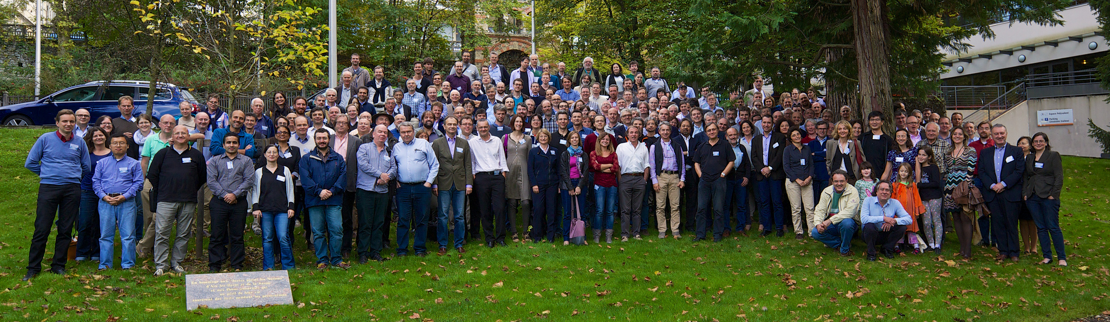
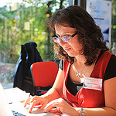


Thank you:
To all the Participants for the lively discussions
To Petya, Connie and Dawn for making this workshop very pleasant
And to G. Darbo for the pictures https://www.flickr.com/photos/giovannidarbo/sets/72157648495683310/

